Slide 1
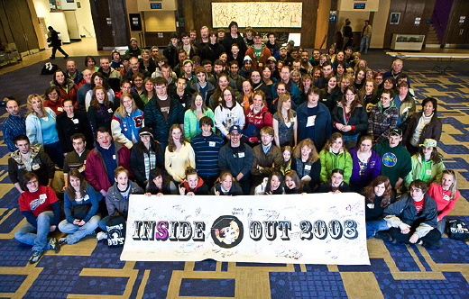
UAF Recruitment Plan
2011-2013
Presented by:
Mike Sfraga
&
Mike Earnest
February 1, 2011

Slide 2
Profile: Incoming Class
Fall 2010
Source: PAIR Nov 2010
Notes:
Thank you for the opportunity to tell you about a few of the exciting things happening at UAF!

Slide 3
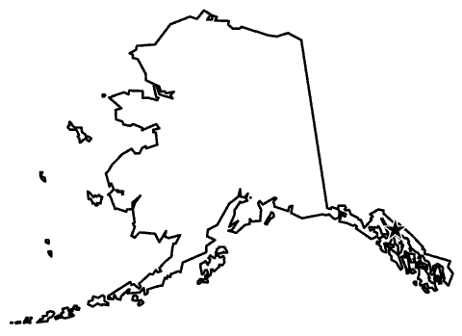
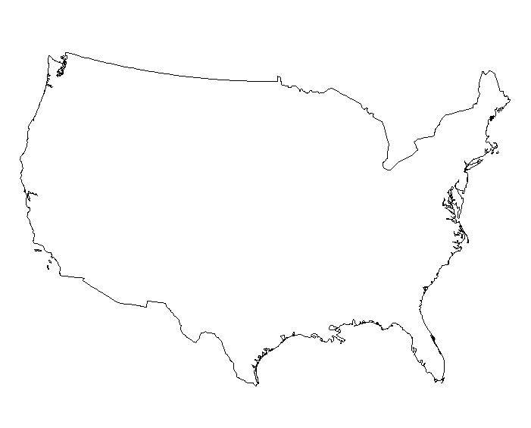
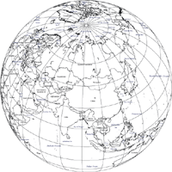
Profile: Incoming Class
Fall 2010
Alaska:
82%
Rockies:
2%
West Coast:
4%
Midwest:
2%
East Coast:
2%
South:
3%
International:
5%
Source: PAIR Fact Book Oct 2010
Notes:
Thank you for the opportunity to tell you about a few of the exciting things happening at UAF!

Slide 4
Profile: Incoming Class
Fall 2010
Also, with 1 student each:
Australia Austria Azerbaijan Czech Republic Finland Ghana
Hungary Iran Kazakhstan Kenya Liberia Mongolia
Netherlands Nigeria South Korea Spain Thailand Turkey

Slide 5
Profile: Incoming Class
Fall 2010
Net Change 2009-2010
UNDERGRADUATES | 4%
All UA Scholars | 3.5%
UA Scholars Class of 2010 | 2.9%
All First Time Freshman | 3.5%
Returning | 1.3%
Transfers | 7.8%
Others/Exchange | 37.5%
GRADUATES | 6.5%
Source: PAIR Nov 2010
Notes:
Thank you for the opportunity to tell you about a few of the exciting things happening at UAF!

Slide 6
Profile by Location:
FTE Fall 2010
Source: PAIR Fact Book Oct 2010
Notes:
Thank you for the opportunity to tell you about a few of the exciting things happening at UAF!

Slide 7
Profile by Location:
FTE Fall 2010
Location | 1-year change | 2-year change
Fairbanks | 4.7% | 9.6%
UAF CTC | 7.2% | 10.3%
Comm. Campuses | 3.6% | 22.3%
Rural College | 7.6% | 20.7%
UAF Overall | 4.9% | 12%
UAA | 4.1% | 9.5%
UAS | 7.7% | 20.3%
UA System | 4.7% | 11.2%
Source: PAIR Oct 2010
Notes:
Thank you for the opportunity to tell you about a few of the exciting things happening at UAF!

Slide 8
Profile by Degree:
All UAF, Fall 2010
Source: PAIR Oct 2010
Notes:
Thank you for the opportunity to tell you about a few of the exciting things happening at UAF!

Slide 9
UAF AK High School Capture Rates
2008-2010
High Yield Schools
Notes:
Thank you for the opportunity to tell you about a few of the exciting things happening at UAF!

Slide 10
UAF AK High School Capture Rates
2008-2010
Moderate Yield Schools
Notes:
Thank you for the opportunity to tell you about a few of the exciting things happening at UAF!

Slide 11
UAF AK High School Capture Rates
2008-2010
Moderate Yield Schools
Notes:
Thank you for the opportunity to tell you about a few of the exciting things happening at UAF!

Slide 12
UAF AK High School Capture Rates
2008-2010
Low Yield Schools
Notes:
Thank you for the opportunity to tell you about a few of the exciting things happening at UAF!

Slide 13
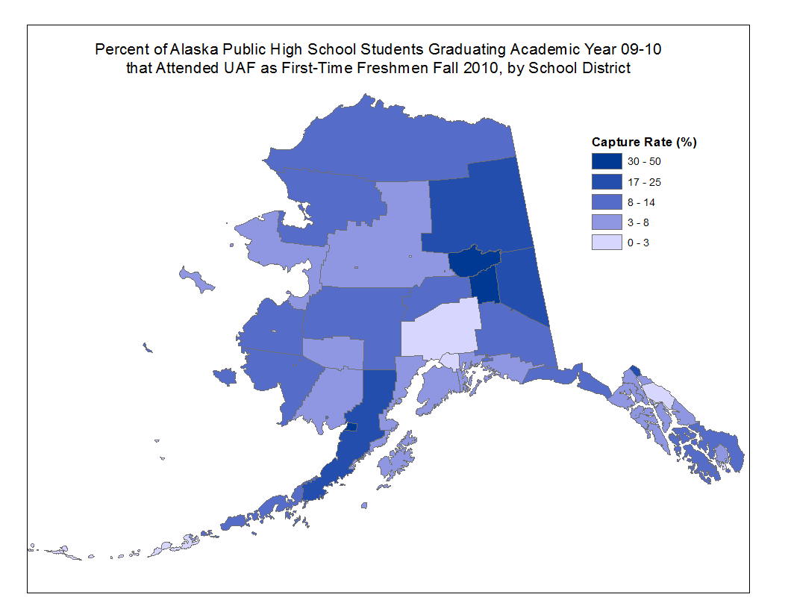

Slide 14
UAF Recruitment Plan
2011-2013
Recruitment Efforts
Feeder Markets
Target Segments
Strategy
Notes:
Thank you for the opportunity to tell you about a few of the exciting things happening at UAF!

Slide 15
UAF Recruitment Plan
2011-2013
Please Consider:
School/College Targets
School/College Strategy
Integrative Actions/Efforts
Internal Communication
Notes:
Thank you for the opportunity to tell you about a few of the exciting things happening at UAF!

Slide 16
UAF Recruitment Plan
2011-2013
Targeted Priority Market Segments:
Full-time, First-time Freshman (FT FTF) – increase 5% (+55)
UA Scholars – increase 5% (+11)
Transfer – increase 10% (+53)
International – Emerging market
Notes:
Thank you for the opportunity to tell you about a few of the exciting things happening at UAF!

Slide 17
UAF Recruitment Plan
2011-2013
Priority Academic Programs:
CEM – Civil, Mechanical, Petroleum, EE
CLA – English, Theatre, Psychology
CNSM – Biology, Geology, Chemistry
SFOS – Fisheries (BA & BS)
SNRAS – Geog, Res. Mgt, H.L. Ag.
SOE – Elementary Education
SOM – Bus. Admin, Economics
Notes:
Thank you for the opportunity to tell you about a few of the exciting things happening at UAF!

Slide 18
UAF Recruitment Plan
2011-2013
Targeted Geographic Areas:
Fairbanks
Interior
Rural Alaska (esp. where we have campuses)
Southcentral (Matsu, Kenai P, Palmer, Wasilla)
Southeast (Juneau, Sitka, etc)
WUE (focus – CA, OR, WA, CO)
BRANCH OUT TO Other States via ONLINE recruiting?
F T F T F
Notes:
Thank you for the opportunity to tell you about a few of the exciting things happening at UAF!

Slide 19
UAF Recruitment Plan
2011-2013
Strategic Prospective Student Sources
Inquiries (online, fairs, HS visits)
Name Buys (100,000+/year)
Alaska HS Lists
Test Score Submissions (ACT, SCT)
FAFSA Submissions
Phi Theta Kappa (Transfers)
F T F T F
Notes:
Thank you for the opportunity to tell you about a few of the exciting things happening at UAF!

Slide 20
UAF Recruitment Plan
2011-2013
Recruitment Activities: Southcentral
& Southeast
Market-Focused Recruitment/Comm Plan
1 Dedicated FTE Counselor
Anchorage Fairs and HS Visits
Host Anchorage Counselors @ UAF
HS visits from Houston to Homer
College fairs in Juneau and Ketchikan
Customized Initiatives throughout SE
F T F T F
Notes:
Thank you for the opportunity to tell you about a few of the exciting things happening at UAF!

Slide 21
UAF Recruitment Plan
2011-2013
Recruitment Activities: 1st Time Freshman
Develop Prospect Lists From HS (Jr/Sr): Comm. Plan starts in fall of junior year
Targeted Comm. Plan
UAF Info Packets - All AK HS Counselors
High School Visits
Financial Aid Info Sessions AK-Wide
“Discover UA” – Open House Model
F T F T F
Notes:
Thank you for the opportunity to tell you about a few of the exciting things happening at UAF!

Slide 22
UAF Recruitment Plan
2011-2013
Recruitment Activities: 1st Time Freshman (outside Alaska)
Host UAF Campus Visits (Student/Parent)
Targeted Parent Comm/Outreach Plan
Utilize Student Ambassador Program
Enhanced Online/Social Media Tools
UAF CollegeWeekLive.com Program
Virtual College Tours
“Discover UA” – Open House Model
Telecounseling: Near-Peer Model
F T F T F
Notes:
Thank you for the opportunity to tell you about a few of the exciting things happening at UAF!

Slide 23
UAF Recruitment Plan
2011-2013
Recruitment Activities: WUE
Targeted Name Buys (ACT, PSAT/NMSQT, NRCCUA)
Targeted Travel: WA, CA, OR, CO
Customized Communication Plan
F T F T F
Notes:
Thank you for the opportunity to tell you about a few of the exciting things happening at UAF!

Slide 24
UAF Recruitment Plan
2011-2013
Recruitment Activities: UA Scholars
Waive Application Fee (Approximately $12K waived annually by Office of Admissions)
Scholar Events/Programs Throughout AK
Scholar-Specific Communication Plan
Award $ Scholarship To Highest GPAs (Roughly $150K per year)
½ FTE Dedicated to UA Scholars
UA Scholars
Notes:
Thank you for the opportunity to tell you about a few of the exciting things happening at UAF!

Slide 25
UAF Recruitment Plan
2011-2013
Recruitment Activities: Transfer
Outreach to Phi Theta Kappa
Community College Fairs
Community College Visits
(Through Deans) 2+2 agreements
Core waiver for AA/AS: in discussion
WICHE Core Passport Initiative
Transfer
Notes:
Thank you for the opportunity to tell you about a few of the exciting things happening at UAF!

Slide 26
UAF Recruitment Plan
2011-2013
Recruitment Activities: International
Expand From Faculty-Driven Model
Current Geographic Affinity: Circumpolar North (Canada, Russia, Scandinavia), GROW UARCTIC
CHINA (2+2), INDIA (Undergraduate fair)
New Markets include Middle East, Asia
Integration of ESL instruction
International
Notes:
Thank you for the opportunity to tell you about a few of the exciting things happening at UAF!

Slide 27
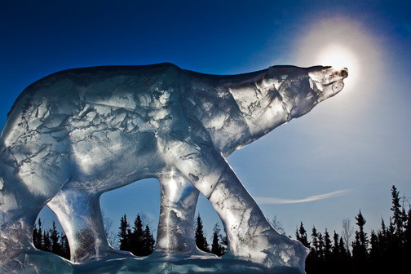
Discussion

