Slide 1
Topological Quantum Computing
Michael Freedman
April 23, 2009

Slide 2
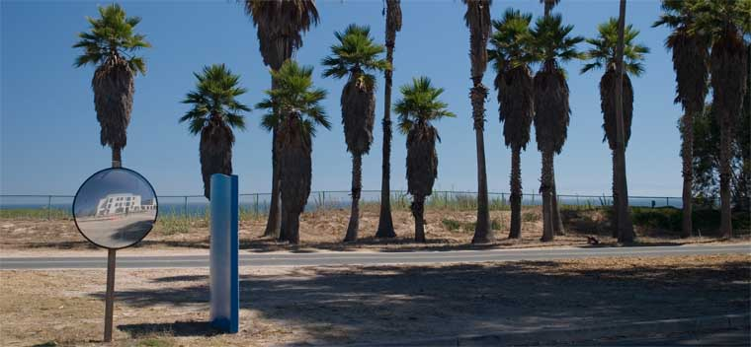
Station Q
Parsa Bonderson
Adrian Feiguin
Matthew Fisher
Michael Freedman
Matthew Hastings
Ribhu Kaul
Scott Morrison
Chetan Nayak
Simon Trebst
Kevin Walker
Zhenghan Wang

Slide 3
Explore: Mathematics, Physics, Computer Science, and Engineering required to build and effectively use quantum computers
General approach: Topological
We coordinate with experimentalists and other theorists at:
Bell Labs
Caltech
Columbia
Harvard
Princeton
Rice
University of Chicago
University of Maryland

Slide 4
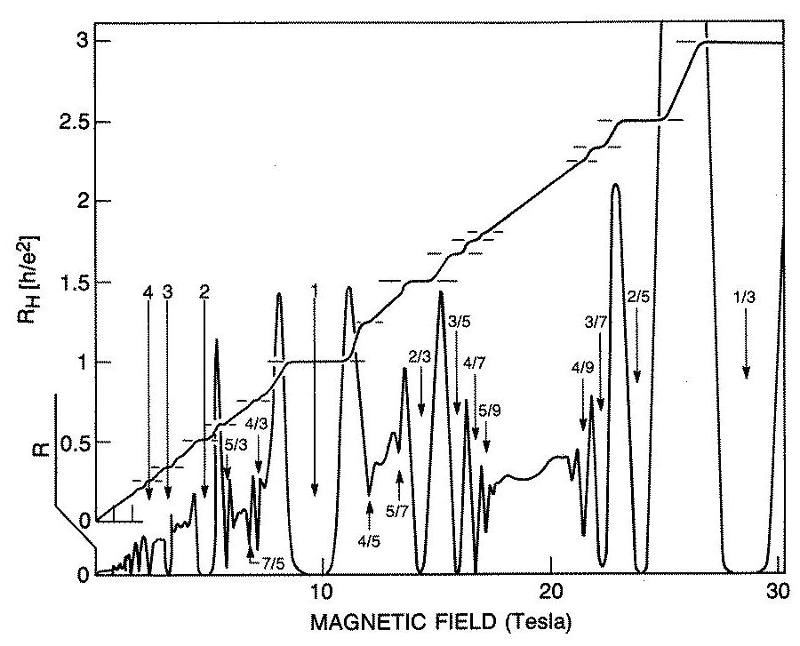
We think about: Fractional Quantum Hall
2DEG
large B field (~ 10T)
low temp (< 1K)
gapped (incompressible)
quantized filling fractions
fractionally charged quasiparticles
Abelian anyons at most filling fractions
non-Abelian anyons in 2nd Landau level, e.g. ν= 5/2, 12/5, …?

Slide 5
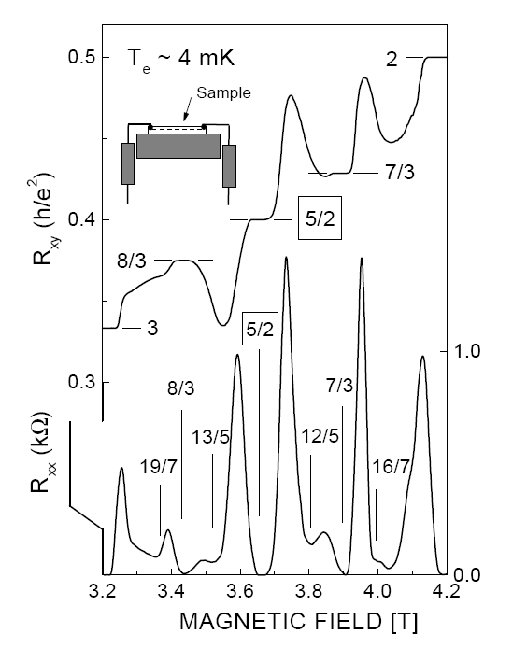
The 2nd Landau level
FQHE state at ν=5/2!!!
Willett et al. PRL 59, 1776, (1987)
Pan et al. PRL 83, (1999)

Slide 6
Our experimental friends show us amazing data which we try to understand.

Slide 7
Woowon Kang
Test of Statistics Part 1B: Tri-level Telegraph Noise
B=5.5560T
Clear demarcation of 3 values of RD
Mostly transitions from middle<->low & middle<->high;
Approximately equal time spent at low/high values of RD
Tri-level telegraph noise is locked in for over 40 minutes!

Slide 8
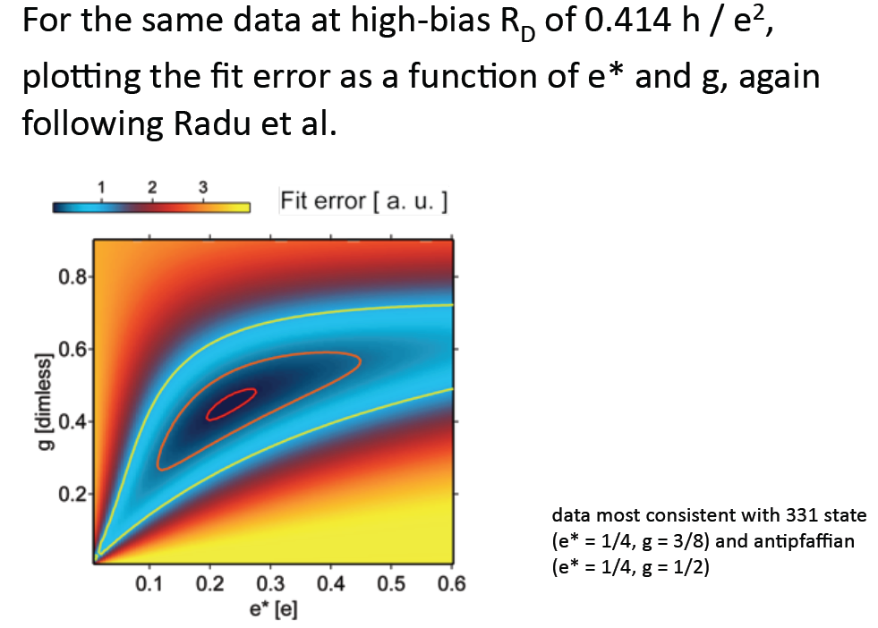
Charlie Marcus Group

Slide 9
ν=5/2
backscattering = |t_{left}+t_{right}|²
backscattering = |t_{left}-t_{right}|²

Slide 10




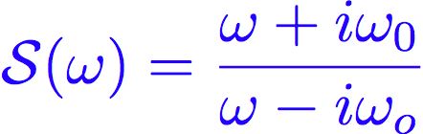




Dynamically “fusing” a bulk non-Abelian quasiparticle to the edge
Paul Fendley
Matthew Fisher
Chetan Nayak
RG crossover
UV
IR
Single p+ip vortex impurity pinned near
the edge with Majorana zero mode
non-Abelian “absorbed” by edge
Couple the vortex to the edge
Exact S-matrix:
pi phase shift for
Majorana edge fermion

Slide 11
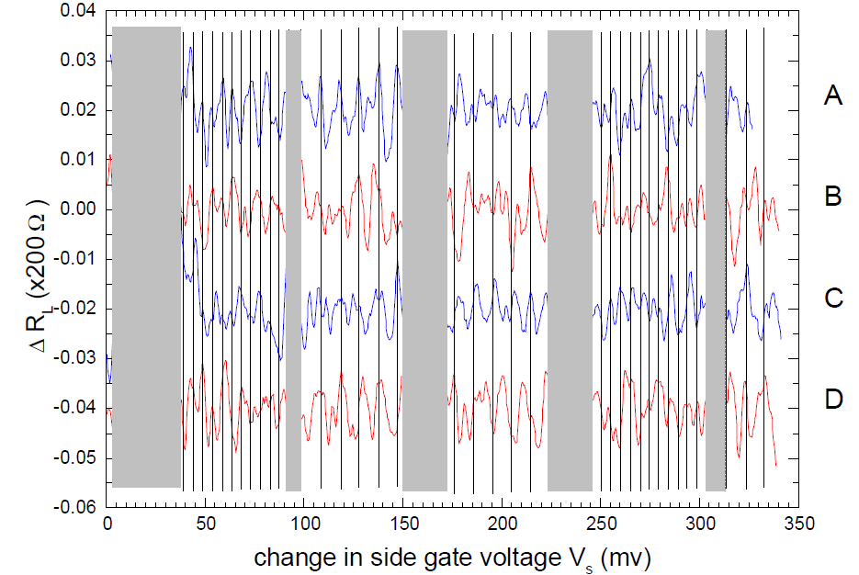
Reproducibility
Bob Willett
24 hrs/run
τ_{error} ~ 1 week!!

Slide 12
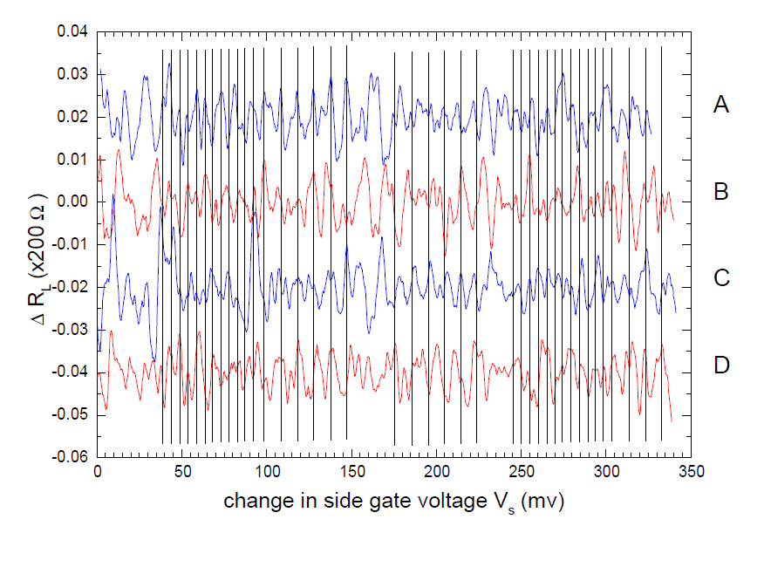
Bob Willett

Slide 13
Quantum Computing is an historic undertaking.
My congratulations to each of you for being part of this endeavor.

Slide 14
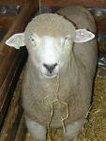
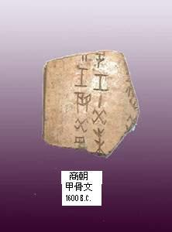

Briefest History of Numbers
-12,000 years: Counting in unary
-3000 years: Place notation
Hindu-Arab, Chinese
1982: Configuration numbers as basis of a Hilbert space of states
Possible futures contract for sheep in Anatolia

Slide 15
Within condensed matter physics topological states are the most radical and mathematically demanding new direction
They include Quantum Hall Effect (QHE) systems
Topological insulators
Possibly phenomena in the ruthinates, CsCuCl, spin liquids in frustrated magnets
Possibly phenomena in “artificial materials” such as optical lattices and Josephson arrays

Slide 16
One might say the idea of a topological phase goes back to Lord Kelvin (~1867)
Tait had built a machine that created smoke rings … and this caught Kelvin's attention:
Kelvin had a brilliant idea: Elements corresponded to Knots of Vortices in the Aether.
Kelvin thought that the discreteness of knots and their ability to be linked would be a promising bridge to chemistry.
But bringing knots into physics had to await quantum mechanics.
But there is still a big problem.

Slide 17

Problem: topological-invariance is clearly not a symmetry of the underlying Hamiltonian.
In contrast, Chern-Simons-Witten theory:
is topologically invariant, the metric does not appear.
Where/how can such a magical theory arise as the low-energy limit of a complex system of interacting electrons which is not topologically invariant?

Slide 18
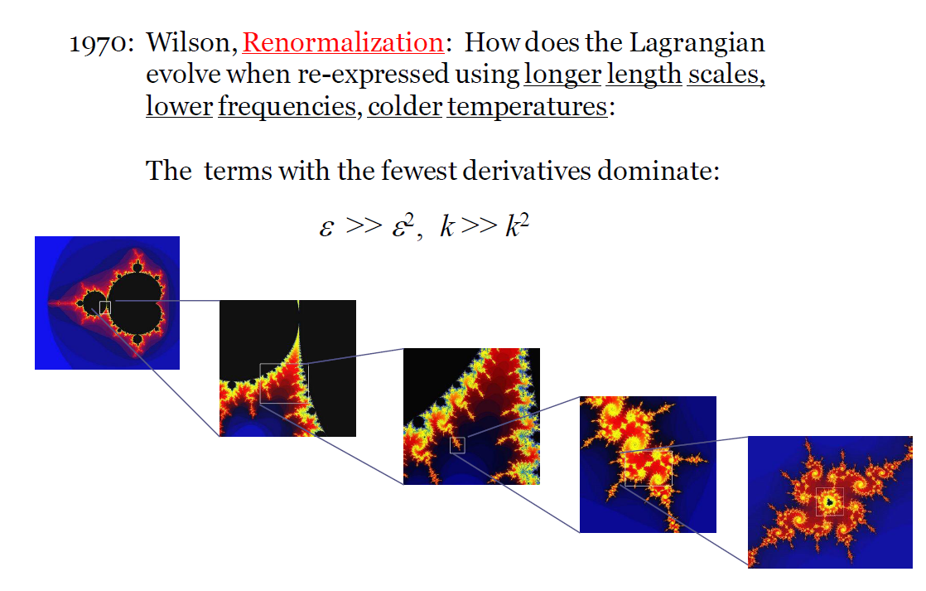
The solution goes back to:

Slide 19
Chern-Simons Action: A d A + (A ∧ A ∧ A) has one derivative,
while kinetic energy (1/2)mν² is written with two derivatives.
In condensed matter at low enough temperatures, we expect to see systems in which topological effects dominate and geometric detail becomes irrelevant.

Slide 20
Mathematical summary of QHE:
Landau levels. . .
Integer
QM
GaAs
effective field theory
Chern Simons WZW CFT TQFT
fractions

Slide 21
The effective low energy CFT is so smart it even remembers
the high energy theory:
The Laughlin and Moore-Read wave functions arise as correlators.
at
at (or )

Slide 22
When length scales disappear and topological effects dominate, we may see stable degenerate ground states which are separated from each other as far as local operators are concerned. This is the definition of a topological phase.
Topological quantum computation lives in such a degenerate ground state space.

Slide 23
The accuracy of the degeneracies and the precision of the nonlocal operations on this degenerate subspace depend on tunneling amplitudes which can be incredibly small.
L
V
tunneling
well
degeneracy split by a
tunneling process
L×L torus

Slide 24
The same precision that makes IQHE the standard in metrology can make the FQHE a substrate for essentially error less (rates <10⁻¹⁰) quantum computation.
A key tool will be quasiparticle interferometry

Slide 25
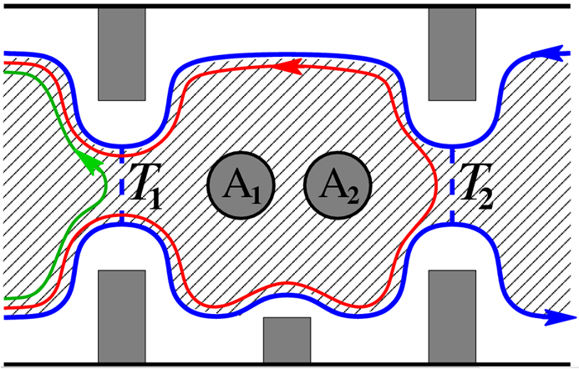
Topological Charge Measurement
e.g. FQH double point contact interferometer

Slide 26
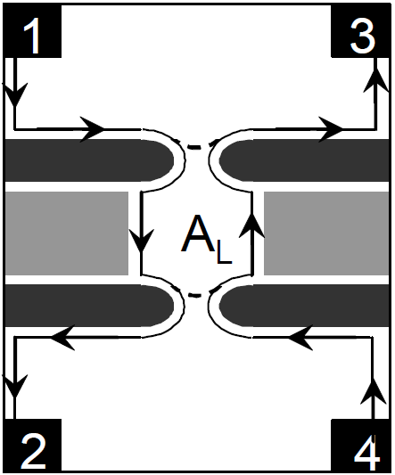
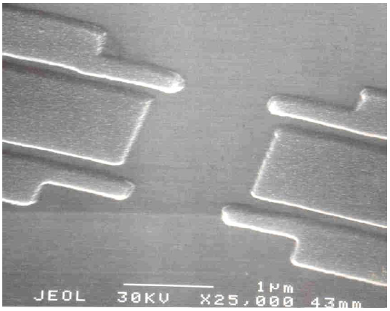
FQH interferometer
Willett et al. `08
for ν=5/2
(also progress by: Marcus, Eisenstein,
Kang, Heiblum, Goldman, etc.)

Slide 27
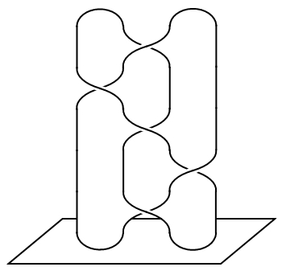
Recall: The “old” topological computation scheme
Measurement (return to vacuum)
(or not)
Braiding = program
time
Initial ψ₀ out of vacuum

Slide 28
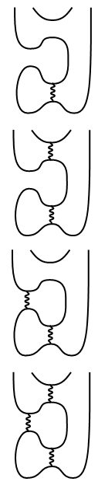
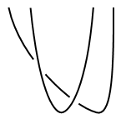
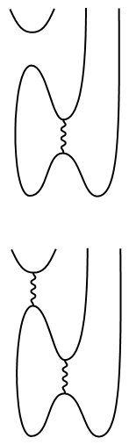
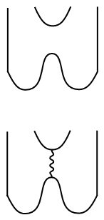

New Approach:
measurement
Parsa Bonderson
Michael Freedman
Chetan Nayak
“forced measurement”
motion
braiding
=

Slide 29
Use “forced measurements” and an entangled ancilla to simulate braiding. Note: ancilla will be restored at the end.

Slide 30
Measurement Simulated Braiding!

Slide 31
FQH fluid (blue)

Slide 32
Reproducibility
Bob Willett
24 hrs/run
τ_{error} ~ 1 week!!

Slide 34
Ising vs Fibonacci (in FQH)
Braiding not universal (needs one gate supplement)
Almost certainly in FQH
Δ_{ν=5/2} ~ 600 mK
Braids = Natural gates (braiding = Clifford group)
No leakage from braiding (from any gates)
Projective MOTQC (2 anyon measurements)
Measurement difficulty distinguishing I and ψ (precise phase calibration)
Braiding is universal (needs one gate supplement)
Maybe not in FQH
Δ_{ν=12/5} ~ 70 mK
Braids = Unnatural gates (see Bonesteel, et. al.)
Inherent leakage errors (from entangling gates)
Interferometrical MOTQC (2,4,8 anyon measurements)
Robust measurement distinguishing I and ε (amplitude of interference)

Slide 35
Future directions
Experimental implementation of MOTQC
Universal computation with Ising anyons, in case Fibonacci anyons are inaccessible
- “magic state” distillation protocol (Bravyi `06)
(14% error threshold, not usual error-correction)
- “magic state” production with partial measurements
(work in progress)
Topological quantum buses
- a new result “hot off the press”:

Slide 36
Bonderson, Clark, Shtengel
...
a = I or ψ
t
-t*
Tunneling
Amplitudes
r
r*
b
|r|² = 1-|t|²
...
One qp
+
+
+
b
Aharonov-Bohm
phase

Slide 37
For b = σ,
a = I or ψ

