Slide 1
Performance Evaluation of the Fuzzy ARTMAP for Network Intrusion Detection
Nelcileno Araújo
Ruy de Oliveira
Ed’Wilson Tavares Ferreira
Valtemir Nascimento
Ailton Akira Shinoda
Bharat Bhargava

Slide 2
Presentation
Introduction
Motivation
Goals
Methodology
Fuzzy ARTMAP Neural Networks
Investigating the Performance of the Fuzzy ARTMAP in detecting intrusions
Conclusions and outlook

Slide 3
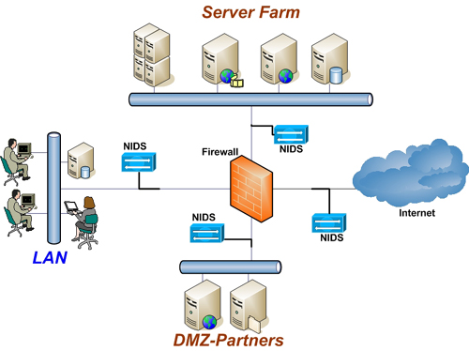
Introduction
The problem of intrusion detection
Intrusion => someone who is trying to sneak into or misuse the system.
How to provide this protection? Intrusion Detection Systems (IDS)

Slide 4
Motivation
How to have a good intrusion detection without an excessive computational cost and maintaining good levels of detection and false alarm rates?

Slide 5
Goals
Investigate the performance of Fuzzy ARTMAP classifier in intrusion detection
Study the ability of the MAC frame to represent the intrusive behavior into WLAN supporting WEP e WPA encryption

Slide 6
Methodology
To do a survey about Adaptative Ressonance Teory (ART) based Neural Networks
To analyze the ability of intrusion detection of Fuzzy ARTMAP classifier on two databases:
KDD99 – a fictitious military environment based on wired network
A real 802.11 wireless network supporting WEP and WPA encryption

Slide 7
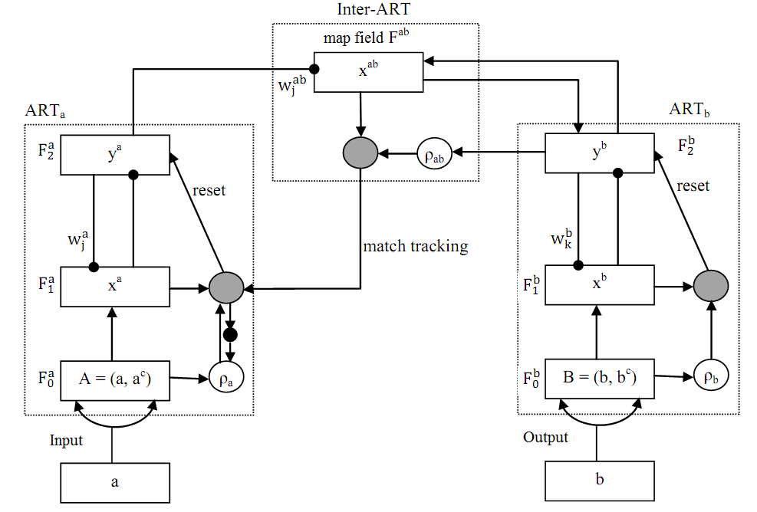
Fuzzy ARTMAP Neural Networks
Fast training
Supervised learning
Stability / plasticity - ability to maintain the previously acquired knowledge (stability) and to adapt to new classification standards (plasticity)

Slide 8
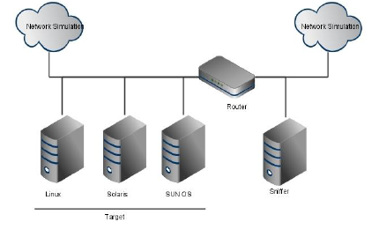
Investigating the Performance of the Fuzzy ARTMAP in detecting intrusions
Applying Fuzzy ARTMAP Classifier on KDD99 Dataset
KDD99 is a data set constructed for a international competition on data mining at MIT.

Slide 9
Applying Fuzzy ARTMAP Classifier on KDD99 Dataset
Types of attacks represented by base KDD99
Denial of Service (DoS) – connections trying to prevent legitimate users from accessing the service in the target-machine.
Scanning (Probe) – connections scanning a target machine for information about potential vulnerabilities.
Remote to Local (R2L) – connections in which the attacker attempts to obtain non-authorized access into a machine or network.
User to Root (U2R) –connection in which a target machine is already invaded, but the attacker attempts to gain access with superuser privilegies.
Dataset | DoS | Probe | u2r | r2l | Normal
Training | 391458 | 4107 | 52 | 1126 | 97277
Test | 229853 | 4166 | 70 | 16347 | 60593

Slide 10
Applying Fuzzy ARTMAP Classifier on KDD99 Dataset
Configuration of the simulated scenarios
Configuration parameters for the Fuzzy ARTMAP classifier
Scenario | Total registers of the KDD99 training dataset in each phase
 | Training | Test
1 | 33% | 67%
2 | 50% | 50%
3 | 66% | 34%
Parameter | Value
Choice Parameter (α) | 0,001
Training rate (β) | 1
Network vigilance Parameter ARTa(ρ_{a}) | 0,99
Network vigilance Parameter ART_{b}(ρ_{b}) | 0,9
Vigilance Parameter of the inter-ART(ρ_{ab}) | 0,99

Slide 11
Applying Fuzzy ARTMAP Classifier on KDD99 Dataset
Results of the Simulated Scenarios
Scenario | Performance
 | IDS training duration (seg) | Global detection rate (%)
1 | 122,97 | 72,85
2 | 118,81 | 87,20
3 | 121,54 | 88,91

Slide 12
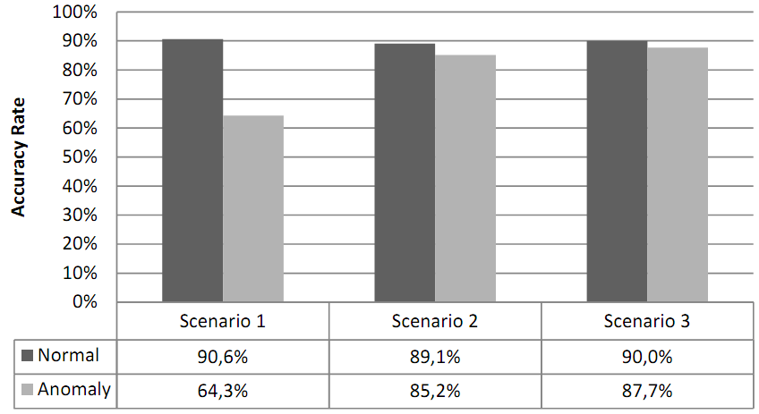
Applying Fuzzy ARTMAP Classifier on KDD99 Dataset
Results of the accuracy rate for the simulated scenarios

Slide 13
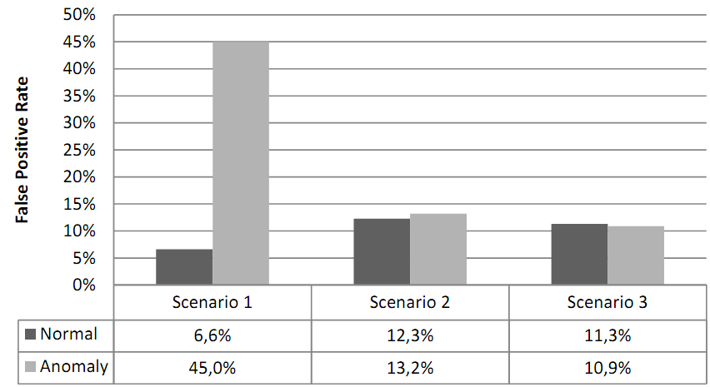
Applying Fuzzy ARTMAP Classifier on KDD99 Dataset
Results of the false positive rate for the simulated scenarios

Slide 14
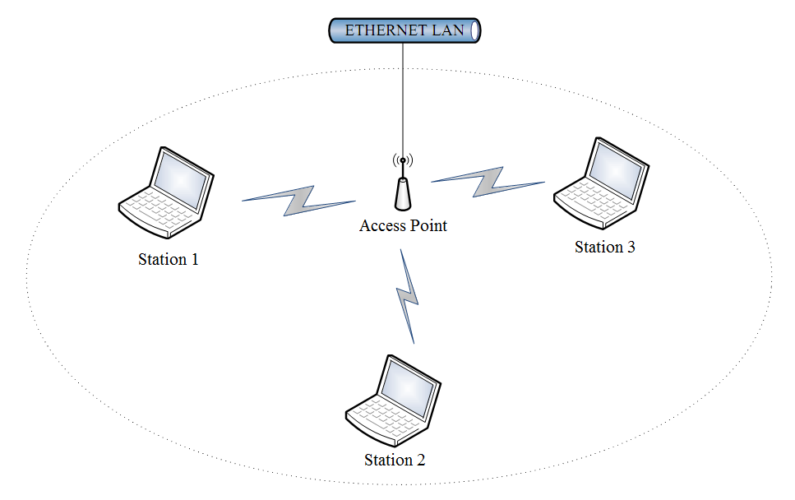
Applying Fuzzy ARTMAP Classifier on a WLAN supporting WEP e WPA encryption
Topology of the WLAN used for generating data

Slide 15
Applying Fuzzy ARTMAP Classifier on a WLAN supporting WEP e WPA encryption
Types of denial of service attacks used in the experiments
Chopchop – attacker intercept a cryptography frame and uses the base station to guess the clear text of the frame by brute force that is repeated until all intercepted frames are deciphered.
Deauthentication - attacker transmits to the client stations a false deauthentication frame to render the network unavailable.
Duration - attacker sends a frame with the high value of NAV (Network Allocation Vector) field to prevent any client station from using the shared medium to transmit.
Fragmentation - attacker uses a fragmentation/assembly technique running in the base station to discover a flow key used to encrypt frames in a WLAN.

Slide 16
Applying Fuzzy ARTMAP Classifier on a WLAN supporting WEP e WPA encryption
Distribution of the samples collected from the WLAN into datasets
 |  |  | Datasets
 |  |  | Training | Validation | Test
Intrusion Categories of | Normal |  | 6000 | 4000 | 5000
 | Intrusion | ChopChop | 900 | 600 | 800
 |  | Deauthentication | 900 | 600 | 800
 |  | Duration | 900 | 600 | 800
 |  | Fragmentation | 900 | 600 | 800
Total Number of Samples |  |  | 9600 | 6400 | 8200

Slide 17
Applying Fuzzy ARTMAP Classifier on a WLAN supporting WEP e WPA encryption
Configuration parameters for the Fuzzy ARTMAP classifier
Parameter | Value
Choice Parameter (α) | 0,01
Training rate (β) | 1
Network vigilance Parameter ARTa(ρ_{a}) | 0,7
Network vigilance Parameter ART_{b}(ρ_{b}) | 1
Vigilance Parameter of the inter-ART(ρ_{ab}) | 0,99

Slide 18
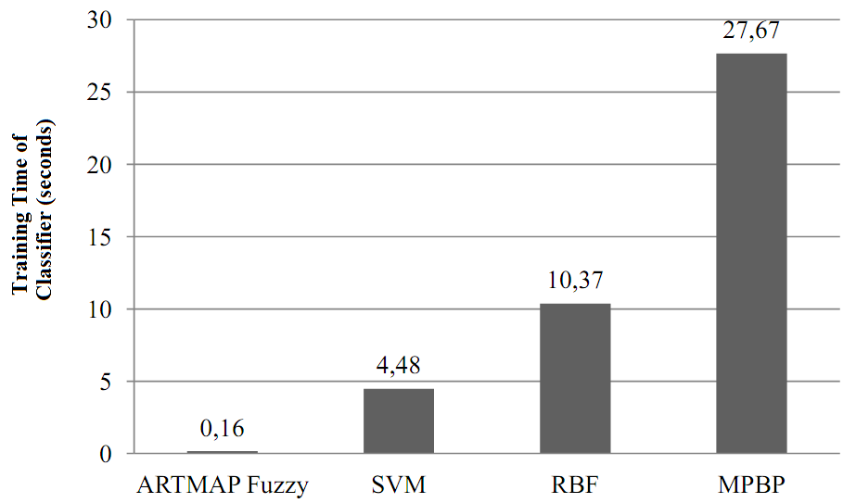
Applying Fuzzy ARTMAP Classifier on a WLAN supporting WEP e WPA encryption
we compared our results with the ones of other three classifiers: Suport Vector Machine (SVM), Multilayer Perceptron with Backpropagation (MPBP) and Radial Basis Function (RBF)
establishes a methodology for evaluating performance based on three metrics: detection rate, false alarm rate and learning time of the classifier
Training Time of classifiers

Slide 19
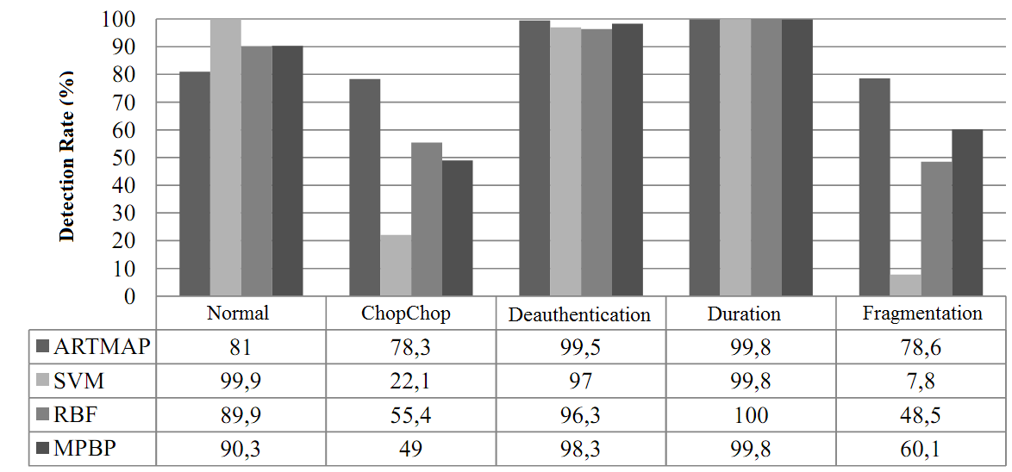
Applying Fuzzy ARTMAP Classifier on a WLAN supporting WEP e WPA encryption
Detection rate for the classifiers

Slide 20
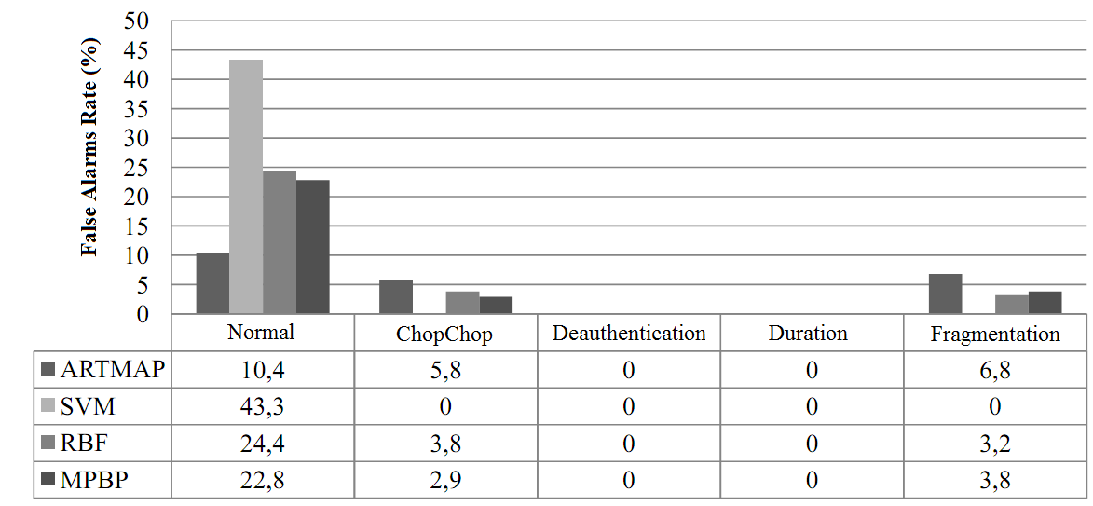
Applying Fuzzy ARTMAP Classifier on a WLAN supporting WEP e WPA encryption
False Alarm Rate for classifiers

Slide 21
Conclusions
A strong point of Fuzzy ARTMAP classifier is the metric of training time.
Fields of MAC frame are insufficient to generate reliable signatures to identify class of tested attacks.
The absence of a computational optimization technique for the generation of the configuration parameters of the fuzzy ARTMAP network may have contributed to a more limited performance of classifier.

Slide 22
Outlooks
Check the performance of Fuzzy ARTMAP classifier on a WLAN supporting IEEE 802.11i and IEEE 802.11w security amendments.
Applying Particle Swarm Optimization metaheuristic in learning mechanism of neural network.
Search the most representative features in management/control/data frame that describe on signatures of tested attacks.

