Slide 1



Talent Development in Science, Technology, Engineering, and Mathematics (STEM)
Sylvia Hurtado, Kevin Eagan, Gina Garcia, Juan Garibay, & Felisha Herrera
AERA Annual Meeting, Vancouver, Canada
April 13, 2012

Slide 2
Overview of Symposium
Introduction to Topic
Paper #1: Passing Through the Gates: Identifying and Developing Talent in Introductory STEM Courses
Paper #2: Accentuating Advantage: Developing Science Identity During College
Paper #3: A Model for Redefining STEM through Identity: Insights from the Educational Trajectories of Talented STEM Graduate Students
Implications & Conclusions

Slide 3
Introduction
The symbiotic connections of an ecosystem and survival of the fittest.
We explore the interdependences of context, student and the role of faculty that result in talent development, while at the same time, the same elements are involved in sorting to limit the production of scientists.

Slide 4
Passing Through the Gates: Identifying and Developing Talent in Introductory STEM Courses

Slide 5
Background
STEM attrition in the first two years of college
Low grades and un-engaging pedagogy are just some of the obstacles students encounter
Success and talent
Measured by grades
Determined by prior achievement and study skills

Slide 6
Purpose
To explore alternative measures of talent (beyond grades) in introductory STEM courses
To determine how talent is developed and harvested within introductory STEM courses
To examine how “thinking” and “acting” like a scientist contributes to success in STEM courses

Slide 7
Sequential, Explanatory Mixed Methods Design
Collected, analyzed, and integrated both quantitative and qualitative data during the research process
Quantitative data collected first; informed selection of institutional sites for qualitative data collection
Data fully integrated during the analysis
Quantitative data provided a broad picture of students’ engagement
Qualitative data more deeply explored student views regarding their introductory classroom experience

Slide 8
Connecting Quantitative & Qualitative Phases
QUANTITATIVE Data Analysis
Integrating Quantitative & Qualitative Results
QUANTITATIVE Data Collection
Qualitative Data Collection
Qualitative Data Analysis

Slide 9
Quantitative Methodology
Four data sources
Pre- and post-survey for students in introductory course
One-time survey for faculty teaching introductory course
Registrar’s data
Sample
15 colleges and universities
73 introductory STEM courses
2,873 students
52% White
61% Women
42% aspired to earn a medical degree
21% aspired to earn a Ph.D. or an Ed.D.
75% reported majoring in a STEM discipline.

Slide 10
Quantitative Methodology
Three outcome variables
Final grade in introductory course
Acting like a scientist (latent)
Thinking like a scientist (latent)
Predictor variables
Demographic characteristics
Pre-college preparation
Experiences in introductory STEM courses
Pedagogical techniques used in introductory STEM courses

Slide 11
Quantitative Methodology
Weighted data to adjust for non-response bias
Missing values analysis
Confirmatory factor analysis
Multilevel structural equation modeling (SEM)

Slide 12
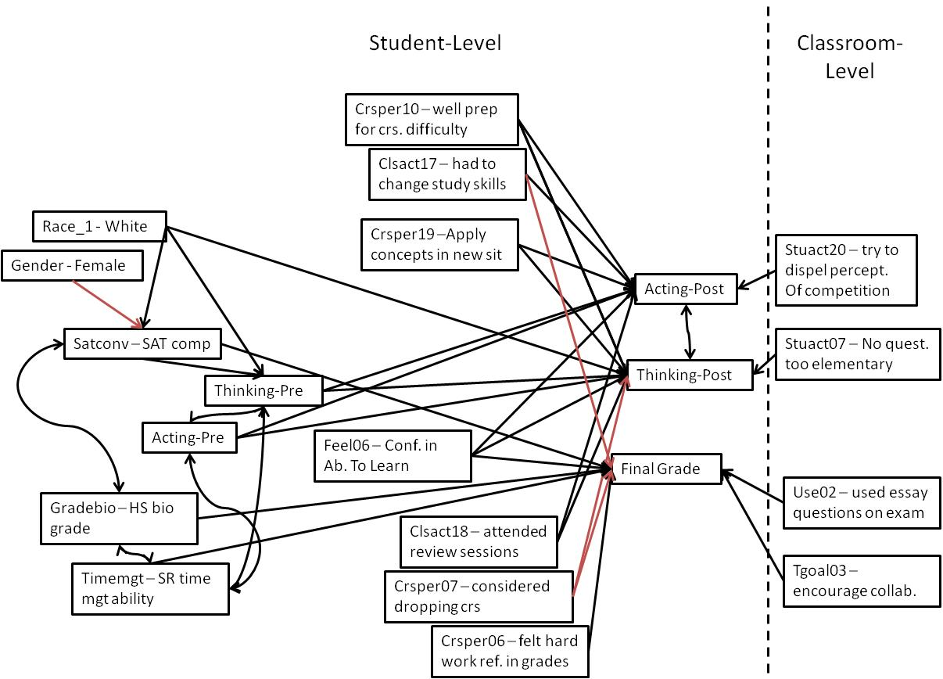

Slide 13
Qualitative Methodology
Eight sites
1 HBCU, 1HSI, 6 PWIs
Two data sources
Students: 41 focus groups (n = 241 students)
54% White
21% Asian/Asian America
14% African American
8% Latino
3% Native American
62% Women
Faculty: 25 in-depth interviews with faculty
Chemistry, biology , mathematics, & engineering

Slide 14
Qualitative Methodology
Semi-structured interview protocol
Experiences in introductory STEM courses, motivation, course structure, learning, instruction, & assessment
Goals and objectives for introductory STEM courses, pedagogical approaches, structure, forms of assessment, & institutional support for teaching
Emergent code development
Open coded in NVivo8
Inter-rater reliability: 80-85%
Re-validated coding architecture
Linked codes to participant attributes

Slide 15
Alternative Ways to Identify Talent
I like the questions they ask, so for the vert bio I'll be lecturing long and I'll ask a little question here and there that might be pointed. You know, like, “how do you think the sharks ventilate if they're not doing this buccal pumping kind of thing, cuz they don‘t have the operculum?” I'll get them to, I answer questions in class just to make sure [they're] kinda tracking me or thinking about stuff. But then the ones that I'm like, whew, you're really good, [ask], "Okay, you've told me about how they change their osmoregulation when they go from fresh water to salt water. How exactly does that happen, and how does it happen on the way back?” (Professor Veerdansky, Western Private Master’s College)

Slide 16
Direct Effects: Final Grade
Predictor | β | Sig
Confidence in ability to learn | 0.06 | ***
Composite SAT | 0.19 | ***
HS Biology Grade | 0.15 | ***
I felt my hard work was reflected in my grades | 0.14 | ***
I considered dropping the course | -0.26 | ***
I was well-prepared for course | 0.09 | ***
Self-rated time management | 0.13 | ***
Changed study habits during term | -0.14
Classroom Level: Professor used essay exam | -0.39 | **

Slide 17
Grades Do Not Matter
Yeah. I had a student…he got [a] B plus, but he would solve problems that nobody could solve. He wouldn’t be able to solve the problems that everybody could solve, but he solved the problems that no one could. Now, that was very impressive, but he didn’t do well on the exams…he actually did very well later on.
(Professor Pace, Western Public Research University)

Slide 18
Direct Effects: Acting Like a Scientist
Predictor | β | Sig
Pre-test: Acting like a scientist | 0.41 | ***
Pre-test: Thinking like a scientist | 0.11 | ***
Confidence in ability to learn | 0.16 | ***
Course emphasizes applying concepts to new situations | 0.11 | ***
I was well-prepared for course | 0.06 | **
Changed study habits during term | 0.04 | **
Attended review sessions | 0.08 | ***
Classroom level: Professor dispelled perceptions of competition | 0.59 | *

Slide 19
Acting Like a Scientist
Well, like how the labs really supplement the class, like they really make you think about the main concepts, about like how you would apply it to like real life or what you would actually do that shows this process of whatever. The really helps you kind of think about it other than just like bullet points on a piece of paper, so that really helps.
(Marissa, Southeastern Private Master’s College)

Slide 20
Direct Effects: Thinking Like a Scientist
Predictor | β | Sig
Pre-test: Acting like a scientist | 0.11 | ***
Pre-test: Thinking like a scientist | 0.38 | ***
Confidence in ability to learn | 0.22 | ***
Course emphasizes applying concepts to new situations | 0.07 | ***
I considered dropping the course | -0.04 | *
I was well-prepared for course | 0.06 | **
Race: White | 0.04 | **
Attended review sessions | 0.10 | ***
Classroom level: No question is too elementary | 0.57 | *

Slide 21
Thinking Like a Scientist
Well, I took Basic Chemistry last year, and I’m taking General Chemistry, which is the next step above it, and I feel like I was really prepared for it. ‘Cuz right now I’m in Gen Chem [and] like, I already know this, yeah? Like, I guess the professor who taught me was good at what she was doing ‘cuz I already knew what I was doing and like, right now some kids are already confused about like, the stuff we learned last year. And we were supposed to know this already, but I guess they were confused because of the professor. But for me it was kind of a breeze.
(Sameer, Southwestern Public Research University)

Slide 22
Discussion
Grades useful for sorting talent but not for capturing gains in dispositions for scientific work
Necessary to broaden performance criteria
Change pedagogical styles to allow students to apply concepts to encourage thinking like scientist
Reframe introductory STEM courses to focus on higher-order thinking rather than merely transmission of knowledge

Slide 23
Accentuating Advantage: Developing Science Identity During College
Kevin Eagan, Sylvia Hurtado, Juan Garibay, & Felisha Herrera

Slide 24
Background
Early commitment to STEM can have lasting effects on STEM persistence.
Call to identify practices that promote stronger STEM identity given high attrition rates in STEM.
Strong STEM identity:
Improves STEM retention (Chang et al., 2011)
Shapes trajectories within STEM disciplines (Carlone & Johnson, 2007)

Slide 25
Purpose
To examine how students’ experiences at various time points and across institutional contexts help shape the development of students’ science identity during college.

Slide 26
STEM Identity
Competence, Performance, & Recognition*
STEM identity is a negotiated self, constantly under construction
STEM identity is shaped by*^:
Individual’s own assertions
External ascriptions
Experiences in STEM
*(Carlone & Johnson, 2007)
^(Martin, 2007)
Notes:
According to Carlone & Johnson (2007) students with strong STEM identities are those who demonstrate competence in the discipline, possess the skills to perform scientific practices, and achieve recognition (from oneself and meaningful others)

Slide 27
Influences on STEM Identity
Early learning experiences (Tran et al., 2011)
Number of high school STEM courses (Russell & Atwater, 2005)
Pre-college research experiences (Tran et al., 2011)
Agents
Faculty & Peers (Carlone & Johnson; Martin, 2007)
Parents (Tran et al, 2011)
Self-efficacy (Carlone & Johnson; Hurtado et al., 2009)
College Experiences
Undergrad Research Programs (Hurtado et al., 2009)
STEM Culture (Seymour & Hewitt, 1997)

Slide 28
Theoretical Frameworks
Cumulative Advantage (Allison & Stewart, 1972; Cole & Cole, 1973; Merton, 1973)
To examine patterns of inequality across time
Accentuation Effects (Feldman & Newcomb, 1969)
To acknowledge and comprehend how predispositions are accentuated during college
Notes:
Cumulative Advantage theory provides a mechanism for understanding inequality across time in which a favorable relative position facilitates further relative gains. In education, a C. A. process is “capable of magnifying small differences over time and makes it difficult for an individual or group that is behind at a point in time in education development..to catch up”. For STEM students’ developing science identities, C. A. theory suggests that students who prior to college have access to particular resources or experiences that helped develop relatively stronger STEM identities early on are more likely to have even stronger relative STEM identities in the future especially since they tend to gain greater access to those important resources and activities during college.
Students enter college with predispositions that are likely to be accentuated during college as they have much liberty in choosing their peer groups and college activities they take part in. Students tend to find peers with mutual interests and seek opportunities that meet their goals and interests, which are likely to accentuate their predispositions. According to Feldman & Newcomb (1969), the principle of accentuation is conditional based upon whether students’ predispositions are valued and nurtured in the particular setting in which they choose to participate. The accentuation framework may help to understand how particular activities and settings can serve to solidify students’ STEM identity during college.

Slide 29
Quantitative Methodology
Data Sources:
2004 CIRP Freshman Survey
2005 CIRP Your First College Year Survey
2008 CIRP College Senior Survey
Sample:
1,133 aspiring STEM majors
137 institutions
Analysis:
Structural Equation Modeling (SEM)
MPlus Software

Slide 30
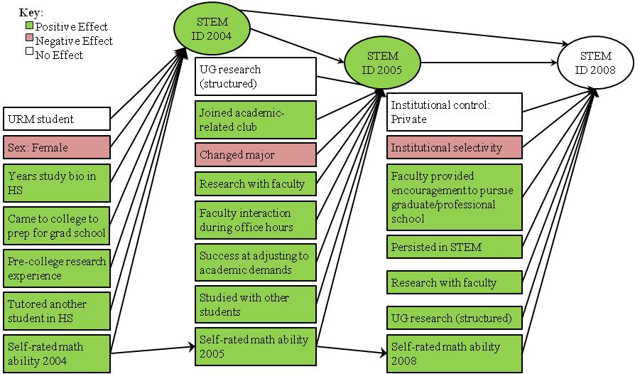
**CFI= 0.93, RMSEA=0.03

Slide 31
Direct Effects: Predicting Changes in STEM Identity
STEM Identity 2004 |  | β(sig)
 | Sex: Female | -0.07 (*)
 | Pre-college Summer Research Prog | 0.13 (***)
 | Years of Biology in High School | 0.17 (***)
 | College Reason: Prepare for Grad School | 0.37 (***)
***p<0.001, **p<0.01, *p<0.05

Slide 32
Direct Effects: Predicting Changes in STEM Identity
STEM Identity 2005 |  | β(sig)
 | STEM Identity 2004 | 0.72(***)
 | Pre-professional/departmental club | 0.06(*)
 | Worked on Professor’s Research Proj | 0.10(**)
 | Freq: Faculty Interaction (Office Hours ‘04/05) | 0.09(**)
 | Success adjusting to college academic demands | 0.08(**)
 | Self-rating: Math ability 2005 | 0.11(***)
 | Changed to Non-STEM major in ‘04/05 year | -0.15(***)
***p<0.001, **p<0.01, *p<0.05

Slide 33
Direct Effects: Predicting Changes in STEM Identity
STEM Identity 2008 |  | β(sig)
 | STEM Identity 2004 | 0.25(**)
 | STEM Identity 2005 | 0.36(***)
 | Structured research program during college | 0.11 (***)
 | Persisted in STEM through 2008 | 0.15(***)
 | Worked on professor’s research project | 0.17(***)
 | Faculty encouragement to pursue grad school | 0.14(***)
 | Institutional Selectivity | -0.09(**)
Self-rating: Math ability 2008
 | Self-rating: Math ability 2005 | 0.41(***)
 | Self-rating: Math ability 2004 | 0.30(***)
***p<0.001, **p<0.01, *p<0.05

Slide 34
Indirect Effects: Predicting Changes in STEM Identity
STEM Identity 2005 |  | β(sig)
 | Sex: Female | -0.05(*)
 | Years of Biology in High School | 0.13(***)
 | Pre-college Summer Research Program | 0.09 (***)
 | College Reason: Prepare for Grad School | 0.26(***)
***p<0.001, **p<0.01, *p<0.05

Slide 35
Indirect Effects: Predicting Changes in STEM Identity
STEM Identity 2008 |  | β(sig)
 | Years of biology in high school | 0.04(*)
 | Decided to pursue non-STEM major in ‘04/05 | -0.05(**)
 | STEM Identity 2004 | 0.26(***)
 | Pre-college summer research program | 0.03(**)
 | College Reason: Prepare for graduate school | 0.09(***)
 | Freq: Faculty Interaction (office hours) ‘04/05 | 0.03(*)
 | Success adjusting to college academic demands | 0.03(*)
 | Worked on professor’s research project | 0.04(*)
***p<0.001, **p<0.01, *p<0.05

Slide 36
Discussion
Cumulative Advantage
Students who have access to stronger preparation/resources enter college w/ stronger STEM identities.
These students appear more likely to continue to access in college these critical resources that further strengthen their STEM identities.
Accentuation Effects
Initial STEM identities are accentuated during college as students tend to participate in activities that value and nurture their STEM identities.
Find peers with mutual interests
Identify early opportunities for strengthening their STEM ID

Slide 37
Implications
Importance of understanding inequality in STEM identity development
Importance of early experiences:
With research
Support networks w/ peers and faculty
Early contact with & receiving recognition from faculty
Stronger high school preparation
Notes:
While providing greater access to these important resources early on is critical to eliminating inequities in the educational process of STEM students, it is probable that many students, particularly from low-income communities, may continue to lack access to these significant resources. As such, if colleges seek to increase the retention rates of all STEM students they must be proactive in providing access to these educational opportunities and resources during college for students who did not have access prior to entering college.

Slide 38
A Model for Redefining STEM through Identity: Insights from the Educational Trajectories of Talented STEM Graduate Students
Felisha A. Herrera
Sylvia Hurtado
Gina A. Garcia
Josephine Gasiewski

Slide 39
Introduction
Underrepresented Racial Minority (URM) students aspire to major in STEM at the same proportional rates as their White and Asian American peers
URM students earn only 17% of STEM bachelor degrees
Several scholars have utilized the construct of identity to understand students’ STEM pathways and the recruitment or alienation of URM students in STEM

Slide 40
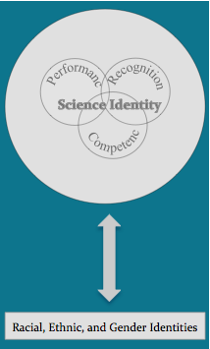
Science Identity Carlone & Johnson, 2007)
Competence
Performance
Recognition
Influence of Racial, Ethnic, & Gender Identities

Slide 41
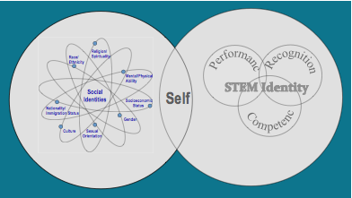
STEM Identity
Intersectionality lens
STEM Identity merged with social identities
Adapted from Jones & McEwen (2000), “Multiple dimensions of identity” and Carlone & Johnson (2007), “Science Identity

Slide 42
Contexts & Opportunities for Recognition
Structures within contexts
“the patterns that characterize, facilitate and constrain groups and societies, including social norms, social roles, and the conformity pressures that individuals may experience within groups”
STEM disciplines/contexts
Racial/ethnic community contexts

Slide 43
Societal Context
Performance
Recognition
STEM Identity
Self
Competence
interaction
interaction
Redefining
STEM
Racial/Ethnic
Communities
interaction
Non-STEM Contexts
STEM Contexts
Groups/Communities
Groups/Communities

Slide 44
Recognition of Talent
Invisible strategies developed through perseverance despite facing structural inequities
I came from a very low-income family so the kind of resources I have available to me and throughout college and even now is very different from that of other people and that’s always been very salient to me. It’s just the different sorts of resources I had available to me and the kinds of things I reference. This taught to take full advantage of every resource that I could get my hands on. (Sophia, Latina, Epidemiology)

Slide 45
Recognition of Racial/Ethnic Community Cultural Knowledge
Cultural knowledge: a currency students use to make meaning
“When is science?” Racial/ethnic communities as contexts where science occurs
I was raised in a small farming community. So my family has always had the same interest in agriculture. They have farmer’s knowledge from what their parents taught them and what their parents taught them…that has a strong background in sciences (Mason, Latino, Environmental Science)

Slide 46
Recognition of Racial/Ethnic Community Networks
Broad cultural networks as opportunities for interactions with diverse communities
My first advisor actually was pretty awful, but now I have a good advisor that’s invested in my [participation] in the things that are important to me like teaching Indian students and going to these conferences to meet other Indian people and network so I can get a job teaching and working in science with Indians (Carson, American Indian, Bioinformatics)

Slide 47
Implications
Practical Implications
Acknowledging the historically oppressive contexts
Highlighting significant ethnic minority figures in STEM
Surfacing the historical and cultural context of STEM research
Different ways of knowing used around the world
Implications for Research
Identity lens for a deeper understanding of URM pathways in STEM
Framing of the benefits for increasing representation in STEM
Notes:
Practical Implications
acknowledging the historically oppressive contexts that shape opportunities for URM students
making students aware of significant ethnic minority figures in the field
surfacing the historical and cultural context in which STEM research is situated
highlighting different ways of knowing used around the world
Implications for Research
Identity lens for
Framing: benefits for increasing representation in STEM

Slide 48
Overall Conclusions
Context matters
Early exposure to research
Prime and cultivate students’ interest in STEM early in college

Slide 49

Contact Info
Faculty/Co-PIs:
Sylvia Hurtado
Mitchell Chang
Postdoctoral Scholars:
Kevin Eagan
Josephine Gasiewski
Administrative Staff:
Dominique Harrison
Graduate Research Assistants:
Tanya Figueroa
Gina Garcia
Juan Garibay
Felisha Herrera
Bryce Hughes
Cindy Mosqueda
Papers and reports are available for download from project website:
http://heri.ucla.edu/nih
Project e-mail: herinih@ucla.edu
This study was made possible by the support of the National Institute of General Medical Sciences, NIH Grant Numbers 1 R01 GMO71968-01 and R01 GMO71968-05, the National Science Foundation, NSF Grant Number 0757076, and the American Recovery and Reinvestment Act of 2009 through the National Institute of General Medical Sciences, NIH Grant 1RC1GM090776-01. This independent research and the views expressed here do not indicate endorsement by the sponsors.

