Slide 1
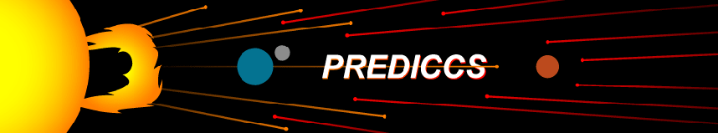
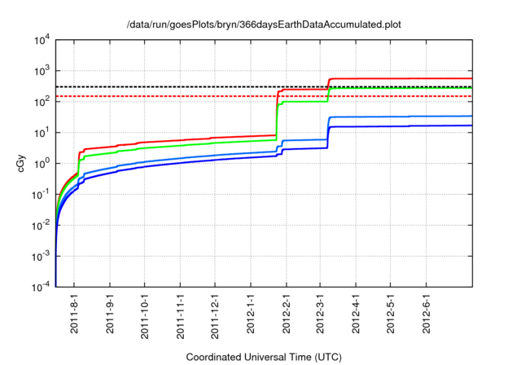
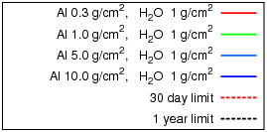
System for Radiation Environment characterization (fluxes, doses, dose equivalents at Earth, Moon and Mars) on hourly thru yearly time frame
Example: Snapshots of Current Yearly Doses at Earth and Mars
Note: Exceeding 1-yr Free Space Dose Limits at Earth and Moon for < 1 g/cm² Al Shielding
See more at http://prediccs.sr.unh.edu/
Free Space Dose Near Earth

Slide 2
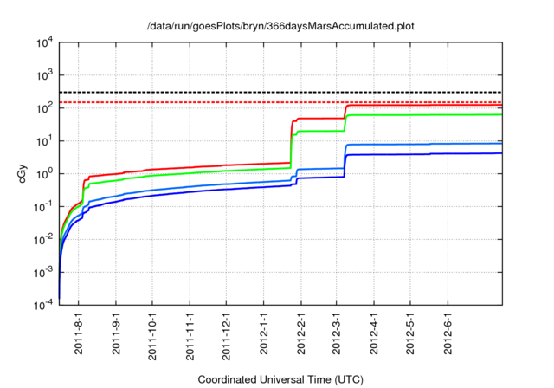
Approaching 1-yr Free Space Dose Limits at Mars
See more at http://prediccs.sr.unh.edu/
Free Space Dose Near Mars

Slide 3
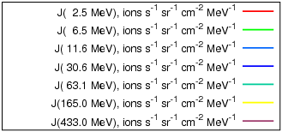
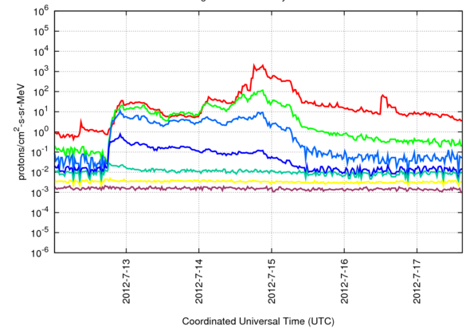
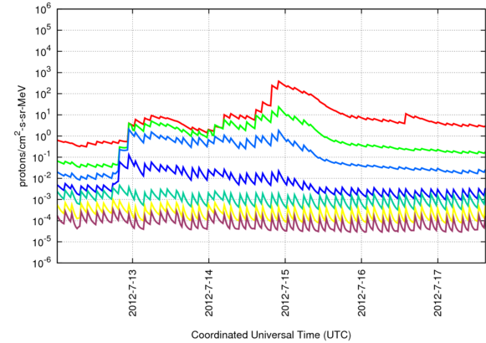
Fluxes Near Moon
Hourly updates (Earth, Moon, Mars) give time-critical updates on space radiation at Earth, Moon & Mars
Shown Here recent 7/12 and 7/15 events at Moon and Mars
Fluxes Near Mars

Slide 4
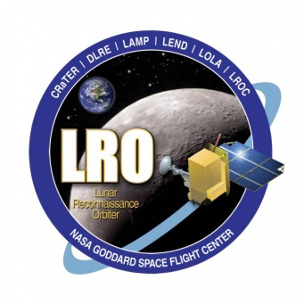

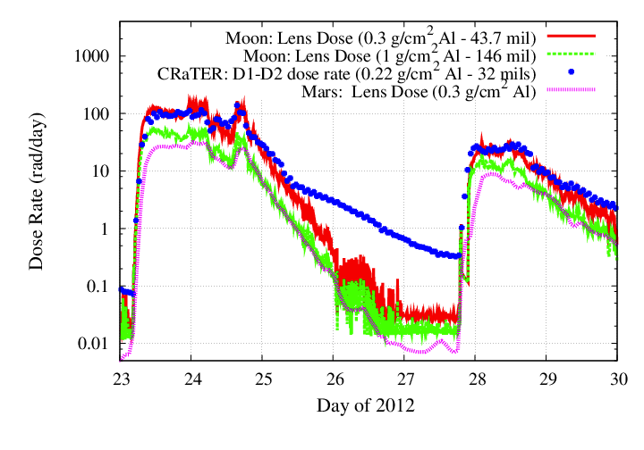
Validation with CRaTER!
SEP Events During 2012: Indicators of Larger SEP Events in the New Cycle (24)
Shown here are the major SEP events of 2012 and the comparisons between CRaTER observations (blue) and prediccs predictions (red and green).
Agreement reveals overall accuracy of models, while deviations likely reveal heavy ion contributions to dose observed by CRaTER
Mar 7, 2012 Event
Jan. 23rd , 2012 Event
May 16, 2012 Event

Slide 5
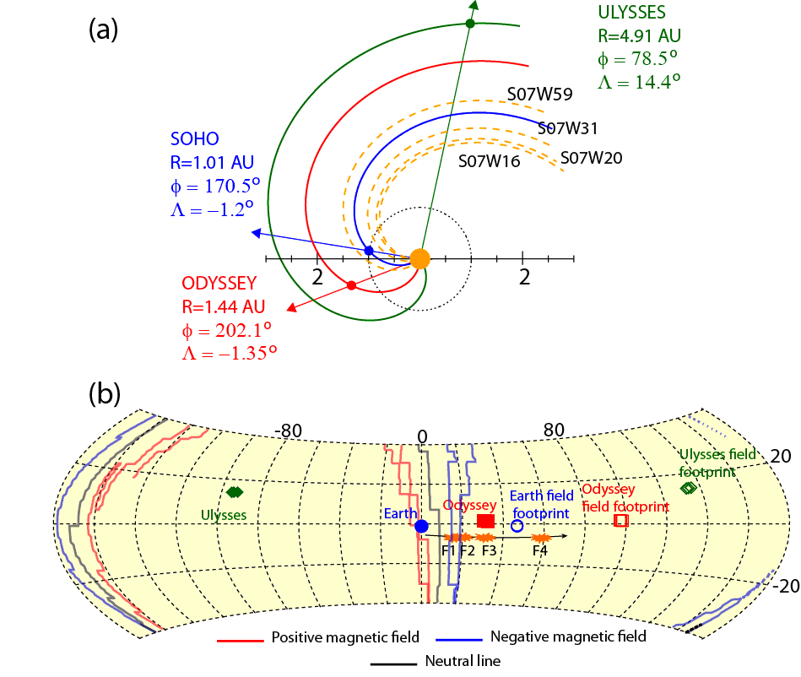
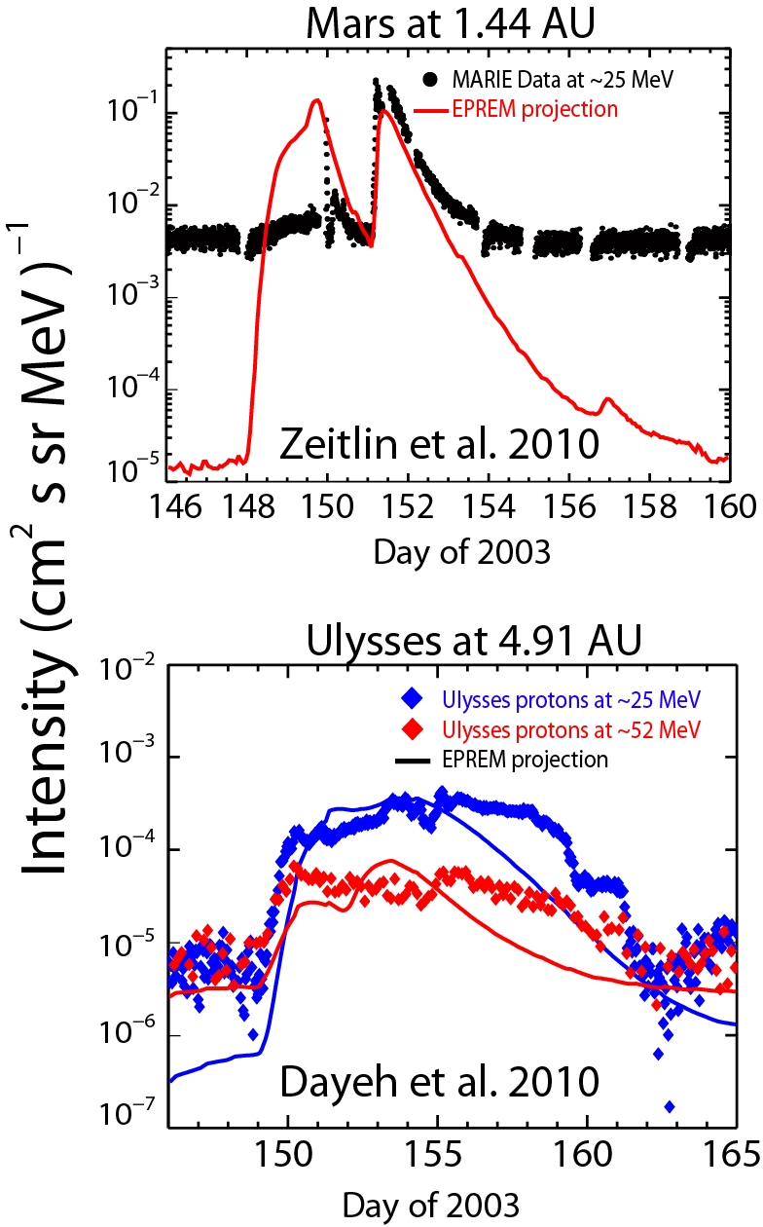
EMMREM has proved very successful at predicting SEP spectra and radiation dose estimates at different distances in the inner heliosphere. Figures below show two recent papers by which SEP time profiles, onset, and radiation estimates were successfully predicted at Mars (Odyssey) and Ulysses located at 1.44 AU and 4.91 AU, respectively. 1 AU measurement from ACE, SoHO, and GOES.
SEP Modeling — EMMREM
GCR
background
Dayeh, M. A., et al, Space Weather, 8, S00E07, doi:10.1029/2009SW000566
Zeitlin, C., et al., Space Weather, 8, S00E06, doi:10.1029/2009SW000563.

Slide 6
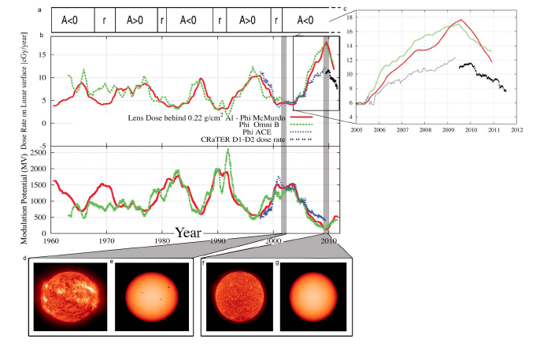
[From Schwadron et al., JGR Planets, 2011] The modulation parameter based on observations of neutrons using McMurdo data (red),interplanetary magnetic field (green) and based on the Advanced Composition Explorer (ACE) Cosmic Ray Isotope Spectrometer (CRIS) measurements (blue [see O’Neill, 2006]). The modulation potentials are used via EMMREM to infer GCR lens dose rates. (a) Dose rates deduced from EMMREM are shown as well as measurements from CRaTER’s D1-D2 detectors (black curve). The CRaTER D1-D2 dose rates were altitude adjusted to the lunar surface, have been adjusted for dose deposition in water (these dose rates), and represent two-week averages with SEP events removed. The polarity of the large-scale solar magnetic field is indicated by A: for A > 0 the Sun’s large-scale northern polarity is positive. The periods indicated by r show when field reversals occurred. Dose rates observed by CRaTER (black points in Figures 2a and 2c) near the highest dose levels during the space age. (d–g) The solar images showconditions of the corona (Figures 2d and 2f) and photosphere (Figures 2e and 2g) near solar maximum (Figures 2d and 2e) and solar minimum (Figures 2f and 2g)

Slide 7
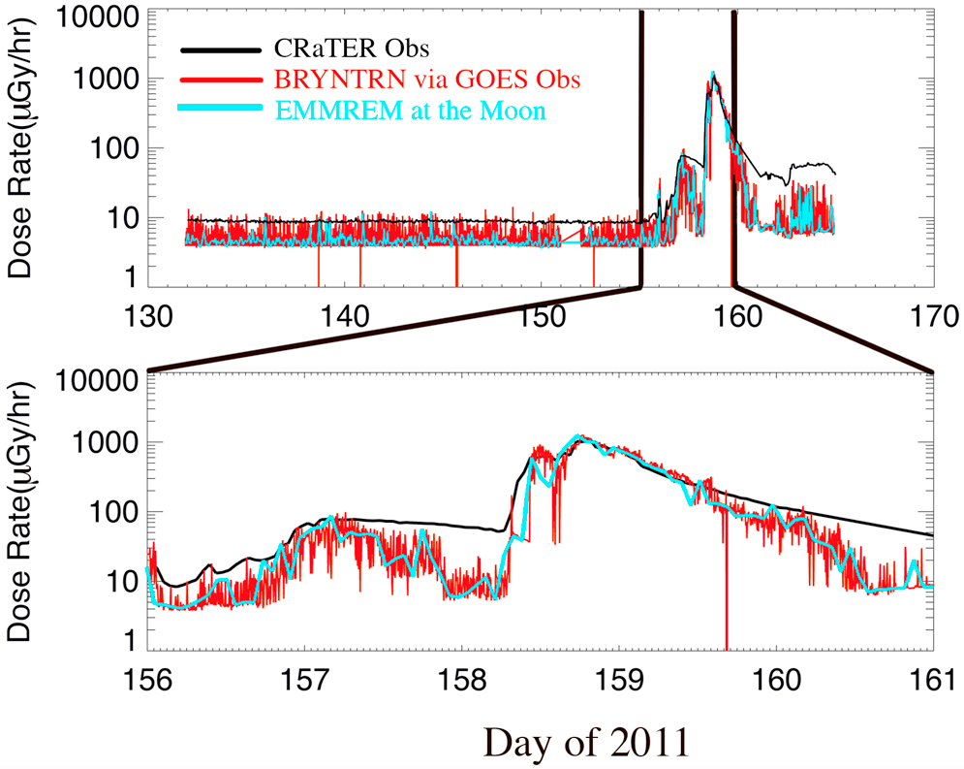
[From Schwadron et al., JGR Planets, 2011] Comparison between EMMREM and CRaTER showing excellent agreement for dose rate. Observations from GOES at energy levels [0.74–4.2, 4.2–8.7, 8.7–14.5,15–40, 38–82, 84–200, 110–900] MeV are fed into BRYNTRN on a 5-min basis and used as the boundary conditions for characterizing the radiation environment throughout the inner heliosphere [Schwadron et al., 2010a]. Observations are both fed directly into BRYNTRN (red curves) and utilized as input within the EMMREM framework (blue curves) allowing propagation throughout the inner heliosphere. We show both the progression of the doses over (top) a month and (bottom) a 5-day period focused on the June 7 event.

Slide 8
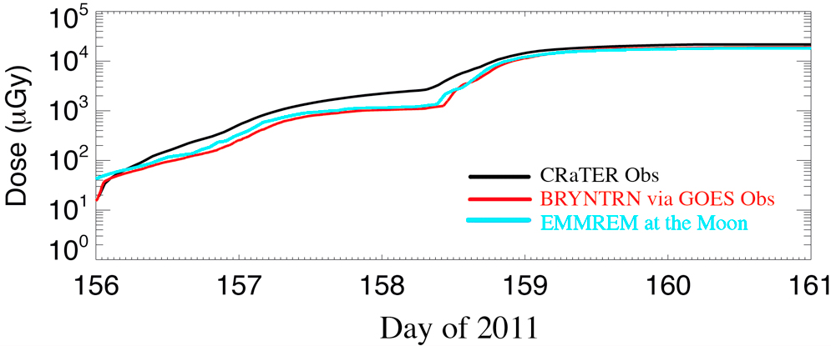
[From Schwadron et al., JGR Planets, 2011] The accumulated dose during the June 7, 2011 CRaTER event. The final dose for the June 7, 2011 event is 2 cGy, much smaller than historic events that typically reveal 100 s of cGy. The agreement between modeled and observed doses is excellent. The small offsets between data values at the start of DOY 156 are due to differences in the resolution of the different data sources.

Slide 9
PREDICCS - Predictions of radiation from REleASE, EMMREM, and Data Incorporating CRaTER, COSTEP, and other SEP measurements - is an on-line system to predict and forecast the radiation environment through interplanetary space. PREDICCS uses SEP (Solar Energetic Particle) measurements from the Cosmic Ray Telescope for the Effects of Radiation (CRaTER) instrument currently on the Lunar Reconnaissance Orbiter (LRO) and data from the Comprehensive Suprathermal and Energetic Particle Analyzer (COSTEP) and integrates two radiation environment models: The Earth-Moon-Mars Radiation Environment Module (EMMREM) and the Relativistic Electron Alert System for Exploration (REleASE). REleASE very accurately forecasts SEP events up to one and a half hours ahead of the event. The EMMREM model predicts the real-time radiation environment using Energetic Particle Radiation Environment Module (EPREM) and the Baryon Transport Module (BRYNTRN). We combine these two models to nowcast and forecast the radiation environment at various observers - including the Earth, Moon, Mars, and at specific target observers such as comets and asteroids - and for future SEP events.
Support for the Project:
THE NASA-NSF/LWS/EMMREM PROJECT (GRANT NUMBER NNX07AC14G)
NASA LRO/CRATER/PREDICCS PROJECT (CONTRACT NUMBER NNG11PA03C)
NSF/FESD SUN-TO-ICE PROJECT (GRANT NUMBER AGS1135432)
NSF/FESD SUN-TO-ICE PROJECT (GRANT NUMBER AGS1135432)

