Slide 1
Developing a Visual Analytics Approach to Analytic Problem-Solving
William Ribarsky
UNC Charlotte

Slide 2
Two Key Statements
The purpose of visualization is insight (and practical knowledge building) not pictures.
Visual analytics is the integration of interactive visualization and analyses to solve complex reasoning problems.
Notes:
The purpose of computing is insight not numbers

Slide 3
The Future Environment:
The Data Problem & the Complexity Problem
The amount of data generated or observed will continue to outstrip the ability to analyze it in a deep way.
The amount of data will continue to outstrip the ability to store it comprehensively.
Comprehensive data sharing will become more and more difficult.
Databases and warehouses are becoming opaque.
Simulations and models will become even more complex and integrated.
Notes:
Yet, human-generated content is manageable.
Store comprehensively—especially over time.

Slide 4
The Future Environment:
The Data Problem & the Complexity Problem
The process cannot be entirely automated. Providing meaning and direction in the analysis process requires human involvement.
Data, simulations, and simulation results are becoming so complex and large that their content is not completely knowable. They must be probed, explored, discovered.
Humans (and many times expert humans) are a very expensive and/or limited resource.
So, a significant aspect of the data and complexity problems is how to involve the human in an intimate partnership with the computer even when the problem becomes very complex and large.
Yet…
Notes:
Even if you compose a transactional database whose individual elements are knowable, it can have emergent properties that are not directly knowable and can only be discovered by exploration. Exploration implies not knowing exactly what you are looking for.

Slide 5
What Can Visual Analytics Provide?
It provides a human-centered approach to attack the human reasoning bottleneck.
Visual analytics provides an approach that starts from integration of computer-based analysis methods and interactive visualization to support:
Reasoning and evidence gathering at scale
Exploration in context and uncovering of unforeseen relationships.
Insight discovery.
A main goal of visual analytics over the next 5-10 years will be to begin attacking the data and complexity problems and resolving the human reasoning bottleneck.

Slide 6
Financial Transaction Data
Financial transactional data warehouses for large banks are very big (billions of records over many years).
-Knowing what to query for is a big problem.
No transaction, by itself, is risky or fraudulent.
Although data records tend to be structured or semi-structured, items can be missing, mis-categorized, have spelling or abbreviation variations, etc.
There may be unstructured free text that can be valuable.
Notes:
Large banks are now integrating all their transactions (not so across banks or insurance companies, though). Even though efficient, scalable database systems are used, getting the right data is still hard.
Searching for a needle in a stack of needles.

Slide 7
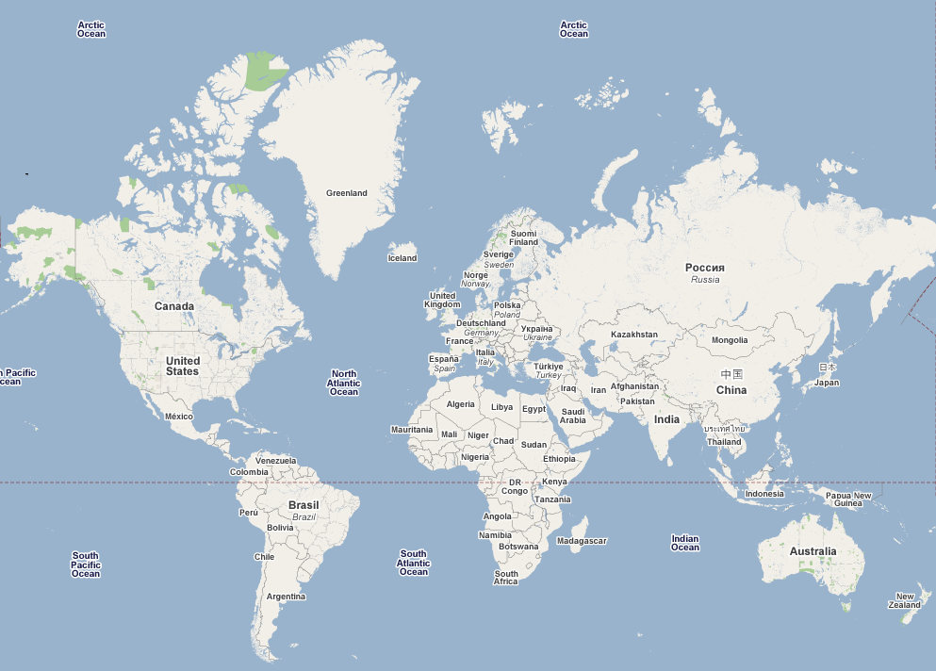
Challenges with Wire Fraud Detection
(Bank of America Example)
London
Charlotte, NC
Singapore
Indonesia
Size
More than 200,000 transactions per day
“No transaction by itself is suspicious”
Lack of International Wire Standard
Loosely structured data with inherent ambiguity

Slide 8
Challenges with Wire Fraud Detection
London
Charlotte, NC
Singapore
Indonesia
No Standard Form…
When a wire leaves Bank of America in Charlotte…
The recipient can appear as if receiving at London, Indonesia or Singapore
Vice versa, if receiving from Indonesia to Charlotte
The sender can appear as if originating from London, Singapore, or Indonesia
Notes:
Bank of America example. Other banks

Slide 9
WireVis: Financial Transaction Analysis
This work is supported by Bank of America and DHS. (Significantly wider deployment to other banks and financial analysts now under discussion.)
Current practice has been to do database queries filtered by keywords, amounts, date, etc. and investigate using spreadsheets.
This process is inadequate and inefficient because patterns of interest (e.g., fraud or risk) will change in unpredictable ways, it is difficult to be exploratory using query methods (especially for very large transactional databases), and analysts cannot see patterns over longer time periods.
Notes:
Not just visual query interface where one knows what one is looking for and can make specific queries. Highly interactive.

Slide 10
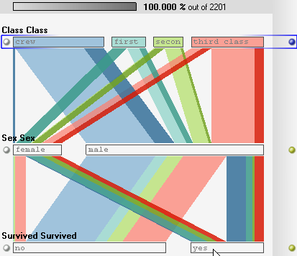
The Pipeline for Financial Anomaly Analysis
All transaction activity
Identify
Google
Interactive
Visualization
Prioritize
Report
Investigate
Notes:
A modest proposal: put interactive visualization at the center.
Dealing with the data for a particular application. Identify potential suspicious activity worthy of further investigation. Prioritize with risk ratings.
Make high dimensional, large scale visualization the overall user interface for the whole process.

Slide 11
WireVis: Using Keywords
Keywords…
Words that are used to filter all transactions
Only transactions containing keywords are flagged
Highly secretive
Typically include
Geographical information (country, city names)
Business types
Specific goods and services
Etc
Updated based on intelligence reports
Ranges from 200-350 words
Could reduce the number of transactions by up to 90%
Most importantly, gives useful meaning (label) to each transaction
Notes:
Keywords are “keys” into expert’s investigative knowledge.

Slide 12
WireVis: Financial Transaction Analysis System Overview
Search by Example (Find Similar Accounts)
Heatmap View
(Accounts to Keywords Relationship)
Keyword Network
(Keyword Relationships)
Strings and Beads
(Relationships over Time)
For full projects and publications, go to www.srvac.uncc.edu
Work by Remco Chang et al.
Notes:
Developed with Bank of America for fraud and broader financial analysis. Can handle all wire transactions over a year (many million). A multi-window interface is used with linked interaction among the windows (so that, for example, a selection or filtering operation in one window causes updates in the other windows) and balanced interaction (the same types of interaction are available in all windows).

Slide 13
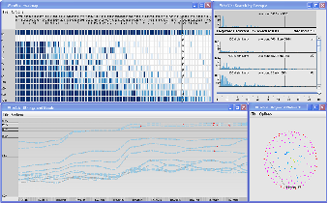
WireVis: Integrated with Full Transaction Database
Scalability
We have connected to the data warehouse at Bank of America with 10-20 millions of records, for wire transactions alone, over the course of a rolling year (13 months).
Connecting to a database makes interactive visualization tricky.
Unexpected Results (Access through the VA interface!)
“go to where the data is” – operations relating to the data are pushed onto the database (e.g, clustering).
Database
SQL
JDBC
Stored
Procedure
Raw Data
Temp Tables
WireVis Client
Notes:
This important result shows the benefit of an exploratory, “pre-query” approach. With this approach, one learns what one is interested in and then makes detailed queries. It provides a needed capability for comprehensive, complex data collections like the BoA data warehouse, where 80% of a user’s time is spent in querying and 20% in actually using the results.

Slide 14
WireVis: Integrated with Full Transaction Database
Performance Measurements
Data-driven operations such as re-clustering, drilldown, transaction search by keywords require worst case of 1-2 minutes.
All other interactions remain real time
No pre-computation / caching
Single CPU desktop computer
WireVis is in deployment with James Price’s and the WireWatch team for testing and evaluation.
It is the foundation for substantial new project on risk analysis.

Slide 15
Some General Conclusions
WireVis is a general tool. Though it was developed to investigate money-laundering and fraud, it can be applied to everything from risk analysis to financial business intelligence. WireVis’s power is due to:
Contextualizing in terms that are meaningful to the analyst.
The context may be in terms keywords that encapsulate knowledge or tradecraft, specific procedures that describe types of transactions, or some other way.
Organizing and discriminating among data using MDS, discriminating cluster analysis, filtering based on keywords, and other methods (but all based on the cognitive or conceptual space of the analysts).
Supporting highly interactive exploration from overview to particular case.
Notes:
The context provides the appropriate “viewpoint in the multidimensional space. These are general techniques. General techniques>>specific tasks.

Slide 16
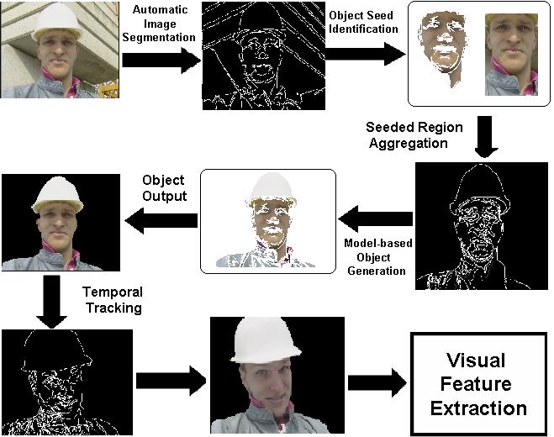
Multimedia: Automated Video Content Analysis
Work by Jianping Fan et al.
Notes:
Also an audio analysis component, used for differentiation of stories and synchronization.

Slide 17
Multimedia: Automated Video Content Analysis
Audio and Video Analysis: Story Boundary Detection
Notes:
The analysis is entirely automated and unstructured.

Slide 18
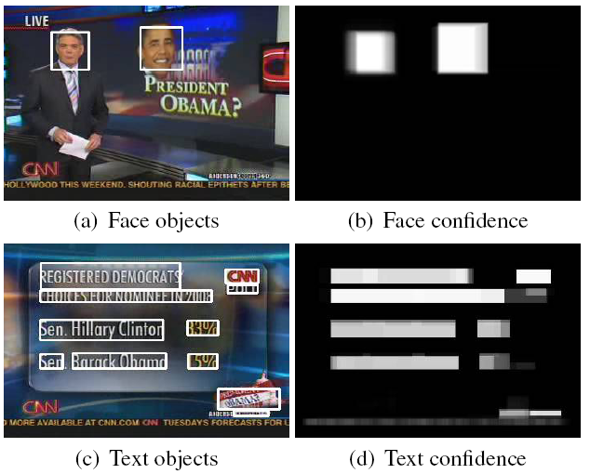
Video Scene Understanding and Search by Example
News Topic Detection:
Video Analysis

Slide 19
Multimedia: Automated Video Content Analysis
News Interestingness Prediction
News Story
Collection
Predictor
Interestingness
User Preference
Set of
news stories
Usage History
Result: analysis can automatically find news (or potentially other content) in unstructured media regardless
of language.
Notes:
Since have complete analyzed content, interestingness measure can be recalibrated or changed.

Slide 20
EventRiver: Determining Events
An event is an occurrence that happens at a specific time and draws continuous attention.
Events are derived from a cluster of multimedia documents that have closely related content and coincide in time.
Events are characterized by the semantics of their related documents, namely a group of interrelated significant keywords summarizing the major themes in the cluster, and the temporal information describing how the cluster strength changes over time..
Work by Jing Yang et al.

Slide 21
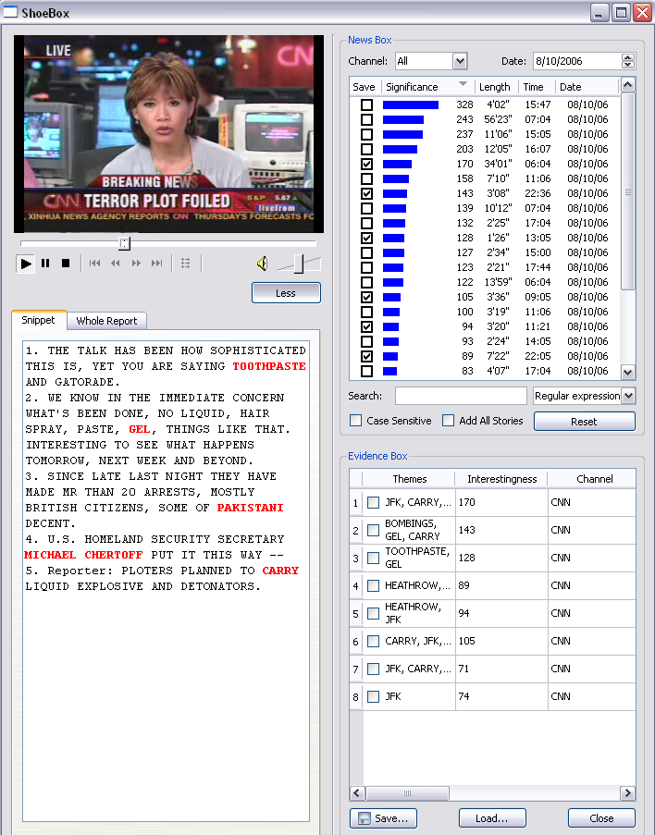
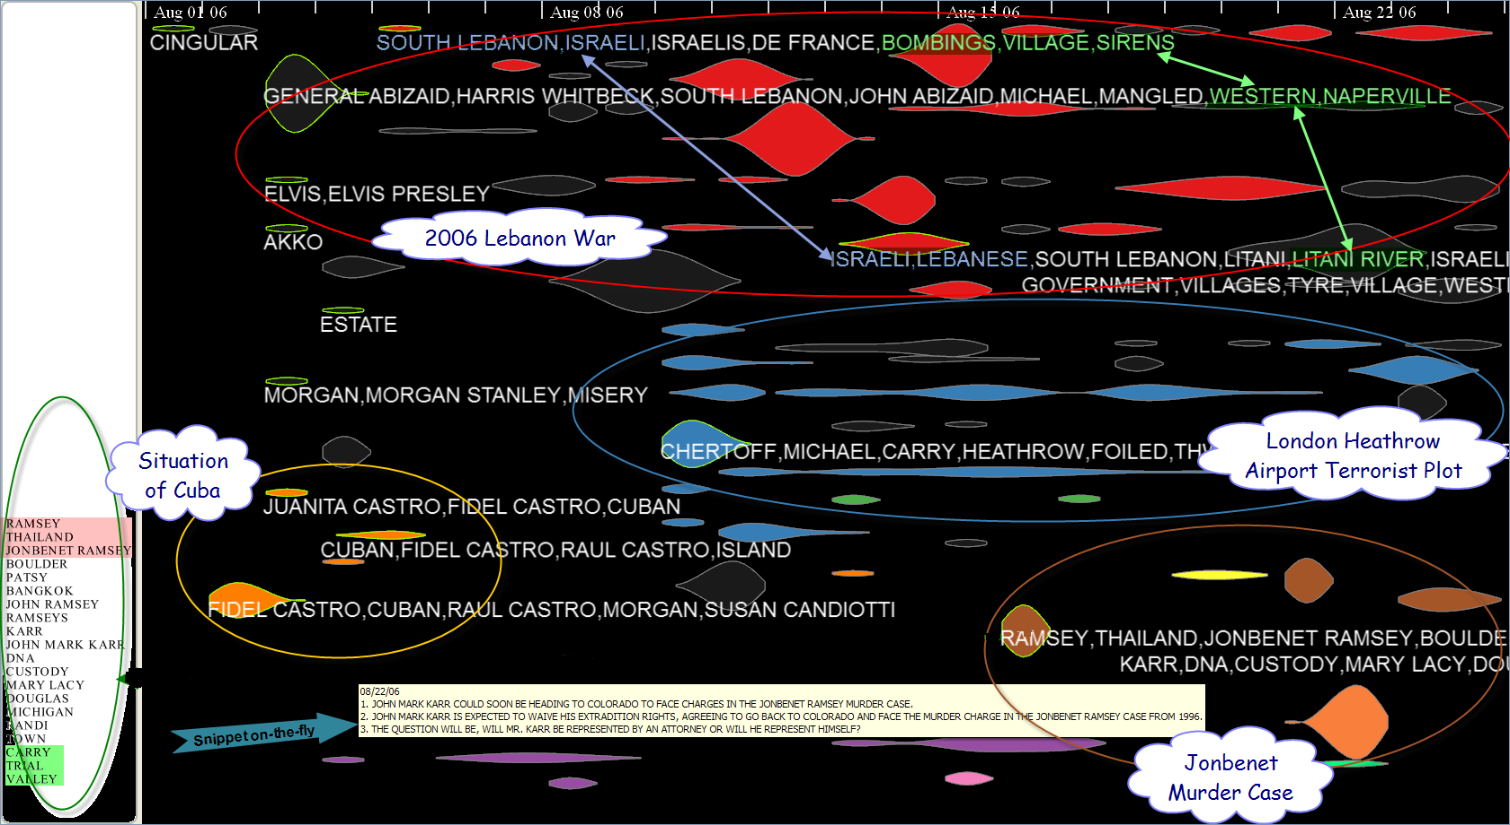
EventRiver - Visually Exploring Broadcast News Videos
Features:
Automatic incremental event extraction,
Event browsing and inspection
A rich set of navigation, search, and analysis tools.
The figure shows major CNN news from August 1 to 24 in 2006 (right) and a shoebox for examining an event in details (left).

Slide 22
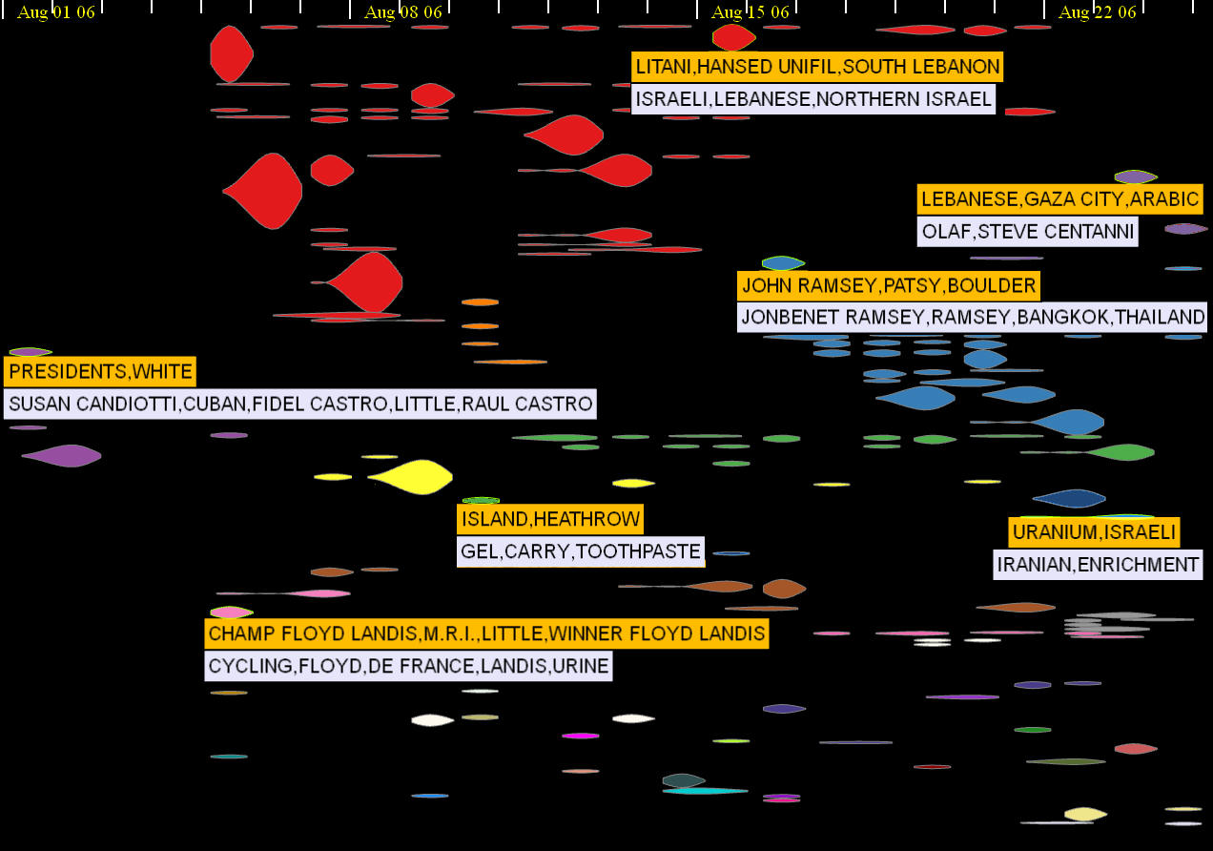
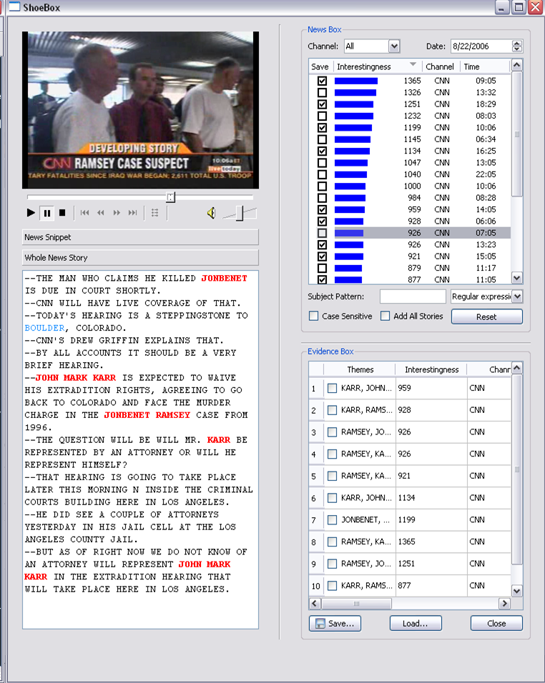
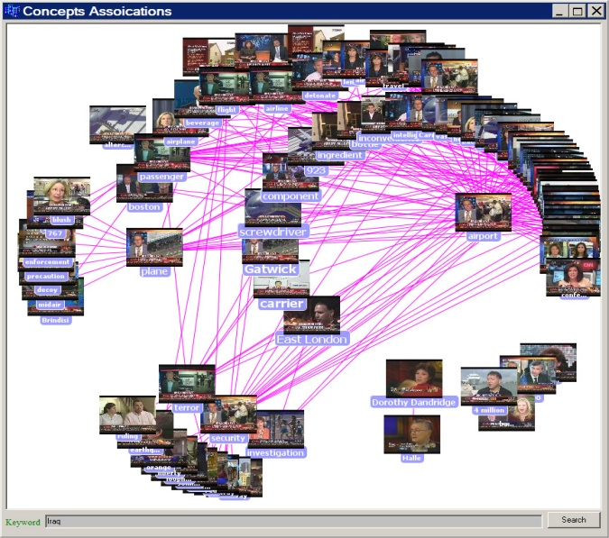
EventRiver Exploration and Filtering
Search by Example
EventRiver
Notes:
This is our latest version of exploratory news analysis. It has automatic organization of news stories associated with news events. It permits the user to explore all news events and stories, quickly boiling down to events and stories of interest.

Slide 23
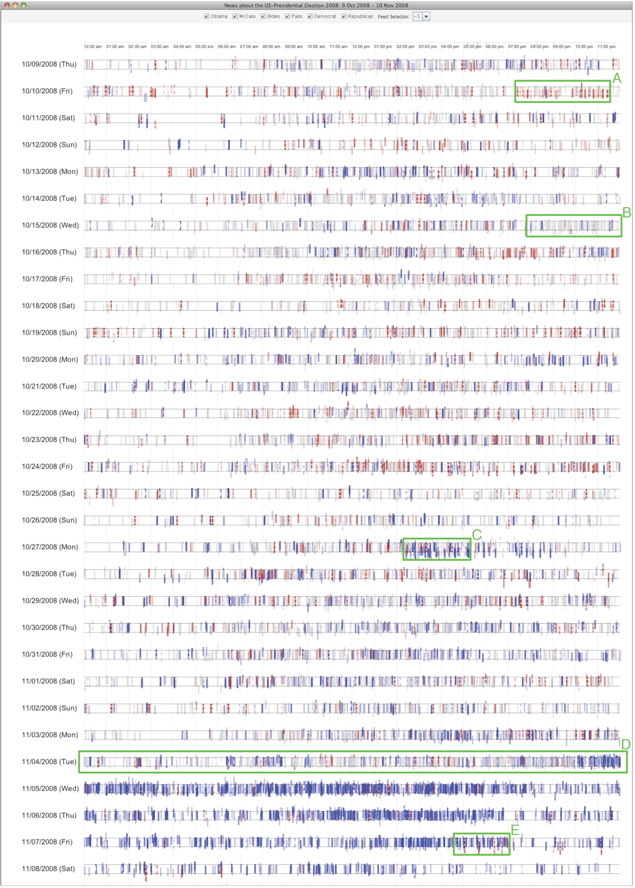
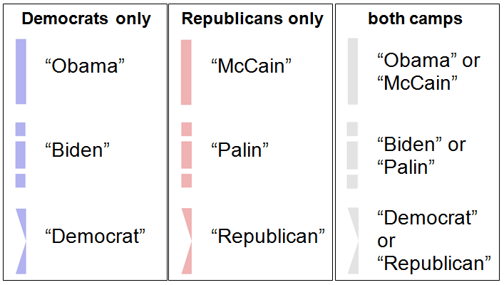
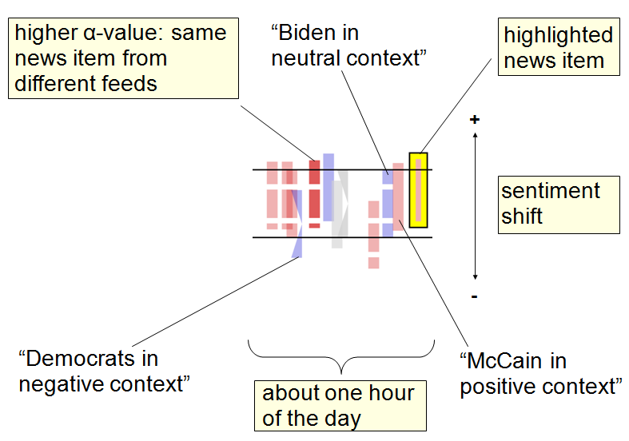
Sentiment Analysis on RSS Feeds
50 RSS News Feeds featuring the US Presidential Election in 2008 (10/9/2008 – 11/8/2008)
Work by Daniel Keim and his team

Slide 24
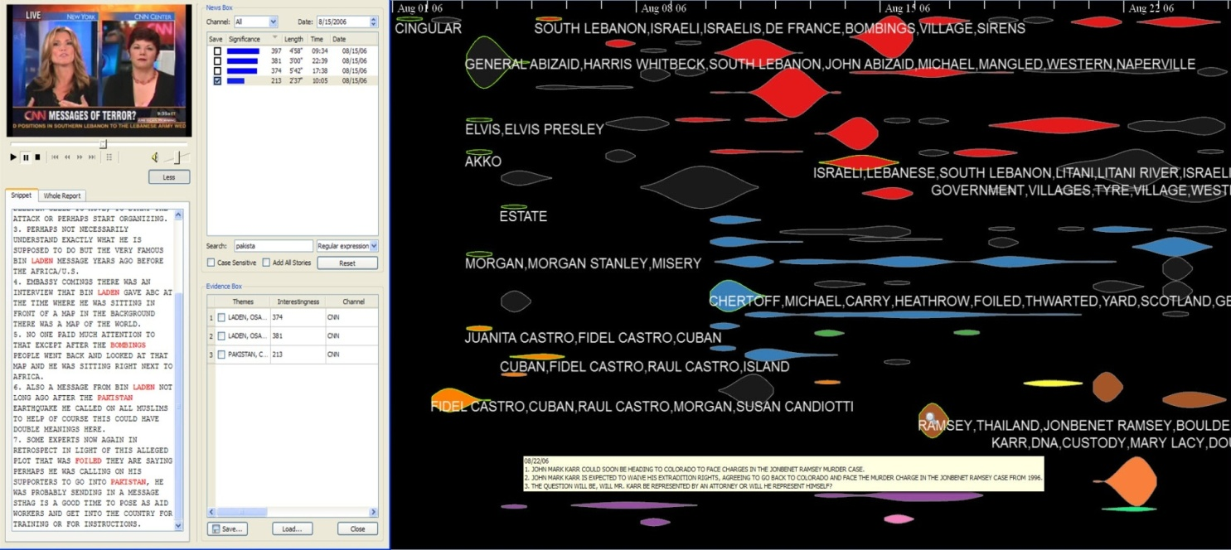

EventRiver: Expanded Capabilities
Sentiment Analysis
Geographic/Temporal Entity Extraction
Comparative Event
Trend Analysis

Slide 25
A Data Model for News Streams
Clustered News: daily news clusters; each cluster groups all the news reports towards the same incident.
Joint work between the U. Kontanz and UNC Charlotte teams

Slide 26
A Data Model for News Streams
A (bursty)Event: temporal divided portions of a story based on time series analysis of the statistics of clustered news.
A News Story
Cluster
Size
Date
Event
A
B
C
D
E
Notes:
Event-driven collection of news stories broken down into sub-events.

Slide 27
A Data Model for News Streams
Are there any correlations between Story 1 and Story 2 ?
News Stream
Clustered News are “local”, missing temporal information
Story 1
Story 2
Story n
……
Clustered News
Clustered News
Clustered News
……
……
……

Slide 28
A Data Model for News Streams
Events contain both Semantic and temporal information; act like routers to connect different news stories
Are there any correlations between Story 1 and Story 2 ?
News Stream
Story 1
Story 2
Story n
……
E
E
E
E
E
E
E
E
Clustered News
Clustered News
Clustered News
……
……
……

Slide 29
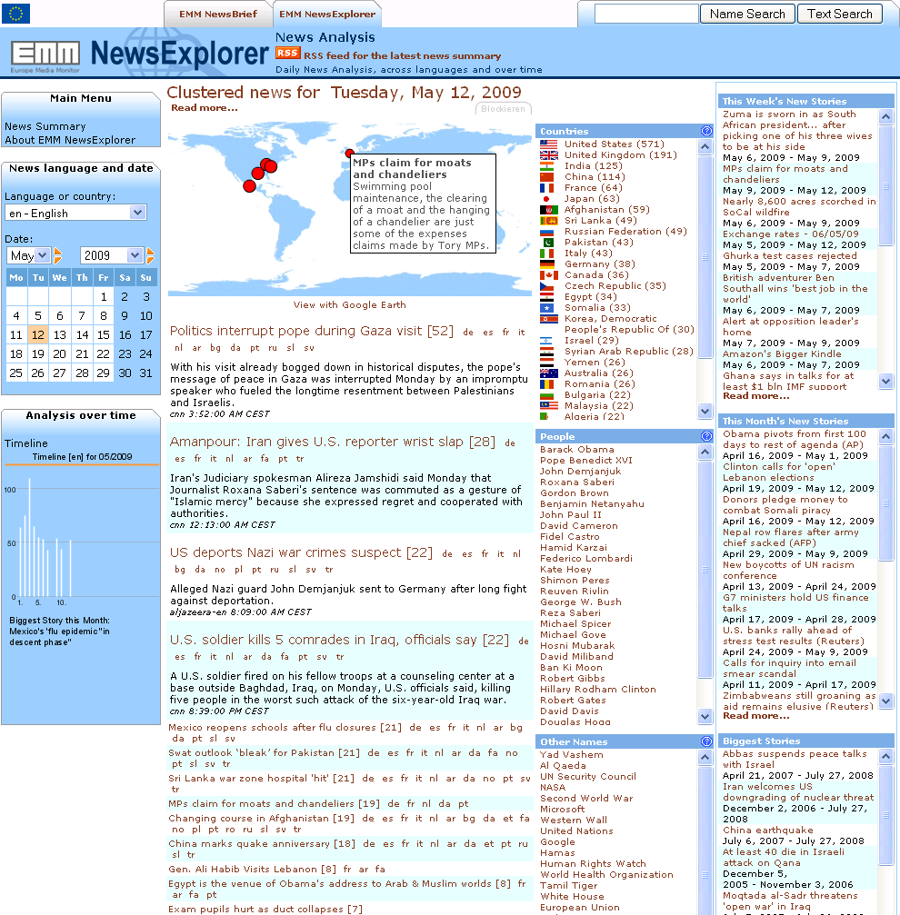
JRC European Media Monitor
geo-tagged
multilingual
clustered (event detection) and categorized
extracted entities
News Stream
monitoring about 4000 sources from 1600 portal in 43 languages
Work by Daniel Keim and his team
Notes:
What is the JRC?
The European Commission's Joint Research Centre (JRC) is a department (Directorate-General, DG) of the European Commission providing independent scientific and technological support for EU policy-making. It works closely on the development of EU legislation with the relevant Commission services, such as the Agricultural, Enterprise, Environment, and Health and Consumer Protection DGs. Knowledge comes from specific application- and issue-oriented research within the seven JRC Institutes and close co-operation with over 1000 public and private organisations in 150 networks in Member State and applicant countries. The JRC also liases with non-EU and global scientific and standard-setting bodies.
Some more information about EMM
The European Commission's Joint Research Centre (JRC) has developed a number of news aggregation and analysis systems to support EU institutions and Member State organisations. The three Web Portals NewsBrief, NewsExplorer and MedISys are publicly accessible and attract up to 1,2 Million hits per day. The system was initially developed as an in-house application for the European Commission’s Directorate General Communication (DG COMM) to replace their tedious and expensive manual media monitoring and press cutting services. Since then, EMM has become a crucial instrument in the daily work of almost all Commission services and many other public organisations. EMM is the news gathering engine behind a number of applications. EMM monitors the live web, i.e. the part of the web that has ever changing content, such as news sites, discussion sites and publications. All applications are developed, maintained and run by the JRC.

Slide 30
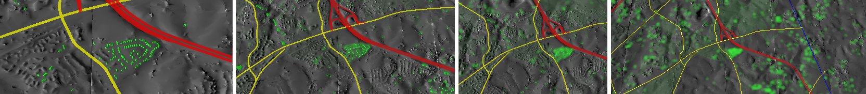
What is a Probe?
Pair consisting of:
- Region-of-Interest
- Coordinated Visualization
& Some visual connection
Rendered directly within the main visualization
Can be directly interacted with
Powerful in multiples

Slide 31
Why Probes?
More massive simulations
Computer experiments, requiring experimental probing of data collection & exploration of the simulation space.
Massive observational networks
Again, must be probed experimentally.
Notes:
Lose detail or lose context; can’t see or investigate relationships.

Slide 32
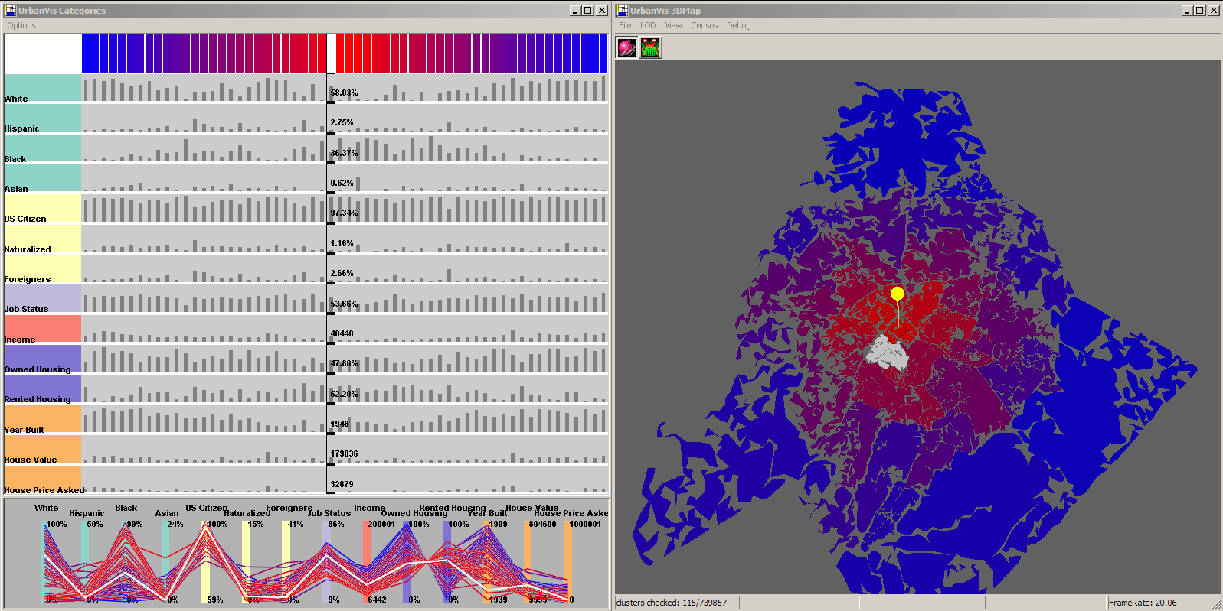
UrbanVis, Before
Work by Tom Butkiewicz, Remco Chang et al.

Slide 33
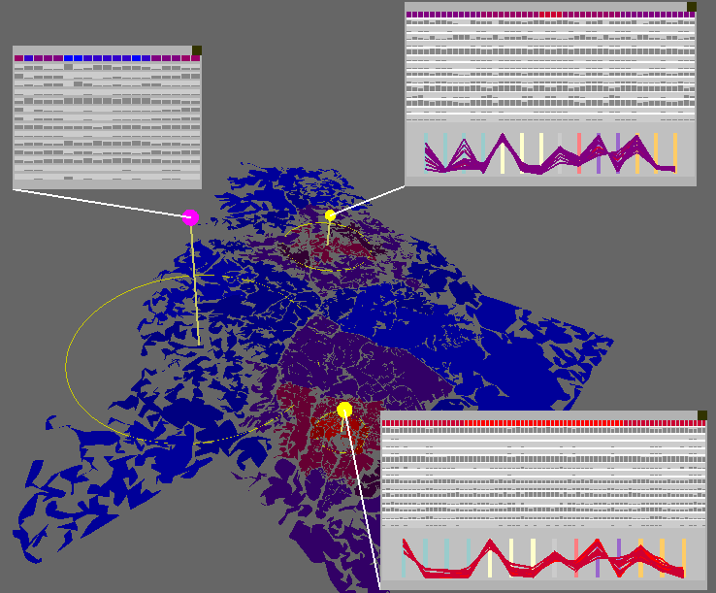
UrbanVis, After

Slide 34
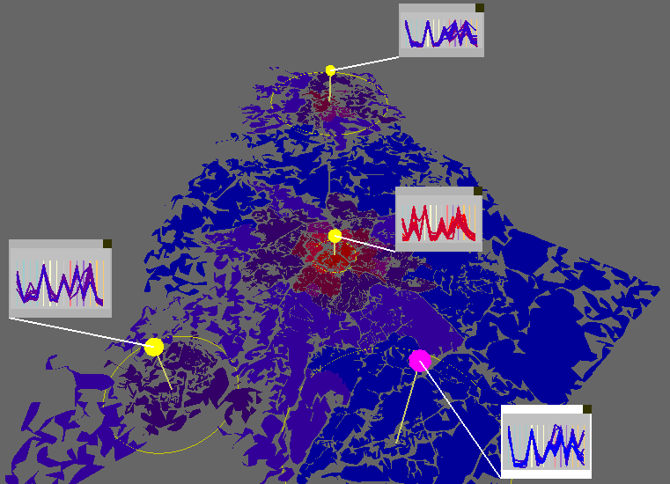
UrbanVis, After

Slide 35
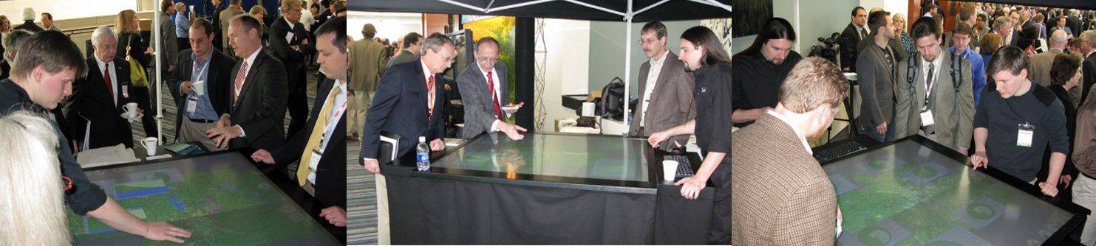
Multitouch ProbeVis

Slide 36
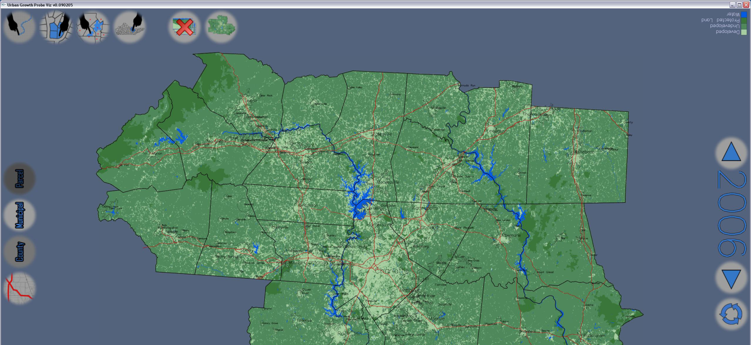
Multitouch ProbeVis
Large scale urban land use simulation
Difficult to see & understand details in context
Difficult to compare & understand trends in different areas

Slide 37
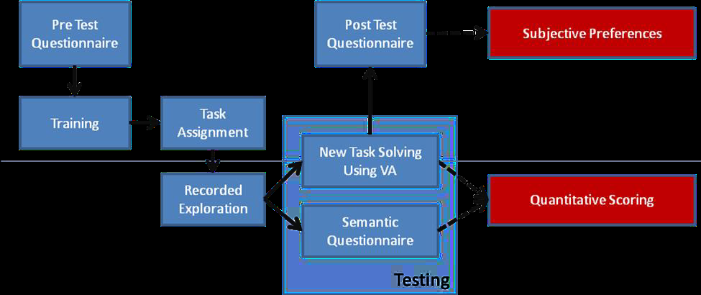
Evaluation
New evaluation strategies and results have emerged.
Learning-based Evaluation
Describe and measure knowledge gain and insights discovered.
Must separate out 3 types of learning: about the system, the data, and the cognitive task(s) at hand.
Notes:
Recorded evaluation to learn users analysis process, strategies, and findings in open-ended exploration. Watch and record. Will learn more about users and the system and its effectiveness.

Slide 38
A Few Words about Knowledge and Insight….
Knowledge is compact.
Knowledge begets knowledge.
Knowledge is flexible, reusable, and generalizable.
There are two types of insight
Spontaneous insight
Knowledge-building insight
Notes:
What’s come clear in thinking about all this. Knowledge begets: associative quality

Slide 39
Long-Term Research Goals
Establish design principles for visual analytics systems.
Develop a predictive human cognitive model.
Create a theory of interaction.
Develop a process for evaluation of exploratory, investigative, insight discovery, and knowledge-building systems.
Successfully attack large, complex real-world problems.
Notes:
Interaction is the medium of the flow of reasoning. It is also the binding medium between different visualizations (balanced interaction).

Slide 40
Questions?
www.srvac.uncc.edu

