Slide 1
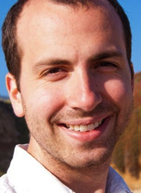


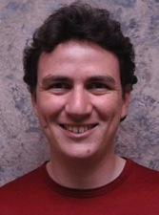
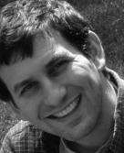
A Framework for Machine Learning and Data Mining in the Cloud
Yucheng Low
Joseph
Gonzalez
Aapo
Kyrola
Danny
Bickson
Carlos
Guestrin
Joe
Hellerstein

Slide 2
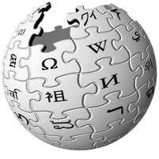



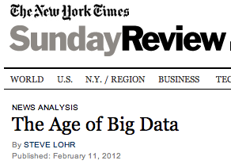
Big Data is Everywhere
6 Billion
Flickr Photos
900 Million
Facebook Users
72 Hours a Minute
YouTube
28 Million
Wikipedia Pages
“…growing at 50 percent a year…”
“… data a new class of economic asset, like currency or gold.”
Notes:
- everywhere
- useless -> actionable.
- identify trends, create models, discover patterns. → Machine Learning. Big Learning.

Slide 3
How will we design and implement Big learning systems?
Big Learning

Slide 4
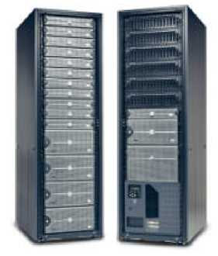
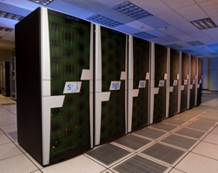
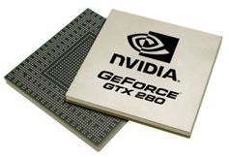
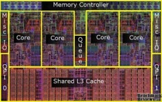

Shift Towards Use Of Parallelism in ML
GPUs
Multicore
Clusters
Clouds
Supercomputers
ML experts repeatedly solve the same parallel design challenges:
Race conditions, distributed state, communication…
Resulting code is very specialized:
difficult to maintain, extend, debug…
Graduate students
Avoid these problems by using
high-level abstractions
Notes:
- shift towards parallelism in different forms: …
- addressing
- built to solve very specific tasks.

Slide 5












MapReduce – Map Phase
CPU 1
CPU 2
CPU 3
CPU 4
Notes:
- An example:
- MapReduce. Two Phases.
- Map phase: independent embarassingly parallel computation : feature extraction from images.

Slide 6
MapReduce – Map Phase
CPU 1
4
2
.
3
2
1
.
3
2
5
.
8
1
2
.
9
CPU 2
CPU 3
CPU 4
Embarrassingly Parallel independent computation
No Communication needed
Notes:
- MapReduce. Two Phases.
- Map phase: independent embarassingly parallel computation : feature extraction from images.

Slide 7
MapReduce – Map Phase
CPU 1
8
4
.
3
1
8
.
4
8
4
.
4
2
4
.
1
CPU 2
CPU 3
CPU 4
1
2
.
9
4
2
.
3
2
1
.
3
2
5
.
8
Embarrassingly Parallel independent computation
No Communication needed
Notes:
- MapReduce. Two Phases.
- Map phase: independent embarassingly parallel computation : feature extraction from images.

Slide 8
MapReduce – Map Phase
CPU 1
6
7
.
5
1
4
.
9
3
4
.
3
1
7
.
5
CPU 2
CPU 3
CPU 4
1
2
.
9
2
4
.
1
4
2
.
3
8
4
.
3
2
1
.
3
1
8
.
4
2
5
.
8
8
4
.
4
Embarrassingly Parallel independent computation
No Communication needed
Notes:
- MapReduce. Two Phases.
- Map phase: independent embarassingly parallel computation : feature extraction from images.

Slide 9
MapReduce – Reduce Phase
Attractive Face
Statistics
Ugly Face
Statistics
22
26
.
26
17
26
.
31
CPU 1
CPU 2
Attractive Faces
Ugly Faces
1
2
.
9
2
4
.
1
1
7
.
5
4
2
.
3
8
4
.
3
6
7
.
5
2
1
.
3
1
8
.
4
1
4
.
9
2
5
.
8
8
4
.
4
3
4
.
3
U A A U U U A A U A U A
Image Features
Notes:
“fold” or an aggregation operation over the results.
- features of ugly faces, and features of attractive faces.

Slide 10
MapReduce for Data-Parallel ML
Excellent for large data-parallel tasks!
Data-Parallel Graph-Parallel
Is there more to
Machine Learning
?
MapReduce
Feature
Extraction
Cross
Validation
Graphical Models
Gibbs Sampling
Belief Propagation
Variational Opt.
Semi-Supervised Learning
Label Propagation
CoEM
Computing Sufficient
Statistics
Collaborative
Filtering
Tensor Factorization
Graph Analysis
PageRank
Triangle Counting
Notes:
- data parallel are map reduceable
Is there more to ML?
Yes!

Slide 11
Exploit Dependencies
Notes:
A lot of powerful ML methods come in exploitng dependencies between data!

Slide 12

Hockey
Scuba Diving
Hockey
Underwater Hockey
Scuba Diving
Hockey
Scuba Diving
Hockey
Scuba Diving
Hockey
Notes:
- product recommentations.
- Impossible. Social Network.
- Close friends.

Slide 13
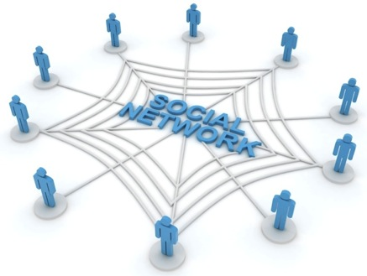
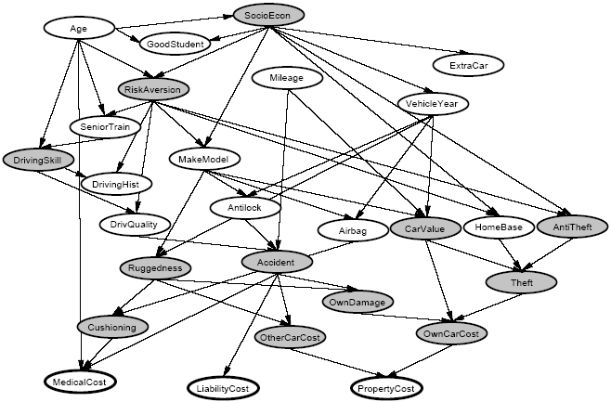
Graphs are Everywhere
Social Network
Collaborative Filtering
Users
Netflix
Movies
Probabilistic Analysis
Text Analysis
Docs
Wiki
Words
Notes:
- infer interests
- collaborative filtering: sparse matrix of movie rentals
- text
- relate random variables.

Slide 14
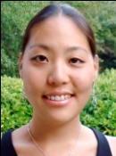

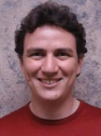




Properties of Computation on Graphs
Dependency
Graph
Local Updates
Iterative
Computation
My Interests
Friends Interests
Notes:
- Data related to each other via a graph
- Computation has locality properties. The computation of parameters on a vertex may depend only on the vertices adjacent to it.
- Iterative in nature. Sequence of operations that are repeated
(3.30)

Slide 15
ML Tasks Beyond Data-Parallelism
Data-Parallel Graph-Parallel
Map Reduce
Feature
Extraction
Cross
Validation
Graphical Models
Gibbs Sampling
Belief Propagation
Variational Opt.
Semi-Supervised Learning
Label Propagation
CoEM
Computing Sufficient
Statistics
Collaborative
Filtering
Tensor Factorization
Graph Analysis
PageRank
Triangle Counting
Notes:
- Universe
- GraphLab is designed to target

Slide 16
ML Tasks Beyond Data-Parallelism
Data-Parallel Graph-Parallel
Map Reduce
Map Reduce?
Feature
Extraction
Cross
Validation
Graphical Models
Gibbs Sampling
Belief Propagation
Variational Opt.
Semi-Supervised Learning
Label Propagation
CoEM
Computing Sufficient
Statistics
Collaborative
Filtering
Tensor Factorization
Graph Analysis
PageRank
Triangle Counting
Notes:
A whole universe of methods which we call Graph Parallel.
And that is what GraphLab is designed to target.

Slide 17
Properties of Graph-Parallel Algorithms
Dependency
Graph
Local Updates
Iterative
Computation
My Interests
Friends Interests
Notes:
- Data lives in a graph.
- Computation has locality properties. The computation of parameters on a vertex may depend only on the vertices adjacent to it.
- Iterative in nature.

Slide 18
Map-Reduce for Data-Parallel ML
Excellent for large data-parallel tasks!
Data-Parallel Graph-Parallel
Map Reduce
Map Reduce?
Feature
Extraction
Cross
Validation
Graphical Models
Gibbs Sampling
Belief Propagation
Variational Opt.
Semi-Supervised Learning
Label Propagation
CoEM
Computing Sufficient
Statistics
Collaborative
Filtering
Tensor Factorization
Data-Mining
PageRank
Triangle Counting
Notes:
GraphLab is a high level abstraction used to target this family of tasks

Slide 19

What is GraphLab?

Slide 20
Shared Memory GraphLab
BP+Parameter Learning
Gibbs Sampling
CoEM
16
Ideal
16
16
Ideal
Ideal
12
12
12
8
8
8
Speedup
Speedup
Speedup
4
Speedup
4
4
Speedup
Speedup
4
8
12
16
4
8
12
16
4
8
12
16
#proc
#proc
#proc
Lasso
Compressed Sensing
16
16
Ideal
Ideal
12
12
8
8
Speedup
Speedup
4
4
Speedup
Speedup
4
8
12
16
4
8
12
16
#proc
#proc
GraphLab: A New Parallel Framework for Machine Learning
Y. Low, J. Gonzalez, A. Kyrola, D. Bickson, C. Guestrin, and J. M. Hellerstein (UAI 2010)
Notes:
In 2010 we first proposed and developed a shared memory implementation of GraphLab on which we demonstrated
very good scaling on a variety of ML tasks.

Slide 21
Alternating Least
Squares
SVD
Splash Sampler
CoEM
Bayesian Tensor
Factorization
Lasso
Belief Propagation
LDA
2010
PageRank
Shared Memory
SVM
Gibbs Sampling
Linear Solvers
Matrix
Factorization
…Many others…
Notes:
Algorithms
users

Slide 22
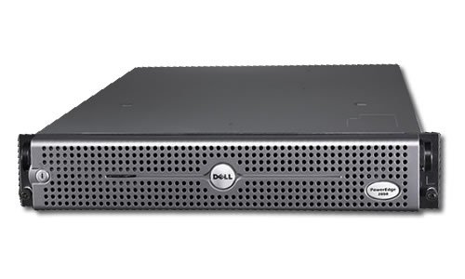
Limited CPU Power
Limited Memory
Limited Scalability

Slide 23

Distributed Cloud
Unlimited amount of computation resources!
(up to funding limitations)
Distributing State
Data Consistency
Fault Tolerance
Notes:
- classical

Slide 24
The GraphLab Framework
Graph Based
Data Representation
Update Functions
User Computation
Consistency Model
Notes:
- overview
- - -

Slide 25
Data Graph
Data associated with vertices and edges
Graph:
Social Network
Vertex Data:
User profile
Current interests estimates
Edge Data:
Relationship
(friend, classmate, relative)
Notes:
Core GL datastrucutre.
Arbitrary graph
(5)

Slide 26
Distributed Graph
Partition the graph across multiple machines.
Notes:
- cut along edges
- gaps. Local-> remote

Slide 27
Distributed Graph
Ghost vertices maintain adjacency structure and replicate remote data.
“ghost” vertices
Notes:
- ghost. Maintain adjacency. replicate data.

Slide 28
Distributed Graph
Cut efficiently using HPC Graph partitioning tools (ParMetis / Scotch / …)
“ghost” vertices
Notes:
- Too difficult -> random

Slide 29
The GraphLab Framework
Graph Based
Data Representation
Update Functions
User Computation
Consistency Model
Notes:
- However, given this data, what can I do with it?

Slide 30
Update Functions
User-defined program: applied to a vertex and transforms data in scope of vertex
Update function applied (asynchronously)
in parallel until convergence
Many schedulers available to prioritize computation
Pagerank(scope){
// Update the current vertex data
// Reschedule Neighbors if needed
if vertex.PageRank changes then
reschedule_all_neighbors;
}
Why Dynamic?
Dynamic computation
Notes:
weighted sum
Neighbors needs to be recomputed

Slide 31
BSP ML Problem: Synchronous Algorithms can be Inefficient
Bulk Synchronous
Asynchronous Splash BP
Notes:
This relates to work in graphical model inference we did in the past, where we demonstrated that there are ML problems where asynchronous/dynamic computation can be substantially faster than synchronous.
For instance, in this work we did in 2009, we demonstrated that a well designed asynchronous/dynamic computation can converge substantially faster than a synchronous version: here, running faster on 1 proc, than synchronous on 8.

Slide 32
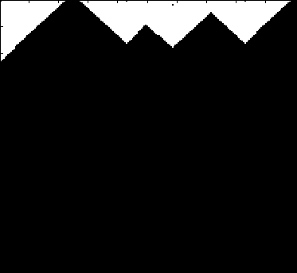

Asynchronous Belief Propagation
Challenge = Boundaries
Many
Updates
Few
Updates
Cumulative Vertex Updates
Algorithm identifies and focuses
on hidden sequential structure
Graphical Model
Notes:
Focus on where it is hardest
Dynamic graphical model inference procedure.
Observe that the procedure quicky focuses on where the problem is hardest. The ability to focus computation on where it matters can produce substantial performance benefits

Slide 33
Shared Memory Dynamic Schedule
Scheduler
CPU 1
a
b
d
b
c
a
h
e
f
g
a
b
i
h
i
j
k
CPU 2
Process repeats until scheduler is empty
Notes:
Implement dyanimc asynchronous in shared memory
Each task is an update function applied on a vertex
scheduler = parallel data structure

Slide 34
Distributed Scheduling
Each machine maintains a schedule over the vertices it owns.
a
f
b
d
a
b
c
h
c
g
e
f
g
h
i
j
k
i
j
Distributed Consensus used to identify completion
Notes:
Each machine does the same as in the shared memory setting.
Pulls a task out and runs it

Slide 35
Ensuring Race-Free Code
How much can computation overlap?
Notes:
- in such an asynchronous, dynamic computation environment, where ...access scope..
-prevent race conditions.
- overlap

Slide 36
Common Problem: Write-Write Race
Processors running adjacent update functions simultaneously modify shared data:
CPU1 writes:
CPU 1
CPU 2
CPU2 writes:
Final Value
Notes:
But if two adjacent vertices are updated simultaneously…. We could get a clash on the center edge.
The result on the center edges could become inconsistent. For instance, the left vertex could write the blue histogram to the edge.
The right.
But due to the collision, it is possible for the final value can be very wrong.

Slide 37
The GraphLab Framework
Graph Based
Data Representation
Update Functions
User Computation
Consistency Model

Slide 38
PageRank Revisited
Pagerank(scope) {
…
}
Notes:
- revisit
- core piece of computation.
- see how it behaves if we allow it to race

Slide 39
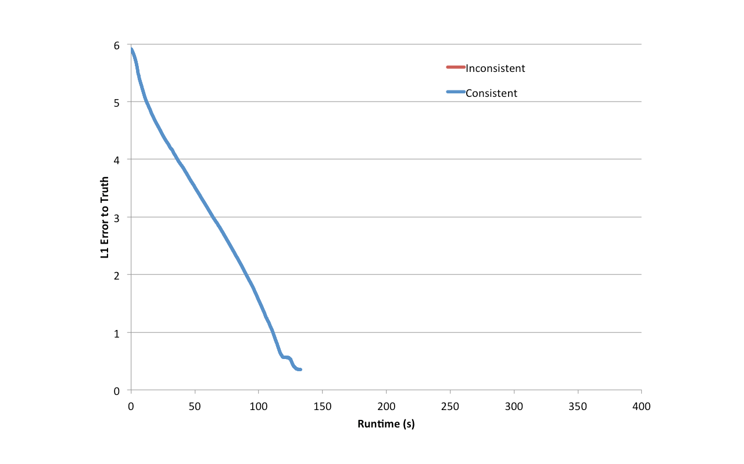
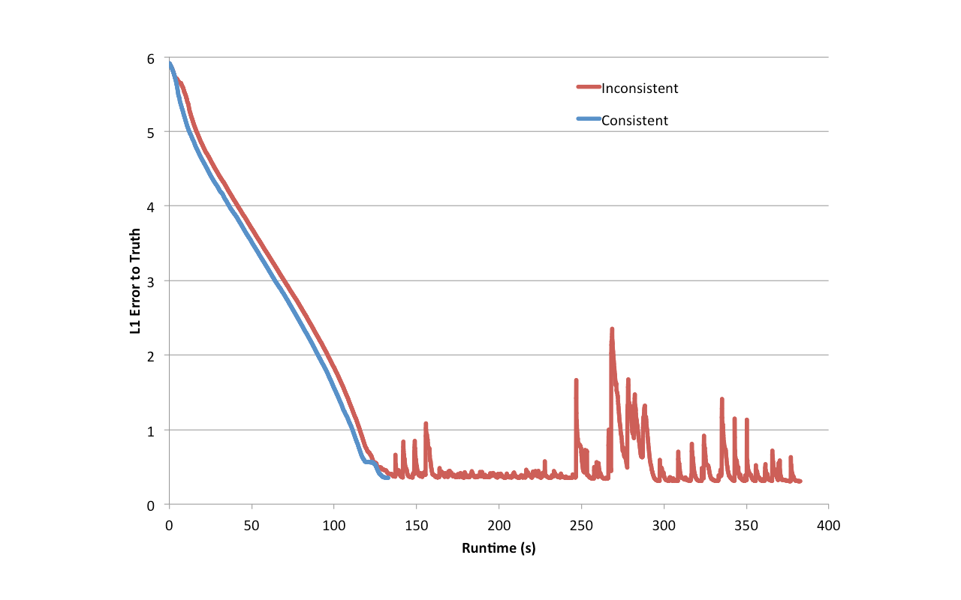
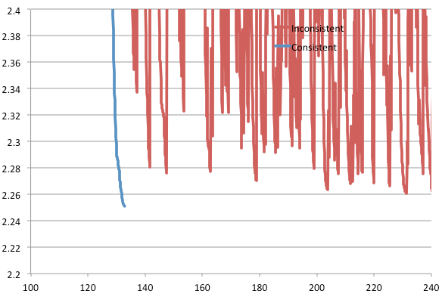
Racing PageRank
This was actually encountered in user code.
Notes:
Plot error to ground truth over time.
- if we can run consistently. Converges just fine
- if we don’t.
- zoom in. Fluctures near convergence and never quite gets there.
- PageRank: provably convergent under inconsistency. Yet it does not converge.
- Why?

Slide 40
Bugs
Pagerank(scope) {
…
}
Notes:
Take a look at the code again. Can we see the problem?
- fluctuates when neighbors read. Resulting in propagation of bad values.

Slide 41
Bugs
Pagerank(scope) {
…
}
tmp
tmp
Notes:
Store in a temporary, and only modify the vertex once at the end.
- First problem: without consistency, the programmer has to be constantly aware of that fact and be careful to code around it.

Slide 42
Throughput != Performance
No Consistency
Higher Throughput
(#updates/sec)
Potentially Slower Convergence of ML
Notes:
- It has been said that ML algorithms are robust to no consistency … ignore it .. And it will still work out.
- Allow computation to race
- … higher throughput … != finish faster.

Slide 43
Racing Collaborative Filtering
Notes:
- matrix factorization
- Training RMSE over time.
- much larger number of updates

Slide 44
Serializability
For every parallel execution, there exists a sequential execution of update functions which produces the same result.
CPU 1
time
Parallel
CPU 2
Sequential
Single
CPU
Notes:
- defines race free operation using notion of serializability.
- serializability.

Slide 45
Serializability Example
Write
Stronger / Weaker
consistency levels available
User-tunable consistency levels
trades off parallelism & consistency
Read
Overlapping regions
are only read.
Update functions one vertex apart can be run in parallel.
Edge Consistency
Notes:
Example: …
- expert user.
- only focus on edge consistency.

Slide 46
Stronger / Weaker Consistency
Write
Write
Does not read
adjacent vertices
Full Consistency
Vertex Consistency
Parallel Updates must be
two vertices apart
Parallel Updates can be
adjacent.
Notes:
We can also define stronger or weaker consistency levels using the same techniques.
Say the update function writes to its neighbors. Then to achieve consistency, only updates which are two vertices apart may run in parallel. This, we call full consistency.
Similarly, if the update function only writes to the central vertex. Then all updates can be run in parallel and we call this vertex consistency.

Slide 47




Solution 1
Distributed Consistency
Solution 2
Graph Coloring
Distributed Locking

Slide 48
Edge Consistency via Graph Coloring
Vertices of the same color are all at least one vertex apart.
Therefore, All vertices of the same color can be run in parallel!

Slide 49
Chromatic Distributed Engine
Execute tasks
on all vertices of
color 0
Execute tasks
on all vertices of
color 0
Ghost Synchronization Completion + Barrier
Time
Execute tasks
on all vertices of
color 1
Execute tasks
on all vertices of
color 1
Ghost Synchronization Completion + Barrier
Notes:
simple

Slide 50
Matrix Factorization
Netflix Collaborative Filtering
Alternating Least Squares Matrix Factorization
Model: 0.5 million nodes, 99 million edges
Users
Users
Movies
Netflix
d
Movies
Notes:
- factor sparse matrix
-easy to color

Slide 51

Netflix Collaborative Filtering
Ideal
MPI
Hadoop
D=100
D=20
GraphLab
# machines
# machines
Notes:
- good performance with D. D.
- two orders. MPI.

Slide 52
The Cost of Hadoop
Notes:
- less discussed. Cost. Time is money. Wrong Abstraction costs money.
- runtime and cost, difference cluster sizes on EC2.
- 100x more, 100x longer. Logarithmic axes.

Slide 53
CoEM (Rosie Jones, 2005)
Named Entity Recognition Task
the cat
<X> ran quickly
Is “Cat” an animal?
Is “Istanbul” a place?
Australia
travelled to <X>
Vertices: 2 Million
Edges: 200 Million
Istanbul
<X> is pleasant
0.3% of Hadoop time
Hadoop | 95 Cores | 7.5 hrs
GraphLab | 16 Cores | 30 min
Distributed GL | 32 EC2 Nodes | 80 secs
Notes:
-Answer questions
- Construct bipartite graph from corpus

Slide 54
Distributed NER
Hadoop | 95 Cores | 7.5 hrs
GraphLab | 16 Cores | 30 min
Hadoop
Distributed GL | 32 EC2 Nodes | 80 secs
GraphLab
0.3% of Hadoop time
Notes:
We scale moderately well.

Slide 55
Problems
Require a graph coloring to be available.
Frequent Barriers make it extremely inefficient for highly dynamic systems where only a small number of vertices are active in each round.
Notes:
- Complex graphs, user cannot provide a graph coloring. And we cannot use the chromatic engine to find a graph coloring.
-

Slide 56
Solution 1
Distributed Consistency
Solution 2
Graph Coloring
Distributed Locking
Notes:
Thus we have a second engine implementation built around distributed locking.

Slide 57

Distributed Locking
Edge Consistency can be guaranteed through locking.
: RW Lock
Notes:
We associate a rw-lock with each vertex.

Slide 58
Consistency Through Locking
Acquire write-lock on center vertex, read-lock on adjacent.
Notes:
- write on center, read on adjacent, taking care to acquire locks in canonical ordering
- read lock acquired more than once
- minor variations.

Slide 59

Consistency Through Locking
Multicore Setting
PThread RW-Locks
A
C
Distributed Setting
B
D
Distributed Locks
CPU
Machine 1
Challenges
Latency
A
C
A
B
D
Solution
Pipelining
Machine 2
A
C
B
D
Notes:
- easy in shared.
- distributed, latency, limiting.

Slide 60
No Pipelining
lock scope 1
Process request 1
Time
scope 1 acquired
update_function 1
release scope 1
Process release 1
Notes:
- visualize
- acquire a remote lock, send a message.
- only when locks are acquire then machine can run the update function.

Slide 61
Pipelining / Latency Hiding
Hide latency using pipelining
lock scope 1
lock scope 2
Process request 1
Time
lock scope 3
Process request 2
scope 1 acquired
Process request 3
scope 2 acquired
scope 3 acquired
update_function 1
release scope 1
update_function 2
Process release 1
release scope 2
Notes:
- large number (10K) simultaneous.
- update function when locks ready. In flight.
- Hide latency of individual.

Slide 62

Latency Hiding
Hide latency using request buffering
Residual BP on 190K Vertex 560K Edge Graph
4 Machines
No Pipelining | 472 s
lock scope 1
Pipelining | 10 s
lock scope 2
Process request 1
Time
lock scope 3
Process request 2
scope 1 acquired
47x Speedup
Process request 3
scope 2 acquired
scope 3 acquired
update_function 1
release scope 1
update_function 2
Process release 1
release scope 2
Notes:
- Small problem

Slide 63
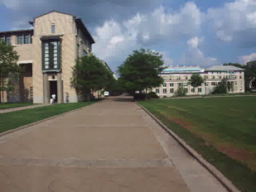
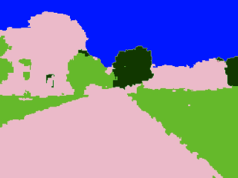
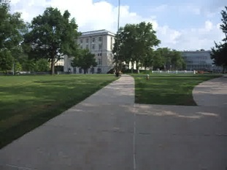
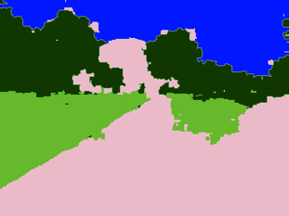
Video Cosegmentation
Segments mean the same
Probabilistic Inference Task
1740 Frames
Model: 10.5 million nodes, 31 million edges
Notes:
- To evaluate…

Slide 64
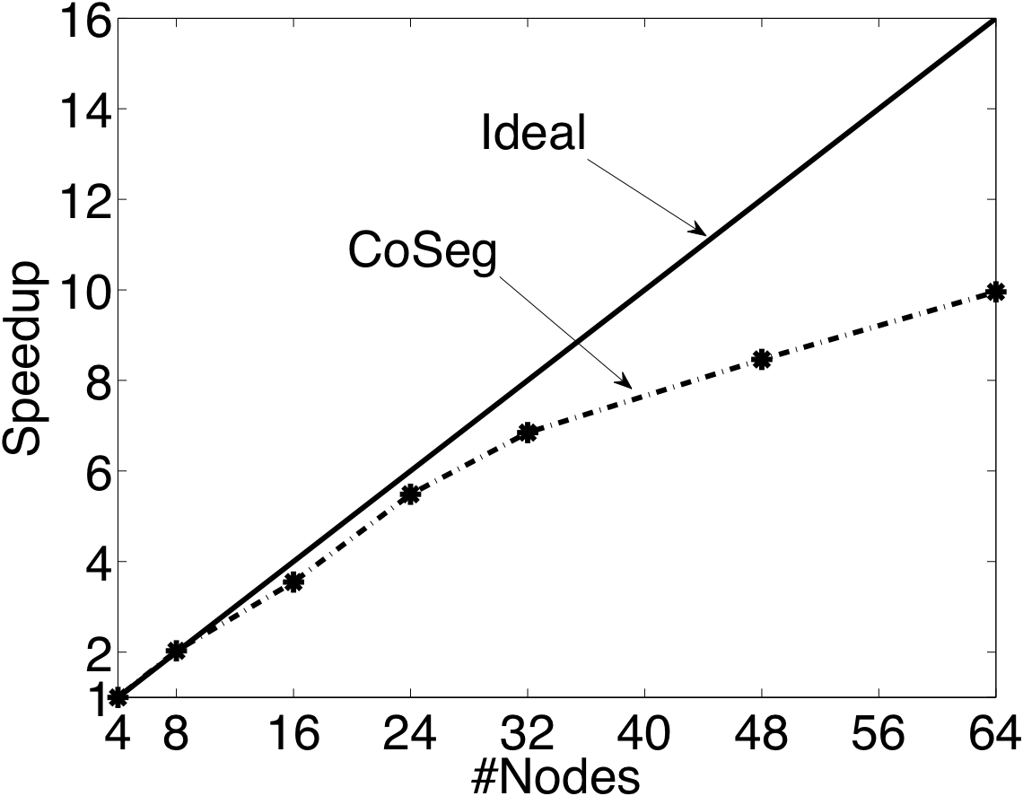
Video Coseg. Speedups
Ideal
GraphLab
# machines
Notes:
Highly dynamic and stresses the locking engine. We do pretty well.

Slide 65
The GraphLab Framework
Graph Based
Data Representation
Update Functions
User Computation
Consistency Model
Notes:
Concludes.
- how data is distributed , how computation is performed , how consistency is maintained
However,

Slide 66
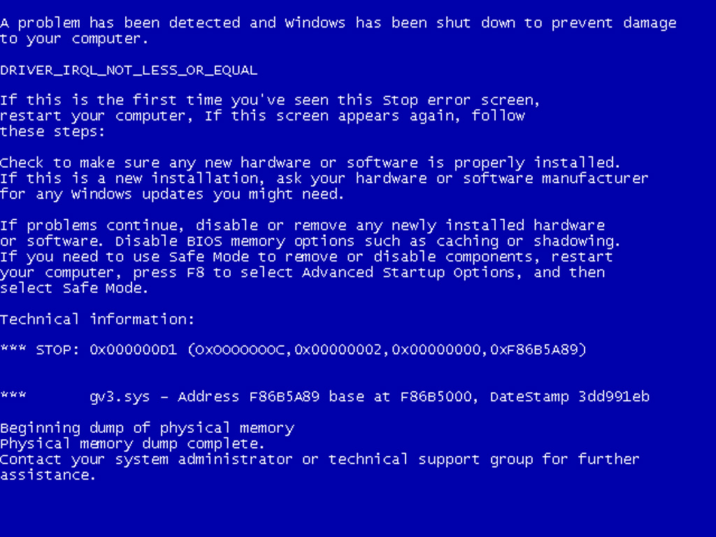
What if machines fail?
How do we provide fault tolerance?

Slide 67
Checkpoint
1: Stop the world
2: Write state to disk

Slide 68
Snapshot Performance
Because we have to stop the world,
One slow machine slows everything down!
No Snapshot
Snapshot
Snapshot time
One slow machine
Slow machine
Notes:
- evaluate behavior. Plot progress.
- linear progress
- Introduce one slow machine into the system

Slide 69
How can we do better?
Take advantage of consistency

Slide 70
Checkpointing
1985: Chandy-Lamport invented an asynchronous snapshotting algorithm for distributed systems.
snapshotted
Not snapshotted
Notes:
- Typically hard to implement.
- Our comm layer design makes it hard to implement this.

Slide 71
Checkpointing
Fine Grained Chandy-Lamport.
Easily implemented within GraphLab as an Update Function!
Notes:
- instead of snapshotting machines, lets think extremely fine grained. We have a graph. Lets map this to the graph.
- On such granularity, did we make the problem harder?
given edge consistency, extremely easy in GraphLab!
GraphLab’s async checkpointing can be done entirely within GraphLab!

Slide 72
Async. Snapshot Performance
No penalty incurred by the slow machine!
No Snapshot
Snapshot
One slow machine
Notes:
Lets see the behavior of this Asynchronous Snapshot procedure.
Instead of a flat-line, we get a little curve.

Slide 73
Summary
Extended GraphLab abstraction to distributed systems
Two different methods of achieving consistency
Graph Coloring
Distributed Locking with pipelining
Efficient implementations
Asynchronous Fault Tolerance with fined-grained Chandy-Lamport
Performance
Efficiency
Scalabilitys
Useability
Notes:
Obtain Performance ,efficiency and scalability while as a high level abstraction, while as a high level abstraction without sacrificing useability

Slide 74
What’s next?

Slide 75
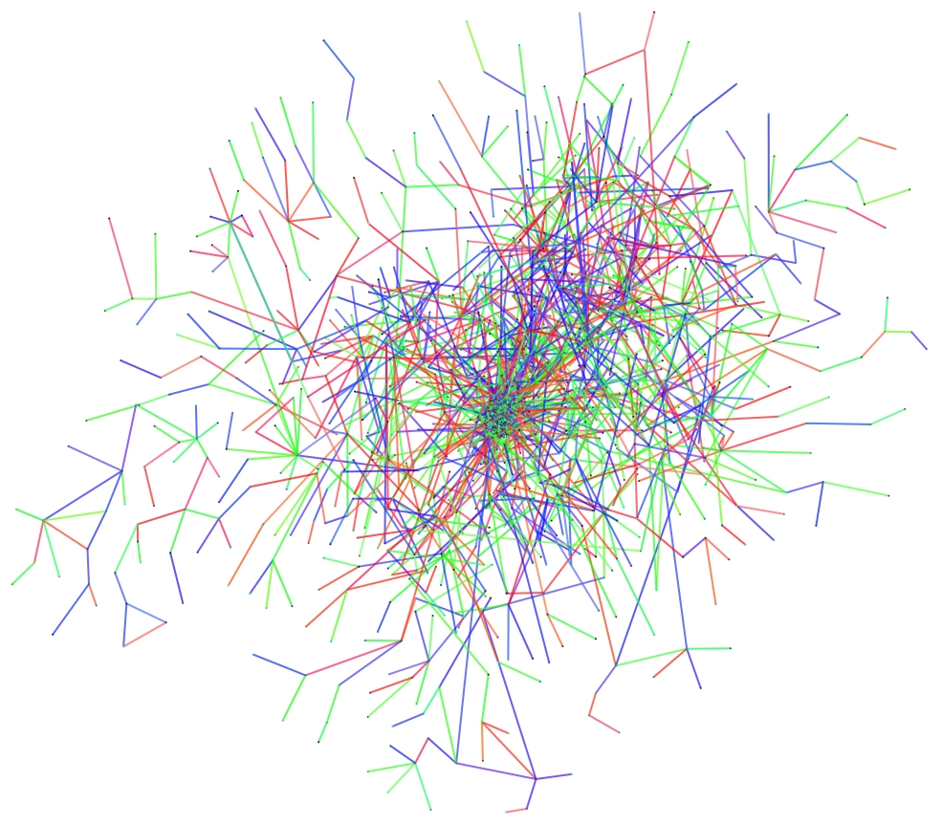
Natural Graphs

Slide 76
Natural Graphs → Power Law
Yahoo! Web Graph: 1.4B Verts, 6.7B Edges
Top 1% of vertices is adjacent to
53% of the edges!
“Power Law”
Notes:
----- Meeting Notes (11/15/11 20:27) -----
Review of the scope.

Slide 77

OSDI PowerGraph
Revised Abstraction
Improved Distributed Graph Placement
New distributed locking protocol (fined grained Chandy-Misra)
Demonstrated scaling to billions of vertices and tens of billions of edges.
… many more …

Slide 78
Release 2.1 + many toolkits
http://graphlab.org
Major Improvements to be published in OSDI 2012
PageRank:
40x faster than Hadoop
1B edges per second.
Triangle Counting:
282x faster than Hadoop
400M triangles per second.
Notes:
Improved graph placement, improved parallel locking procedure, modifications which improve scalability to
BILLIONS of vertices, 10s/100s BILLIONS of edges..
- 1min 30s for the entire twitter graph. Or about 2 minutes end to end loading from raw text. Hadoop running on a much much larger cluster took 7 hours.

Slide 79
Release 2.1 available now
http://graphlab.org
Major Improvements to be published in OSDI 2012
64 EC2 HPC Nodes
Toolkits
- Graph Analytics
- Collaborative Filtering
- Clustering
- Topic Modeling
- Graphical Models
- Computer Vision
PageRank: 40x faster than Hadoop
1B edges per second.
Triangle Counting: 282x faster than Hadoop
400M triangles per second
Notes:
Improved graph placement, improved locking procedure, modifications which improve scalability even further.
- We also provide a few toolkits, all running distributed, to perform some graph analytics, topic modelling,collaborative filter tasks.

