Slide 1
Computational Extraction of Social and Interactional Meaning from Speech
Dan Jurafsky and Mari Ostendorf
Lecture 4: Accommodation, Entrainment
(+ Logistic Regression, Alzheimers detection)
Dan Jurafsky

Slide 2
Communication Accommodation Theory (CAT)
Giles et al. 1987.
Convergence:
“individuals adapt to each other's communicative behaviors”

Slide 3
Giles et al. summary of early work
a

Slide 4
Giles et al. summary of early work
Hungarian (Kontra and Gosy 1988),
Frisian and Dutch (Gorter 1987; Ytsma 1988),
Hebrew (Yaeger-Dror 1988),
Taiwanese Mandarin (van den Berg 1986),
Japanese (Welkowitz, Bond, and Feldstein 1984),
Cantonese (Feldstein and Crown 1990)
Thai (Beebe 1981).

Slide 5
Communication Accommodation Theory (CAT)
Divergence:
Speakers accentuate speech and nonverbal differences between themselves and others

Slide 6
Divergence: Bourhis and Giles (1977)
Welsh participants (strongly Welsh-identified) were surveyed by interviewer
with strong British accent
arrogant
called Welsh “dying language with a dismal future”
Reply: participants broadened Welsh accent

Slide 7
Upwards and Downwards convergence
Upwards:
toward prestigious variety
Downwards:
toward more stigmatized or less socially valued

Slide 8
Natale 1975
Natale, Michael. 1975. Convergence of Mean Vocal Intensity in Dyadic Communiction as a Function of Social Desirability. Journal of Personality and Social Psychology 32,5:790-804.
Variables measured
Mean vocal intensity of accented words
Every 10 seconds, find nearest peak in intensity, average over the whole conversation
Social desirability: a measure of participants’ "need for approval".
Experiment 1: Have interviewer raise intensity over 3 regions of 20 utterances, measure whether subjects matched, increasing intensity from region 1 to 3.
Experiment 2: use 3 1-hour sessions between strangers and see if desirability correlates with intensity matching.
Results:
Subjects increased intensity when interviewer did.
Subjects with greater "need for approval" did it more.

Slide 9
Chartrand and Bargh 1999
Chartrand, Tanya L. and John A. Bargh. 1999. The Chameleon Effect: The Perception-Behavior Link and Social Interaction. Journal of Personality and Social Psychology 76,6:893-910
Variables measured
Number of times rubbed face
Number of times shook foot
Results:
If experimenter rubs face or shakes foot, subjects mimiced gestures
If experimenter mimics subject, subject likes them better (asked afterwards) and said the interaction 'went more smoothly'.
Subjects with higher "empathy" (emotional concern for others) were more likely to mimic

Slide 10
Namdy et al 2002
Namdy, Laura L, Lynne C. Nygaard, and Denise Sauerteig. 2002. Gender Differences in Vocal Accommodation: The Role of Perception. Journal of Language and Social Psychology 21, 4: 422-432.
Variables measured
words judged more “phonetically similar”
in shadowing tasks
across gender
Results:
Women accommodate more than men

Slide 11
Pardo 2006
Jennifer S. Pardo. 2006. On phonetic convergence during conversational interaction. JASA 119 (4) 2382-2393.
Variables measured
Map task
Phonetic similarity of a word from speaker A to the same word spoken by speaker B
As judged by independent listener
Results:
Words from speaker A got closer to the pronunciation of speaker B
Compared to the same word from speaker A spoken before speaker B.

Slide 12
Why convergence?

Slide 13
CAT Theory
convergence reflects a speakers’s need for social integration or identification with another
Draws on similarity attraction (Byrne 1971)
if I become more similar to you
you will like me more.

Slide 14
Giles: Social results of accommodation
Participants who accommodate on speech rate
perceived as more socially attractive (Putnam and Street 1984, Bourhis, Giles, Lambert 1975)
perceived as more competent (Street 1984)
on speech rate rated as more “intimate”
more more likely to be (Buller and Aune 1988)

Slide 15
Giles CAT claim
The greater the need to gain social approval
the greater the accommodation

Slide 16
Related theories
Coordination-Engagement Theory
(Niederhoffer/Pennebaker):
TThe more two people are actively engaged with each other, the more verbal coordination.

Slide 17
Alternative Theory
Perception/Behavior Link
('Automatic Accommodation')
Chartrand & Bargh, Pickering and Garrod
Accommodation is automatic, perhaps acting as priming at lexical and syntactic level.
Chartrand & Bargh: Accommodation may cause greater liking

Slide 18
How to measure accommodation?

Slide 19
Non-computational work: word pronunciation
extract words from speech
present to labelers
ask if my pronunciations gets closer to yours

Slide 20
Non-computational work: pitch
Compute my (average) pitch
Show that it gets closer to yours over time

Slide 21
Linguistic Style Matching: Niederhoffer and Pennebaker
Two measures, both based on correlating counts of the LIWC categories in two speakers
Whole conversation
Turn by turn

Slide 22
Nenkova, Gravano, Hirschberg 2008
Entrainment of high frequency words
Across entire conversation
Compute entr(w) for 25 frequent words
um, how, okay, go, I’ve, all, very, as, or, up, a, no, more, something, from, this, what, too, got, can, he, in, things, you, and.

Slide 23
Linguistic Style Matching (Ireland et al 2011, Ireland &Pennebaker 2011)
Represents each side by LIWC counts of 9 variables

Slide 24
Linguistic Style Matching (Ireland et al, Ireland and Pennebaker)
Represents each side by LIWC counts of 9 variables
For each variable, e.g. Prepositions:
Then compute the average of these 9 values
LSMprep + LSMart + LSMconj… + LSMneg
LSM = ----------------------------------------------------------------------------------------------------------------
9

Slide 25
Linguistic Style Matching
Danescu-Niculescu-Mizil and Lee (2011)
found convergance on each of the 9 LSM metrics
Difference between 2 probs
my prob of using feature t
my prob of using feature t
if you used feature t just before me

Slide 26
Our speed-dating work: Content words
Content words that I used in turn i
that you used in turn i-1
Normalized by their frequency in Switchboard.

Slide 27
Our speed-dating work: Function words
Function words that I used in turn i
that you used in turn i-1

Slide 28
Our speed-dating work: rate of speech accommodation
Correlation between our rates of speech
if I get faster do you get faster?
Compute the rate of speech for each side
vector of rates of speech for me
vector of reates of speech for you
correlation between those vectors.

Slide 29
Our speed-dating work: laughter accommodation
I laugh in turn i and you laughed in turn i-1

Slide 30
Accommodation in speed dating
No strong effects of accommodation in friendly or flirtatious speakers.
minor negative effects of accommodation in awkward speakers, but only for self-reported awkward men.
Increased accommodation in assertive speakers (content word accommodation in women, rate and laughter accommodation in men).
More partner accommodation to flirting women
Men talking to flirting women accommodated function words

Slide 31
More on classification

Slide 32
Real estate ads
Modifier/adjective class 1
the classic charmer
this wonderful home
chic & fun home
Modifier.adjective class 2
Extensively remodeled in 2011
oversized shower, frameless glass door, subway tiles
large bedrooms
hardwood floors throughout.
tall ceilings

Slide 33
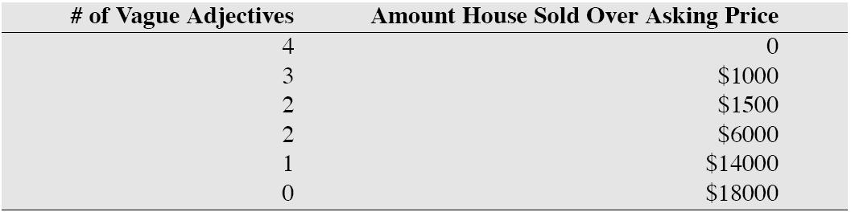
Linear Regression
Example from Freakonomics (Levitt and Dubner 2005)
Fantastic/cute/charming versus granite/maple
Can we predict price from # of adjs?

Slide 34
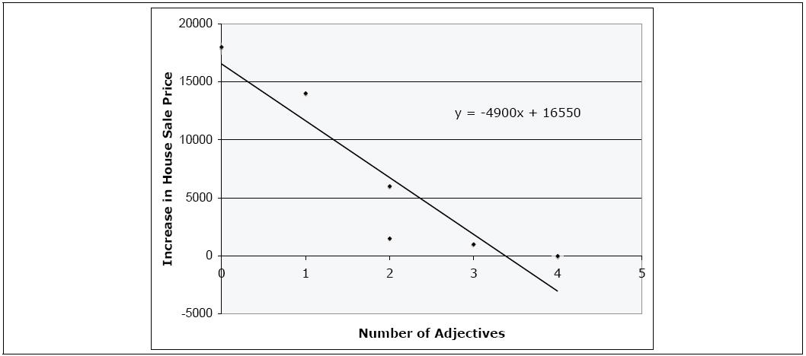
Linear Regression

Slide 35
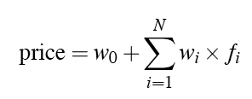
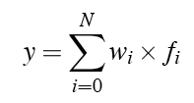
Muliple Linear Regression
Predicting values:
In general:
Let’s pretend an extra “intercept” feature f0 with value 1
Multiple Linear Regression

Slide 36
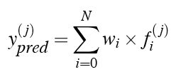
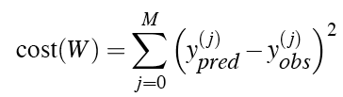
Learning in Linear Regression
Consider one instance xj
We’d like to choose weights to minimize the difference between predicted and observed value for x_{j}:
This is an optimization problem that turns out to have a closed-form solution

Slide 37

Logistic regression
But in these language cases we are doing classification
Predicting one of a small set of discrete values
Could we just use linear regression for this?

Slide 38


Logistic regression
Not possible: the result doesn’t fall between 0 and 1
Instead of predicting prob, predict ratio of probs,
but still not good: doesn’t lie between -∞ and +∞
So how about if we predict the log:

Slide 39
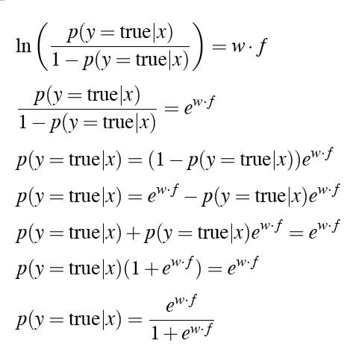
Logistic regression
Solving this for p(y=true)

Slide 40
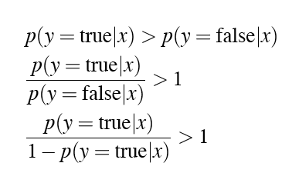

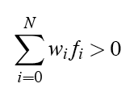
Logistic Regression
How do we do classification?
Or:
Or back to explicit sum notation:

Slide 41
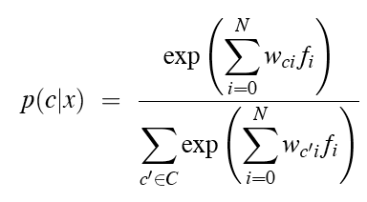
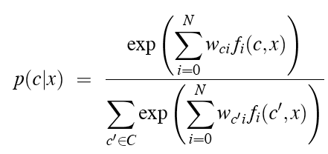
Multinomial logistic regression
Multiple classes:
One change: indicator functions f(c,x) instead of real values

Slide 42
Features
f1(c,x) = 1 if word_{i} = “fantastic” and class = cheap
f1(c,x) = 0 otherwise
f2(c,x) = 1 if word_{i} = “tall” and word_{i+1} = “ceiling” and class = expensive
f2(c,x) = 0 otherwise
f3(c,x)….

Slide 43
Alzheimers
Garrod et al. 2005
Lancashire and Hirst 2009

Slide 44
The Nun Study
Linguistic Ability in Early Life and the Neuropathology of Alzheimer’s Disease and Cerebrovascular Disease: Findings from the Nun Study
D.A. SNOWDON, L.H. GREINER, AND W.R. MARKESBERY
The Nun Study: a longitudinal study of aging and Alzheimer’s disease
Cognitive and physical function assessed annually
All participants agreed to brain donation at death
At the first exam given between 1991 and 1993, the 678 participants were 75 to 102 years old.
This study:
subset of 74 participants
for whom we had handwritten autobiographies from early life,
all of whom had died.

Slide 45
The data
In September 1930
leader of the School Sisters of Notre Dame religious congregation requested each sister write
“a short sketch of her own life. This account should not contain more than two to three hundred words and should be written on a single sheet of paper ... include the place of birth, parentage, interesting and edifying events of one's childhood, schools attended, influences that led to the convent, religious life, and its outstanding events.”
Handwritten diaries found in two participating convents, Baltimore and Milwaukee

Slide 46
The linguistic analysis
Grammatical complexity
Developmental Level metric (Cheung/Kemper)
sentences classified from 0 (simple one-clause sentences) to 7 (complex sentences with multiple embedding and subordination)
Idea density:
average number of ideas expressed per 10 words. elementary propositions, typically verb, adjective, adverb, or prepositional phrase. Complex propositions that stated or inferred causal, temporal, or other relationships between ideas also were counted.
Prior studies suggest:
idea density is associated with educational level, vocabulary, and general knowledge
grammatical complexity is associated with working memory, performance on speeded tasks, and writing skill.

Slide 47
Idea density
“I was born in Eau Claire, Wis., on May 24, 1913 and was baptized in St. James Church.”
(1) I was born,
(2) born in Eau Claire, Wis.,
(3) born on May 24, 1913,
(4) I was baptized,
(5) was baptized in church
(6) was baptized in St. James Church,
(7) I was born...and was baptized.
There are 18 words or utterances in that sentence.
The idea density for that sentence was 3.9 (7/18 * 10 = 3.9 ideas per 10 words).

Slide 48
Results
correlation between neuropatholocially defined Alzheimers desiease
had lower idea desnity socres than thnon-Alzheimers
Correlations between idea density scores and mean neurofibrillary tangle counts
−0.59 for the frontal lobe,
−0.48 for the temporal lobe,
−0.49 for the parietal lobe

Slide 49
Explanations?
Early studies found same results with a college-education subset of the population who were teachers, suggesting education was not the key factor
They suggest:
Low linguistic ability in early life may reflect suboptimal neurological and cognitive development which might increase susceptibility to the development of Alzheimer’s disease pathology in late life

Slide 50
Garrod et al. 2005
British writer Iris Murdoch
last novel published 1995,
Diagnosed with Alzheimers 1997
Compared three novels
Under the Net (first)
The Sea (in her prime)
Jackson's Dilemma (final novel)
All her books written in longhand with little editing

Slide 51
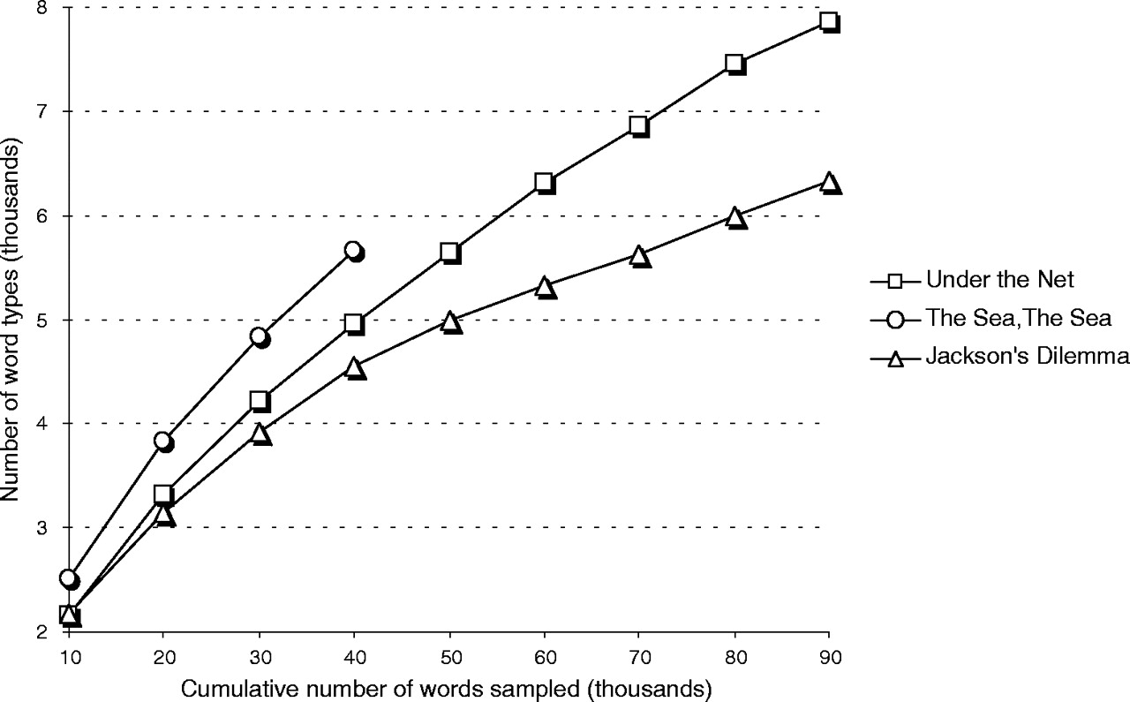
Type to token ratio in the 3 novels

Slide 52
Syntactic Complexity

Slide 53
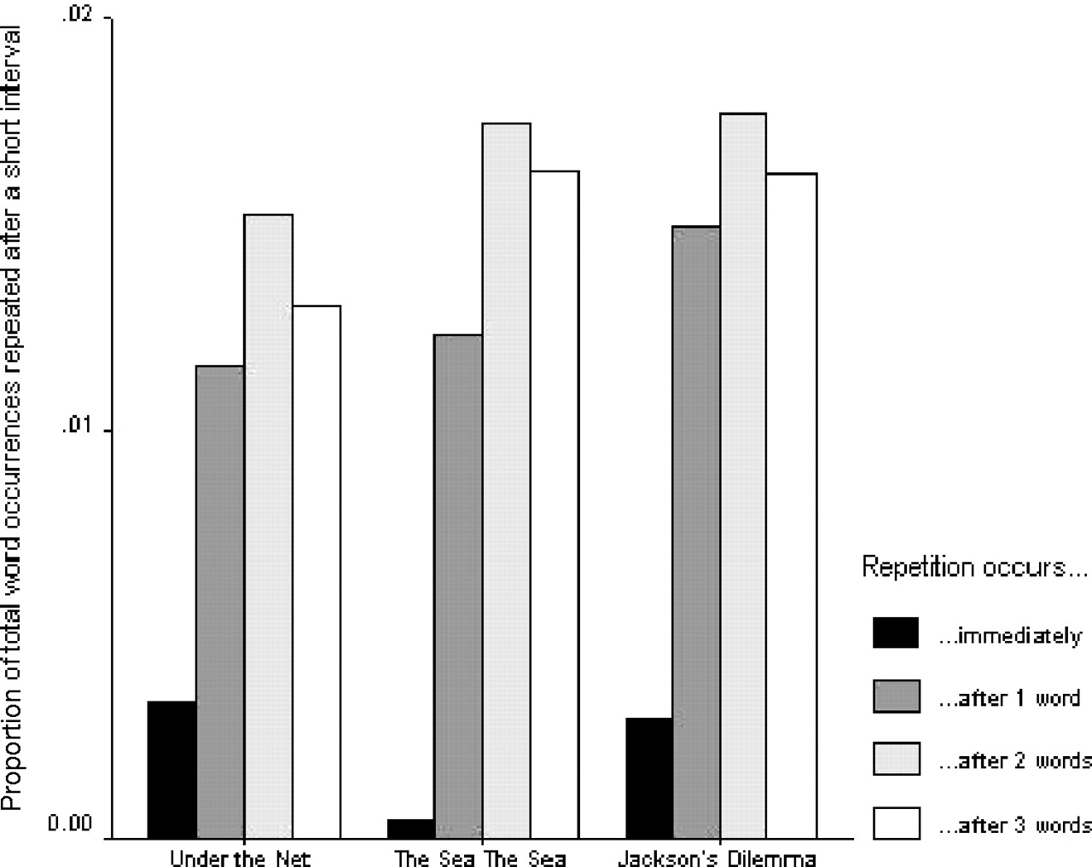

Mean proportions of usages of the 10 most frequently occurring words in each book that appear twice within a series of short intervals, ranging from consecutive positions in the text to a separation of three intervening words.
Garrard P et al. Brain 2005;128:250-260
Brain Vol. 128 No. 2 © Guarantors of Brain 2004; all rights reserved
Notes:
Mean proportions of usages of the 10 most frequently occurring words in each book that appear twice within a series of short intervals, ranging from consecutive positions in the text to a separation of three intervening words.

Slide 54
Parts of speech

Slide 55
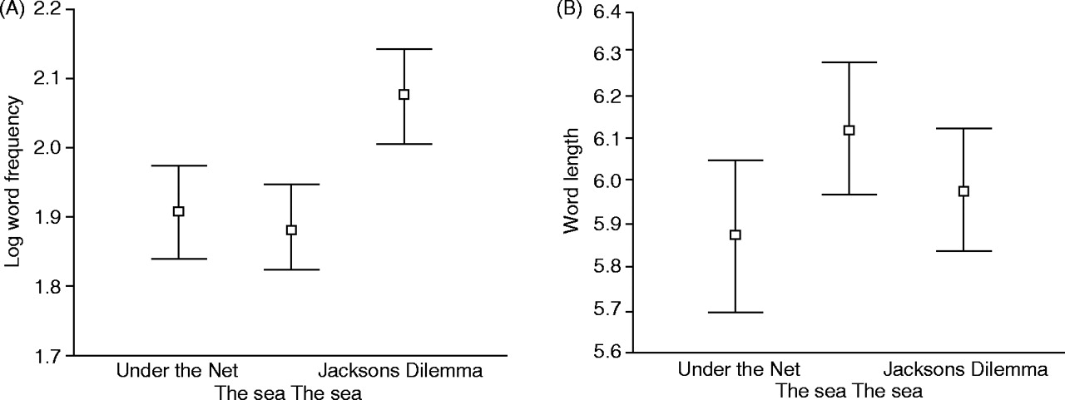
Comparative distributions of values of: (A) frequency and (B) word length in the three books.
Garrard P et al. Brain 2005;128:250-260
Brain Vol. 128 No. 2 © Guarantors of Brain 2004; all rights reserved
Notes:
Comparative distributions of values of: (A) frequency and (B) word length in the three books.

Slide 56
From Under the Net, 1954
"So you may imagine how unhappy it makes me to have to cool my heels at Newhaven, waiting for the trains to run again, and with the smell of France still fresh in my nostrils. On this occasion, too, the bottles of cognac, which I always smuggle, had been taken from me by the Customs, so that when closing time came I was utterly abandoned to the torments of a morbid self-scrutiny.”
From Jackson's Dilemma, 1995
"His beautiful mother had died of cancer when he was 10. He had seen her die. When he heard his father's sobs he knew. When he was 18, his younger brother was drowned. He had no other siblings. He loved his mother and his brother passionately. He had not got on with his father. His father, who was rich and played at being an architect, wanted Edward to be an architect too. Edward did not want to be an architect."

Slide 57
Lancashire and Hirst
Vocabulary Changes in Agatha Christie’s Mysteries as an Indication of Dementia: A Case Study
Ian Lancashire and Graeme Hirst 2009

Slide 59
Vocabulary Changes in Agatha Christie’s Mysteries as an Indication of Dementia: A Case Study Ian Lancashire and Graeme Hirst 2009
Examined all of Agatha Christie’s novels
Features:
Nicholas, M., Obler, L. K., Albert, M. L., Helm-Estabrooks, N. (1985). Empty speech in Alzheimer’s disease and fluent aphasia. Journal of Speech and Hearing Research, 28: 405–10.
Number of unique word types
Number of different repeated n-grams up to 5
Number of occurences of “thing”, “anything”, and “something”

Slide 61
Results

