Slide 1
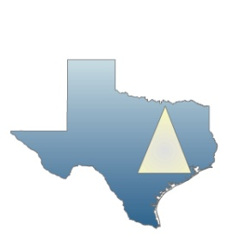
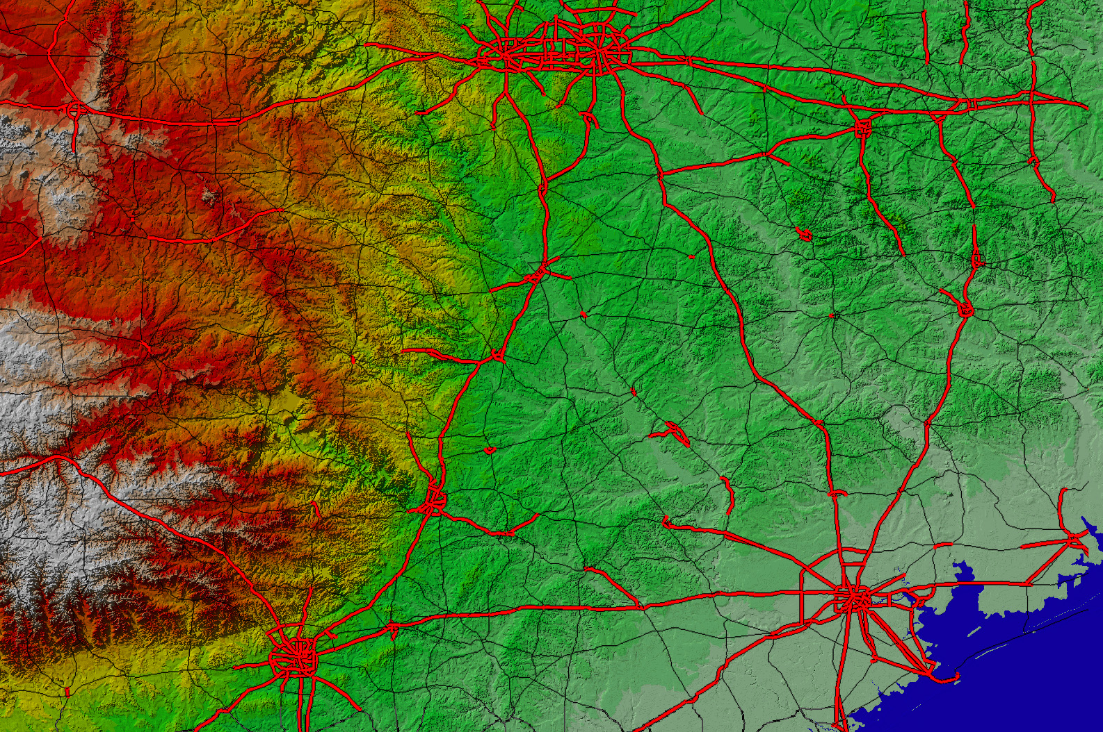
TEXAS URBAN TRIANGLE:
FRAMEWORK FOR FUTURE GROWTH
Dallas/Ft. Worth
Texas Urban Triangle Regional Analysis
2006 - 2007
Plan 662 Prof Bright
Plan 675 Prof Neuman
Dept. of Landscape
Architecture and Urban Planning
Texas A&M University
Funded by SWUTC
Waco
Killeen
College Station
Austin
Houston
San Antonio

Slide 2
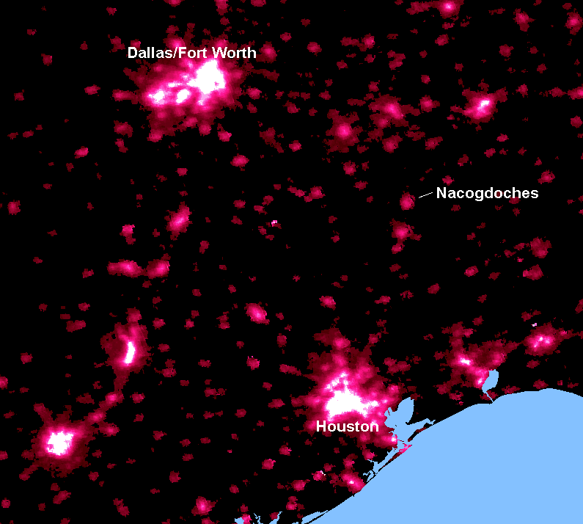
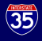
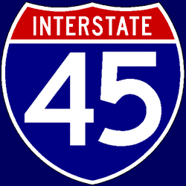
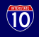
TEXAS URBAN TRIANGLE AT NIGHT
San Antonio
Stephen F. Austin State University

Slide 3
RESEARCH TEAM - FACULTY
Michael Neuman, Department of Landscape Architecture and Urban Planning Texas A&M University
Elise Bright, Department of Landscape Architecture and Urban Planning Texas A&M University
Douglas Wunneburger, Department of Landscape Architecture and Urban Planning Texas A&M University
David Ellis, Texas Transportation Institute
Jose Gavinha, Department of Geography Texas A&M University
Eric Dumbaugh, Department of Landscape Architecture and Urban Planning Texas A&M University *
Chris Ellis, formerly, Department of Landscape Architecture and Urban Planning Texas A&M University *
* advisory

Slide 4
RESEARCH TEAM - students
Plan 662 Plan 675
Ernest Nortey – Urban Planning Brent Bassett – Civil Engineering
Jacob Browning – Urban Planning Cameron Muhic – Urban Planning
Jennifer Opon – Urban Planning Chris Wynveen – Rec., Parks & Tourism
Juton Hortsman – Urban Planning Cristin Burton – Urban Planning
Leslie Lutz – Urban Planning Joe Seitzer – Architecture
Luis Estevez – Urban Planning Munmun Parmar – Urban Planning
Matthew Hilgemeier – Urban Planning Neethi Rajagopalan – Civil Engineering
Michelle Audenaert – Urban Planning Omkar Gupta – Urban Planning
Shelanski White – Urban Planning Pamela Hile Chen – Architecture
Tamara Palma – Urban Planning Sheena Arora – Landscape Architecture
Tony Topping – Urban Planning Subrity Rajbhandari – Urban Planning
Xiaoyu Zhang – Urban Planning
Professor Elise Bright Professor Michael Neuman

Slide 5
Previous and ongoing research
Christopher Ellis, et al. (Texas A&M University) - “Texas Urban Triangle: Working Toward Sustainable New Communities” - 1999
Texas Department of Transportation – “Crossroads of the Americas: Trans-Texas Corridor Plan” - 2003
Federal Reserve Bank of Dallas – “The Texas Triangle as Megalopolis” and “The Economics of the Texas Urban Triangle” - 2004
Regional Plan Association – “Dancing Through the Scales: From Region to Mega-Region” – 2004
Robert Lang and Dawn Dhavale (Virginia Tech University) – “Beyond Megalopolis: Exploring America’s New ‘Megalopolitan’ Geography” - 2005
Jose Gavinha (Texas A&M University) – “Globalization and the Texan Metropolises: Competition and Complementarity in the T.U.T.” - 2007
Notes:
Lang, R.E., and D. Dhavale. 2005. Beyond Megalopolis: Exploring
America’s new “megapolitan” geography. Census Report 05.01.
Metropolitan Institute at Virginia Tech.

Slide 6
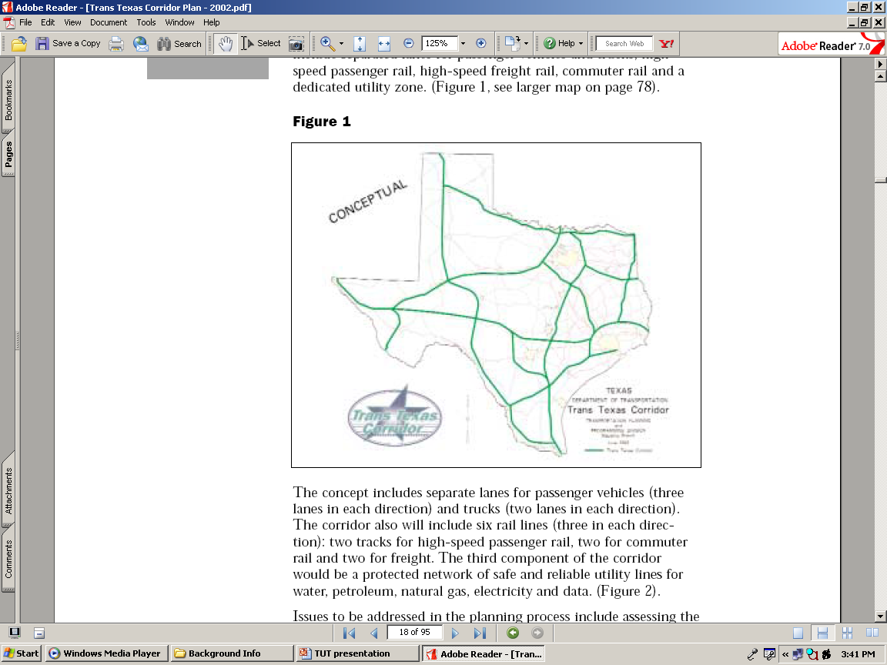
Previous and ongoing proposals
Trans Texas Corridor
Dallas/Fort Worth
Austin
Houston
San Antonio
Notes:
Notably, the Trans Texas Corridor did not enter and connect the major cities whose markets it was meant to serve.
The Trans Texas Corridor was envisioned as a network of transportation corridors up to 1,200 feet wide.
The statewide corridor anticipated separated lanes for passenger vehicles and trucks, high speed
passenger rail, high-speed freight rail, commuter rail, and a dedicated utility zone.

Slide 7
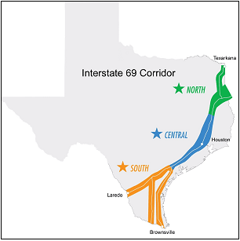


Previous and ongoing projects
Trans Texas Corridor
Dallas/Fort Worth
Austin
Houston
San Antonio

Slide 8
Previous and ongoing research
Regional Plan Association / University of Pennsylvania, 2004
Urban mega-regions identified by the University of Pennsylvania, School of Design

Slide 9
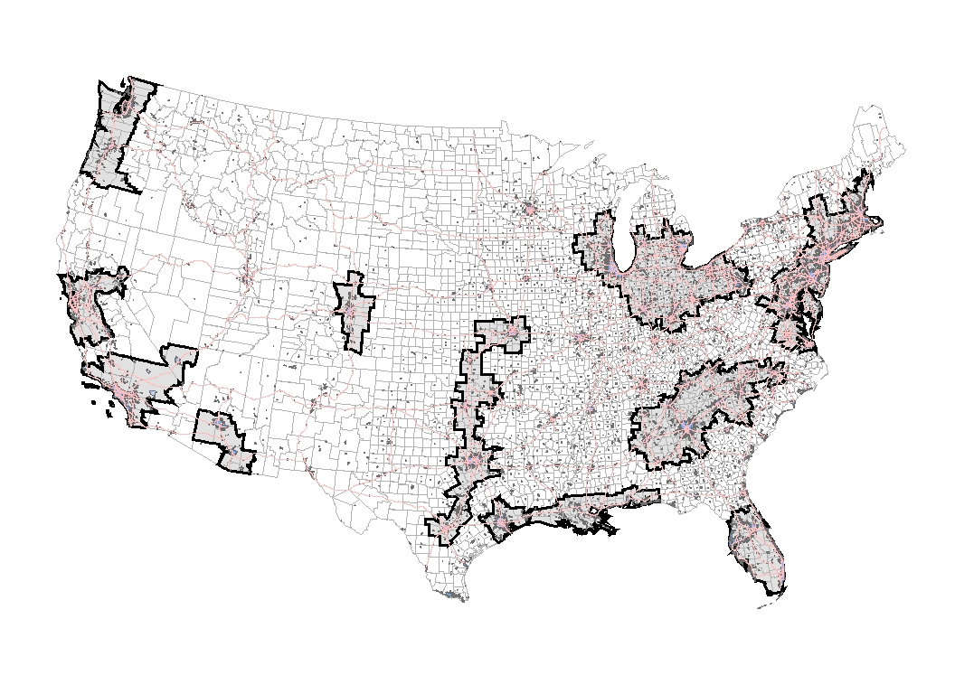
Previous and ongoing research
Robert Lang – Virginia Tech University, Metropolitan Institute, 2005
Megapolitan Region | Anchor Metros | Signature Industry
Cascadia | Seattle Portland | Aerospace
Florida Peninsula | Miami Orlando | Tourism
Front Range | Denver Colorado Springs | Telecom
Great Lakes Crescent | Chicago Detroit | Manufacturing
Gulf Coast | Houston | Energy
I-35 Corridor | Dallas Austin | High Tech
Megalopolis | New York Washington, D.C | Finance
NorCal | San Francisco Sacramento | High Tech
Piedmont | Atlanta Charlotte | Consumer Banking
SoCal | Los Angeles Las Vegas | Entertainment
Sun Corridor | Phoenix Tucson | Home Building
Megapolitan Regions (2005)
Notes:
AN UPDATE OF THIS RESEARCH IS BEING PUBLISHED IN THE JOURNAL REGIONAL STUDIES, IN A SPECIAL ISSUE TITLED “THE FUTURE OF THE CITY REGION” WHICH I AM EDITING WITH ANGELA HULL, DIRECTOR OF THE URBAN AND REGIONAL RESEARCH INSTITUTE AT HARRIOT WATT UNIVERSITY IN EDINBURGH.

Slide 10
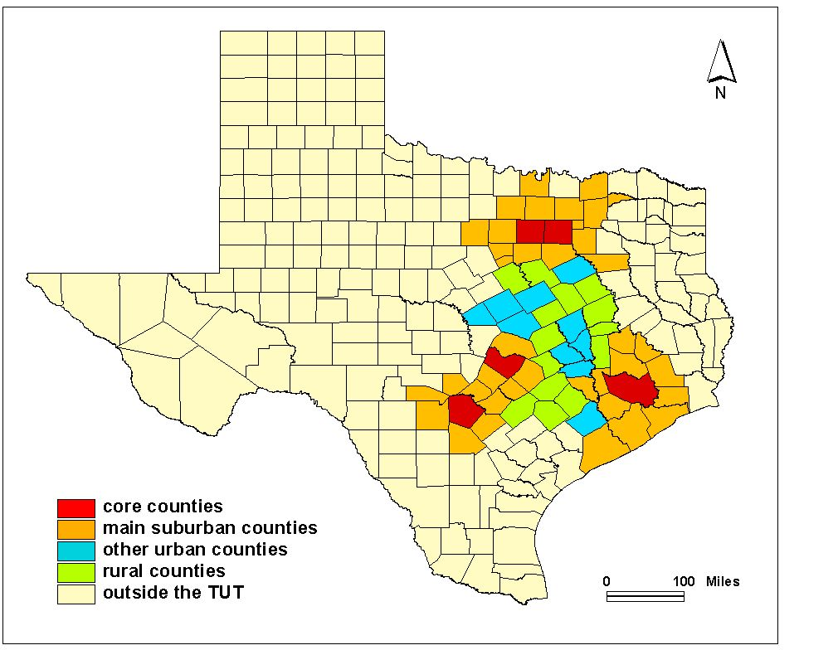
TEXAS URBAN TRIANGLE Counties, 2007
Source: Gavinha (2007)
Notes:
THERE ARE SOME PERIPHERAL COUNTIES INCLUDED IN THIS STUDY THAT DO NOT MATCH CURRENT MPO BOUNDARIES. THOSE COUNTIES WILL BE EXCLUDED FROM THE NEW STUDY FUNDED BY THE UTCM WHICH WE ARE UNDERTAKING NOW.
There are up to five “peripheral” counties on the metro fringes that may not fit?

Slide 11
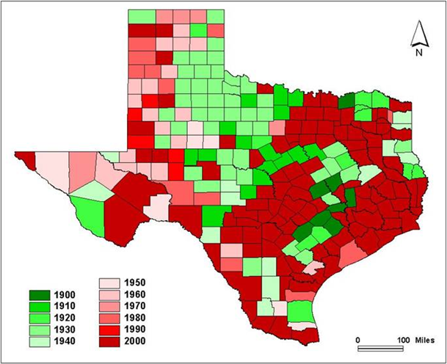
TEXAS COUNTY PEAK POPULATIONS, 1990 - 2000
Source: Gavinha (2007)
Notes:
Gavinha J. 2007. Globalization and the Texas Metropolises:
Competition and complementarity in the Texas Urban Triangle.
Unpublished doctoral dissertation. College Station, TX: Texas
A&M University.

Slide 12
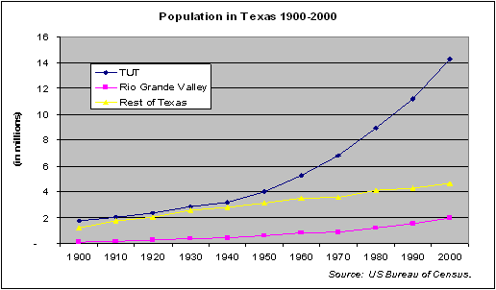
TEXAS URBAN TRIANGLE population Change, 1990 - 2000
Source: Gavinha (2007)
Notes:
Gavinha J. 2007. Globalization and the Texas Metropolises:
Competition and complementarity in the Texas Urban Triangle.
Unpublished doctoral dissertation. College Station, TX: Texas
A&M University.

Slide 13
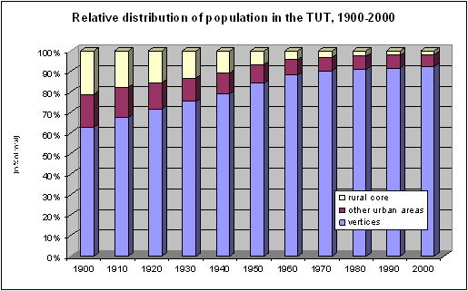
TEXAS URBAN TRIANGLE population DISTRIBUTION, 1990 - 2000
Source: Gavinha (2007)
Notes:
THE TRIANGLE ITSELF IS BECOMING MORE URBAN
Gavinha J. 2007. Globalization and the Texas Metropolises:
Competition and complementarity in the Texas Urban Triangle.
Unpublished doctoral dissertation. College Station, TX: Texas
A&M University.

Slide 14
Previous and ongoing research
Comparing the TX Urban Triangle to other American metropolises CSA’s, 2007
 | Total CSA Population | Total Personal Income (MSA only) Billions of Dollars | Per Capita Personal Income (MSA only) $
New York | 21,961,994 | 1,005 | 53,423
Los Angeles | 17,755,322 | 539 | 41,875
Chicago | 9,745,165 | 416 | 43,714
Baltimore -Washington | 8,241,912 | 287 | 54,211
Boston | 7,476,689 | 241 | 53,763
San Francisco - San Jose | 7,264,887 | 257 | 61,337
Philadelphia | 6,385,461 | 264 | 45,460
Texas Triangle | 16,548,737 | 683 | 35,542
Census Bureau, Population Division and Bureau of Economic Analysis
Notes:
UPDATE USING 2007 US CENSUS POPULATION ESTIMATES – SEE WWW.CENSUS.GOV

Slide 15
Previous and ongoing research
Comparing the TX Urban Triangle metropolises, 2007
2007 | Total Population | Total Personal Income, Millions of Dollars | Annual Per Capita Personal Income, Dollars
Dallas – Fort Worth | 6,144,489 | 256,943 | 41,813
Houston | 5,629,127 | 260,213 | 46,235
San Antonio | 1,997,969 | 68,239 | 34,279
Austin | 1,593,400 | 59,958 | 37,517
Bryan / College Station | 207,734 | 5,448 | 26,790
Texas Urban Triangle | 16,548,737 | 682,903 | 35,542
Census Bureau, Bureau of Economic Analysis
Notes:
UPDATE USING 2007 US CENSUS POPULATION ESTIMATES – SEE WWW.CENSUS.GOV
FOUR COLUMNS, FIVE ROWS
ROWS DFW, HOU, SA, AUS, TUT
DROP THE COST OF LIVING COLUMN
DROP ALL RANK COLUMNS
CHANGE MIDDLE COLUMN HEADING TO TOTAL PERSONAL INCOME, ALSO FOR PREVIOUS SLIDE
ELIMINATE THE NOTE
EXPAND THE BOX TO MAKE FOR EASIER READING

Slide 16
Previous and ongoing research
TX Urban Triangle Metropolitan Population 1940 – 2030
Austin DFW Houston SA
U.S. Bureau of Census (1950-2000) and Office of the State Demographer (2030)

Slide 17
TEXAS URBAN TRIANGLE as a proportion of Texas, 2007
Source: United States Bureau of Census (2008)
Notes:
UPDATE WITH 2007 CENSUS ESTIMATES

Slide 18
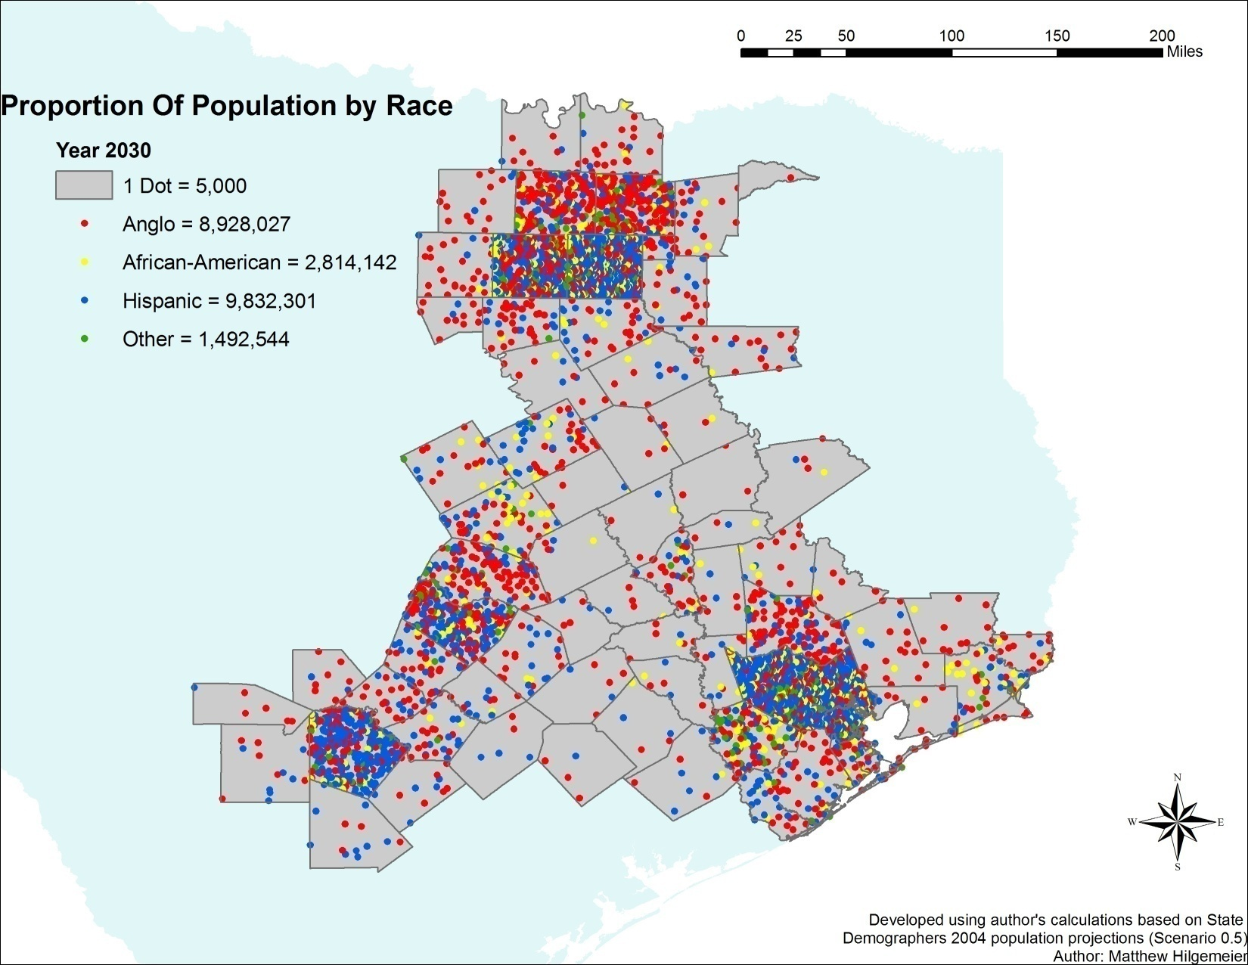
TEXAS URBAN TRIANGLE racial composition, 2030
Source: Hilgemeier (2007)

Slide 19
TEXAS URBAN TRIANGLE AGE composition, 2000 – 2030
Estimated population of the Texas Urban Triangle by age group, 2000-2030
Source: Hilgemeier (2007)
Notes:
source: Matt Hilgemeier 2007

Slide 20
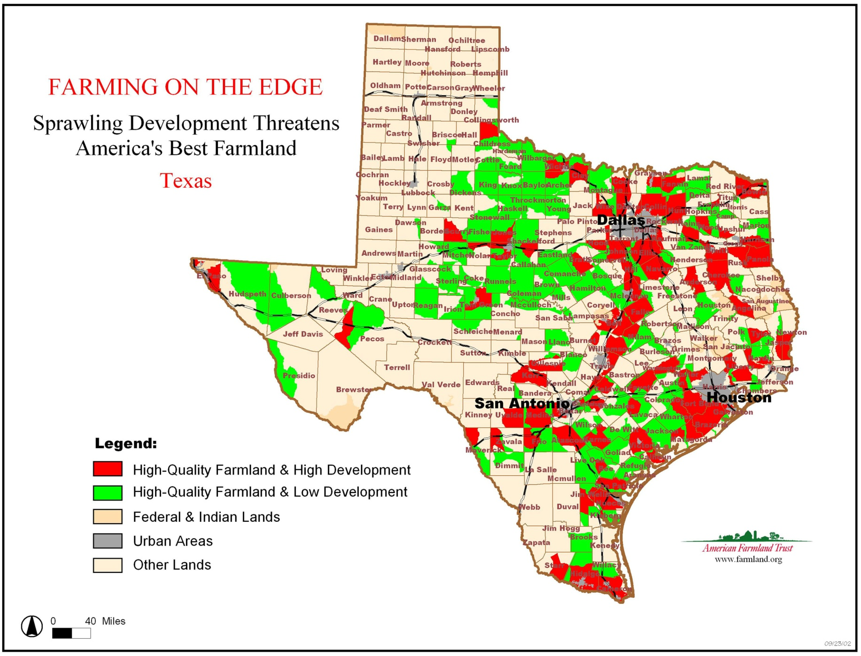
FARMING AND URBAN DEVELOPMENT, 1992 - 1997
Notes:
2002 MAP
(American Farmland Trust). 2003. Going, Going, Gone: The
Impact of land fragmentation on Texas Agriculture and Wildlife.
Northampton, MA: AFT. Online: http://www.farmland.org/
resources/reports/texas/default.asp

Slide 21
CHANGE IN NON-DEVELOPED RURAL LAND VALUES, 1992 - 2001
)
Source: Wilkins, et al. (2003)
Notes:
Wilkins, N., A. Hays, G. Kubenka et al. 2003. Texas Rural Lands: Trends
and Conservation Implications for the 21st century. College
Station: Texas Cooperative Extension, The Texas A&M University
System. Online: http://landinfo.tamu.edu/projects/aft/rldocl.pdf.
February 24, 2007.

Slide 22
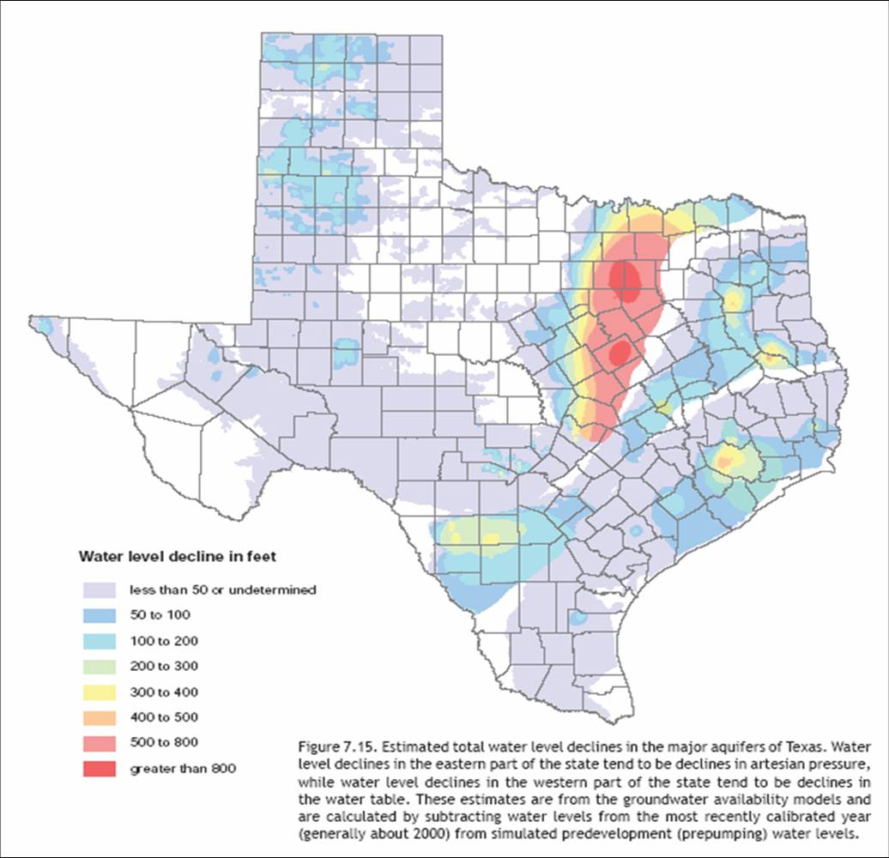
ESTIMATED TOTAL WATER LEVEL DECLINES IN MAJOR AQUIFERS, 2007
Source: 2007 State Water Plan

Slide 23
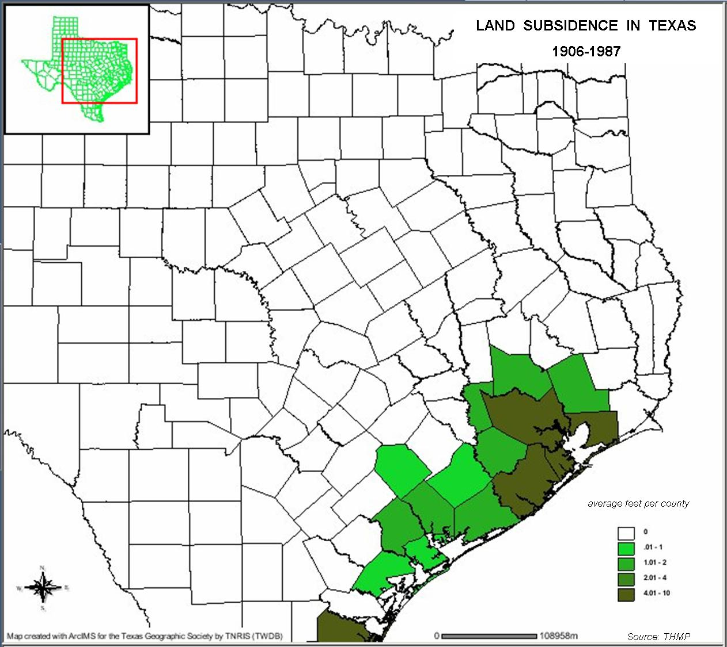
LAND SUBSIDENCE IN EAST TEXAS, 1906 - 1987
Notes:
THMP [Texas Hazard Mitigation Package]. 2003. Texas Hazard
Mitigation Package. Online www.thmp.info. 20 September 2006

Slide 24
LAND SUBSIDENCE IN HOUSTON, 1906 - 2000
Notes:
HGCSD 2006 Harris-Galveston Coastal Subsidence District

Slide 25
PROJECTED LAND SUBSIDENCE IN HOUSTON, 1987 - 2025
Source: Lutz (2007).
Notes:
LAND SUBSIDENCE IS PROJECTED TO INCREASE AT AN EVEN FASTER RATE IN THE COMING YEARS, PLACING HOUSTON IN GREATER JEOPARDY IN THE FACE OF RISING SEA LEVELS AND DEADLIER STORM SURGES.
THMP [Texas Hazard Mitigation Package]. 2003. Texas Hazard
Mitigation Package. Online www.thmp.info. 20 September 2006

Slide 26
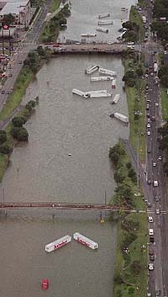
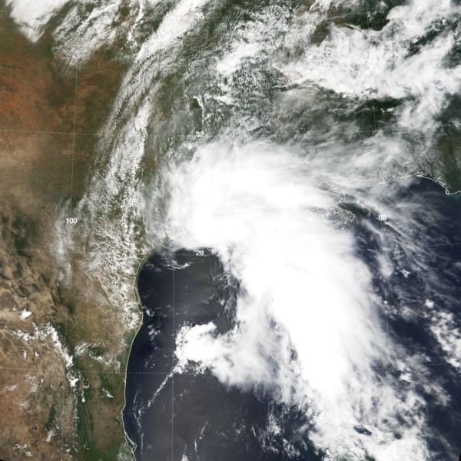
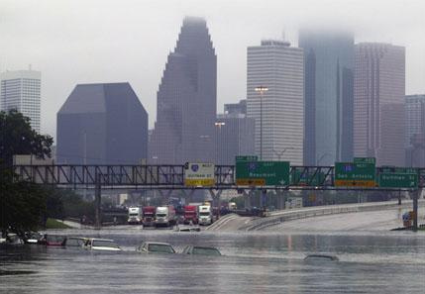
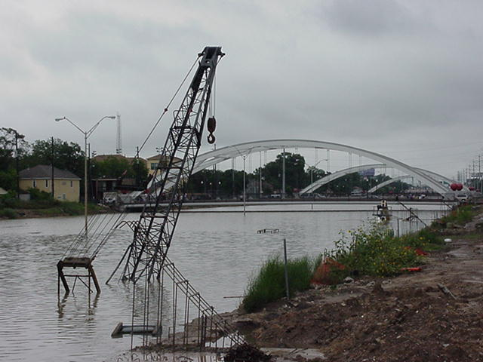
TROPICAL STORM ALLISON 2001
Notes:
PER THE NATIONAL WEATHER SERVICE, ALLISON CLAIMED 22 LIVES IN THE HOUSTON AREA, DROPPED 37 INCHES OF RAIN IN TWO DAYS, DESTROYED 3,000 HOMES AND CAUSED $5 BILLION IN OVERALL DAMAGE.

Slide 27
WATER CONSUMPTION BY TYPE, 1996
Notes:
TWDB (Texas Water Development Board). 1998. Summary Historical
Water Use, 1996. Austin: Texas Water Development Board.

Slide 28
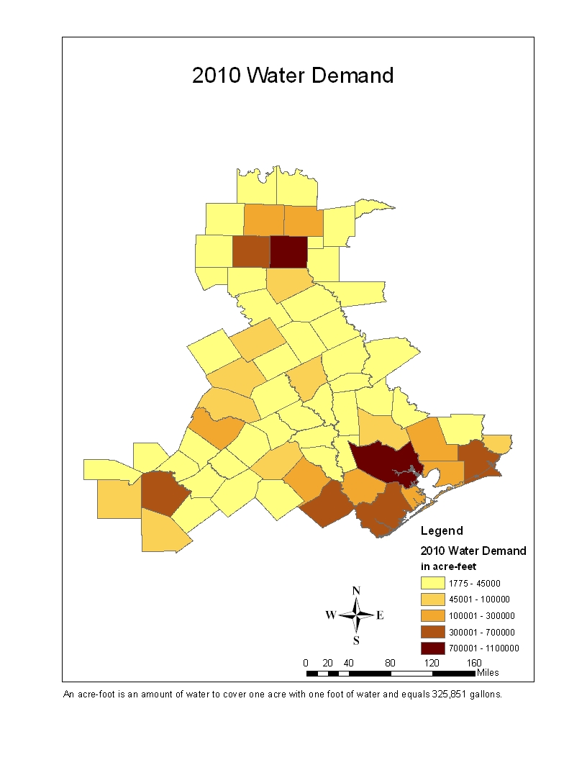
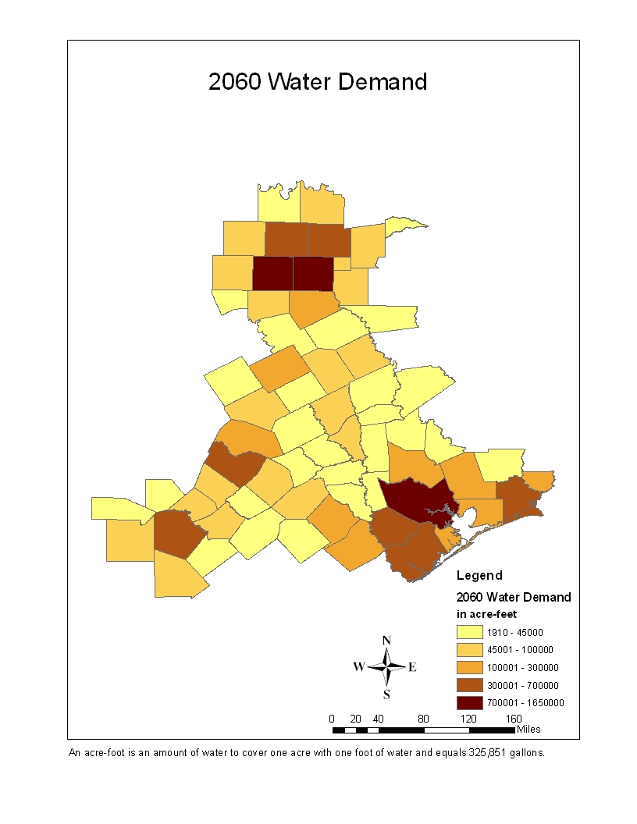
PROJECTED WATER DEMAND, 2010 - 2060
Texas Water Development Board
2006 Regional Water Plan, Austin, TX; 2006
Texas Water Development Board
2006 Regional Water Plan, Austin, TX; 2006
Source: Texas Water Development Board, 2006 Regional Water Plan.
Notes:
Note the increase in the upper limit of 2060 last class.

Slide 29
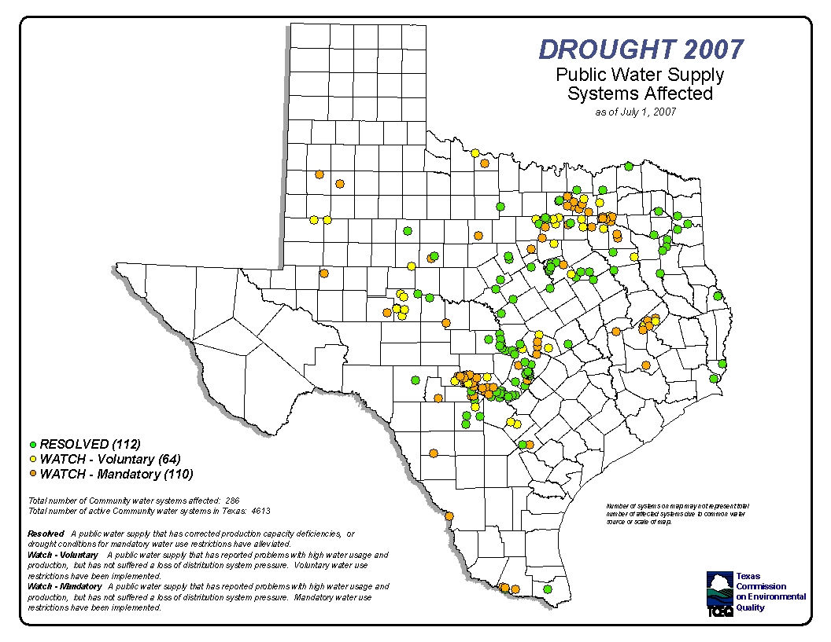
PUBLIC WATER SUPPLIES SYSTEMS AFFECTED BY DROUGHT, SUMMER 2007

Slide 30
NUMBER OF CONFIRMED CONTAMINATED GROUNDWATER CASES IN TEXAS, 2000
Notes:
TCPS (Texas Center for Policy Studies). 2000. Texas Environmental
Almanac [2nd edition]. Austin: University of Texas Press.

Slide 31
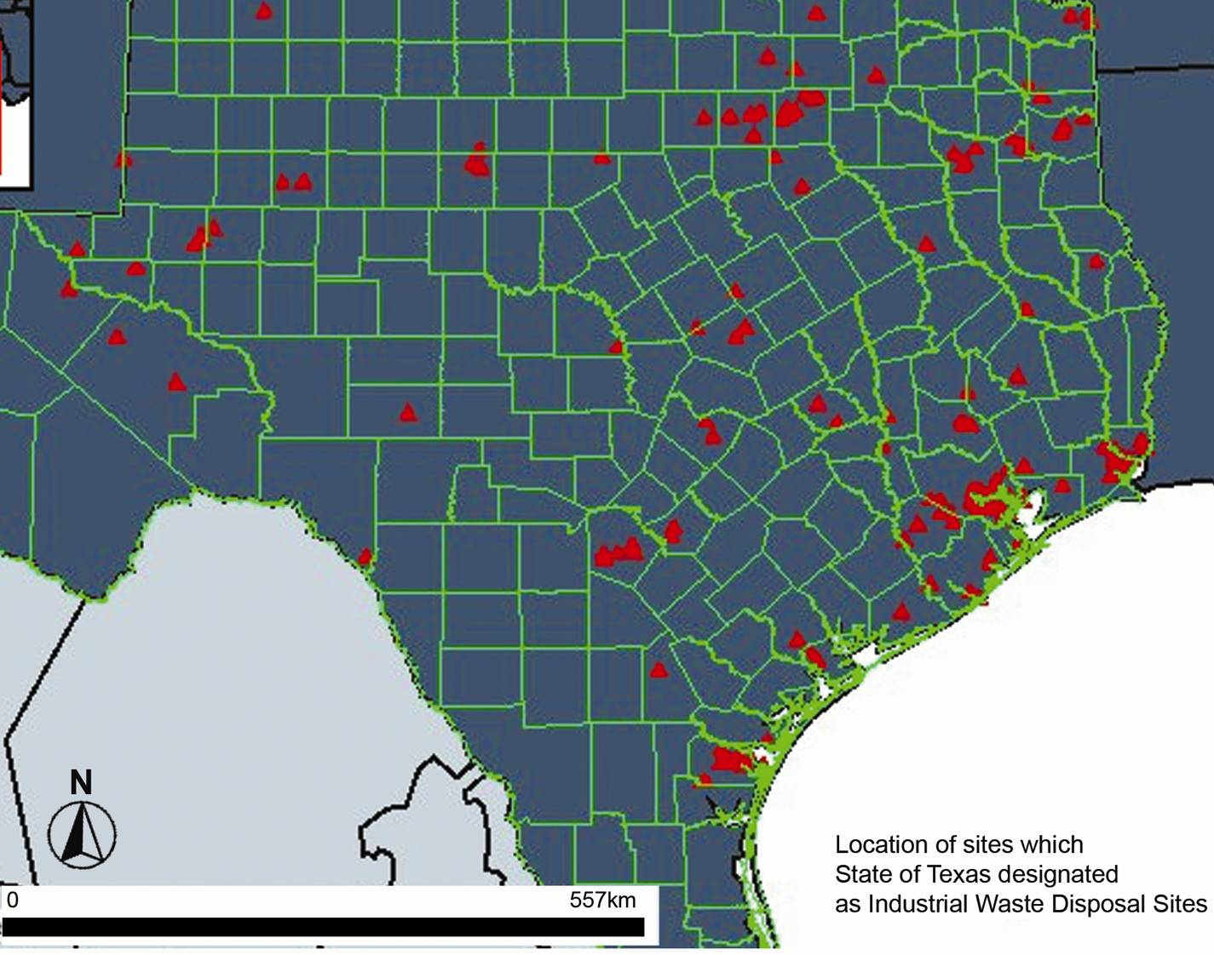
TEXAS URBAN TRIANGLE
Industrial Waste Disposal Sites
Notes:
SOURCE? DATE?

Slide 32
HURRICANE RISK ZONES & HAZARDOUS MATERIALS FACILITIES
Notes:
THMP [Texas Hazard Mitigation Package]. 2003. Texas Hazard
Mitigation Package. Online www.thmp.info. September 20, 2006

Slide 33
SUBSIDENCE RISK ZONES & HAZARDOUS MATERIALS FACILITIES, 1906 - 1987
Notes:
There were 141 hazardous waste sites in the Texas Urban Triangle (2004), plus 16 radioactive waste sites in 2000 (still around in 2004), and 73 superfund sites (2004), totaling 230 hazardous materials facilities.
THMP [Texas Hazard Mitigation Package]. 2003. Texas Hazard
Mitigation Package. Online www.thmp.info. September 20, 2006

Slide 34
TROPICAL STORM TRACKS & HAZARDOUS MATERIALS FACILITIES

Slide 35
TEXAS URBAN TRIANGLE
Rail Freight Through Texas, 1999

Slide 36
TEXAS URBAN TRIANGLE
Texas Freight Rail Lines
Dallas/Fort Worth
Austin
Houston
San Antonio

Slide 37
TEXAS URBAN TRIANGLE
Rail Commodity Flows in Texas, 2000
Dallas/Fort Worth
Austin
Houston
San Antonio

Slide 38
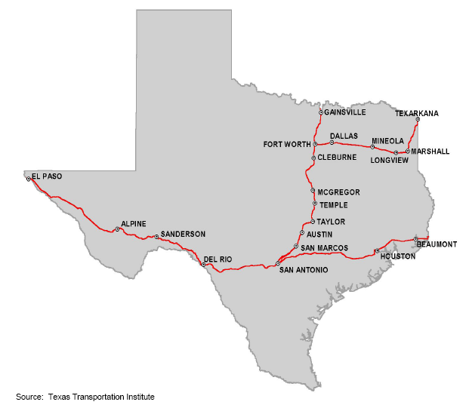
TEXAS URBAN TRIANGLE
Current Amtrak Routes
Route | Station | FY95 | FY00 | FY04
Texas Eagle | San Antonio - Dallas | 80,617 | 112,444 | 138,978
Sunset Limited | San Antonio- - Houston - Beaumont | 51,696 | 35,055 | 33,015
TUT Total |  | 132,313 | 147,499 | 171,993
Source: Amtrak, Department of Government Affairs.

Slide 39
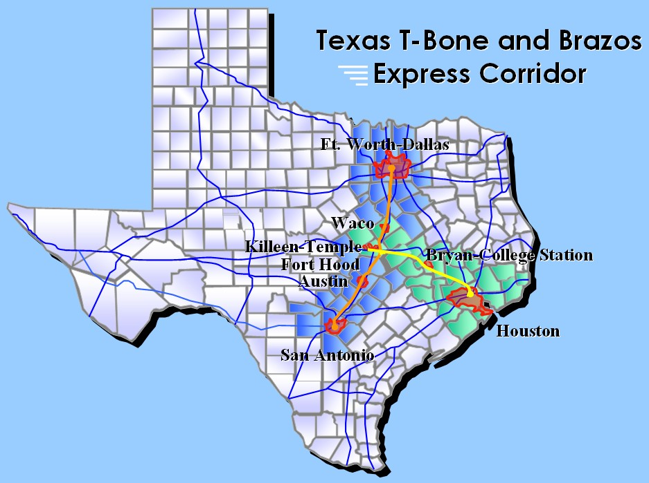
TEXAS URBAN TRIANGLE
Notes:
MOST RECENT OF FOUR DIFFERENT HIGH SPEED RAIL PROPOSALS, ONE EACH DECADE SINCE THE 1970´S.
THIS PROPOSAL IS DISTINGUISHABLE FOR ITS INCONVENIENCE FOR PASSENGERS TRAVELLING BETWEEN HOUSTON AND DFW, AND HOUSTON AND SAN ANTONIO.

Slide 40
TEXAS URBAN TRIANGLE
Austin – San Antonio
Commuter Rail
Corridor Plan, 2005

Slide 41
TEXAS URBAN TRIANGLE
Scheduled Bus Network
Dallas/Fort Worth
Austin
Houston
San Antonio

Slide 42
TEXAS URBAN TRIANGLE
Forecasted VMTs in Selected Counties, 2000 - 2025
Source: Forecast prepared by Cambridge Systematics

Slide 43
TEXAS URBAN TRIANGLE
Forecasted VMTs on Inter-City Corridors, 2000 - 2025
Source: Forecast prepared by Cambridge Systematics
Notes:
THIS IS SUGGESTIVE OF WHICH CORRIDORS FOR HIGH SPEED RAIL SHOULD BE DEVELOPED WITH HIGHER PRIORITY. SAN ANTONIO TO HOUSTON COULD BE THIRD.

Slide 44
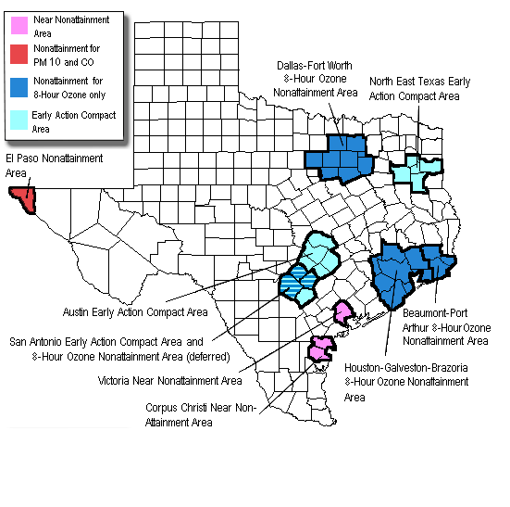
OZONE NON-ATTAINMENT RATINGS, 2006 (EPA)
Notes:
ONE CAN IMAGINE HOW OZONE WILL INCREASE, GIVEN THE VMT ESTIMATES IN THE PRIOR SLIDES. IN 2008, VMT DECREASED, AND WITH INCREASES IN PUBLIC TRANSIT USAGE, LOWER EMISSIONS FROM HIGHER FUEL MILEAGE VEHICLES SUCH AS HYBRIDS AND PLUG-IN ELECTRIC HYBRIDS, IT IS CONCEIVABLE THAT VMT’S AND EMISSIONS WILL DECLINE IN THE FUTURE.

Slide 45
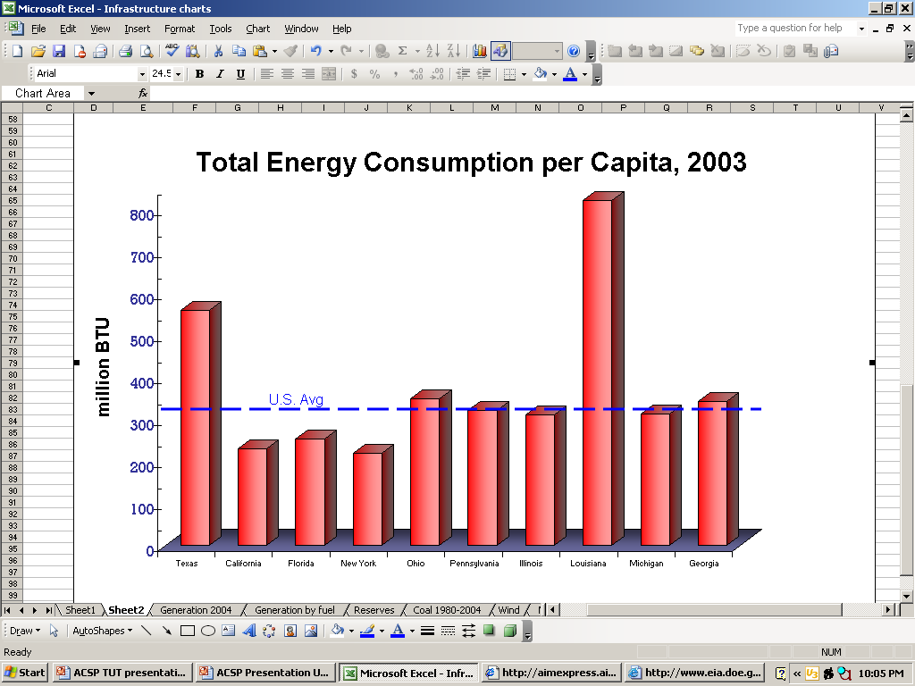
TEXAS AND UNITED STATES Energy Consumption
Per Capita Energy Consumption, 2003
U. S. Energy Information Administration (2004)
Notes:
THIS SLIDE TELLS YOU ABOUT ALL YOU NEED TO KNOW.
AIR CONDITIONING AND VEHICLE MILES TRAVEL ACCOUNT FOR MUCH OF THE DISPARITY.

Slide 46
Policy and planning implications
County and Regional Planning
Urban Growth Management
High Speed Rail and Local Mass Transit
Regional and Green Infrastructure Networks
Infrastructure Financing
Water Policy
Farmland Preservation
Notes:
Extend blue box to include Farmland Preservation

