Slide 1

New Statistical Applications for Differential Privacy
Rob Hall
11/5/2012
Committee: Stephen Fienberg, Larry Wasserman,
Alessandro Rinaldo, Adam Smith.
rjhall@cs.cmu.edu
http://www.cs.cmu.edu/~rjhall

Slide 2
Contributions
Overall theme: construction of practical methods for privacy-preserving statistical inference.
Part 1: Private histograms
Laplace noise addition spoils histograms when n > p
A hard thresholding approach results in greatly increased utility.
Part 2: Approximate differential privacy in an RKHS
Port noise addition techniques to an infinite dimensional function space.
Part 3: Differential privacy for kernel density estimation
Laplace noise spoils the convergence rate in dimension > 3.
A new method obtains the correct rate.

Slide 3
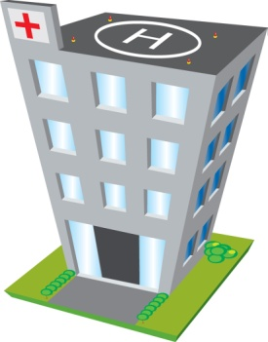

Importance of Privacy
1. Agency has data about individuals.
Patient ID | Tobacco | Age | Weight | Heart Disease
0001 | Y | 36 | 170 | N
0002 | N | 26 | 150 | N
0003 | N | 45 | 165 | Y
… | … | … | … | …
2. They release some statistics (e.g., for researchers to examine).
3. Somebody combines this with some side-information and identifies some individuals in the database.
Embarrassment to agency, individuals, etc. (at very least).

Slide 4
Importance of Privacy
1. Agency has data about individuals.
Patient ID | Tobacco | Age | Weight | Heart Disease
0001 | Y | 36 | 170 | N
0002 | N | 26 | 150 | N
0003 | N | 45 | 165 | Y
… | … | … | … | …
2. They release some statistics (e.g., for researchers to examine).
3. Somebody combines this with some side-information and identifies some individuals in the database.
Embarrassment to agency, individuals, etc. (at very least).
Goal of “Privacy-Preserving Data Mining” is to prevent identification, while maintaining utility in the release.

Slide 5
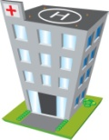
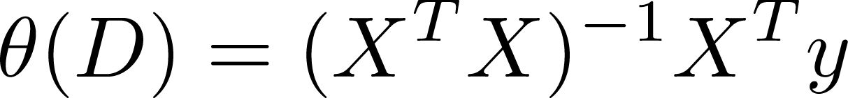

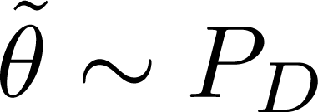
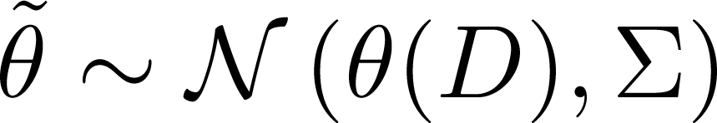
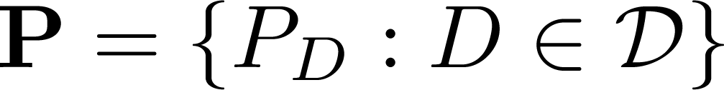
Privacy via Noise Addition
Consider algorithms which incorporate randomness:
We characterize private methods as sets of probability measures indexed by datasets:
Some private quantity of interest
Patient ID | Age | Weight
0001 | 36 | 170
0002 | 26 | 150
0003 | 45 | 165
… | … | …
Output (to world)
Private Input data
e.g.,
Called a “mechanism.”

Slide 6
(α,β)-Differential Privacy
A mechanism is called (α,β)-Differentially Private when:
Remarks:
Symmetric in D and D’.
Means that the distribution of the output “doesn’t change much” when the input changes by one element.
Called “Approximate Differential Privacy” when β > 0.
Implications…[WZ]
A pair of databases which differ by one element (“adjacent”).
The measurable sets in the output space.

Slide 7
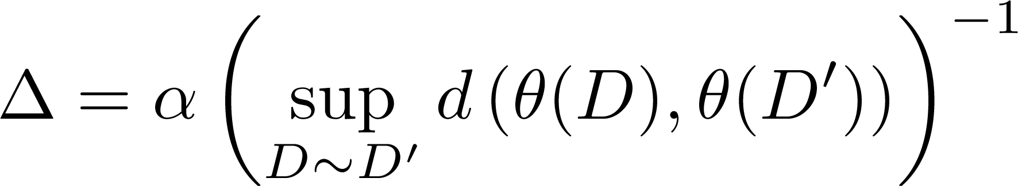
Methods of Differential Privacy
Almost all methods to achieve (α,0)-differential privacy boil down to this:
Leads to
Laplace noise, “gamma” noise (Euclidean space with L1 or L2 norms).
Exponential mechanism [MT] (discrete output space).
K-norm mechanism [HT] (Euclidean space with a Minkowski norm).
For β > 0, lighter tailed distributions may be used (e.g., Gaussian).
Metric on the output space
“global sensitivity”

Slide 8
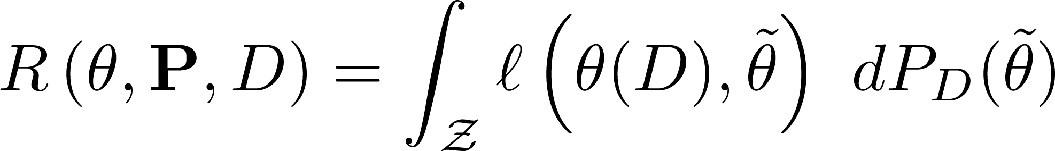
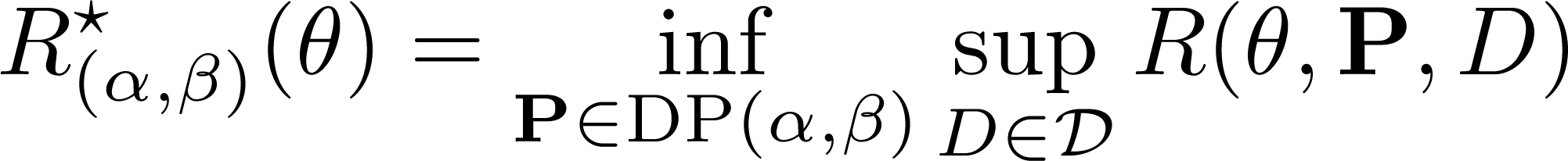
Part 1: Lower Risk Bounds
Noise addition leads to a loss in “utility” which we characterize by risk:
We characterize the cost of differential privacy by the minimum worst case risk available:
Depends on the function to release, the mechanism, and the data itself.
The “loss function.”
Depends only on the function to release.
The smallest among all methods P which admit differential privacy.

Slide 9
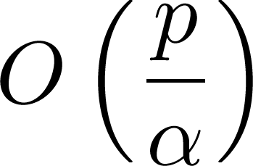
Basic Private Histograms
Histograms were one of the first statistical estimators to be studied under (α,0)-DP.
Add iid Laplace noise in each cell.
Overall error rate of this method is
Is this the minimax rate?
Noise
addition
Note, leads to negative and non-integer values (can be fixed without altering error rate).
# of cells

Slide 10
Lower Risk Bounds for Histograms
Regard the set of histograms as lattice points in an appropriately scaled simplex.
WLoG: consider mechanism to be indexed by histograms rather than datasets.

Slide 11
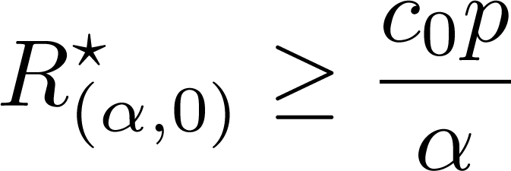
Lower Risk Bounds for Histograms
For a hypercube of lattice points having appropriate width:
(α,0)-DP ensures the distributions at these points are close (in KL).
Fano’s inequality leads to lower risk bound.
Alternative technique due to [HT].
Only holds for mechanisms which admit a kind of “continuous extension” (unclear how important this is [De]).
Some universal constant
e.g., for l₁ loss
Laplace noise addition achieves the optimal rate.

Slide 12
Histograms in High Dimensions
When p > n, noise addition completely swamps the data.
In high dimensional histograms we encounter sparsity
Noise
addition
Noise addition leads to non-sparse private histogram.

Slide 13
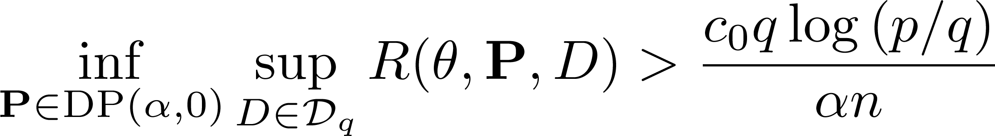
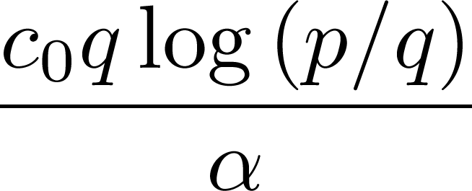
Histograms in High Dimensions
Sacrifice minimaxity in order to obtain better performance when the histogram is sparse.
Suppose that only q < p cells will ever be occupied.
Thus if the number of occupied cells is small relative to n there is still hope.
Note similarity to sparse normal means problem [J11].
Restrict to datasets which produce sparse histograms
Now depends linearly on q, logarithmically on p

Slide 14
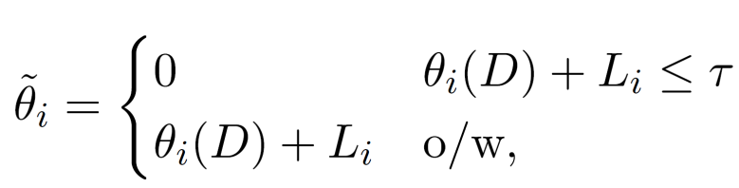
Methods for Sparse Private Histograms
The Laplace noise technique evidently doesn’t achieve this rate (since the risk is the same for all histograms).
We hard-threshold the resulting histogram [CPST]
Threshold
Output for cell i
True cell value plus Laplace noise.

Slide 15
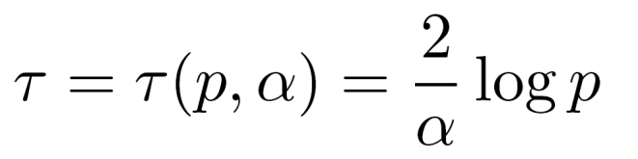
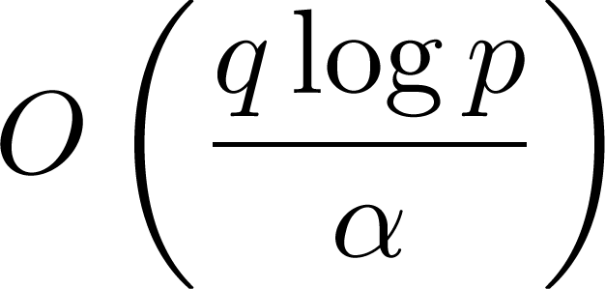
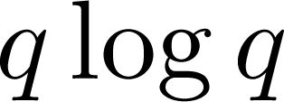
Low Risk for Thresholded Histograms
We hard-threshold the resulting histogram [CPST]
If we choose then the risk is
This is close to the “restricted minimax risk” but off by an additive amount of the order .
To achieve actual minimax rate: know q in advance or do FDR [J11].
Threshold
Output for cell i
True cell value plus Laplace noise.

Slide 16
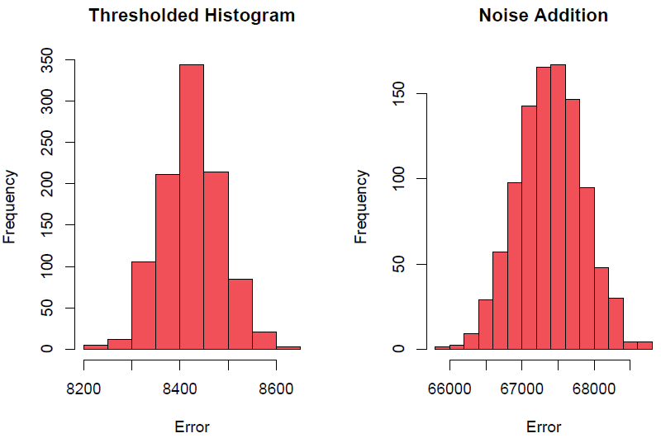
Thresholding Dramatically Improves Utility
Error distribution over several trials, NLTCS data with p=2¹⁶, q=3152 and n=21574.

Slide 17
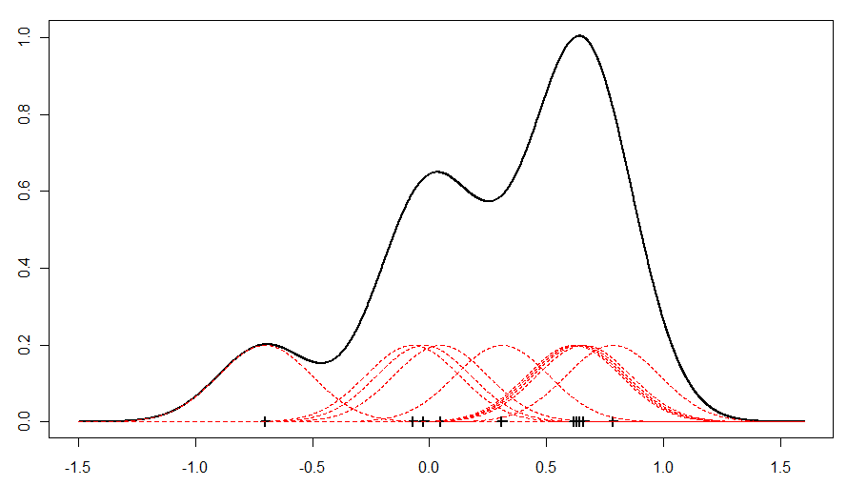
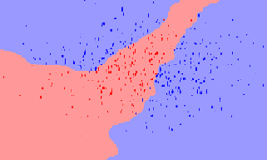
Part 2: Approximate Privacy in an RKHS
Sometimes the goal is to release a function
e.g., kernel density estimation, SVM regression functions etc.
The basic techniques to achieve DP do not work in this infinite dimensional setting (no dominating measure).
Techniques exist for DP linear SVMs though [CMS,RBHT].

Slide 18
Project, Privatize then Reconstruct
Idea: reduce to finite m-dimensional vector and apply existing DP techniques to coordinates.
1. Original function
2. Projection to finite vector
3. Reconstruction of function
Noise added to achieve DP.
Reconstructed original function and DP function.

Slide 19
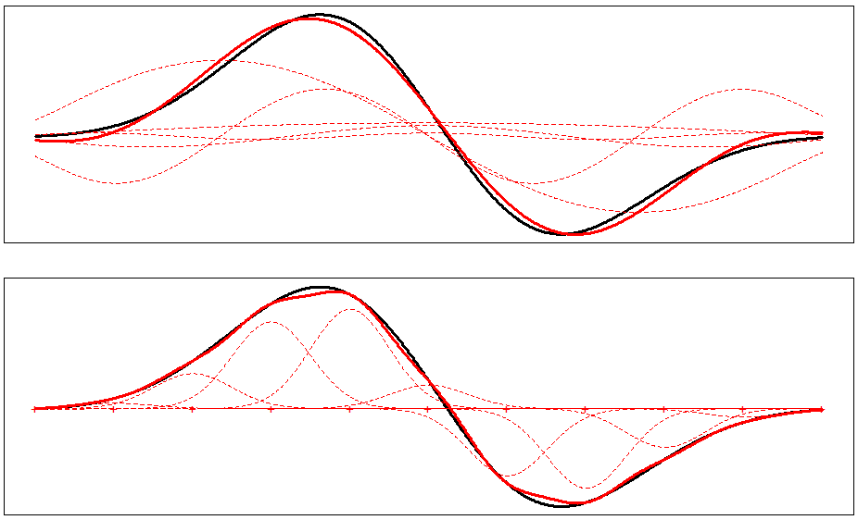
RKHS Projections
Two ideas for finite representations:
Expansion into orthonormal basis of eigenfunctions.
Approximation by linear combination of kernels
Alternatives: Taylor’s series, Fourier series etc.

Slide 20
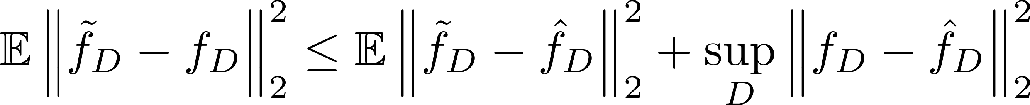
(α,β)-DP in an RKHS
Add Gaussian noise calibrated to sensitivity.
Measured in L₂, the error decomposes:
Allow the dimension to grow to infinity:
The first term is bounded (easy to see for eigen-representation).
The second term vanishes (under e.g., seperability).
Sensitivity of finite vectors.
RKHS distance between functions.
Noise addition
Approximation error

Slide 21
(α,β)-DP in an RKHS
Both techniques become the same thing: addition of a GP with mean zero and covariance function = the reproducing kernel of the RKHS.
Eigendecomposition:
Linear combination of kernels:
“Coordinates” of f
Gaussian noise
Gaussian Process
Equivalent to output of function values + noise at kernel locations.
Kolmogorov’s extension theorem…

Slide 22
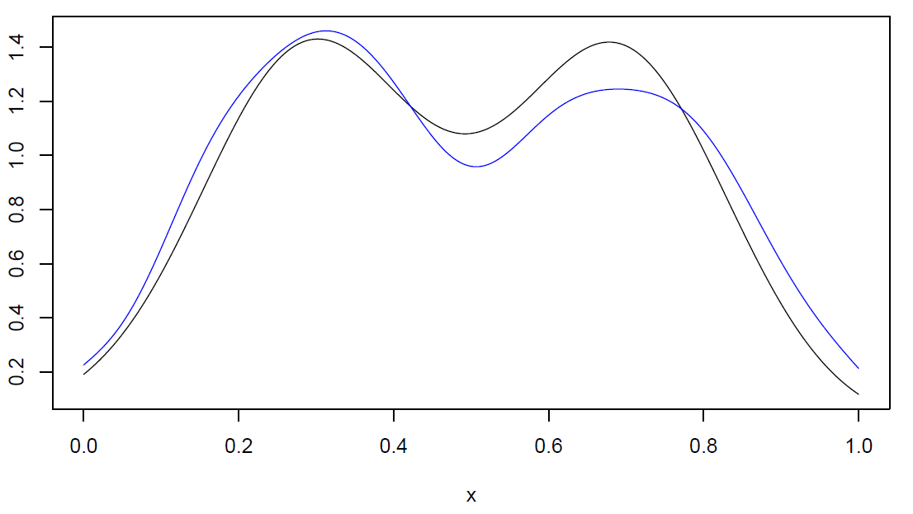
Example 1: (α,β)-DP Kernel Density Estimation
Remarks: released function is smooth, error is of smaller order than sampling error.

Slide 23
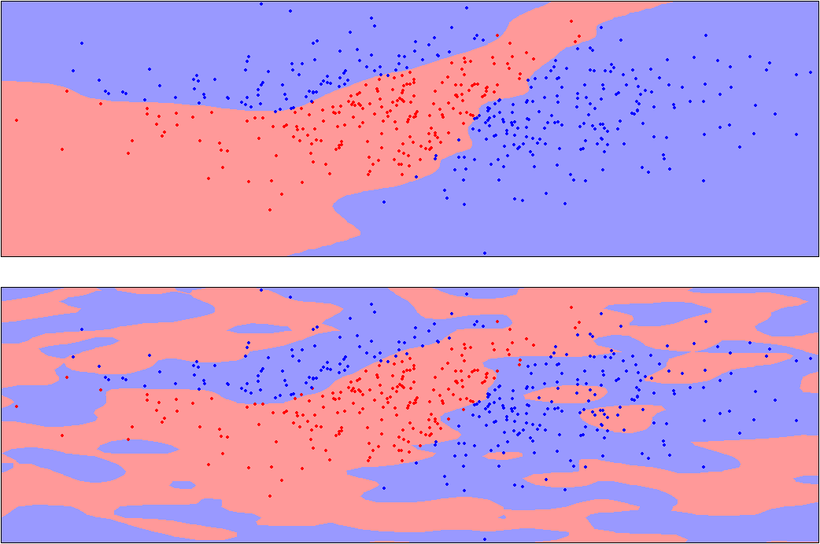
Example 2: (α,β)-DP Kernel SVM

Slide 24
Part 3: Differentially Private Kernel Density Estimation
So far we have an (α,β)-DP method for this task which does not spoil the convergence rate.
We turn attention to the construction of a (α,0)-DP method.
Unfortunately cannot simply modify the previous technique.
[WZ] give a technique which works in one dimension under different regularity conditions.

Slide 25
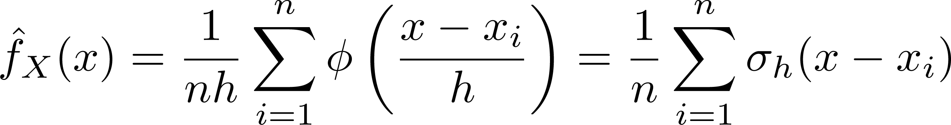
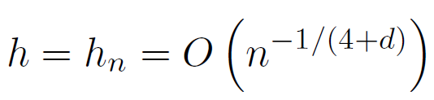
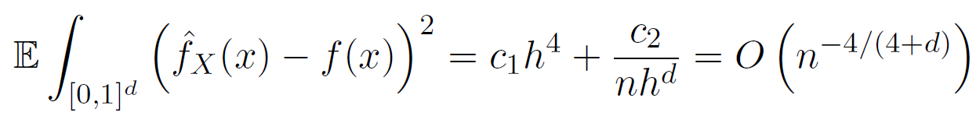
Facts About Kernel Density Estimation
Recall the form
Under appropriate regularity conditions, and when
then this estimate enjoys the minimax convergence rate
Standard normal density.
Normal density with std. dev. h

Slide 26
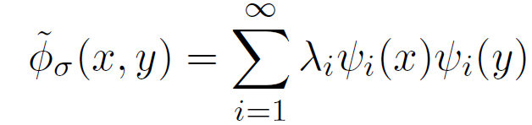
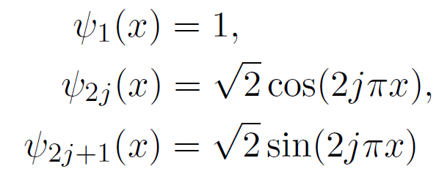
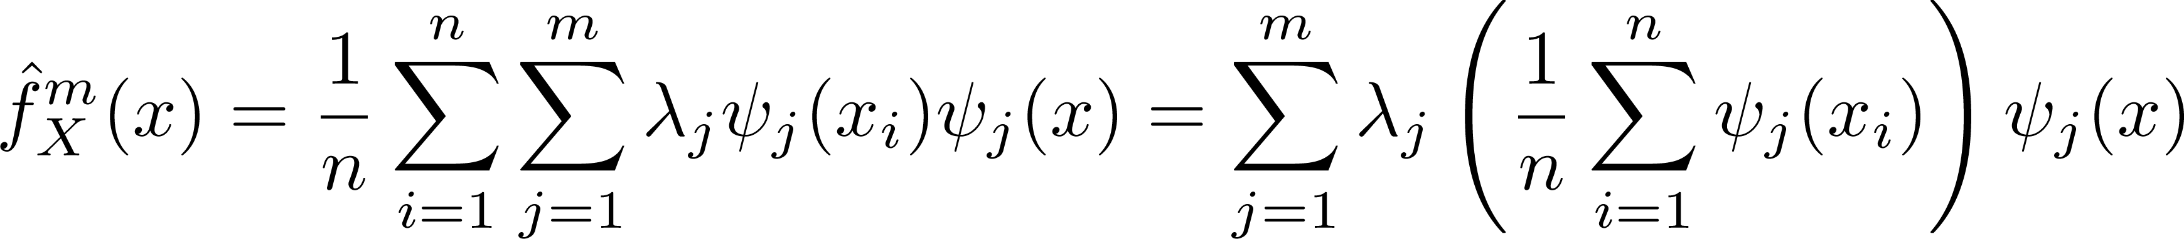
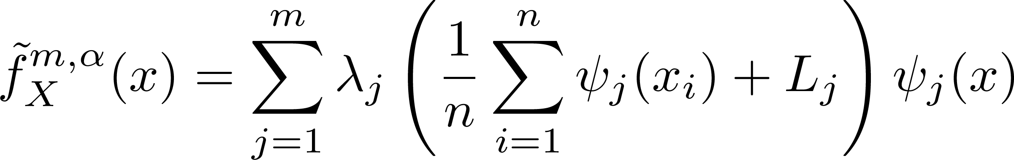
Basic Private Kernel Density Estimation
We eigendecompose the Gaussian kernel into the Fourier basis
Truncation to the first m terms leads to the modified KDE
Following [WZ] we add Laplace noise to each coordinate…
Periodic version of kernel.
Coordinates in Fourier basis
For d>1 use a tensor product construction

Slide 27
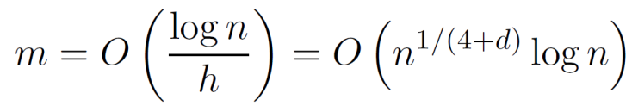
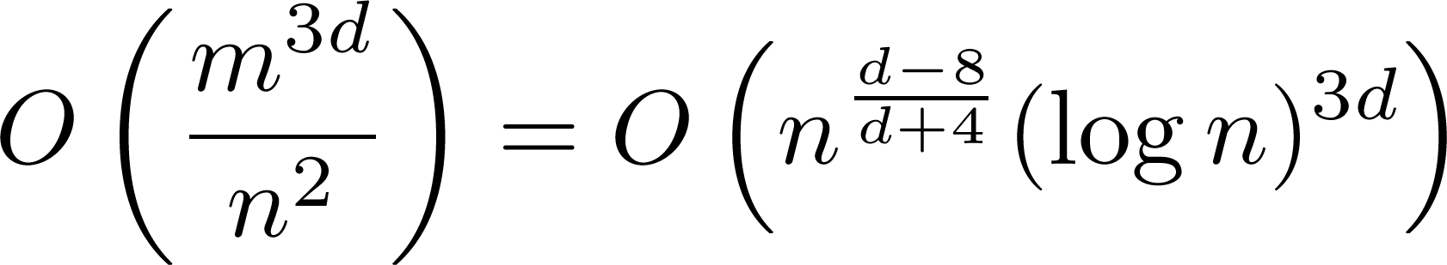
Laplace Noise Spoils the Rate
The error may be written
The first term is in the minimax rate so long as
But then the second term is in the order
Independent Laplace noise adds more error than is necessary.
Here the coordinates exhibit dependence.
Error due to truncation
Error due to noise
Incorrect rate when d > 3

Slide 28
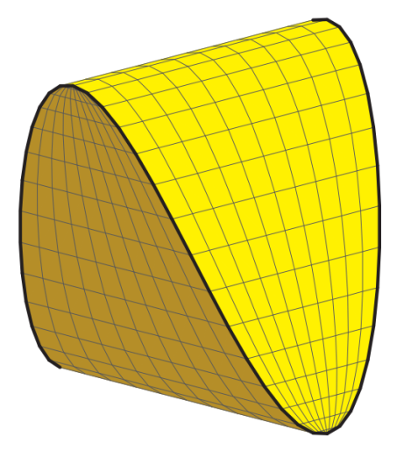
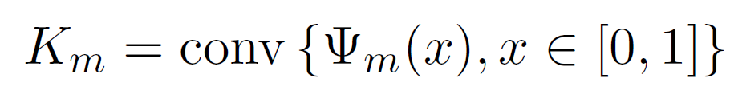
The “K-Norm” Method Achieves the Minimax Rate
In one dimension, each kernel function corresponds to a point on the trigonometic moment curve
and the truncated estimate corresponds to the average of these, which resides in the convex body
This is known as the “Caratheodory Orbitope” and is studied for its facial structure in the algebraic geometry literature [SSS].
Using noise calibrated to the seminorm associated with this body [HT] leads to error in the correct order.
Efficient sampling is feasible using MCMC (at least when d=1).
Image from [SSS].

Slide 29
Contributions
Discrete estimators
Study of the utility of private histograms (contingency tables etc).
Theoretical demonstration of improved error rates in sparse settings.
Private functions
Theoretically clean method for the release of private functions.
Easy to implement in practice (see text).
Private density estimation
A density estimator in the correct minimax rate.
A new way of using the K-norm approach of [HT].
Allows e.g., the construction of private synthetic data through sampling.

Slide 30
Open Problems
Discrete estimators
Attainment of the true minimax rate in a sparse setting via FDR.
Private functions
What can be done to relax the requirement for approximate DP?
Private density estimation
How can the sampling be done efficiently in high dimensions?
What other kinds of functions are amenable to this analysis?

Slide 31
Bibliography
[CMS] Chaudhuri, K., Monteleoni, C. and Sarwate, A. Differentially private empirical risk minimization. JMLR 2011.
[CPST] Cormode, G., Procopiuc, C., Srivastava, D. and Tran, T. Differentially private publication of sparse data. CoRR 2011.
[De] De, A. Lower bounds in differential privacy. CoRR 2011.
[HT] Hardt, M. and Talwar, K. On the geometry of Differential privacy. STOC 2010.
[J11] Johnstone, I. Gaussian estimation: Sequence and multiresolution models (textbook draft).
[MT] McSherry, F. and Talwar, K. Mechanism design via differential privacy. FOCS 2007.
[RBHT] Rubinstein, B., Bartlett, P., Huang, L. and Taft, N. Learning in a large function space: Privacy-preserving mechanisms for SVM learning. JPC 2012.
[SSS] Sanyal, R., Sottile, F. and Sturmfels, B. Orbitopes. CoRR 2009.
[WZ] Wasserman, L. and Zhou, S. A statistical framework for differential privacy. JASA 2010.

Slide 32
Thanks.

Slide 33
Part 4: Relaxed Privacy Definitions
Consider sparse high-dimensional settings
Census data, genetic data etc.
Utility loss required by DP may render inference impossible.
c.f., Charest’s thesis.
Possible solutions:
Abandon the inference.
Abandon privacy and publish the raw data.
Use α-DP with some huge α.
Adhere to some weaker notion of privacy.
i.e., abandon hope of protecting against DP adversary.

Slide 34
Random Differential Privacy
Move from a worst-case to an average case guarantee:
Much weaker than DP:
Protects a random individual with high probability.
Individuals in the tail of P(x) may be exposed.
Nevertheless may be useful in certain situations.
Composes nicely (DP composition + “union bound”).
Usual DP condition
The (n+1)-fold product measure over elements of D,D’
A new parameter

Slide 35

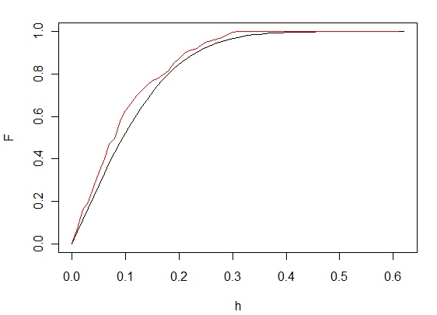
RDP via Sensitivity Analysis
Consider functions g for which the sensitivity decomposes as
Taking a sample quantile of h(x_{i},x_{j}) leads to a bound on the sensitivity which holds w.h.p:
Invoke e.g., DKW to get upper bound on requisite quantile.
“Sensitivity bound” depends on data
Requires “smooth sensitivity” treatment.
Smoothness established (w.h.p) by Kiefer’s work on U-quantiles.

Slide 36
RDP Sparse Histograms
n large relative to number of zero cells: zero cells have low probability under P(x) (“structural zeroes”).
No noise added to zero cells, since w.h.p. they are also zero for D’
The “adversary” doesn’t learn anything from these cells since (from his data alone) he could already conclude they have low probability.

Slide 37
RDP Sparse Histograms

Slide 38
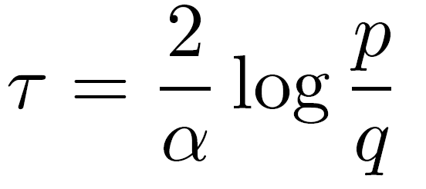
Methods for Sparse Private Histograms
Just as in the sparse normal means problem, if q were known we could take
which leads to hard-thresholding at the minimax rate.
However since q is generally unknown this is not satisfactory
As in the normal means problem, the solution will be to control the “false discovery rate” (FDR) [cite].
Mostly a theoretical exercise since we anticipate q (and hence the reduction in risk) to be small, whereas the analysis is considerably more complex.
Thus left as future work.

