Slide 1
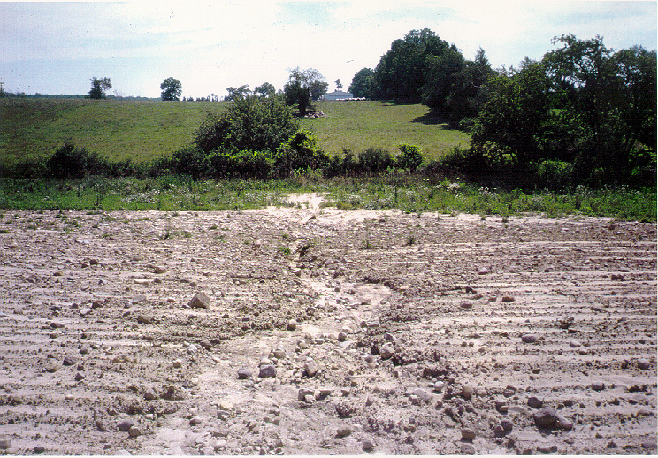
High Impact Targeting (HIT)
“Applying Conservation Tools to the Worst Erosion Areas for Maximum Sediment/Nutrient Reductions“
Glenn O’Neil: Institute of Water Research – Michigan State University
Teresa Salveta: Michigan Department of Agriculture
Tom Hanselman: Huron County Conservation District
Lauren Lindeman: Lenawee County Conservation District
John Switzer: Clinton County Conservation District
Notes:
The CIG project that I am presenting we call HIT (High Impact Targeting). As the subtitle describes, “targeting” refers to optimally locating conservation practices on eroding agricultural lands. My colleagues on this project are Teresa Salveta from the Michigan Department of Agriculture, Tom Hanselman from the Huron County Conservation District, Lauren Lindeman from the Lenawee County Conservation District, and John Switzer from the Clinton County Conservation District. I included the photograph here to illustrate the project rationale. This is a gully loading into Sycamore Creek, just south of the MSU campus. There is a monitoring station immediately downstream of this gully. As you might expect, it was reporting some high values for nutrients and TSS. This knowledge contributed to efforts by state and local agencies to install conservation practices upstream. But, as has been custom, the locations of these practices are either placed randomly when a producer volunteers to enroll in a conservation program, or “targeted” through “windshield” surveys by field technicians. This picture was taken after money had already been spent installing practices. Had there been a more systematic tool to help identify locations like this gully, those efforts could have realized a greater improvement in nutrient readings at the downstream monitoring station. HIT is such a tool.

Slide 2
HIT Model
SEDMOD¹
Land Cover
Surface
Roughness
Delivery
Ratio
Soil Clay
Content
Soil
Texture
Weighting
DEM
Distance to
Stream
Sediment
Yield
LS Factor
Landuse/Tillage
C Factor
Soil Erodibility
K Factor
Soil
Erosion
Rainfall
R Factor
Support
Practice
P Factor
RUSLE²
Fraser. May 1999
Renard, Foster, Weesies, McCool, Yoder. 1996.
Notes:
The HIT tool starts with modeling. The HIT model is relatively simple, with a small number of inputs. Its simplicity makes it easier to run the model in multiple locations, but also limits the data output. HIT is the product of two models, RUSLE, which estimates soil erosion, and SEDOMD, which estimates the delivery of eroded soil to the stream network. This is done within a GIS grid, or raster, environment which allows us to come up with an estimate of sediment loading for each 100 square meter or 900 square meter (depending on the resolution of available data).

Slide 3


Early Targeting Efforts
Da Ouyang (IWR), Jon Bartholic (IWR), Jim Selegean (ACE)
- Coarse Great Lakes Basin analysis¹
Notes:
This project did not pioneer the HIT modeling approach, but built off of previous efforts. The Army Corps of Engineers has long had an interest in keeping sediment on the land, since they’re responsible for dredging many of the Great Lake harbors. The Corps worked with IWR in estimating sediment loading, using the HIT approach, throughout the Great Lakes basin. This was a coarse analysis, but got the ball rolling for future studies.

Slide 4
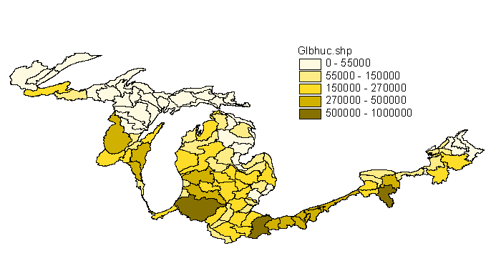
Early Targeting Efforts
Estimated Total Sediment Loading by 8-digit Watershed
Notes:
The effort resulted in estimates of sediment loading from each of the Great Lakes Basin 8-digit watersheds. This helped the Corps with prioritizing efforts at the macro scale, but the results were not at scales more practical for organizations with the means to install conservation practices. Conservation districts would benefit from finer 10 and 12 digit watershed-scale data, and especially field-level data.

Slide 5


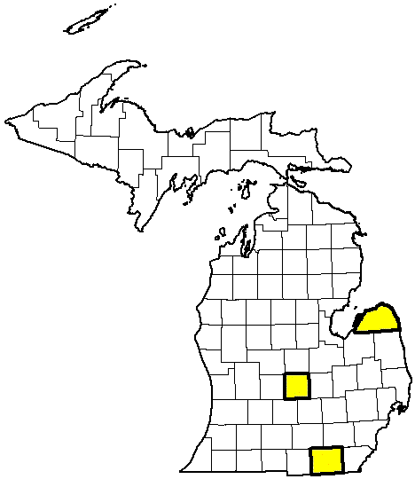
Conservation Innovation Grant
A multi-scale partnership
- Federal:
Project oversight
Funding
- State:
Project coordination
Outreach
- University:
Model and Web
development
- Local:
Conservation Districts
Clinton
Huron
Lenawee
Model evaluation
Website feedback
Outreach
BMP targeting
Notes:
This CIG project that I’m presenting here built off this previous effort, but in a more thorough way. Our project linked federal, state, university, and local agencies in an effort target conservation practices, taking advantage of the strengths of each team member.

Slide 6
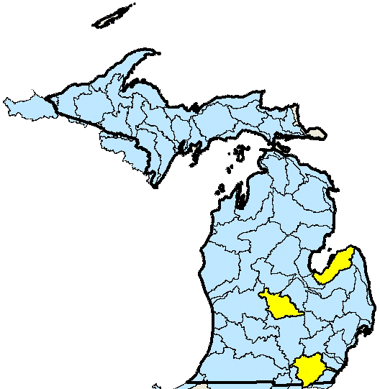
Conservation Innovation Grant
Project Goal:
Apply conservation tools to the worst erosion areas for maximum sediment/nutrient reductions.
Timeframe:
2007 - 2009
Pilot Areas:
Three Michigan watersheds
Pigeon-Wiscoggin
Maple
Raisin
Notes:
The three Michigan watersheds were selected because farmers in areas are eligible for conservation programs, CRP and CREP.

Slide 7
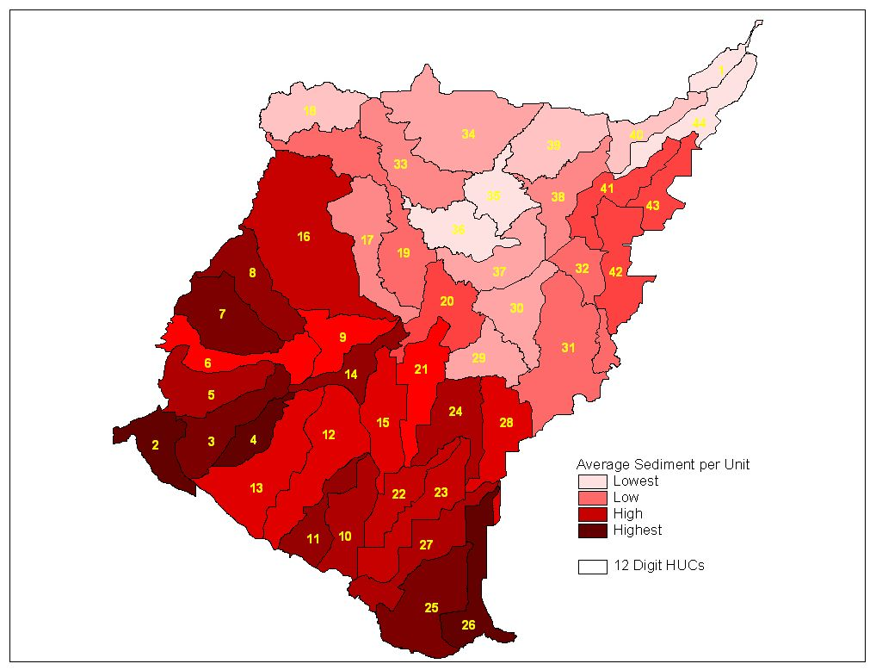
Targeting Sub-watersheds (Lower Maumee River Watershed – NW Ohio)
Notes:
These are 12-digit sub-watersheds of the Lower Maumee River watershed in NW Ohio. This is not part of the CIG study area, but it illustrates two points. First, there are multiple agencies and interests in modeling sediment loading around the GLB. EPA Region V, ACOE, Ohio NRCS, and other have had interest in the Maumee, and IWR has collaborated by developing HIT models for the Lower Maumee. Two, this map and subsequent table show the benefits that can be realized by targeting watersheds. Note sub-watersheds #7 and #39.

Slide 8
Applying BMP (no-till) on highest risk acres in contrasting watersheds
Watershed |  | Acres | Tillage | Total Sediment (tons) |  | Reduction (tons) | Percent Change
Garret | 18,065 |  | current practice |  | 1,591 | 0 | 0%
Garret |  |  | no till on worst 5% |  | 1,322 | 269 | 17%
Garret |  |  | no till on worst 10% |  | 1,223 | 368 | 23%
Wolf | 17,440 |  | current practice |  | 286 | 0
Wolf |  |  | no till on worst 5% |  | 216 | 69
Wolf |  |  | no till on worst 10% |  | 202 | 84

Slide 9
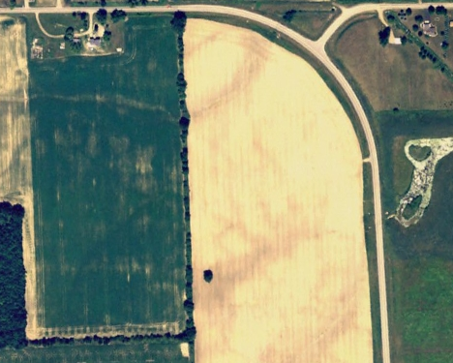
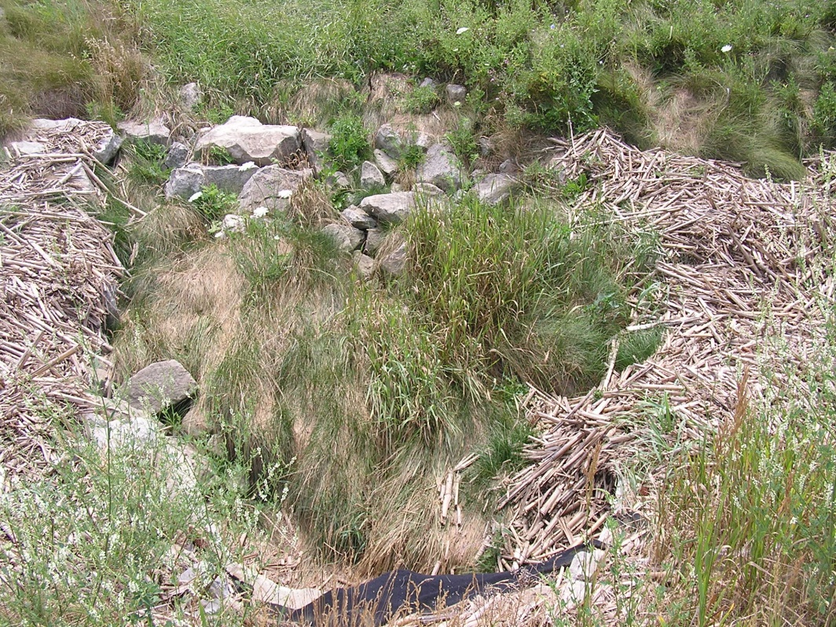
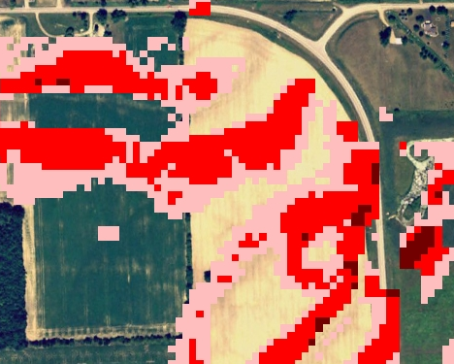
Spatially exploring areas at high-risk for sediment loading
A site in the Maple River Watershed:
0.2 – 0.4 tons/acre
0.4 – 0.8 tons/acre
Corn residue runoff in ditch.
> 0.8 tons/acre
Notes:
Once a sub-watershed has been targeted, the next question is where within the watershed should be targeted. Since the HIT analysis is spatially explicit, we can identify raster cells with higher values for sediment loading. Thus enabling a group like the Clinton County conservation district to prioritize efforts at a macro scale (sub-watersheds) and the micro scale (fields), which they did in the development of their recent 319 plan.

Slide 10
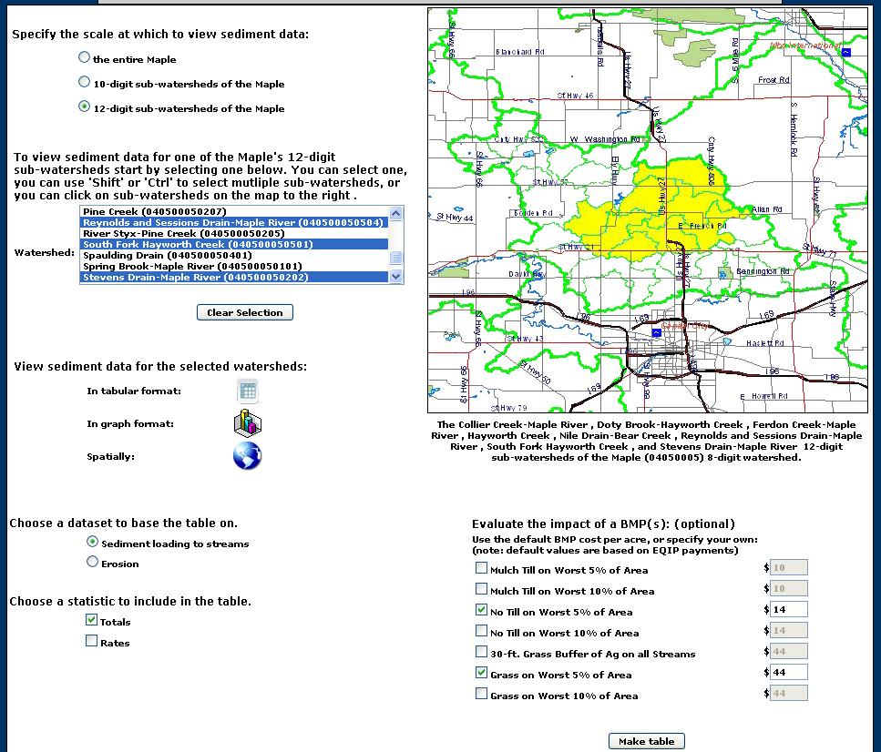
Making the Data Web-Accessible:
www.iwr.msu.edu/hit
Analyze data at different watershed scales
Work with single, all, or subset of sub-watersheds
View data in multiple formats
View sediment loading or erosion data
Optionally evaluate a BMP
Notes:
Thus far I’ve covered how the HIT model works and what kind of outputs it produces. But the goal of this project was not to simply generate models, but make the data available in a readily accessible format. So we built a website around the modeling that allows users to generate tables like those we saw for the Lower Maumee, and maps like the one on the previous slide. Here is screen capture.

Slide 11
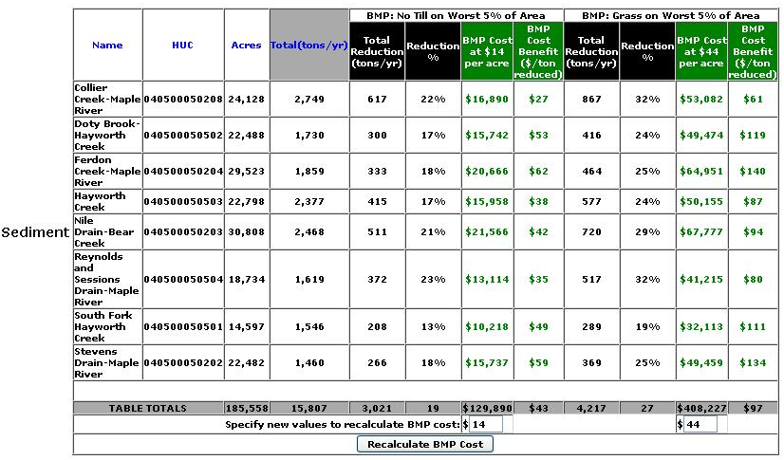
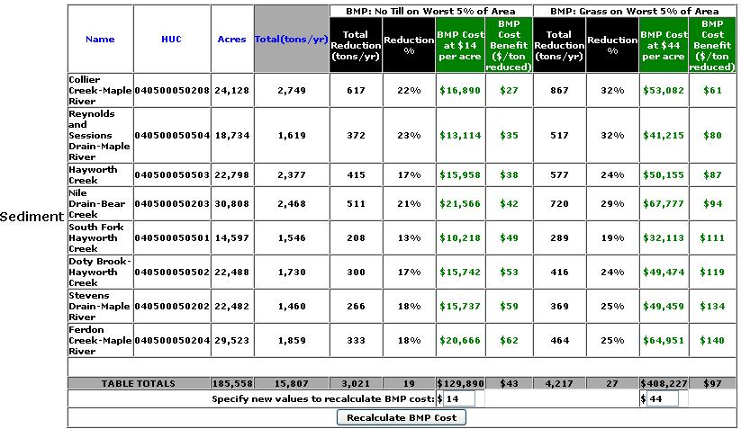
Making the Data Web-Accessible:
Table Results
Estimated sediment loading
BMP impact and cost/benefit
Basic watershed info.
Columns can be sorted.
BMP costs can be recalculated on-the-fly

Slide 12
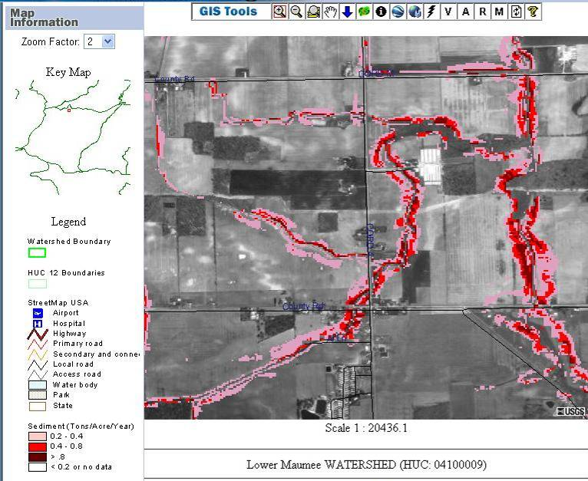
Making the Data Web-Accessible:
Viewing the data spatially

Slide 13
Team Effort
Development of HIT was a team effort:
Clinton C.D. – John Switzer
Huron C.D. – Tom Hanselman
Lenawee C.D – Lauren Lindeman
Michigan Dept. of Ag. – Teresa Salveta
Provided feedback on HIT
Facilitated public outreach
Helped define HIT’s appropriate audiences
Assessed HIT model through field evaluations and stream monitoring
Notes:
The development of the on-line system was a team effort. The Conservation District technicians provided feedback on what would make the tool more useful. These included expanding the list of BMP options, additional data layers in Digital Watershed, and a more interactive selection of watersheds to view data for. MDA and the CD Technicians also held public meetings where they presented the tool to local agencies (such as drain commissioners), watershed groups, and citizens. This also provided useful feedback to IWR as it refined HIT, but more importantly helped us define the best audience for HIT. We originally envisioned designing a tool that catered to federal, state, and local governments, watershed groups, and farmers. But in our early conversations with farmers we realized that showing them where high-risk areas were in their field wasn’t news. They already knew where the problem areas were. They also did not have much interest in seeing BMP scenarios over a watershed, their primary interest is their fields. So that forced us to tailor the tool for use by the other groups I mentioned (federal, state, local gov’ts, and watershed groups). The technicians also helped by conducting thorough field evaluations of the model’s characterization of the landscape.

Slide 14
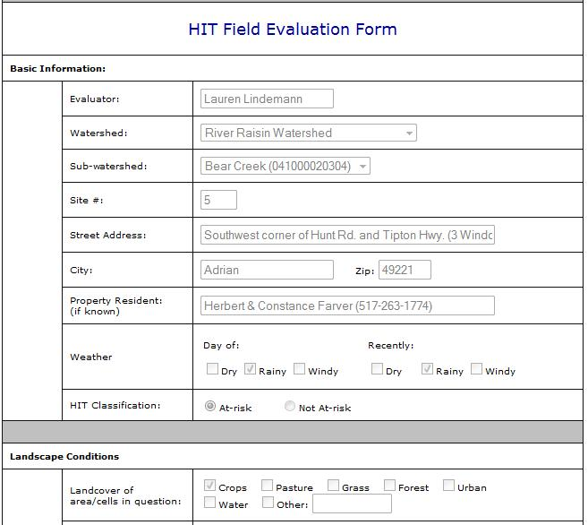
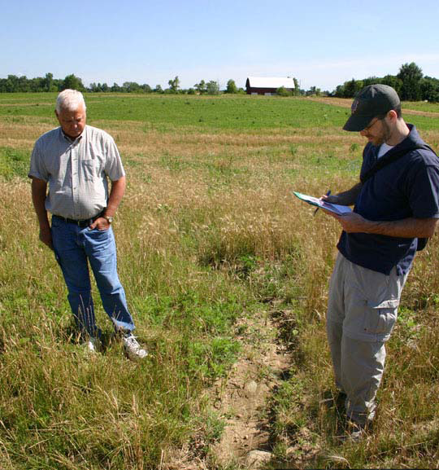
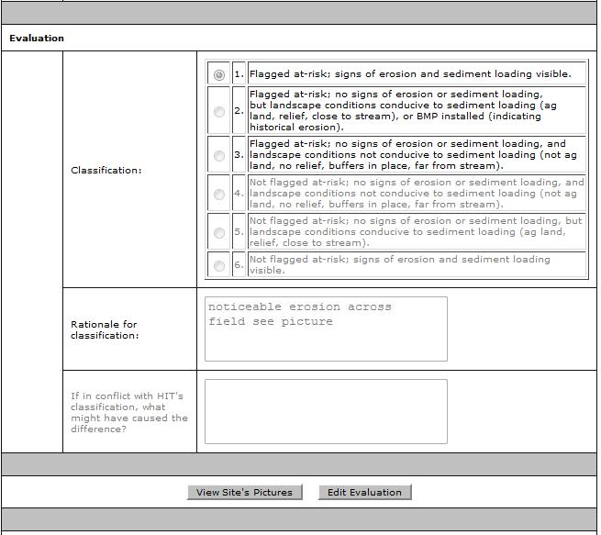
Field Evaluations
The C.D. technicians visited over 200 fields in the pilot watersheds and evaluated the accuracy of the high-risk maps.
Notes:
The technicians visited over 200 fields across the three pilot watersheds and assessed how well HIT was evaluating those fields. They printed high-risk maps from Digital Watershed, visited the selected sites, and filled out an on-line evaluation form IWR developed.

Slide 15
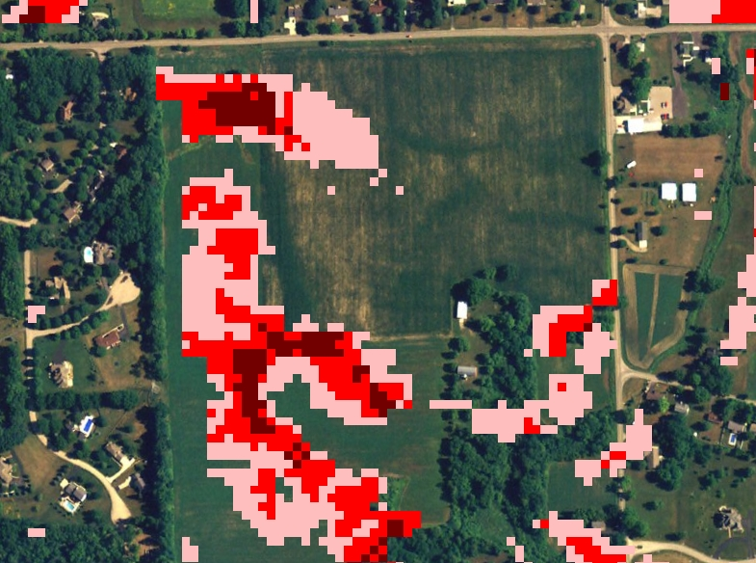
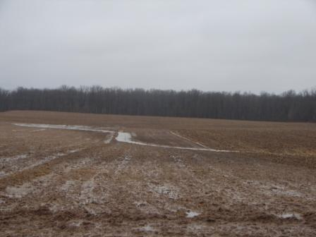
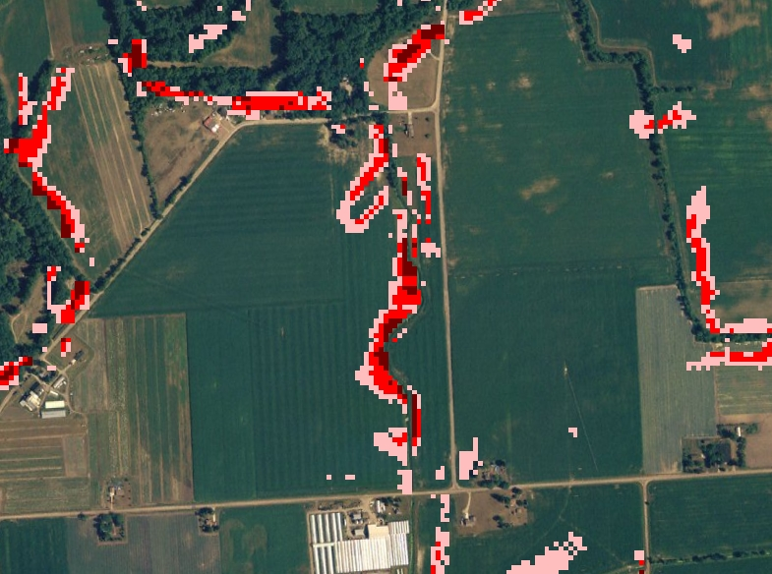
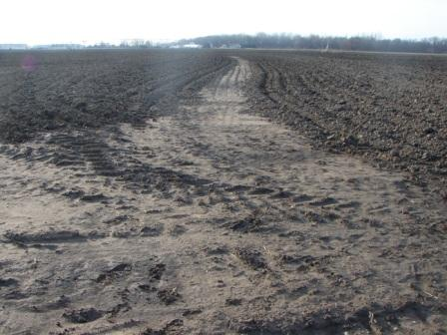
Field Evaluations
Results: 70% of the time HIT maps correctly characterized the landscape. locations.
Notes:
The results showed that roughly 70% of the time HIT had correctly characterized the landscape. Here are some examples.

Slide 16
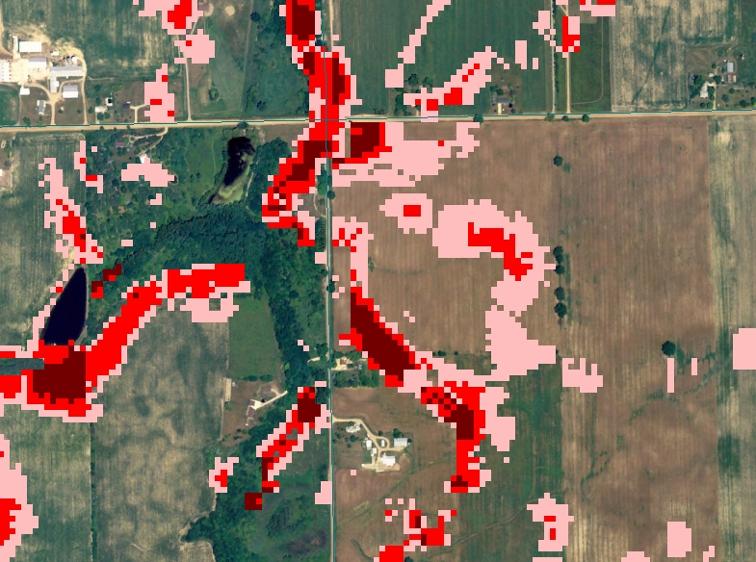
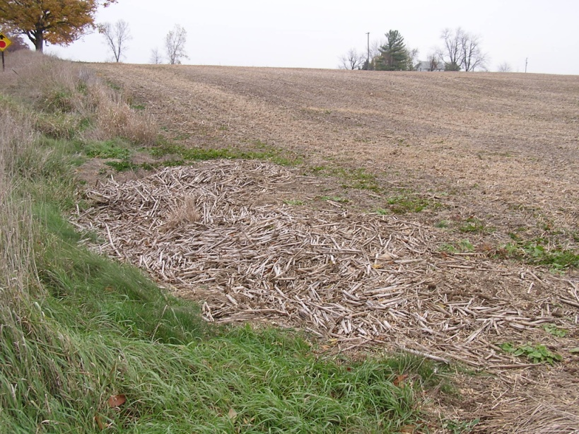
Field Evaluations
Primary causes of errors at other 30%:
- Coarse land cover input (30-meter resolution)
- DEM unable to accurately characterize flow-direction
Notes:
Of course, I cherry-picked some of the better locations and pictures to show here. We did explore the 30% of misses to try and determine why HIT erred. Coarse land-cover was the primary reason for most of these misses. The landcover input was NLCD (30-meter) which is fine for characterizing farm fields; we can be fairly confident that the cells in the middle of the field are correctly characterized as agriculture. The problem arises when the ag-land cells abut road cells. It may say that a road is 30 meters wide and is immediately adjacent to agriculture. This leaves out the drainage ditch between the road and field, which is the key geographic feature in the scene. Another problem, is that in flatter locations it can be hard for a DEM to accurately represent flow-direction. Our models may have predicted flow from a field heading east, when in fact it was heading west. Therefore our efforts to locate gullies on the fields eastern edge proved fruitless.

Slide 17
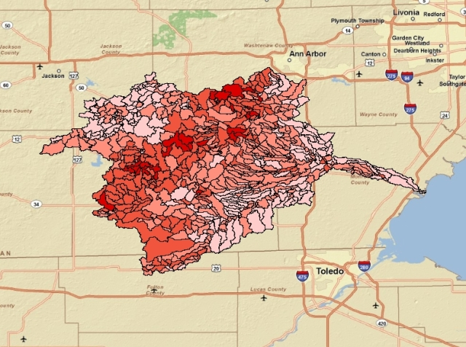
Stream Monitoring
MDA and Conservation Districts are currently evaluating HIT sediment estimates.
NHD Plus catchments (average size 700 acres) were ranked by sediment loading through HIT. .
C.D. Technicians took samples during weather events and sent them to Michigan DEQ for analysis.
- IWR will utilized DEQ results to determine if HIT adequately ranked catchments by sediment loading
NHD Plus catchments of the River Raisin Watershed
Notes:
So the field evaluations were an assessment of one aspect of HIT, the spatially explicit high-risk maps. MDA and the technicians are also evaluating HIT ranking of sub-watersheds by sediment loading. We used HIT to estimate sediment loading at the NHD Plus catchment scale (average size of 700 acres). The technicians each selected 10 catchments to sample. They waited for rain, and gathered samples from each location. They did this for 5 different rain events. They shipped their samples to MDA, who is currently working with Michigan DEQ to analyze the samples. Once the results come back, IWR will perform a Spearman Rank correlation to see how well HIT ranked the catchments. Note, we’re not going to statistically analyze the exact measurements of sediment, but just the ranks. I’ll come back to this in a moment.

Slide 18
HIT Highlights
Conservation districts are using HIT to prioritize efforts.
HIT data is being viewed within the NRCS Toolkit, integrating HIT into the workflow of conservation technicians.
Michigan DEQ is promoting HIT in the development of 319 plans. Clinton C.D. and consultants have used it in Maple River 319 plan.

Slide 19
HIT Limitations
Focused primarily on agricultural lands, not suitable for urban analysis.
Focused on sheet erosion (RUSLE), not gully, bank, or wind.
Estimates of erosion and sediment loadings are for relative comparisons of watersheds, are not precise.
Notes:
You may recall from the slide of the Lower Maumee that Toledo was shaded as low for sediment loading. This is probably true, but should not imply that Toledo does not contribute nutrients to the Maumee. RUSLE isn’t going to help you in downtown Toledo, unless green roofing starts to kick in. There are models out there that allow for urban analysis, such as L-THIA from Purdue University, which we have actually begun to interface with in other projects. RUSLE only measures one form of erosion, sheet. It’s estimates do not include sediments from gully erosion, bank erosion, or wind erosion; which can be significant sources depending on the location. This is why we recommend the use of HIT estimates of sediment loading at a watershed scale for relative comparisons only. It’s probable that any HIT estimate of sediment loading for a watershed is below the actual amount. But this does not limit a users ability to utilize HIT to target practices within a watershed. Even though the raw numbers may not quantify gully erosion, the field evaluations have shown that the model’s spatially explicit results can help you locate them.

Slide 20
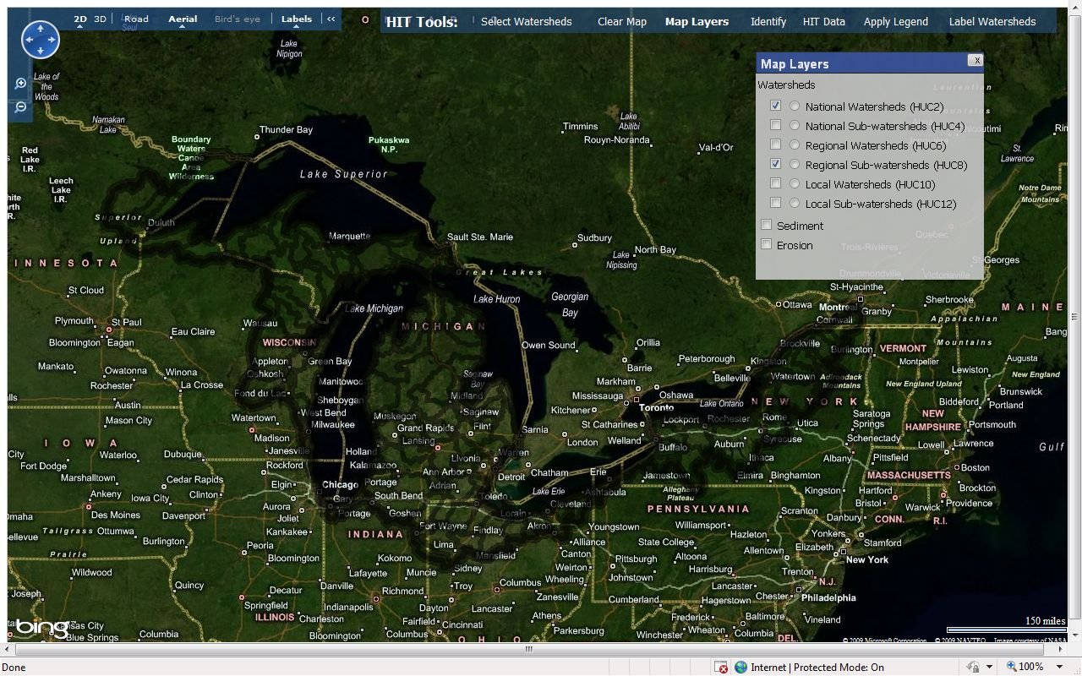
What’s Next?
HIT “2.0”
- Built on Microsoft Bing Maps
- Available for the entire Great Lakes Basin
- Allows for analysis at all watershed scales
Notes:
A stated goal in the CIG’s original proposal was to develop a program that could be expandable. Using all that we’ve learned from this CIG project, and all of the feedback that we’ve received, we have begun to do that. We’re tentatively calling it HIT 2.0. It’s built on Microsoft’s Bing Maps (Used to be Live Maps, but MS inexplicably renamed it Bing, to go along with its new search engine – But It’s Not Google). HIT 2.0 allows for analysis across the Great Lakes Basin. Note: I understand that we’re leaving out Canada, but thus far the data necessary for modeling has only been readily available for the U.S. side. And allows for analysis at all watershed scales, 2-digit through 12.

Slide 21
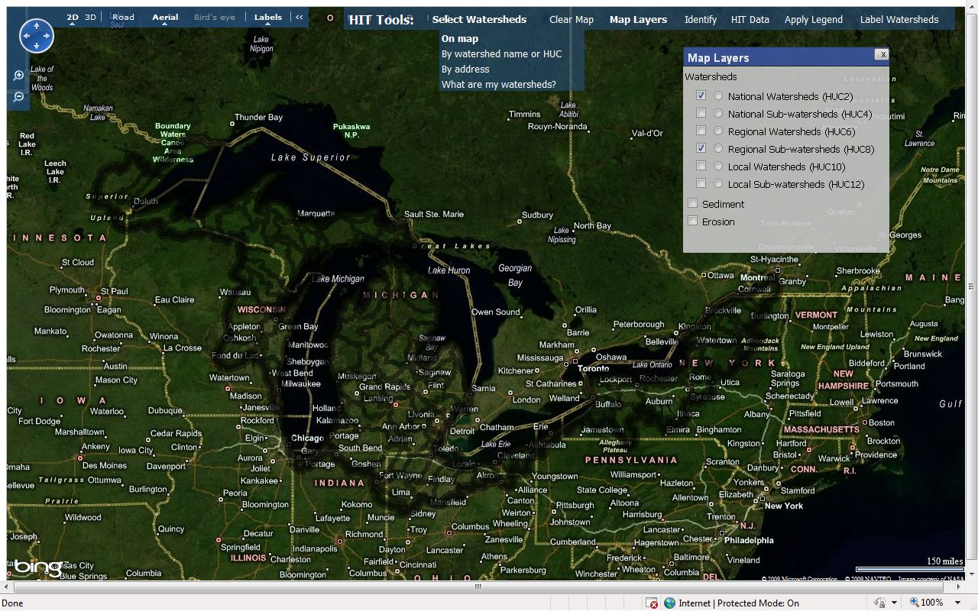
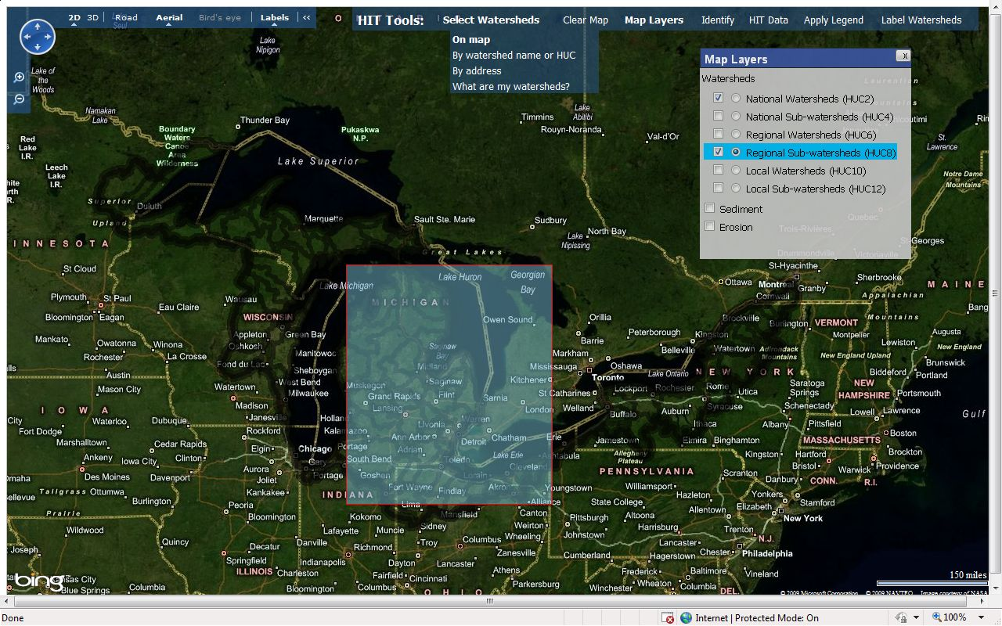
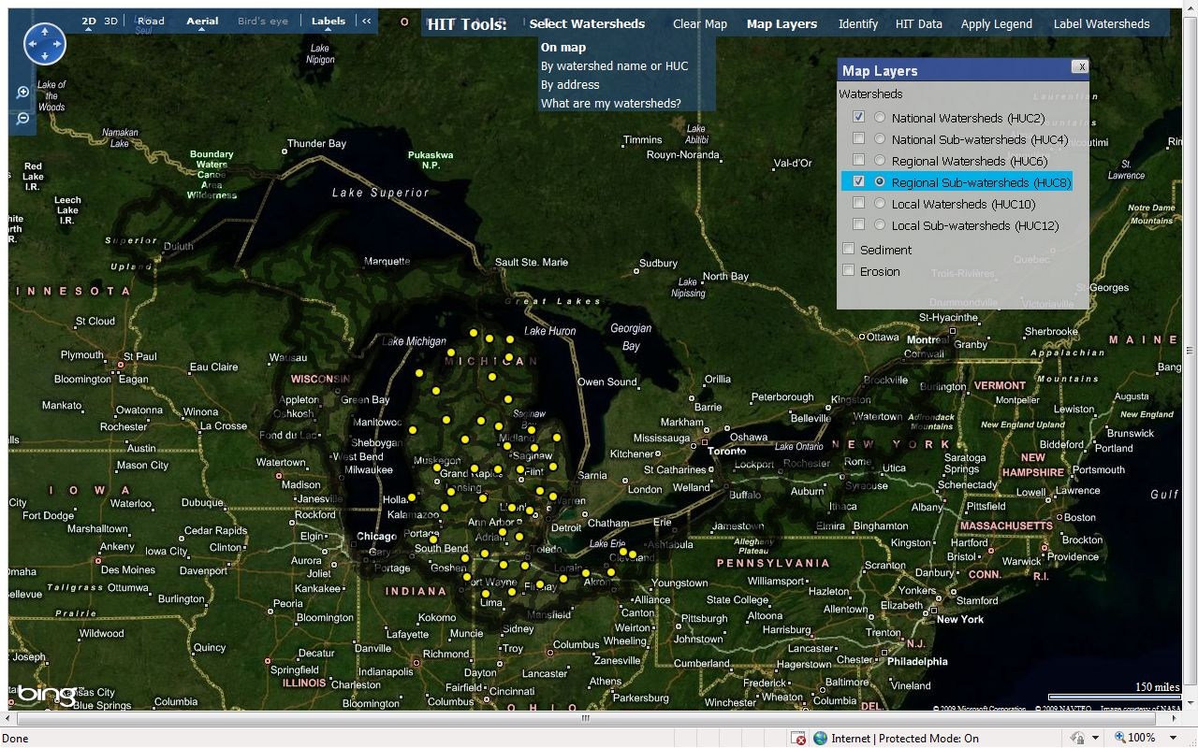
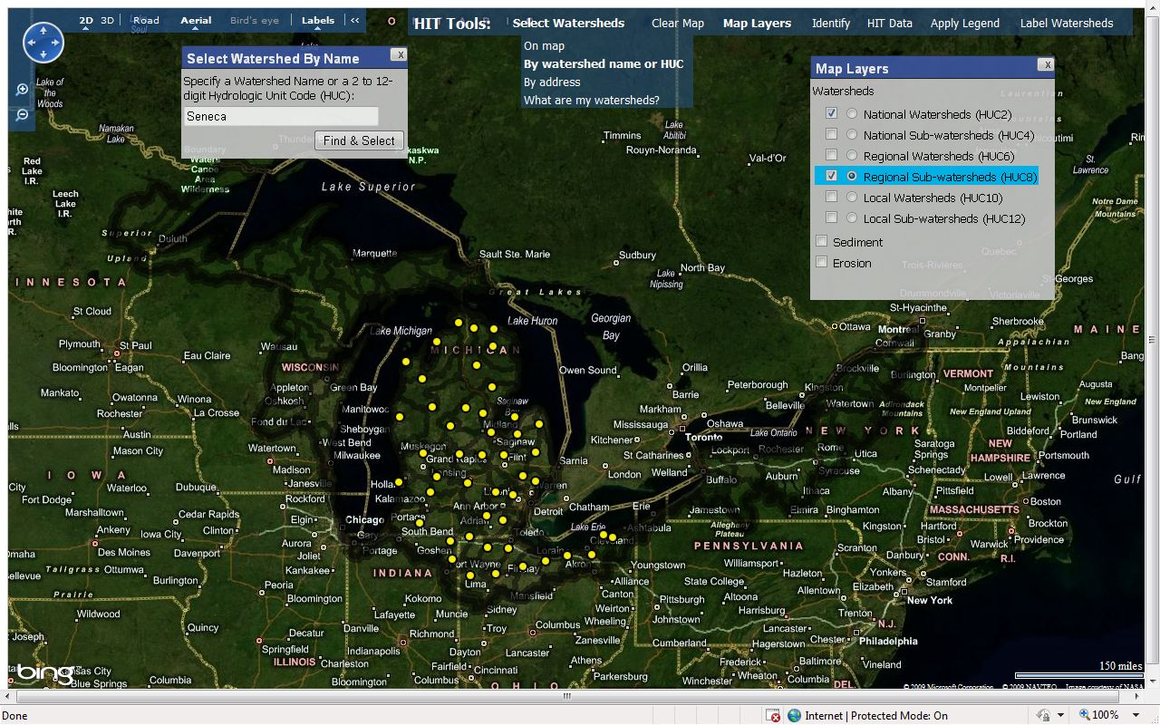



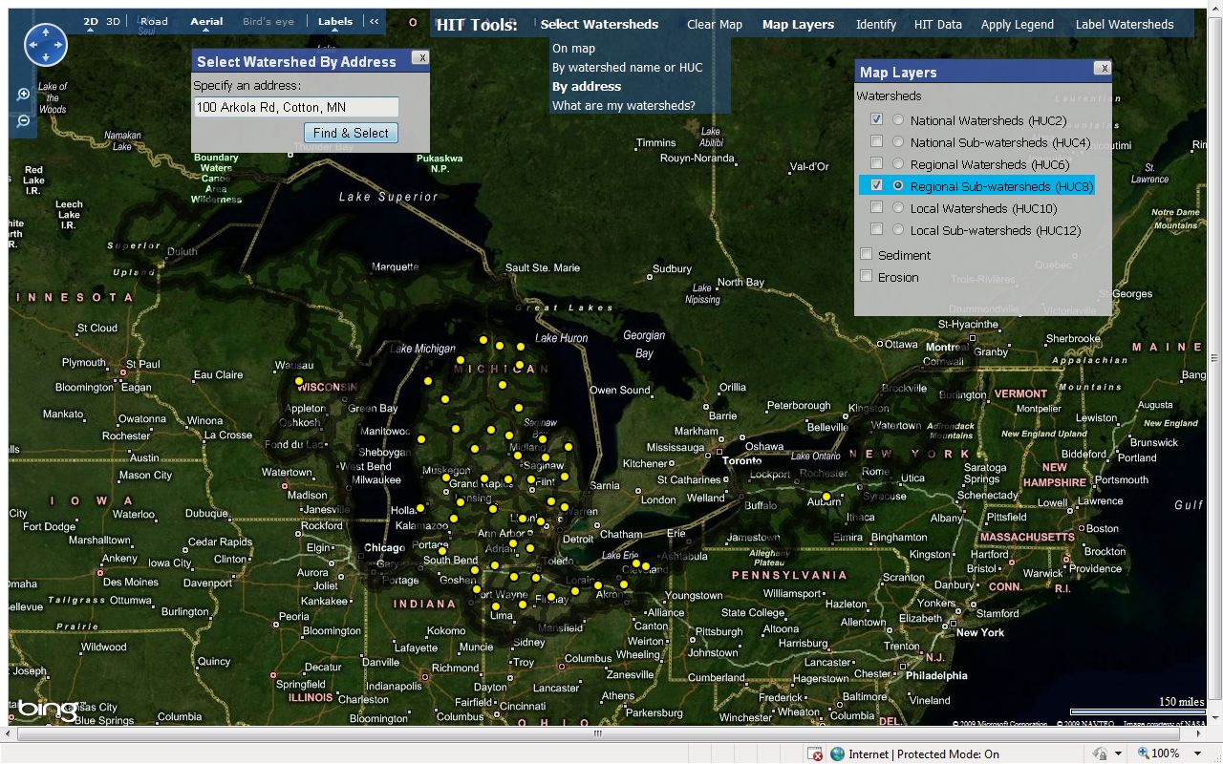
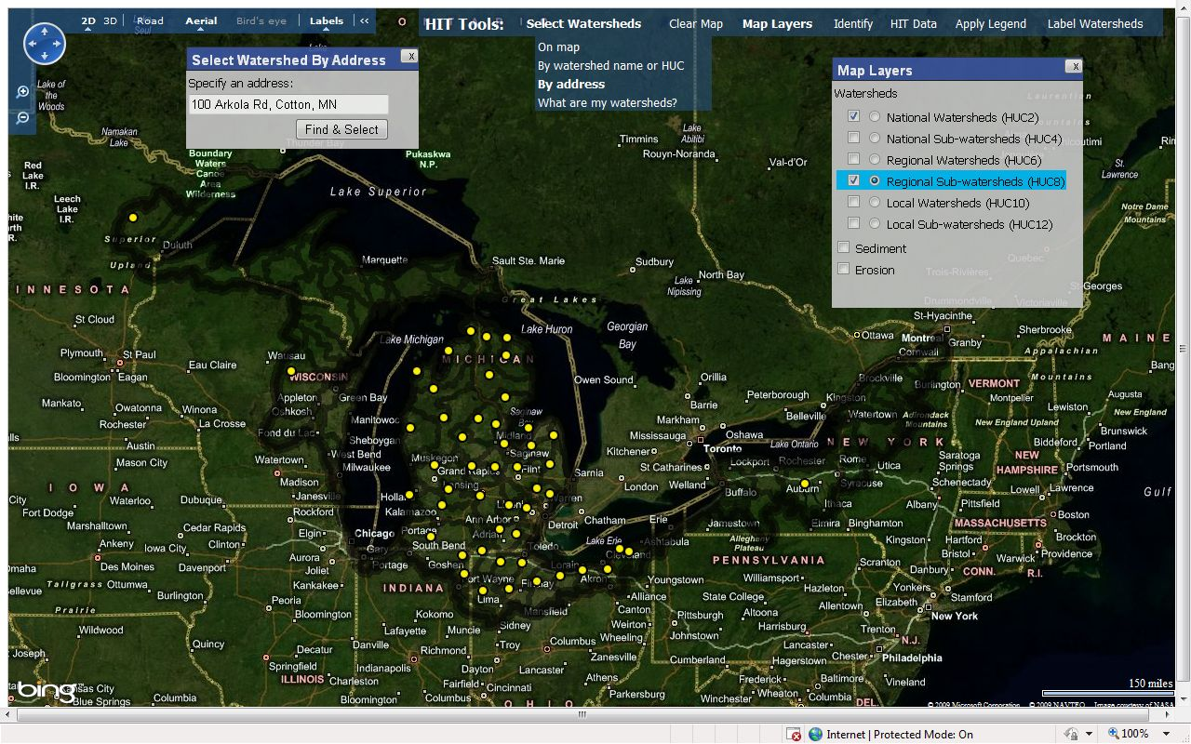
HIT 2.0
Select watersheds for analysis spatially, by name, HUC, or address.

Slide 22
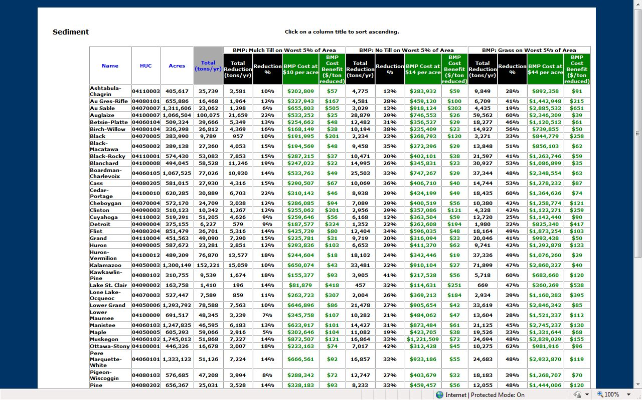
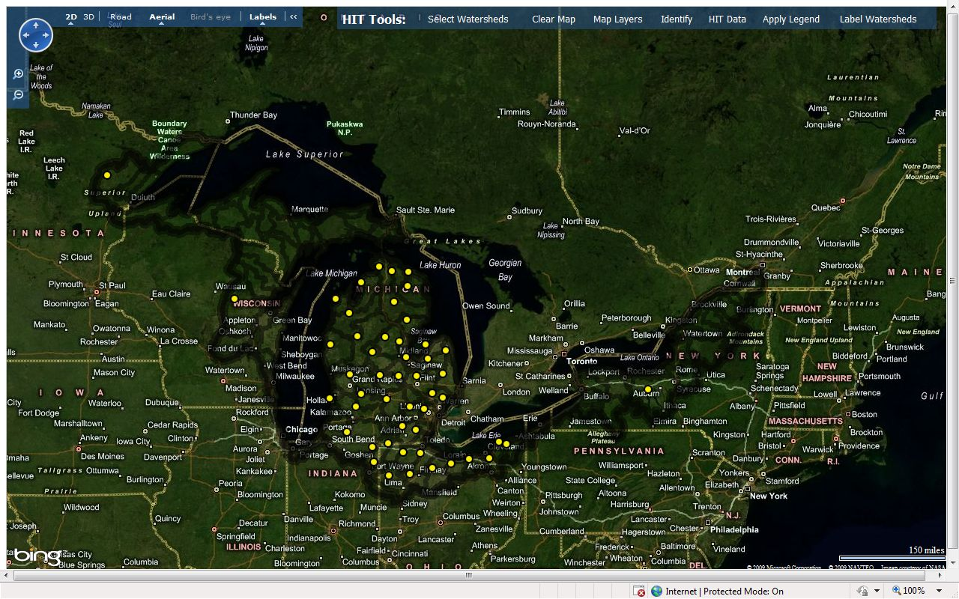
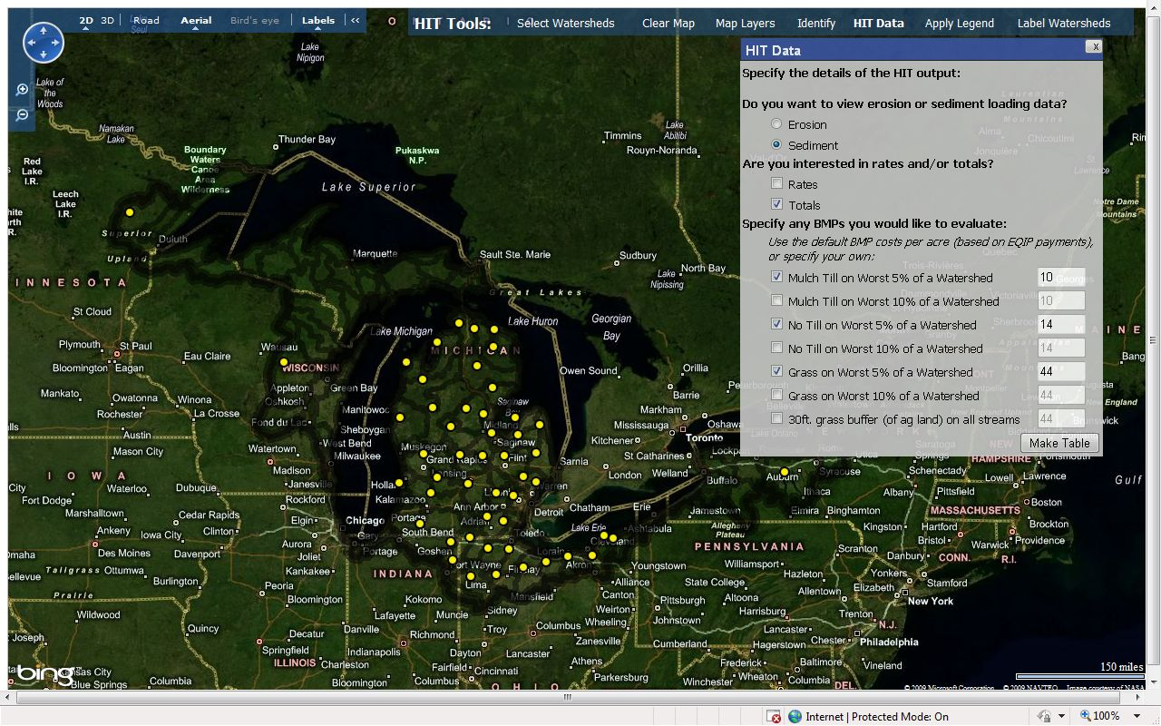
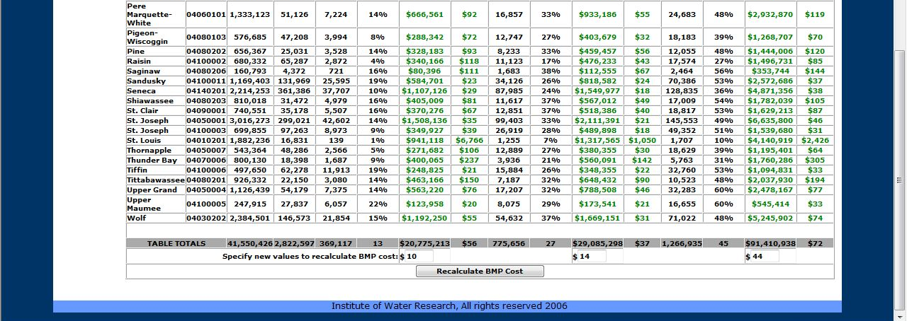
HIT 2.0
HIT tables can be generated as in the original system.

Slide 23
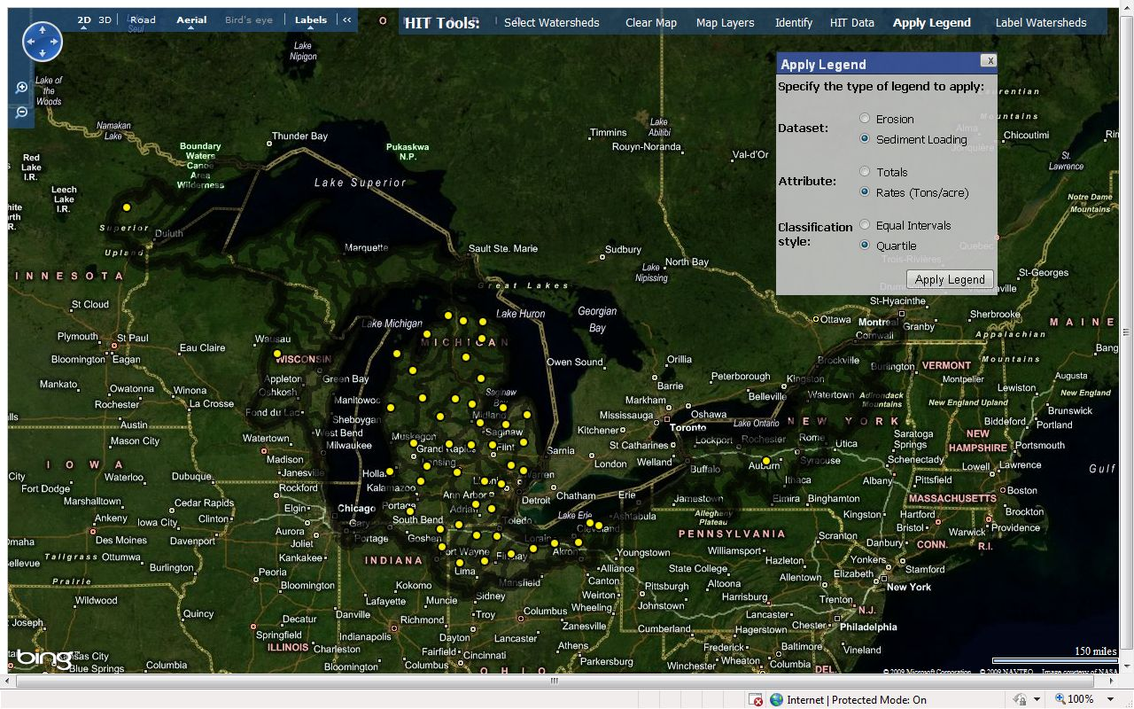
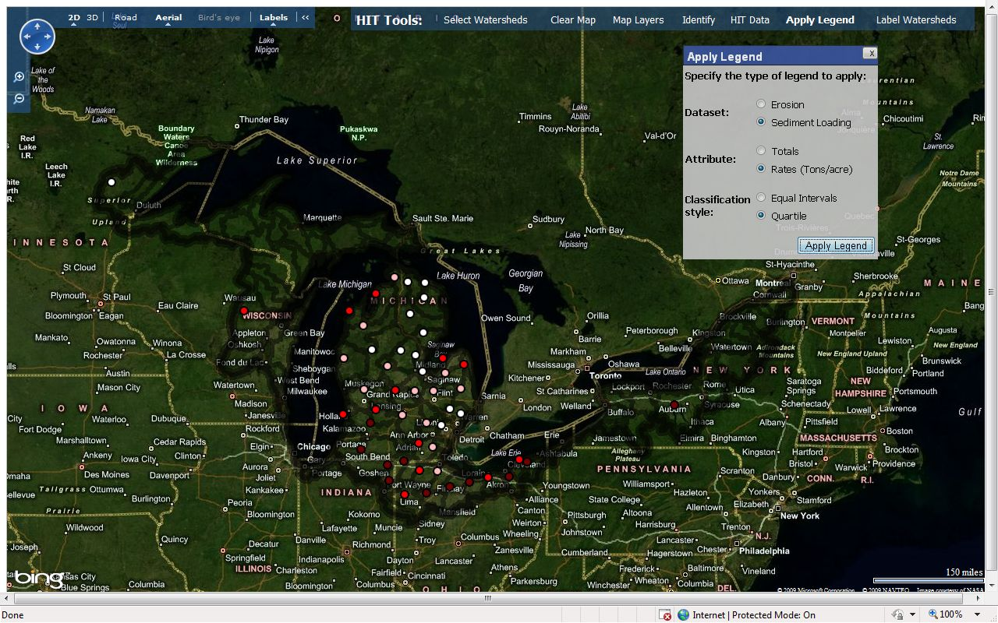
HIT 2.0
Least loading per acre
Less loading per acre
More loading per acre
Watersheds can be shaded by erosion or sediment data.
Most loading per acre

Slide 24
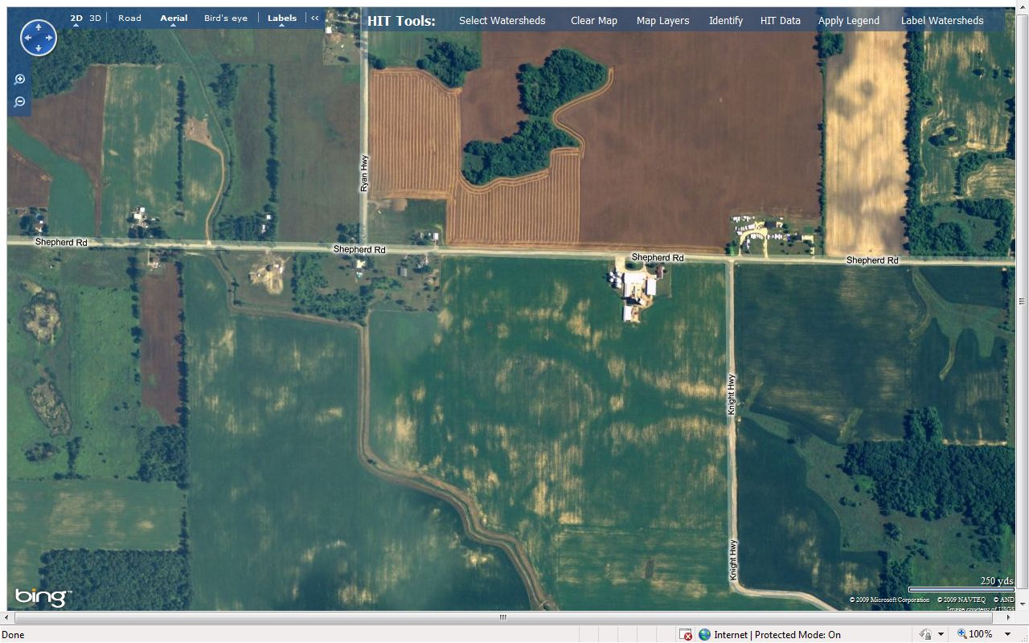
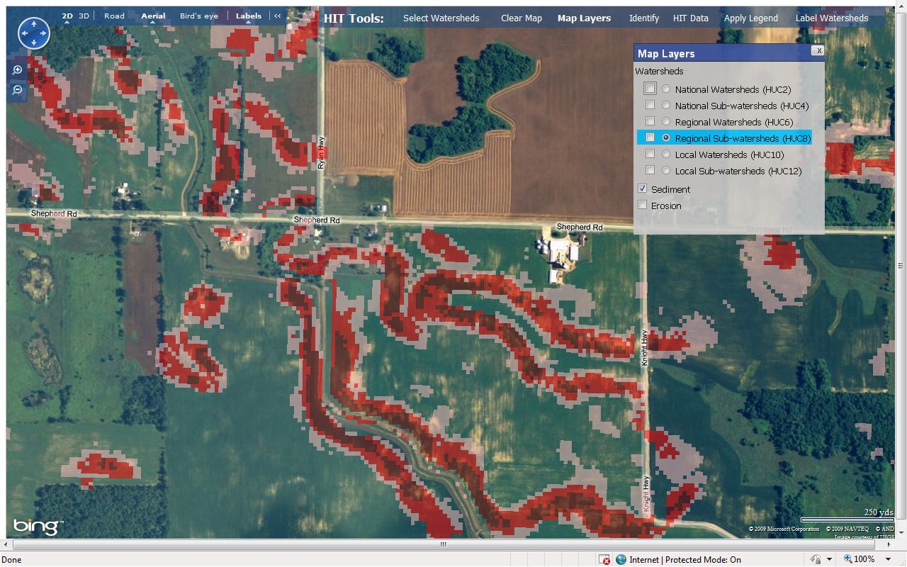
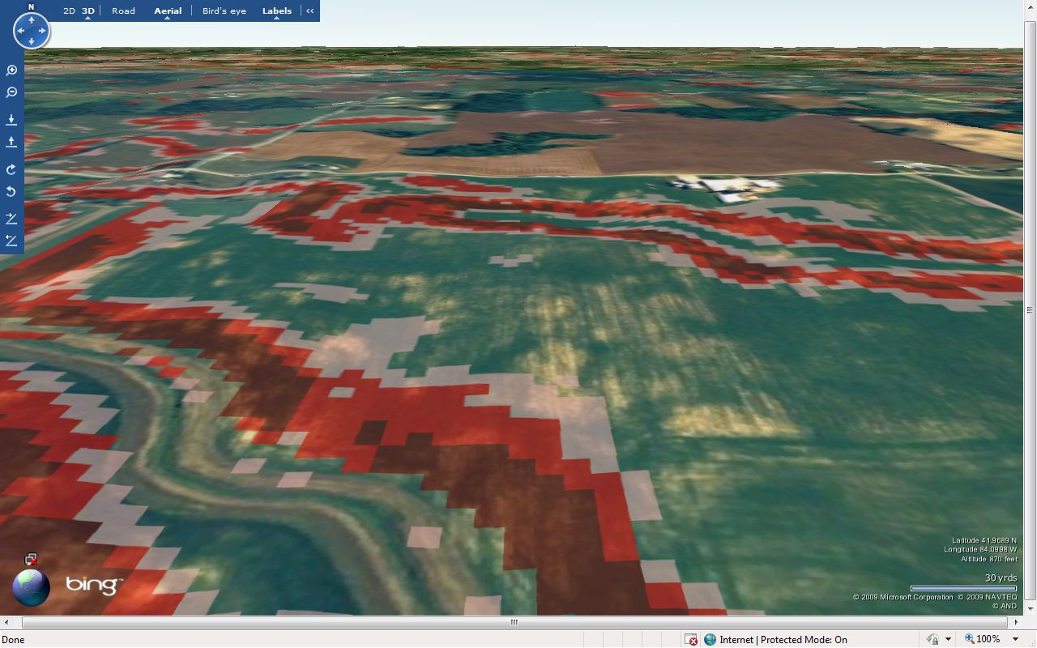
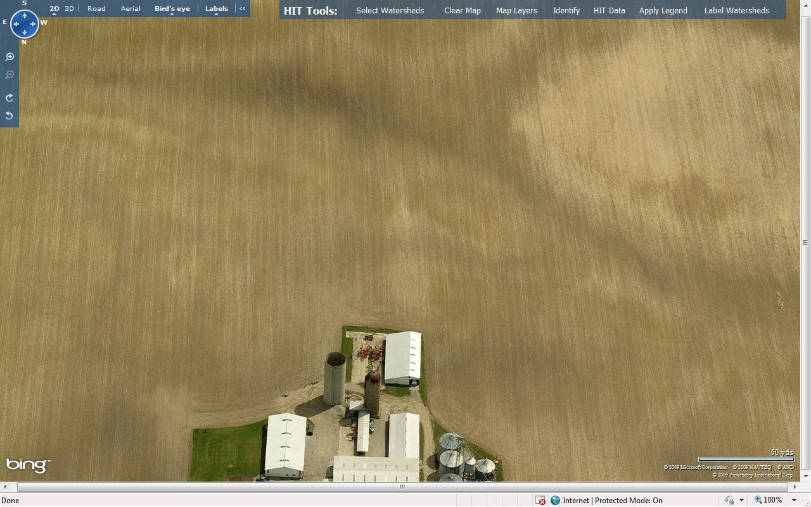
HIT 2.0
Improved aerial imagery allows for richer field-level analysis.

Slide 25
In Conclusion
Through the development of HIT, this CIG project has helped local conservation districts prioritize efforts to reduce erosion and sediment loading from agricultural lands.
Field evaluations have shown HIT’s high-risk maps to be reliable.
Stream monitoring assessments are underway to evaluate HIT’s relative erosion and sediment loading estimates.
An enhanced, Great Lakes basin-wide version of HIT will be available soon.

Slide 26
References
Fraser, R. SEDMOD: A GIS-based Delivery Model for Diffuse Sources
Pollutants (doctoral dissertation). Yale University. May 1999.
Ouyang, D.; Bartholic, J.; Selegean, J. "Assessing Sediment
Loading from Agricultural Croplands in the Great Lakes Basin." The Journal of American Science. Vol. 1, No. 2, 2005.
Renard, K.; Foster, G.; Weesies, G.; McCool, D.; Yoder, D. Predicting Soil
Erosion by Water: A Guide to Conservation Planning with the Revised Universal Soil Loss Equation (RUSLE). USDA, Agriculture Handbook Number 703. 1996.

Slide 27
Thank You
oneilg@msu.edu

