Slide 1


Anomaly Detection in Communication Networks
Brian Thompson James Abello

Slide 2
Outline
Introduction and Motivation
Model and Approach
The MCD Algorithm
Experimental Results
Conclusions and Future Work

Slide 3
Outline
Introduction and Motivation
Model and Approach
The MCD Algorithm
Experimental Results
Conclusions and Future Work

Slide 4


Communication Networks
People like to talk
phone calls email Twitter IP traffic
May be stored in communication logs:
Sender | Receiver | Timestamp
Alice | Bob | Nov. 16, 2010 5:20pm
Alice | Chris | Nov. 17, 2010 9:45am
Bob | Dave | Nov. 17, 2010 7:00pm

Slide 5
Communication Networks
Commonly visualized as graphs, where nodes are people and edges signify communication
Edge weights may indicate the quantity or rate of communication
Graph analysis tools may then be applied to gain insights into network structure or identify outliers
Alice
Dave
highest weight edge!
1
1
4
Bob
Chris
1
2
Eve
highest degree vertex!
most connected subgraph!

Slide 6
Motivation
Communication networks are BIG and highly volatile
Traditional techniques are ineffective for analyzing network dynamics, dealing with lots of streaming data
We address questions of temporal and structural nature
Traditional Question | Our Question
Which nodes have the highest degree? | Which nodes have seen a recent change in connectivity patterns?
Which subgraphs are the most well-connected? | Which subgraphs have shown a sudden increase in activity?

Slide 7
Applications
Monitor suspected malicious individuals or groups
Detect the spread of viruses on a local network
Identify blog posts that have achieved sudden popularity among a small subset of users, that might otherwise fall below the radar
Flag suspicious email or calling patterns without examining the content or recording conversations

Slide 8
Related Work
Approach 1: segment time into blocks, construct summary graph, apply static graph metrics
Metric forensics: a multi-level approach for mining volatile graphs. Henderson, et. al. KDD 2010.
Anomaly Detection Using Scan Statistics on Time Series Hypergraphs. Park, et. al. SDM 2009.
GraphScope: Parameter-free Mining of Large Time-evolving Graphs. Sun, et. al. KDD 2007.
Approach 2: time series analysis
Monitoring Time-Varying Network Streams Using State-Space Models. Cao, et. al. InfoCom 2009.
Notes:
Henderson, Eliassi-Rad, Faloutsos, Akoglu, Li, Maruhashi, Prakash, Tong
Park, Priebe, Marchette, Youssef
Sun, Faloutsos, Papdimitriou, Yu
8

Slide 9
Challenges
Time scale bias – appropriate time granularity may depend on which subgraph is being studied
Detect local changes that may not have a visible effect on global metrics
Combinatorial explosion – may not know beforehand which subgraphs to monitor
Scalability – want streaming algorithms with minimal storage space costs

Slide 10
Outline
Introduction and Motivation
Model and Approach
The MCD Algorithm
Experimental Results
Conclusions and Future Work

Slide 11
Recency
For each pair of people, at a given point in time, tells us how much time has passed since those people communicated
Allows us to focus on the most relevant activity in the network
8:00 am
10:00 am
12:00 pm
NOW!
<Alice, Bob>
<Chris, Dave>
Problem: The most frequent communicators will always seem “recent”, overshadowing others’ behavior.
We call this time scale bias.

Slide 12
An Edge Model
We model communication across an edge as a renewal process: a sequence of time-stamped events
sampled from a distribution of inter-arrival times (IATs)
<Alice, Bob>
9:00 am
10:30 am
2:00 pm
9:30 am
11:30 am

Slide 13
An Edge Model
IATs for human interaction follow a power law
The Bounded Pareto distribution gives us a concise model that matches well with real-world data and can be updated in real-time and constant space
Notes:
the 5 edges with most network activity in each dataset

Slide 14
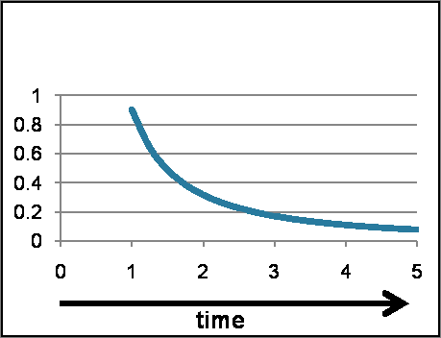
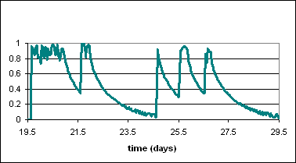
Recency
The recency function Rec : 2^{T} x T → [0,1] assigns a weight to an edge e at time t based on the age of the renewal process (time since the last event), decreasing from age = 0 to x_{max}.
Given an IAT distribution, there is a unique such function that is uniform over [0,1] when sampled uniformly in time.
This property eliminates time scale bias.
Bounded Pareto Distribution
Recency of Edge <3,22> in Bluetooth Dataset
x_{min}
x_{max}

Slide 15
Divergence
Consider the weighted graph G = (V,E) representing a communication network, with w(e) = Rec(e).
For , let = # of edges in E’ with Rec(e) ≥ θ. We define , where .
Question: How do we know what’s the right threshold?
θ = 0.7
|E’| = 6
0.7
0.4
0.9
0.5
0.3
0.5
X_{E’,0.7} = 4
0.8
0.1
0.6
0.3
0.2
P(X ≥ 4) = 0.07
0.7
0.9
0.7
0.8
Div_{0.7}(E’) = 14.19
E’

Slide 16
Max-Divergence
Problem: No fixed threshold will catch all anomalies
|E’| = |E’’| = 10
w(E’) = {0.1, 0.15, 0.25, 0.3, 0.35, 0.5, 0.6, 0.9, 0.93, 0.95}
w(E’’) = {0.05, 0.1, 0.3, 0.4, 0.45, 0.76, 0.78, 0.8, 0.85, 0.93}
θ | E[X] | X_{E’, θ} | Div_{θ} (E’) | X_{E’’, θ} | Div_{θ} (E’’)
0.9 | 1 | 3 | 14.247 | 1 | 1.535
0.75 | 2.5 | 3 | 2.108 | 5 | 12.800
0.5 | 5 | 5 | 1.605 | 5 | 1.605
Solution:

Slide 17
Maximal Components
A (maximal) θ-component of G = (V,E) is a connected subgraph C = (V’,E’) such that
w(e) ≥ θ for all e in E’
w(e) < θ for all e not in E’ incident to V’
0.7
0.4
0.9
θ = 0.7
0.5
0.3
0.5
0.8
0.1
0.6
0.3
0.2
0.7
0.9
0.7
0.8
The set of θ-components form a partition of V, for all θ in [0,1].

Slide 18
Outline
Introduction and Motivation
Model and Approach
The MCD Algorithm
Experimental Results
Conclusions and Future Work

Slide 19
The MCD Algorithm
Calculate edge weights using the Recency function
Gradually decrease the threshold, updating components and divergence values as necessary
Output: Disjoint components with max divergence
0.9
V₂
θ | Component | Div(C)
0.9 | {V₁,V₂} | 2.908
2.4
V₁
0.7
0.75
0.75 | {V₁,V₂,V₃} | 2.723
2.7
6.1
0.1
V₃
0.7 | {V₁,V₂,V₃} | 6.132
0.5 | {V₄,V₅} | 1.143
2.9
V₃
1.1
V₅
0.3
2.9
0.3 | {V₁,V₂,V₃,V₄,V₅} | 2.380
0.5
V₄
0.1 | {V₁,V₂,V₃,V₄,V₅} | 1.882
V₁
V₂
V₄
V₅

Slide 20
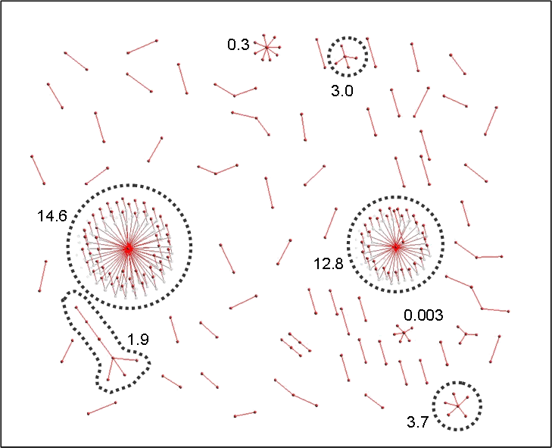
Sample Output
MCD | θ | #V(C) | E-frac | %E(C) | %E(G)
14.57 | 0.07 | 54 | 53/212 | 0.25 | 0.08
12.84 | 0.08 | 32 | 31/88 | 0.35 | 0.08
3.70 | 0.10 | 6 | 5/7 | 0.71 | 0.10
2.97 | 0.18 | 5 | 4/4 | 1.00 | 0.14
1.91 | 0.05 | 7 | 6/41 | 0.15 | 0.04
Notes:
Data from LBNL IP traffic network at 11:58am on Dec. 15, 2004. (1722 live edges)

Slide 21
Outline
Introduction and Motivation
Model and Approach
The MCD Algorithm
Experimental Results
Conclusions and Future Work

Slide 22
Data
Dataset | # Nodes | # Edges | # Timestamps
ENRON – email network of Enron employees | 1141 | 2017 | 4847
BLUETOOTH – proximity of mobile devices | 101 | 2815 | 102563
LBNL – logs of IP traffic | 3317 | 9637 | 9258309
TWITTER – directed messages | 262932 | 307816 | 1134722

Slide 23
Validation of Results

Slide 24
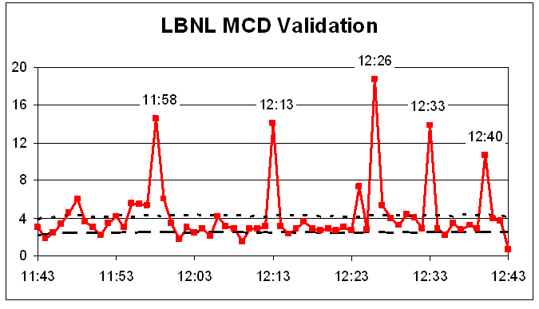
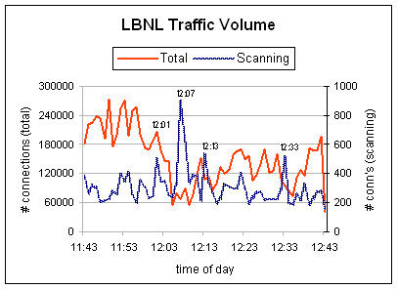
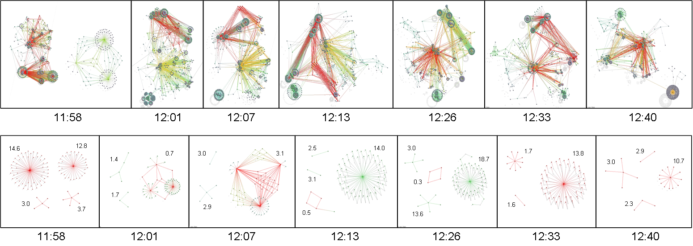
LBNL Case Study

Slide 25
Complexity Analysis
Dataset: Twitter messages, Nov. 2008 – Oct. 2009 (263k nodes, 308k edges, 1.1 million timestamps)
Updates O(1) per communication
MCD Algorithm O(m log m), where m = # of edges; can be approximated in O(m) time

Slide 26
Outline
Introduction and Motivation
Model and Approach
The MCD Algorithm
Experimental Results
Conclusions and Future Work

Slide 27
Conclusions
A novel approach for analyzing temporal and structural properties of communication networks
Effective as a stand-alone application, or as a tool to assist IT staff or security personnel
Flexible: parameter-free, applicable to a wide variety of real-world domains
Scalable: algorithms are streaming, and run in O(m) space and O(m) time in practice, where m is # of edges

Slide 28
Future Work
Incorporate duration of communication and other edge properties into our model
Extend our method to accommodate other data types, such as recommendation systems or hypergraphs
Develop techniques to take past correlation of edges into account (to avoid recurring “anomalies”)
Make it even more efficient – linear in number of nodes?

Slide 29
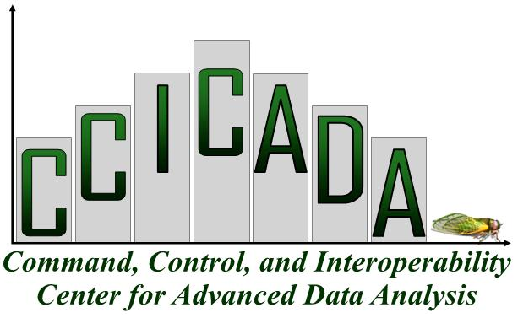

Acknowledgements
Part of this work was conducted at Lawrence Livermore National Laboratory, under the guidance of Tina Eliassi-Rad.
This project is partially supported by a DHS Career Development Grant, under the auspices of CCICADA, a DHS Center of Excellence.

Slide 30
Questions?

