Slide 1


Slide 2




Accelerating Spatially Varying Gaussian Filters
Jongmin Baek and David E. Jacobs
Stanford University
Notes:
Thank Vladlen for introduction.
Introduce the talk title.
Mention co-author.

Slide 3

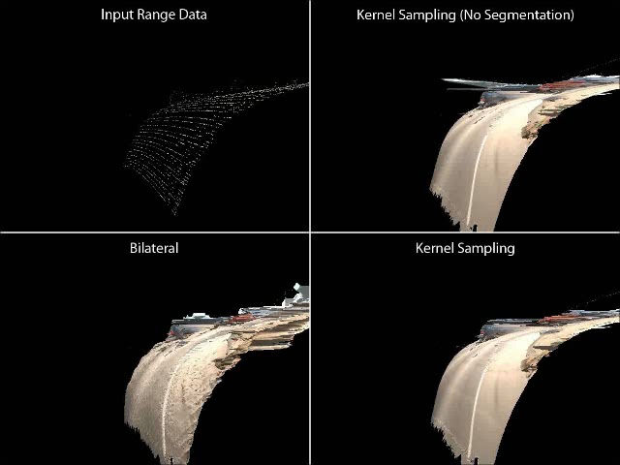
Motivation
Input
Spatially
Varying
Gaussian
Filter
Gaussian
Filter

Slide 4
Roadmap
Accelerating Spatially Varying Gaussian Filters
Accelerating Spatially Varying Gaussian Filters
Accelerating Spatially Varying Gaussian Filters
Applications
Notes:
Lay out the talk, explaining the four bullet points.

Slide 5
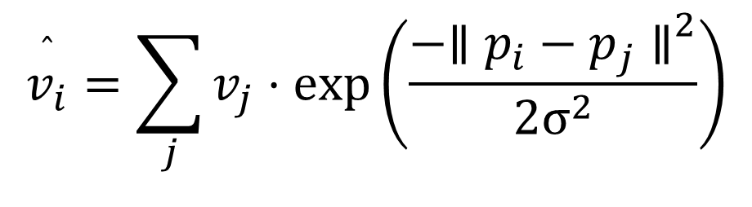

Gaussian Filters
Position
Value
Given $\left(pi,vi\right)$ pairs as input,
$$\overset{ˆ}{v_{i}}=\sum_{j}{v_{j}⋅exp\left.\left(\frac{−{\left.∥p_{i}−p_{j}∥\right.}^{2}}{2σ^{2}}\right)\right.}$$
Notes:
“Gaussian filters can be expressed by the following equation.”
Tell the audience that we will look in detail at what this equation does.

Slide 6
Gaussian Filters
Each output value …
$$\overset{ˆ}{v_{i}}=\sum_{j}{v_{j}⋅exp\left.\left(\frac{−{\left.∥p_{i}−p_{j}∥\right.}^{2}}{2σ^{2}}\right)\right.}$$
Notes:
“Gaussian filters can be expressed by the following equation.”
Tell the audience that we will look in detail at what this equation does.

Slide 7
Gaussian Filters
… is a weighted sum of input values …
$$\overset{ˆ}{v_{i}}=\sum_{j}{v_{j}⋅exp\left.\left(\frac{−{\left.∥p_{i}−p_{j}∥\right.}^{2}}{2σ^{2}}\right)\right.}$$
Notes:
“Gaussian filters can be expressed by the following equation.”
Tell the audience that we will look in detail at what this equation does.

Slide 8
Gaussian Filters
… whose weight is a Gaussian …
$$\overset{ˆ}{v_{i}}=\sum_{j}{v_{j}⋅exp\left.\left(\frac{−{\left.∥p_{i}−p_{j}∥\right.}^{2}}{2σ^{2}}\right)\right.}$$
Notes:
“Gaussian filters can be expressed by the following equation.”
Tell the audience that we will look in detail at what this equation does.

Slide 9
Gaussian Filters
… in the space of the associated positions.
$$\overset{ˆ}{v_{i}}=\sum_{j}{v_{j}⋅exp\left.\left(\frac{−{\left.∥p_{i}−p_{j}∥\right.}^{2}}{2σ^{2}}\right)\right.}$$
Notes:
“Gaussian filters can be expressed by the following equation.”
Tell the audience that we will look in detail at what this equation does.

Slide 10
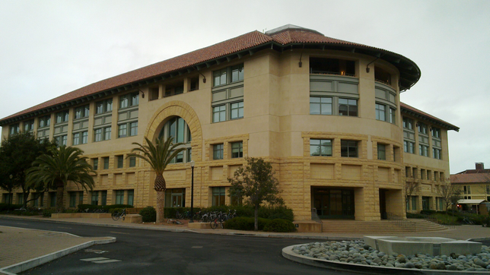
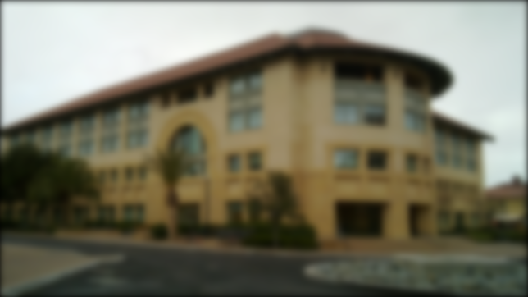
Gaussian Filters: Uses
Gaussian Blur
$$p i=\left(xi,yi\right), v i=(ri,gi,bi)$$
Notes:
This is the simplest example of Gaussian filter.

Slide 11
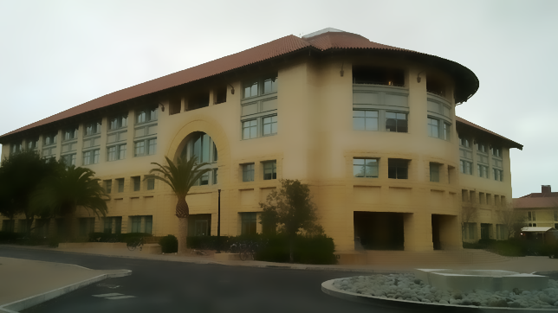
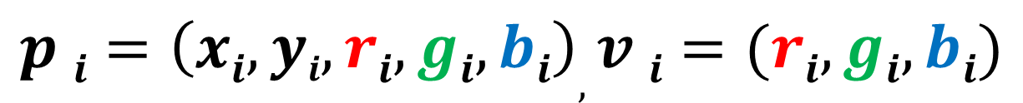
Gaussian Filters: Uses
Bilateral Filter
$$p i=\left(xi,yi,ri,gi,bi\right), v i=(ri,gi,bi)$$
Notes:
We can define the distance between pixels as not only their spatial distance, but also take into account their distance in the color space.
This gives the popular bilateral filter, which blurs the image while preserving strong edges.

Slide 12
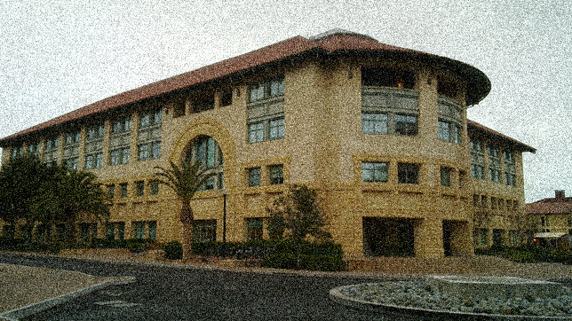
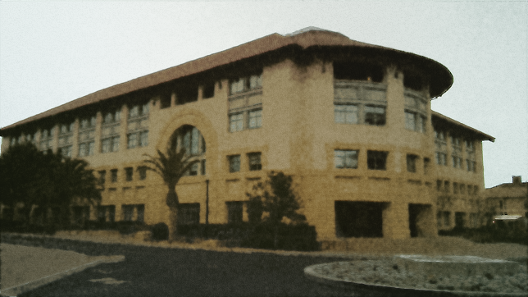
Gaussian Filters: Uses
Non-local Means Filter
$$p i=\left(xi,yi, \right) v i=(ri,gi,bi)$$
Notes:
We can also elect to mix pixels that have similar neighborhood patches, and this is known as a non-local means filter, which is great for denoising.

Slide 13
Gaussian Filters: Summary
Applications
Denoising images and meshes
Data fusion and upsampling
Abstraction / Stylization
Tone-mapping
...
Previous work on fast Gaussian Filters
Bilateral Grid (Chen, Paris, Durand; 2007)
Gaussian KD-Tree (Adams et al.; 2009)
Permutohedral Lattice (Adams, Baek, Davis; 2010)
Notes:
These instances of Gaussian filters have many applications, such as BLAH.
Hence, the fast evaluation of Gaussian filters has received much attention recently.

Slide 14
Gaussian Filters: Implementations
Summary of Previous Implementations:
A separable blur flanked by resampling operations.
Exploit the separability of the Gaussian kernel.
Notes:
BLAH

Slide 15
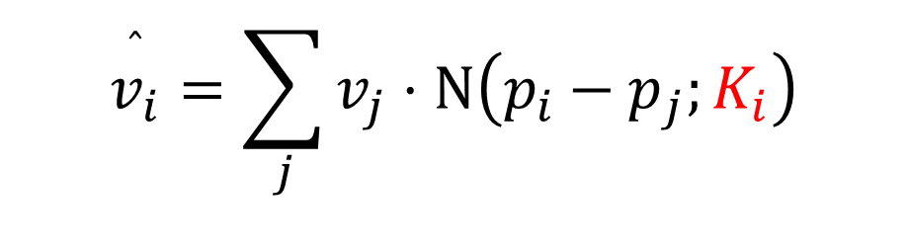
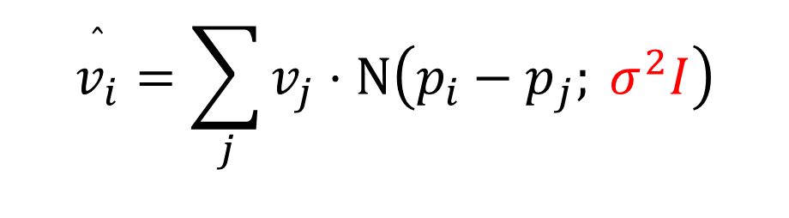
Spatially Varying Gaussian Filters
$$\overset{ˆ}{v_{i}}=\sum_{j}{v_{j}⋅N\left.\left(p_{i}−p_{j}; σ^{2}I\right)\right.}$$
Spatially Invariant
$$\overset{ˆ}{v_{i}}=\sum_{j}{v_{j}⋅N\left.\left(p_{i}−p_{j};K_{i}\right)\right.}$$
Spatially varying covariance matrix
Notes:
Note that the kernel is now position-dependent.

Slide 16
Spatial Variance in Previous Work
Trilateral Filter (Choudhury and Tumblin, 2003)
Tilt the kernel of a bilateral filter along the image gradient.
“Piecewise linear” instead of “Piecewise constant” model.
Notes:
Make sure to explain the axes. This is a 1D signal.

Slide 17
Spatially Varying Gaussian Filters: Tradeoff
Input
Bilateral-filtered
Trilateral-filtered
Benefits:
Can adapt the kernel spatially.
Better filtering performance.
Cost:
No longer separable.
No existing acceleration schemes.
Notes:
Can’t be expressed as a simple convolution as before, thus not separable.

Slide 18
Acceleration
Problem:
Spatially varying (thus non-separable) Gaussian filter
Existing Tool:
Fast algorithms for spatially invariant Gaussian filters
Solution:
Re-formulate the problem to fit the tool.
Need to obey the “piecewise-constant” assumption

Slide 19
Naïve Approach (Toy Example)
I LOST THE GAME
Input Signal
1
2
1
3
1
4
Desired Kernel
filtered w/ 1
1
1
1
filtered w/ 2
2
filtered w/ 3
3
filtered w/ 4
Output Signal
4

Slide 20
Challenge #1
In practice, the # of kernels can be very large.
Desired Kernel K(x)
Range of
Kernels needed
Pixel Location x
Notes:
Explain this figure!!!! (THE AXES)
Contrast with 4 kernels in the last example.

Slide 21
Solution #1
Sample a few kernels and interpolate.
Desired Kernel K(x)
K₁
Interpolate result!
Sampled
kernels
K₂
K₃
Pixel Location x

Slide 22
Assumptions
Interpolation needs an extra assumption to work:
The covariance matrix Ʃ_{i} is either piecewise-constant, or smoothly varying.
Kernel is spatially varying, but locally spatially invariant.

Slide 23
Challenge #2
Runtime scales with the # of sampled kernels.
Desired Kernel K(x)
K₁
Filter only some regions of the image with each kernel.
(“support”)
Sampled
kernels
K₂
K₃
Pixel Location x
Notes:
Note that now the region being filtered with each kernel is potentially unstructured (no longer a nice rectangular image.) This is no longer an issue because the most recent works in Gaussian filtering can handle sparse input data.
Two new questions arise:
(1) how to define the support for each kernel.
(2) how to calculate the support.

Slide 24
Defining the Support
In this example, x needs to be in the support of K₁ & K₂.
Desired Kernel K(x)
K₁
K₂
K₃
Pixel Location x
Notes:
Though, you could get boundary artifacts with this approach, because when you filter a segment, every pixel needs a large enough neighborhood.

Slide 25
Dilating the Support
Desired Kernel K(x)
K₁
K₂
K₃
Pixel Location x
Notes:
Thus we dilate the set to be filtered with each kernel. Morphological dilation is expensive, so we solve this by probabilistically sampling neighbors.

Slide 26
Algorithm
Identify kernels to sample.
For each kernel, compute the support needed.
Dilate each support.
Filter each dilated support with its kernel.
Interpolate from the filtered results.

Slide 27
Algorithm
Identify kernels to sample.
For each kernel, compute the support needed.
Dilate each support.
Filter each dilated support with its kernel.
Interpolate from the filtered results.
K₁
K₂
K₃

Slide 28
Algorithm
Identify kernels to sample.
For each kernel, compute the support needed.
Dilate each support.
Filter each dilated support with its kernel.
Interpolate from the filtered results.
K₁
K₂
K₃

Slide 29
Algorithm
Identify kernels to sample.
For each kernel, compute the support needed.
Dilate each support.
Filter each dilated support with its kernel.
Interpolate from the filtered results.
K₁
K₂
K₃

Slide 30
Algorithm
Identify kernels to sample.
For each kernel, compute the support needed.
Dilate each support.
Filter each dilated support with its kernel.
Interpolate from the filtered results.
K₁
K₂
K₃

Slide 31
Algorithm
Identify kernels to sample.
For each kernel, compute the support needed.
Dilate each support.
Filter each dilated support with its kernel.
Interpolate from the filtered results.
K₁
K₂
K₃

Slide 32
Applications
HDR Tone-mapping
Joint Range Data Upsampling

Slide 33
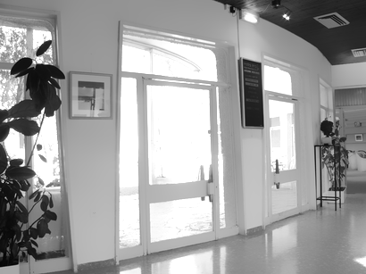

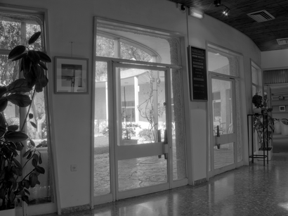
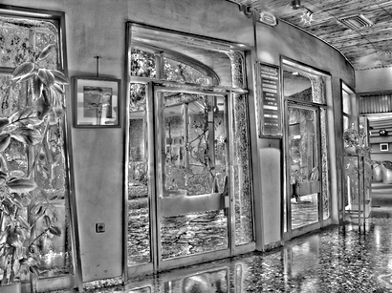
Application #1: HDR Tone-mapping
Base
Input HDR
Filter
Output
Attenuate
Detail
Notes:
In tone-mapping, the input is a high-dynamic-range image, such as this. There are portions of the images too bright and/or too dark for a target display.
One can tone-map this image with a bilateral filter as follows: filter the image to generate what’s called a base layer. The difference from the input is the detail layer.
Now, simply re-combine them with some weights to obtain the result.
EXPLAIN WHY THIS STANDS TO BENEFIT FROM KERNEL SAMPLING.

Slide 34
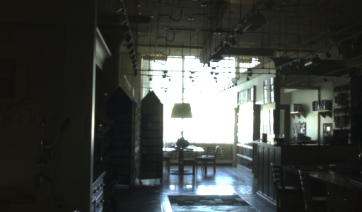
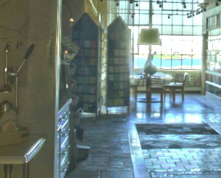
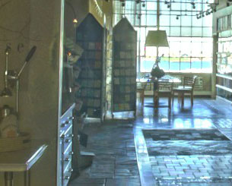
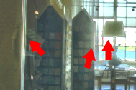
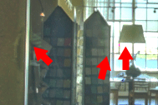
Tone-mapping Example
Bilateral Filter
Kernel Sampling
Notes:
Should say things like, false edges, blooming
Perhaps add that there is work in literature to address this problem as a post-processing, but simply by assuming a more general model, we can remove these artifacts.

Slide 35
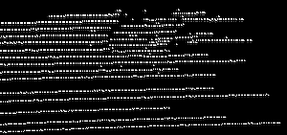
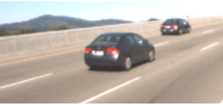
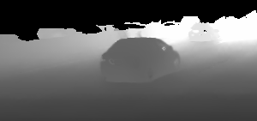
Application #2: Joint Range Data Upsampling
Range Finder Data
Scene Image
Filter
Sparse
Unstructured
Noisy
Output
Notes:
The input in this case is the depth data collected from a laser-scanning range finder. It is typically sparse, unstructured, and noisy
If we want dense depth map, that is, fill in all the missing depth values, we can do so by doing a Gaussian blur on the input.
Existing literature notes that if a scene image is available, you can try to mix depth values that have similar color values, since they are likely to belong to the same object. This yields a fairly reasonable dense depth map.
But the assumption that pixels of similar colors have similar depth is actually not quite right; rather, pixels of similar colors tend to belong to the same surface, which might not necessarily be flat. So, we are relaxing the assumption in existing literature on piecewise constant depth, to piecewise linear depth.

Slide 36
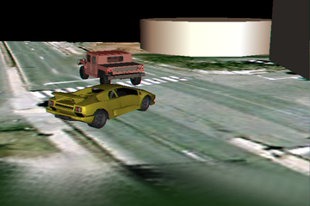
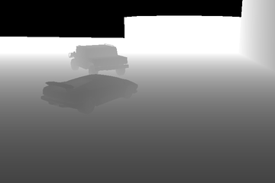
Synthetic Example
Scene Image
Ground Truth Depth

Slide 37
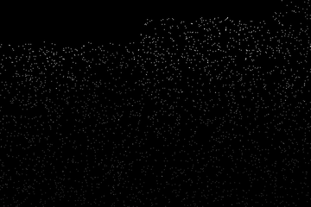
Synthetic Example
Scene Image
Simulated Sensor Data

Slide 38
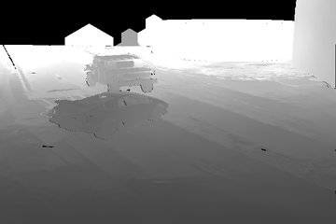
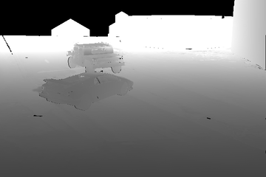
Synthetic Example : Result
Bilateral Filter
Kernel Sampling

Slide 39
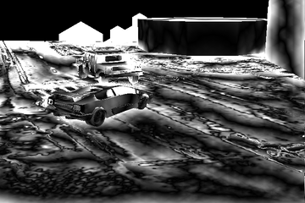
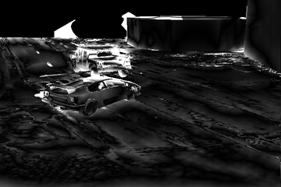
Synthetic Example : Relative Error
Bilateral Filter
Kernel Sampling
2.41% Mean Relative Error
0.95% Mean Relative Error

Slide 40
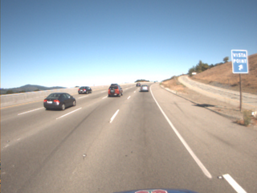
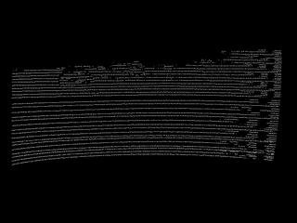
Real-World Example
Scene Image
Range Finder Data
*Dataset courtesy of Jennifer Dolson, Stanford University

Slide 41
Real-World Example: Result
Input
Naive
Bilateral
Kernel
Sampling

Slide 42
Performance
 | Kernel Sampling | Choudhury and Tumblin (2003) | Naïve
Tonemap1 | 5.10 s | 41.54 s | 312.70 s
Tonemap2 | 6.30 s | 88.08 s | 528.99 s
 | Kernel Sampling | Kernel Sampling (No segmentation)
Depth1 | 3.71 s | 57.90 s
Depth2 | 9.18 s | 131.68 s

Slide 43
Conclusion
A generalization of Gaussian filters
Spatially varying kernels
Lose the piecewise-constant assumption.
Acceleration via Kernel Sampling
Filter only necessary pixels (and their support) and interpolate.
Applications

