Slide 1





Retrieval of Reading Materials for Vocabulary and Reading Practice
Michael Heilman, Le Zhao, Juan Pino, Maxine Eskenazi
Language Technologies Institute
Carnegie Mellon University

Slide 2
The Goal
To help ESL teachers find reading materials for a particular curriculum or set of students.

Slide 3
Motivating Example
Situation: ESL teacher Greg wants to find texts that…
Are in grade 4-7 reading level range,
Use specific target vocabulary words from class,
Discuss a specific topic, international travel.
First Approach: Searching for “international travel” on a commercial search engine…

Slide 4
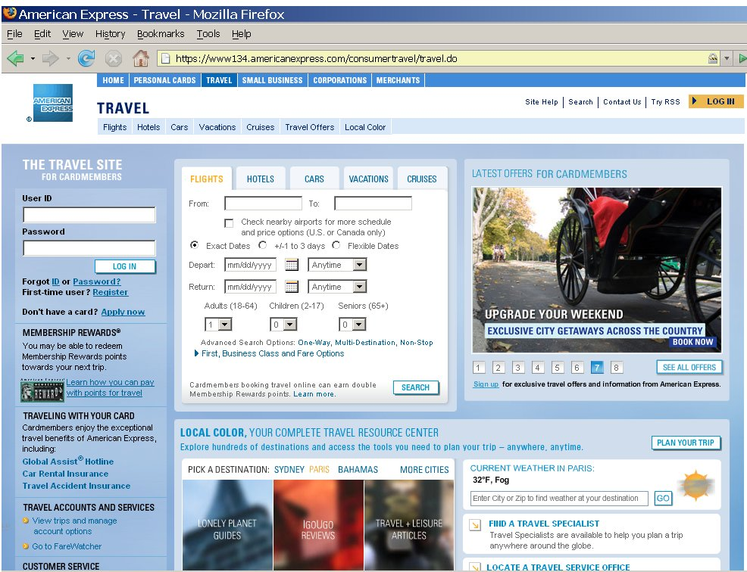
Commercial Search Engine Result

Slide 5
The Problem
Commercial search engines are not set up with the needs of language teachers in mind.

Slide 6
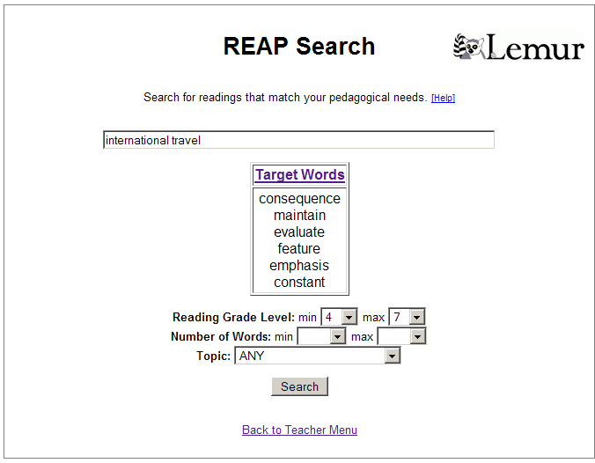
Familiar query box for specifying keywords.
Option to set target vocabulary words.
Extra options for specifying pedagogical constraints.
User clicks Search, then selects a document from a list of results with titles and snippets…

Slide 7
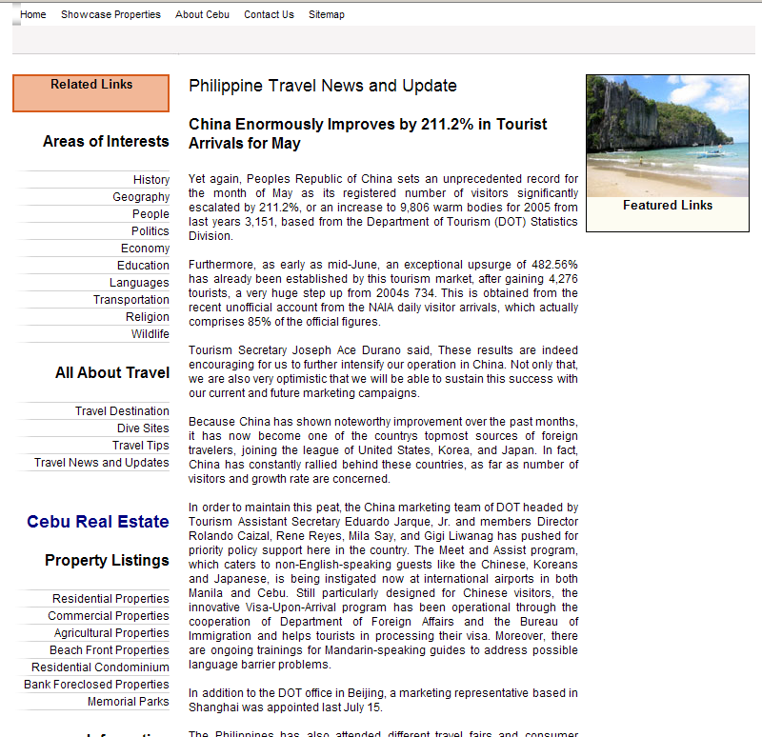

Slide 8
Map
Motivating Example
Creating a Digital Library
Retrieving Texts from the Library
Learner and Teacher Support
REAP Tutor and Related Work
Pilot Study
Concluding Remarks

Slide 9
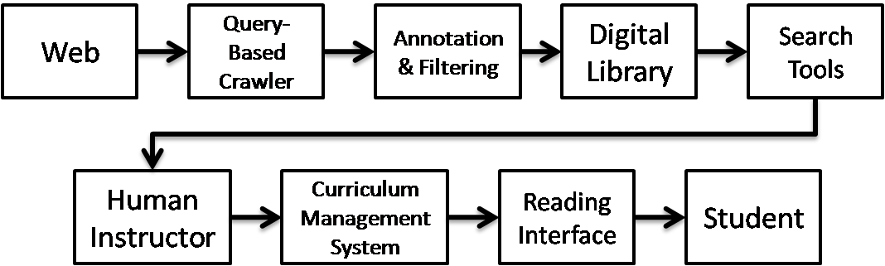
Path of a Reading
REAP Search is a system for helping teachers find reading material from the Web.
Readings follow a path from the Web to the student:
Notes:
In the REAP Search system, reading materials take a path from the Web to students through various intermediate steps as depicted in Figure 1. First, a crawling program issues queries to large-scale commercial search engines to retrieve candidate documents. These documents are annotated, filtered, and stored in a digital library, or corpus. This digital library creation process is done offline. A customized search interface facilitates the retrieval of useful reading materials by teachers, who have particular curricular goals and constraints as part of their information needs. The teachers organize their selected readings through a curriculum manager. The reading interface for students accesses the curriculum manager’s database and provides the texts along with support in the form of dictionary definitions and practice exercises.

Slide 10

Creating a Digital Library
To support the search interface, we create an annotated database of texts.
Annotators
& Filters
The Web
Local Storage
Full-Text Index
Queries with word subsets
(e.g., “create AND distribute AND specific”)
Query Generator
List of possible target words
(e.g., Academic Word List)
Notes:
-Need an annotated database of potential readings, or “library”

Slide 11
Annotations and Filters
Basic Annotations and Filters
Text length, profanity, number of target words, …
Reading Level
Assigns grade level labels from 1-12.
Currently uses a text classification approach based on lexical unigram features.
General Topic Areas
16 categories (Business, Sports, Music, Health, …)
Uses maximum margin-based text classifier (SVMlight) with unigram features.
Training data from Open Directory Project (dmoz.org)

Slide 12
Text Quality Annotation
Goal: Filter out web pages that are just lists of links, product descriptions, navigation menus, etc.
Method: Estimate the percentage of word tokens that are contained in well-formed “content” sentences.

Slide 13
Text Quality Annotation
Parses web page into a Document Object Model tree structure.
Organizes word tokens into text units using markup tags.
Traverse DOM tree in depth first manner.
<p>, <td>, <div>, <span> indicate the start of a new text unit.
Tags the tokens in each text unit with parts of speech.
Labels units as well-formed content units if they contain both a noun and a verb.
Filters out texts with less than 85% of tokens in well-formed units.

Slide 14
Text Quality Annotation
Alternative Approach: use confidence scores from a parser to measure grammaticality.
Slightly better at filtering out low-quality texts.
Considerably slower than POS-tagging approach.

Slide 15
Map
Motivating Example
Creating a Digital Library
Retrieving Texts from the Library
Learner and Teacher Support
REAP Tutor and Related Work
Pilot Study
Concluding Remarks

Slide 16
Boolean vs. Ranked Retrieval
Commercial search engines use boolean retrieval models
The approach is extremely fast but also strict. All terms must appear in the text or inlinks.
Top results are typically texts containing all query terms.
Queries with 10+ target vocabulary words often return:
Long lists of vocabulary words,
Glossaries,
Dictionary entries.

Slide 17
Boolean vs. Ranked Retrieval
Using a ranked retrieval model enables REAP Search to find texts that have some, but not necessarily all, target words.
e.g., a teacher might find texts with 5 out of the 20 target words discussed in class during a particular week.
Structured queries allow REAP to assign different priorities to:
target vocabulary words (e.g., contact, affect, theory)
other query terms (e.g., climate change)

Slide 18
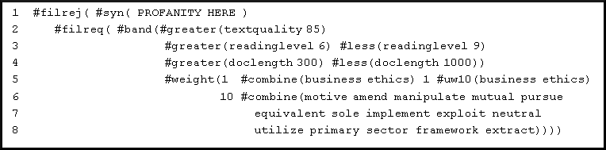
Example Structured Query
From input to search interface, REAP generates a structured query specified according to Indri’s query grammar.
Builds up a complex query from simpler elements.
Pedagogical constraints
Query terms
Target words

Slide 19
Map
Motivating Example
Creating a Digital Library
Retrieving Texts from the Library
Learner and Teacher Support
REAP Tutor and Related Work
Pilot Study
Concluding Remarks

Slide 20
Teacher Support
Web-based interfaces
easily accessible
portable.
Search interface
Management interface
order the presentation of texts,
choose target words to be highlighted,
specify time limits,
add practice questions or exercises.

Slide 21
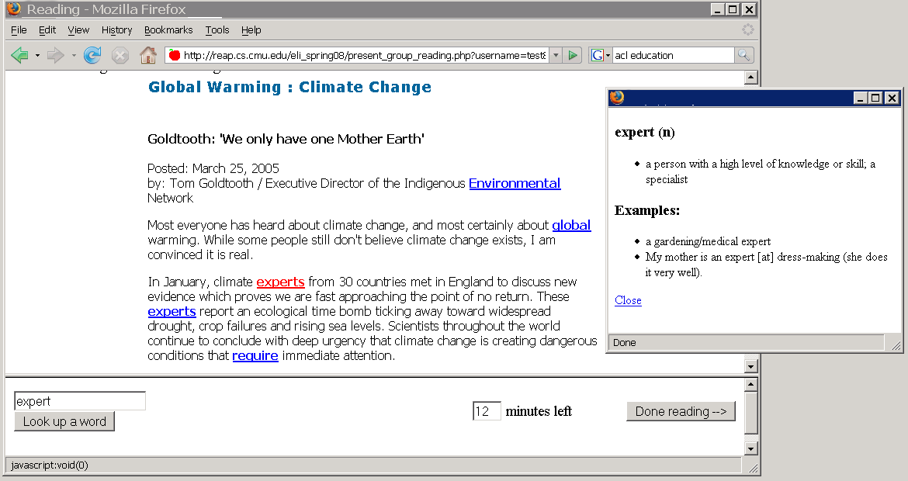
Learner Support: Reading Interface
Students click on target words for definitions
Target words specified by the teacher are highlighted.
Optional timer helps with classroom management.
Definitions available for non-target words as well.

Slide 22
Map
Motivating Example
Creating a Digital Library
Retrieving Texts from the Library
Learner and Teacher Support
REAP Tutor and Related Work
Pilot Study
Concluding Remarks

Slide 23
Comparison to REAP Tutor
 | REAP Search | REAP Tutor
Uses digital library of annotated texts from web | Yes | Yes
Texts contain target vocabulary. | Yes | Yes
Selection of Readings | Teacher selects the same text(s) for the whole class. | Computer selects different texts for each student based on individual needs.
Individualized readings for each student. | No | Yes
Blended with group instruction. | Yes | No

Slide 24
Related Work
Project/System | Reference | Description
WERTi | Amaral, Metcalf, & Meurers, 2006 | An intelligent automatic workbook that uses Web texts to increase knowledge of English grammatical forms and functions.
SourceFinder | Sheehan, Kostin, & Futagi, 2007 | An authoring tool for finding suitable texts for standardized test items on verbal reasoning and reading comprehension.
READ-X | Miltsakaki & Troutt, 2007 | A tool for finding texts at specified reading levels.

Slide 25
Map
Motivating Example
Creating a Digital Library
Retrieving Texts from the Library
Learner and Teacher Support
REAP Tutor and Related Work
Pilot Study
Concluding Remarks

Slide 26
Pilot Study
Who?
Two instructors and 50+ students
What?
Individual practice using teacher-selected texts followed by variety of group instruction, discussion, and activities.
Where?
Pittsburgh Science of Learning Center’s English LearnLab
at the University of Pittsburgh’s English Language Institute
Why?
To study use of this educational technology in a realistic environment.
When?
Spring 2008 semester
Eight weeks, one 50-minute session per week

Slide 27
Query Log Analysis
Analyzed 4 weeks of query logs.
REAP has since expanded its digital library to make finding texts easier.
47
unique queries
=
queries per selected text
2.04
23
selected texts used in courses
Library for Pilot Study: | 3,000,000 texts
Current Library: | 8,000,000 texts
Notes:
Ideally we would like to have one query or less per selected text…

Slide 28
Teachers’ Approaches to Finding Texts
Target Words
To find texts using vocabulary words in their curriculum.
20 target words specified on average.
ad hoc queries
To find texts on topics that match up with their curriculum.
e.g., “surviving winter,” “miner’s safety,” “gender roles,” “unidentified flying objects”
Both of the above
Sometimes this placed too many constraints on the search.

Slide 29
Learning Outcomes
End-of-semester post-test
Assessed target vocabulary word knowledge.
15 multiple-choice cloze (fill-in-blank) items.
Compared to similar post-test in study with REAP Tutor in Fall 2006.
Tutor provided computer-selected texts based on individual needs.
Tutor was not blended into the course curriculum.
This is not a true experimental study.
The results demonstrate the success of using REAP Search in a blended curriculum.

Slide 30
Conclusions
REAP Search
has been used in two courses by over fifty ESL students.
is an educational application utilizing various language technologies ranging from text retrieval to POS tagging.
enables teachers to find appropriate, authentic texts from the Web for vocabulary and reading practice.

Slide 31
Visit http://reap.cs.cmu.edu for more information or to request access.

Slide 32
Open Issues
Can language learners effectively and efficiently use such a system to search for reading materials directly, rather than reading what a teacher selects?
Students could use the system, but a more polished user interface and further progress on filtering out readings of low text quality is necessary.
Is such an approach adaptable to other languages, especially less commonly taught languages for which there are fewer available Web pages?
Certainly there are sufficient resources available on the Web in commonly taught languages such as French or Japanese, but extending to other languages with fewer resources might be significantly more challenging.
How effective would such a tool be in a first language classroom?
Such an approach should be suitable for use in first language classrooms, especially by teachers who need to find supplemental materials for struggling readers.
Are there enough high-quality, low-reading level texts for very young readers?
From observations made while developing REAP, the proportion of Web pages below fourth grade reading level is small. Finding appropriate materials for beginning readers is a challenge that the REAP developers are actively addressing.

Slide 33
Approaches to Finding Texts
 | Cost | Effort | Quantity | Quality
Existing Textbooks | High | Low | Medium | High
Manually Authored or Edited Texts | Low | High | Low | High
Texts Gathered from the Web | Low | ??? | High | ???

Slide 34
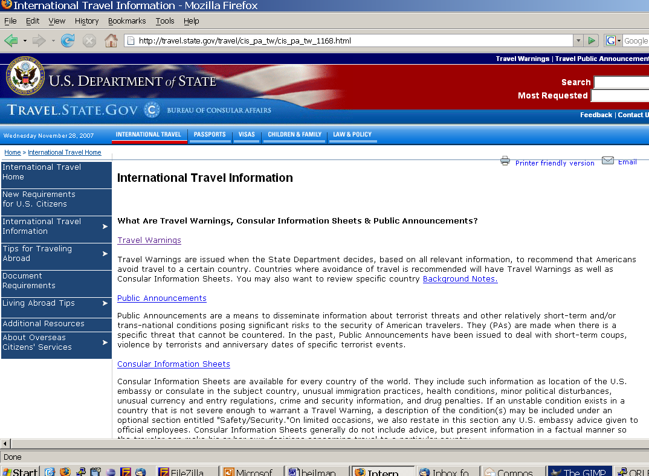
Commercial Search Engine Result

Slide 35
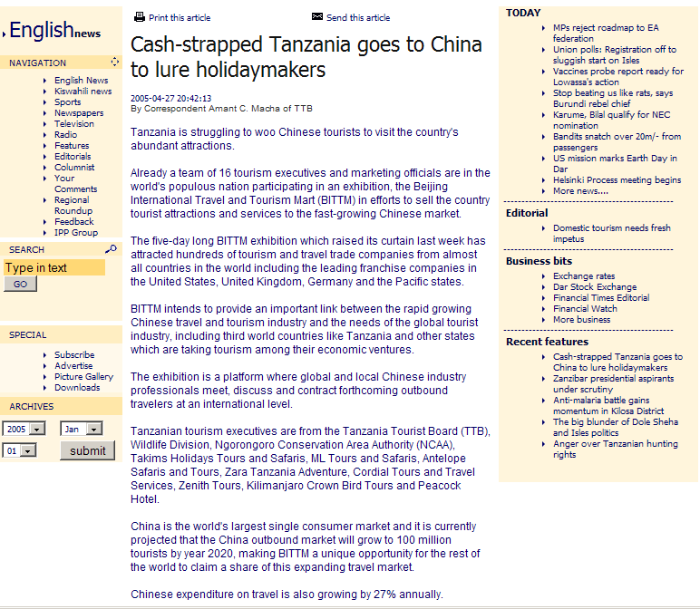
REAP Search Example

