Slide 1
MRI Safety, Policies and Procedures
SUNY Stony Brook
Social Cognitive, and Affective Neuroscience (SCAN) Center
Updated: September 2011

Slide 2
Outline of Presentation
Understanding MRI
Magnets and Magnetic Fields
The 3 Tesla Magnet
MR Safety
Screening Patients / Colleagues
Emergency Buttons
The difference between the E-stop and Quench Buttons

Slide 3
The Magnet is ALWAYS ON
24 hrs/day
365 days/year
The magnetic field is on even when the magnet is NOT in use.
Even if the electrical portion of the machine is off, the magnetic field is still up
Anyone using the magnet must be trained in MRI safety and approved by the SCAN center.
The MRI technologist has final say in who may be allowed to go into the operation and/or scanner room.

Slide 4
Magnetism
All substances have some form of magnetism.
The degree of magnetism exhibited depends on the atoms that form the material.
Magnetic susceptibility: the ability of a substance to become magnetized.
Ferromagnetic substances have large magnetic susceptibility (i.e. iron). These substances can be easily magnetized and will become a magnet itself.
All magnets have a North and a South pole.
All magnets have a “fringe” field which extends to the surrounding area.

Slide 5
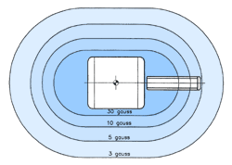
Magnetic Fringe Fields
The fringe field is the magnetic field which exists in the area around the magnet.
This field can extend many feet from the inner bore of the magnet.
These imaginary lines of force demonstrate the pattern of the magnetic field.
Safety and operational concerns make it necessary to contain the fringe field to a small area.
Rooms are shielded to contain the field as much as possible
Magnetic fields are measured in units of Gauss or Tesla.
(1T = 10,000G)

Slide 6
Characteristics of the Magnetic Field
The force of the field is measured in Tesla (T). Our scanner is measured at 3.0Tesla (T)
The force of the field is greatest at the center of the magnet.
The magnetic FORCE INCREASES as you move closer to the center of the magnet.
What is not attracted to the magnet outside the fringe field can be attracted to the magnet as you move closer to the center of the machine

Slide 7
3Tesla Magnets
The main magnetic field of a 3T system is 60,000 times the earth's magnet field.
It is double the strength of a 1.5T operating system.
It is important to remember that objects that are clear for a 1.5T magnet cannot go into a 3T magnet unless it has been cleared for a 3T machine.
Mrisafety.com has the largest database of items that are cleared for the 3T environment
The acoustic noise in a 3T system approaches twice that of the 1.5T system as well. It can reach excess of 130 dBA, ear protection and headset must be used.

Slide 8
Bioeffects
There is no conclusive evidence of permanent or harmful bioeffects in humans below 3.0T. Most accidents happen because of user error!
Reversible abnormalities include (but are not limited to):
Localized tissue and core body temperature heating
Tingling sensations
Peripheral nerve stimulation (involuntary muscle contractions)
Burns

Slide 9
Bioeffects
Burn Hazards are caused by damaged hardware or by electrical currents produced in conductive loops of material.
It is important to not let the patient cross their legs or intertwine their fingers during the exam because it creates a closed circuit and can increase the heating in the subject
Localized heating is caused by RF energy absorption to a volume of tissue. FDA limits the amount of absorption we can give to the subject.

Slide 10
Specific Absorption Rate
The rate the subject absorbs the RF energy is described in terms of Specific Absorption Rate (SAR), measured in watts/kg.
SAR is calculated by the patient’s weight, height and the expected increase in body temperature for each imaging pulse sequence.
The scanner will calculate how much heat will be absorbed by the patient per scan. If the SAR for the scan is too high the scanner will not let you run your scan.

Slide 11
Forces in the MR Environment
There are two types of effects the magnet will have on Ferromagnetic substances
Translation: The “Missile Effect”
Rotation/Torque: The “Rotational Effect”

Slide 12
Translational Force: The Missile Effect
Also referred to as the “Projectile Effect” and is used to describe the attraction of the object to the center of the magnetic field
This transforms objects into projectiles as they accelerate toward the magnet
These items can become airborne, accelerating at speeds of up to 40 miles per hour.
This effect has repeatedly resulted in accidents jeopardizing the safety of patients and staff, as well as the MRI equipment itself.

Slide 13
Rotational/Torque Force: Rotational Effect
This force relates to the North and South pole orientation of the scanner’s magnetic field
Ferrous objects will attempt to align their long axes with this orientation
This force will rotate objects until they are aligned with the magnetic field.
Translational and Rotational Force happen at the same time making objects projectiles and dangerous!

Slide 14
MRI Safety - Projectiles
Projectile effects of metal objects seriously compromise safety.
This potential harm cannot be over emphasized.
For example, paper clips can travel at a velocity of 40mph @ 3T.
Larger objects travel at a higher velocity and may be fatal.
*If you question the ferromagnetic qualities of your equipment please ask the MRI technologist *

Slide 15
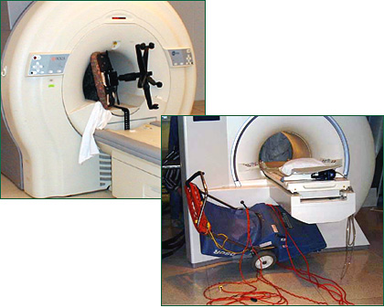
Metal Objects Becoming Projectiles

Slide 16
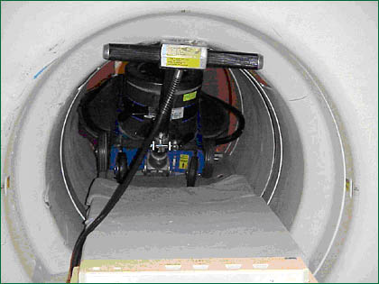
Metal Objects Becoming Projectiles

Slide 17
Accidents CAN Happen!
In 2003, a New Mexico woman sued claiming the magnetic pull of an MRI scanner caused an oxygen tank to hit her in the back.
In 2001, a 6 year old boy, was killed while undergoing an MRI when an oxygen tank flew out of the hands of an anesthesiologist toward the machine, hitting him in the head.
In 1992, a woman hemorrhaged and died after an aneurysm clip in her brain shifted while she was on a table preparing for an MRI procedure.

Slide 18
Who should know MR Safety?
All persons that have reason to enter the MR suite area should be trained in MR safety procedures. These include but are not limited to:
MR technologists, researchers, research assistants
Research volunteers and test subjects
Maintenance and janitorial personnel
Public safety forces (i.e. law and fire personnel) that would respond to the MR suite for an emergency must also know the potential hazards of the MR equipment.

Slide 19
Common examples of items that can become projectiles:
MR technologists, students, researchers & other medical personnel | Maintenance & Janitorial personnel
Scissors | Dustpans
Hairclips and bobby pins | Mops and buckets
Tools (for projector, button boxes) | Buffers
Paperclips and staples | Vacuum Cleaners
Clipboards and pens | Tools and tool kits

Slide 20
What to in case of a medical emergency
Should a condition exist where the patient is having a medical emergency, every effort should be made to remove the patient from the scan room.
Once the patient is removed from the MR scan room, close the door to prevent re-entry.
If you cannot remove the patient remember the magnet is always on. Under no circumstances should anyone be allowed to enter the scan room without proper screening!

Slide 21
Examples of items public safety forces have that can become projectiles
Law enforcement personnel | Fire Department personnel
Guns | Axes
Knives | Hose couplings
Handcuffs | Nozzles
Clipboards | Pike poles
Flashlights | Fire extinguishers
 | Oxygen tanks

Slide 22
Items that can be damaged by the magnet
The magnetic field can seriously damage or impair the following personal items:
Cameras
Watches
Credit /Bank cards
Hearing Aids
Hair Accessories, Belt Buckles, Shoes
I-pods
Please remember to empty ALL pockets before entering the scanning room.

Slide 23
What can you take into a magnetic field?
Only items that are MRI compatible
Examples of non-ferrous metals are:
Brass
Aluminum
Plastic
If you have any questions we can check an object with a hand held magnet
If item is implanted in body must have information card on implant. Check www.mrisafety.com.
If you are not sure if an object is MRI compatible…Do NOT take it into the room.

Slide 24
Noise
The MR scanner can produce very high acoustic noise levels.
Some patients may experience discomfort from the associated noise of the scanner.
Prior to scanning ear plugs and a head set is provided to the patient to reduce the noise level.

Slide 25
MRI Safety
The greatest risk of injury and damage to the system results from:
Mistreatment or abuse of the MR equipment.
Failure to comply with our safety procedures.
Lack of proper inspection and maintenance of the MR equipment.

Slide 26
The Screening Process - Researcher
Every person that enters the MRI room must be screened for possible contraindications that could affect their health and safety.
As a PI or research assistant you will need to initially be screened as well. If there is ever any changes in your health please let the MRI technologist know.
Before you may enter the room please fill out a Researcher Clearance Form that can be found on our web site or as the MRI technologist for one.

Slide 27
The Screening Process – Research Volunteer
Every research subject must also fill out a clearance form to make sure they are able to enter the magnetic field.
This can also be found on our web site or at the center
The SCAN Center staff has final say over who may or may not be scanned.

Slide 28
Absolute Contraindications
If you or your volunteer has any of these items, they can NOT be allowed into the scanning room
Cardiac Pacemakers
Cochlear (inner ear) implants
Ferromagnetic or unidentifiable aneurysm clips of the brain
Implanted neuro stimulators
Metal or unidentifiable foreign bodies in the eyes
Implanted pumps to deliver medicine that cannot be removed
Full mouth braces or retainers that cannot be removed

Slide 29
Tattoos
There have been some documented cases of unusual sensation or tingling from a tattoo site during the procedure to receiving burns or raised skin at the site.
The likely hood of this happening is very low but all subjects should be aware of the issue before agreeing to take part in a study.
Once at the center any subject with a tattoo will be informed again of the risks of tattoos in the MRI environment. At this time they will have a chance to cancel the exam.
If the subject complains of any unusual sensation during the exam the study will be immediately stopped.
If the area becomes red or irritated a hand cold compresses will be applied (these can be found in the bathroom storage container at the center)

Slide 30
Pregnancy and MRI
Female research subjects must be 100% possible there is not chance of pregnancy if they are to be scanned.
If a research subject is pregnant the exam must be canceled regardless of trimester.

Slide 31
Controlled Access Area
Although not noticeable a magnetic field is always on and can be dangerous to equipment and to people.
For your safety, controlled access areas have been established.
This area is clearly labeled with the use of warning signs and markings.
Public access begins at the 5 gauss line (0.5mT).

Slide 32
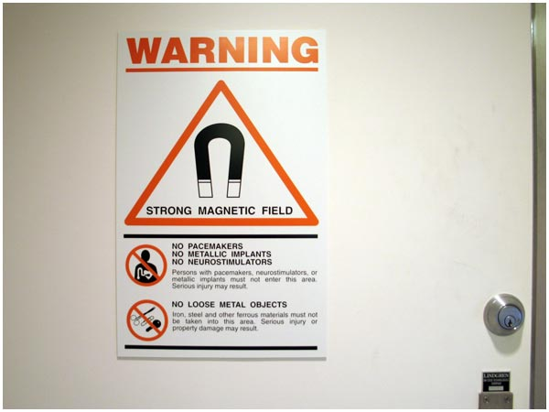
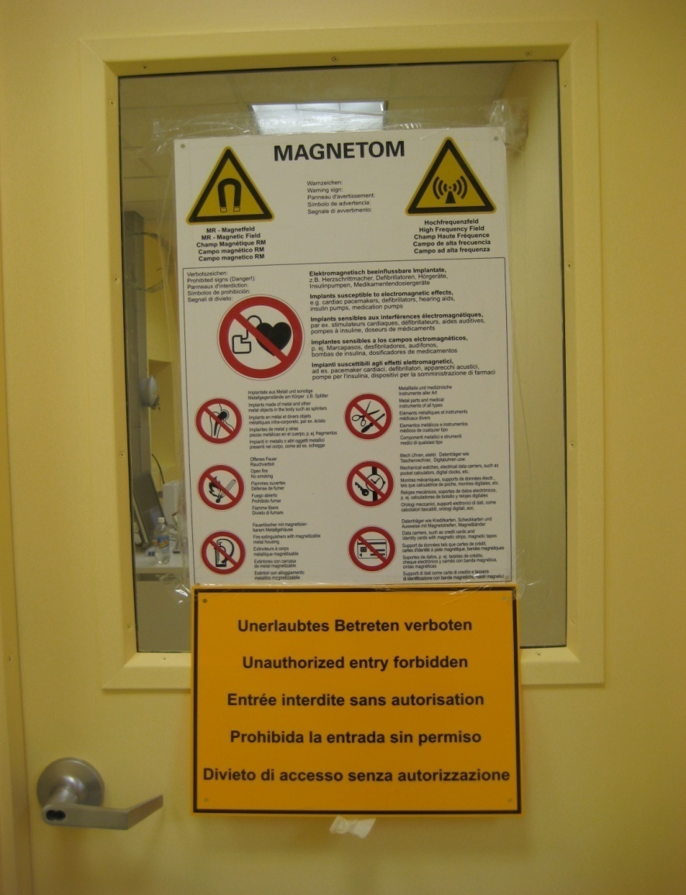
Controlled Access Area Signs

Slide 33
Operating Safely
When operating the MR equipment, be attentive to the following abnormal conditions:
Louder-than-normal motor noises
Sparks
Overheating
Smoke or odors coming from the electronic equipment or from within the scan room.

Slide 34
Magnetic Field / Scan Room Emergencies
If an emergency situation arises, you may need to quickly shut down the operating systems and remove power from the MR system.
The nature of the emergency will dictate which procedure you follow.
Each procedure has a distinct and specific purpose.

Slide 35
Magnetic Field / Scan Room Emergencies
Each magnet is equipped with two emergency buttons:
Emergency Stop / Shut Off
Turns off all incoming electrical power. The scanner will turn off as well as the operating computer.
The magnetic field however will still be on.
Quench or Emergency Run Down
Causes immediate collapse of the superconductive magnetic field within minutes. The magnetic field will dissipate.
FAMILIARIZE YOURSELF WITH THESE BUTTONS AND KNOW THE DIFFERENCE!

Slide 36
Emergency Stop / Shut Off Button
Shutting power may be required for situations such as:
Fire in the computer room
Fire, sparks, loud noises emanating from the scan room
Flooding or sprinkling system goes off
Catastrophic equipment failure
Keep in mind that when this button is pushed, it does not initiate a quench, the magnetic field remains on. Exercise caution to make sure that all ferromagnetic materials remain outside of the scan room, they can still become projectiles.

Slide 37
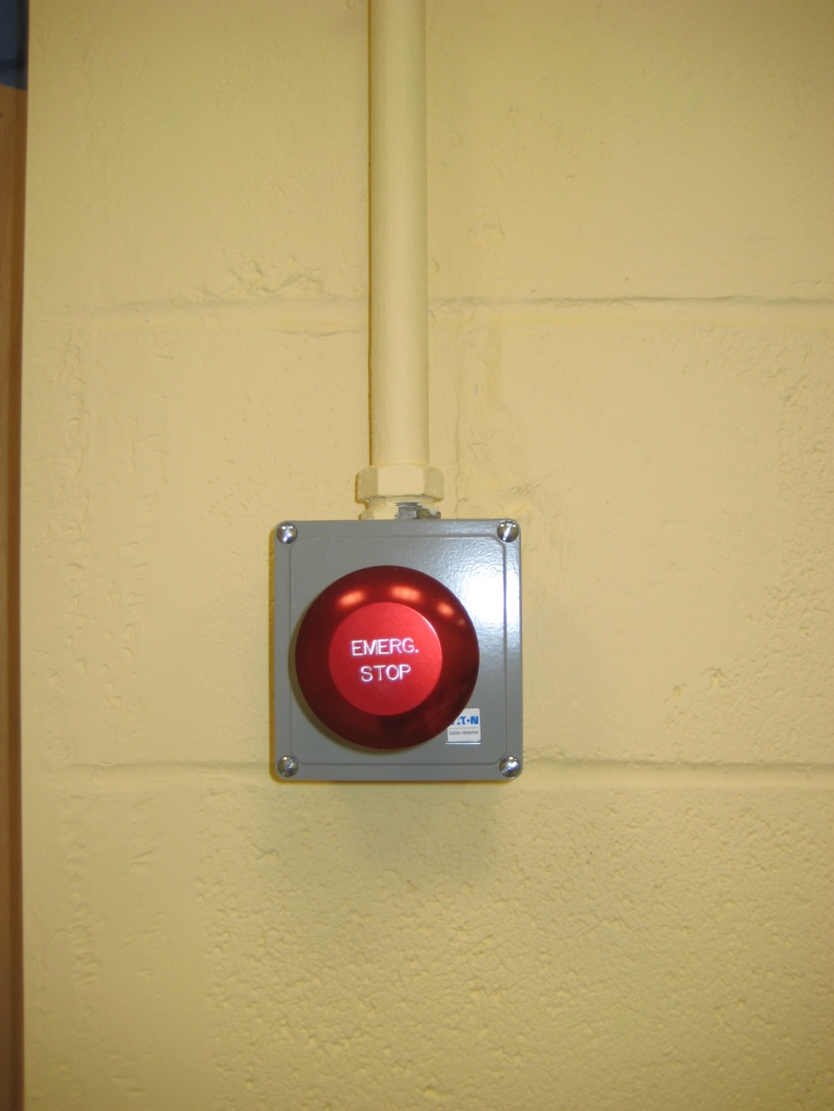
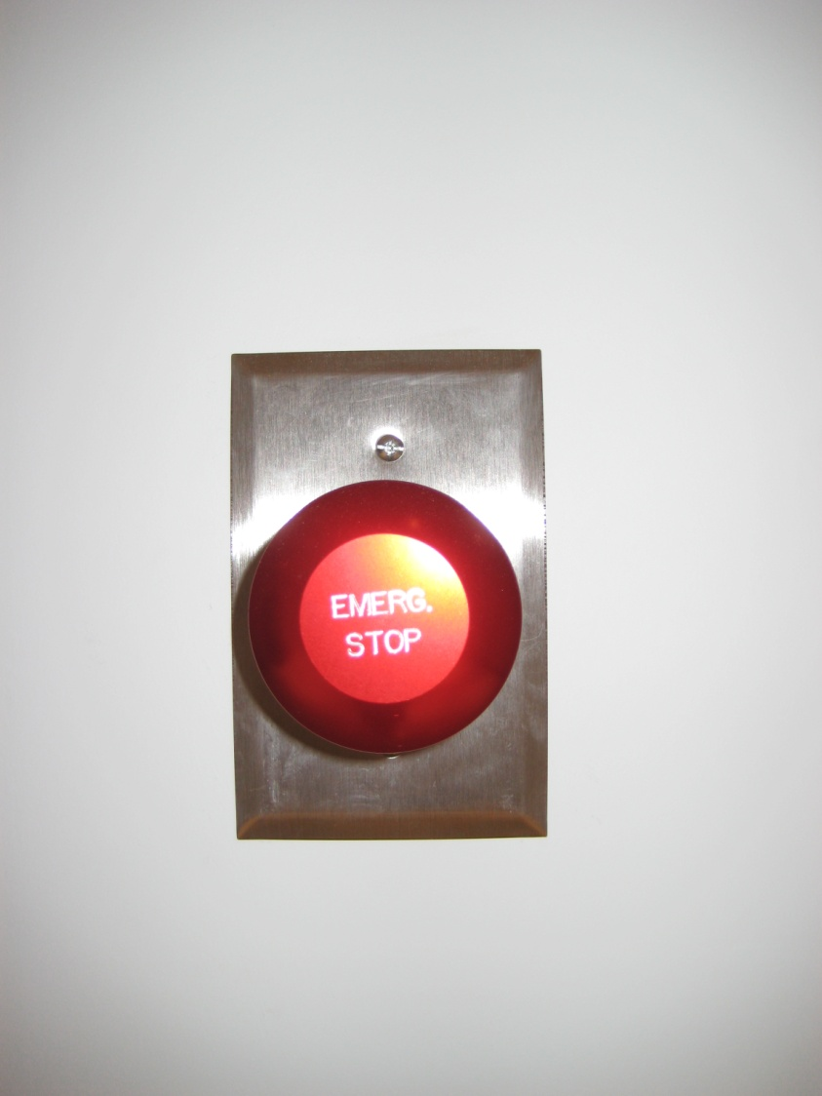
Emergency Buttons @ the SCAN center: The E-Stop Button
Located in the operations room
Located in the scanning room

Slide 38
Quench / Emergency Run Down Button
MR scanners are super cooled with gases such as helium.
If these cryogens boil off either intentionally or unintentionally, a quench has occurred.
This is extremely bad.
An intentional quench is done in an emergency to run the magnetic field to zero. This is done in extreme situations only (ex- a projectile that is pinning a patient against the magnet, injuring them).
If a quench occurs, everyone must be removed from the room immediately. The vapors and gases are very cold and can cause frostbite. They also often condense the moisture in air, creating a highly visible fog that can replace oxygen in the room.

Slide 39
Quenching
A magnet quench will result in several days’ downtime and is extremely expensive.
Do not press the button except in a true emergency.
The quench button will have a protective covering over the button so it cannot be pressed inadvertently.
Do not attempt to test this button!

Slide 40
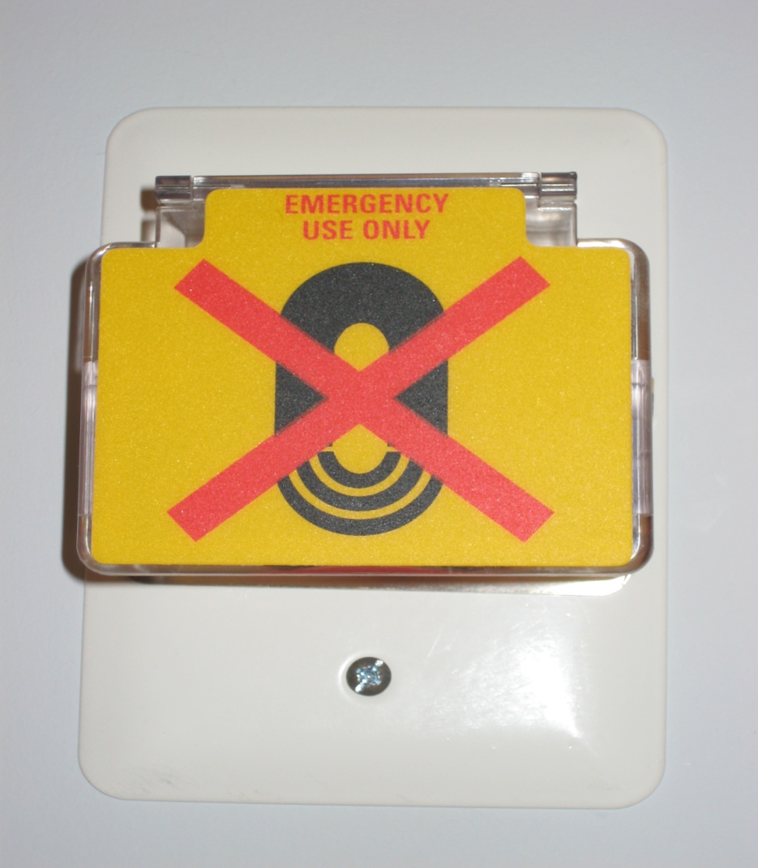
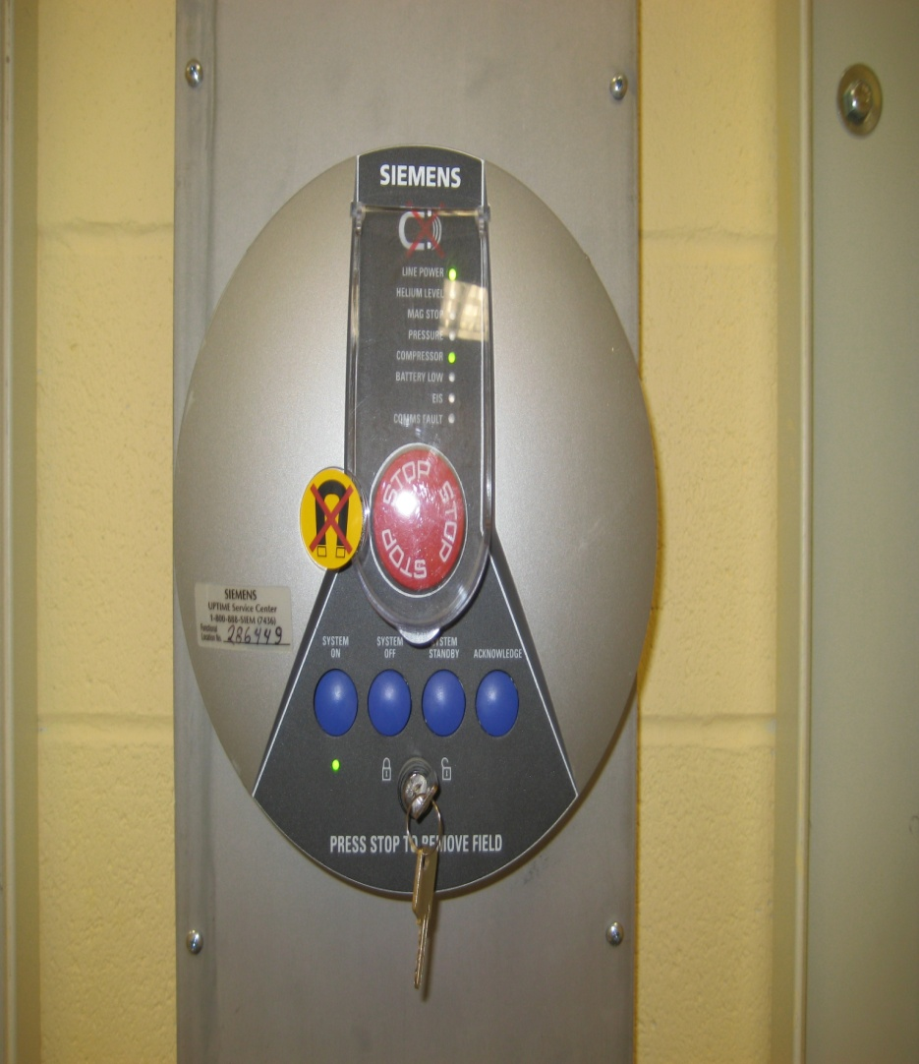
Emergency Buttons @ the SCAN center: The Quench Button

Slide 41
Summary
MRI scanners are powerful magnets with the ability to attract ferromagnetic objects.
Any personnel around the MRI suite must be adequately screened for metallic implants and personal items before entering the scan room.
Patients in the scanner must be carefully monitored for reversible bioeffects caused by the magnet’s hardware.
Become familiarized with Electronic Stop vs. Quench buttons at each scanner.

Slide 42
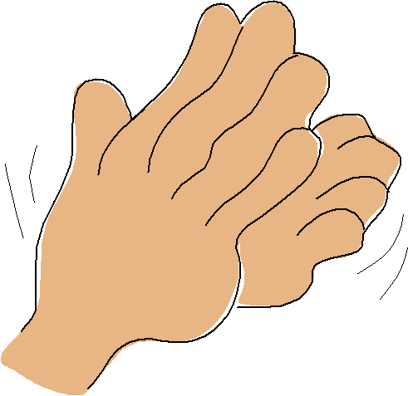
Congratulations!
You have completed the SCAN Center’s MRI Safety Training presentation!
Please take the Safety Quiz and return it to Kim at the center along with your clearance form.
Both the quiz and the form can be found on our website at http://www.psychology.sunysb.edu/scancenter/

