Slide 1


Reducing Peak Power with a Table-Driven Adaptive Processor Core
Vasileios Kontorinis (UCSD)
Amirali Shayan (UCSD)
Rakesh Kumar (UIUC)
Dean Tullsen (UCSD)
Notes:
(My name is Vasileios Kontorinis)
The peak power impacts key design parameters such as the efficiency and cost of power delivery,
voltage variation, on-chip decoupling capacitance. We will show how our architecture can reduce peak power by 25-30% while giving up little performance.
And doing so can decrease voltage variation by up to 35% or reduce the required decoupling capacitance by 5% in terms of core area.
This work was done in collaboration with Amirali Shayan from UCSD, Rakesh Kumar from UIUC and Dean Tullsen again from UCSD.

Slide 2

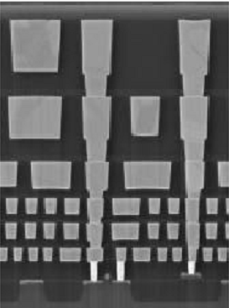
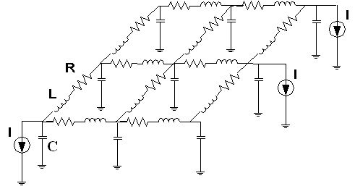
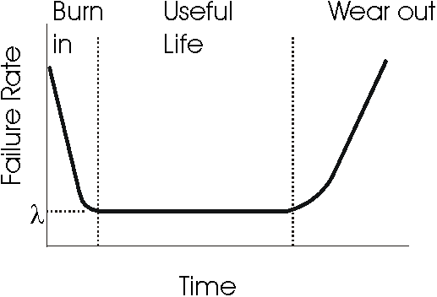
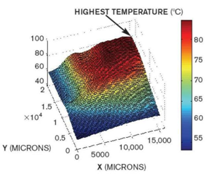
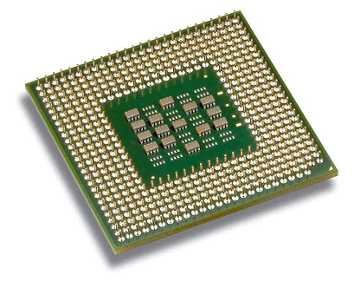
The Power Problem
$
$
$
$
Power related issues:
Wall power costs
Processor design constraints
Power delivery network
Thermals
Packaging
Reliability
Notes:
At first let’s backup a little and discuss why we care about power at the first place. Architects need to think of all these power-related issues.
Tons of work has been published regarding average power (slide)

Slide 3
The Power Problem
$
$
$
$
Power related issues:
Wall power costs
Processor design constraints
Power delivery network
Thermals
Packaging
Reliability
Average Power
Notes:
And this work has been well justified because average related directly to Wall power costs, thermals and reliability.
However, very few things have been done for peak power (slide)

Slide 4

The Power Problem
Power related issues:
Wall power costs
Processor design constraints
Power delivery network
Thermals
Packaging
Reliability
Peak Power
Notes:
Much less has been done for peak power which more directly impacts
processor design – architects design chips for the worst case current and therefore power not the average,
power delivery – the on-chip power grid is usually over-provisioned to address power spikes,
packaging – expensive packaging solutions are required when voltage variation targets are not met.
Hence peak power is very important and following we will discuss our approach on how we can reduce it.

Slide 5
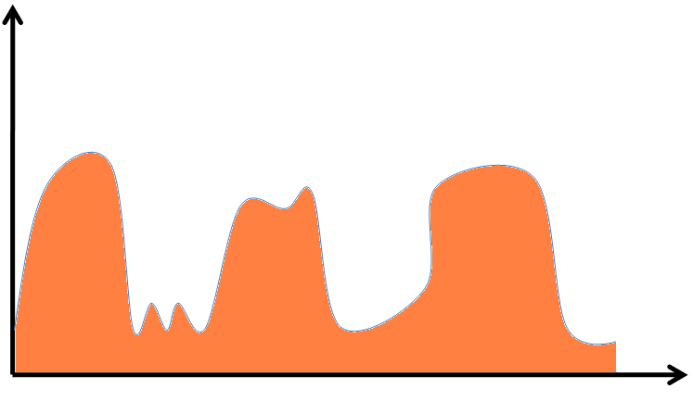
Theoretical Peak vs Execution Peak
Power
Time
Notes:
But first we need to define the term Peak Power.
This figure show the core power consumption when a benchmark is executing.

Slide 6
Theoretical Peak vs Execution Peak
Power
Average
Time
Notes:
We can see the average power (slide)

Slide 7
Theoretical Peak vs Execution Peak
Execution Peak
Power
Average
Time
Notes:
the peak execution power (slide)

Slide 8
Theoretical Peak vs Execution Peak
Theoretical Peak
Execution Peak
Power
Average
Time
Notes:
and the theoretical peak power. Theoretical peak power is the accumulation of
the power of all core components, when these components operate with maximum activity factors.
Architects design their hardware especially the power delivery network with the theoretical peak in mind, not the average.

Slide 9
Our Approach
Motivation:
Most applications have few resource bottlenecks.
Ample opportunity to disable core components without hurting performance
Goal:
Partially disable core components to limit Peak Power
Method:
Each resource can be maximally configured
Not all resources maximized at the same time
(centralized control mechanism).
Notes:
In our studies we observed that most application have few resources bottlenecks and will perform well as long as those key resources
are sufficiently provided. With resources we mean the number of alus, registers, cache size etc.
Our goal is to provide the performance critical resources and disable the rest to limit peak power.
This sounds much like what we would do to limit average power instead of peak power.
However, the key difference is that we reduce peak power by not allowing all the resources to get their maximum value at the same time.
For example an application can use maximum number of alus, reg. files entries, cache ways for performance reasons but not all of them at once.
In order to optimize the power delivery network or reduce the decoupling capacitance it is imperative to provide guarantees that peak power budget
is never exceeded.

Slide 10
Motivating Experiment:
We reduce 10 core resources
Max config
 | MIN | MAX
INT inst. Queue | 16 | 32
FP Queue | 16 | 32
INT regs | 64 | 128
FP regs | 64 | 128
INT alus | 2 | 4
FP alus | 1 | 3
LdSt units | 1 | 2
ROB | 128 | 256
Icache | 4K | 32K
Dcache | 4K | 32K
Min config
Notes:
In order to demonstrate that most application have few resource bottlenecks we run the following experiment.
We compare these two configurations, the MIN and the MAX shown in this table.
The performance difference is significant. Specifically Media benchmarks require those resources to achieve more than 70% additional performance.
“The question that comes up is do we need all those resources to get that performance?”

Slide 11
Motivating Experiment:
We reduce 10 core resources
We selectively maximize resources
10 params max
1 out of 10 parameters max
Min config
Notes:
To answer that, we selectively maximize resources
and observer that maximizing one out of ten resources we cover a big part of the performance difference between minimum and maximum configuration.
It is important to have adaptive architecture, because which resource performs best varies per application.

Slide 12
Motivating Experiment:
We reduce 10 core resources
We selectively maximize resources
10 params max
2 out of 10 parameters max
Min config
Notes:
Next we maximize two out of ten resources and see that we cover an even bigger portion of the performance difference.

Slide 13
Motivating Experiment:
We reduce 10 core resources
We selectively maximize resources
10 params max
3 out of 10 parameters max
Min config
Notes:
Finally we maximize 3 out of the ten resources and see that we get most of the potential performance.
This is very interesting result. (slide) By intelligently providing the right resources we can have 7/10 resources underconfigured and
still get most of the potential performance.
[The closer an application gets to the behavior of a power virus the worse our technique will perform. Since there will be no margin to exploit.]

Slide 14
Motivating Experiment:
We reduce 10 core resources
We selectively maximize resources
We can aggressively reduce core components and give up little performance

Slide 15
Outline
Introduction
Architecture
Results
Conclusions
Notes:
This is the outline of my talk. I will now go over the proposed architecture of this work, describing in detail how it reduces peak power. Then will discuss our results and the benefits we get from the peak power reduction and eventually conclude.

Slide 16
Outline
Introduction
Architecture
Results
Conclusions

Slide 17
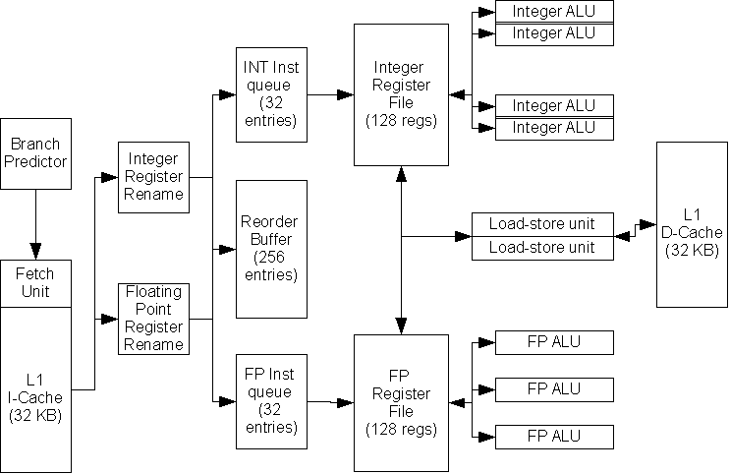
Baseline Architecture
Notes:
Here we see the architecture of an out-of-order core.
A bunch of techniques have been proposed to reduce the average power of various processor structures. We assume a subset of these techniques applied to this structures (structs become gray).

Slide 18
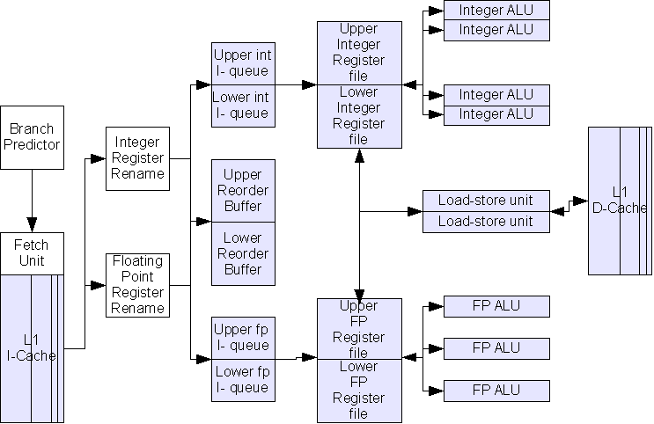

Baseline Architecture with Average Power Management
Notes:
These techniques affect both leakage and dynamic power. However,
This architecture does nothing to limit peak power since there is nothing preventing it from maximizing all the resources at once.

Slide 19
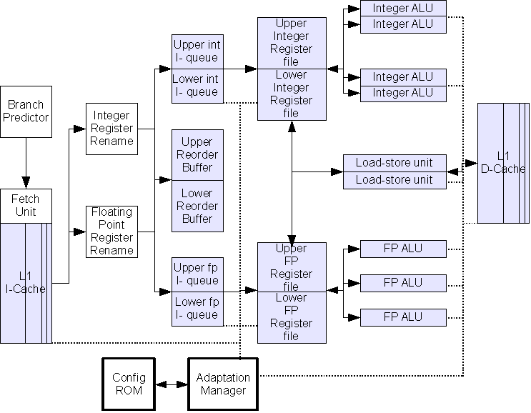
Proposed Architecture with Peak Power Management
Notes:
To limit peak power in this work WE PROPOSE the addition of the Configuration ROM (or Config ROM) and the Adaptation Manager.

Slide 20
Proposed Architecture with Peak Power Management
Holds possible core
configurations
Does bookkeeping and
enforces configurations
Notes:
Config ROM holds all the allowed configurations that the core can be in without violating an arbitrarily chosen peak power budget.
The adaptation manager is responsible to communicate with the configurable components, find the most appropriate configuration and enforce that
Configuration.
The transitions between configurations take place in a way that we never allow the peak power to be exceeded. First we disable resources and then we enable .
This architecture will only allow us to be in the one of the states in the Config ROM. Therefore there are two critical issues we need to solve to make
This architecture work (slide)

Slide 21
Two Critical Issues
Which configurations to make available?
(contents of Config ROM)
How to transition among the available configurations?
(Adaptation manager policies)
Notes:
What configuration to place in the Config ROM in order to always respect the targeted peak power and perform well
How to intelligently choose at run-time the next configuration to be in.
Next we will go over the first issue (Slide)

Slide 22
Two Critical Issues
Which configurations to make available?
(contents of Config ROM)
How to transition among the available configurations?
(Adaptation manager policies)
Notes:
the contents of Config ROM.
While we will present the second issue in the results section.

Slide 23
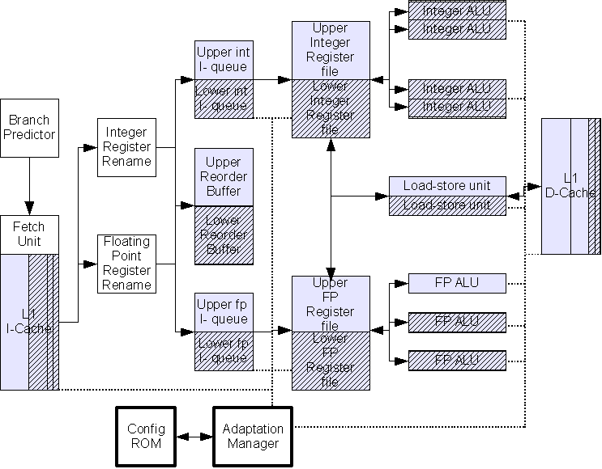

Finding Appropriate Configurations
Config ROM - 70% of core peak power
Iq | Fq | ialu | falu | ldstu | rob | Iregs | fregs | icache | dcache
0 | 0 | 1 | 1 | 0 | 0 | 0 | 0 | 2 | 1
0 | 0 | 1 | 2 | 0 | 0 | 0 | 0 | 2 | 1
Notes:
This table shows the contents of a config ROM targeting the 70% threshold of the original core peak power.
These numbers maps to the value of each parameter. For instance Iregs “0” indicates only half integer register file is active. Iregs “1” means the whole integer register file is on. Similarly 0 corresponds to 1 fp alu, 1 corresponds to 2 fp units and 2 corresponds to 3 fp units.
The highlighted entry is equivalent to the diagram below where we can see the active portions of the configurable parts.

Slide 24
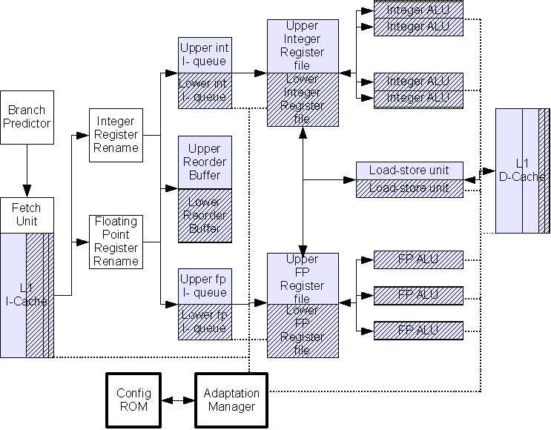
Finding Appropriate Configurations
Config ROM - 70% of core peak power
Iq | Fq | ialu | falu | ldstu | rob | Iregs | fregs | icache | dcache
0 | 0 | 1 | 1 | 0 | 0 | 0 | 0 | 2 | 1
0 | 0 | 1 | 2 | 0 | 0 | 0 | 0 | 2 | 1
Notes:
The second highlighted entry is depicted on the right.

Slide 25
Finding Appropriate Configurations
Consider all possible configurations
Config ROM - 70% of core peak power
Iq | Fq | ialu | falu | ldstu | rob | Iregs | fregs | icache | dcache
0 | 0 | 1 | 1 | 0 | 0 | 0 | 0 | 2 | 1
0 | 0 | 1 | 2 | 0 | 0 | 0 | 0 | 2 | 1
… | … | … | … | … | … | … | … | … | …
69%
71%
Notes:
To ensure that all the configurations in the Config ROM respect the peak power we target, we consider the peak power for all the possible configurations and then optimize out the configuration we do not want.
Those two configurations differ only on the number of active fp alus. The configuration one the left has fewer FP alus active, as a result, the configuration on the left has peak power of 69% while the right one 71%.
The 2nd configuration is exceeding the targeted peak power threshold and therefore is left out of the config ROM. (slide)

Slide 26
Finding Appropriate Configurations
Consider all possible configurations
Remove configs exceeding targeted peak power threshold
Config ROM - 70% of core peak power
Iq | Fq | ialu | falu | ldstu | rob | Iregs | fregs | icache | dcache
0 | 0 | 1 | 1 | 0 | 0 | 0 | 0 | 2 | 1
0 | 0 | 1 | 2 | 0 | 0 | 0 | 0 | 2 | 1
… | … | … | … | … | … | … | … | … | …
69%
71%
Notes:
This ensures that all the configurations by construction will respect the peak power budget.
Now consider another case. (next slide)

Slide 27
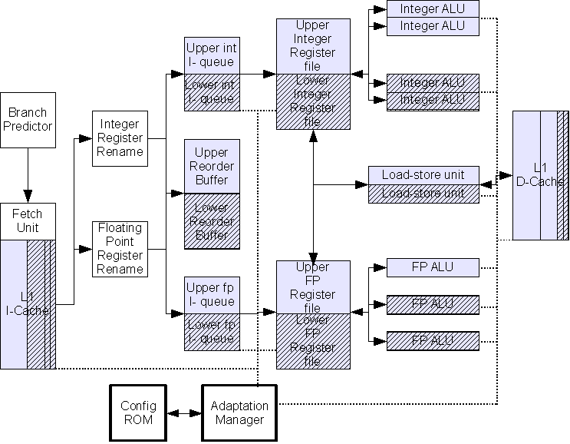
Finding Appropriate Configurations
Consider all possible configurations
Remove configs exceeding targeted peak power threshold
Config ROM - 70% of core peak power
Iq | Fq | ialu | falu | ldstu | rob | Iregs | fregs | icache | dcache
0 | 0 | 1 | 1 | 0 | 0 | 0 | 0 | 2 | 1
0 | 0 | 0 | 1 | 0 | 0 | 0 | 0 | 2 | 1
… | … | … | … | … | … | … | … | … | …
69%
68%
Notes:
Configurations that are strict subsets of another configuration already in the config ROM.
We will call these configurations redundant.
For instance, here both configurations are under the threshold , but the second one has 2 integer alus while the first one has 4.
All the rest resources are exactly the same.
We expect the configuration with more resources to perform better than the one with fewer, therefore is redundant will be eliminated.(slide)

Slide 28
Finding Appropriate Configurations
Consider all possible configurations
Remove configs exceeding targeted peak power threshold
Remove redundant configs
Config ROM - 70% of core peak power
Iq | Fq | ialu | falu | ldstu | rob | Iregs | fregs | icache | dcache
0 | 0 | 1 | 1 | 0 | 0 | 0 | 0 | 2 | 1
0 | 0 | 0 | 1 | 0 | 0 | 0 | 0 | 2 | 1
… | … | … | … | … | … | … | … | … | …
69%
68%
Notes:
With this methodology we manage to considerably reduce the total number of configurations. (slide)

Slide 29
Contents of the Config ROM
Manageable number of configurations
We find the best configuration faster
Relative power threshold | # of possible configurations | # of non-redundant configurations
70% | 493 | 132
75% | 1658 | 279
80% | 3418 | 360
85% | 4987 | 285
100% | 6144 | 1
Notes:
Out of originally 6144 different possible configurations, this is the product of the possible values of each parameter, we see the number of possible
configurations in each threshold and the number the configurations after the removal of redundant configurations.
Our technique achieves two things.
we end up with a more manageable number of configurations. E.g. for the 70% threshold we have only 132.
We facilitate the process of finding the best configuration, since we consider a smaller number of them.

Slide 30
Implementation Overhead
Area: <1.25% increase
(~0.5KB for Config ROM)
Peak Power: < 1.1% overhead
Average Power: negligible
(infrequent epoch-based adaptation)
Power-gating delays of up to 650 cycles.
Verification Cost higher than non-adaptive core, less than fully-adaptive core
Notes:
Here we present the implementation overhead of our additions. Less than 1.25% of additional area is required for the one Config Rom and the Adaptation Manager.
There 1.1 peak power overhead. The average power impact because the adaptation between configuration takes place infrequently.
We carefully mode Power-gating latencies so that rush current and di/dt will not be an issue.
Finally verification cost is an important issues, since we expect this to be more complicated than a non-adaptive core but less costly than a fully-adaptive core.
[How does this implementation compares power-wise to the non-adaptable core. :
If they press me hand-wave the overheads should be in the percent range extra. Plus modern microprocessors already employ clock-gating and power-gating in their designs.
What if you want to include more parameters? Your design space would explode.
I would be surprised if you would find more than 10 resources that consistently matter
We do explore further reduction of design space, performance actually improved. Someone could be more aggressive than we are. ]

Slide 31
Outline
Introduction
Architecture
Results
Dynamic Adaptation vs Static Tuning
Realistic Adaptive Techniques
Voltage Variation and Decoupling Capacitance Benefits
Conclusions
Notes:
And now we will go over the evaluation of this adaptive architecture.
Specifically, I will discuss how adynamically adapting architecture compares to a statically tuned one
Will discuss realistic online adaptive techniques
And will go over some of the benefits of peak power reduction in terms of voltage variation and decoupling capacitance .

Slide 32
Dynamic Adaptation vs Static Tuning
70% of core peak
Best Static Configuration:
iqs:32. fqs:32 ialu:2 falu:1 ldst:1 ics:16KB dcs:16KB ipr:64 fpr:64 rob:256
Notes:
We constaint the peak power of our core to 70% of its original value and consider all configurations within this budget.
We find the configuration that performs best across our benchmark set and use it as our baseline. We call this architecture BEST_STATIC, it is shown with the blue bars.
This is more or less how we build processsors today, we simulate a wide range of applications within some constraints and find which configuration works best. The bigger the benchmark pool
the harder it is to optimize for all of them. This is the difficulty of building a general purpose processor.
We compare this architecture to another one that can dynamically adapt. It switches to the best configuration within the peak power budget every 1M instructions. This architecture has oracle knowledge of what is best for each benchmark and each phase of the benchmark and since we do not know a priori what is best. We call this policy
IDEAL_ADAPT policy. This is the red one. Finally we have the maximally configured core where there is no peak power constraint. This is MAX_CONF with the orange bars and corresponds to the
original core.
In other words Blue: find the best performing configuration within the peak power budget. Red: adapt to the best configuration every 1M instructions within budget. Orange :
all resources are max, no peak power constaints.
In the y axis there is speedup normalized to BEST_STATIC config and on the x axis the benchmarks of our set. Higher is better. As expected, the ideally adaptive core reaches closer to the performance of the maximally configured core than the static processor. MAX_CONFIG on average is 20% better than BEST_STATIC and IDEAL_ADAPT is 16% better than the BEST_STATIC. (slide)

Slide 33
Dynamic Adaptation vs Static Tuning
70% of core peak
FP REGs needed
INT ALUs needed
Nothing
needed
Best Static Configuration:
iqs:32. fqs:32 ialu:2 falu:1 ldst:1 ics:16KB dcs:16KB ipr:64 fpr:64 rob:256
Notes:
I have isolated three characteristic cases to explain the performance difference. For parser the static configuration is sufficient and as a result, all three perform similarly.
However there are other benchmarks like Media g721d which required 4 alus to perform well and those are not provided in the configuration. Or mg that requires more fp registers.
The ideal adapt can provide these and performs better.
Note that the more diverse is the set of applications in our benchmark pool the more the adaptive core will outperform the static one.
Now that we have quantified the importance of adaptation we should ask how close realistic techniques can reach to the ideal one (slide)

Slide 34
Two Critical Issues
Which configurations to make available?
(contents of Config ROM)
How to transition among the available configurations?
(Adaptation manager policies)
Notes:
This relates to how the adaptation manager will choose the next configuration (Slide)

Slide 35
Realistic Adaptive Techniques
When to adapt ? | Which configuration to choose ? | How to evaluate a configuration ?
Interval(INTV): every fixed interval of cycles (2M cycles) | RANDOM: randomly pick the next configuration | NONE: pick the chosen configuration, do not evaluate
EventDriven(EVDRIV): capture phase changes by adapting when IPC or cache misses/instr. change by more than 30% |  | SAMPLE: sample different configurations and pick the one with highest instructions per cycle (ipc)
 | SCORE: evaluate configurations based on which provides more of the bottleneck resource. Choose the highest score .
AdaptiveInterval(INTVAD): mitigate adaptation costs by extending interval when cannot find better configurations, shrink it otherwise. (0.5M – 8M cycles)
Notes:
When it come to designing heuristics for online adaptation there are three questions that need to answered.
When we will trigger an adaptation, which will be the next configuration and how we will evaluate the configuration we have used.

Slide 36
Realistic Adaptive Techniques
When to adapt ? | Which configuration to choose ? | How to evaluate a configuration ?
Interval(INTV): every fixed interval of cycles (2M cycles) | RANDOM: randomly pick the next configuration | NONE: pick the chosen configuration, do not evaluate
EventDriven(EVDRIV): capture phase changes by adapting when IPC or cache misses/instr. change by more than 30% |  | SAMPLE: sample different configurations and pick the one with highest instructions per cycle (ipc)
 | SCORE: evaluate configurations based on which provides more of the bottleneck resource. Choose the highest score.
AdaptiveInterval(INTVAD): mitigate adaptation costs by extending interval when cannot find better configurations, shrink it otherwise. (0.5M – 8M cycles)
Notes:
Regarding the first question, we consider 3 alternatives, adapt every 2M cycles (INTV policy) , adapt when we detect a phase change (EVDRIV policy)
extend the adaptation interval when we have a good configuration and cannot find a better one, shrink the adaptation interval when we do find better
configuration to speedup the learning process.

Slide 37
Realistic Adaptive Techniques
When to adapt ? | Which configuration to choose ? | How to evaluate a configuration ?
Interval(INTV): every fixed interval of cycles (2M cycles) | RANDOM: randomly pick the next configuration | NONE: pick the chosen configuration, do not evaluate
EventDriven(EVDRIV): capture phase changes by adapting when IPC or cache misses/instr. change by more than 30% |  | SAMPLE: sample different configurations and pick the one with highest instructions per cycle (ipc)
 | SCORE: evaluate configurations based on which provides more of the bottleneck resource. Choose the highest score.
AdaptiveInterval(INTVAD): mitigate adaptation costs by extending interval when cannot find better configurations, shrink it otherwise. (0.5M – 8M cycles)
Notes:
Regarding the second question, which configuration to choose we consider 2 alternatives, randomly pick one, and employ a scoring technique.
We maintain a vector based on performance counters that indicates which resources are under pressure and would be more beneficial to increase. Then
We evaluate each configuration according to whether it increases or decreases those resources. If it increases them we give a bonus to the configuration
Score, while if it dereases them we penalize the configurations score. We choose the highest scores.

Slide 38
Realistic Adaptive Techniques
When to adapt ? | Which configuration to choose ? | How to evaluate a configuration ?
Interval(INTV): every fixed interval of cycles (2M cycles) | RANDOM: randomly pick the next configuration | NONE: pick the chosen configuration, do not evaluate
EventDriven(EVDRIV): capture phase changes by adapting when IPC or cache misses/instr. change by more than 30% |  | SAMPLE: sample different configurations and pick the one with highest instructions per cycle (ipc)
 | SCORE: evaluate configurations based on which provides more of the bottleneck resource. Choose the highest score.
AdaptiveInterval(INTVAD): mitigate adaptation costs by extending interval when cannot find better configurations, shrink it otherwise. (0.5M – 8M cycles)
Notes:
Finally, for the last question, how to evaluate a configuration, we consider NO evaluation and sampling. None corresponds to sticking to the configuration
we have chosen. The sampling policy enables us to consider several configurations, try them for a short period of time and finally choose the one with the highest ipc.

Slide 39
Realistic Adaptive Techniques
When to adapt ? | Which configuration to choose ? | How to evaluate a configuration ?
Interval(INTV): every fixed interval of cycles (2M cycles) | RANDOM: randomly pick the next configuration | NONE: pick the chosen configuration, do not evaluate
EventDriven(EVDRIV): capture phase changes by adapting when IPC or cache misses/instr. change by more than 30% |  | SAMPLE: sample different configurations and pick the one with highest instructions per cycle (ipc)
 | SCORE: evaluate configurations based on which provides more of the bottleneck resource. Choose the highest score.
AdaptiveInterval(INTVAD): mitigate adaptation costs by extending interval when cannot find better configurations, shrink it otherwise. (0.5M – 8M cycles)
e.g. INTVAD_SCORE_SAMPLE
Notes:
This three questions are not conflicting. Actually, we need to answer all three of them to have an adaptive policy.
For instance, INTVAD_SCORE_SAMPLE will use the adaptive interval to trigger adaptations, employ the scoring evaluation to find contestants for the next epoque and finally sample the highest scoring configurations for short period of time to find the best one.

Slide 40
Realistic Adaptive Techniques
Notes:
Here we have the performance of our realistic adaptive techniques.
On the y axis there the speedup normalized to the BEST_STATIC policy and the on the x axis we have the benchmark groups.

Slide 41
Realistic Adaptive Techniques
Most configs in Config ROM perform poorly
Notes:
The policy INTV_RANDOM select periodically a random configuration from the Config ROM, has no notion of good or bad configuration and what
is required at each point and therefore performs poorly. It’s more of an indication of how good configurations exist in the Config ROM

Slide 42
Realistic Adaptive Techniques
SCORE marginally better than BEST_STATIC
Notes:
The addition of the Scoring Scheme improves performance and make it comparable to the BEST_STATIC. With Scoring the more educated selections
of configurations take place and hence the better performance.

Slide 43
Realistic Adaptive Techniques
SAMPLING a big win!
Notes:
Finally the addition of sampling gives a big boost in performance since evaluation helps as select the best over a number of configurations.
The adaptation triggering makes small difference with the adaptive interval INTVAD being slightly better.
All the results so far are for the 70% budget. Now we consider what happens for the best policy to other peak power budgets.

Slide 44
Results Across Peak Power Budgets vs Maximized Core
Reducing the configurations in Config ROM further improves performance
At 75% within 5% of maximized core
At 80% within 2.5% of maximized core
Peak power constraint
Notes:
On the y axis again we have speedup over BEST_STATIC while on the x the peak power budget.
In this graphs we have the best realistic policy INTVAD_SCORE_SAMPLE and we also show the same policy on a reduced set of configurations. We
run this experiments to explore how additional benchmarking can improve performance. Ideal adapt and the processor without peak power constraints.
When we relax the peak power constaint to 75% we are within 5% of the maximally configured core and when we go to 80% we are
Within 2.5% of the maximally configured core. So to give the big picture. We can reduce peak power by 25% give up 5% of performance or 20% and
give up 2.5%.
[ Here they will probably ask why IDEAL_ADAPT is better and I will go to backup slide…]
[ If someone pushes. Wattch better for relative numbers instead of absolute that’s why 70% instead of Watts.]
[Why normalized against BEST STATIC and not have an average or geometric average, because each metric has it’s pros and cons.
Average stresses big values, geometric means stresses small values, BEST STATIC is a compromise]

Slide 45
So what have we gained?
Metrics
Power efficiency
AP_ratio =
Decoupling Capacitance (% of total core area)
Voltage Variation (% of Vdd)
Notes:
So what have we gained?
To quantify the benefits of peak power reduction we use these metrics.
We measure the ratio of average over peak power, the AP_ratio.
High value of this ratio means that the average power is close to peak, we do not overprovision the on-chip power grid the power spikes will be smaller. Therefore we can design cheaper, more efficient power supplies, on-chip PDNs.
2) We measure the required decoupling capacitance in terms of % of the total core area
3) We measure the voltage variation for a fixed decap budget as a percentage of Vdd.

Slide 46
Power Efficiency
Both average and peak power decrease
Notes:
In this graph on the x axis we have the peak power constraint and on the y Watts.
As we reduce peak power in this architecture. Average power goes down as well.

Slide 47
Power Efficiency
AP_ratio:
56%
61%
63%
64%
67%
Both average and peak power decrease
AP_ratio improves as we constrain the peak power
Notes:
Even more importantly, the ratio of Ave/ peak is lowered as well.
From 56% for the core without peak power constraint our architecture increases the ratio to 67% when peak power is reduced by 30%.

Slide 48
Voltage variation and Decoupling Capacitance benefits
 | Constant Voltage Variation | Constant Decoupling Cap.
Relative power threshold | On-chip Decap (%of total Core Area) | Max. Voltage Variation (% V_{DD} )
70% | 9% | 4.48%
75% | 9.7% | 4.80%
80% | 10.5% | 5.12%
85% | 11.5% | 5.44%
100% | 15% | 6.48%
Notes:
As it was explained thoroughly in the previous presentation, the voltage fluctuation depends among other things the magnitude of current and the frequencies
the current waveform contains. By limiting the peak power we limit the maximum current that can be drawn. As a result we limit the voltage droop and
we require less decoupling capacitance for a given voltage variation target.
To measure this effect we have run two related experiments.

Slide 49
Voltage variation and Decoupling Capacitance benefits
 | Constant Voltage Variation | Constant Decoupling Cap.
Relative power threshold | On-chip Decap (%of total Core Area) | Max. Voltage Variation (% V_{DD} )
70% | 9% | 4.48%
75% | 9.7% | 4.80%
80% | 10.5% | 5.12%
85% | 11.5% | 5.44%
100% | 15% | 6.48%
Notes:
In the first experiment we hold keep Voltage variation the same and measure the amount of required decoupling capacitance to achieve that.
We present the decap in terms of % of total Core area. Considerable reduction is achieved, since the required area is reduced from 15% to 9%.

Slide 50
Voltage variation and Decoupling Capacitance benefits
 | Constant Voltage Variation | Constant Decoupling Cap.
Relative power threshold | On-chip Decap (%of total Core Area) | Max. Voltage Variation (% V_{DD} )
70% | 9% | 4.48%
75% | 9.7% | 4.80%
80% | 10.5% | 5.12%
85% | 11.5% | 5.44%
100% | 15% | 6.48%
Notes:
Then in the second experiment we keep the decoupling capacitance the same and see the reduction in voltage variation as we reduce peak power.
Again considerable reduction in voltage variation is achieved since from 6.4 is reduced to 4.4 which is roughly 35%.

Slide 51
Voltage variation and Decoupling Capacitance benefits
 | Constant Voltage Variation | Constant Decoupling Cap.
Relative power threshold | On-chip Decap (%of total Core Area) | Max. Voltage Variation (% V_{DD} )
70% | 9% | 4.48%
75% | 9.7% | 4.80%
80% | 10.5% | 5.12%
85% | 11.5% | 5.44%
100% | 15% | 6.48%
Reduced Peak Power Less required on-chip decap
Smaller Voltage Variation
Notes:
Therefore less peak power means less decap for the same voltage variation goal or smaller voltage variation levels for the same decap budget..

Slide 52
Conclusions
Peak power is a first-class design constraint
Impacts the efficiency and cost of power delivery.
Affects on-chip decoupling capacitance and voltage variation
Table-driven adaptation can be employed to limit peak power while giving up little performance
Reduces Peak power by 25% while giving up less than 5% performance.
Notes:
To wrap up. Peak power is a first-class design constraint. Since it impacts power delivery and cost of power supply.
It affects on chip decap and voltage variation.
We have shown that a table driven approach can reduce peak power by 25% while giving up 2.5% performance.
[do simulation backup slide]

Slide 53
Reducing Peak Power with a Table-Driven Adaptive Processor Core
Vasileios Kontorinis (UCSD)
Amirali Shayan (UCSD)
Rakesh Kumar (UIUC)
Dean Tullsen (UCSD)
Notes:
With that I will thank you and will happily answer your questions.

Slide 54
Backup slides

Slide 55
Design Space
INT instruction queue | 16,32 entries
FP instruction queue | 16,32 entries
INT registers | 64,128
FP registers | 64,128
INT alus | 2,4
FP alus | 1,2,3
Load/Store units | 1,2
Reorder Buffer | 128,256 entries
Icache | 1,2,4,8 ways of 4K each
Dcache | 1,2,4,8 ways of 4K each

Slide 56
Multiple Config ROMs and their potential applications
Dynamic Thermal Management
Hot Spot Avoidance
Combat process variation
Budget Peak Power across multiple cores to maximize throughput

Slide 57
Benchmarks performing better with fewer resources
Explanation:
Going further down the wrong path puts extra pressure in the memory subsystem . May negatively affect performance.

Slide 58
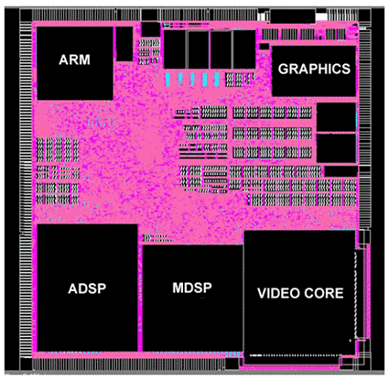
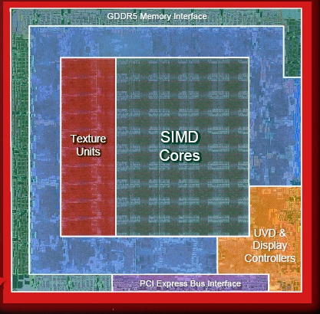
Decoupling capacitance on die
Decoupling Ring
Decoupling Capacitors
Core
Notes:
We are designing core and the PDN with decaps as separate modules. Microarchitectural techniques could considerably ease the power delivery design.

Slide 59
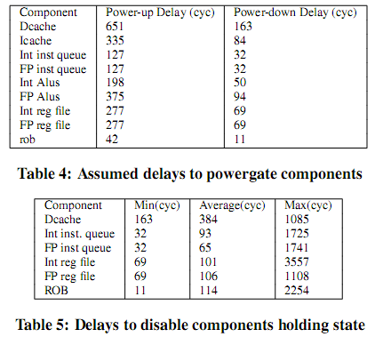
Delays

Slide 60
Adaptation transition
 | Iq | Fq | ialu | falu | ldstu | rob | Iregs | fregs | Icache | dcache
Config 1 | 32 | 16 | 2 | 1 | 1 | 256 | 128 | 0 | 32k | 16k
Config 2 | 16 | 16 | 2 | 2 | 1 | 256 | 128 | 0 | 32k | 16k
Falu power-up begins
Falu power-up ends
Active falus
2
1
Time(cyc)
Adaptation
Triggered – Reg. Renaming Throttled
Iqueue Powergating begins
Instructions in Iqueue
Iqueue Powergating ends – Reg. Renaming restarts
32
16
0
1000
2000
3000
Time(cyc)

Slide 61
Reducing Peak Power with a Table-Driven Adaptive Processor Core
Vasileios Kontorinis (UCSD)
Amirali Shayan (UCSD)
Rakesh Kumar (UIUC)
Dean Tullsen (UCSD)

