Slide 1
Flat Datacenter Storage Microsoft Research, Redmond
Ed Nightingale, Jeremy Elson
Jinliang Fan, Owen Hofmann, Jon Howell, Yutaka Suzue

Slide 2


Slide 3
Writing
Fine-grained write striping → statistical multiplexing → high disk utilization
Good performance and disk efficiency

Slide 4
Reading
High utilization (for tasks with balanced CPU/IO)
Easy to write software
Dynamic work allocation → no stragglers

Slide 5
Easy to adjust the ratio of CPU to disk resources

Slide 6
Metadata management
Physical data transport

Slide 7
FDS in 90 Seconds
Outline
FDS is simple, scalable blob storage; logically separate compute and storage without the usual performance penalty
Distributed metadata management, no centralized components on common-case paths
Built on a CLOS network with distributed scheduling
High read/write performance demonstrated (2 Gbyte/s, single-replicated, from one process)
Fast failure recovery (0.6 TB in 33.7 s with 1,000 disks)
High application performance – web index serving; stock cointegration; set the 2012 world record for disk-to-disk sorting

Slide 8
Outline
FDS is simple, scalable blob storage; logically separate compute and storage without the usual performance penalty
Distributed metadata management, no centralized components on common-case paths
Built on a CLOS network with distributed scheduling
High read/write performance demonstrated (2 Gbyte/s, single-replicated, from one process)
Fast failure recovery (0.6 TB in 33.7 s with 1,000 disks)
High application performance – set the 2012 world record for disk-to-disk sorting

Slide 9
// create a blob with the specified GUID
CreateBlob(GUID, &blobHandle, doneCallbackFunction);
//...
// Write 8mb from buf to tract 0 of the blob.
blobHandle->WriteTract(0, buf, doneCallbackFunction);
// Read tract 2 of blob into buf
blobHandle->ReadTract(2, buf, doneCallbackFunction);
Client

Slide 10

Clients
Network
Metadata Server
Tractservers

Slide 11
Outline
FDS is simple, scalable blob storage; logically separate compute and storage without the usual performance penalty
Distributed metadata management, no centralized components on common-case paths
Built on a CLOS network with distributed scheduling
High read/write performance demonstrated (2 Gbyte/s, single-replicated, from one process)
Fast failure recovery (0.6 TB in 33.7 s with 1,000 disks)
High application performance – set the 2012 world record for disk-to-disk sorting

Slide 12
– Centralized metadata server
– On critical path of reads/writes
– Large (coarsely striped) writes
+ Complete state visibility
+ Full control over data placement
+ One-hop access to data
+ Fast reaction to failures
GFS, Hadoop
+ No central bottlenecks
+ Highly scalable
– Multiple hops to find data
– Slower failure recovery
FDS
DHTs

Slide 13
Metadata Server
Tract Locator Table
Client
Locator | Disk 1 | Disk 2 | Disk 3
0 | A | B | C
1 | A | D | F
2 | A | C | G
3 | D | E | G
4 | B | C | F
… | … | … | …
1,526 | LM | TH | JE
Oracle
Consistent
Pseudo-random
Tractserver Addresses
(Readers use one;
Writers use all)
O(n) or O(n²)
Blob_GUID Tract_Num
(hash( ) + ) MOD Table_Size

Slide 14
(hash(Blob_GUID) + Tract_Num) MOD Table_Size
—1 = Special metadata tract
Extend by 10 Tracts (Blob 5b8)
Write to Tracts 10-19
Extend by 4 Tracts (Blob 5b8)
Write to Tracts 20-23
Extend by 7 Tracts (Blob d17)
Write to tracts 54-60
Extend by 5 Tracts (Blob d17)
Write to tracts 61-65

Slide 15
Outline
FDS is simple, scalable blob storage; logically separate compute and storage without the usual performance penalty
Distributed metadata management, no centralized components on common-case paths
Built on a CLOS network with distributed scheduling
High read/write performance demonstrated (2 Gbyte/s, single-replicated, from one process)
Fast failure recovery (0.6 TB in 33.7 s with 1,000 disks)
High application performance – set the 2012 world record for disk-to-disk sorting

Slide 16
Bandwidth is (was?) scarce in datacenters due to oversubscription
Network Core
10x-20x
Top-Of-Rack Switch
CPU Rack

Slide 17
Bandwidth is (was?) scarce in datacenters due to oversubscription
CLOS networks:
[Al-Fares 08, Greenberg 09]
full bisection bandwidth at datacenter scales

Slide 18
Bandwidth is (was?) scarce in datacenters due to oversubscription
CLOS networks:
[Al-Fares 08, Greenberg 09]
full bisection bandwidth at datacenter scales
4x-25x
Disks: ≈ 1Gbps bandwidth each

Slide 19
Bandwidth is (was?) scarce in datacenters due to oversubscription
CLOS networks:
[Al-Fares 08, Greenberg 09]
full bisection bandwidth at datacenter scales
FDS: Provision the network
sufficiently for every disk:
1G of network per disk

Slide 20
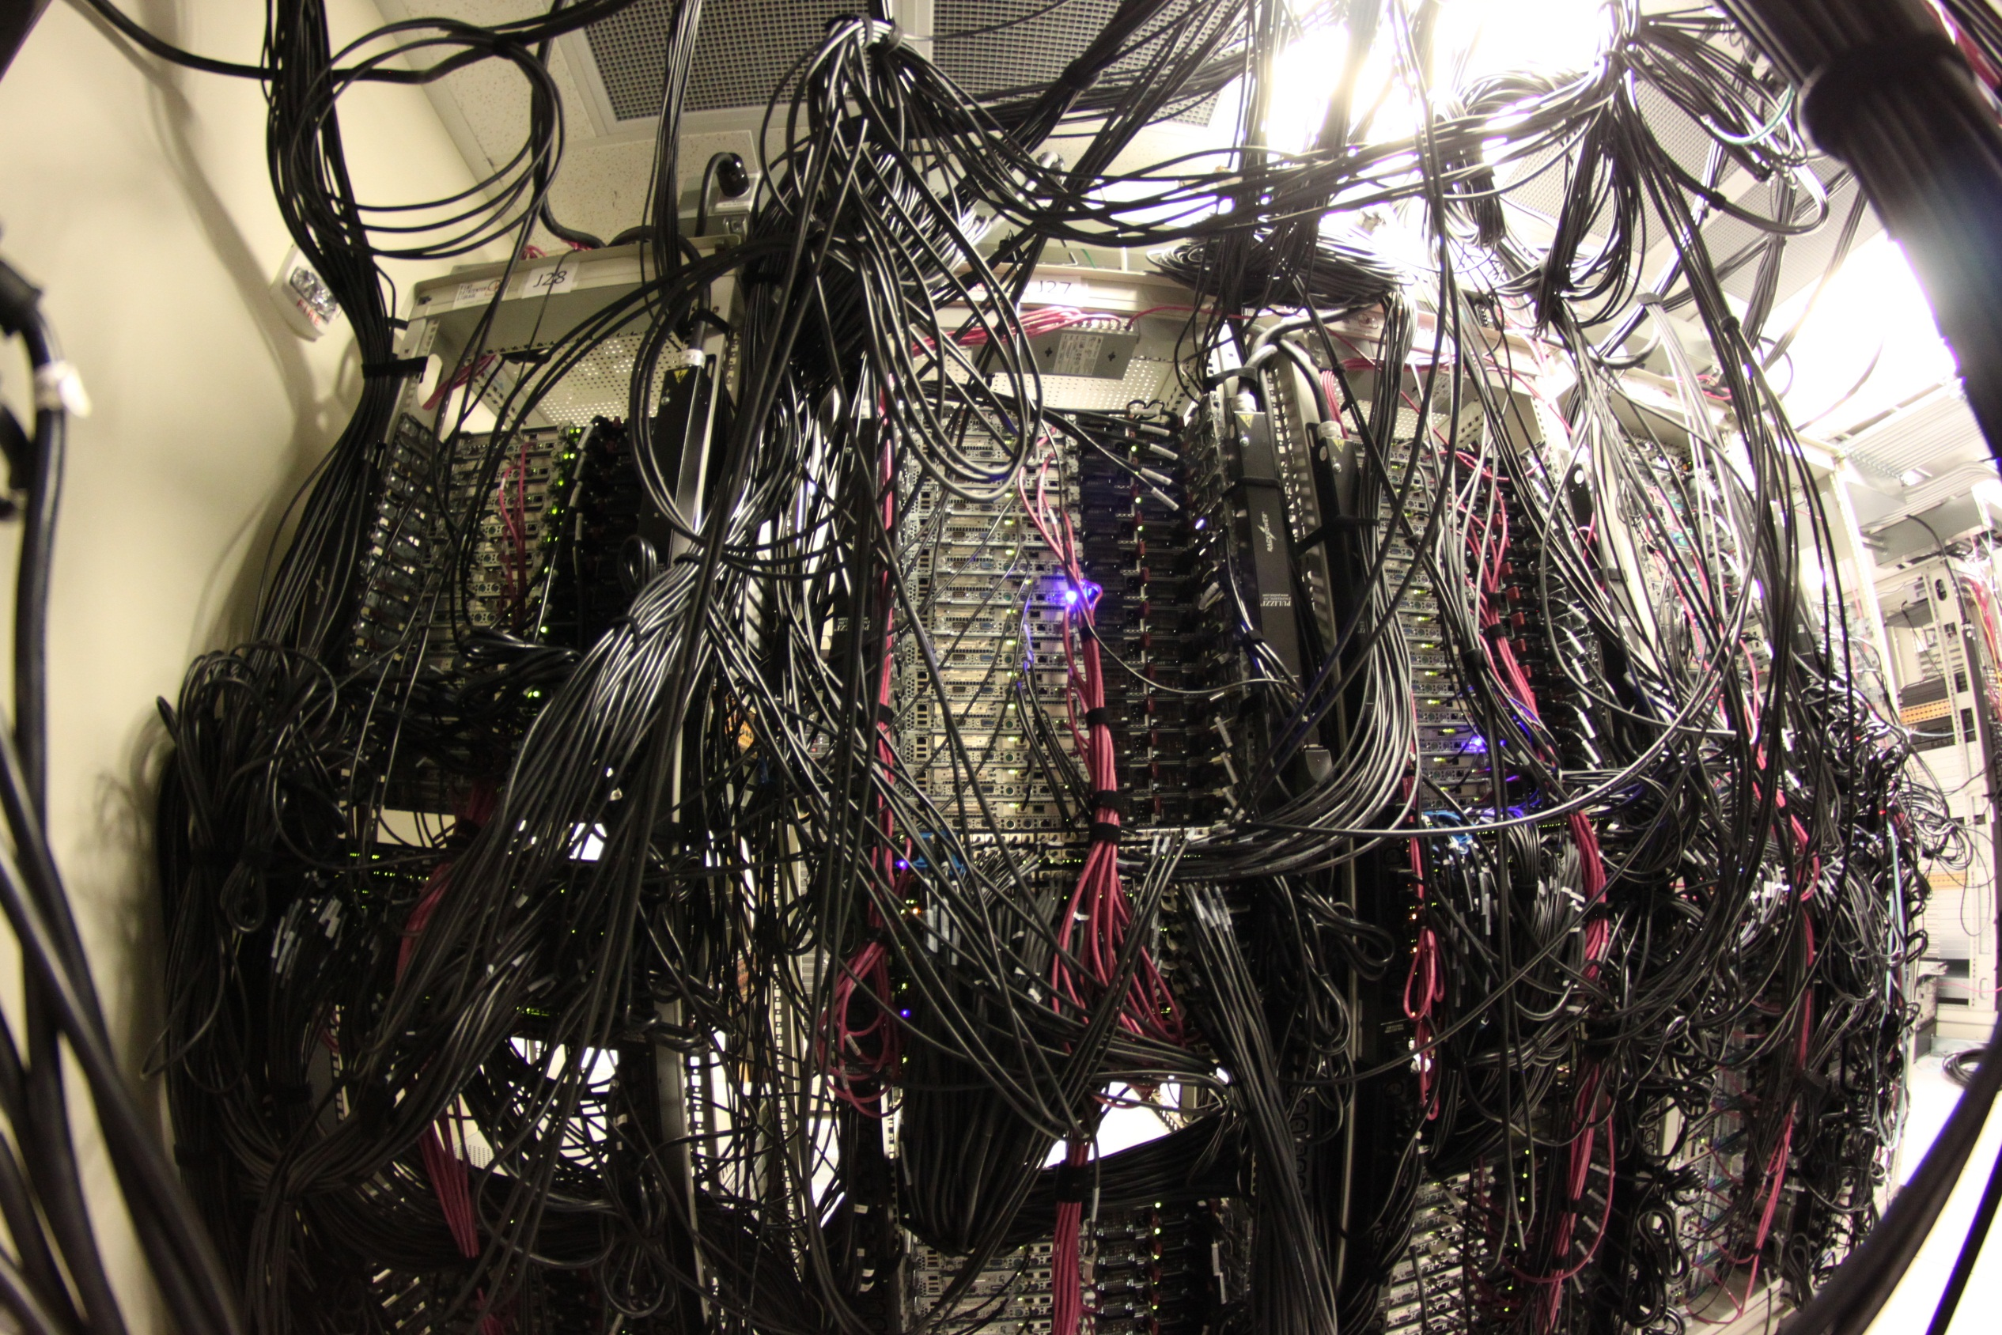
~1,500 disks spread across ~250 servers
Dual 10G NICs in most servers
2-layer Monsoon:
Based on Blade G8264 Router 64x10G ports
14x TORs, 8x Spines
4x TOR-to-Spine connections per pair
448x10G ports total (4.5 terabits), full bisection

Slide 21
No Silver Bullet
Full bisection bandwidth is only stochastic
Long flows are bad for load-balancing
FDS generates a large number of short flows are going to diverse destinations
Congestion isn’t eliminated; it’s been pushed to the edges
TCP bandwidth allocation performs poorly with short, fat flows: incast
FDS creates “circuits” using RTS/CTS
X

Slide 22
Outline
FDS is simple, scalable blob storage; logically separate compute and storage without the usual performance penalty
Distributed metadata management, no centralized components on common-case paths
Built on a CLOS network with distributed scheduling
High read/write performance demonstrated (2 Gbyte/s, single-replicated, from one process)
Fast failure recovery (0.6 TB in 33.7 s with 1,000 disks)
High application performance – set the 2012 world record for disk-to-disk sorting

Slide 23
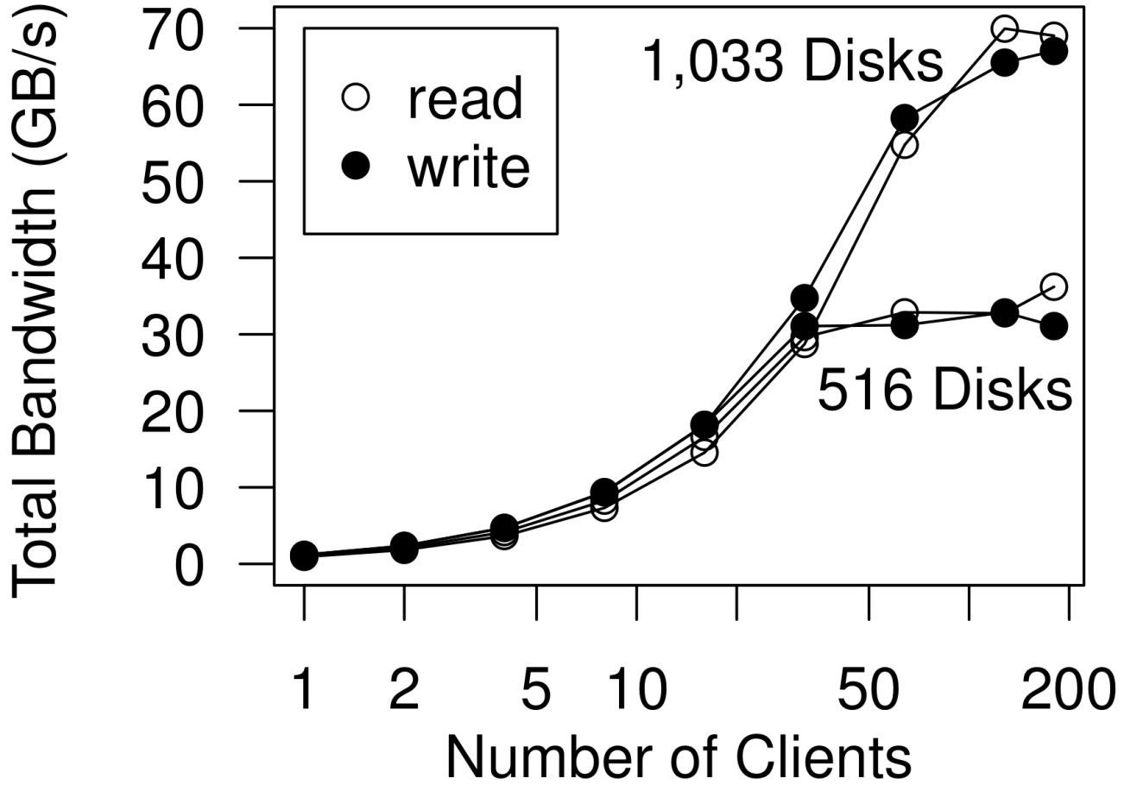
Read/Write Performance Single-Replicated Tractservers, 10G Clients
Read: 950 MB/s/client Write: 1,150 MB/s/client

Slide 24
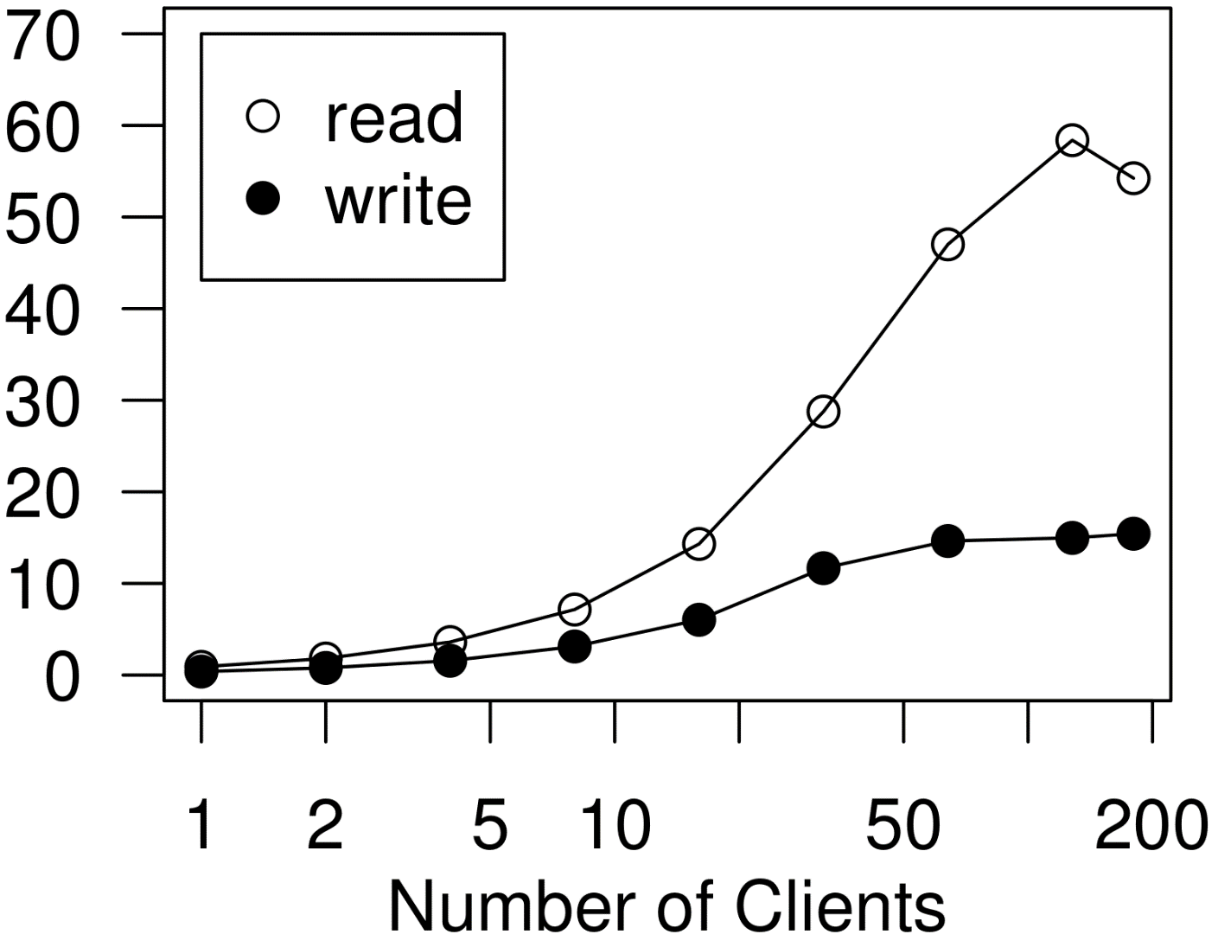
Read/Write Performance Triple-Replicated Tractservers, 10G Clients

Slide 25
Outline
FDS is simple, scalable blob storage; logically separate compute and storage without the usual performance penalty
Distributed metadata management, no centralized components on common-case paths
Built on a CLOS network with distributed scheduling
High read/write performance demonstrated (2 Gbyte/s, single-replicated, from one process)
Fast failure recovery (0.6 TB in 33.7 s with 1,000 disks)
High application performance – set the 2012 world record for disk-to-disk sorting

Slide 26
X
Hot Spare

Slide 27
More disks →
faster recovery

Slide 28
Locator | Disk 1 | Disk 2 | Disk 3
1 | A | B | C
2 | A | C | Z
3 | A | D | H
4 | A | E | M
5 | A | F | C
6 | A | G | P
… | … | … | …
648 | Z | W | H
649 | Z | X | L
650 | Z | Y | C
All disk pairs appear in the table
n disks each recover 1/nth of the lost data in parallel

Slide 29
Locator | Disk 1 | Disk 2 | Disk 3
1 | A | B | C
2 | A | C | Z
3 | A | D | H
4 | A | E | M
5 | A | F | C
6 | A | G | P
… | … | … | …
648 | Z | W | H
649 | Z | X | L
650 | Z | Y | C
M
S
R
D
S
N
All disk pairs appear in the table
n disks each recover 1/nth of the lost data in parallel

Slide 30
Locator | Disk 1 | Disk 2 | Disk 3
1 | A | B | C
2 | A | C | Z
3 | A | D | H
4 | A | E | M
5 | A | F | G
6 | A | G | P
… | … | … | …
648 | Z | W | H
649 | Z | X | L
650 | Z | Y | C
B
M
1
M
S
R
C
S
D
2
S
N
H
R
1
3
…
…
All disk pairs appear in the table
n disks each recover 1/nth of the lost data in parallel

Slide 31
Failure Recovery Results
Disks in Cluster | Disks Failed | Data Recovered | Time
100 | 1 | 47 GB | 19.2 ± 0.7s
1,000 | 1 | 47 GB | 3.3 ± 0.6s
1,000 | 1 | 92 GB | 6.2 ± 6.2s
1,000 | 7 | 655 GB | 33.7 ± 1.5s
We recover at about 40 MB/s/disk + detection time
1 TB failure in a 3,000 disk cluster: ~17s

Slide 32
Failure Recovery Results
Disks in Cluster | Disks Failed | Data Recovered | Time
100 | 1 | 47 GB | 19.2 ± 0.7s
1,000 | 1 | 47 GB | 3.3 ± 0.6s
1,000 | 1 | 92 GB | 6.2 ± 6.2s
1,000 | 7 | 655 GB | 33.7 ± 1.5s
We recover at about 40 MB/s/disk + detection time
1 TB failure in a 3,000 disk cluster: ~17s

Slide 33
Outline
FDS is simple, scalable blob storage; logically separate compute and storage without the usual performance penalty
Distributed metadata management, no centralized components on common-case paths
Built on a CLOS network with distributed scheduling
High read/write performance demonstrated (2 Gbyte/s, single-replicated, from one process)
Fast failure recovery (0.6 TB in 33.7 s with 1,000 disks)
High application performance – set the 2012 world record for disk-to-disk sorting

Slide 34
Minute Sort
Jim Gray’s benchmark: How much data can you sort in 60 seconds?
Has real-world applicability: sort, arbitrary join, group by <any> column
Previous “no holds barred” record – UCSD (1,353 GB); FDS: 1,470 GB
Their purpose-built stack beat us on efficiency, however
Sort was “just an app” – FDS was not enlightened
Sent the data over the network thrice (read, bucket, write)
First system to hold the record without using local storage
System | Computers | Disks | Sort Size | Time | Disk Throughput
MSR FDS 2012 | 256 | 1,033 | 1,470 GB | 59 s | 46 MB/s
Yahoo! Hadoop 2009 | 1,408 | 5,632 | 500 GB | 59 s | 3 MB/s
15x efficiency improvement!

Slide 35
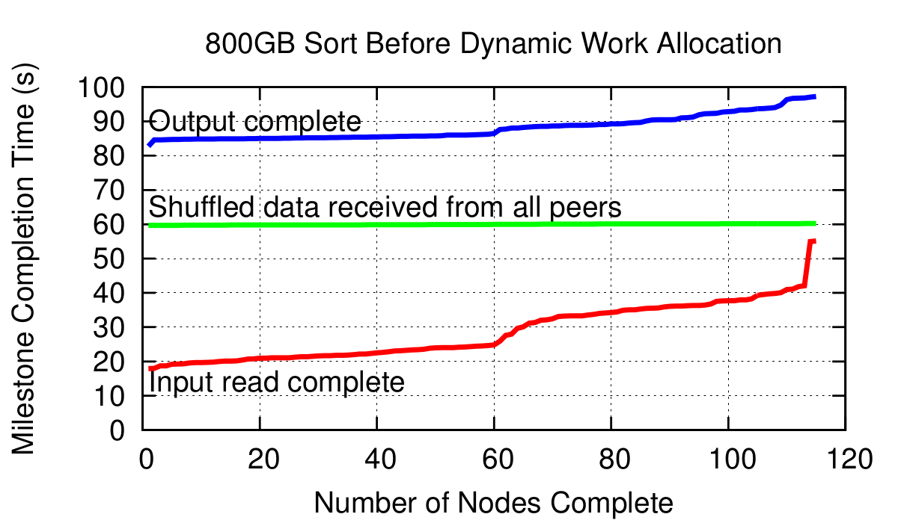
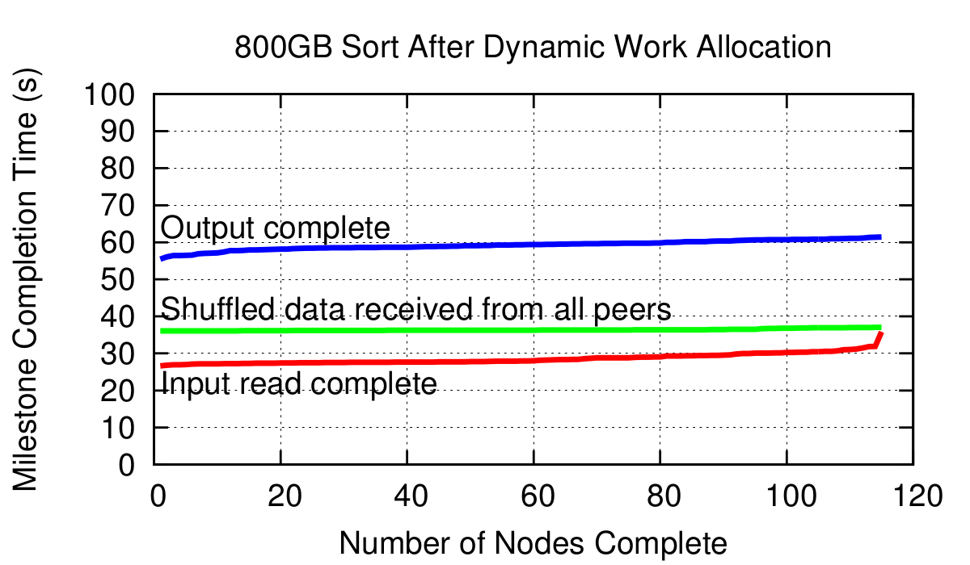

Dynamic Work Allocation

Slide 36
Conclusions
Agility and conceptual simplicity of a global store, without the usual performance penalty
Remote storage is as fast (throughput-wise) as local
Build high-performance, high-utilization clusters
Buy as many disks as you need aggregate IOPS
Provision enough network bandwidth based on computation to I/O ratio of expected applications
Apps can use I/O and compute in whatever ratio they need
By investing about 30% more for the network and use nearly all the hardware
Potentially enable new applications

Slide 37
Thank you!

Slide 38
FDS Sort vs. TritonSort
System | Computers | Disks | Sort Size | Time | Disk Throughput
FDS 2012 | 256 | 1,033 | 1,470GB | 59.4s | 47.9MB/s
TritonSort 2011 | 66 | 1,056 | 1,353GB | 59.2s | 43.3MB/s
Disk-wise: FDS is more efficient (~10%)
Computer-wise: FDS is less efficient, but …
Some is genuine inefficiency – sending data three times
Some is because FDS used a scrapheap of old computers
Only 7 disks per machine
Couldn’t run tractserver and client on the same machine
Design differences:
General-purpose remote store vs. purpose-built sort application
Could scale 10x with no changes vs. one big switch at the top

Slide 39
Hadoop on a 10G CLOS network?
Congestion isn’t eliminated; it’s been pushed to the edges
TCP bandwidth allocation performs poorly with short, fat flows: incast
FDS creates “circuits” using RTS/CTS
Full bisection bandwidth is only stochastic
Software written to assume bandwidth is scarce won’t try to use the network
We want to exploit all disks equally

Slide 40
Stock Market Analysis
Analyzes stock market data from BATStrading.com
23 seconds to
Read 2.5GB of compressed data from a blob
Decompress to 13GB & do computation
Write correlated data back to blobs
Original zlib compression thrown out – too slow!
FDS delivered 8MB/70ms/NIC, but each tract took 218ms to decompress (10 NICs, 16 cores)
Switched to XPress, which can decompress in 62ms
FDS turned this from an I/O-bound to compute-bound application

Slide 41
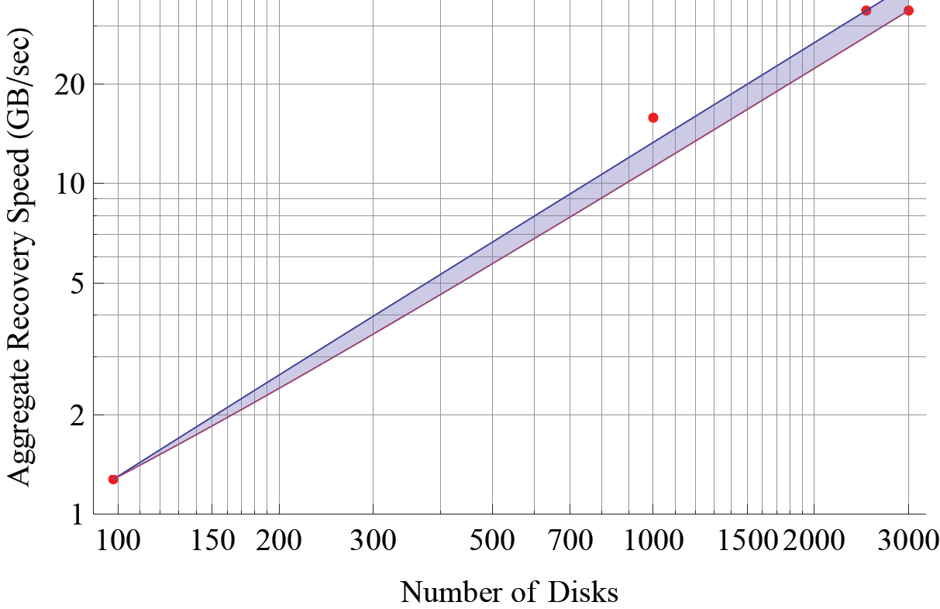
FDS Recovery Speed: Triple-Replicated, Single Disk Failure
2012 Result:
1,000 disks, 92GB per disk, recovered in 6.2 +/- 0.4 sec
2010 Estimate:
2,500-3,000 disks, 1TB per disk, should recover in 30 sec
2010 Experiment:
98 disks, 25GB per disk, recovered in 20 sec

Slide 42
Why is fast failure recovery important?
Increased data durability
Too many failures within a recovery window = data loss
Reduce window from hours to seconds
Decreased CapEx+OpEx
CapEx: No need for “hot spares”: all disks do work
OpEx: Don’t replace disks; wait for an upgrade.
Simplicity
Block writes until recovery completes
Avoid corner cases

Slide 43

FDS Cluster 1
14 machines (16 cores)
8 disks per machine
~10 1G NICs per machine
4x LB4G switches
40x1G + 4x10G
1x LB6M switch
24x10G
Made possible through the generous support of the eXtreme Computing Group (XCG)

Slide 44
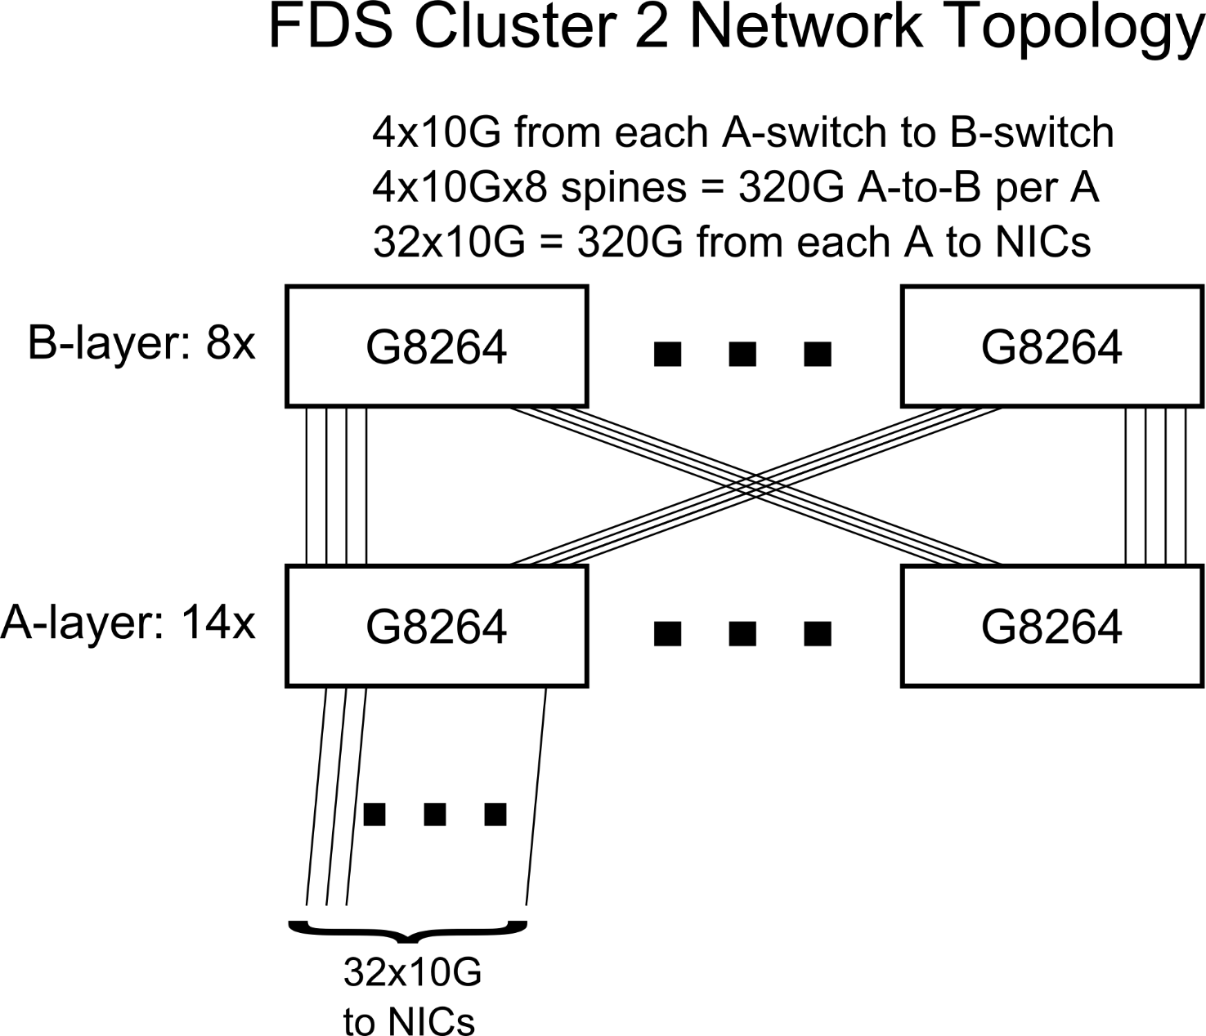
Cluster 2 Network Topology

Slide 45
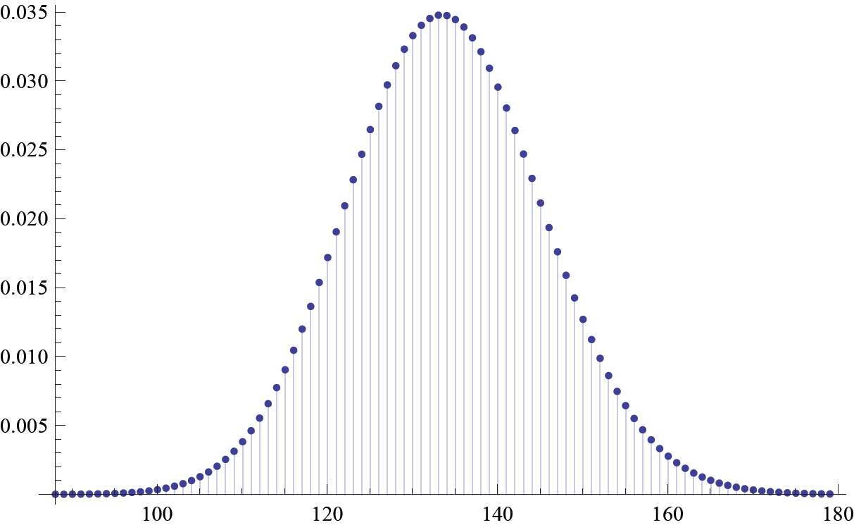
Distributing 8mb tracts to disks uniformly at random:
How many tracts is a disk likely to get?
60GB, 56 disks:
μ = 134, σ = 11.5
Likely range: 110-159
Max likely 18.7% higher than average

Slide 46
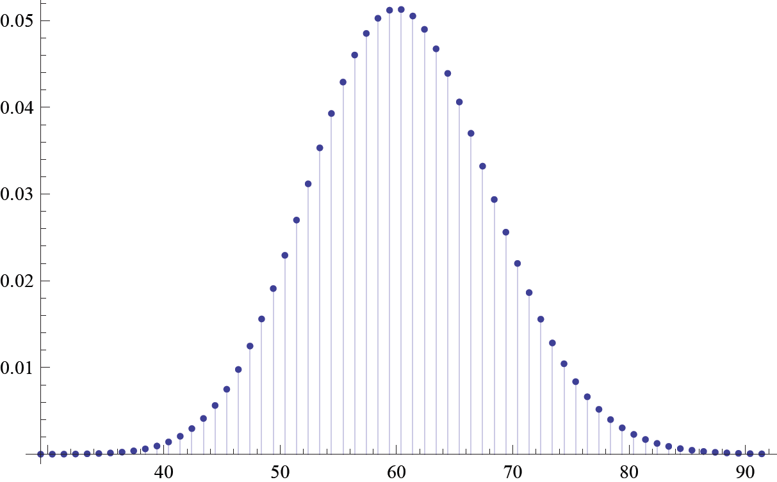
Distributing 8mb tracts to disks uniformly at random:
How many tracts is a disk likely to get?
500GB, 1,033 disks:
μ = 60, σ = 7.8
Likely range: 38 to 86
Max likely 42.1% higher than average
Solution (simplified): Change locator to
(Hash(Blob_GUID) + Tract_Number) MOD TableSize

