Slide 1

HULL: High bandwidth,
Ultra Low-Latency
Data Center Fabrics
Mohammad Alizadeh
Stanford University
Joint with:
Abdul Kabbani, Tom Edsall, Balaji Prabhakar, Amin Vahdat, Masato Yasuda

Slide 2
Latency in Data Centers
Latency is becoming a primary metric in DC
Operators worry about both average latency, and the high percentiles (99.9th or 99.99th)
High level tasks (e.g. loading a Facebook page) may require 1000s of low level transactions
Need to go after latency everywhere
End-host: software stack, NIC
Network: queuing delay
This talk

Slide 3







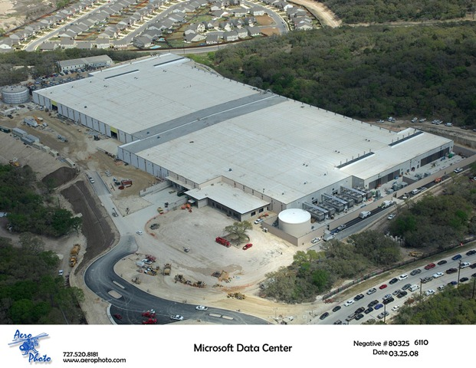










Example: Web Search
TLA
1.
Picasso
Art is…
Deadline = 250ms
2. Art is a lie…
3.
…..
Strict deadlines (SLAs)
Missed deadline
Lower quality result
Many RPCs per query
High percentiles matter
Picasso
MLA
………
MLA
1. Art is a lie…
1.
Deadline = 50ms
2.
2. The chief…
…..
3.
…..
3.
“Everything you can imagine is real.”
“Computers are useless.
They can only give you answers.”
“It is your work in life that is the ultimate seduction.“
“Bad artists copy.
Good artists steal.”
“I'd like to live as a poor man
with lots of money.“
“Art is a lie that makes us
realize the truth.
“The chief enemy of creativity is good sense.“
“Inspiration does exist,
but it must find you working.”
Deadline = 10ms
Worker Nodes
Notes:
After the animation, say “this follows what we call the partition/aggregate application structure. It’s actually quite general any time you have to do distributed lookups of large data structures to resolve queries.”

Slide 4
Roadmap: Reducing Queuing Latency
Baseline fabric latency (propagation + switching): ~10μs
TCP
~1–10ms
DCTCP
~100μs
HULL
~Zero Latency
Notes:
"With TCP, queuing delays can be in the milliseconds; more than 3 orders or magnitude larger than the baseline"

Slide 5


Low Latency & High Throughput
Data Center Workloads:
Short messages [50KB-1MB]
(Queries, Coordination, Control state)
Large flows [1MB-100MB]
(Data updates)
Low Latency
High Throughput
The challenge is to achieve both together.

Slide 6
TCP Buffer Requirement
Bandwidth-delay product rule of thumb:
A single flow needs C×RTT buffers for 100% Throughput.
B < C×RTT
B ≥ C×RTT
Buffering needed to absorb TCP’s rate fluctuations
B
Buffer Size
B
100%
100%
Throughput
Notes:
Now in the case of TCP, the question of how much buffering is needed for high throughput has been studied and is known in the literature as the buffer sizing problem.
End with: “So we need to find a way to reduce the buffering requirements.”

Slide 7
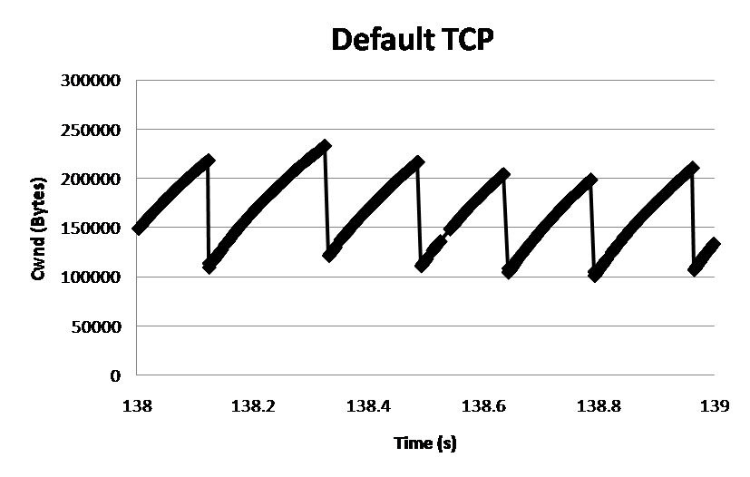
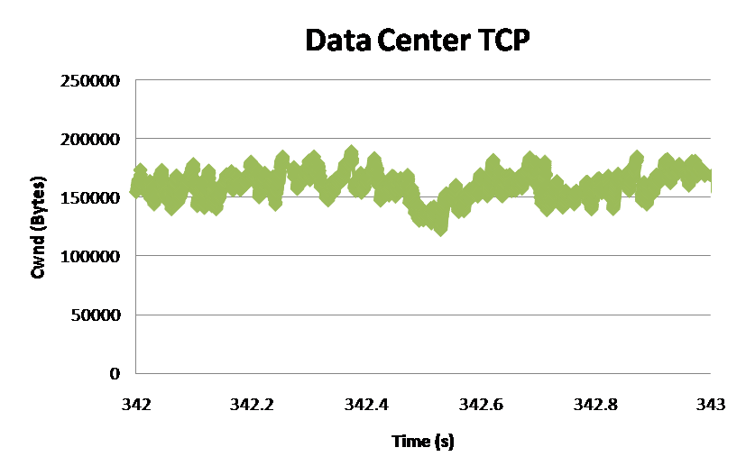
DCTCP: Main Idea
B
K
Don’t
Mark
Switch:
Set ECN Mark when Queue Length > K.
Mark
Source:
React in proportion to the extent of congestion
Reduce window size based on fraction of marked packets.
ECN Marks | TCP | DCTCP
1 0 1 1 1 1 0 1 1 1 | Cut window by 50% | Cut window by 40%
0 0 0 0 0 0 0 0 0 1 | Cut window by 50% | Cut window by 5%
Notes:
Start with: “How can we extract multi-bit information from single-bit stream of ECN marks?”
- Standard deviation: TCP (33.6KB), DCTCP (11.5KB)

Slide 8
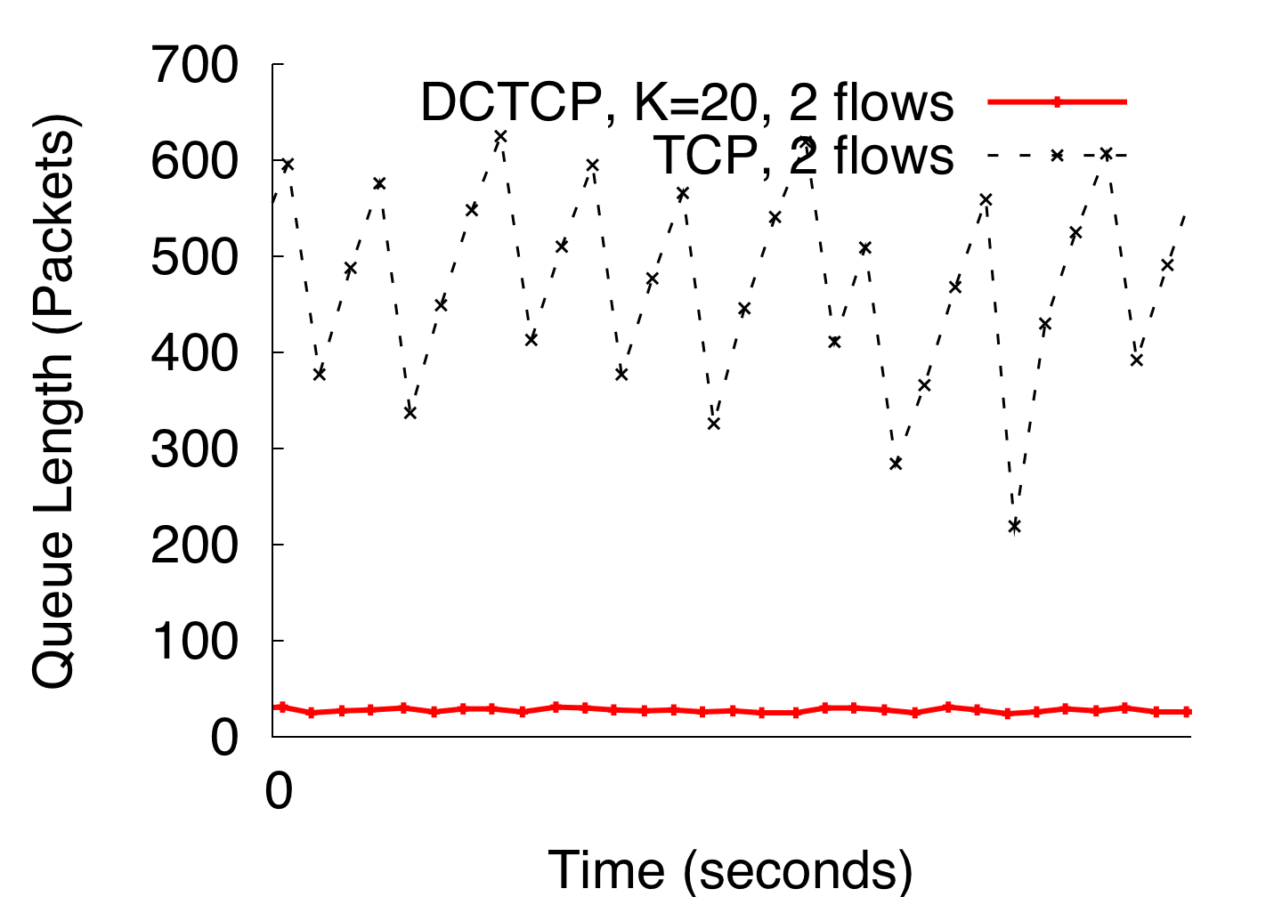
DCTCP vs TCP
(Kbytes)
Setup: Win 7, Broadcom 1Gbps Switch
Scenario: 2 long-lived flows,
ECN Marking Thresh = 30KB
Notes:
Not ns2.

Slide 9
HULL: Ultra Low Latency

Slide 10
What do we want?
TCP
Incoming Traffic
C
TCP:
~1–10ms
DCTCP
K
Incoming Traffic
C
DCTCP:
~100μs
~Zero Latency
How do we get this?

Slide 11
Phantom Queue
Key idea:
Associate congestion with link utilization, not buffer occupancy
Virtual Queue (Gibbens & Kelly 1999, Kunniyur & Srikant 2001)
Switch
Bump on Wire
Link
Speed C
Marking Thresh.
γC
γ < 1 creates
“bandwidth headroom”

Slide 12
Throughput & Latency vs. PQ Drain Rate
Throughput
Switch latency (mean)

Slide 13
The Need for Pacing
TCP traffic is very bursty
Made worse by CPU-offload optimizations like Large Send Offload and Interrupt Coalescing
Causes spikes in queuing, increasing latency
Example. 1Gbps flow on 10G NIC
65KB bursts every 0.5ms

Slide 14
Hardware Pacer Module
Algorithmic challenges:
Which flows to pace?
Elephants: Begin pacing only if flow receives multiple ECN marks
At what rate to pace?
Found dynamically:
Token Bucket
Rate Limiter
Flow Association
Table
R
Q_{TB}
TX
Outgoing Packets
From
Server NIC
Un-paced Traffic

Slide 15
Throughput & Latency vs. PQ Drain Rate
(with Pacing)
Throughput
Switch latency (mean)

Slide 16
No Pacing vs Pacing (Mean Latency)
No Pacing
Pacing

Slide 17
No Pacing vs Pacing (99th Percentile Latency)
No Pacing
Pacing

Slide 18

The HULL Architecture
Phantom Queue
Hardware
Pacer
DCTCP Congestion Control

Slide 19
More Details…
Large Flows
Small Flows
Link (with speed C)
Host
Large
Burst
NIC
Switch
Pacer
DCTCP CC
Application
PQ
LSO
Empty Queue
γ x C
ECN Thresh.
Hardware pacing is after segmentation in NIC.
Mice flows skip the pacer; are not delayed.

Slide 20
Dynamic Flow Experiment 20% load
9 senders → 1 receiver (80% 1KB flows, 20% 10MB flows).
Load: 20% | Switch Latency (μs) |  | 10MB FCT (ms)
 | Avg | 99th | Avg | 99th
TCP | 111.5 | 1,224.8 | 110.2 | 349.6
DCTCP-30K | 38.4 | 295.2 | 106.8 | 301.7
DCTCP-6K-Pacer | 6.6 | 59.7 | 111.8 | 320.0
DCTCP-PQ950-Pacer | 2.8 | 18.6 | 125.4 | 359.9
~93% decrease
~17% increase

Slide 21
Dynamic Flow Experiment 40% load
9 senders → 1 receiver (80% 1KB flows, 20% 10MB flows).
Load: 40% | Switch Latency (μs) |  | 10MB FCT (ms)
 | Avg | 99th | Avg | 99th
TCP | 329.3 | 3,960.8 | 151.3 | 575
DCTCP-30K | 78.3 | 556 | 155.1 | 503.3
DCTCP-6K-Pacer | 15.1 | 213.4 | 168.7 | 567.5
DCTCP-PQ950-Pacer | 7.0 | 48.2 | 198.8 | 654.7
~91% decrease
~28% increase

Slide 22
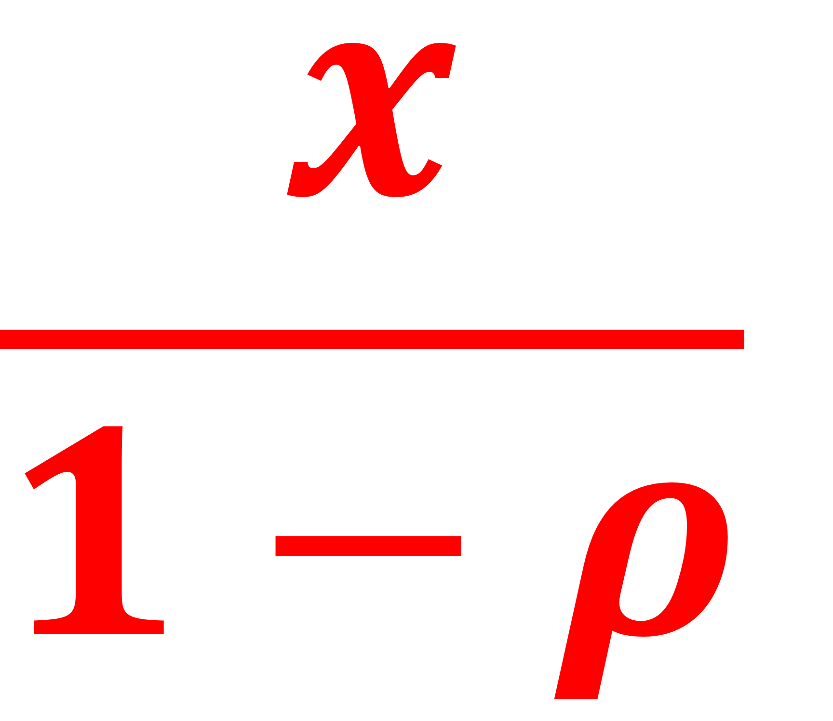
Slowdown due to bandwidth headroom
Processor sharing model for elephants
On a link of capacity 1, a flow of size x takes
on average to complete (ρ is the total load).
Example: (ρ = 40%)
Slowdown = 50%
Not 20%
1
0.8

Slide 23
Slowdown: Theory vs Experiment
DCTCP-PQ800
DCTCP-PQ900
DCTCP-PQ950

Slide 24
Summary
The HULL architecture combines
DCTCP
Phantom queues
Hardware pacing
A small amount of bandwidth headroom gives significant (often 10-40x) latency reductions, with a predictable slowdown for large flows.

Slide 25
Thank you!

