Slide 1
The Skywatch Observatory: ATOC keeping an eye to the sky
http://skywatch.colorado.edu

Slide 2
Overview
The path to Skywatch
Video tour of the facility
Brief rooftop instrument overview
Description of real-time and archived data available on skywatch.colorado.edu
Specific cases
Future
Notes:
Ulterior motive to the talk
Motive students and faculty use the Skywatch resources and maybe contribute to the advancement of our effort to develop a high quality local enviromental monitoring system.
Opportunity to look to the sky then investigate what the instrumentation observes.
Improve your skills as an atmospheric scientist.
Will discuss some student contributions in the talk.

Slide 3
History of Skywatch facility
Department chair requests support from the Dean’s Fund for Renovations – September 2005
Upgrade our office space for suitable use as a classroom/laboratory teaching facility in atmospheric science.
Design and construction started January 2006 and completed January 2007
Notes:
Renovations committee was formed
Peter Pilewskie, Linnea Avallone, Brian Toon, Scott Kittelman, John Cassano, Darin Toohey
Construction was coordinated by Facilities management 20% for themselves and 15% contingency fee
Plumbing and electrical work, new entrance, new flooring, paint, work benches, storage cabinets, wall mount crane, rooftop posts which could be used to mount an
instrument platform.
Because of the high fees charged by FAC man it was recognized early in the process that we needed to focus on the things which were absolutely necessary.

Slide 4
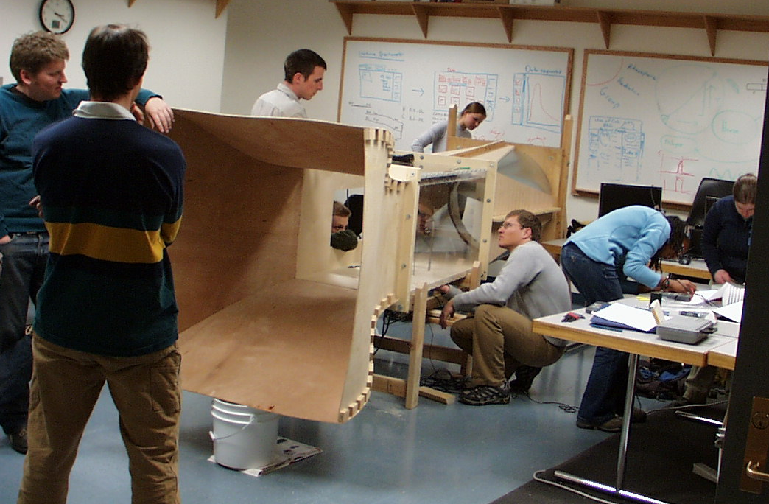
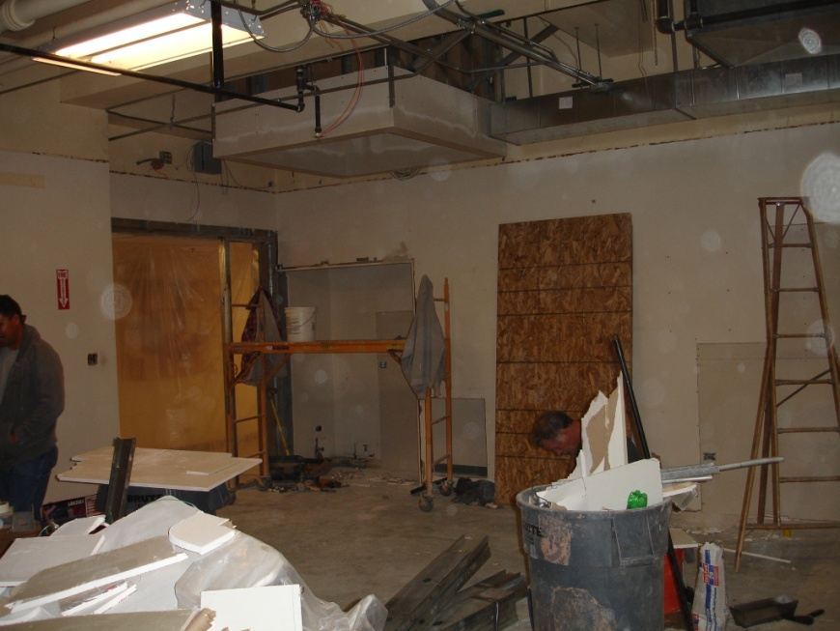
From PAOS office to laboratory/classroom
Notes:
Duane Physics, Room D-318 under construction
Students in Pilewskie’s spring 2008 instrumentation course assemble the ATOC wind tunnel in D-318

Slide 5
Occupying the space
ATOC support
Folding tables & chairs
Audio and video system
Basic laboratory supplies
Standard weather sensors for instrumentation class
Computers & software
Data acquisition systems
Outside instrumentation platform
Color printer and map board for forecasting class
Notes:
Total commitment ~ $40k
Some donated items from the GFD lab
Lab supplies primary of instrumentation course
Electronics, data acquisition, computers, and software allow students to design and construct their own instrumentation

Slide 6
Additional support necessary
Current faculty recognizes the need for a funding source beyond the ATOC department
High quality environmental sensors come at a high price
Proposals written to NSF Geosciences Education
Focus on improving the quality and effectiveness of geoscience education at all educational levels.
Course, Curriculum, and Laboratory Improvement program proves to be a better fit.
Two year award received in January 2009
Notes:
NSF Directorate for Education and Human Resources (EHR)
Transforming Undergraduate Education in Science, Technology, Engineering and Mathematics (TUES)
Program seeks to improve the quality of science, technology, engineering, and mathematics (STEM) education for all undergraduate students.
Skywatch instrumentation on the rooftop totals ~ $150k
Money from the grant pays only for instruments, and not for the effort put in by the principal investigators
In the final proposal which was funded, Katja Friedrich joined the team bringing her expertise in precipitation instrumentation.

Slide 7
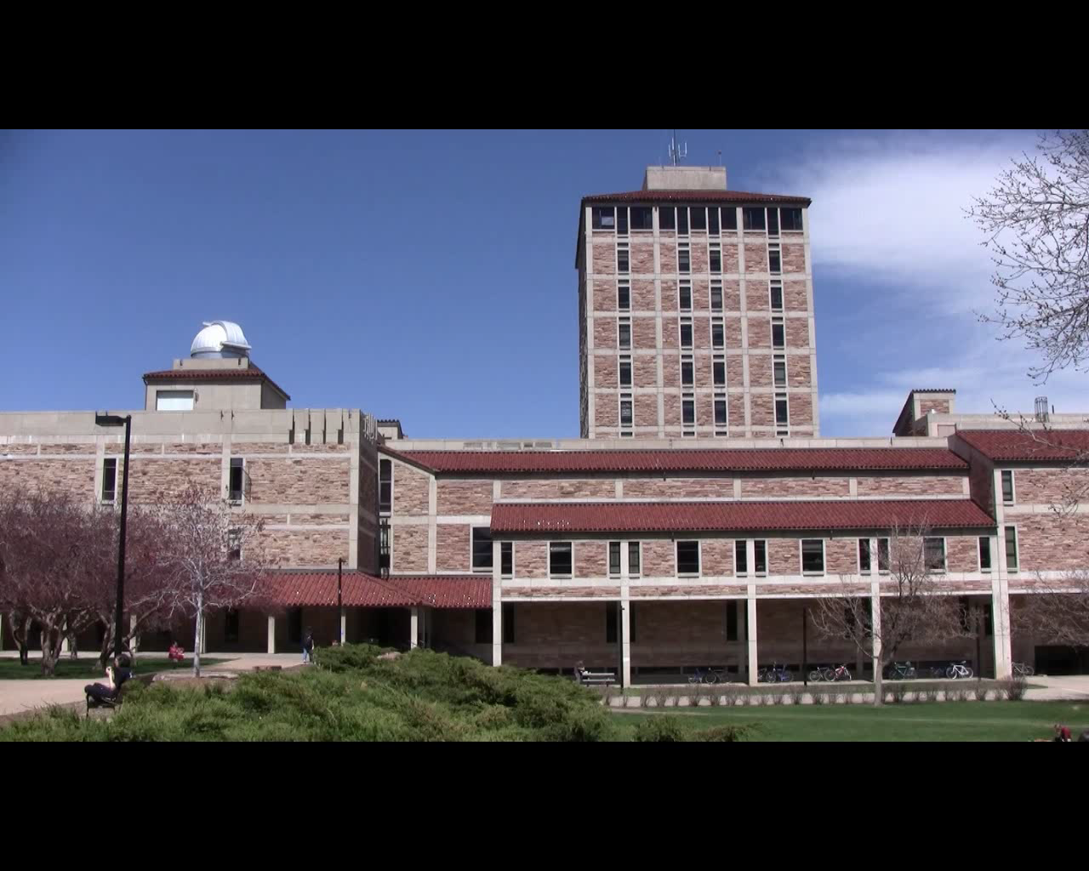
Skywatch facility tour
Notes:
Point out items as the video progresses

Slide 8
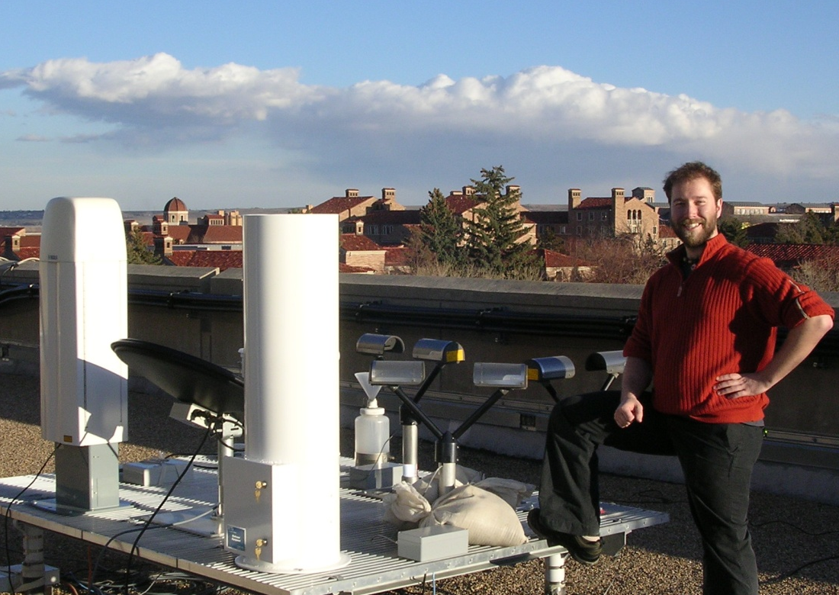
Rooftop Instruments
ATOC weather station
Laser optical disdrometer
Micro rain radar
Total precipitation gauge
Pyranometer
Pyrgeometer
Ceilometer
Sun photometer
Solar Spectral Flux Radiometer
Ozone monitor
Web camera
Notes:
Use laser pointer to show items on the platform as you name them
Graduate student appreciation week next week

Slide 9
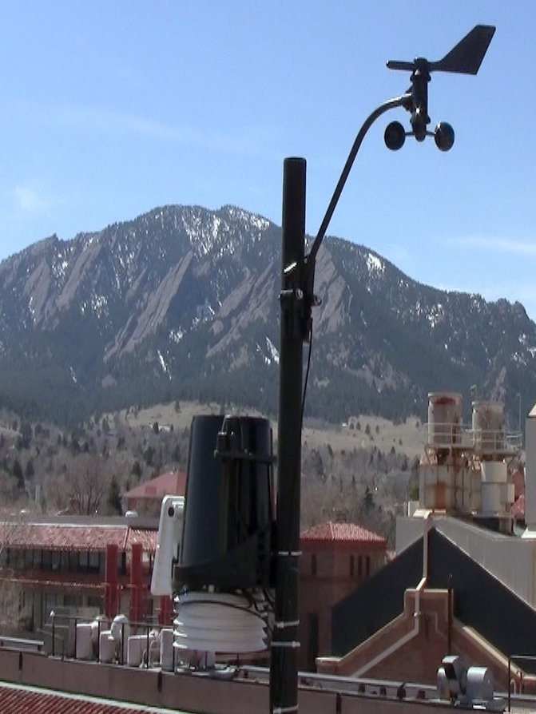
ATOC weather station
Temperature (+/- 0.5 °C)
Humidity
Barometric pressure
Wind speed and direction
Solar radiation
Rain amount
Maintained by faculty member
Davis Vantage Pro2
Notes:
Make special note of the temperature accuracy, and this does not include any systematic error due to location
White passive radiation shield protects humidity and temperature sensors from direct solar radiation
Dave Porter did a study comparing offset due to different radiation shields (statistical effort)
Sensors:
Barometric Pressure
Range 540 to 1100 hPa , accuracy = +/- 1 hPa
Temperature – Thermistor
range -40° to +65° C, accuracy +/- 0.5 C
Relative Humidity - Film capacitor element
Resolution and Units -1%, Range - 1 to 100% RH, Accuracy ±3% (0 to 90% RH), ±4% (90 to 100% RH)
Rain gauge
resolution 0.2mm (one tip) , accuracy = +/- 3% of total
catch diameter is 8.75 inches
Solar radiation
resolution 1 W/m^2, range 0 to 1800 W/m^2, accuracy = +/- 5% of full scale

Slide 10
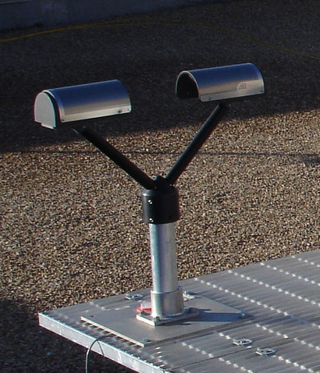
Laser Optical Disdrometer
Laser diode beam 1 mm x 30 mm x 180 mm
Simultaneous measurement of
hydrometeor diameter and velocity
PAR-SI-VEL
Derives accumulated rainfall,
equivalent radar reflectivity (dBZ) ,
and rainfall rate
Size range 0.2 to 25 mm
Fall velocity range .2 to 20 m/s
OTT Parsivel
Notes:
Drop size Distribution Measurement (Disdrometer)
Current measure period is 30 seconds
Rain rate range 0.001 mm/hour to 1,200 mm/hour
dBZ-scale of rain: >40 heavy, 24-39 moderate, 8-23 light ,0-8 Barely anything
The reference level for Z is 1 mm⁶ m⁻³, which is equal to 1 μm³. It is related to the number of drops per unit volume and the sixth power of drop diameter.
Laser diode 650 nm , 3 mW, class II

Slide 11
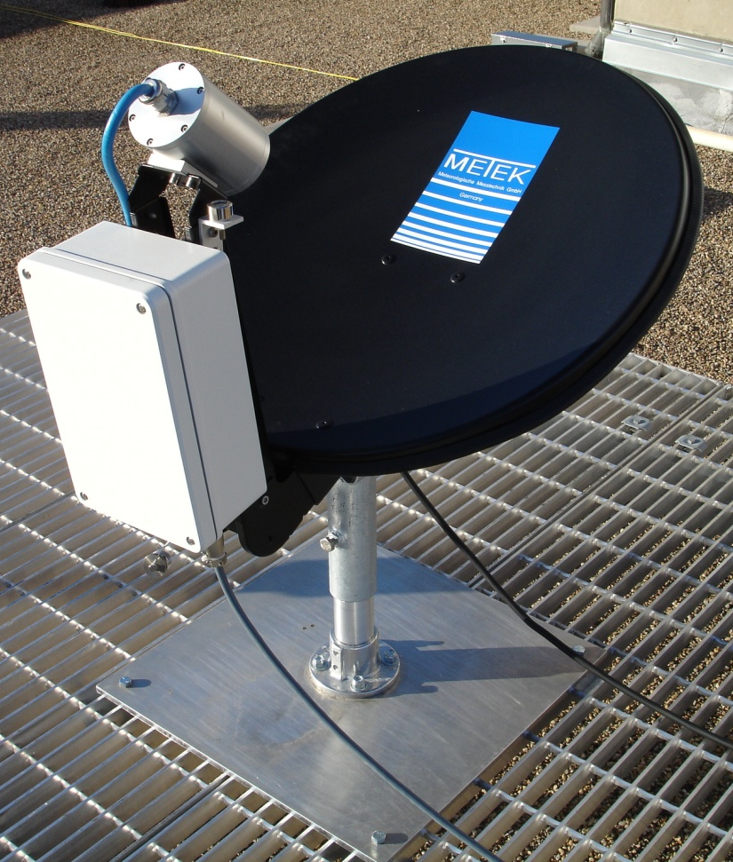
Micro Rain Radar
Zenith pointing radar
24.1Ghz, or λ = 1.2 cm, or K band
Vertical profiles of radar reflectivity, fall velocity, rain rate, and liquid water content
Drop size distribution
Monitoring of the melting layer
Compare with in-situ disdrometer
Metek MRR-2
Notes:
Beam Width (1-way, 3 dB) = 2°
Zenith pointing frequency modulated continuous wave (FMCW) doppler radar – different from pulsed radar
Uses the difference in the frequency between the output signal and the echo to determine the time which in turn can be used to calculate the distance to the reflected signal, however the frequency is also shifted by the fall velocity of the hydrometeors.
An interesting project would be to compare rainfall rates determined by the laser optical disdrometer and micro rain radar
Then compare this to the total precipitation recorded either by the tipping bucket or an instrument I will discuss in a moment.
Height resolution 35 ... 200 m – currently set at 150 meters, with measurements over 31 levels
Averaging time 10 ... 3600 s
Transmit power 50 mW
The measuring principle is based on the relation between dropsize and scattering crosssection and between dropsize and fall velocity. METEK Micro Rain Radar uses a monostatic antenna configuration for reliable retrieval of dropsize distribution (DSD). No a priori assumption on DSD-structure is required.
The IEEE K band is a portion of the electromagnetic spectrum in the microwave range of frequencies ranging between 18 and 27 GHz. K band between 18 and 26.5 GHz is absorbed easily by water vapor (H2O resonance peak at 22.24 GHz, 1.35 cm).
For radars with wavelengths shorter than 3 cm, Mie scattering and attenuation must be considered in the evaluation of the data. The advantage of these shorter wavelength radars, however, is the low production costs because only small antenna sizes are needed to produce narrow beams and because of the low necessary transmitter power due to scattering gain. The cheaper, more flexible, shorter wavelength systems would allow for an extensive network of vertically pointing Doppler radars, leading to an improvement of the monitoring of rainfall with radar.

Slide 12
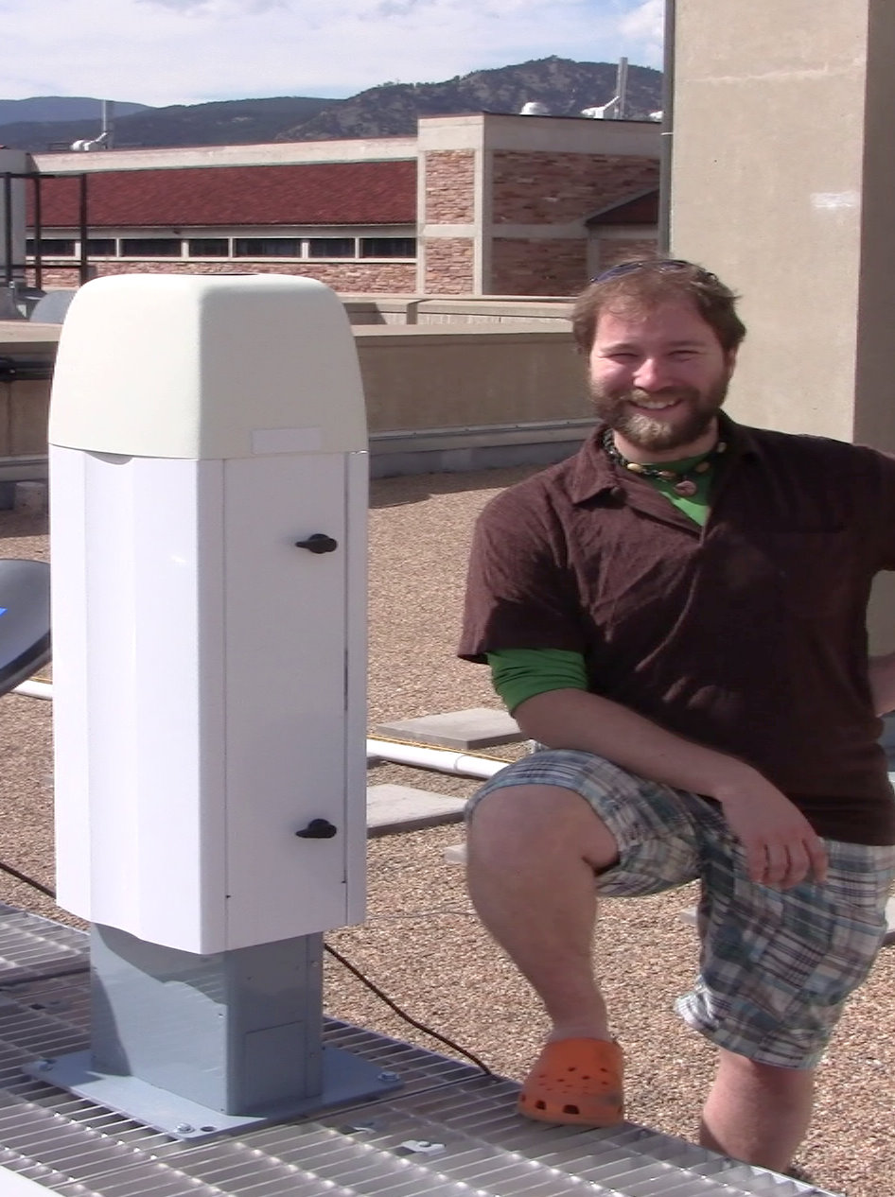
Ceilometer
Measurement- height of cloud base
Multiple layers possible if optically thin
Zenith pointing pulsed diode laser 0.91µm
Backscatter profile range 0 to 7.5 km at
10 m resolution, every 16 seconds
Currently testing for measuring mixing layer height and aerosol concentration
Vaisala Ceilometer CL31
Notes:
measurement cycle can be adjusted between 2 and 120 seconds, currently 16 seconds
Single lens system
Sloped output window surface to drain water and a blower to dry.
Laser InGaAs diode, 910 nm, (Class 1M)

Slide 13
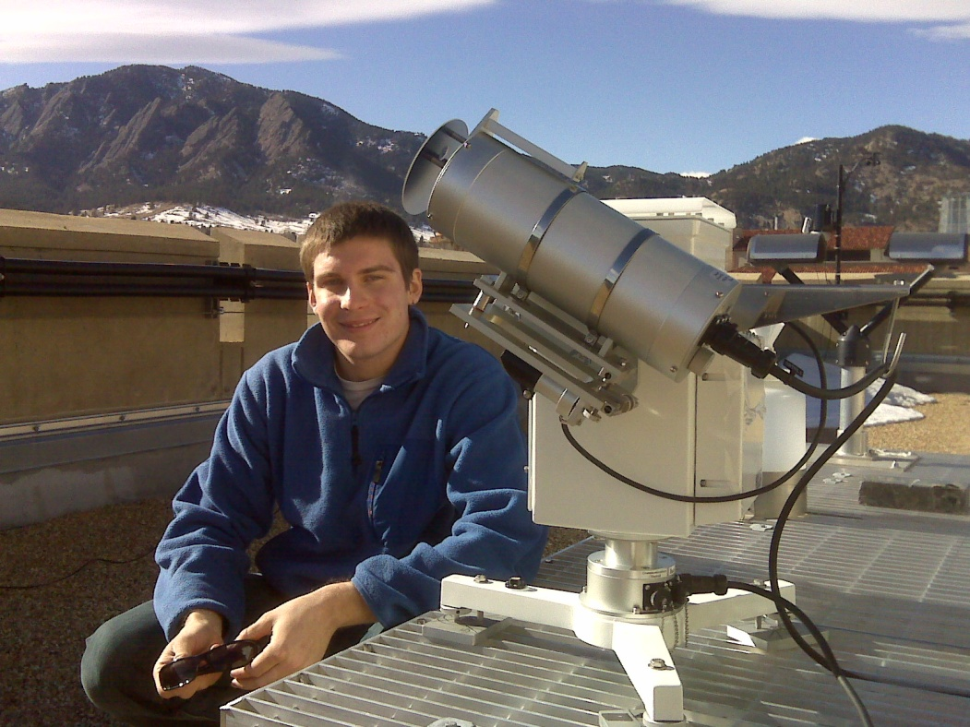
Sun Photometer
Measures direct solar radiation spectrum
Wavelength range 0.35 to -1.05 µm
Grating and 1024 Si CCD array
2° field of view
Solar tracker with active
Sun location sensor
Kipp and Zonen PGS-100
(Prede)
Notes:
Measurement method solid state grating spectrometer, silicon charge-couple device array (move charge between capacitive bins in the device-shift register)
Wavelength range 350 nm to 1050 nm
Resolution 3.6 nm
Wavelength accuracy 0.5 nm
View half-angle 1 º

Slide 14
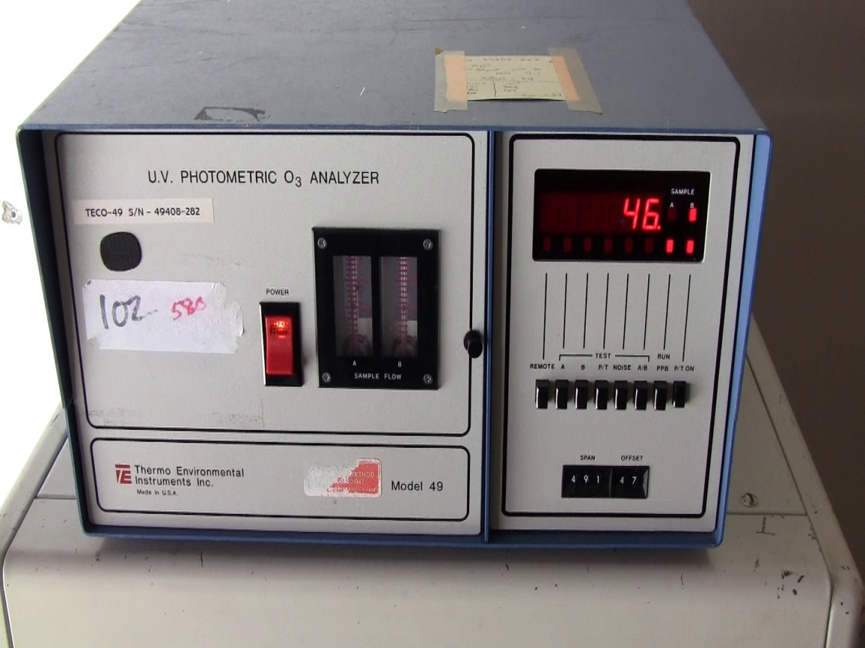
Air Quality
Ozone monitoring
Retired EPA instrument
refurbished and calibrated
Measurement in parts
per billion (PPB)
Thermo Environmental
Instrument Model 49
Notes:
No manual that I can find
Parts are no longer available from the manufacturer
Two cell measurement
UV wavelength 245 nm
Compare absorption with the ozone scrubbed cell

Slide 15
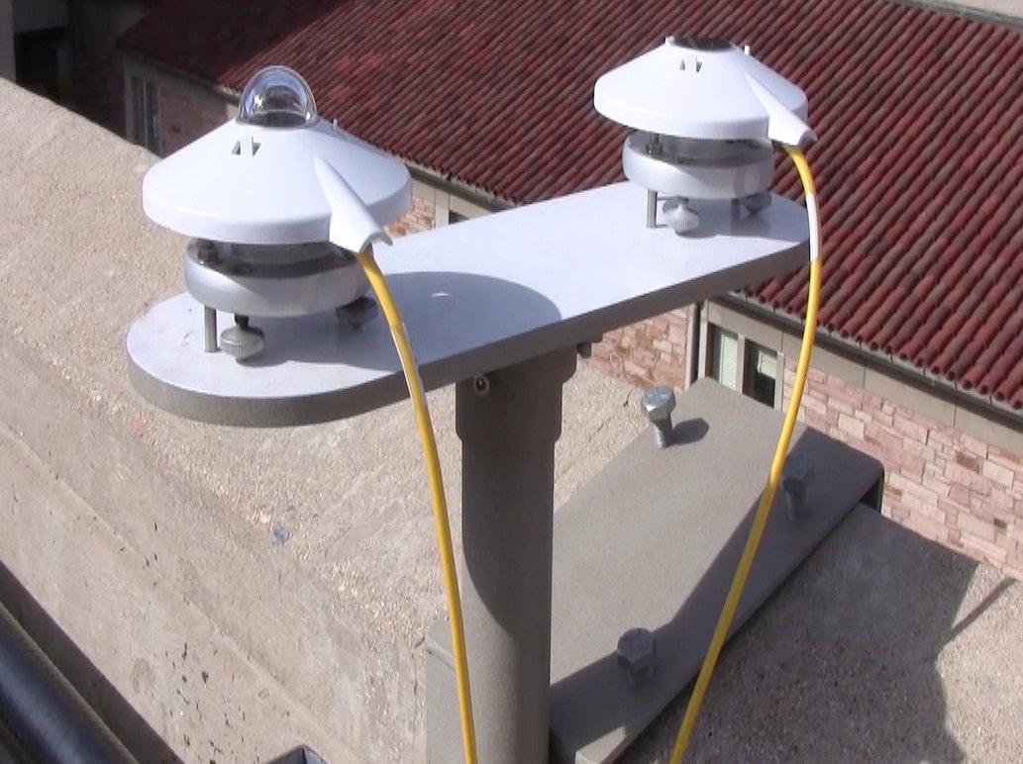
Pyranometer
Measurement - downwelling solar radiation
Wavelength range from 0.31 µm to 2.8 µm
Whole hemisphere field of view
Response time < 18 s
Calibrated in Watts / m²
Kipp & Zonen CMP 3
Notes:
Dome of fused silica (SiO₂)
Good for shedding water
Snow does accumulate and must be removed

Slide 16
Pyrgeometer
Measurement - downwelling infrared radiation
Wavelength range from 4.5 μm to 42 μm
Response time < 18 s
150° hemispheric field
of view
Silicon window
Sebastian Schimdt
calibrated for us using a CG4
in Watts / m²
Kipp & Zonen CGR 3
Notes:
Sebastian Schimdt calibrated against CG4 with 180 degree hemispheric view
Flat window design collects water and dirt
Silicon (a metalloid) windows work as bandpass filters
Interesting fact - Silicon and Germanium are less dense as solids like water.
Demonstrate the hands on portion of the 1070 atmospheric radiation lab
Kim Trenbath leading the effort in education research to assess the effectiveness of our labs

Slide 17
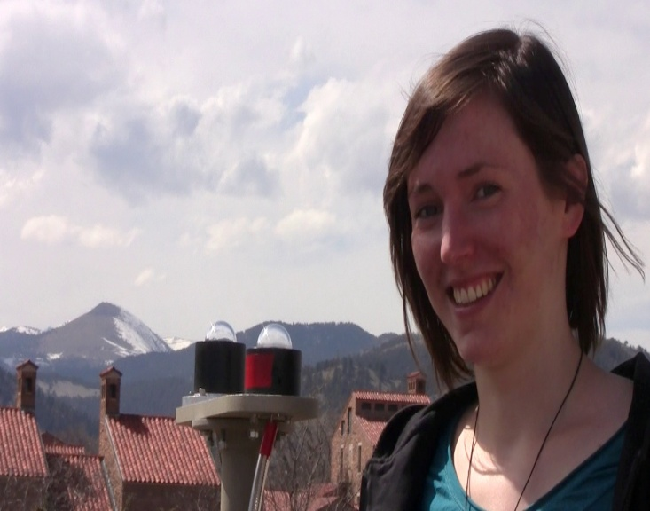
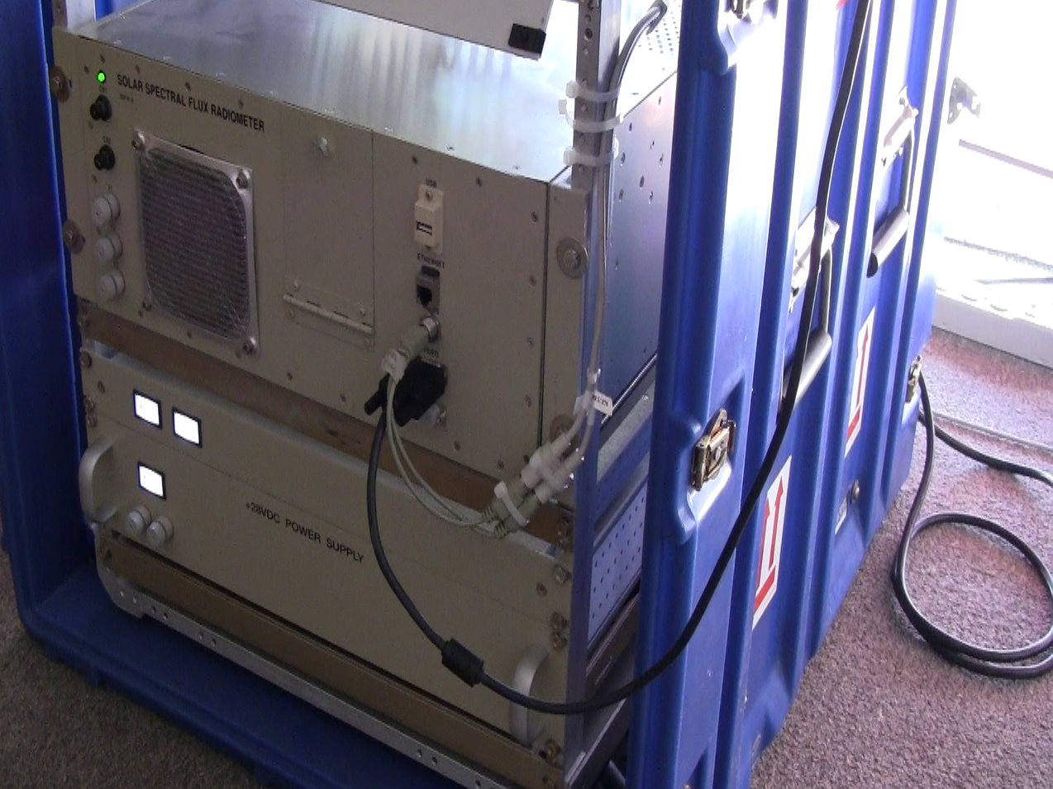
Solar Spectral Flux Radiometer
One scanning sky radiance light collector
One fixed hemispheric light collector
0.35 to 2.15 µm spectral range
8-12 nm spectral resolution
Sampling resolution ~ 3 nm
Si and InGaAs Zeiss
spectrometers
Solar Spectral Flux
Radiometer – donated
Notes:
Zeiss MMS-1 (300-1100 nm; Hamamatsu Si linear diode array)
Zeiss NIR PGS 2.2 (900 – 2200 nm; Hamamatsu InGaAs linear diode array)
Indium gallium arsenide (InGaAs) is a semiconductor composed of indium, gallium and arsenic.
8 nm resolution (full width half max) from 300-975 nm and 12 nm resolution from 975-2200 nm
418 points acquired between 350 nm and 2150 nm

Slide 18
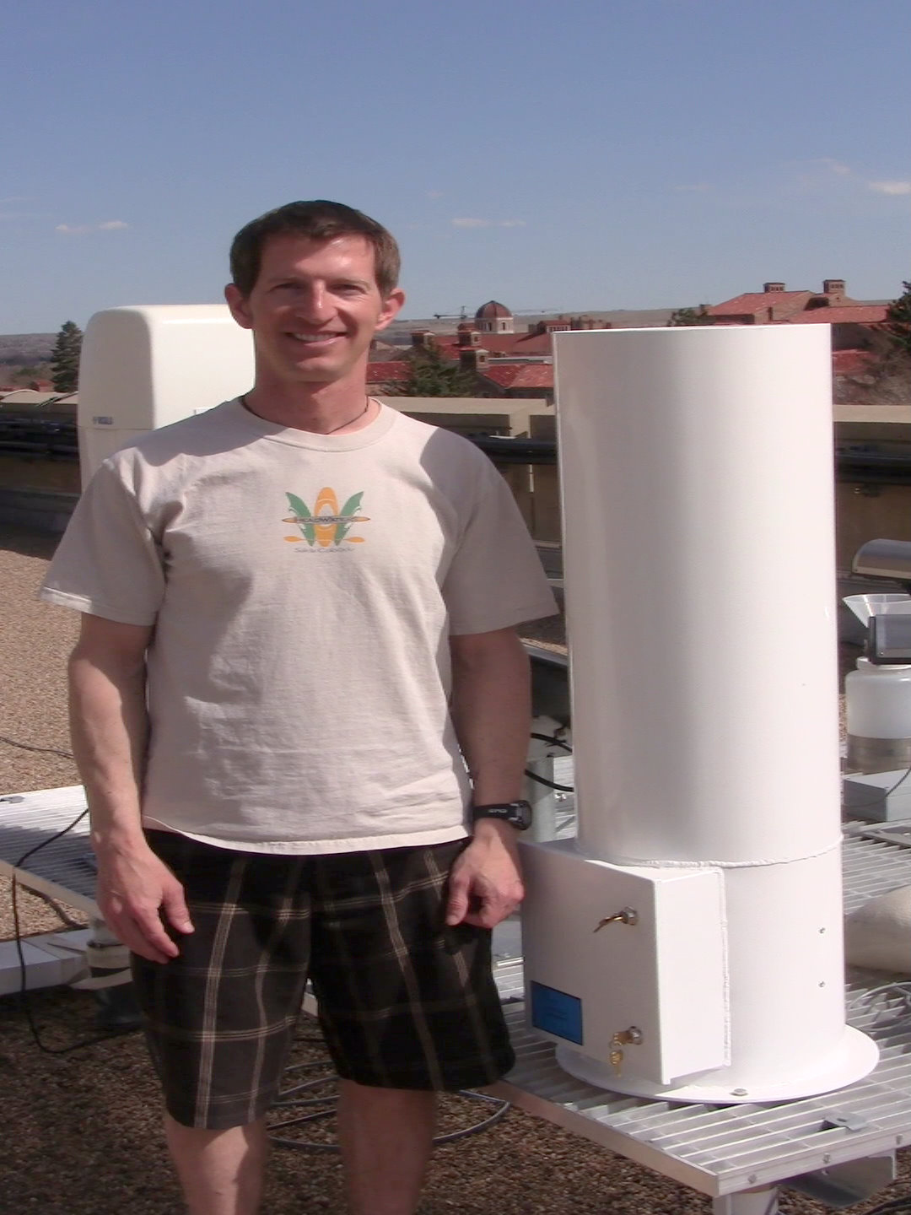
Total Precipitation Gauge
Accumulated precipitation
Measures the weight of the fluid column above a load transducer
Sampling interval 1 minute
Accuracy = +/- 0.25mm
NOAH II from ETI Instrument Systems Inc.
Notes:
Maximum accumulation is 20 inches, but that also depends on the amount of antifreeze required.
Load cell is a transducer that converts force into an electrical signal (millivolt range).
Catch diameter is 12 inches
James is in the process of working with ETI
Mysteriously accumulating precipitation on clear sky days
Interesting during wet snows – accumulation on rim and at the oil interface
Likely will result in precipitation recorded after the storm is over.
Not good for determining snowfall rate.

Slide 19
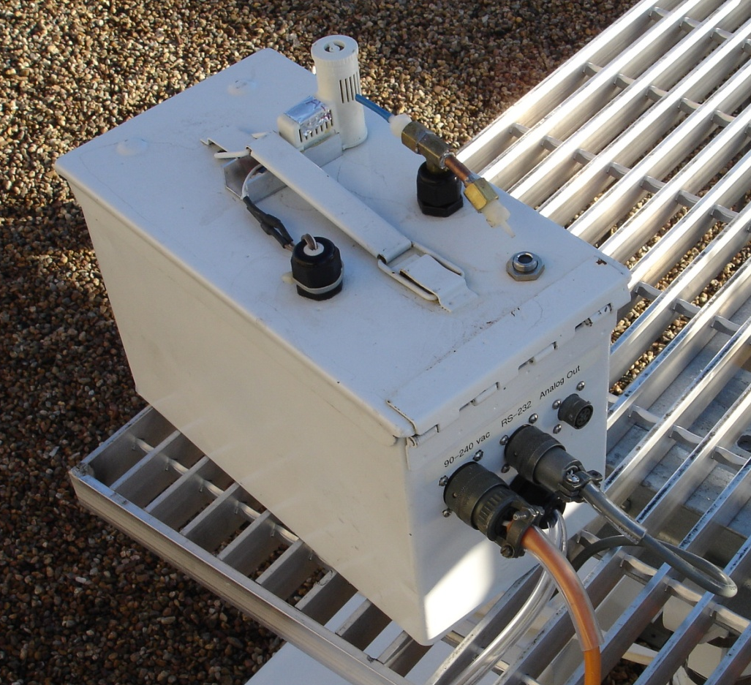
Student instrumentation
Collaborator- Infrared Cloud Thermometer
Compare with ceilometer
For use in a NOAA Global
Monitoring Division
automated lidar system
Notes:
Lidars used to measure episodic injections and background levels of stratospheric aerosols.
Require clear sky conditions
Automation will minimize the current lidar reliance on operator weather observations and maximize the number of observations obtained.
Used the ATOC ceilometer’s ability to detect clouds to compare to the Infrared Cloud Thermometer’s detection ability

Slide 20
Current Data Products
Accessible through: http://skywatch.colorado.edu
Two Formats:
Graphical
Data Ascii File
Can be read through Excel and IDL
Archived

Slide 21
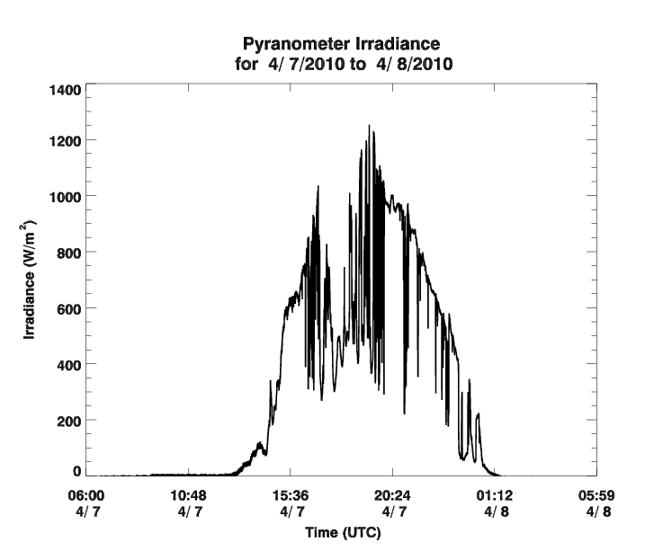
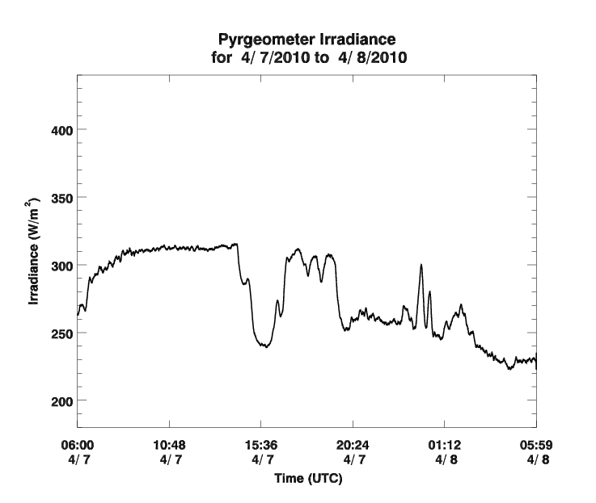
Pyranometer + Pyrgeometer
Pyranometer
Short Wave Irradiance
Time
Irradiance (W/m²⁾
Pyrgeometer
Long Wave Irradiance
Time

Slide 22
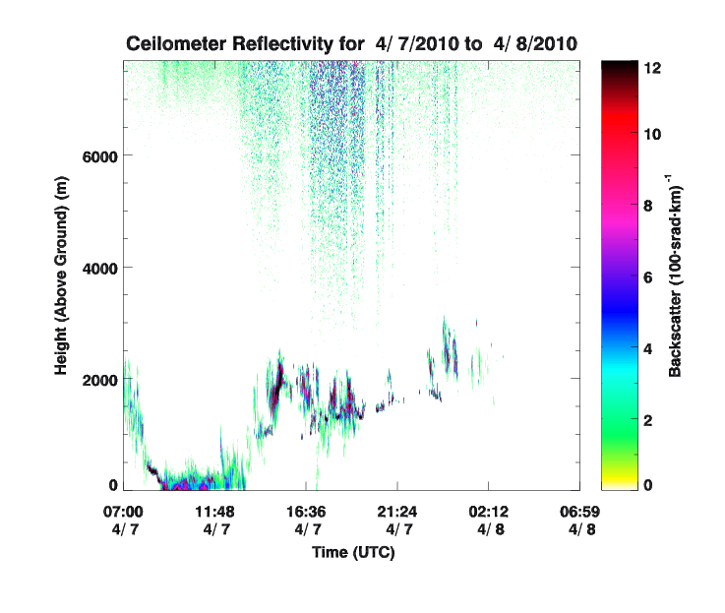
Ceilometer
Reflectivity
Cloud base height (up to 3)
Mixing Layer Height

Slide 23
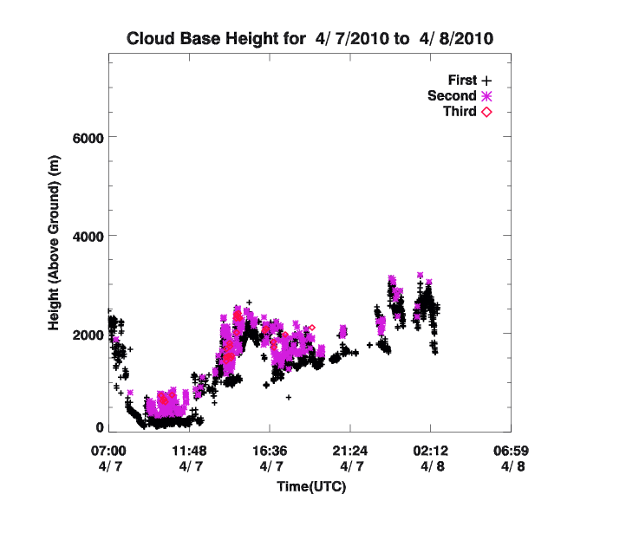
Ceilometer
Reflectivity
Cloud base height (up to 3)
Mixing Layer Height

Slide 24
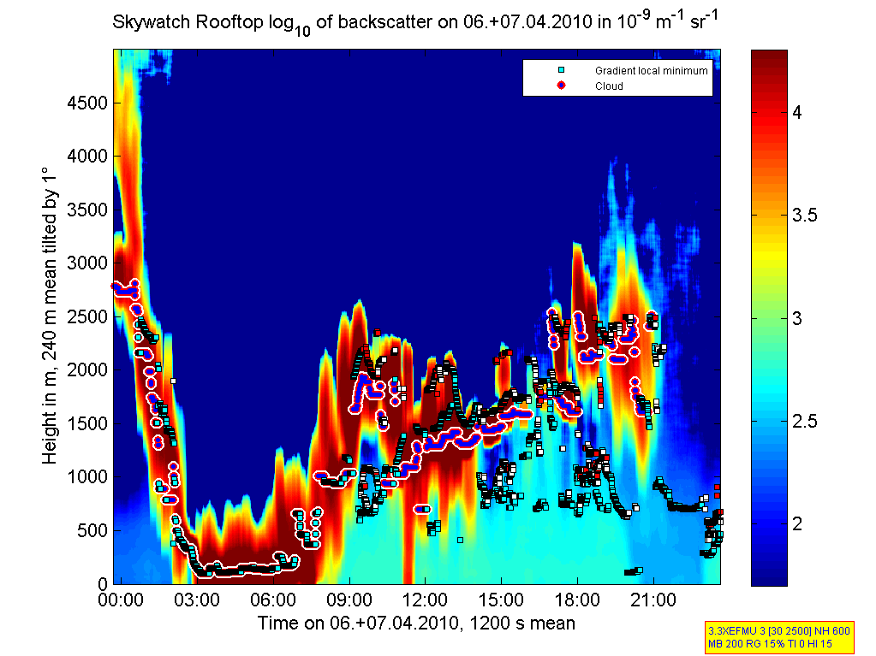
Ceilometer
Reflectivity
Cloud base height (up to 3)
Mixing Layer Height

Slide 25
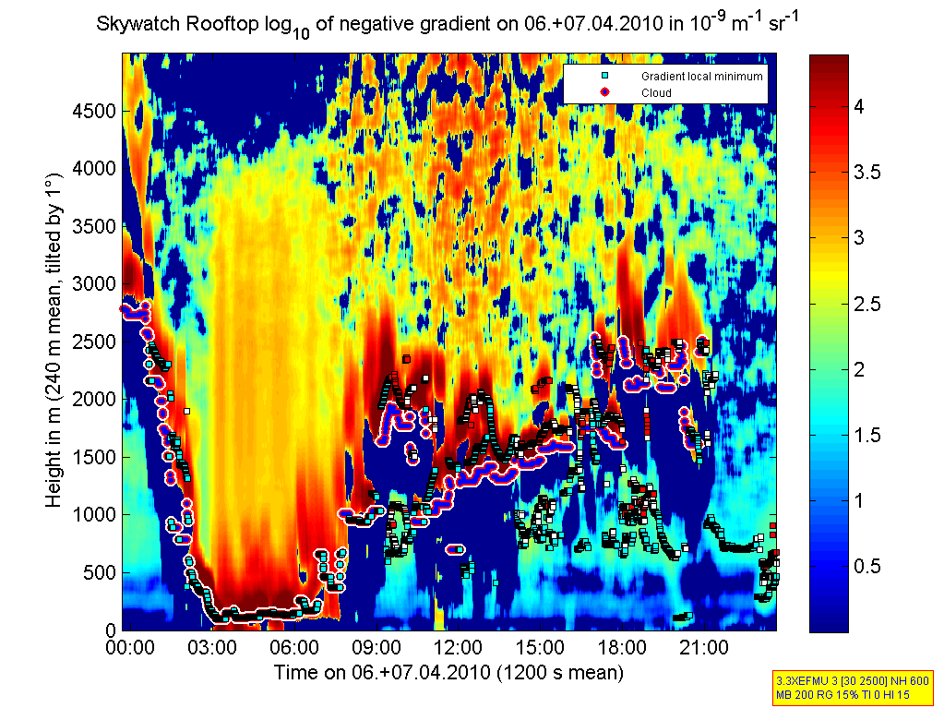
Ceilometer
Reflectivity
Cloud base height (up to 3)
Mixing Layer Height
Looks for the end of high reflectivity due to Aerosols
Detection rate between 40% and 62%
De Haij et al.
Notes:
Hard to detect deep Convective Mixing Layer
Uses Haar Wavelet Transform

Slide 26
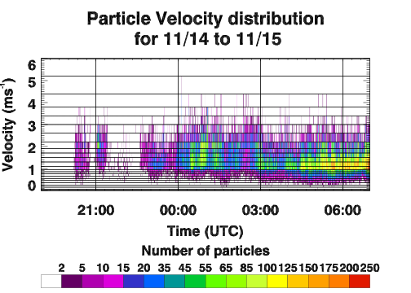
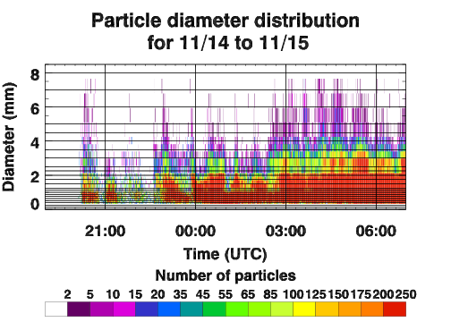
Disdrometer
Drop size and velocity Distribution

Slide 27
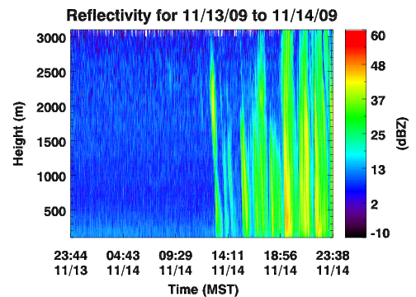
Micro Rain Radar
Reflectivity
Rain Rate
Fall velocity
Liquid Water Content
Drop size distribution
Drop number distribution

Slide 28
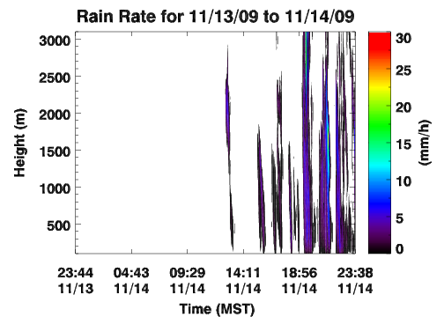
Micro Rain Radar
Reflectivity
Rain Rate
Fall velocity
Liquid Water Content
Drop size distribution
Drop number distribution

Slide 29
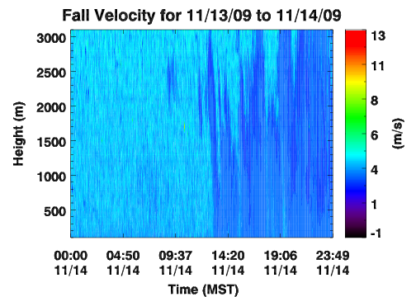
Micro Rain Radar
Reflectivity
Rain Rate
Fall velocity
Liquid Water Content
Drop size distribution
Drop number distribution

Slide 30
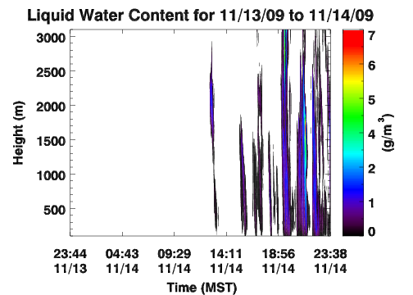
Micro Rain Radar
Reflectivity
Rain Rate
Fall velocity
Liquid Water Content
Drop size distribution
Drop number distribution

Slide 31
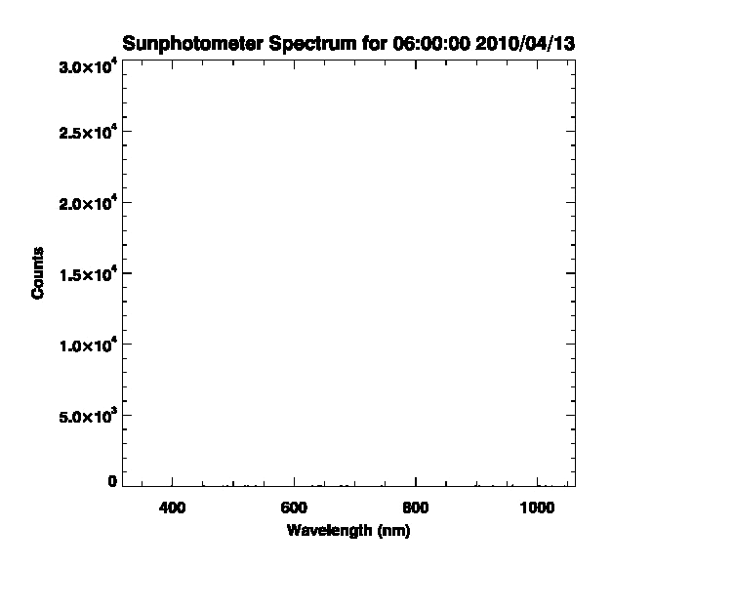
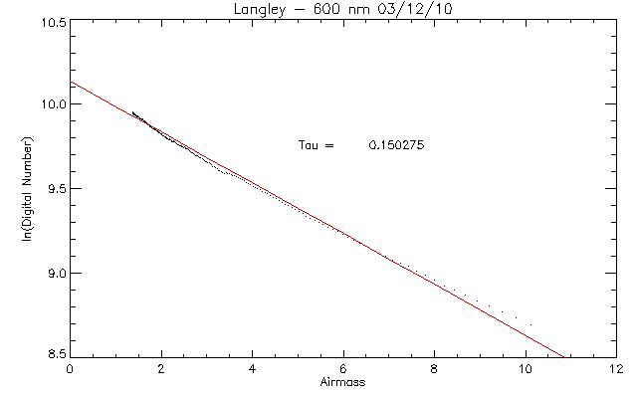
Sunphotometer
Preliminary Sun Spectrum (317nm - 1062nm)
Langley Plot
τ = 0.150275
ln(counts)
Airmass

Slide 32
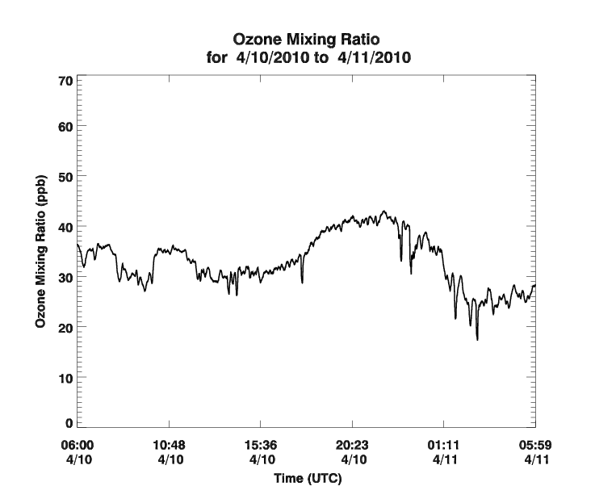
Ozone Analyzer
Preliminary in situ Ozone amounts (ppb)
Running 5 minute average
Mixing Ratio (ppb)

Slide 33
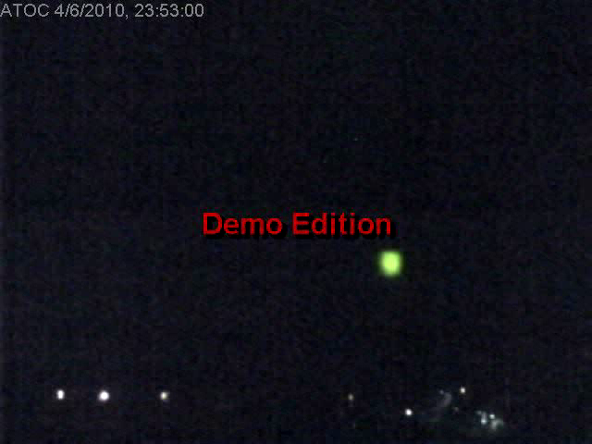
South Facing Web Cam

Slide 34
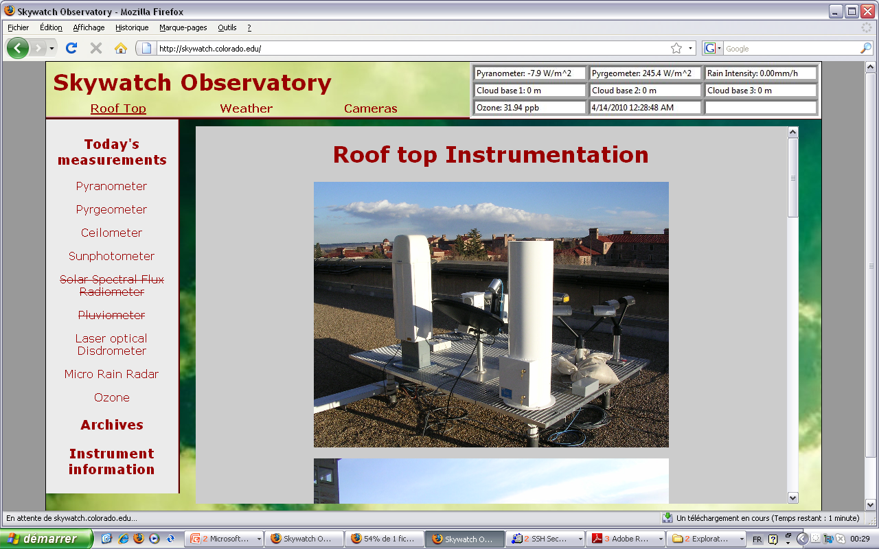
Data Access – Skywatch website

Slide 35
April 7th, 2010
Height (above Ground)
Brightness Temperature:
~272K
Irradiance
~252K
Time
Time

Slide 36
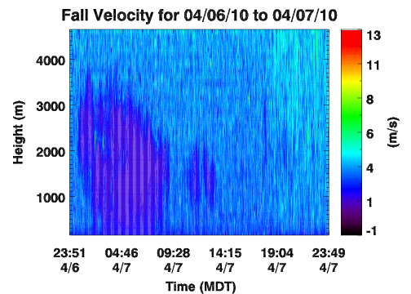
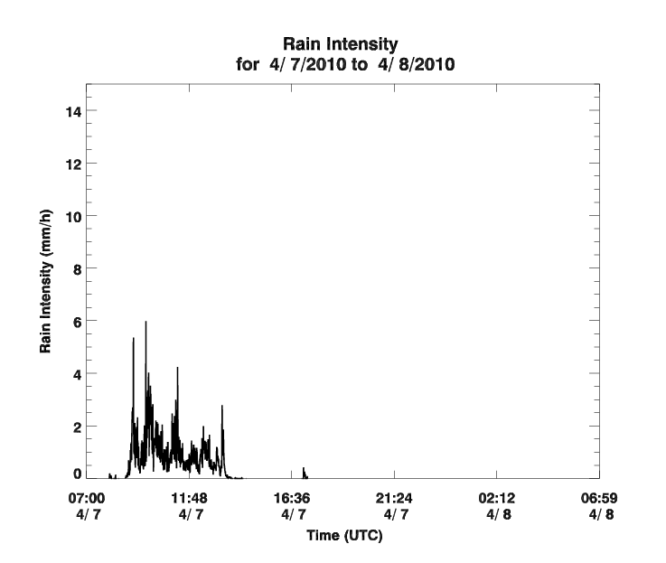
April 7th, 2010 – part 2
Rain Intensity
Time

Slide 37
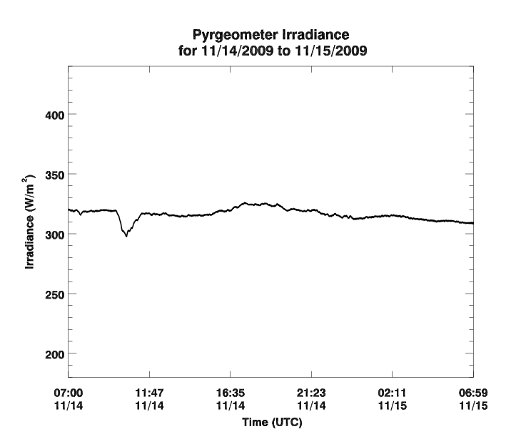
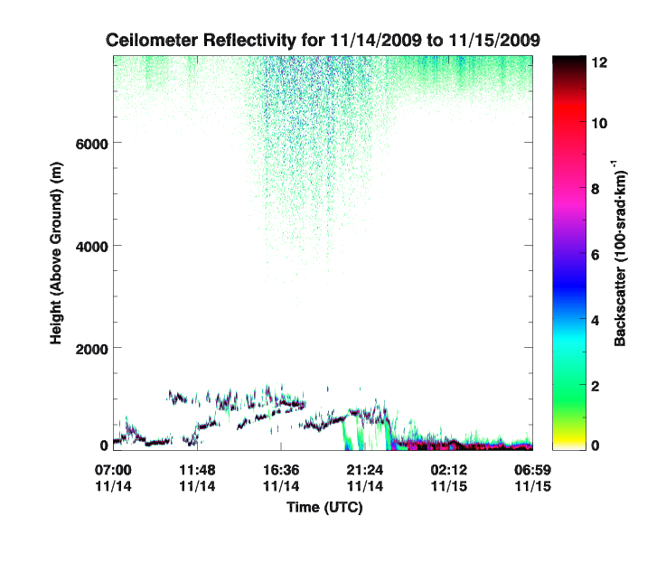
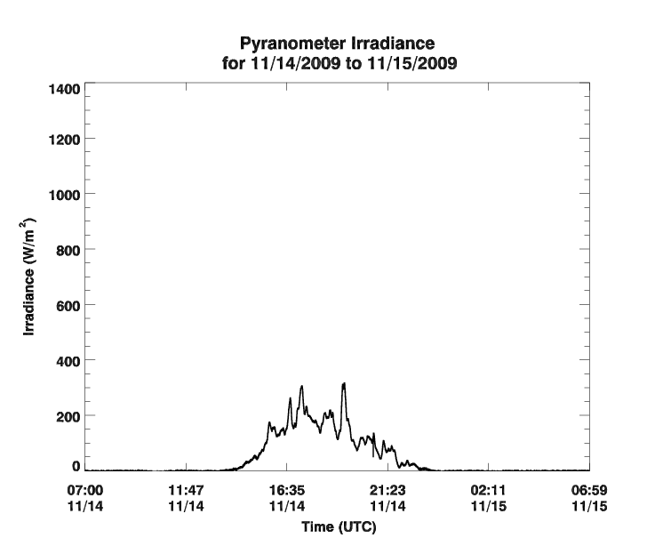
November 14th, 2009

Slide 38
November 14th, 2009 -part 2

Slide 39
Future Instruments
Solar Spectral Flux Radiometer
Hyperspectral Irradiance
Radiance (sun tracking, almucantar and others)
Rain Gauge
Absolute rain amount and rate
All Sky Camera

Slide 40
Future Data Products
Sunphotometer
Aerosol Optical Depth
All sky imagery
Solar Spectral Flux Radiometers
Irradiance and Radiance
Aerosol Optical Depth
Cloud Optical Depth and single scattering albedo
Many others possible

Slide 41



Thank You!
Support:

