Slide 1


Pre-Medical Students Association (PMSA)
Info Session & First General Meeting

Slide 2
What is PMSA?
PMSA is a student-led organization at the University of Chicago that provides academic, extracurricular, social and career-specific support to all pre-medical/pre-health students.
We try to lead fellow pre-med students to resources, experience and mindsets that we have found helpful out of our own pre-medical experience and perspectives!
We collaborate with CCIHP, UCSC and other pre-health RSOs to provide you the best support!

Slide 3
Benefits
Gain insights and valuable perspectives that prepare you for medical school and the health professions
Interact with pre-med professors, health professionals, medical students, CCIHP and UCSC advisors, medical school reps and community workers
Develop camaraderie with fellow pre-meds
Contribute to current and future PMSA activities

Slide 4
Past and ongoing events
General Meetings
Pritzker Luncheon
Panels
Study Breaks
Group Volunteering
Medical School Conference
Colloquium for Cultivating the Practice of Service

Slide 5
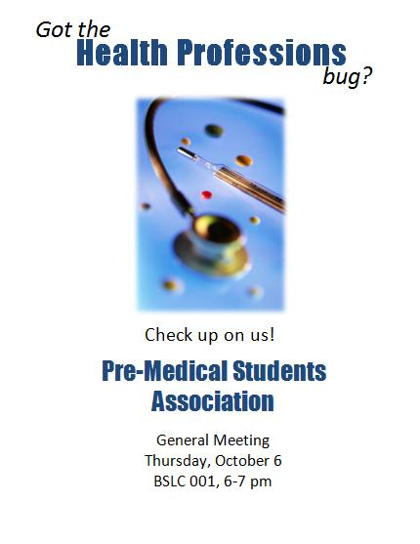
General Meetings
2-3 general meetings per quarter
First one of each quarter = Info Session & Introduction
Following meetings = Guest speakers/ Discussion on themes that concern the entire pre-med/pre-health student body

Slide 6
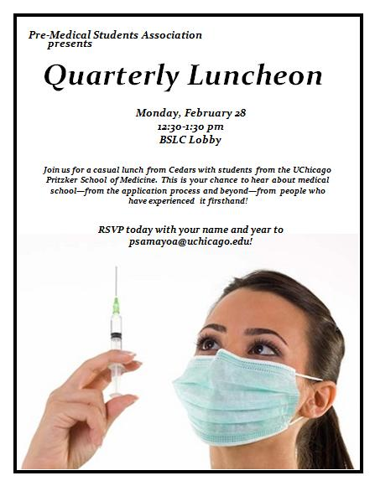
Pritzker Luncheon
Quarterly luncheon with Pritzker medical students in BSLC lobby
Casual environment for conversations with mostly 1st-2nd year medical students
Generally 1 medical students per 4-6 undergrad at a table
Good food served!

Slide 7
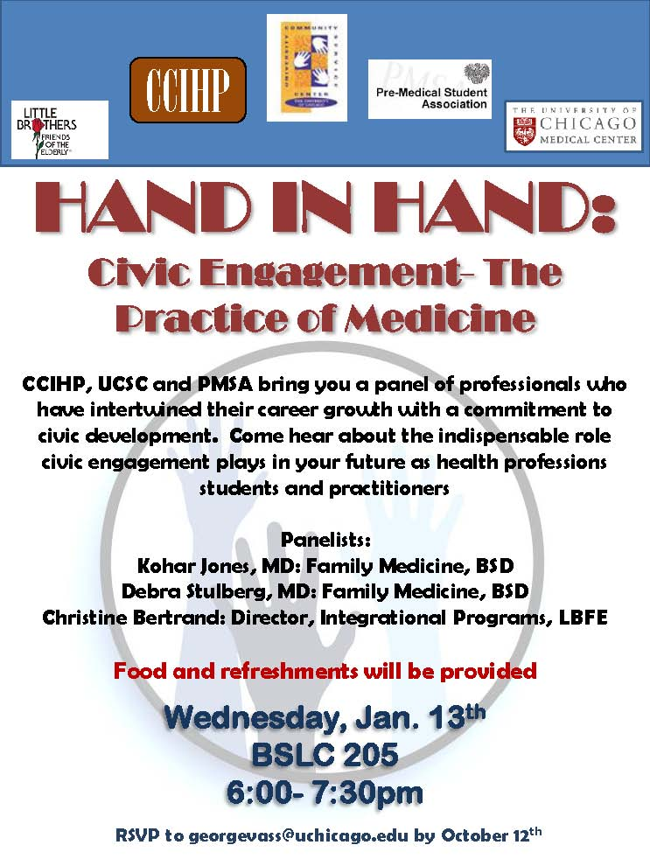
Panels
Panels reflect more specific interests of students
Panelists include:
Professors
Physicians
Non-profit organizations
Medical Students
MCAT course reps, etc.
Topics in the past:
Civic Engagement
Med School Application
Summer Opportunities

Slide 8

Study Breaks
Pizza & ‘House’
This year, different ideas for study breaks – possibly but not limited to:
Iceskate on Midway
Pub Night for Upperclassmen
Doc Film night
Pizza & ‘House’, ‘Scrubs’, ‘Grey’s Anatomy’

Slide 9
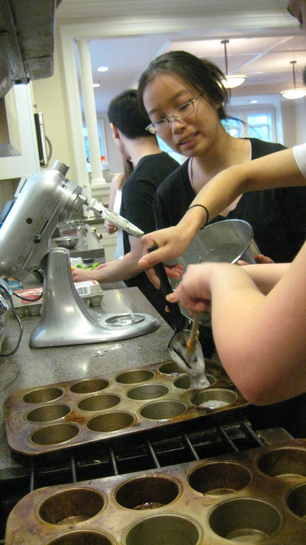
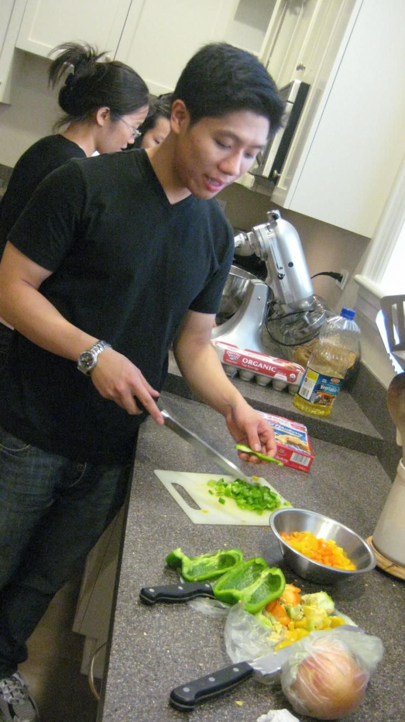
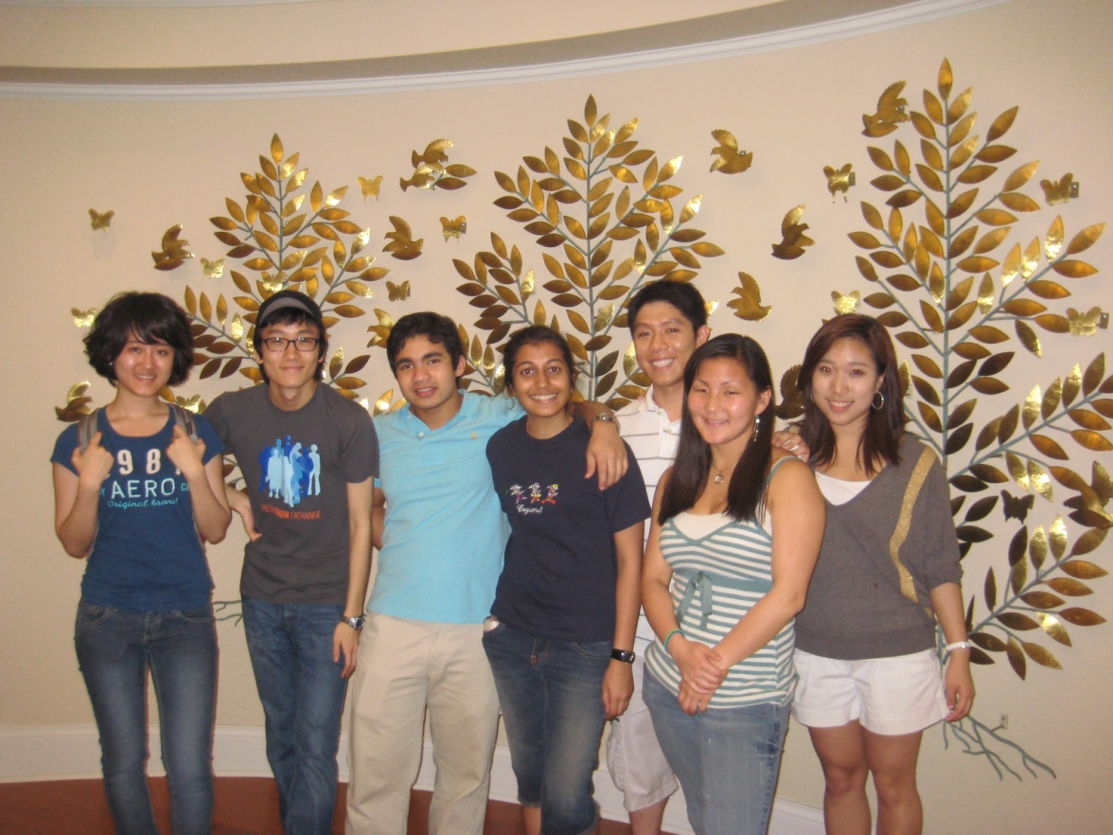
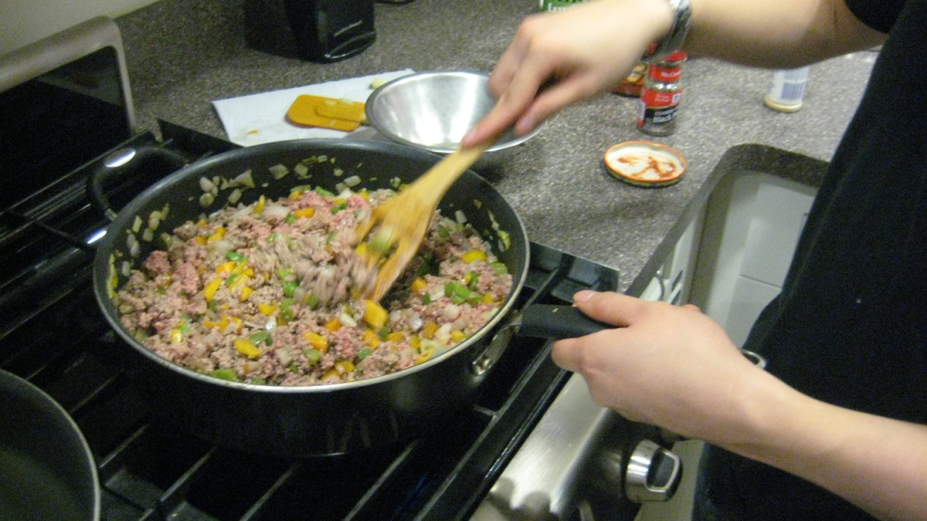
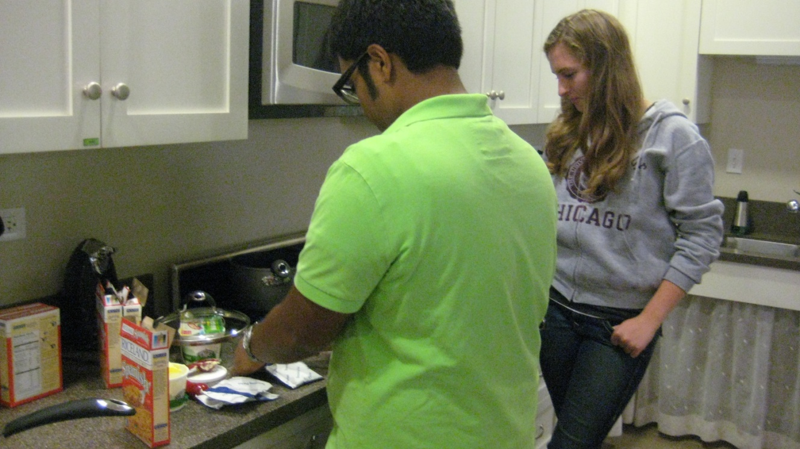
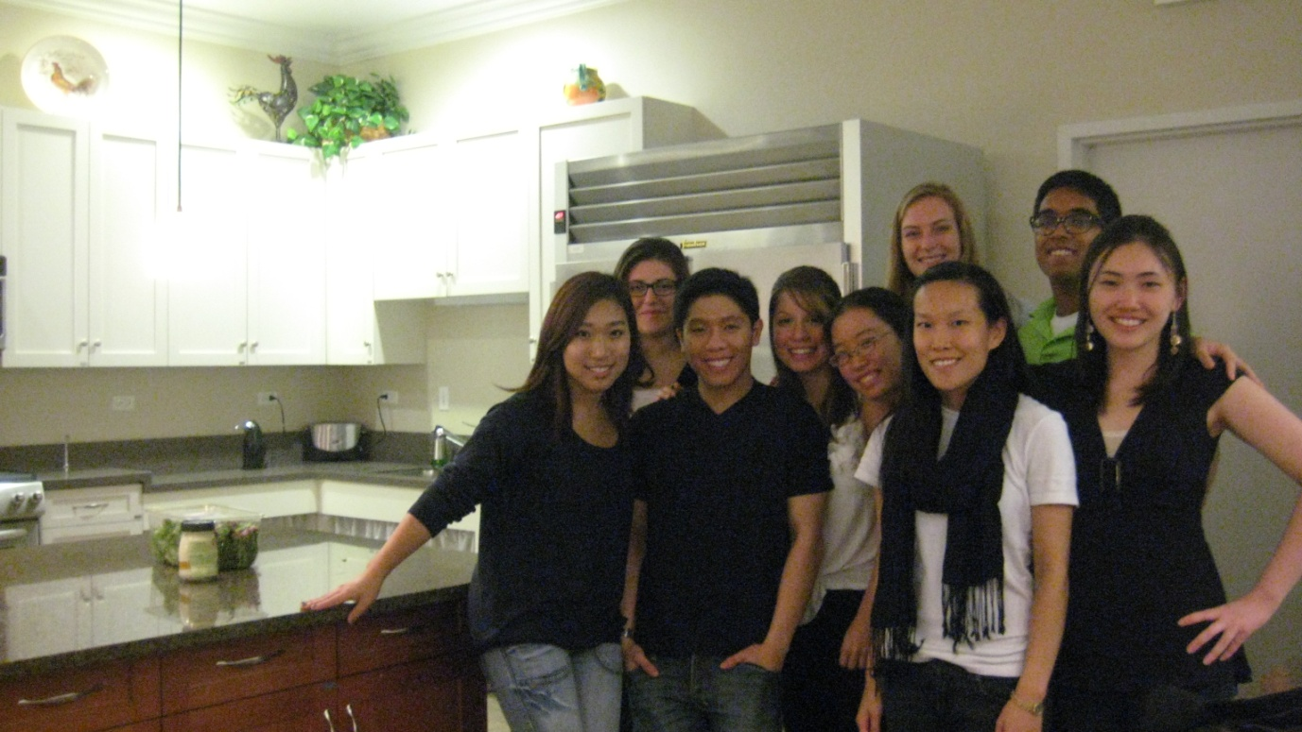
Group Volunteering

Slide 10
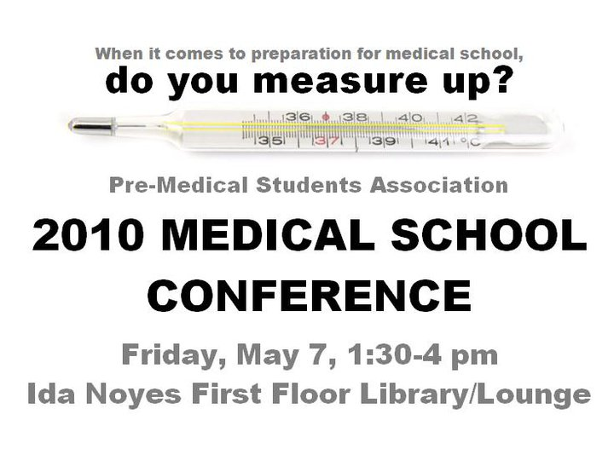
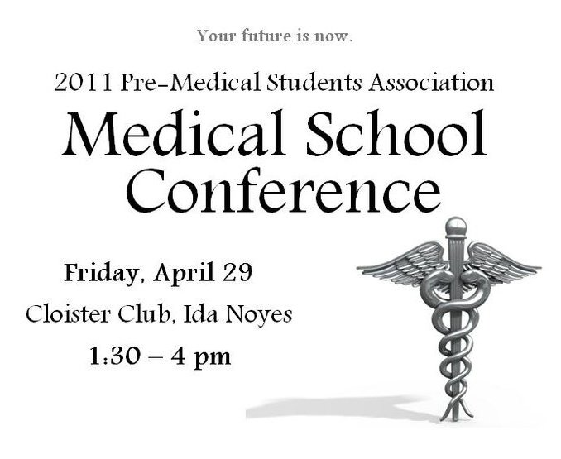
Medical School Conference
Every year at the end of Spring Quarter, we invite admission reps from various medical schools as well as osteopathic, dental & other health- profession schools
Ask questions directly to admission officers, collect pamphlets, leave your contact and practice being in such setting!

Slide 11
Colloquium for cultivating the practice of service
A night of presentation where the PMSA Committee for Civic Engagement members showcase their service work in a simple, educational, and meaningful way
Invite fellow pre-med students as well as our professors, advisors, medical students and doctors in order to share the significance of civic engagement in our process of becoming a dedicated medical practitioner in the future

Slide 12
What is PMSA Committee for civic engagement?
PMSA-CCE is a committee within PMSA promoting civic engagement as a key contributor to our aspirations for a career in medicine
To build a solid pre-medical/pre-health student body committed to helping each other and fellow students get involved in various community services and social projects
Committee members will contribute in various ways to the “Annual Colloquium for Cultivating the Practice of Service” with great support from the advisors of CCIHP and UCSC

Slide 13
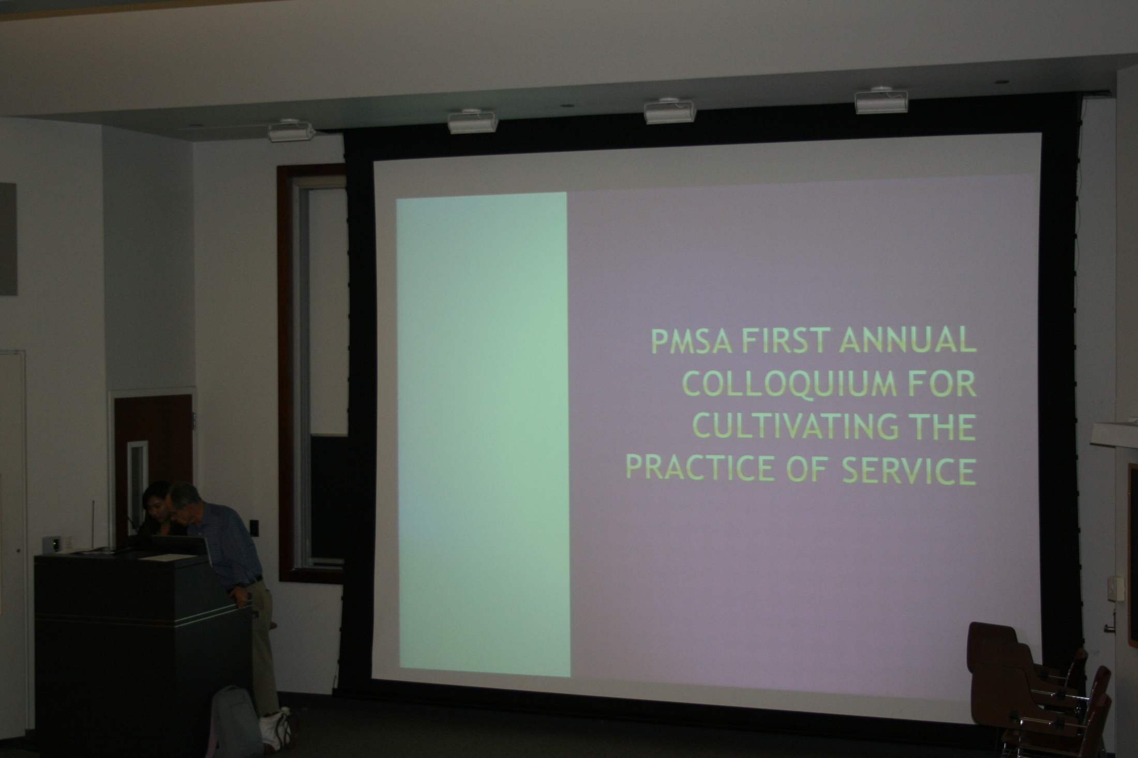
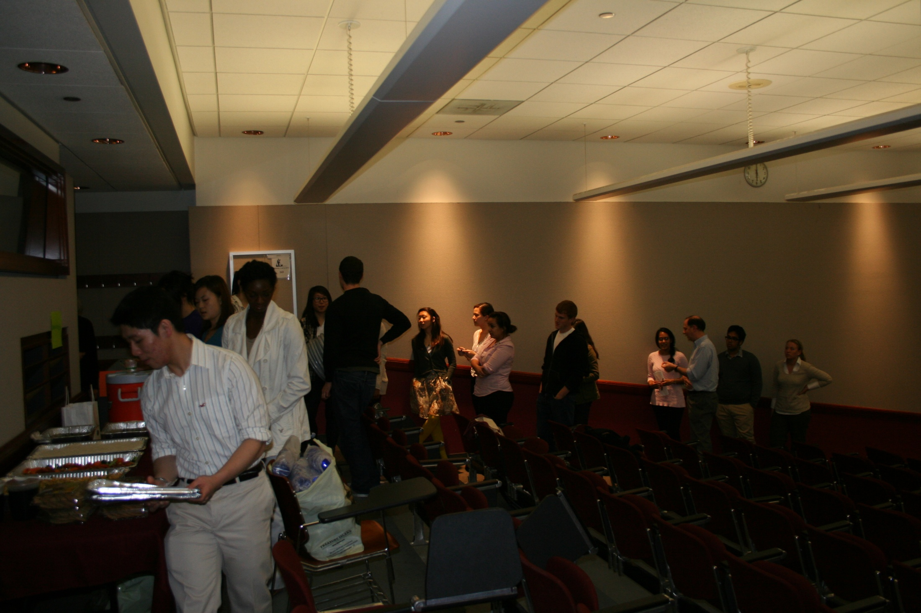

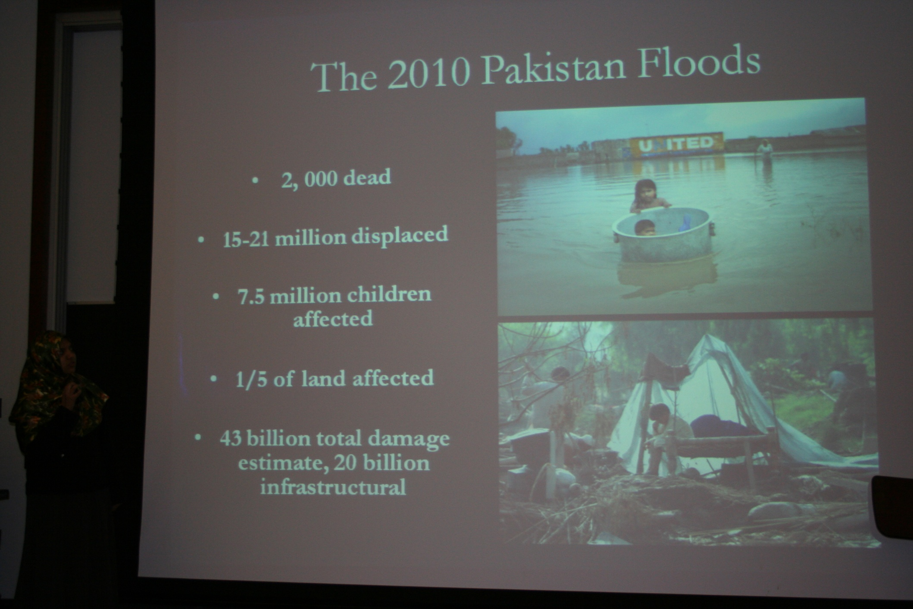
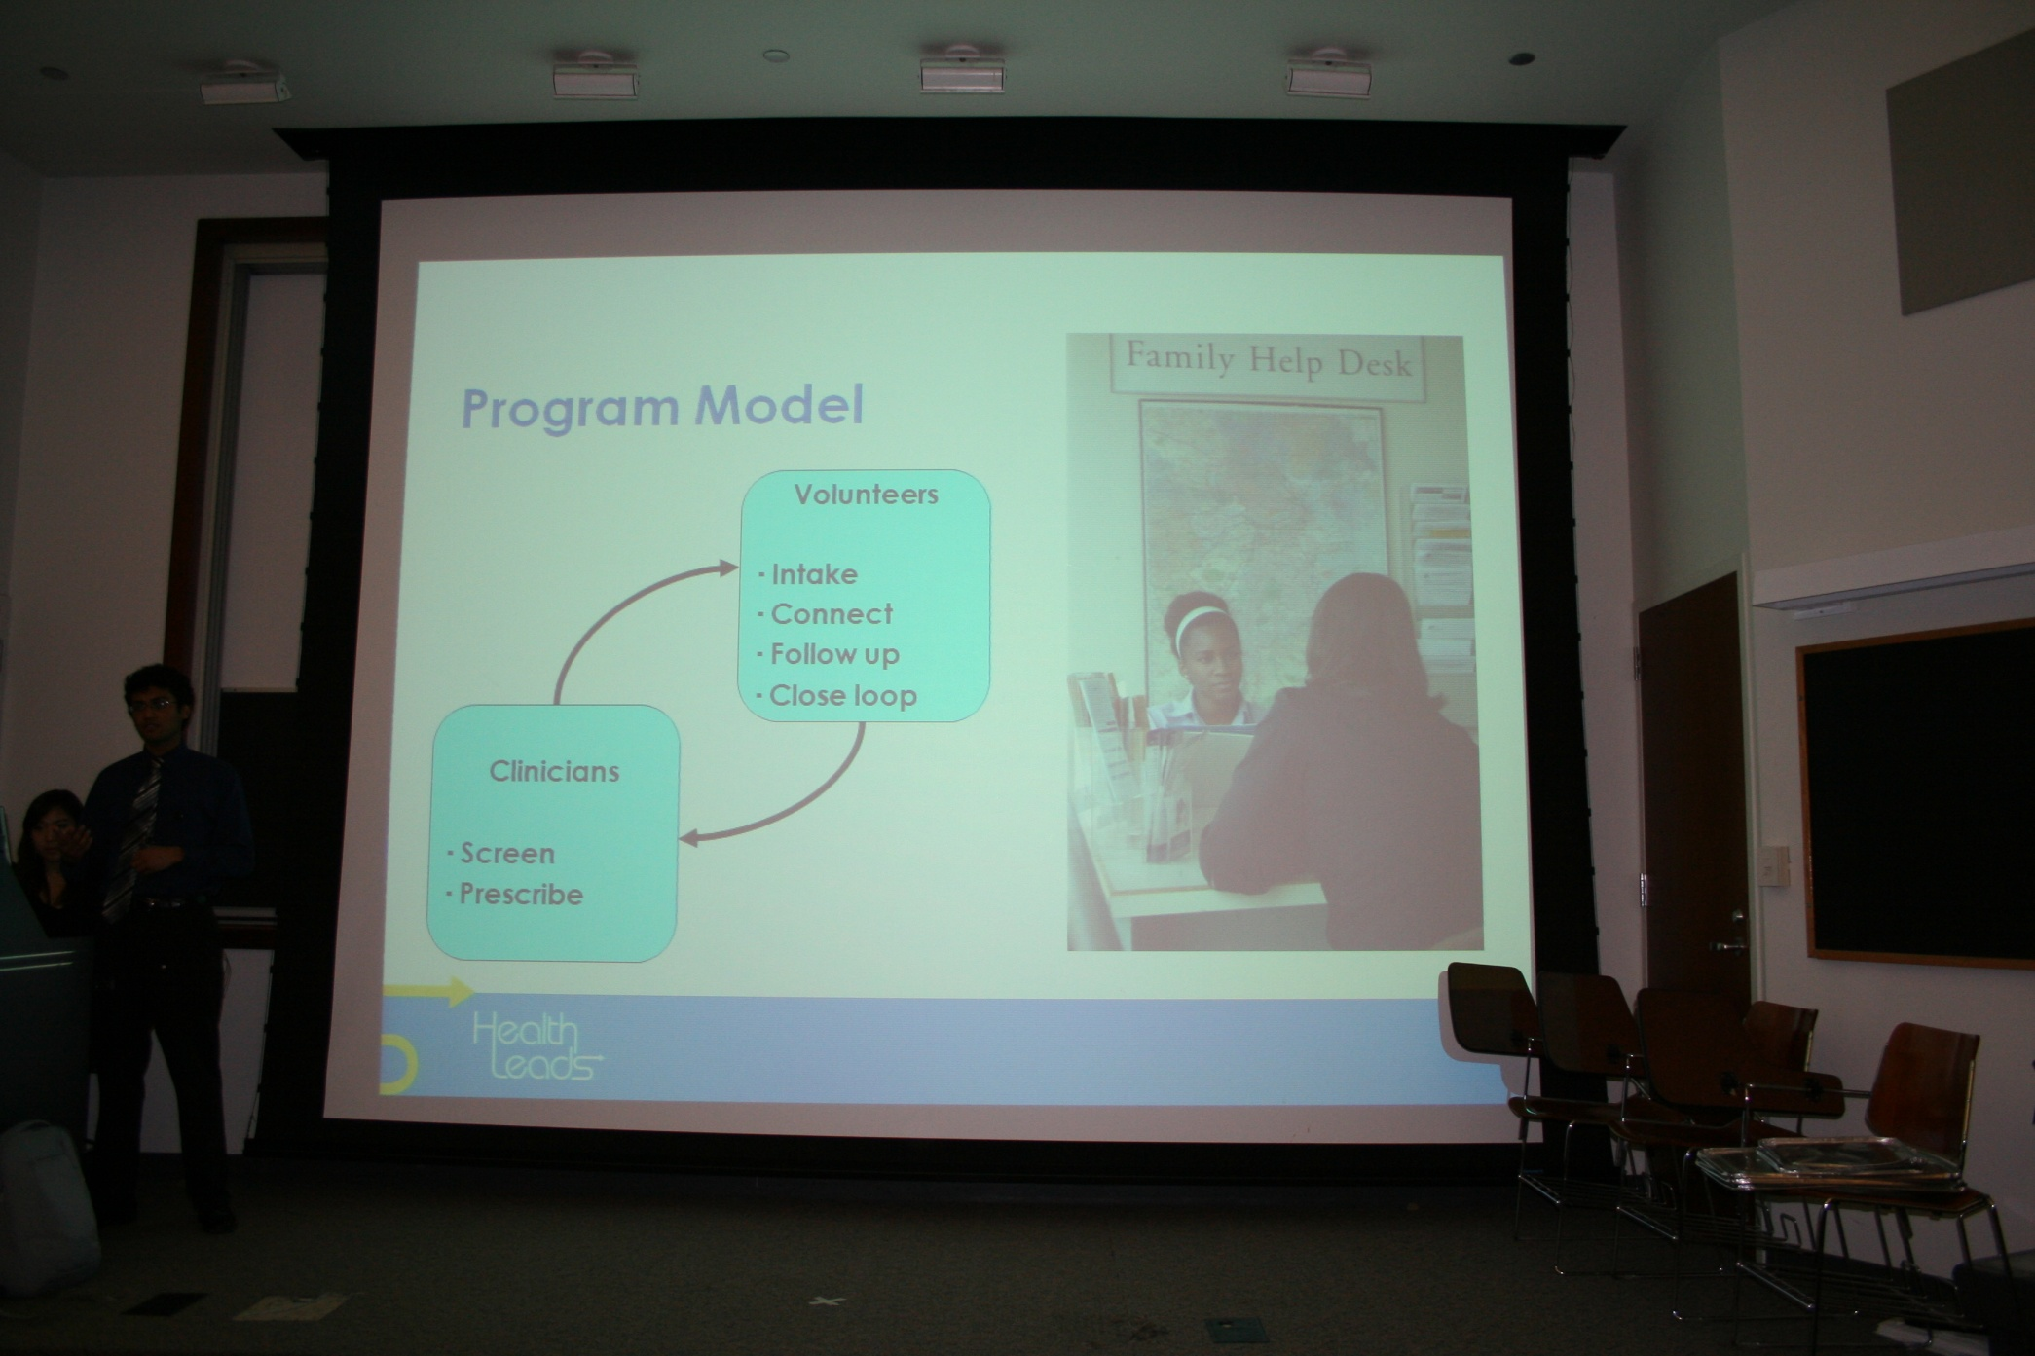
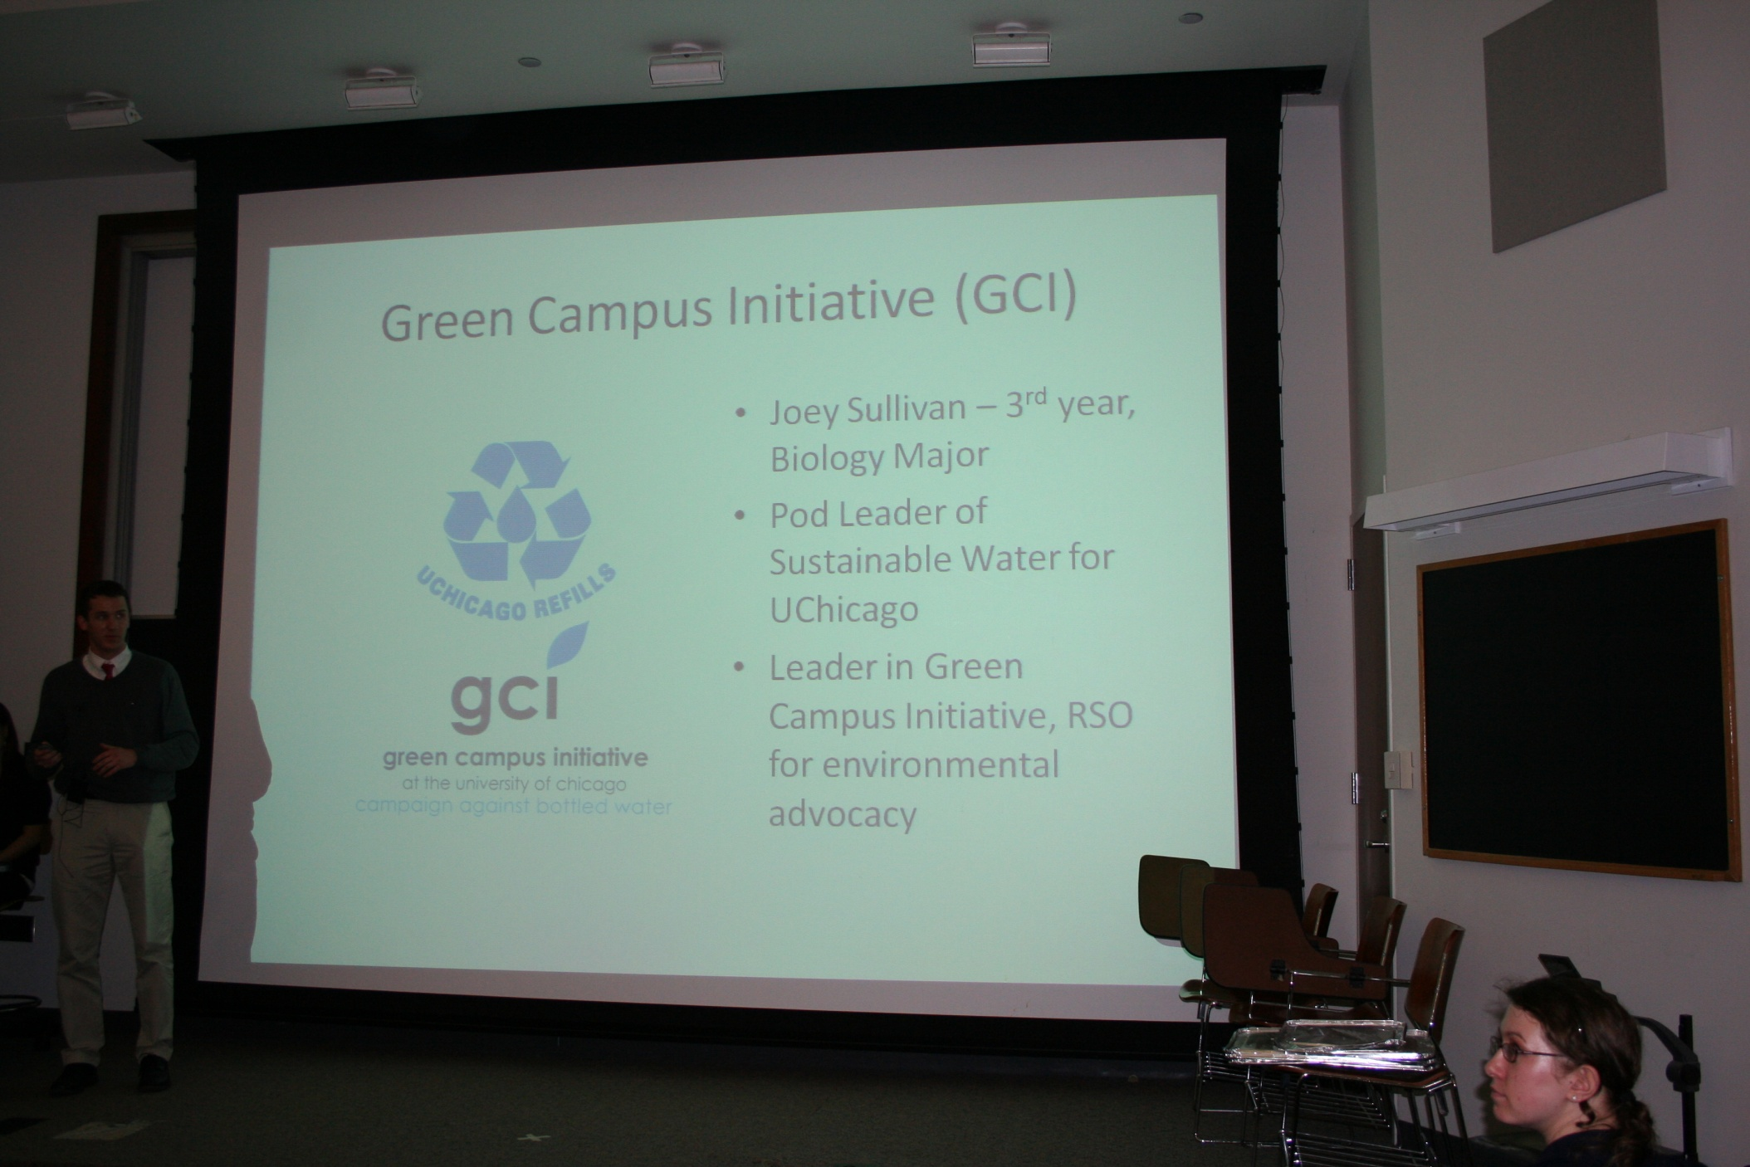
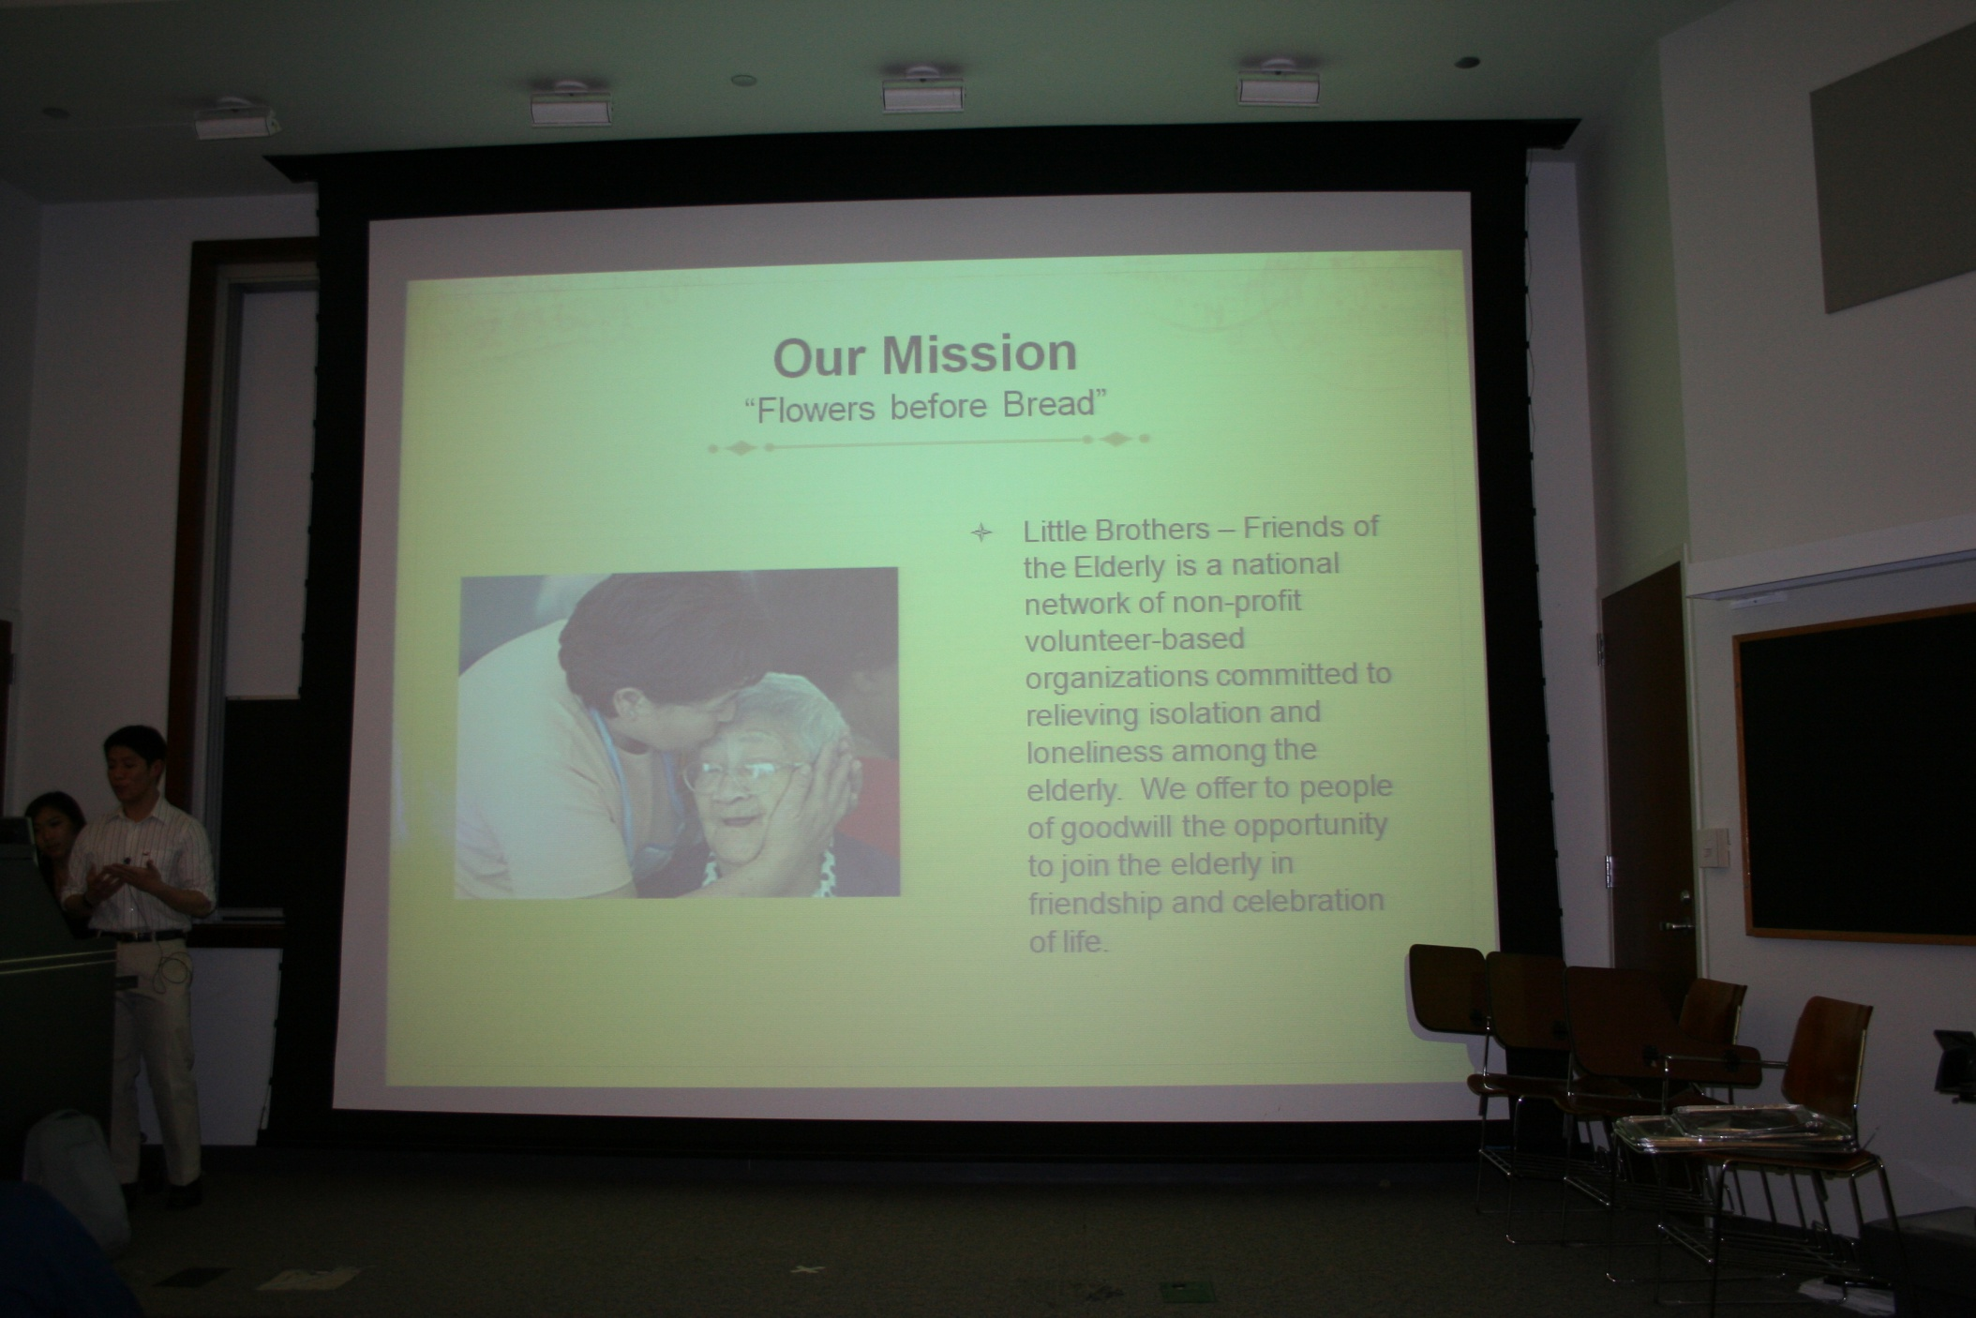

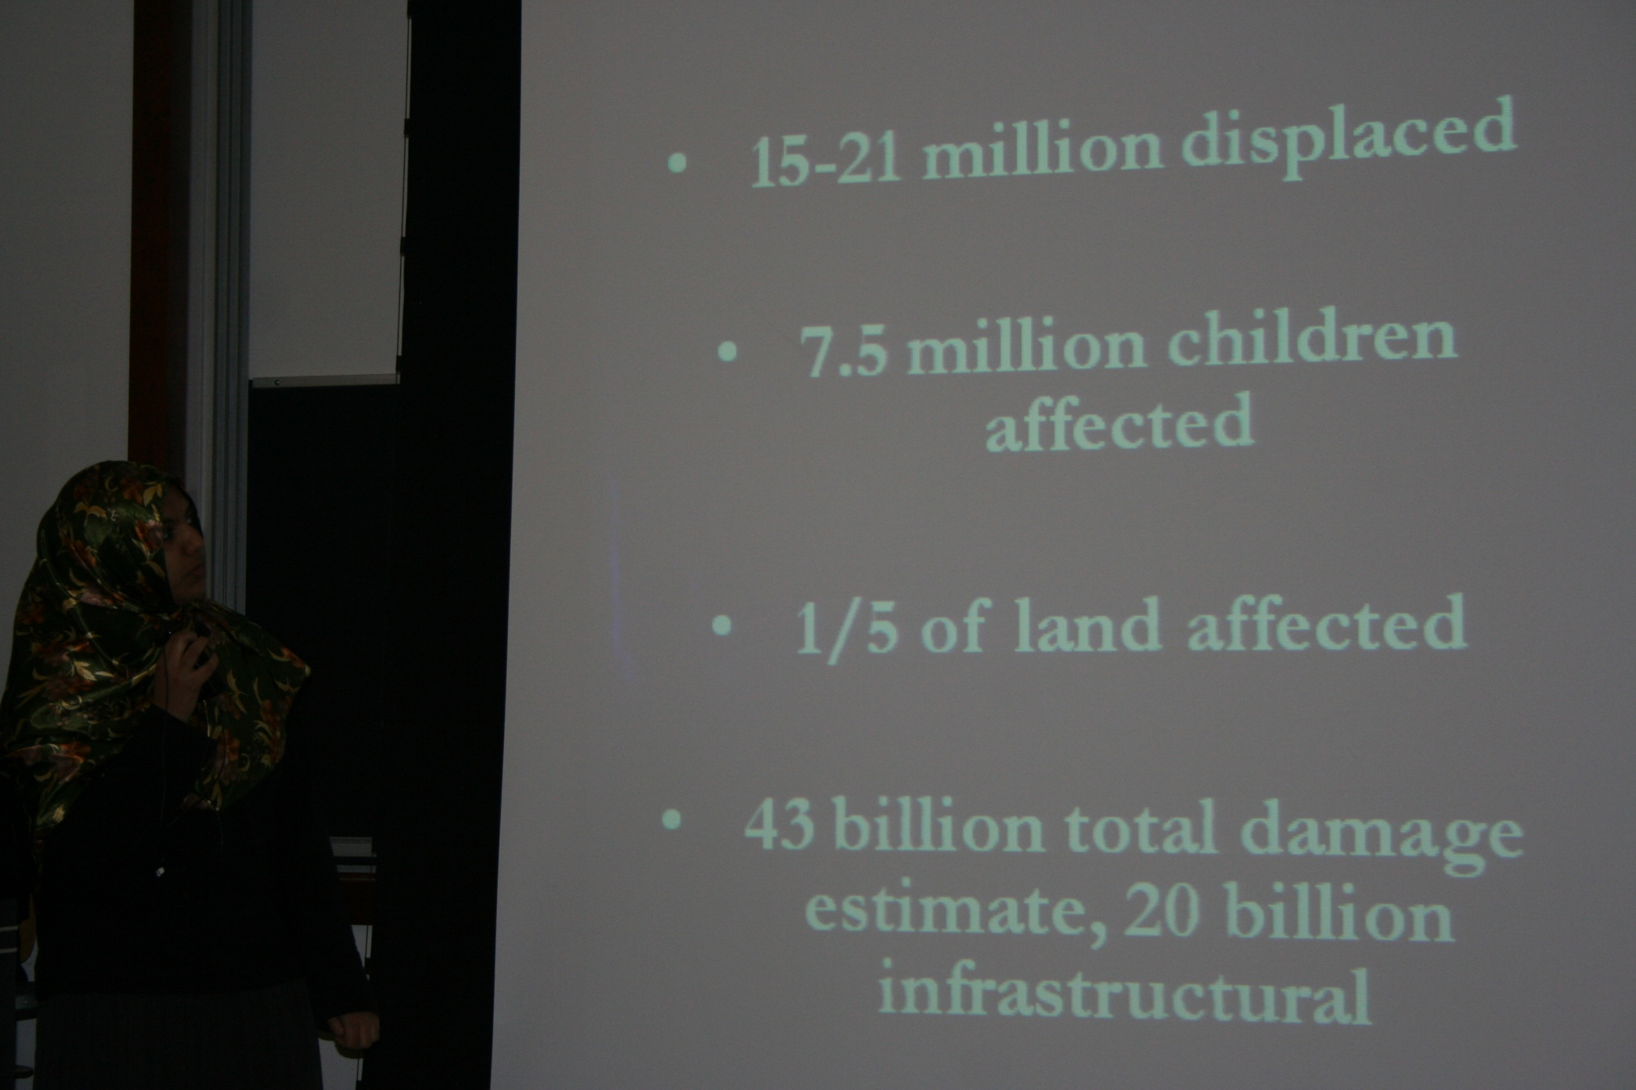
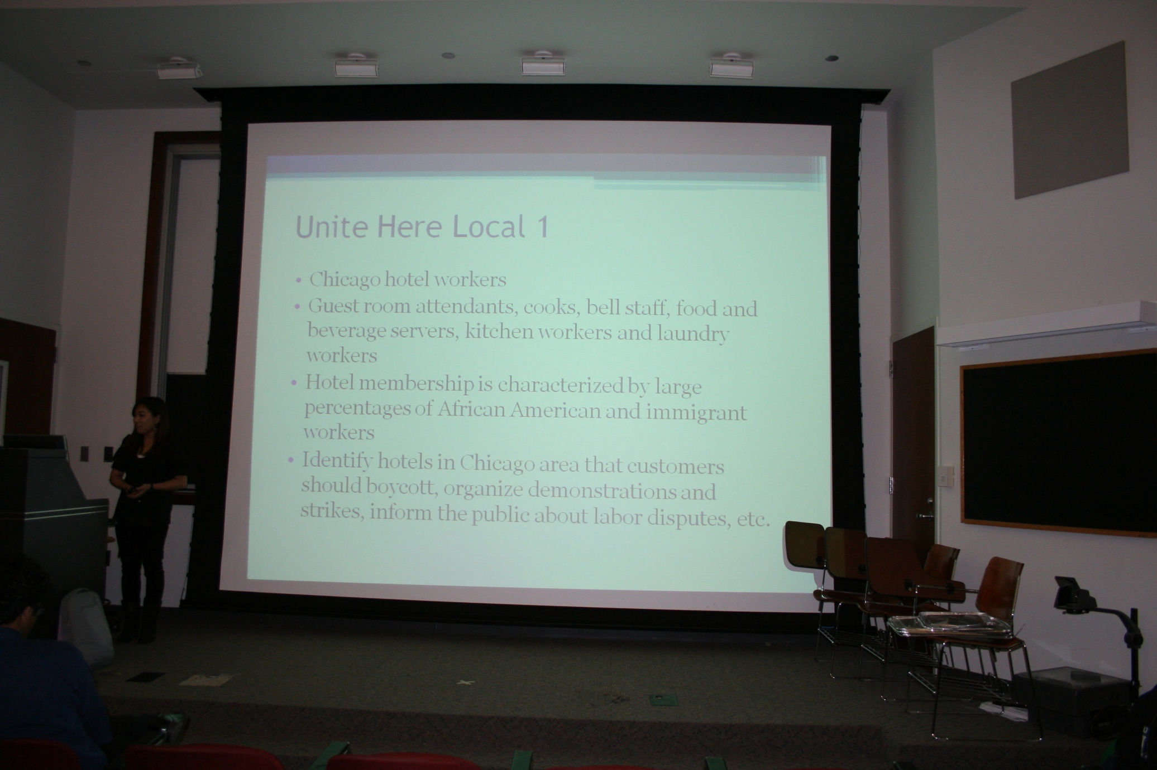

Slide 14
NEW EVENTS 2011-12
Round Table with Professors
Relay for Life – Team PMSA

Slide 15
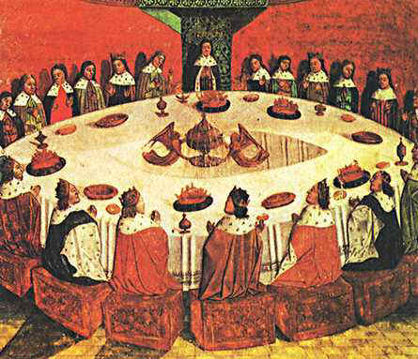
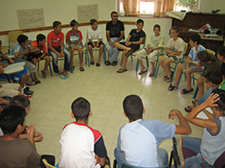
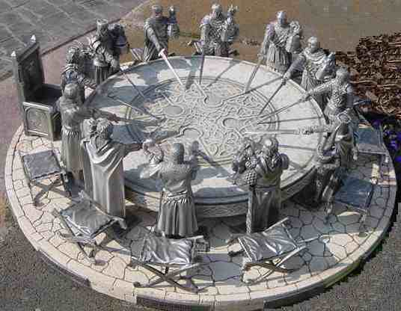
Round Table with Professors
Interactive meeting between pre-med professors and PMSA members
Give you an opportunity to ask questions/ discuss certains things you were too intidimiated to ask 1:1

Slide 16


Relay for Life
Relay for Life is an over-night fundraiser for the American Cancer Society.
UChicago students, faculty and community members gather in teams to celebrate cancer survivors' triumph, remember those whom we have lost, and fight back.
Every year in May during
Spring Quarter. Team PMSA will
participate this year!

Slide 17
Membership requirements
Required to attend two General Meetings each quarter during which members will contribute to the selection of PMSA's quarterly panel topic and directions for the upcoming quarter
Required to attend one out of four following
events (Pritzker Luncheon, Panel, Roundtable, Volunteering)
If missed one General Meeting, then required to attend two out of four mentioned events.
*In summary, all members should participate in at least 3 events each quarter ☺

Slide 18
Want more active engagement?
Join the Committee for Civic Engagement!
Join the Relay for Life team!
If you would like to start a whole new committee dedicated to a specific interest, share your ideas with the board!
Come to study breaks!
Participate in our events!
Join the board!!!

Slide 19
Board 2011-12
President Alice Hyewon Won hwon@uchicago.edu
Vice President Feenalie Patel fpatel7@uchicago.edu
Secretary Elizabeth Rosedoman erosedoman2@uchicago.edu
Treasurer Wonhee Lee wonhee@uchicago.edu
Volunteer Coordinator Richmond Chua rchua@uchicago.edu
Pritzker Luncheon Coordinator Phil Samayoa psamayoa@uchicago.edu
Publicity & Publications Saamia Masoom smasoom@uchicago.edu
Lily Lai lily_l@ymail.com
Medical School Conference Coordinator Lina Mikolajczyk mikolina@uchicago.edu
Webmaster/Kaplan Coordinator Claire Quang cquang@gmail.com
Study Break Coordinator Melissa Velasquez melissav@uchicago.edu

Slide 20
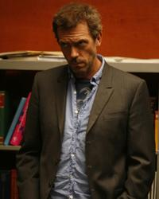
Questions?

Slide 21


Thank you, Good luck with fall quarter! Keep an eye on the listhost for event & meeting details. Check our website: pmsa.uchicago.edu
PMSA

