Slide 1
Oxidation-Reduction Chemistry
Redox

Slide 2
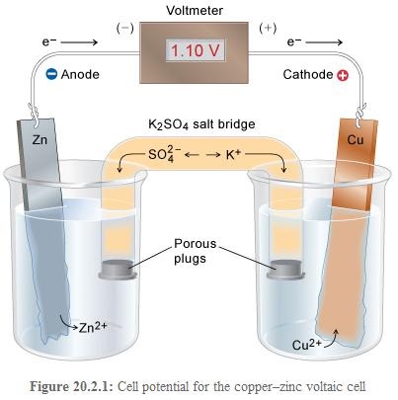
Electrochemical Cells: Batteries

Slide 3
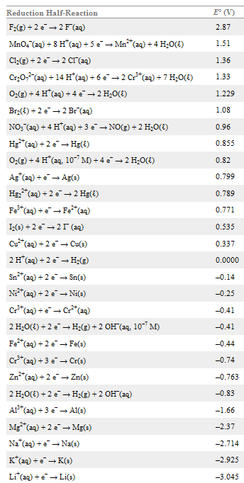
Reduction potential: measure of
how much the reactant wants to
gain electrons to form product.

Slide 4

Reduction Potentials and Cell Potentials
Eº_{cell} = Eº_{anode} – Eº_{cathode} more positive = more favored

Slide 6
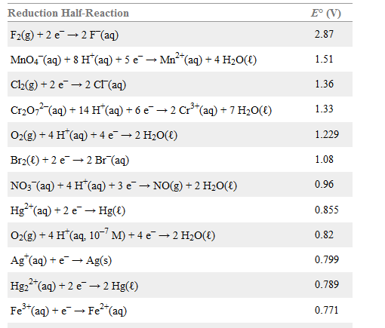

Slide 7
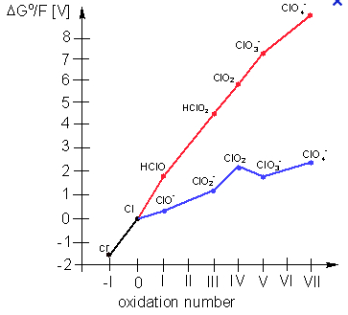
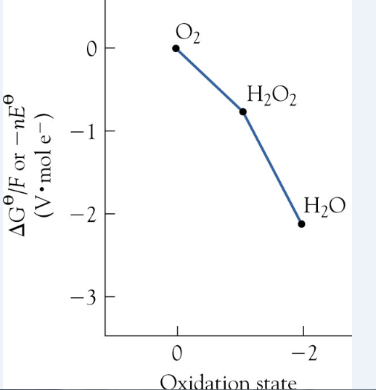

Slide 8
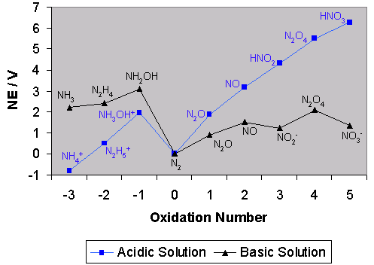
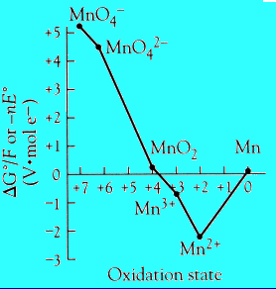

Slide 9
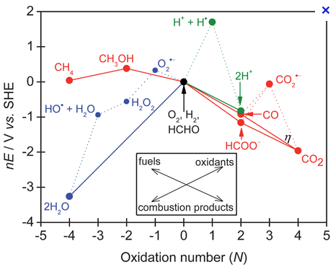

Slide 10
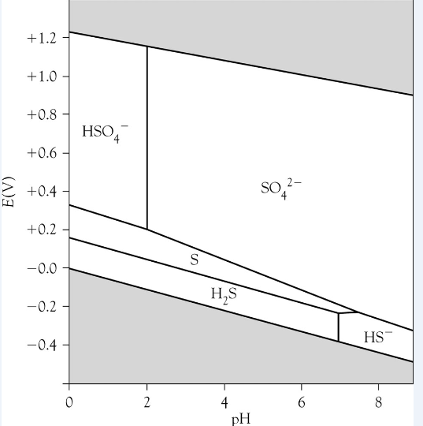

Slide 11
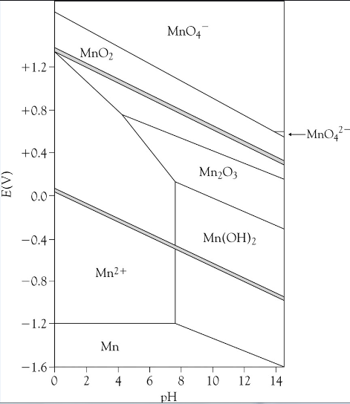

Slide 12
