Slide 1


Statistics and Climate
Peter Guttorp
University of Washington
Norwegian Computing Center
peter@stat.washington.edu

Slide 2
Acknowledgements
2007 ASA climate consensus workshop
IPCC Fourth Assessment
2009 Copenhagen Diagnosis
2011 NRC: America’s Climate Choices
2012 Detection and attribution workshop in Banff
NCAR IMAGe/GSP
SMHI modeling group
SARMA and STATMOS network members, particularly Finn Lindgren and Peter Craigmile

Slide 3
Outline
Difference between weather and climate
Modeling climate
Lines of evidence
Attribution
Data issues and global temperature
Model assessment

Slide 4
Climate and weather
Climate is the general or average weather conditions of a certain region.
American Heritage Science Dictionary (2002)
Climate is what you expect; weather is what you get.
Heinlein: Notebooks of Lazarus Long (1978)
Climate is the distribution of weather.
AMSTAT News (June 2010)

Slide 5
Climate models

Slide 6
Models of climate and weather
Numerical weather prediction:
Initial state is critical
Don’t care about entire distribution, just most likely event
Need not conserve mass and energy
Climate models:
Independent of initial state
Need to get distribution of weather right
Critical to conserve mass and energy
Notes:
Same basic fluid dynamics equations

Slide 7
A simple climate model
What comes in
must go out
Solar constant
1361 W/m²
Earth’s albedo
0.29
Stefan’s constant
5.67×10⁻⁸ W/(K⁴·m²)
Effective emissivity
(greenhouse, clouds)
0.61

Slide 8
Solution
Average earth temperature is T = 289K (16°C; 61°F)
One degree Celsius change in average earth temperature is obtained by changing
solar constant by 1.4%
Earth’s albedo by 4.5%
effective emissivity by 1.4%
ε = 1 yields T = 255K (-18°C; 0°F)
Notes:
Natural variability of solar constant 0.1-0.2%

Slide 9
But in reality…
The solar constant is not constant
The albedo changes with land use changes, ice melting and cloudiness
The emissivity changes with greenhouse gas changes and cloudiness
Need to model the three-dimensional (at least) atmosphere
But the atmosphere interacts with land surfaces…
…and with oceans!

Slide 10
So what is the greenhouse effect?
“What comes in” is concentrated in shorter wavelengths than what “must go out”. The greenhouse gases in the atmosphere absorbs much of the energy in these longer outgoing waves, thus warming the atmosphere.
Most abundant greenhouse gases:
water vapor
carbon dioxide
methane
nitrous dioxide
ozone
Notes:
Circulation time: water vapor 9 days, carbon dioxide 30-1000 years
methane 12 yrs, N2O 114 yrs
Methane conc up 2.5 times over preind, CO2 40%

Slide 11
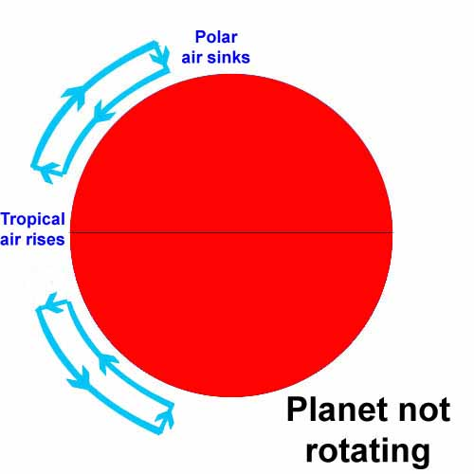
The climate engine I
If Earth did not rotate:
tropics get higher solar radiation
hot air rises, reducing surface pressure
and increasing pressure higher up
forces air towards poles
lower surface pressure at poles makes air sink
moves back towards tropics

Slide 12
The climate engine II
Since earth does rotate, air packets do not follow longitude lines (Coriolis effect)
Speed of rotation highest at equator
Winds travelling polewards get a bigger and bigger westerly speed (jet streams)
Air becomes unstable
Waves develop in the westerly flow (low pressure systems over Northern Europe)
Mixes warm tropical air with cold polar air
Net transport of heat polewards

Slide 13
Climate model history
Early 1900s Bjerknes (equations)
20s Richardson (numeric solution)
1955 Phillips: first climate model
mid 70s Atmosphere models
mid-80s Interactions with land
early 90s Coupled with sea & ice
late 90s Added sulfur aerosols
2000 Other aerosols and carbon cycle
2005 Dynamic vegetation and atmospheric chemistry
2010 Microphysics
Notes:
Richardson took 6 weeks to calculate 8 hours of weather. Wrong answer!

Slide 14
Parameterization
Some important processes happen on scales below the discretization
Typically expressed as regressions on resolved processes
Examples:
clouds
thunderstorms/cyclones
amount of solar radiation reaching ground
pollutant emissions

Slide 15
Cloud effects
Low clouds over ocean
more clouds reflect heat (cooling)
fewer clouds trap heat (warming)
High clouds
more clouds trap heat (warming)
And neither are well described in GCMs
Some new models produce stochastic clouds
Notes:
high: 5-14 km; low < 2km

Slide 16
Evidence of climate change

Slide 17
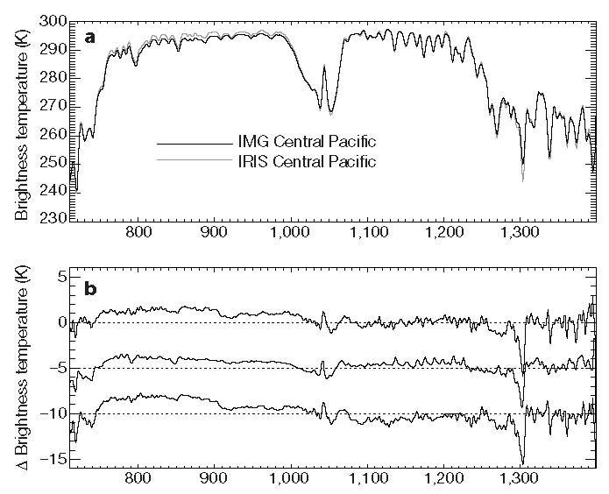
Changes in radiation spectrum
Harries et al., Nature, 2001
1997
1970
Observed difference
Pacific sim.
Global sim.
CO₂
O₃
CH₄

Slide 18
Sea surface temperature
Notes:
trends are increasing in all oceans except north atlantic
Data from buoys, ship logs, stations, sonds etc.

Slide 19
Ocean heat content

Slide 20
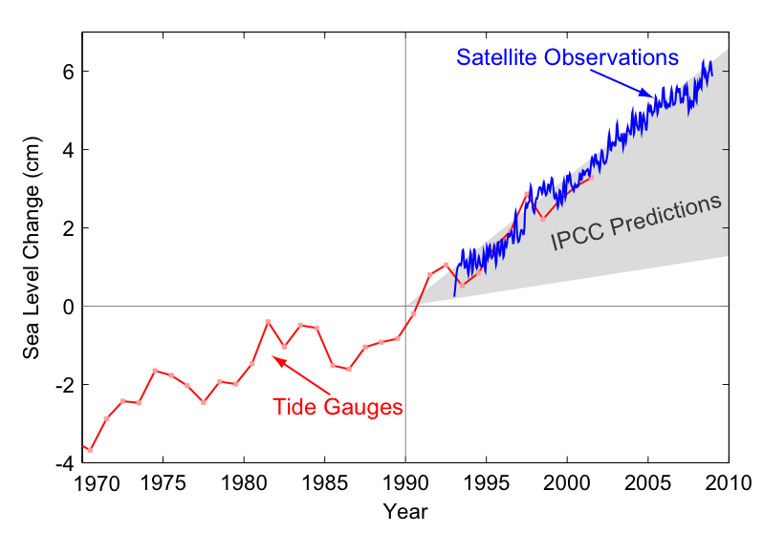
Sea level rise
Notes:
Not uniform—eg larger at north Atlantic coast
Predictions from TAR and CMIP2

Slide 21
Other pieces of evidence
Ocean acidification
Changes in seasons
Increasing global temperature
Heating in upper troposphere and cooling in lower stratosphere
Sea ice decline in Arctic

Slide 22
Detection

Slide 23
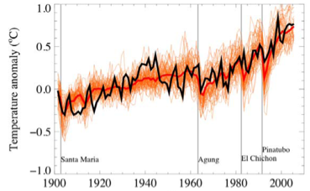
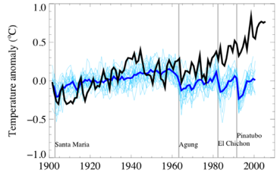
Attribution
Models and data including ghg
Models and data
with solar and volcanic
forcings only
Notes:
90% ranges of uncertainty

Slide 24
Are there alternative explanations?

Slide 25
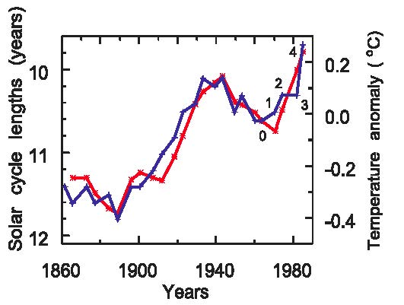
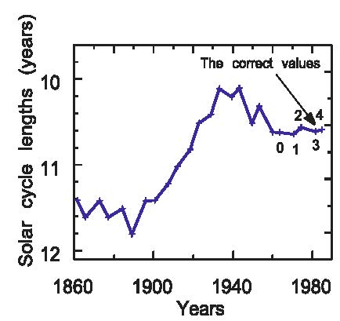
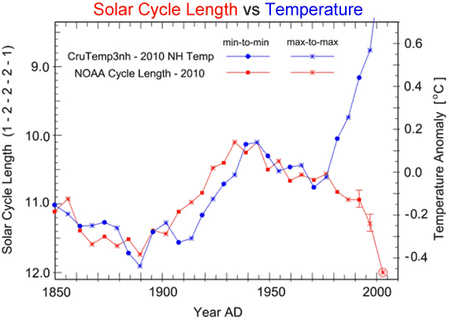
Solar radiation
Notes:
Mechanism?
Friis-Christensen and Lassen, 1991.

Slide 26
Volcanic eruptions
Do volcanic eruptions (which cool the tropospheric temperature) produce similar amounts of CO₂ to the anthropogenic contribution?
2010 emissions ≈ 8 supereruptions
Last supereruption in Indonesia 74 Kyr ago
Previous in USA 2Myr ago
Notes:
Supereruption = 450 km^3 or 108 cubic miles of magma ejected
Mount St Helens .05 cubic miles

Slide 27
Cosmic radiation
Recent experiments at CERN show that interaction between water vapor, ammonium and cosmic radiation increases cloud production.
No change observed in rate of cosmic radiation, increase in atmospheric ammonium concentration

Slide 28
Feedbacks
Positive feedbacks: e.g.
ice-albedo
Negative feedbacks: e.g.
increased CO₂, temperature and precipitation
increases leaf area,
hence evapotranspiration,
leading to cooling
Model calculations indicate effect 3–7 times smaller than warming

Slide 29
Data issues and global temperature

Slide 30
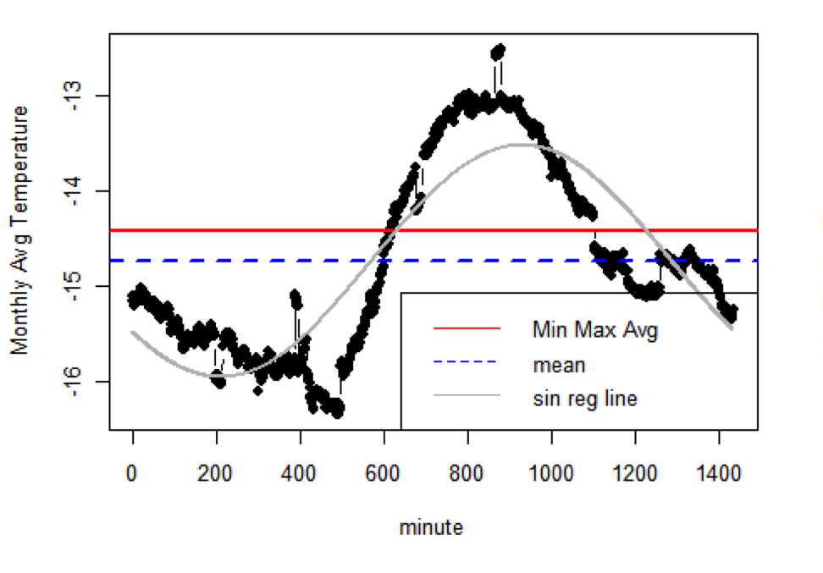
Daily temperature
max
21:00
08:00
min
14:00

Slide 31
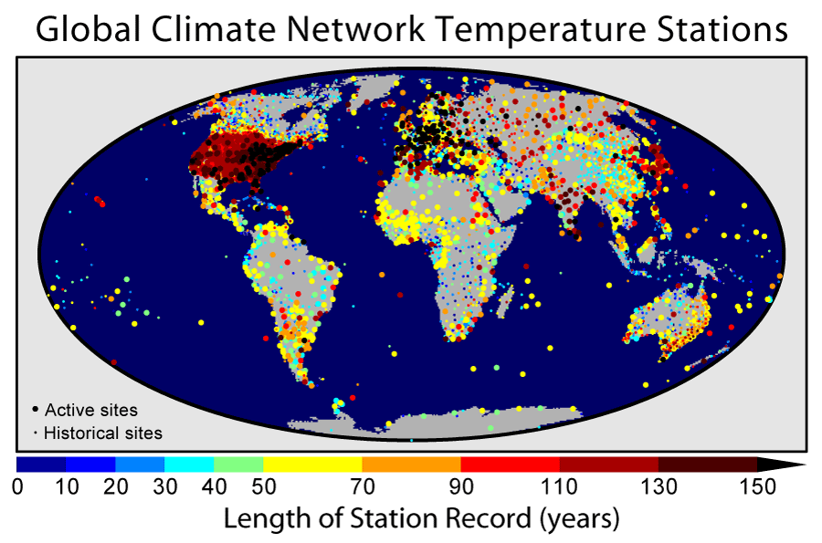
Global Historical Climatology Network
Notes:
Oldest record Berlin cts from 1701

Slide 32
Some issues
Homogenization / instrumentation
Combination of data
Non-digitized
Proprietary
Changing network
…and I am not even talking about sea surface temperatures!

Slide 33
Gaussian Markov random field model
Model parameters
Spatial climate
Weather anomalies
Temperature data
Data model: temperature ~ elevation + climate + anomaly

Slide 34
Trend estimate
Notes:
Inner CI, outer pred int, RW2 smoother

Slide 35
Comparison with other estimates
Notes:
HadCRU red NOAA green GISS purple

Slide 36
Adjusted vs unadjusted

Slide 37
Model assessment

Slide 38
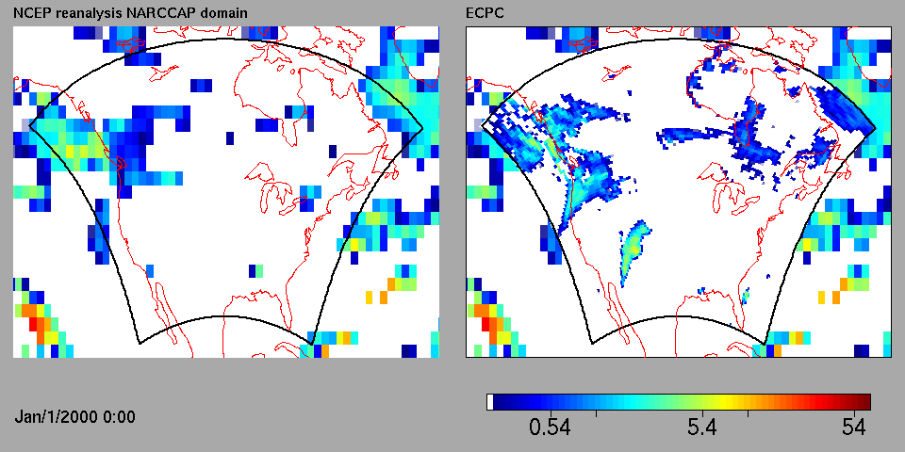
Comparing climate model output to weather data
Global models are very coarse
Regional models are driven by boundary conditions given by global model runs

Slide 39
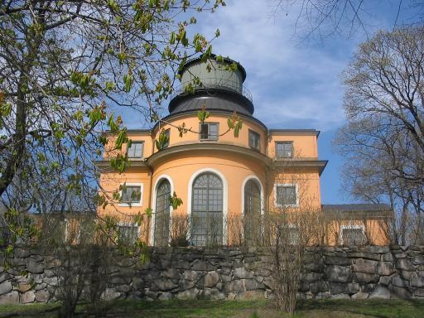
Looking for signals in data and models
Even a regional model describes the distribution of weather
Consider a regional model driven by “actual weather”
Annual min temp; 50 km x 50 km grid, 3 hr time res (SMHI-RCA3; ERA40)
Notes:
Stockholm observations since 1756

Slide 40
How well does the climate model reproduce data?
Notes:
Reason for minima

Slide 41
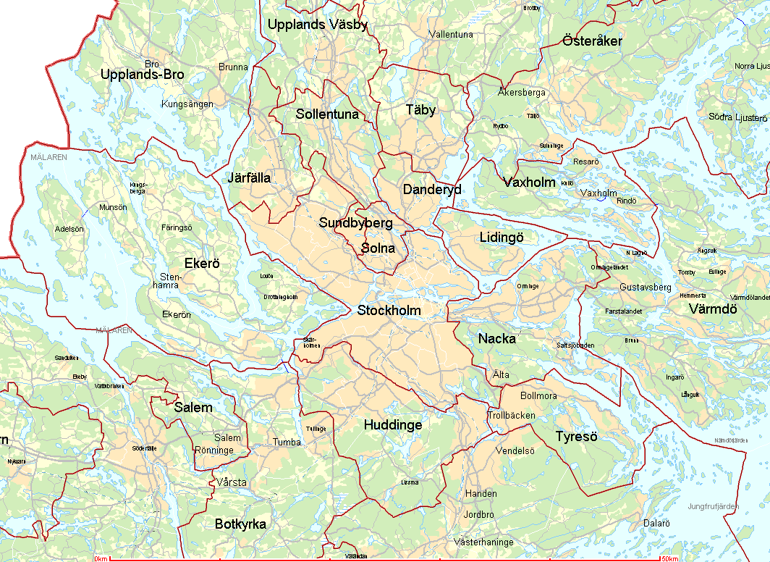
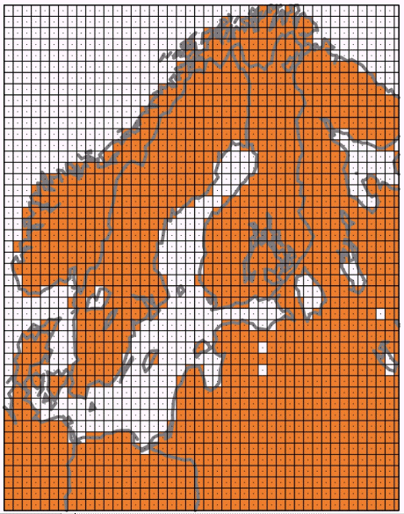
Resolution in a regional climate model
50 x 50 km

Slide 42
Model problem?
Clouds?
Mean annual temperature about 1.7°C higher in model than Stockholm series
Should look at the part of simulation that predicts forested area?
Use more regional series to estimate distribution?

Slide 43
Comparison to forested model output
Notes:
How compare two distributions in nonstationary and dependent case?

Slide 44
Using more data
SMHI synoptic stations in south central Sweden, 1961-2008
Notes:
Not homogenized

Slide 45
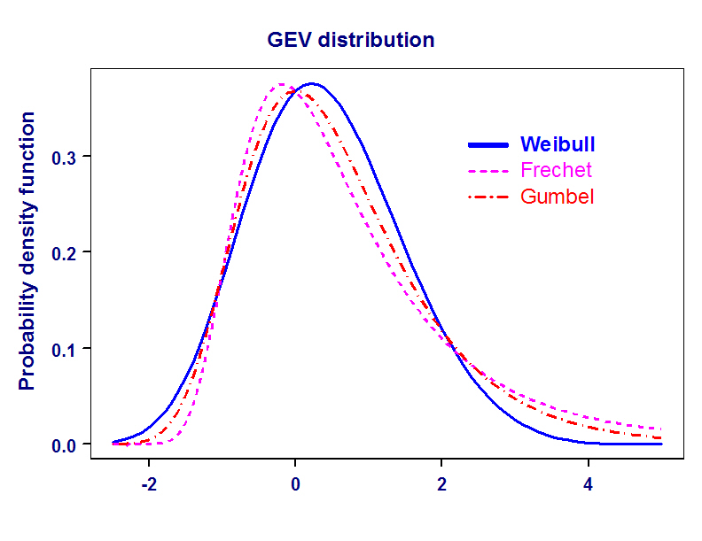
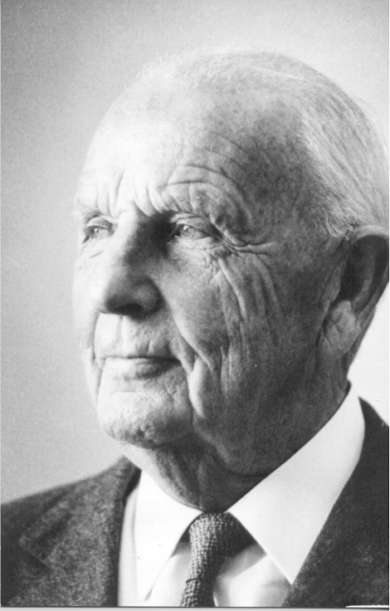
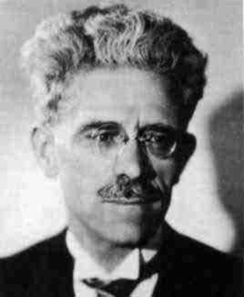

GEV model

Slide 46
Spatial model
where
Parameters describe distribution (i.e. nonstationary climate)
No model for simultaneous minima (i.e. weather)

Slide 47
Location slope vs latitude
MLE
Bayes

Slide 48
Some references
Guttorp (2012) Climate statistics and public policy. Statistics, politics and policy 3:1.
Guttorp, Sain and Wikle (eds.) (2012) Special issue: Advances in statistical methods for climate analysis. Environmetrics 23:5.
NAS (2012) Climate change: Lines of evidence.
Weart (2011) The Discovery of Global Warming.

