Slide 1


Providing Leadership in Times of Chronic Crisis and Uncertainty
May 1, 2009
10 a.m. to 12 noon
USU Grand Salon

Slide 3
Providing Leadership in Times of Chronic Crisis and Uncertainty
Mark Stevens, Ph.D.
Director, University Counseling Services
mark.stevens@csun.edu
Lauren Nile, Esq.
Manager, Professional Development
lauren.nile@csun.edu

Slide 4
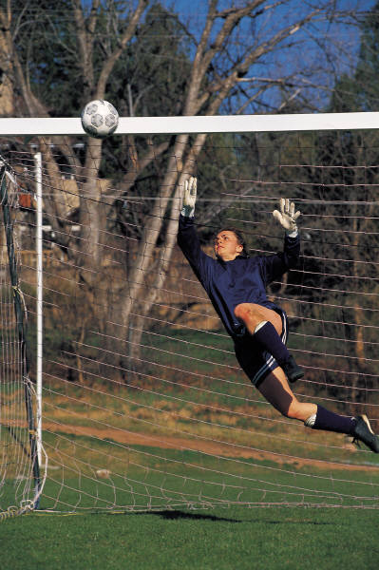
Goals for Today
Increase your understanding of the ways that individuals are psychologically experiencing these times of uncertainty.
Increase your capacity to empower, inspire, ease the despair and provide hope as a leader during these uncertain times.

Slide 5

We See it…
We hear it…
And we feel it!
•It can no longer be ignored.
•It is not going away.
•We are taking some antibiotics (Stimulus Package)
but not certain when and if it will work.

Slide 6
A Virus of Doom is in the Air
The virus enters us through our exposure to newspapers, talk shows, internet, TV, stories heard (some real some not), and gossip. The transmission of this virus is endless. Mass media is more massive and readily accessible than ever before and therefore has spread this virus of doom in an unrelenting manner. Hard to escape. Stock market, foreclosures, job losses, businesses going under – some have hit us in our vicinity, some have hit us in our neighborhood, some have hit our home - - - We have all been hit. Not certain if we will be hit harder, not certain how long we will be hit, not certain what kind of damages we will witness and experience. These are emotionally tight and trying times.

Slide 7

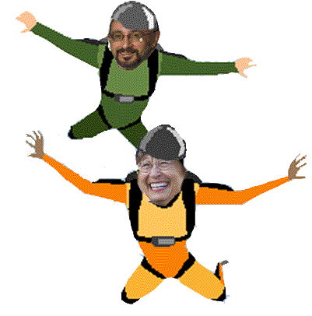
These are Times that
CALL for us as Leaders to…….
Increase our Energy and intention to deliver messages of hope.
Find creative ways to help bring awareness of what folks have (not just what they have lost or are afraid of losing).
Show kindness in small and large ways,
be empathic.

Slide 8
How do we do this

Slide 9
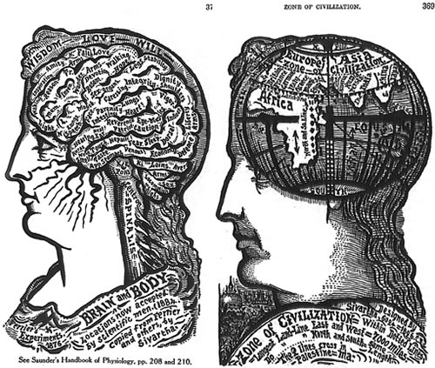
First let us look at some
Mental Maps for understanding how individuals may experience these uncertain times

Slide 10
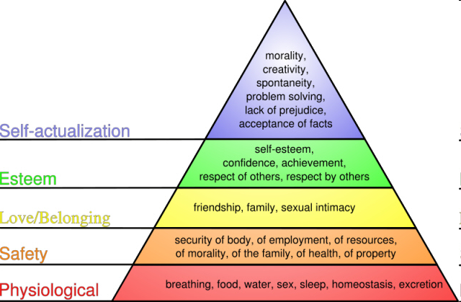
Maslow’s Theory of Needs
Map #1

Slide 11
Map #2
“Emotional Tightness (ET)
&
Emotional Space (ES)”
During these uncertain times
ET & ES is a Dynamic Process
ET and ES is influenced by:
Our genetic structure
Experiences of way back when, yesterday, and today
Anticipation of the future.
ET and ES changes:
Moment to Moment
From hearing bad news and
from hearing good news.
From hearing criticism and
from hearing praise.
From finding something funny and
from getting frustrated.
From getting enough sleep and
from spreading yourself too thin.
Emotional Space Emotional Space
hearing bad news
hearing good news
hearing criticism
hearing praise
finding something funny
getting frustrated
getting enough sleep
spreading yourself too thin

Slide 12

The Goal
To Facilitate Emotional Space
(ES)

Slide 13
Benefits of Emotional Space
The Formula
More Emotional Space = More Cognitive and Emotional Flexibility
More flexibility equals……..
more efficiency
better decision making
more energy
less self absorption
more empathy
The Individual is ___(fill in the blank).___
Emotional Space Emotional Space

Slide 14


Map # 3
Compromised Homeostasis (CH)
During these uncertain times
What is CH?
•Metaphors of feeling
Upside Down,
Falling,
Feeling Chilled,
Wound up
•Feeling overly distracted as one searches for
firmer grounding or emotional balance

Slide 15
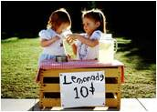


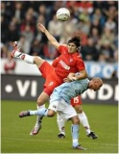


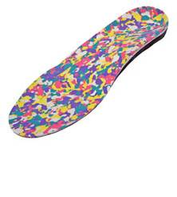
for Compromised Homeostasis (CH)
Providing Stabilizers
Help Break the Fall
Parachutes Help Break the Fall
Life jackets Offer some Breathing Room
Pillows and blankets Provide Warmth
Massage oil Relieve Tension
Orthotics Reduce Pressure
Iced cold lemonade Help Cool things down
Dramamine Help Steady
Eye Exam Provide Perspective
Offer some Breathing Room
Provide Warmth
Relieve Tension
Reduce Pressure
Help Cool things down
Help Steady
Provide Perspective

Slide 16
What can you specifically do as a leader to respond to ET and CH in your work environment?
Scan yourself for your tightness and help create some ES for yourself.
Be realistic with your role in facilitating ES.
Create a game plan for facilitating ES and providing stabilizers.

Slide 17
Creating a Game Plan
At your tables we would like for you to:
Discuss how you could realistically infuse stabilizers and emotional space into your specific work environment to respond to the current times of chronic crisis and uncertainty.
Share any examples (stories) you have of success as a leader in terms of instilling hope and empowerment.
Allow Yourself to be Creative
(and brag just a little)

Slide 18
Special Thanks to Vincent Chavez
for his creative help with the graphics.

