Slide 1


Advancing a Services Oriented Architecture for Sharing Hydrologic Data
Jeffery S. Horsburgh
Utah Water Research Laboratory
Utah State University
D.G. Tarboton, D.R. Maidment, I. Zaslavsky, D.P. Ames, J.L. Goodall, and R.P. Hooper
CUAHSI
HIS
Sharing hydrologic data
Support EAR 0622374

Slide 2
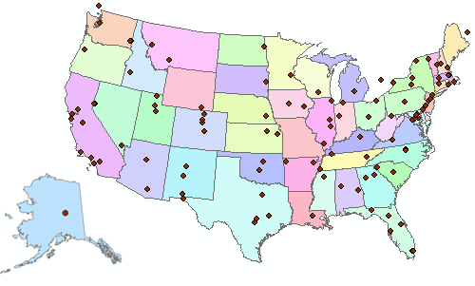

Consortium of Universities for the Advancement of Hydrologic Science, Inc.
Hydrologic Information System
Hydrologic Measurement Facility
Hydrologic Modeling
Hydrologic Education Outreach
An organization representing more than one hundred United States universities, receives support from the National Science Foundation to develop infrastructure and services for the advancement of hydrologic science and education in the U.S.
http://www.cuahsi.org/

Slide 3
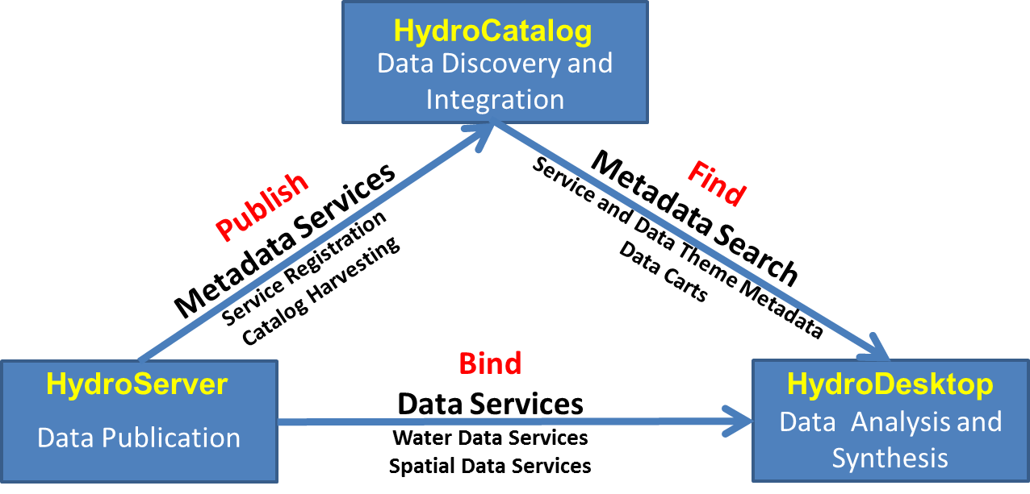
What is the CUAHSI HIS?
UT-Austin, SDSC/UCSD, Utah State U, Idaho State U, Drexel U, U of So. Carolina, CUAHSI
PI: D. R. Maidment (UT-Austin)
Partners:
Academic: 11 NSF hydrologic observatories, CEO:P projects, LTER, CZO…
Government: USGS, EPA, NCDC, NWS, state and local
Commercial: Microsoft, ESRI, Kisters
International: Australia, UK
Standardization: OGC, WMO (Hydrology Domain WG); adopted by USGS, NCDC, Army Corps of Eng.
An online distributed system to support the sharing of hydrologic data from multiple repositories and databases via standard water data service protocols
Software for data publication, discovery, access and integration

Slide 4
HydroServer
Publication of point observations and geospatial datasets
Distributed data with local control for data publishers
Data Discovery and Integration
HydroCatalog
Find
Metadata Search
Service and Data Theme Metadata
Data Carts
Publish
Metadata Services
Service Registration
Catalog Harvesting
Bind
Data Services
Water Data Services
Spatial Data Services
HydroServer
HydroDesktop
Data Publication
Data Analysis and Synthesis

Slide 5
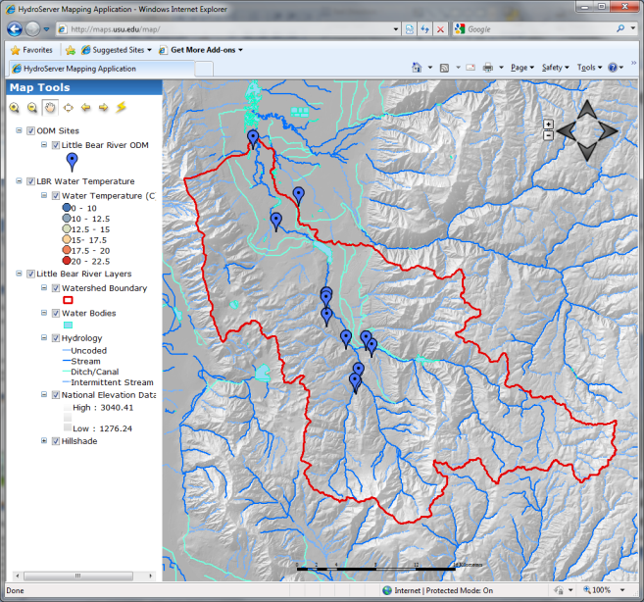

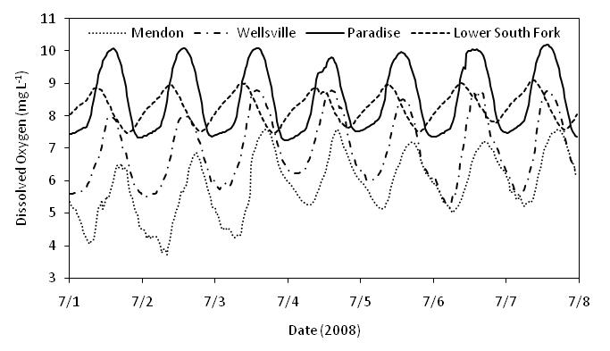

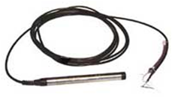
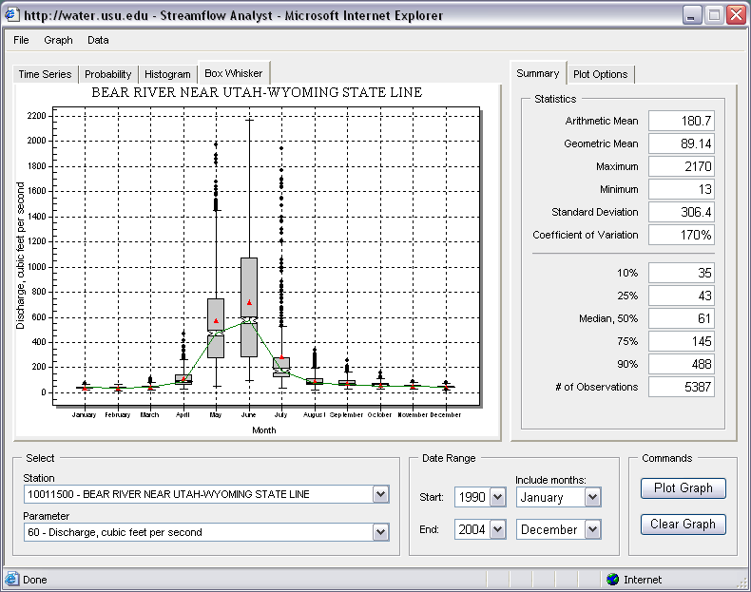
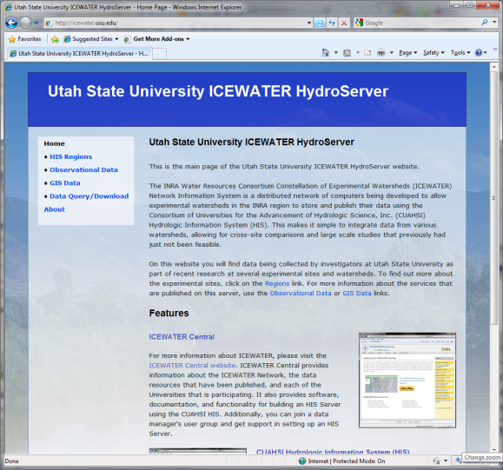
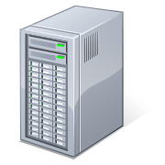
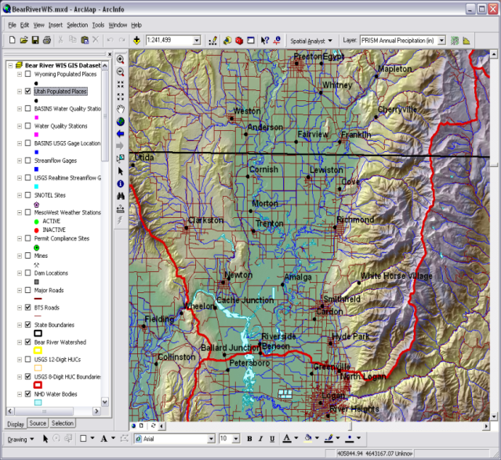
Point Observations Data
Internet Applications
Ongoing Data Collection
Historical Data Files
ODM Database
GetSites
GetSiteInfo
GetVariableInfo
GetValues
GIS Data
WaterML
WaterOneFlow
Web Service
OGC
WMS, WFS, WCS
Data presentation, visualization, and analysis through Internet enabled applications
HydroServer

Slide 6
CUAHSI Observations-Network Information Model
NWIS Daily Values
Data Service
NWIS Sites
Network
San Marcos River at Luling, TX
Sites
Discharge, stage
(Daily or instantaneous)
Variables
Observation
18,700 cfs, 3 July 2002
{Value, Time, Qualifier}
A data source operates an observation network
A network is a set of observation sites
A site is a point location where one or more variables are measured
A variable is a property describing the flow or quality of water
A value is an observation of a variable at a particular time
A qualifier is a symbol that provides additional information about the value

Slide 7
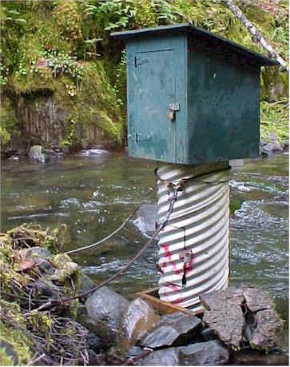
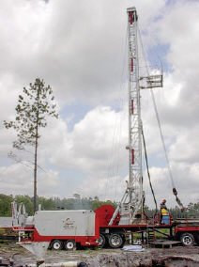
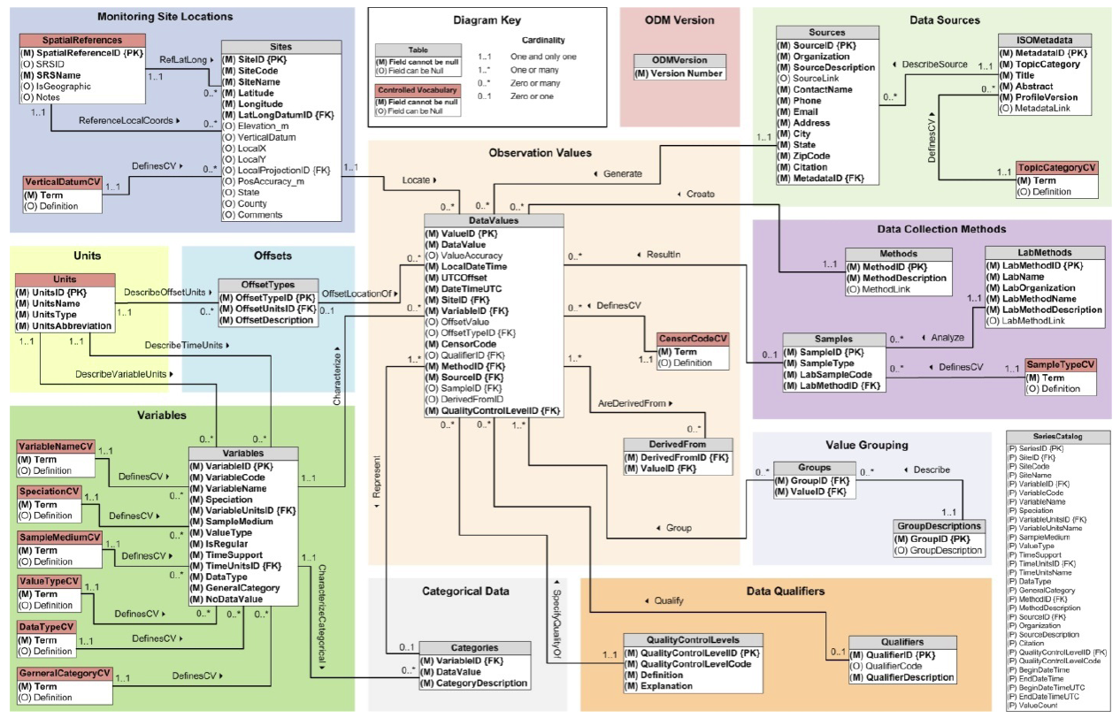
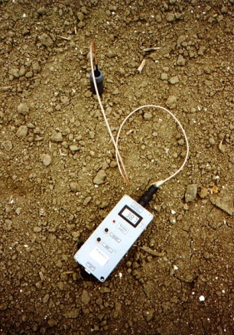
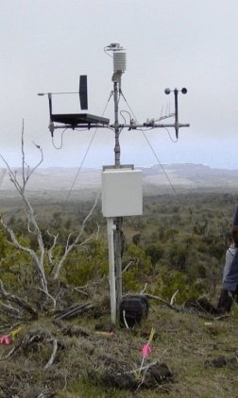
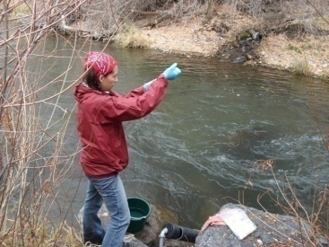
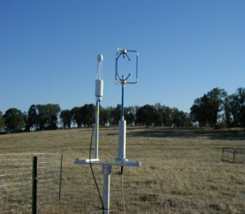
Observations Data Model (ODM)
Streamflow
Groundwater
levels
Precipitation
& Climate
Soil
moisture
data
Water Quality
Flux tower data
A relational database at the single observation level
Metadata for unambiguous interpretation
Traceable heritage from raw measurements to usable information
Promote syntactic and semantic consistency
Cross dimension retrieval and analysis
Horsburgh, J. S., D. G. Tarboton, D. R. Maidment, and I. Zaslavsky (2008), A relational model for environmental and water resources data, Water Resources Research, 44, W05406, doi:10.1029/2007WR006392.

Slide 8
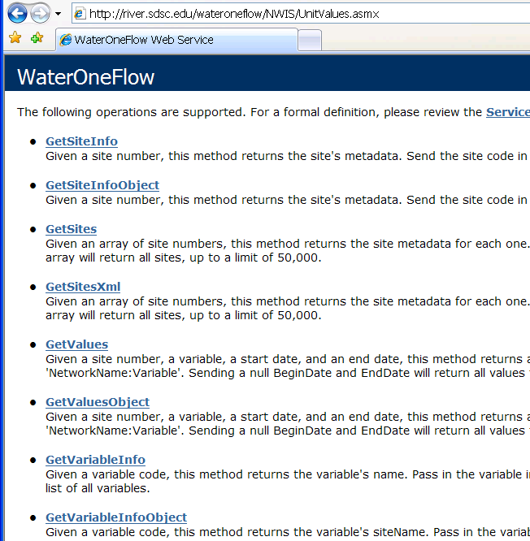
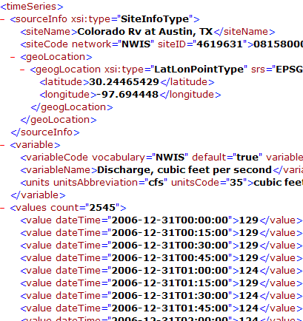
WaterML and WaterOneFlow
WaterML is an XML language for communicating water data
WaterOneFlow is a set of web services based on WaterML
Set of query functions
Returns data in WaterML
Notes:
8

Slide 9
HIS Central - HydroCatalog
Central metadata catalog supporting data discovery
Data Discovery and Integration
HydroCatalog
Find
Metadata Search
Service and Data Theme Metadata
Data Carts
Publish
Metadata Services
Service Registration
Catalog Harvesting
Bind
Data Services
Water Data Services
Spatial Data Services
HydroServer
HydroDesktop
Data Publication
Data Analysis and Synthesis

Slide 10
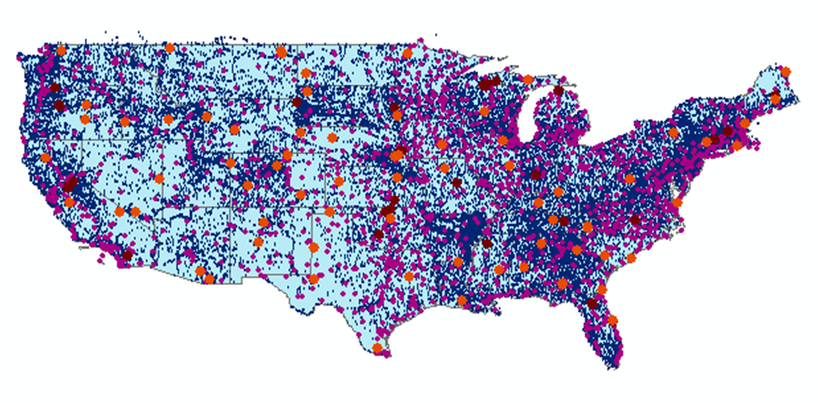
HIS Central HydroCatalog Content (November 2010)
Map integrating NWIS, STORET, & Climatic Sites
65 public web services
18,000+ variables
1.96+ million sites
23.3 million observation time series
Referencing 5.2 billion data values
Available via HIS Central discovery services
Available via GetValues requests
Metadata for most services are harvested weekly

Slide 11
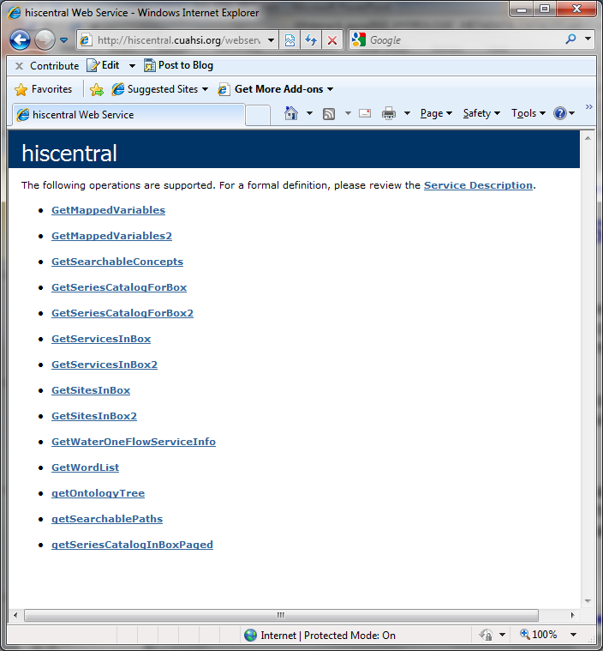
HydroCatalog Search Services
A web service application programmers interface to the metadata catalog
Semantic annotations and a domain ontology aid in discovery

Slide 12
HydroDesktop
Discover, download, visualize, and analyze hydrologic data
Data Discovery and Integration
HydroCatalog
Find
Metadata Search
Service and Data Theme Metadata
Data Carts
Publish
Metadata Services
Service Registration
Catalog Harvesting
Bind
Data Services
Water Data Services
Spatial Data Services
HydroServer
HydroDesktop
Data Publication
Data Analysis and Synthesis

Slide 13
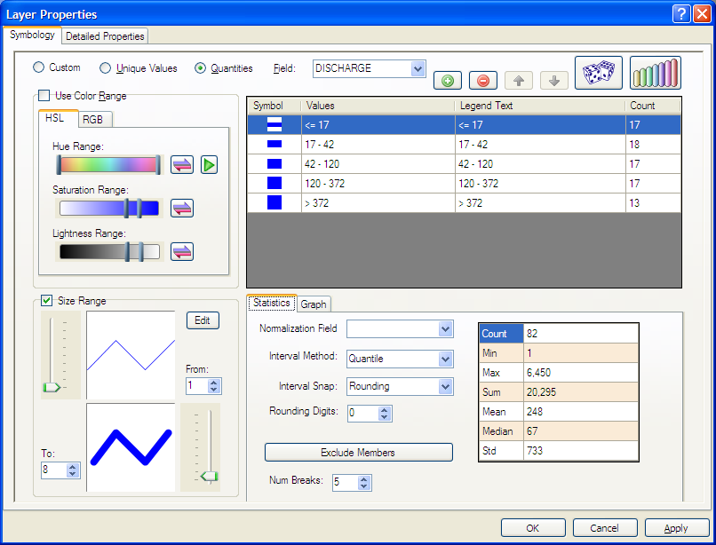
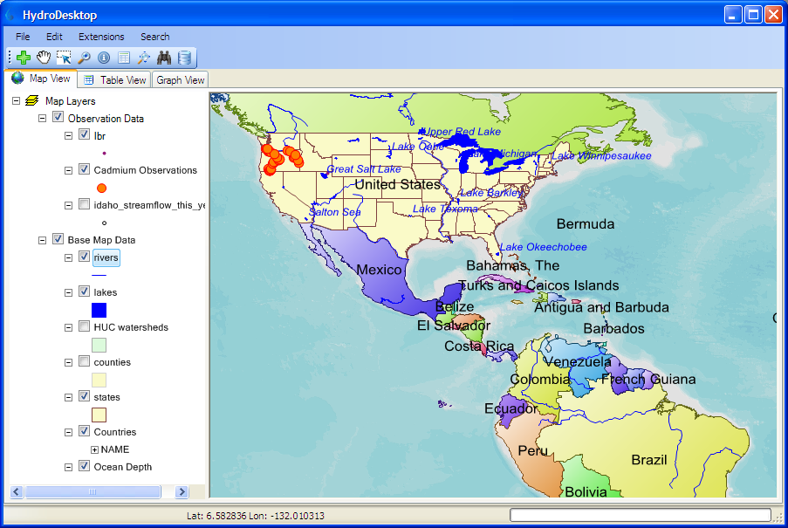
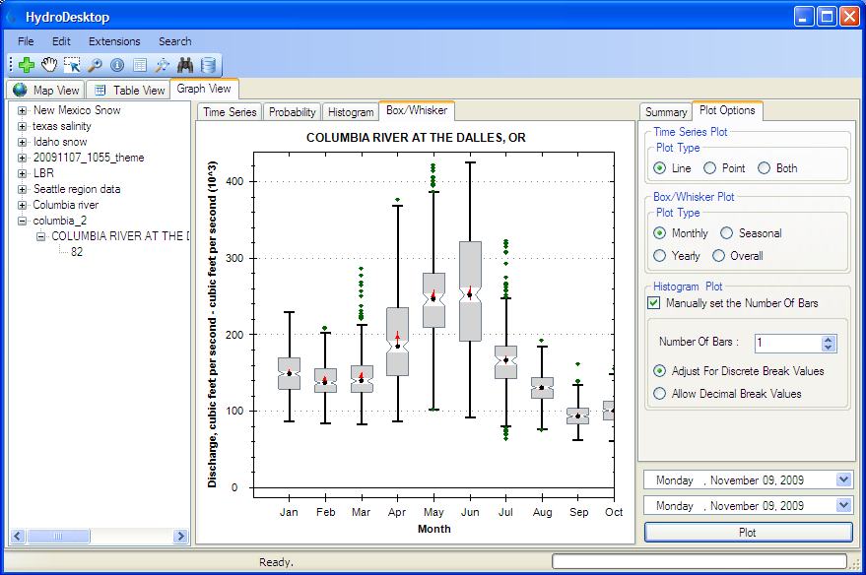
HydroDesktop Capabilities
GIS
Add shapefiles to map
Change symbology and labels
Print and export map
GIS toolbox
Hydrology
Extensibility
Search for data
Download data
Display time series
Export data
A plug-in interface for analytical capabilities

Slide 14
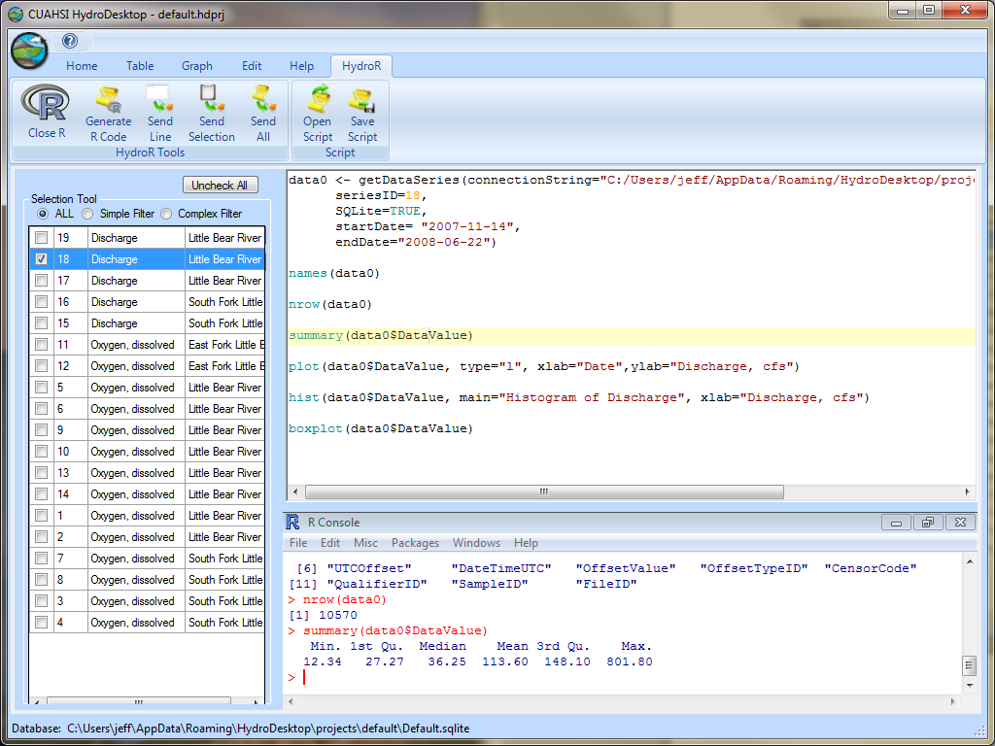
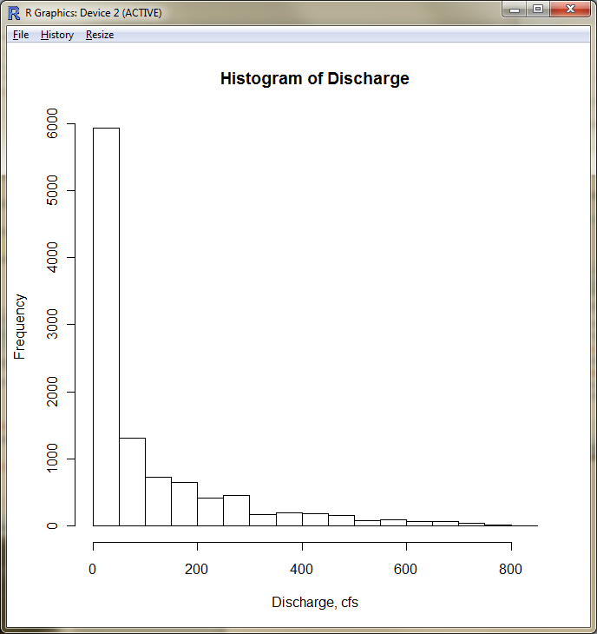
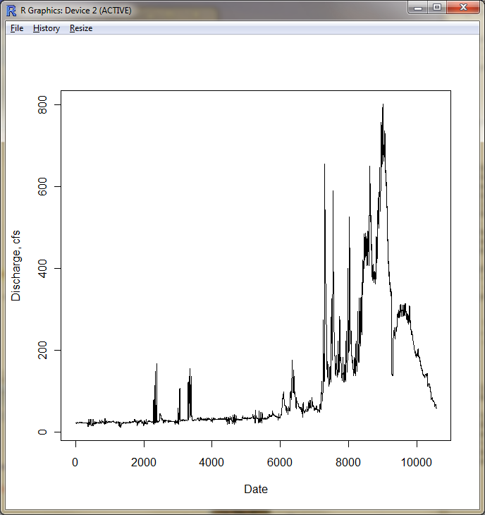

Data Visualization and Analysis in R

Slide 15
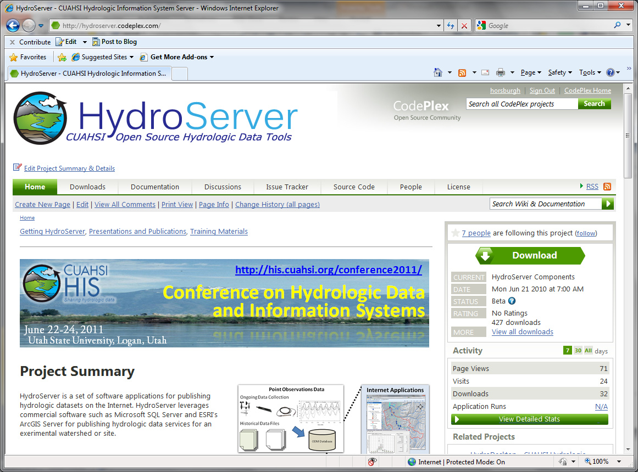
Collaborative Open Source Development
HydroServer – http://hydroserver.codeplex.com
HydroDesktop – http://hydrodesktop.codeplex.com
HydroCatalog – http://hydrocatalog.codeplex.com
Source Code
Downloads
Discussion Forums
Issue Tracker

Slide 16
Toward a Standard SOA for Water Data
CUAHSI has engaged with the Open Geospatial Consortium (OGC) to develop standards for water data
The OGC is a non-profit, international voluntary consensus standards organization that is leading the development of standards for geospatial and location based services
The OGC facilitates a consensus process in which government, private industry, NGOs, and academia collaborate to create open and extensible software application programming interfaces for geospatial and other mainstream information technologies

Slide 17
WaterML 2.0 An OGC Standard for Transmitting Hydrologic Observations
An application schema of GML 3.2.1
Makes extensive use of the Observations and Measurements (O&M) specification (ISO 19156)
Describes:
observations (what/when/where/how/results/context)
time series (values/units/data types/data quality/accuracy/period of record/publisher and owner)
observation processes (sensors/algorithms/models/manual methods)
locations (stations and locations/operators/datums/types of observations/history/time zone/resources)
grouping of measuring locations (i.e. networks)
groupings of observations and time series
OGC Hydrology Domain working group
Working on WaterML
Interoperability experiments

Slide 18
A Standard SOA for Water Data OGC Concept Development Study
Operationalizing the CUAHSI HIS
Encourage broad implementation by software providers and broad uptake by data publishers
Determine optimal web service interfaces and data encodings
Catalog
Publish????
Find????
Bind????
Server
Desktop

Slide 19
Summary
CUAHSI HIS
Cyberinfrastructure for managing and publishing observational data
Overcomes syntactic and semantic heterogeneity using a standard data model, transmission language, controlled vocabularies, and ontology
End-to-end infrastructure - from publication to discovery, access, and analysis
Supports a national network of academic partners, and links to many important federal water data repositories
Maintains national registry of services with searchable metadata
Already deployed at multiple locations, leveraged by other projects, free and open source
New Developments
HydroDesktop and associated plugins for data discovery, download, and analysis
WaterML 2.0 is an emerging OGC standard language for communicating water observations data from academic and government sources
New OGC Concept Development Study to define best practices for web service interfaces and data encodings

Slide 20
Thank you!
CUAHSI
HIS
Sharing hydrologic data
Support EAR 0622374

