Slide 1
Management Information: Key to Strategic Planning Senior Leadership Retreat presented by Mike Andrechak Office of the Provost www.dmi.illinois.edu 333-3551

Slide 2
How can Management Information help you?
With standard web & paper reports
With custom reports
With advice on where to find and how to use management data

Slide 3
Why be data-savvy?
To better manage your unit
To know what others know about you
To respond to inquiries
To avoid reinventing the wheel

Slide 4
“The new source of power is not more money into the hands of the few, but more information into the hands of many.”
--- John Naisbitt

Slide 5
Set a bookmark today:
dmi.illinois.edu

Slide 6
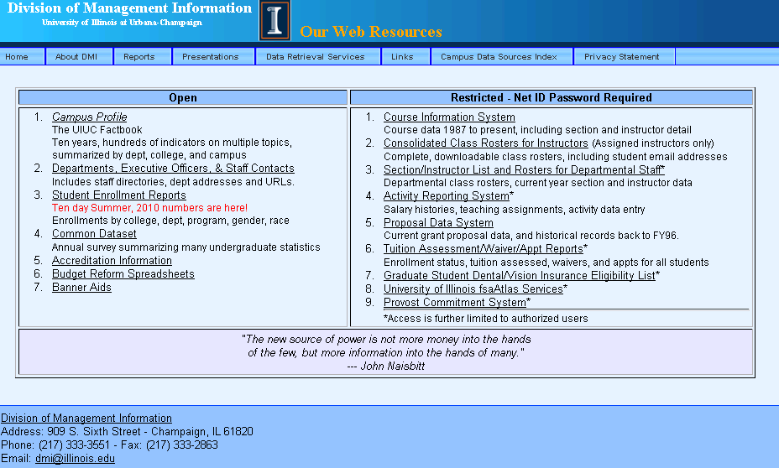
http://www.dmi.illinois.edu
Notes:
This is our main web site. It is organized with open-access resources on the left and
Restricted (password required) resources on the right.

Slide 7
UIUC Campus Profile
Ten years of data summarized by
department, college, and campus:
Budgets & expenditures
FTE and headcount staff
Student enrollment
Course enrollments & IUs
much, much more!

Slide 8
UIUC Campus Profile -- Uses
Compare your unit to similar
units on campus
Look at your unit over time

Slide 9
UIUC Campus Profile Types of Profiles Available
Standard : 357 items
Strategic
54 Campus-wide metrics
Unit-specific metrics
Graphs & Dashboard
Custom: 631 items

Slide 10
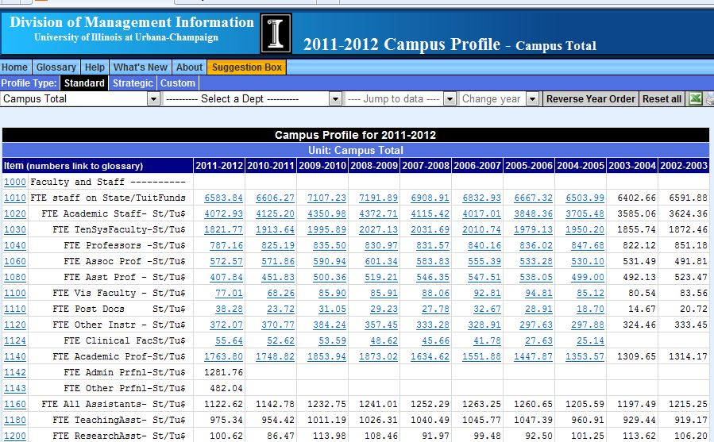
Item numbers are links to glossary
Some data items are “drilldowns”
Notes:
Item numbers are links to glossary/definitions
Note – an excel button on each page, also a print button
Notice that some of the numbers appear to be links….

Slide 11
Campus Profile Drilldowns
Any data item that appears to be a link is drillable
FTE: get staff lists with appointment info
Expenditures: see details by fund and account
Students/degrees: counts by student program, breakouts by gender, race/ethnic, residency
IUs: breakout by section and instructor

Slide 12
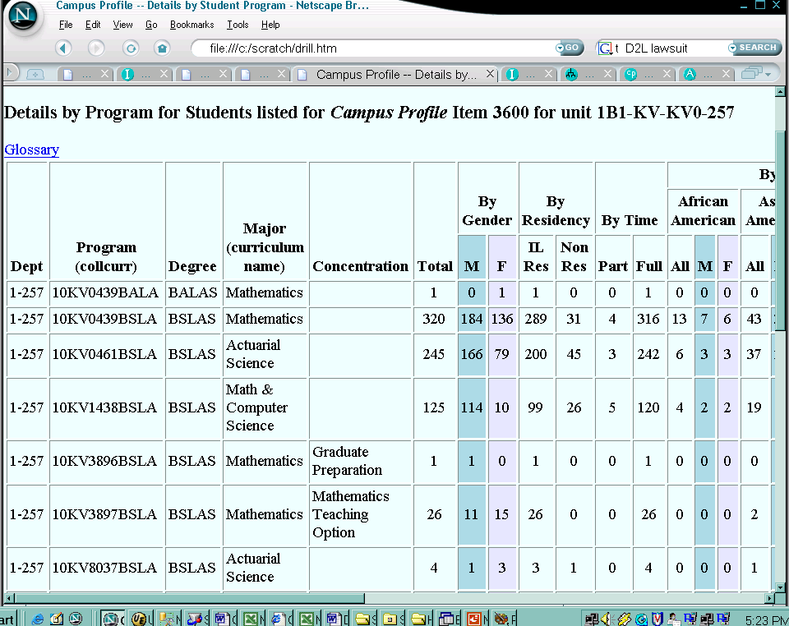

Slide 13
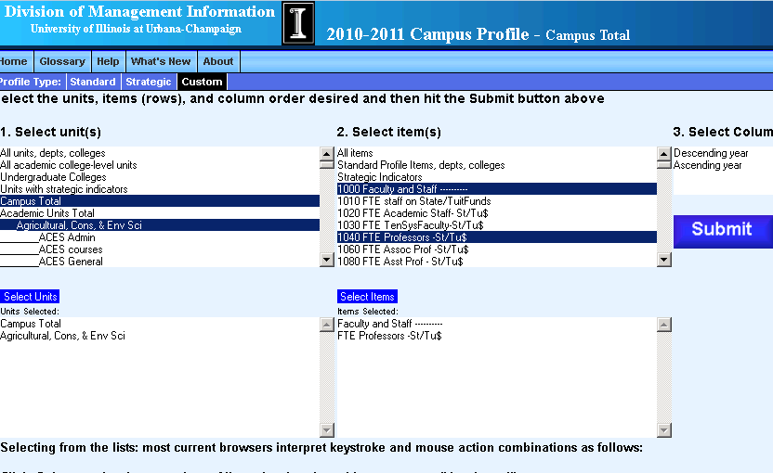
Custom Profile

Slide 14
Strategic Profiles
Campus-wide set of metrics organized by campus goals
College-specific goals, metrics for each goal, and 3-yr & 5-yr targets for each metric
Graphs now available for most metrics
Notes:
Copy in your packet - white

Slide 15
Strategic Profiles – Campus-Wide Metrics
Metrics that are the same for all units. Include:
Students
Faculty
Programs
Selected items are graphed and allow comparisons between units
Notes:
Campus-wide indicators are the same for every unit
Graphs are available for many of the standard items; we’ll be looking at some of those graphs later during our case studies

Slide 16
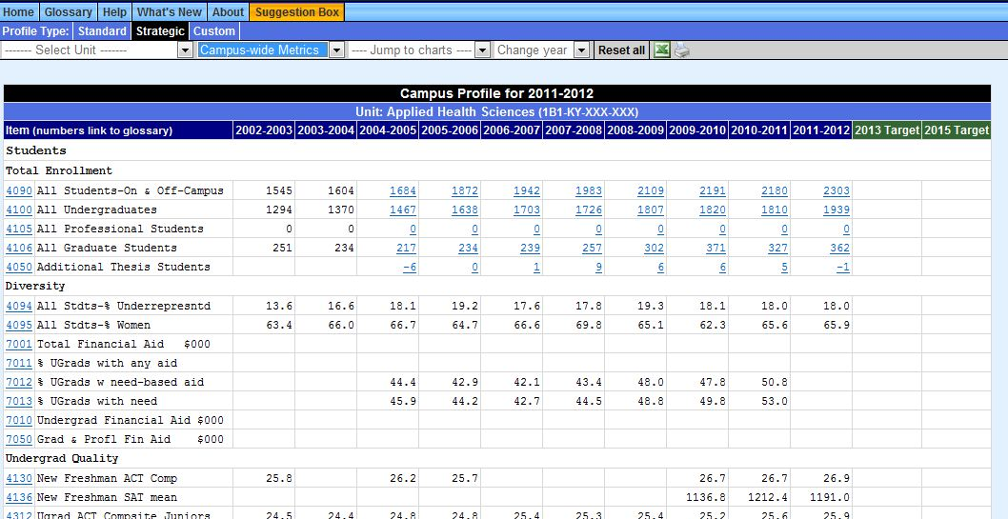
Strategic Profile: Campus-Wide Metrics
Notes:
standard indicators displayed for all units.

Slide 17
Strategic Profile – Unit-Specific Metrics
Organized by college goals
3 & 5 yr targets set by the unit
Primarily college and major unit only, can be extended to depts
Notes:
Colleges negotiate their indicators with the provost’s office, and set their own targets.

Slide 18
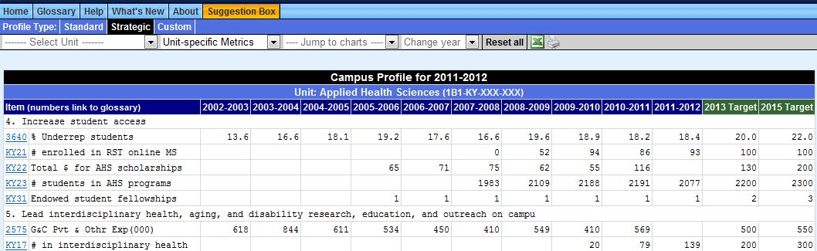
Strategic Profile – Unit-Specific Metrics
Notes:
This is a sample of the unit-specific goals and strategic measures for AHS.
Note the targets and the dropdown to select the type of chart
Every department head should look at his/her college’s strategic profile.

Slide 19
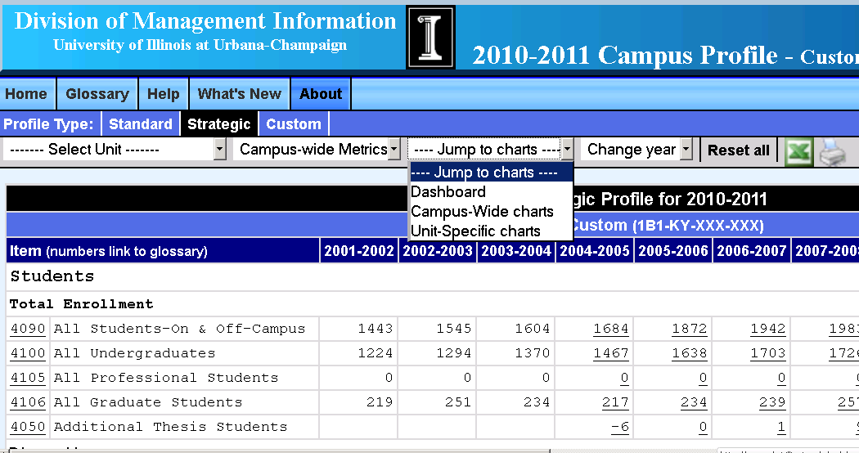
Strategic Profile: Three Graph Types

Slide 20
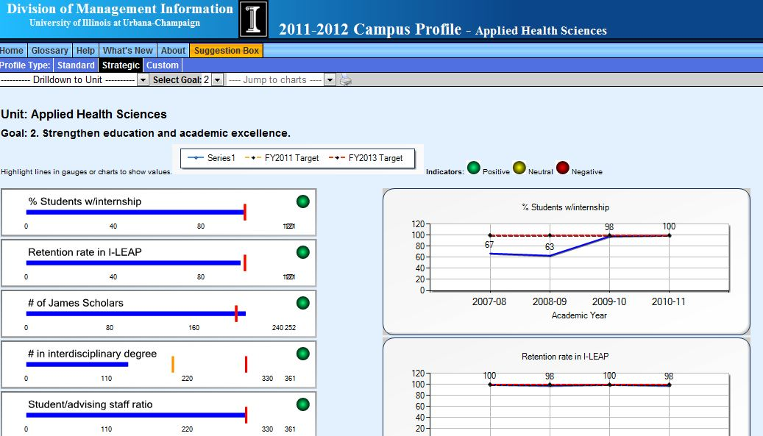
Dashboard – one per goal
Notes:
Dashboards show selected unit-specific measures for each goal. Colleges set their own targets, select which indicators will be graphed, and evaluate (green, yellow, red lights) their own progress towards the targets.
Left side shows current value (blue) and 2011 (yellow) and 2013 (red) targets. Right side shows up to 10 years of data with the targets.

Slide 21
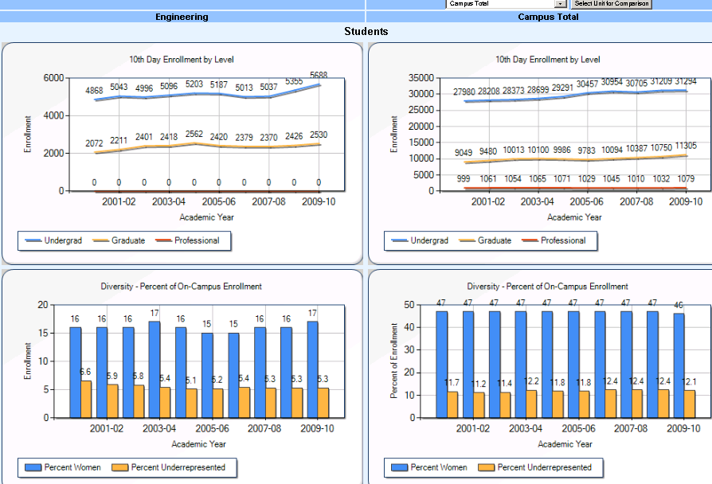
Campus-Wide Charts
Selected unit
Selected comparator
Notes:
This is a sample of the strategic measures for Eng compared to those of the Campus.
Note that there’s a dropdown for the comparison unit – you can compare two departments or colleges, or any unit can be compared to the campus total.

Slide 22
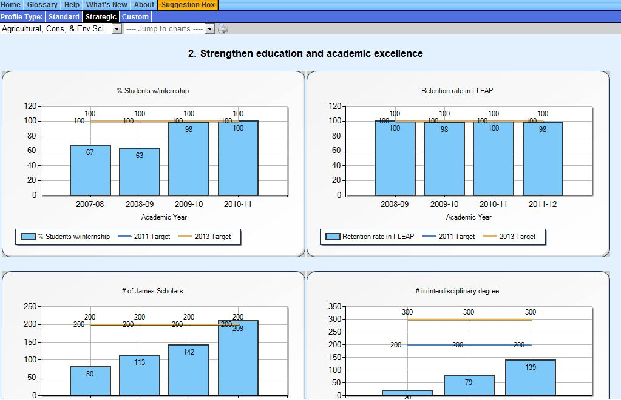
Unit-specific Charts
Notes:
Colleges decide which charts to display. Each chart shows the targets for 2011 and 2013.

Slide 23
Course Information System
Sections, IUs, Instructors by “Offering” department “Paying” department “Controlling” department
Data back to Fall, 1987
Deals correctly with renumberings, crosslistings, new subject names

Slide 24
Course Information System Example Reports
All courses one year
All years for one course
Selected courses and selected terms
All courses, all years for one faculty member
Six – Ten reports
Anomaly reports
Notes:
Explain Six-Ten & Anomaly reports

Slide 25
Other Information Resources for Managing the Instructional Mission
Student Enrollment Reports
“Official” 10-day enrollments
Consolidated class rosters
Section Instructor List/ dept rosters

Slide 26
Information Resources for Managing your Students & Tuition Revenue
Tuition, Waiver, and Appointments System
Tuition charges and waivers for undergrads & grad students enrolled in your unit by term. Includes residency, tuition schedule, range for each student, plus all waiver-generating appts

Slide 27
Who’s Who at the UI: Departments and Executive Officers
All depts in Urbana
Unit heads & other contacts
Staff directories
URLs of each unit
Notes:
I use this page at least 10 times a day. The “other contacts” now includes people such as business managers, HR directors, course scheduler, EEO officers, etc.

Slide 28
Information Resources for Managing the Research Mission
Proposal Data System
All proposals submitted for grants/contracts
1996 to present. Searchable by:
Investigator
Sponsor/agency
Dept or college
Key word
Notes:
You’ll see some examples in one of the cases.

Slide 29
Additional Information Resources for “Managing” Your Faculty
Course Information System: Teaching histories
Activity Reporting System:
Salary histories from FY89,
cost sharing commitments
Notes:
There’s an example of a salary history in one of your cases.

Slide 30
Other Information Resources Available to Units
Banner
Decision Support:
Eddie/Business Objects
Standard reports
Point & click report generation
Enterprise Data Warehouse (EDW)
(for programmers)

Slide 31
A Note on Data Quality
Garbage in → Garbage out
The data we work with originates in the departments. Please make sure your staff members know it’s important to take the time to enter data correctly.

Slide 32
A Note on Data Security
As EO, you are responsible for the uses of data in your unit. Make sure your staff know and obey the policies and laws on data privacy, especially with student data (FERPA)

Slide 33
Towards a Data-driven Decision-Making Culture
More and more, decisions on campus are driven by data. Take the time to understand the rich sources of data you have available and use them !!!

Slide 34
Let Management Information Help
Call (333-3551) or email (dmi@illinois.edu)
Navigation through our site
Understanding the data
Where to find data
Special reports needed

Slide 35
Questions??

Slide 36
Web Systems in Place
UIUC Campus Profile
Activity Reporting System
Tuition Assessment/Waiver/Appt Reports
UIUC Departments & Executive Officers
Student Enrollment Reports
Course information system
Section Instructor List
Proposal Data System

