Slide 1
Hybrid Transitive Trust Mechanisms
Jie Tang, Sven Seuken, David C. Parkes
UC Berkeley, Harvard University,

Slide 2
Motivation
Large multi-agent systems must deal with fraudulent behavior
eBay auctions
P2P file sharing systems
Web surfing
Pool collective experience
Need mechanisms for aggregating trust
Notes:
Multiagent systems today involve interactions between large numbers of anonymous agents
This anonymity allows untrustworthy parties to gain from fraud.
For example, on eBay a seller might not deliver an auctioned item,
(Resnick, 8.1% trust premium)
Or in P2P file sharing systems a user might distribute a trojan or virus.
And a malicious site might install spyware on my computer
Because there are so many agents we are not going to have repeat experience with most counterparties.
It’d be great if we could pool collective experience to identify untrustworthy agents from trustworthy agents
Theres a need for mechanisms which aggregate trust information

Slide 3
Agent Interaction Model
Defn. Agent Type: θ_{i} in [0,1] = prob. of a successful interaction
s₂
s₃
θ₂
s₁
θ₃
θ₁
θ₄
s₄
θ₅
s₅
Notes:
Lets say we have a peer to peer network, and we have agents who would like to exchange files.
They’re going to have a bunch of interactions: say this agent interacts with this other agent, and he has a positive experience (represented by the green arrow) and reports it somewhere, and this agent also has a positive experience, and this agent has a negative experience.
A natural model for this is a graph, where the agents are the vertices and the interactions are represented by directed edges.
We model trustworthy vs. nontrustworthy agents by giving each agent a type theta_i: good agents have high thetai
Now there are two main challenges: first, how do we use these reports to get information about who is most trustworthy? Like to infer s_is
Second, there is motivation for agents to manipulate their reports to try to appear more trustworthy, and we need to find ways to combat that.
So in addition to being low type, may actively subvert mechanism: going to explicitly model
(A directed edge exists from i to j whenever agent i has had a positive experience with agent j
In general these edges can be weighted (imagine giving a rating on eBay, or recording the proportion of bad interactions))

Slide 4
Goals
Informativeness: correlation between scores s_{i} produced by the trust mechanism and true agent types θ_{i} (corr(S, θ))
Strategyproofness: Prevent individual agents from manipulating trust scores s_{i}
Trust mechanisms should be both informative and strategyproof
Optimize tradeoff between informativeness and strategyproofness

Slide 5
Outline
Motivation
Example Mechanisms
Informativeness vs. Strategyproofness
Hybrid Transitive Trust Mechanisms
Theoretical Analysis
Experimental Results
Informativeness
Efficiency
Conclusions
Notes:
These are the two most important questions I’m going to be addressing in this talk.
First, we’re going to briefly highlight some transitive trust algorithms that have been studied and examine how they solve the first problem of going from a trust graph to trust scores which discriminate between untrustworthy and trustworthy agents.
Then we’re going to illustrate the tension between being very informative, between making good use of the available trust graph information and being suspect to manipulation. Existing trust mechanisms either do informativeness well or do strategyproofness well but never both.
Then I’m going to talk about our core contribution, which is a method for taking existing trust algorithms and combining them into hybrid mechanisms that can get best of both worlds. I’m going to talk about a few results which let us adjust the strategyproofness of our hybrids.
And finally I’m going to talk about our experimental validation of the effectiveness of hybrids which show they can do better than existing mechanisms.

Slide 6
Outline
Motivation
Example Mechanisms
Informativeness vs. Strategyproofness
Hybrid Transitive Trust Mechanisms
Theoretical Analysis
Experimental Results
Informativeness
Efficiency
Conclusions
Notes:
These are the two most important questions I’m going to be addressing in this talk.
First, we’re going to briefly highlight some transitive trust algorithms that have been studied and examine how they solve the first problem of going from a trust graph to trust scores which discriminate between untrustworthy and trustworthy agents.
Then we’re going to illustrate the tension between being very informative, between making good use of the available trust graph information and being suspect to manipulation. Existing trust mechanisms either do informativeness well or do strategyproofness well but never both.
Then I’m going to talk about our core contribution, which is a method for taking existing trust algorithms and combining them into hybrid mechanisms that can get best of both worlds. I’m going to talk about a few results which let us adjust the strategyproofness of our hybrids.
And finally I’m going to talk about our experimental validation of the effectiveness of hybrids which show they can do better than existing mechanisms.

Slide 7

Example: PageRank
0.33
0.20
0.16
0.11
0.20
Notes:
Okay, so lets talk about transitive trust mechanisms that have been studied.
One famous mechanism is the PageRank mechanism, which has been applied to scoring the relative authoritativeness of web pages but can just as easily be applied to a generic multiagent system (Eigentrust)
Simulates a random walk on the trust graph with random jumps, and the PageRank is defined as the stationary distribution of this random walk.
(This can be computed as the first eigenvalue of the adjacency matrix A, where Aij is the weight of the edge from i to j divided by the total number of edges leaving i plus the random jump factor)
The idea behind pagerank is that an agent is more trustworthy if it has many links, but its even more trustworthy if it has links from pages that themselves are very trustworthy.
So here are the PageRank values for this graph.
Note that these are symmetric rather than asymmetric, as we had before

Slide 8
Example: Shortest Path
i
j
Notes:
There are a lot of simpler algorithms which have been studied which in some sense don’t do as good a job as PageRank, and I’m going to show you why.
For example, theres the shortest path algorithm, which …
With shortest path, only this edge matters: rest of the graph is pretty irrelevant

Slide 9
Example: Maxflow
i
j
Notes:
Theres the maximum flow algorithm, which …
Maxflow takes a few more edges into account: would be the same overall score if those edges were removed

Slide 10
Example: Hitting Time
i
j
Notes:
Theres also hitting time, which …
Hitting time doesn’t take j’s outlinks into account: we’ve already hit j.
PageRank takes all these edges into account: looking for stationary distribution of random surfer
Seems great, we should all use PageRank.

Slide 11
Example: PageRank
i
j
Notes:
Theres also hitting time, which …
Hitting time doesn’t take j’s outlinks into account: we’ve already hit j.
PageRank takes all these edges into account: looking for stationary distribution of random surfer
Seems great, we should all use PageRank.

Slide 12
Manipulations
Misreport
Sybil
0.32
0.11
0.20
0.08
0.16
0.36
0.11
0.03
0.20
0.07
Notes:
There’s still the other challenge that I mentioned, which is that there are all sorts of incentives for agents to manipulate the trust graph; take the web ranking example, if you get a higher pagerank you can get more hits and more viewers and more advertising money.
So for pagerank, you can do this misreport manipulations, where you lie about which links you’d like to put on the graph
You can also make fake sybil nodes which you control which you can make links to back and forth
Optimal manipulation for pagerank is to do both of these things
In this toy example the agent with the lowest trust score can become the highest trusted agent in the graph.
How can we prevent these sorts of manipulations from being profitable?
(There are Whitewashing, collusion)

Slide 13
Outline
Motivation
Example Mechanisms
Informativeness vs. Strategyproofness
Hybrid Transitive Trust Mechanisms
Theoretical Analysis
Experimental Results
Informativeness
Efficiency
Conclusions
Notes:
So the most informative of our trust mechanisms, namely pagerank, can be suspect to manipulation. Now, let's take a closer look at how we can quantify the ability to manipulate a trust mechanism and the trade-off between informativeness and strategyproofness

Slide 14
Value-strategyproof example
Value strategyproofness: an agent cannot increase its own trust score
j
i
Notes:
We’d like our mechanisms to be strategyproof, so that agents cannot benefit from manipulating
Theres two main ways people have looked at this in the past
Agents cannot increase their absolute trust score from the perspective of any other agent
Shows the maxflow algorithm: maxflow is value strategyproof
In order for j to increase his trust score, I need to increase the capacity of the maximum flow edges from i to j. But any edge that j controls (outlinks) cannot be part of this flow.
Easy way to guarantee value strategyproofness: don’t let my own reports affect my score
Hitting time, maxflow, shortest path are all value strategyproof.
PageRank is NOT value strategyproof (recall manipulations example)

Slide 15
Rank-strategyproof example
Rank strategyproofness: an agent cannot increase its rank
j
i
Notes:
Agents cannot increase their position in a rank order from the perspective of any other agent
Shortest path is rank strategyproof
Say agent j wants to increase his rank in the eyes of agent i.
If another agent j’ has higher trust score than j, j’ must have a shorter shortest path from i. But j cannot lie on this shortest path (because that would be a shorter shortest path than the one currently from i to j).
Therefore j cannot decrease the rank of any agent who is ranked higher.
This is not true for maxflow, hitting time, or pagerank.

Slide 16
ε-strategyproof
ε-value strategyproof: Agents cannot increase their trust score by more than ε through manipulation
ε-rank strategyproof: Agents cannot improve their rank to be above agents who have ε higher trust score
Notes:
We’re going to define some natural generalizations of the value- and rank- strategyproofness concepts that will be useful later for hybrids.
First we define epsilon value strategyproofness, which requires that agents cannot increase their trust score by more than epsilon through manipulation. This means that the maximum value of the manipulation is bounded by epsilon
If epsilon = 0 this reduces to value strategyproofness
We also define the corresponding generalization for rank strategyproofness
Epsilon rank strategyproof mechanisms do not allow agents to improve their rank above agents with epsilon higher trust score
Rank manipulations are locally restricted.

Slide 17
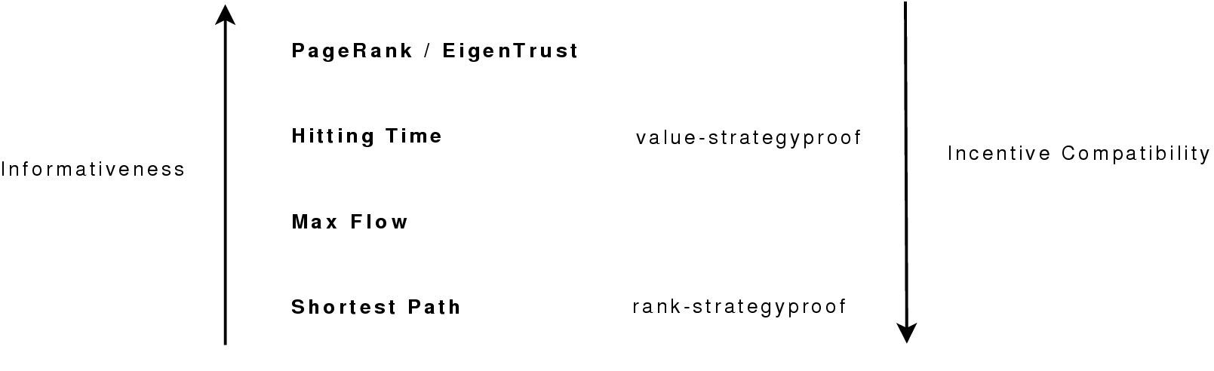
Informativeness vs. Strategyproofness
Notes:
We’d like our mechanism to have good informativeness and strategyproofness properties
But there a tradeoff between informativeness and strategyproofness. For example the most informative mechanism, namely PageRank, is not value- or rank-strategyproof.
Existing mechanisms are either very informative or very strategyproof but never both;
Previous work has generally focused either on getting really accurate informative mechanisms or getting really strong theoretical strategyproofness results.
That being said, value- and rank-strategy proofness are very binary (black/white) definitions---we will now introduce a generalization of these concepts which allows us to quantify a degree of strategy-proofness."

Slide 18
Outline
Motivation
Example Mechanisms
Informativeness vs. Strategyproofness
Hybrid Transitive Trust Mechanisms
Theoretical Analysis
Experimental Results
Informativeness
Efficiency
Conclusions
Notes:
So now we have all the background we need to talk about our main results.

Slide 19
Hybrid Mechanisms
α( ) + (1-α)( )
Convex weighting of two mechanisms (one with good strategyproofness properties, one with good informativeness)
Get intermediate strategyproofness and informativeness properties
Notes:
One natural thing to do is to simply use a convex combination to combine mechanisms together
We can prove results showing these hybrids have intermediate strategyproofness properties. We’ll show later through experiments that they have intermediate informativeness properties.
We’ll also show these hybrid mechanisms can have better overall efficiency for some problem domains

Slide 20

Main Results
Can combine ε-value-strategyproof mechanisms naturally
(1- α)Maxflow- α PageRank hybrid is 0.5α-value strategyproof
Adjust strategyproofness as we vary α
Notes:
First, if we’re interested in value-strategyproofness we have a result concerning combining epsilon value-strategyproof mechanisms. Theres some notation here which I don’t have time to get into but the idea is fairly intuitive: we can bound the maximum value of manipulation as the worst-case value of manipulating either mechanism.
They combine more or less in the intuitive way: the key here is to pick the right mechanisms to combine. If we combine a strategyproof mechanism like Maxflow with an informative mechanism like PageRank we get a family of hybrid parameterized by alpha. By adjusting alpha we can get more or less strategyproof mechanisms.

Slide 21

Main Results:
“Upwards value preservance” and value-strategyproofness yield α-rank strategyproofness
(1- α) Shortest Path- α Hitting Time hybrid is α-rank strategyproof
(1- α) Shortest Path- α Maxflow hybrid is α-rank strategyproof
Notes:
Similarly, if we’d like to get epsilon-rank-strategyproof mechanisms, we have a result that shows how to do that by picking the right base mechanisms
if we combine two value-strategyproof mechanisms that obey a technical condition, we can get alpha-rank-strategyproofness
Shortest path hybrids
Again, defines a family of hybrids parameterized by blend factor alpha
“upwards value preserving” means any agent j who has higher value from another agent k’s perspective than from our perspective cannot have his trust score reduced from agent k’s perspective after the manipulation. Its not quite rank-strategyproofness: imposes conditions on agents which are ranked below us, and we can reduce the rank of certain agents who are higher ranked than us from agent k’s perspective but not by enough relative to our trust score.
Basically this is describing shortest path, trying to factor out more generally exactly what we need.
This is very nice because it relates rank- and value- strategyproofness
It is also nice because its easier to find value-strategyproof mechanisms: we are lifting value strategyproof mechanisms into (locally) rank-strategyproof mechanisms.

Slide 22
Outline
Motivation
Example Mechanisms
Informativeness vs. Strategyproofness
Hybrid Transitive Trust Mechanisms
Theoretical Analysis
Experimental Results
Informativeness
Efficiency
Conclusions
Notes:
So now we’ve characterized the strategyproofness of hybrids
Going to look at the informativeness of our hybrids

Slide 23

Informativeness
Informativeness is the correlation between the true agent types θ_{i} and the trust scores given by each trust mechanism s_{i}
Can only be measured experimentally
Setup
N agents, each with type θ_{i} (fraction of good)
No strategic agent behavior
Agents randomly interact, report results
Vary number of timesteps
Notes:
Empirical informativeness results
Correlation between true types, mechanism predictions

Slide 24
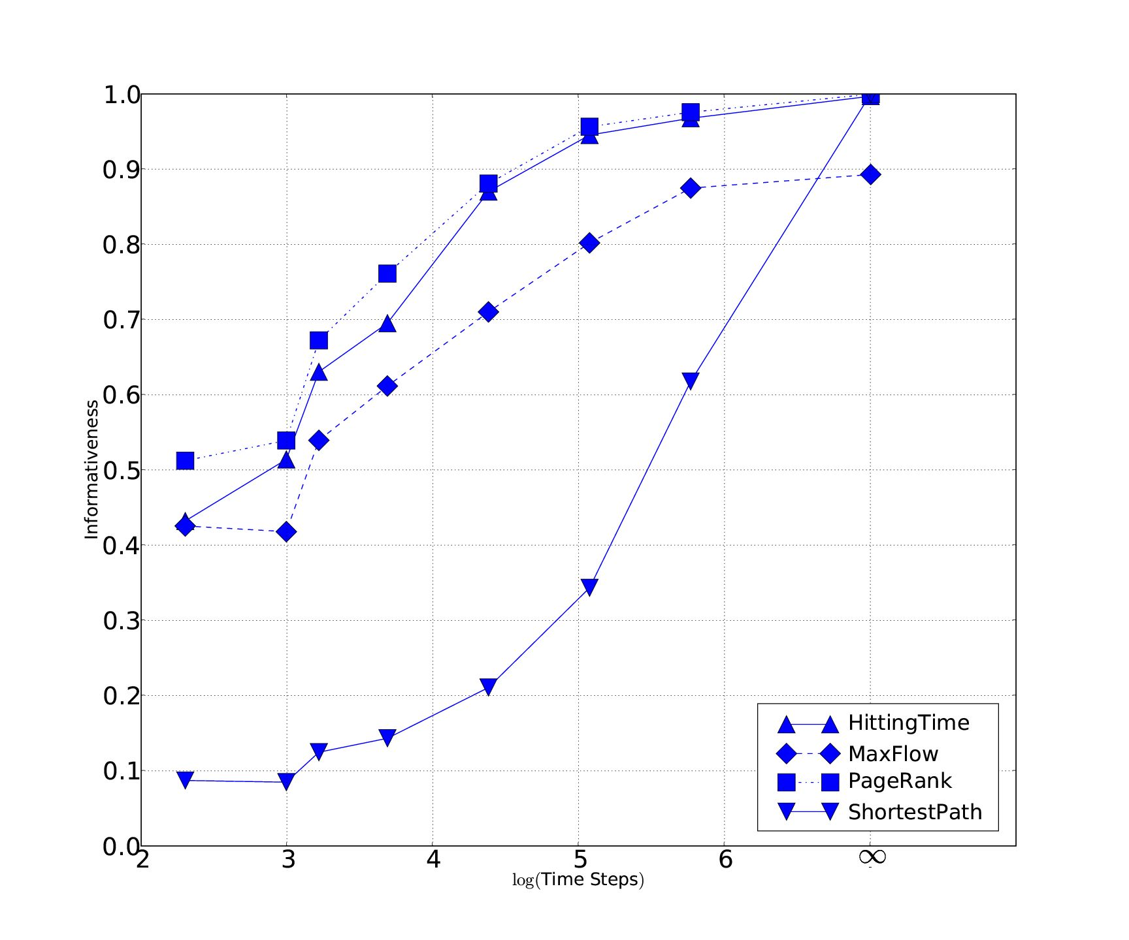
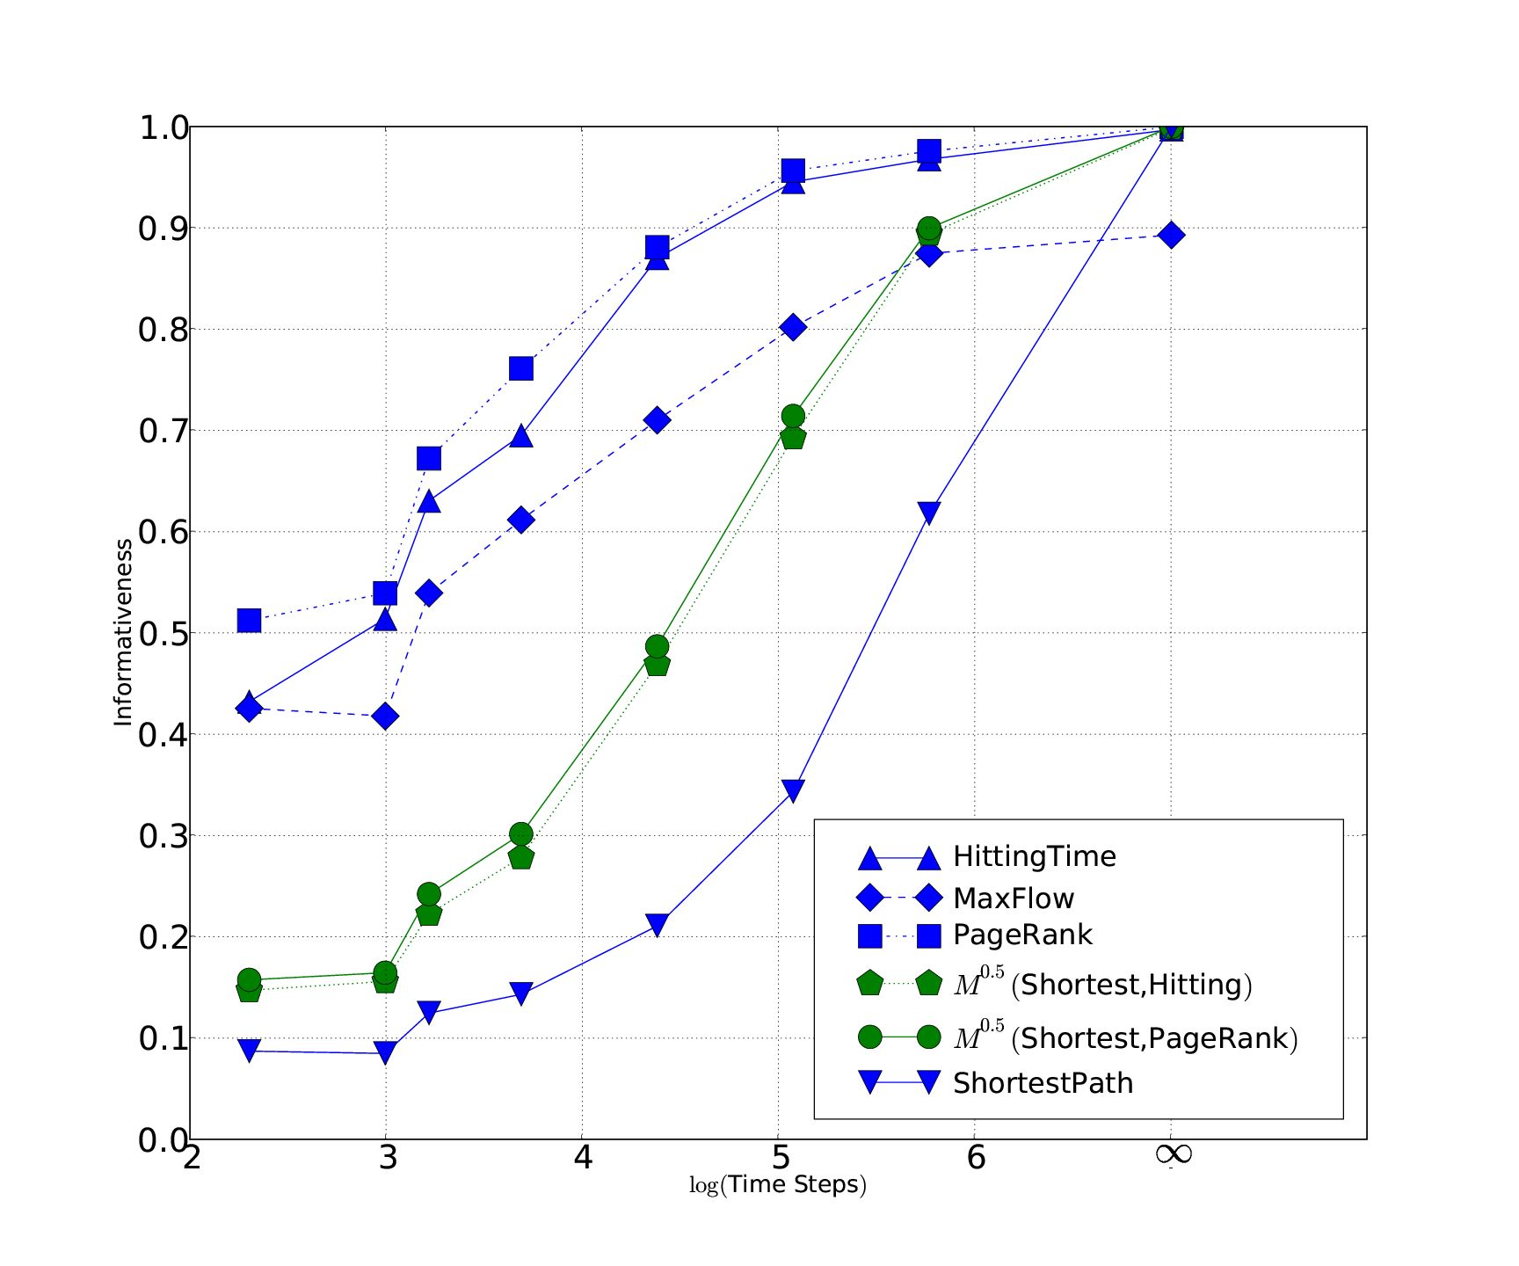
Informativeness Properties
Sometimes hybrids have informativeness even higher than either of their base mechanisms
Notes:
we expect as we increase the # timesteps informativeness increases (check)
Pointer shortest path performs worse than maxflow performs worse than hitting time performs worse than pagerank
Can get intermediate informativeness with 0.5 shortest path hitting time hybrid
In some experiments: with different setup, hybrids higher informativeness than base mechanisms
One possible explanation is that they measure different aspects of the trust graph

Slide 25
Outline
Motivation
Example Mechanisms
Informativeness vs. Strategyproofness
Hybrid Transitive Trust Mechanisms
Theoretical Analysis
Experimental Results
Informativeness
Efficiency
Conclusions
Notes:
In practice: care about trustworthy agents receiving good interactions

Slide 26
Efficiency Experiments
In practice: care about trustworthy agents receiving good interactions
Agents will be strategic
Measure efficiency as fraction of good interactions for cooperative agents
Simulated two application domains, a P2P file sharing domain and a web surfing domain
Setup
Agents use hybrid trust mechanism to choose interaction partners
Report results of interactions to trust mechanism

Slide 27
Cooperative, Lazy free-rider, Strategic
Cooperative agents have high type
Lazy free-rider agents have low type
Strategic agents also have low type, but attempt to manipulate the system
Simple agent utility model:
Assume heterogenous ability to manipulate
Reward proportional to manipulability of algorithm
As α increases, more strategic agents manipulate
Notes:
Define gamma

Slide 28
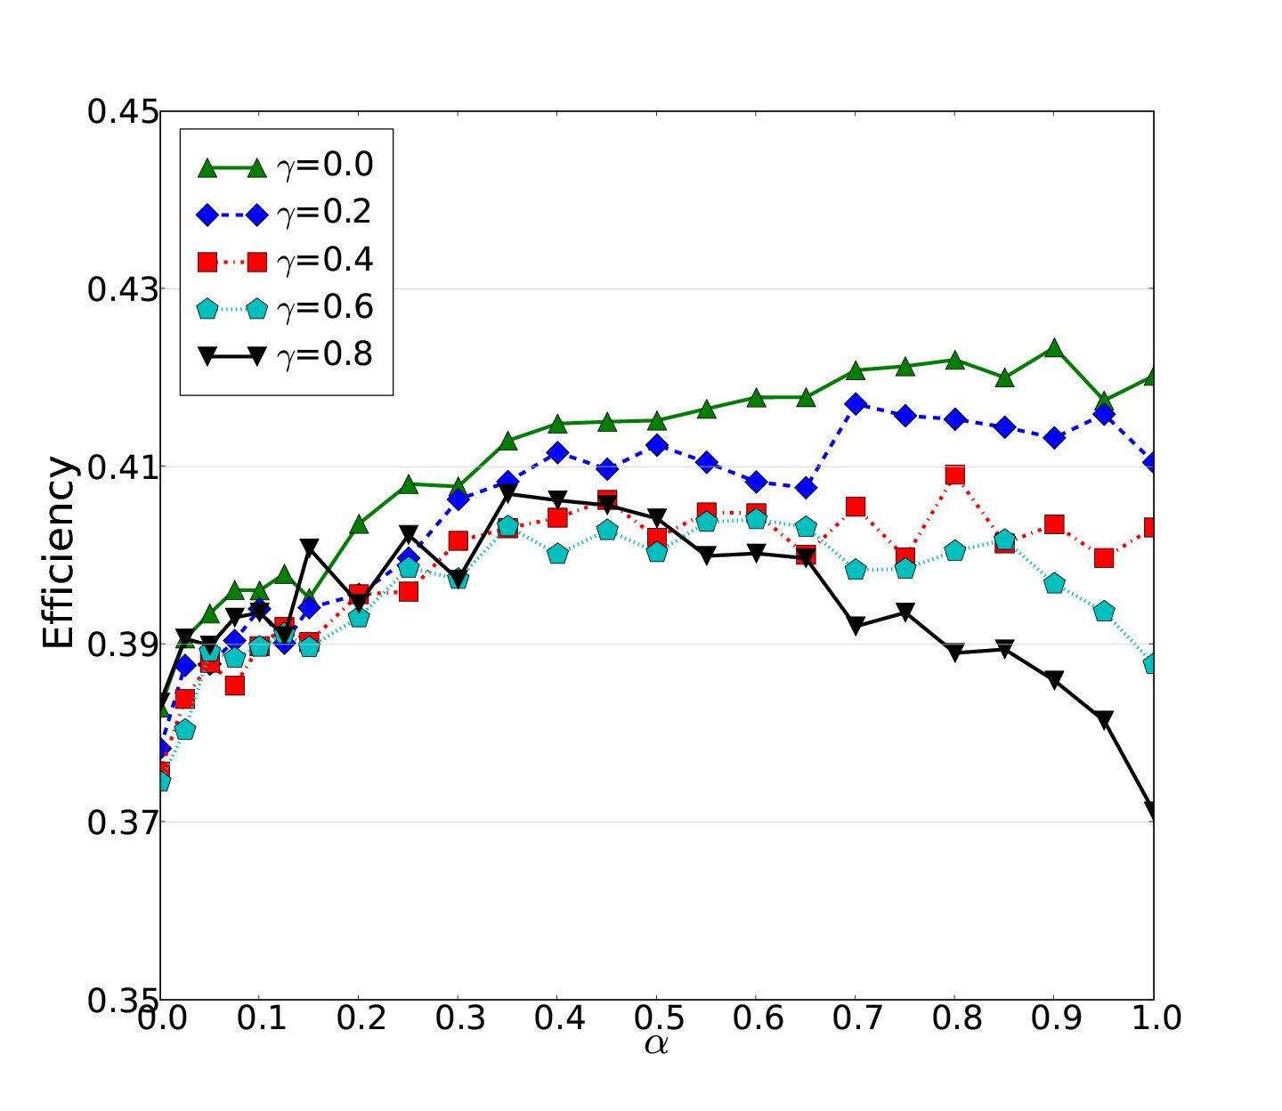
File Sharing Domain
Notes:
On x-axis, hybrid blend factor. 0 is shortest path mechanism, as we move alpha to 1 we have pure hitting time
On y-axis, efficiency
Varying gamma, the proportion of free-riding agents
Green line, no free-riding agents gamma=0, natural that it increases
If all agents are cooperative, we would use hitting time and not shortest path
Once we have free-riding agents the story changes.
Black line, 80% free-riding agents, when alpha=1 all manipulating, so low performance
Peak in the middle, shows hybrid has higher efficiency than either base mechanism
For teal and black optimal efficiency occurs at an alpha between 0 and 1

Slide 29
Conclusions
Analyzed informativeness and strategyproofness trade-off theoretically and experimentally
Hybrid mechanisms have intermediate informativeness, strategyproofness properties
For some domains, hybrid mechanisms produce better efficiency than either base mechanism
Thank you for your attention

Slide 30
Conclusions
Analyzed informativeness and strategyproofness trade-off theoretically and experimentally
Hybrid mechanisms have intermediate informativeness, strategyproofness properties
For some domains, hybrid mechanisms produce better efficiency than either base mechanism
Thank you for your attention

