Slide 1
Supporting Location-Based Approximate-Keyword Queries
Sattam Alsubaiee, Alexander Behm, and Chen Li
University of California, Irvine

Slide 2
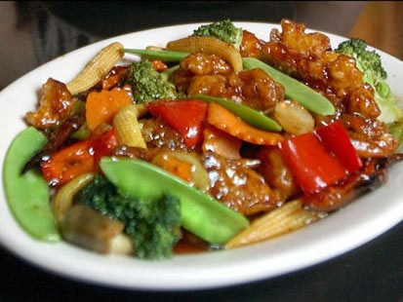

Lunch Time!
I want Chinese food!
Remembering restaurant name?!
Ch-o-chi?!

Slide 3
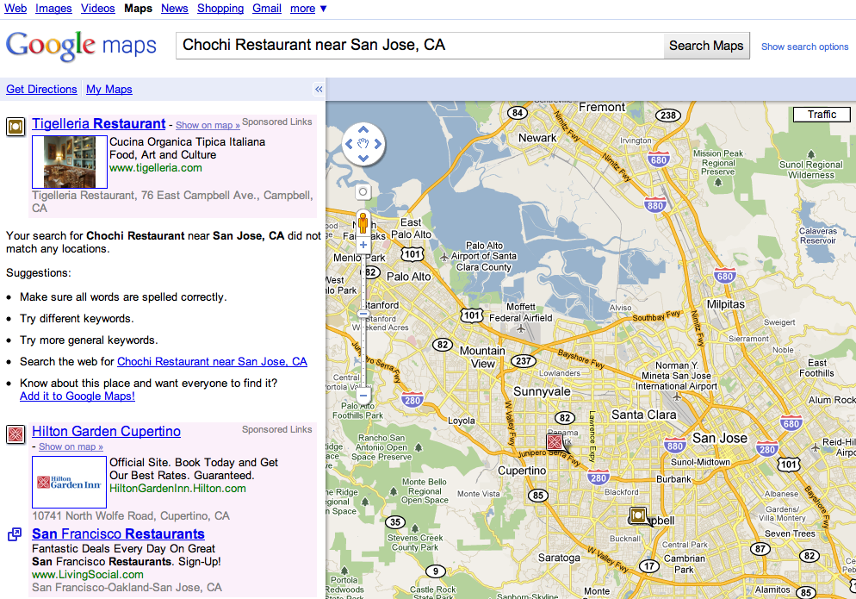


Let’s Find It!

Slide 4
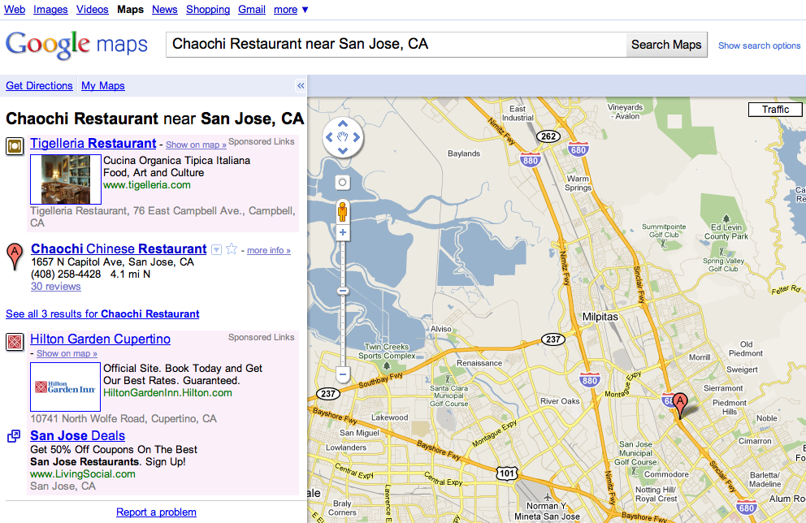

Just One Typo

Slide 5
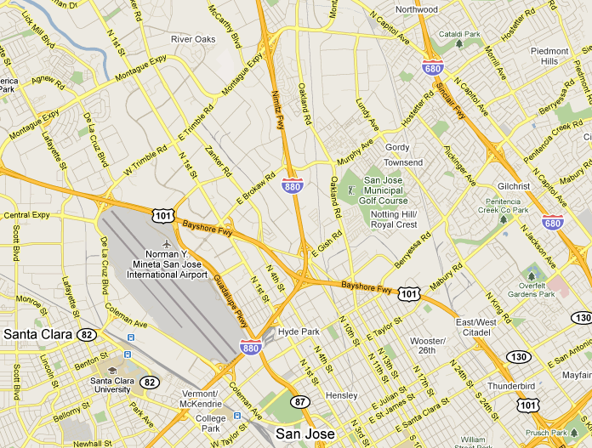
Problem Formulation
Find objects in “San Jose” with keywords similar to “chochi” & “resturant”
Object Collection
chaochi restaurant <37.39, -121.87>
starbucks <37.79, -122.40>
starbucks <40.72, -73.99>
apple store <44.59, -92.99>
sam’s club <43.59, -116.47>
…

Slide 6
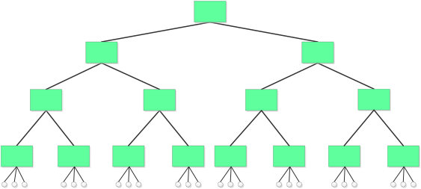

Preliminaries: Location-Based Keyword Search
Find objects within a given spatial region that have a given set of keywords
Augment a hierarchal spatial index with textual information

Slide 7
Preliminaries: Approximate String Search
Collection of strings s
Search
church
chucho
Query q:
chochi
chaochi
…
Output: strings s that satisfy Sim(q,s)≤δ
Sim functions: Edit distance, Jaccard, Cosine, etc
Notes:
7

Slide 8
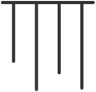
Preliminaries: Approximate String Search
chaochi
Gram-based
inverted-index
Sliding Window
2-grams {ch, ha, ao, oc, ch, hi}
Intuition: similar strings share a certain number of grams
Notes:
8
Main Idea: Use q-grams as signatures for a string
Inverted index on grams supports finding all data strings sharing enough grams with a query

Slide 9
Our Solution
LBAK-Tree
Tree-based spatial index
Approximate string search capability
Keyword search capability
Notes:
Our solution complements the previous studies of location-based keyword search

Slide 10
Contributions
How to combine those indexes
Three Algorithms
Simple fixed-level solution
Utilizing local spatial distribution of objects
Exploiting frequency distribution of keywords

Slide 11
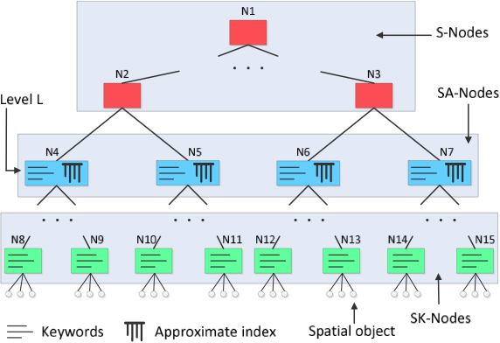
Algorithm 1: Fixed-Level Solution
(Spatial Nodes)
(Spatial-Approximate Nodes)
(Spatial-Keyword Nodes)

Slide 12
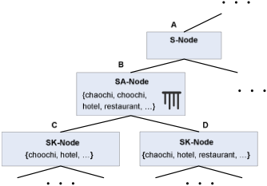
Query Example
Query: objects in “San Jose” with keywords similar to “chochi” & “resturant”
Based on edit distance of 1

Slide 13
Query Example
Query: objects in “San Jose” with keywords similar to “chochi” & “resturant”
Based on edit distance of 1

Slide 14

Query Example
Query: objects in “San Jose” with keywords similar to “chochi” & “resturant”
Based on edit distance of 1

Slide 15

Query Example
Query: objects in “San Jose” with keywords similar to “chochi” & “resturant”
Based on edit distance of 1

Slide 16
How to Choose Level L?
Trade off between space and time – until “some” level (both increase)
Notes:
How to choose a level L that provides good query performance
Trade off between the average query time and the size of the approximate indexes.

Slide 17
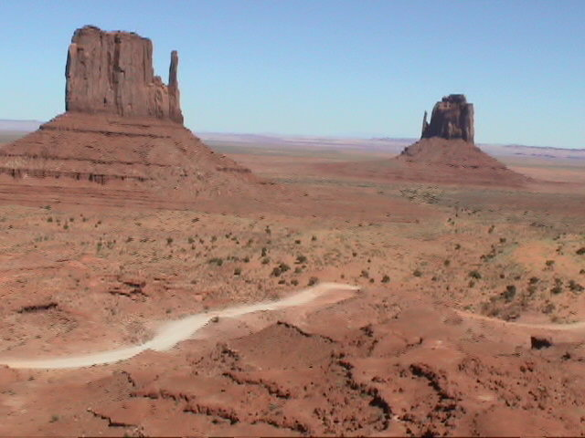
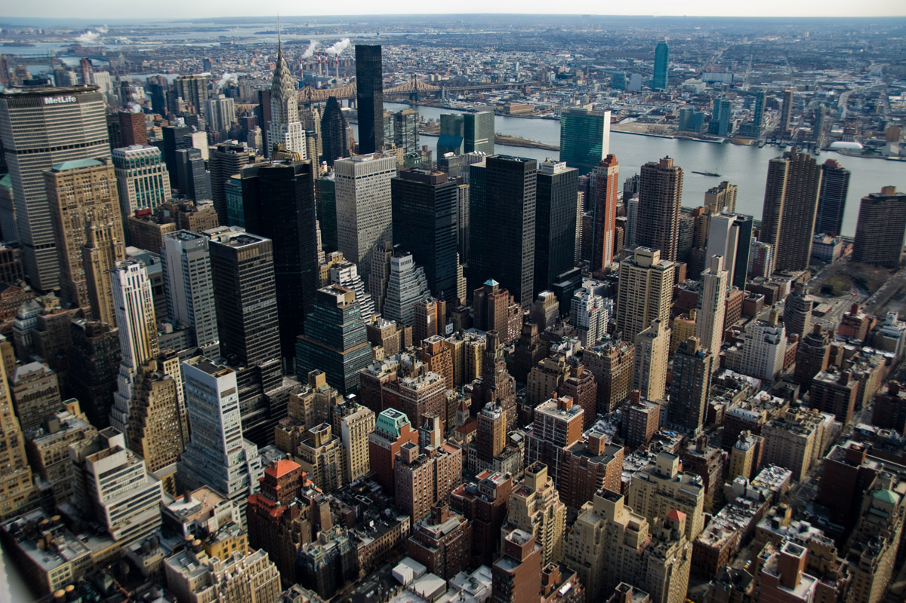
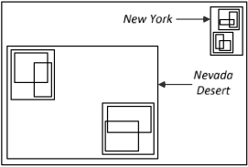
Observations
Query time & index size sensitive to approximate-index locations
Fixed-level solution ignores local spatial distribution of objects
Prefer to build approximate
index at parent
Prefer to build approximate
indexes at children

Slide 18
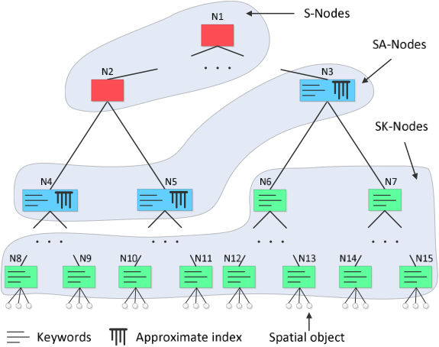
Algorithm 2: Placing Approximate Indexes at Variable Levels
(Spatial Nodes)
(Spatial-Approximate Nodes)
(Spatial-Keyword Nodes)

Slide 19
Selecting Nodes for Approximate Indexes
Goal: find optimal set of nodes that should have approximate indexes
Optimization problem: given an R*-tree and a space budget, choose nodes to store approximate indexes, to minimize query time
NP-hard (Knapsack problem)

Slide 20
Greedy Algorithm: Selecting Nodes for Approximate Indexes
N1
✔
N2
N3
N4
N5
✔
N6
N7
✔
N8
N9
N10
N11
N12
N13
N14
N15
Notes:
Traverses the tree top-down and tries to push approximate indexes down the most promising paths.

Slide 21
Cost/Benefit Estimation
Effects of pushing index down
Increase space cost
Increase or decrease average query time
Typically
Higher levels: good to push index down
Intermediate levels: unclear whether to push it down

Slide 22
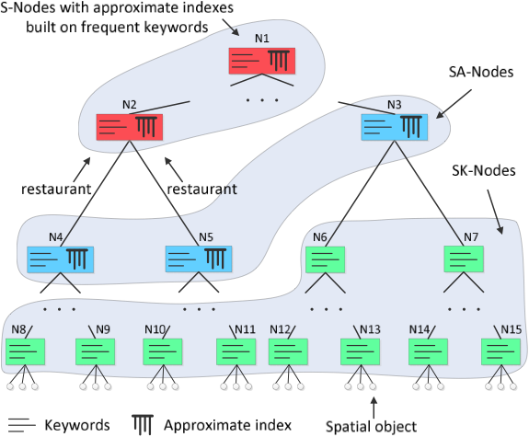
Algorithm 3: Exploiting Frequency Distribution of Keywords
(Spatial-Approximate Nodes)
(Spatial-Keyword Nodes)

Slide 23
Experiments
Settings
Four-core Intel Xeon E5520 2.26Ghz
12GB of RAM
Ubuntu OS
C++ implementation
LBAK-tree in main memory
Keyword-frequency threshold = 1
R*-tree fanout = 40

Slide 24
Experiments
Dataset
CoPhIR Test Collection (CoPhIR)
3.75 million objects
Raw data size: 500MB
Business listings (Business)
20.4 million business listings in the U.S
Raw data size: 4GB
Queries
10,000 queries for each dataset
30km-by-30km query window around randomly selected object
Randomly chose two keywords of the randomly chosen object
Normalized edit-distance of 0.8

Slide 25
Terminology
FL: fixed-level approach
e.g.,“FL-0” approximate indexes are at the root level
VL: variable-level approach
VLF: variable-level approach exploiting keyword-frequencies

Slide 26
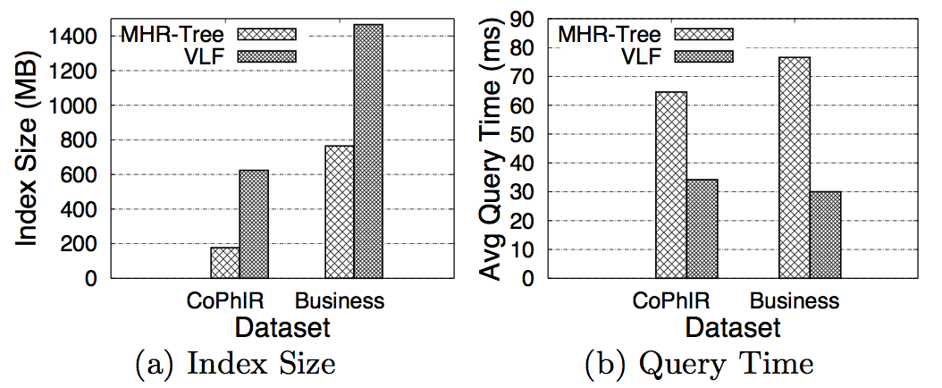
Comparison with MHR-Tree*
Maximum recall for MHR-Tree that we achieved is around 50%
LBAK-Tree recall is 100%
* B. Yao, F. Li, M. Hadjieleftheriou, and K. Hou. Approximate string search in spatial databases. In ICDE, 2010

Slide 27
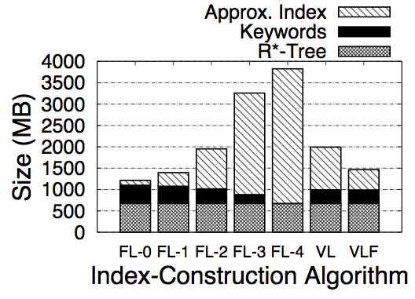
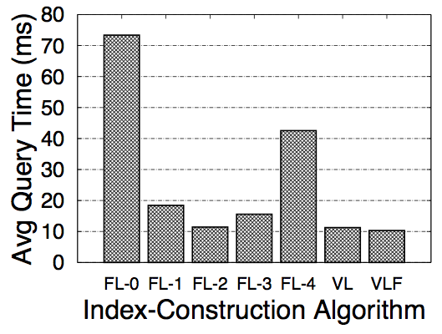
Index Size & Query Time
Business Listings

Slide 28
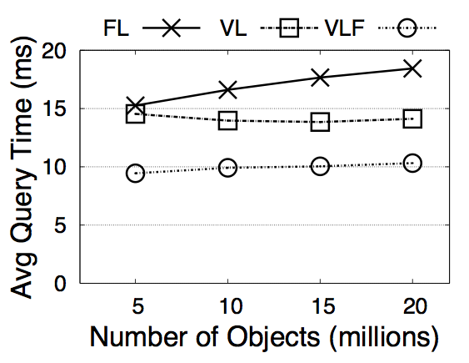
Scalability: Query Time vs. VLF
Used space budge: minimum index size for VLF to achieve best query time
Business Listings

Slide 29
Conclusion
Spatial index + Approximate index = LBAK-tree
Simple fixed-level solution
Utilizing local spatial distribution of objects
Exploiting frequency distribution of keywords

Slide 30
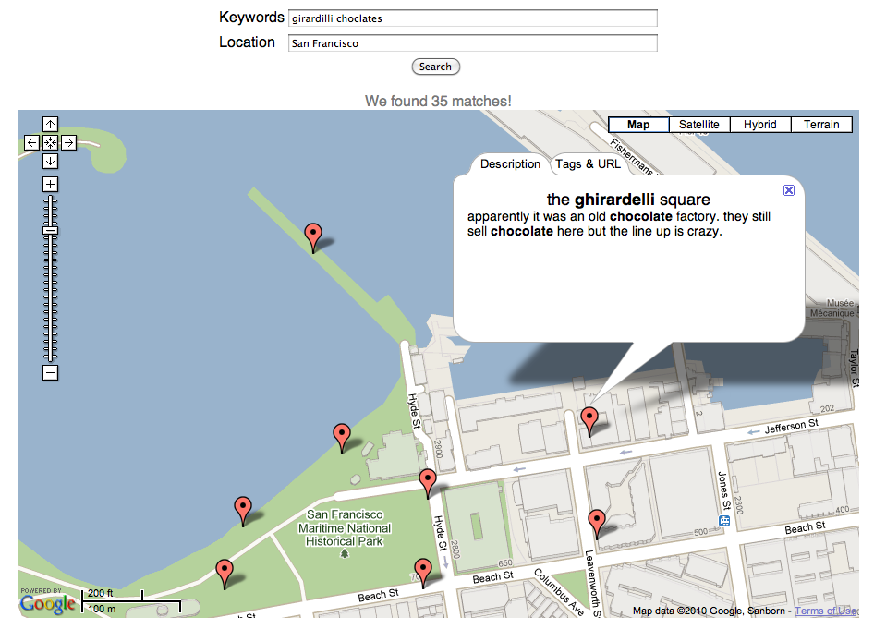
Thank You!
This work is part of
The Flamingo Project
Source Code: http://flamingo.ics.uci.edu
Live Demo: http://flamingo.ics.uci.edu/localsearch/fuzzysearch/

