Slide 1
Tidal Mixing at Steep Topography
Sonya Legg
Princeton University, NOAA-GFDL
Jody Klymak
University of Victoria

Slide 2
The role of deep mixing in the general circulation
Cooling
Eq
Pole
convection
overflows
Overturning
Upwelling
tidal mixing
z
Diapycnal mixing is necessary to close the thermohaline circulation: tides and winds are the likely source of energy for deep diapycnal mixing.
Climate models need physically based parameterizations of spatially and temporally varying tidal mixing: here we will focus on tidal mixing.

Slide 3
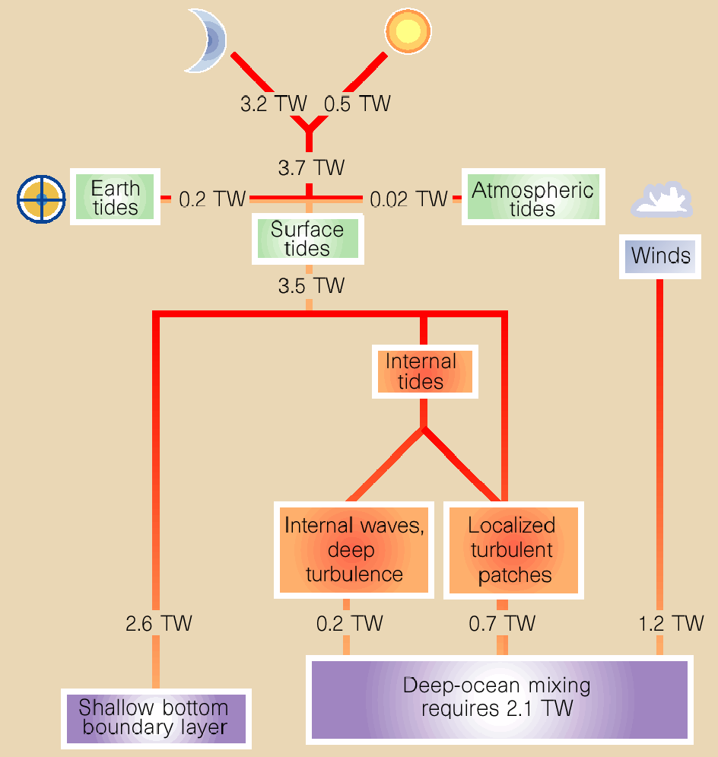
Tidal Energy Budget
Munk and Wunsch, 1998
Most tidal energy is dissipated in coastal oceans, but the small amount dissipated in deep ocean has large impact on climate.
Different climate scenarios (e.g. raising/lowering sealevel) would have different dissipation patterns.

Slide 4
Mechanisms of tidal mixing in deep ocean
1/3 of energy from ocean tides is dissipated in deep ocean.
Used for mixing stratified ocean interior.
Some mixing local to topography, e.g. mid-ocean ridges, seamounts
Some energy carried throughout ocean by waves, leading to distributed mixing.
Barotropic tides
Rough topography
Internal tides
Local
mixing
Wave-wave
interactions
Wave-topography
interactions
Wave steepening
and breaking
Unknowns
How much energy is extracted from tides?
How is it initially partitioned between waves and mixing?
Where do waves eventually break and cause mixing?
Remote and
local mixing
Tidal energy flow chart.
Global climate models do not simulate any part of this chain of events, not just the final mixing.

Slide 5
Governing parameters for tidal flow over topography
Topography: height h, width L, depth H
Flow: speed U, oscillation frequency ω
Others: coriolis f, buoyancy frequency N
H
Nondimensional parameters
h
Wave slope
L
Topography
Relative steepness
Relative height
Flow
Tidal excursion
Froude numbers
Analytical studies assume some or all of topographic/flow parameters are small – numerical simulations don’t have this restriction.

Slide 6
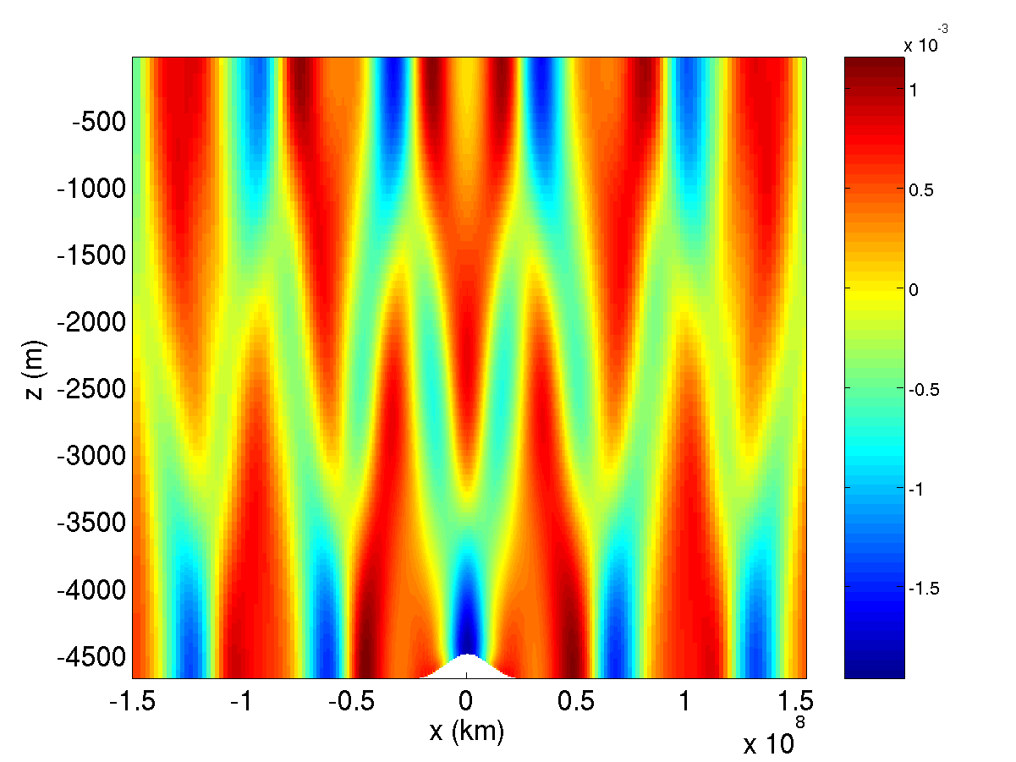
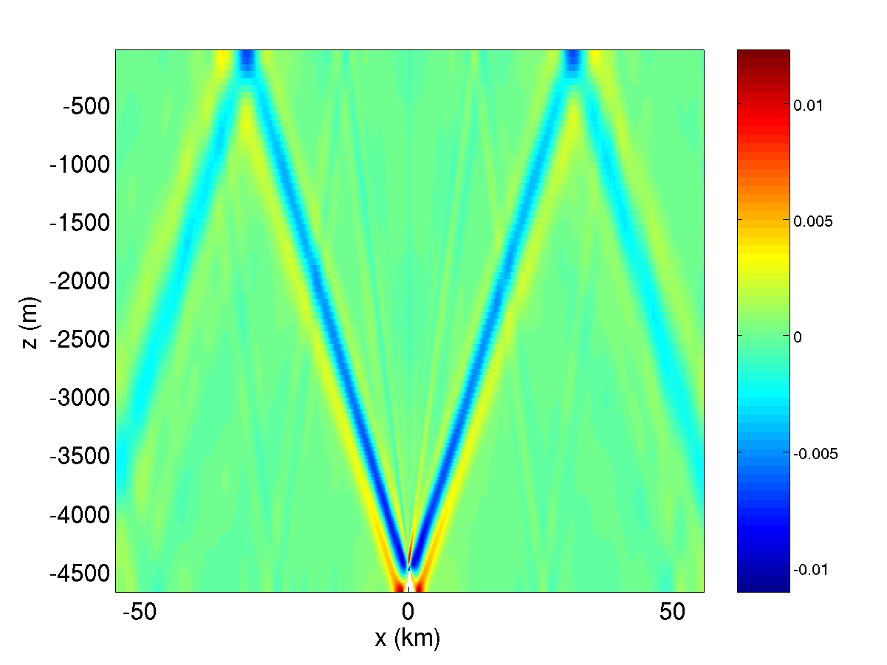
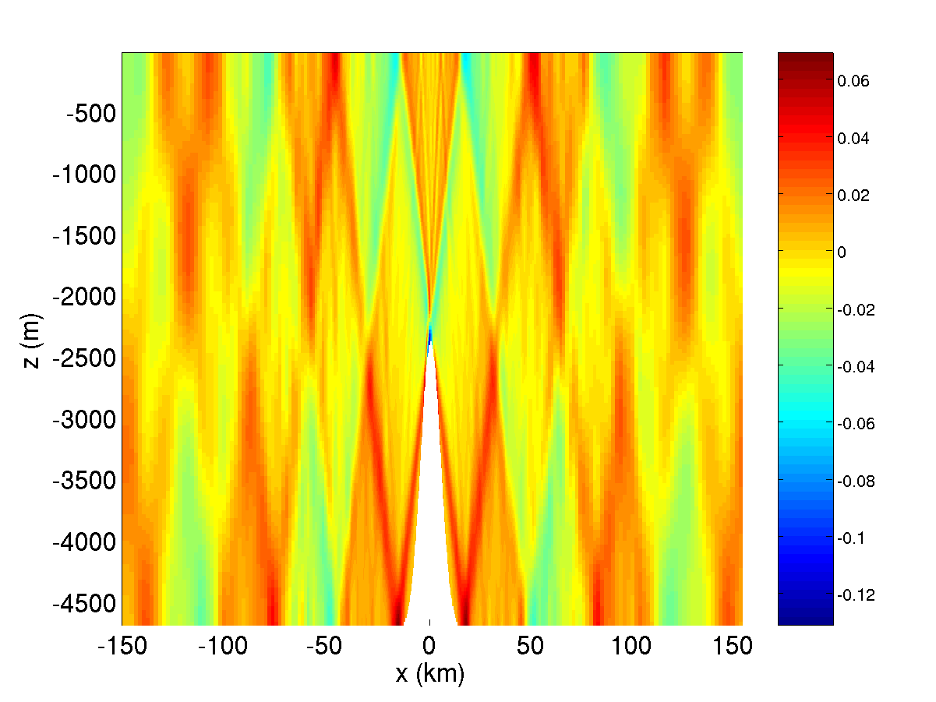
How does the baroclinic response to tidal forcing over steep topography differ from shallow topography?
Low, wide, shallow topo
Low, narrow, steep topo
Tall, steep topo
Baroclinic velocity snapshots from simulations of tidal flow over Gaussian topo with forcing amplitude U0=2cm/s (Legg and Huijts, 2006; using MITgcm).
Steep topography leads to generation of internal tide beams: energy concentrated on wave characteristics.

Slide 7
Quantitative results: energy conversion
Rate of energy conversion from barotropic tide
Ratio of dissipation rate to conversion rate
St Laurent et al prediction for steep topo, h/H=0.5
Bell’s prediction
St Laurent et al prediction for steep topo, deep fluid
Low, wide topography; low, narrow topography; tall wide topography; tall narrow topography
Theoretical predictions of energy conversion agree well with numerical model results.
For wider topo, only 10% of energy extracted from tide is dissipated locally; for narrow topo, much greater fraction.
Tall and steep topography results in larger conversion of energy from barotropic tide.
Narrow steep topography results in larger proportion of local dissipation.

Slide 8
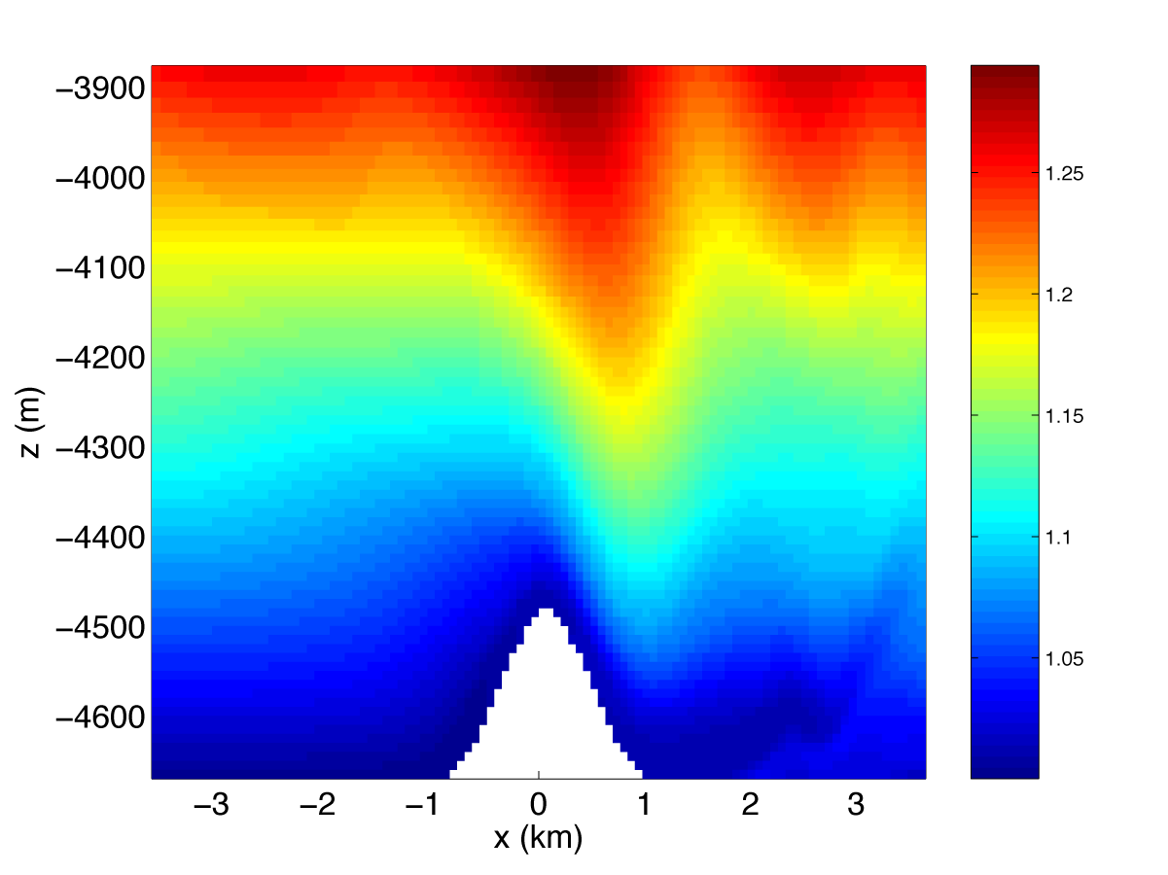
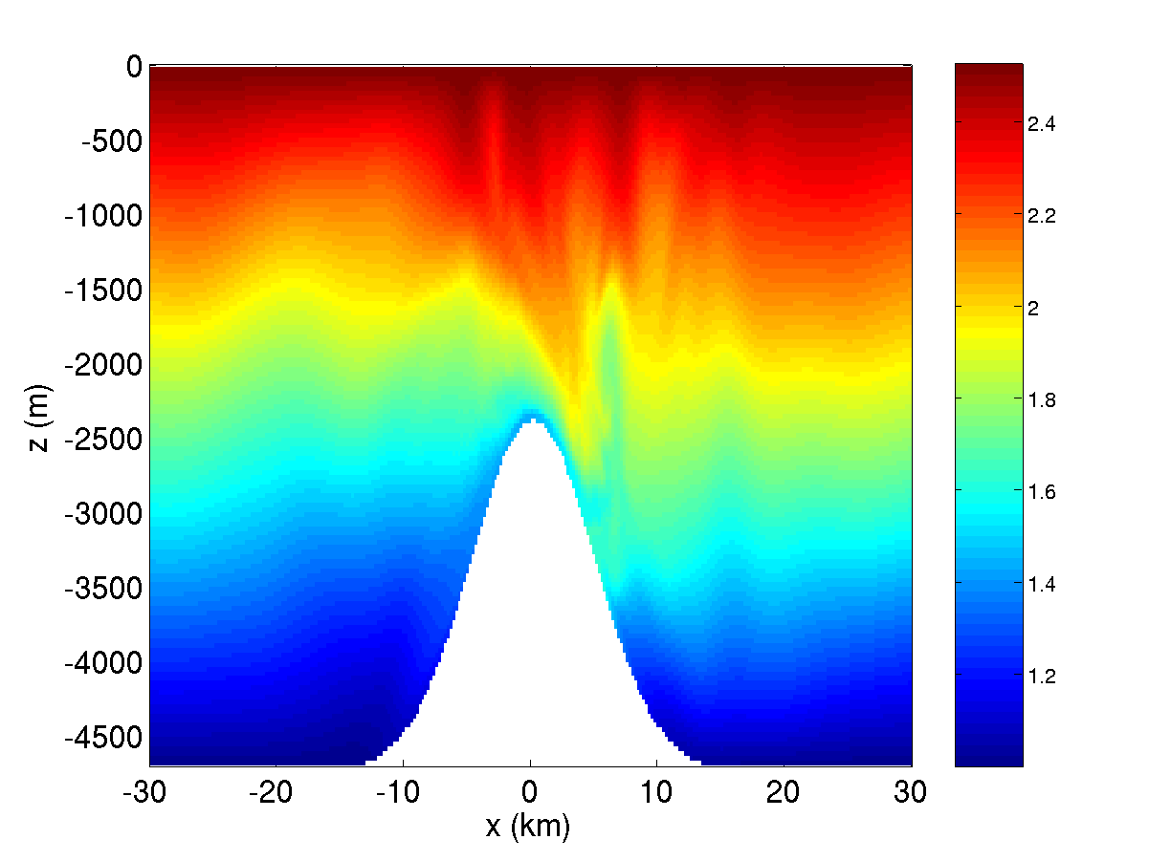
Are narrow beams the only location for dissipation/mixing?
Isopycnal deflection by large amplitude tides: U0 = 24cm/s
Low narrow steep topo
Tall steep topo
Dissipation is all in narrow beams, no hydraulic effects
Possible transient internal hydraulic jumps are a location for overturning
Large amplitude forcing over large amplitude steep topo (when R_{L}>1 and Fr=U/(Nh₀)<1) leads to local overturns in internal hydraulic jump-like features. (Legg and Huijts, 2006)
Q: Can internal hydraulic jumps be important at more moderate (i.e. realistic) forcing velocities?

Slide 9
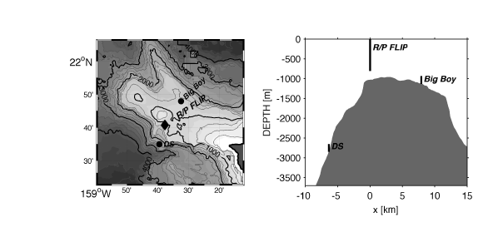
Observations of tidal flow over tall steep topography: Hawaiian Ocean Mixing Experiment, Kaena Ridge
Klymak, Pinkel and Rainville, JPO 2007
Strong dissipation observed during transition from offslope to onslope tidal flow at top of ridge
Q: What is the cause of this high dissipation and associated overturning?

Slide 10
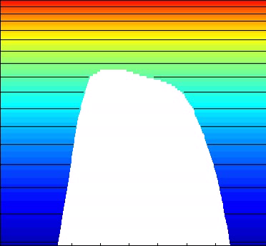
Hawaiian ridge simulations with MITgcm, stratification and topography from Kaena ridge
Buoyancy field for U0=5cm/s, M2 tidal forcing.
-700m
Model details:
2D nonhydrostatic simulations with resolution 115m X 9m near top of slope.
Total domain is 500km X 4300m.
Barotropic tide forced through a body forcing.
Open boundary conditions allow baroclinic tide to radiate away.
-1760m
46km
Hawaiian ridge is tall and steep.
γ> 1, RL < 1, Fr << 1, h/H -> 1.
Hydraulic jumps develop over steep slope during downslope flow: at flow reversal, jumps propagate upslope as internal bores.
Asymmetric response: details of slope are important.

Slide 11
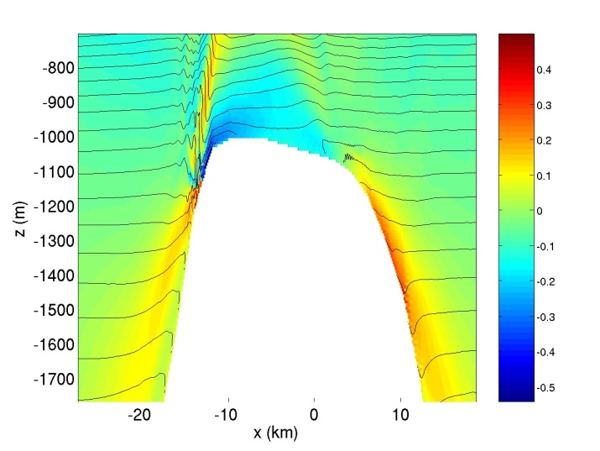
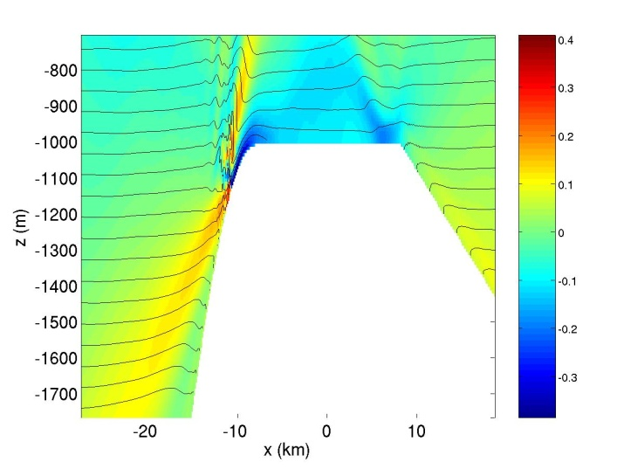
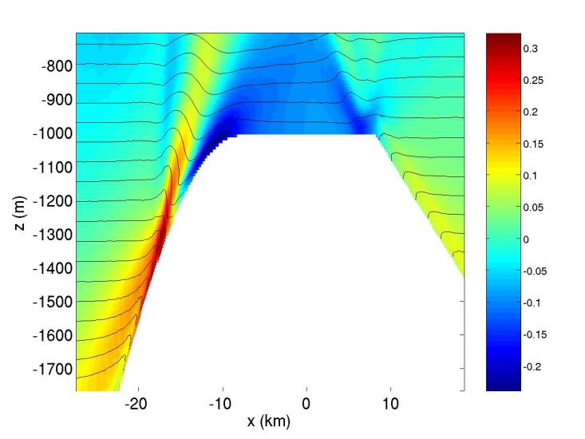
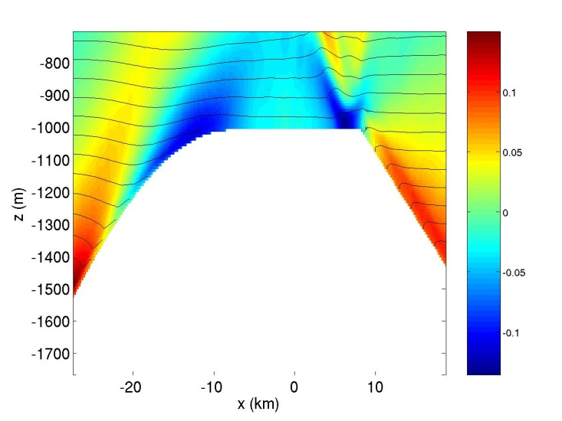
Dependence of overturning on slope
Real topography
dh/dx(max) = 0.2
dh/dx(max) = 0.1
dh/dx(max) = 0.06
Snapshots of U(color) and buoyancy (contours) just after flow reversal, all with U0=5cm/s
Borelike features are found only for steep topography.

Slide 12
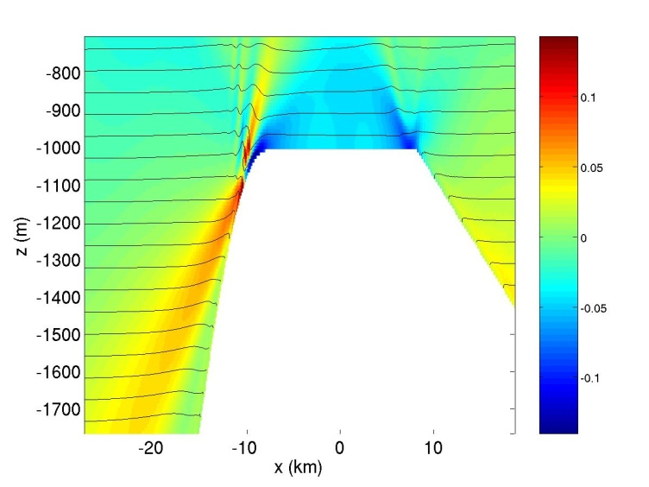
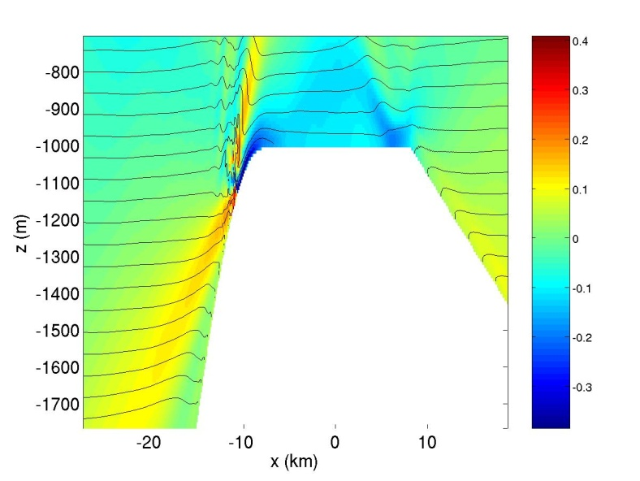
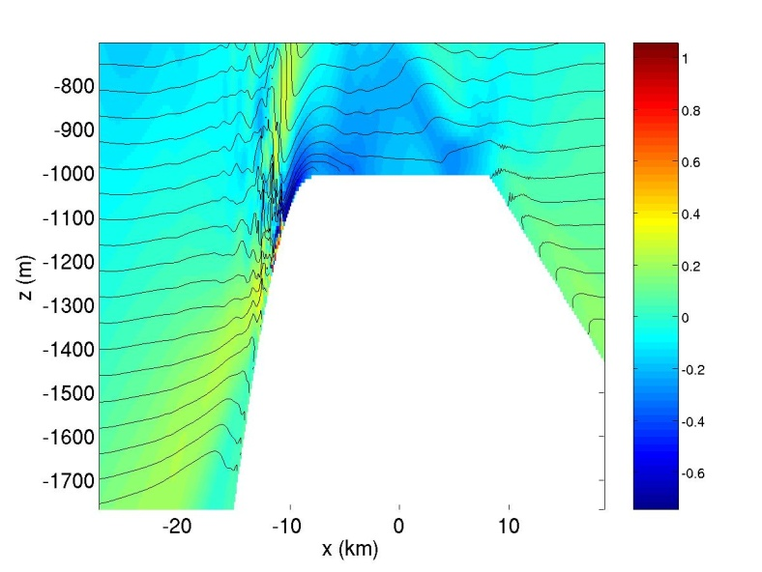
Dependence of overturning on flow amplitude
U0=2cm/s
U0=5cm/s
U0=10cm/s
Snapshots of U (color) and buoyancy (contours) just after flow reversal, for dh/dx(max) = 0.2.
Larger amplitude flow increases vertical extent and vigor of overturning.

Slide 13
Comparison with observations (flip)
For steep slopes and large forcing velocity, simulations generate similar features to observations

Slide 14
Evidence for overturning and internal bores
Height of Ri<1 layer at topographic depth of -1150m
Skewness of dT/dt at top of slope, h=-1028m.
Steeper slopes and stronger flows associated with deeper overturning layer, occurring just after flow reversal.
Negative dT/dt skewness for most runs indicates sudden drops in temperature, associated with upslope propagating internal bores.

Slide 15
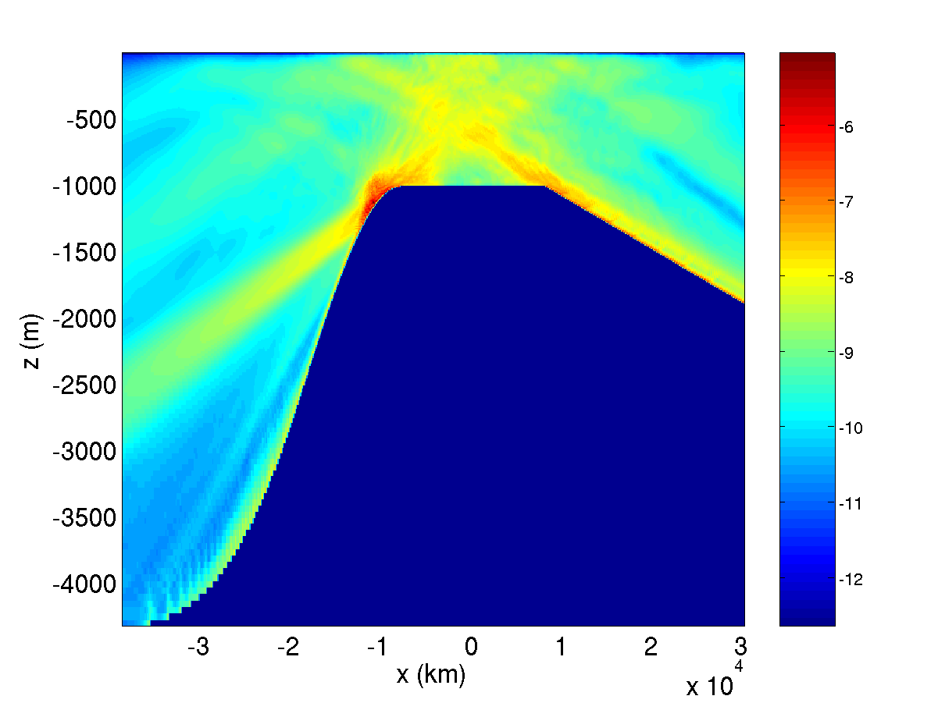
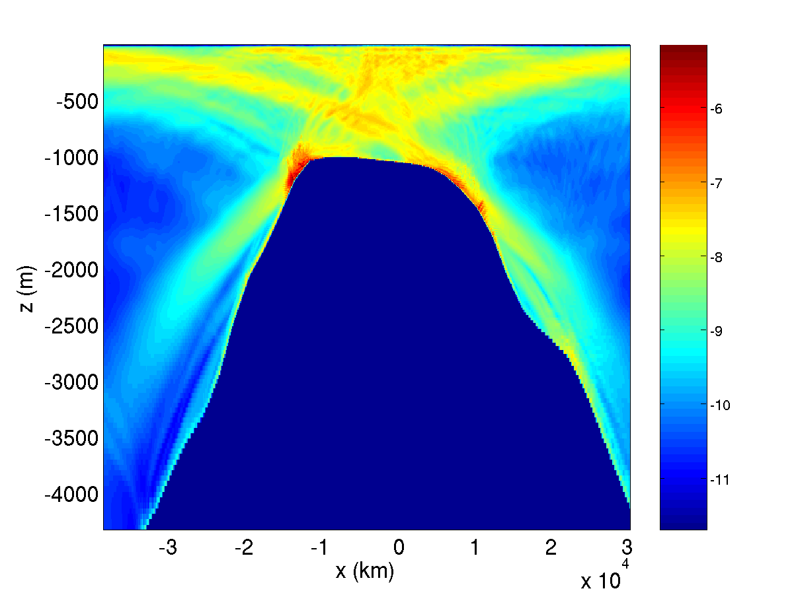
Influence of internal bores on dissipation
Log10 dissipation (time-averaged) for U0=5cm/s, dh/dx=0.2
Log10 dissipation (time-averaged) for U0=5cm/s, realistic topography and stratification
The region affected by internal bores has an order of magnitude higher dissipation than the internal wave beams.

Slide 16
Role of topographic slope in generating transient jumps
In steady state flows, strongly nonlinear leewaves are generated when
Fr << 1: flow is blocked by topography.
Fr >> 1: small amplitude linear leewaves.
(Note, Kaena ridge has Fr<<1)
In tidally oscillating flow, if RL < 1, fluid does not feel full height of topography within a tidal cycle. Instead the vertical scale of topography experienced by flow is the vertical tidal displacement:
By analogy with steady case, we expect strongly nonlinear waves if hω is large enough that
So transient jump-like waves may be possible if slope is sufficiently steep that Frω < 1
Q: Does Fr_{ω} determine the nonlinearity of the response?

Slide 17
Displacement regimes
Nonlinear jump-like waves
Linear waves
Large Fr_{ω}⁻⁻¹ corresponds to steep slopes, lower frequency forcing, higher stratification; the regime of jump-like nonlinear waves.
For small Fr_{ω}⁻⁻¹:
For large Fr_{ω}⁻⁻¹:

Slide 18
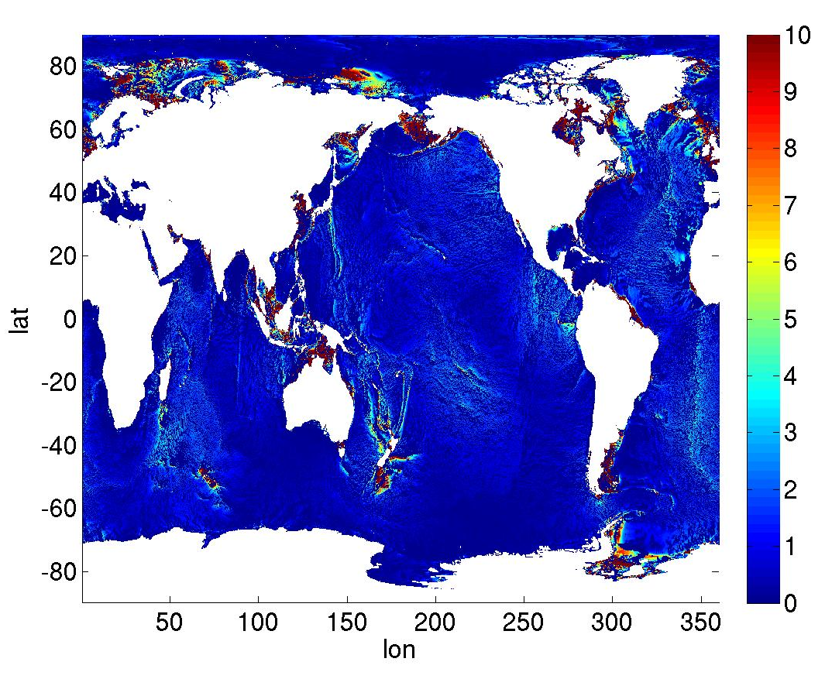
Do tidally driven transient hydraulic jumps matter on a global scale?
Amplitude of tidal velocity projected onto direction of topographic gradient (cm/s)
Frω (N/(ω dh/dx)) calculated on ¼ degree scale
Large velocities combined with Frω < 1 may lead to local overturning in jump-like features: seen in several interesting locations….

Slide 19
Parameterizing tidal mixing in ocean models
St Laurent et al, 2002, implemented in GFDL MOM by Simmons et al, 2004 and in GOLD (Generalized Ocean Layer Dynamics Model)
Spatially variable diffusivity:
Where: q = fraction of energy dissipated locally – set to 1/3.
This should be a function of the horizontal length-scales and steepness of the topography.
Γ = mixing efficiency – set to 0.2 (this could be refined if DNS suggests it is necessary)
Κ₀ = constant background diffusivity, accounting for remote mixing: Need to account for spatial variations in remote mixing, e.g. internal tide breaking, PSI at critical latitude.
E(x,y) = energy extracted from barotropic tide:
F(z) = vertical structure function:
ζ = vertical decay scale – set (arbitrarily) to 500m.
For steep slopes, vertical scale should depend on U/N.
Does not account for preferred locations of mixing: e.g. beams, critical slopes.

Slide 20
Conclusions
Tidal flow over steep topography (γ > 1) leads to qualitative differences in internal tide response compared to shallow slopes.
For low, narrow steep topography, narrow internal wave beams, associated with high vertical wavenumbers, are the location of enhanced dissipation.
For tall, steep topography (where U/(Nh)<<1) overturning internal bores are generated, again associated with enhanced dissipation.
Probable cause of these bores: transient jump-like nonlinear lee-waves are generated during off-slope flow, propagate toward slope when flow relaxes, and cause overturning.
Nonlinear jump-like features only appear when Fr based on tidal excursion distance is small (ω/(Ndh/dx)<<1), implying steep slopes.
Vertical scale of nonlinear features depends on flow amplitude, stratification: (Δh ~ U/N when Fr<<1).
Tall, steep ridges are found in many locations of the world oceans: GCM parameterizations of tidal mixing need to account for these features.

