Slide 1
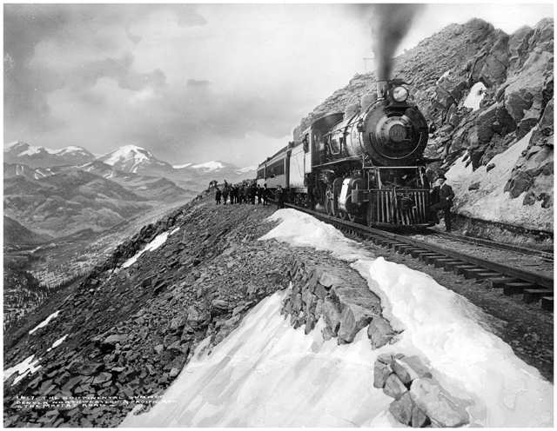


A Scenic Overview of J/ψ Production in Heavy Ion Collisions At PHENIX
Matthew Wysocki, University of Colorado
For the PHENIX Collaboration

Slide 2
Introduction
This is an overview of the PHENIX J/ψ results in hot nuclear matter, ie QGP.
I’ll be showing R_{AA} and v₂ in Au+Au collisions, as well as R_{AA} from Cu+Cu collisions.
Hopefully by the end you’ll have a nice overview of the current landscape.

Slide 3
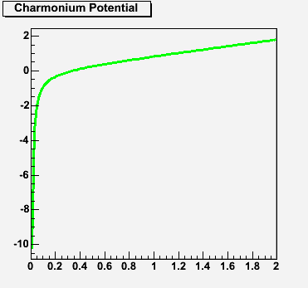
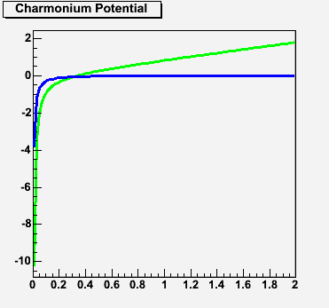
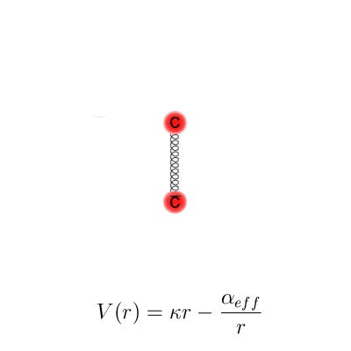
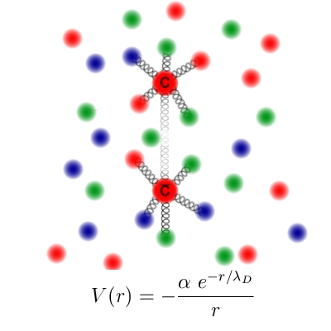
Why J/ψs?
“If high energy heavy ion collisions lead to the formation of a hot quark-gluon plasma, then colour screening prevents cc binding in the deconfined interior of the interaction region.” - Matsui & Satz, 1986
Debye screening (from EM plasmas) is a modification a particle’s potential due to the charge density of the surrounding medium.
One way to look at it is that the charmonium potential well is modified in the medium to become much shallower.
In Medium
T=0
T=T_{c}

Slide 4
J/ψs Unbound
Another view is that the energetic short-range interactions in the QGP overwhelm the charmonium binding interaction.
The charm and anti-charm become unbound, and may combine with light quarks to emerge as open charm mesons.

Slide 5
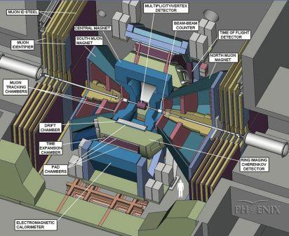
The PHENIX Detectors
Drift Chamber, Pad Chamber, EMCal & RICH detect J/ψ→ee at mid-rapidity.
Au ion
y<0
Beam-Beam Counter used to measure centrality and collision z-position.
MuTr and MuID detect J/ψ→μμ at forward rapidities.
Au ion
y>0

Slide 6
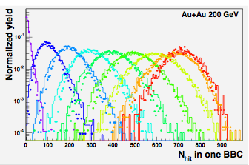
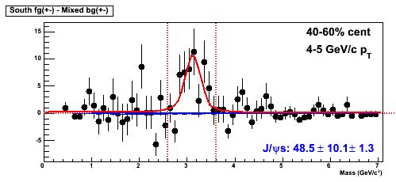
Measuring the J/ψ at PHENIX
Use a Glauber model combined with a Negative Binomial distribution of particles going into the BBC (3<|η|<3.9) to map centrality classes to N_{part}, N_{coll}, etc.
Extract J/ψ by removing the combinatoric background either through like-sign subtraction or event mixing, then fitting the remaining peak.

Slide 7
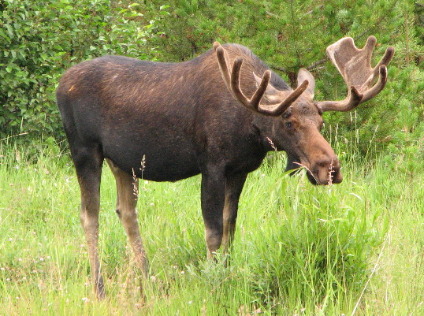
Studying J/ψ Suppression with R_{AA}

Slide 8

R_{AA}
Take the yields from nuclear collisions and divide by p+p yields, scaled by the appropriate number of binary collisions (N_{coll}).
Deviations from unity should first be compared to CNM effects. Any remaining suppression can be attributed to the deconfined medium (QGP).

Slide 9
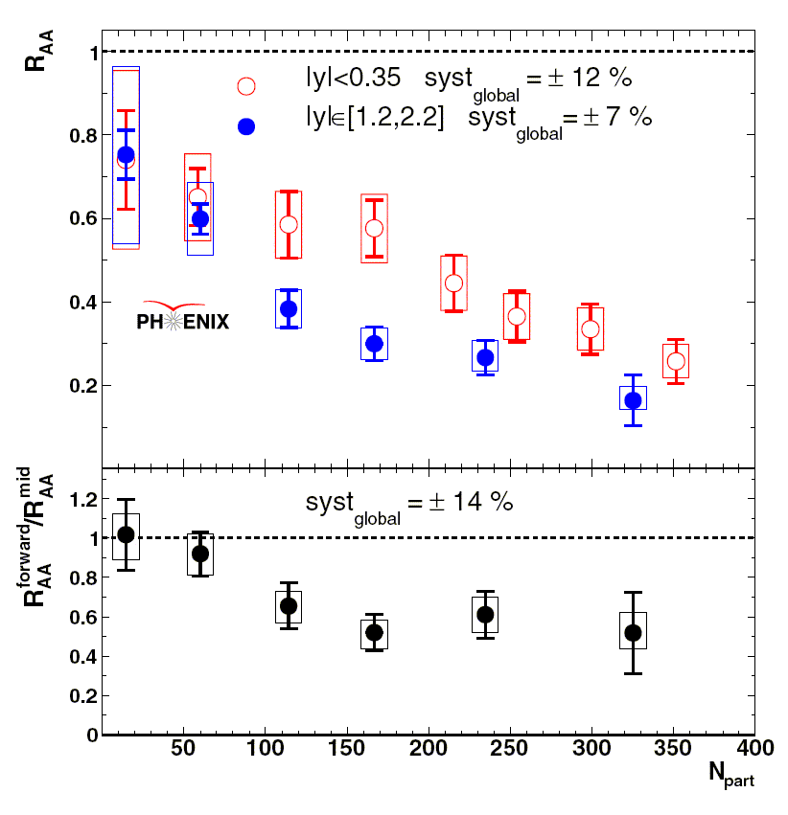
R_{AA} vs. N_{part} in 200GeV Au+Au
Obvious suppression in more central collisions (larger N_{part}).
Larger suppression at forward rapidity than mid-rapidity.
Need better CNM constraints to really test QGP screening. Hopefully Run 8 d+Au data will provide that.
nucl-ex/0611020
Phys. Rev. Lett. 98 (2007) 232301

Slide 10
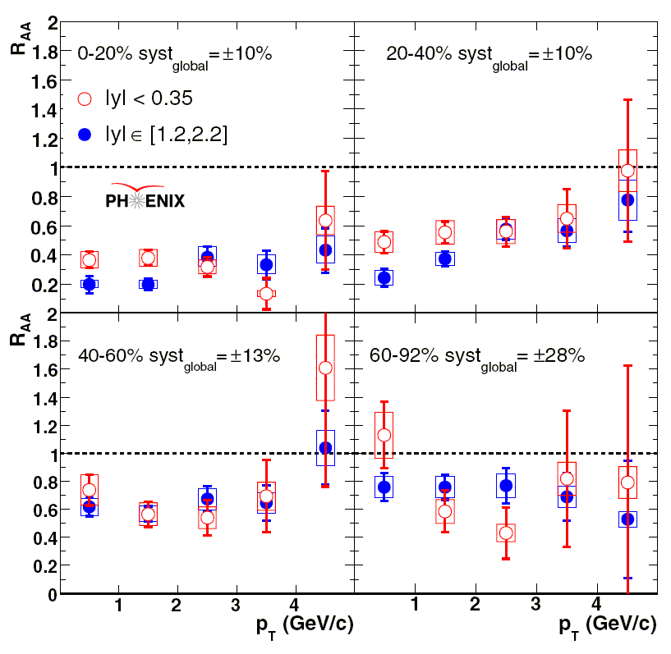
R_{AA} vs. p_{T} in 200GeV Au+Au
Less suppression at higher p_{T} in 20-40% and 40-60% central.
Much interest in p_{T} dependence recently, esp. at higher p_{T}. See for example: Zhao & Rapp, arXiv:0806.1239 Z. Tang (STAR) arXiv:0804.4846
We hope to push higher in p_{T} with Run 7, but still very hard with current statistics.
nucl-ex/0611020
Phys. Rev. Lett. 98 (2007) 232301

Slide 11
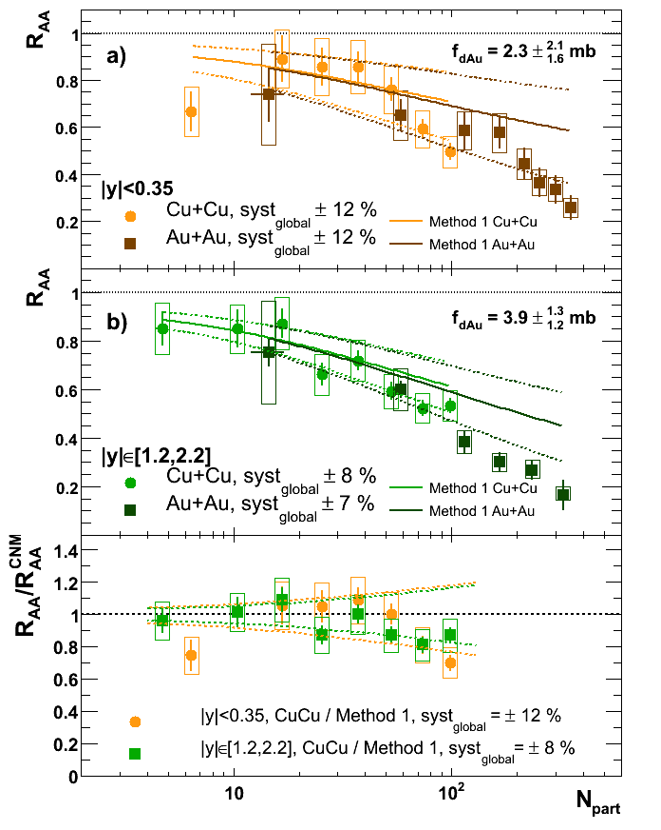
R_{AA} vs. N_{part} in 200GeV Cu+Cu
Run 5 Cu+Cu J/ψ results available at arXiv:0801.0220 and accepted by PRL.
Cu+Cu R_{AA} is in line with CNM projections from d+Au (central lines in panels a &b), while Au+Au is further suppressed.

Slide 12
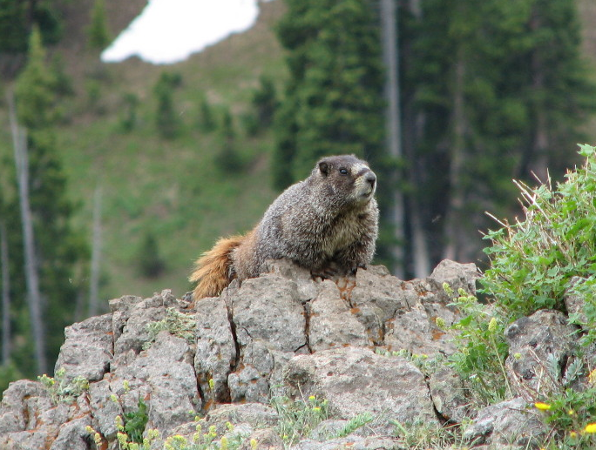
Studying J/ψ Formation with v₂

Slide 13
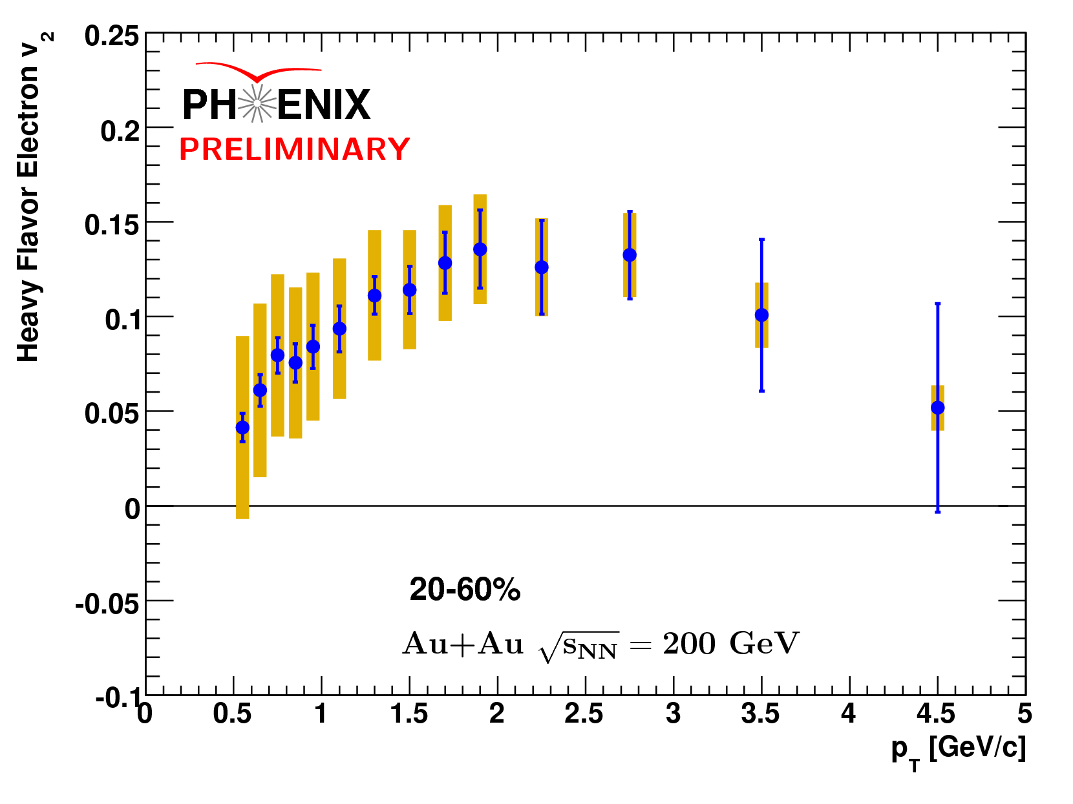
Elliptic Flow
Precise measurements of the flow of heavy quarks could tell us about how they thermalize with the medium, as well as how many J/ψs come from recombination.
We expect J/ψs which are formed via recombination to inherit the flow properties of the individual charm quarks. And, we already know that open charm mesons flow.
So a large J/ψ v₂ could indicate that most J/ψs are coming from recombination. Could also manifest as a difference between forward and mid-rapidity due to differing charm densities.
Alan Dion, QM2008

Slide 14
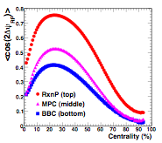

Reaction Plane and v₂
φ
In Run 7, PHENIX used the new Reaction Plane Detector, allowing for almost a factor of 2 improvement in reaction plane resolution.

Slide 15
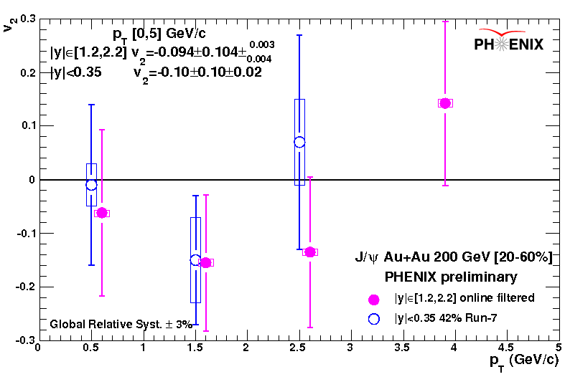
J/ψ v₂ in Run 7 Au+Au collisions
A bit underwhelming at the moment. A small improvement to the dimuon result is expected from analyzing the minimum-bias sample.
For dielectrons, this is only 42% of the Run 7 data, so a larger improvement could be had, but still ~√2.
Most consistent with zero or negative v₂.
Really need RHIC II luminosities to make a precise measurement.
Catherine Silvestre, Hard Probes 2008

Slide 16
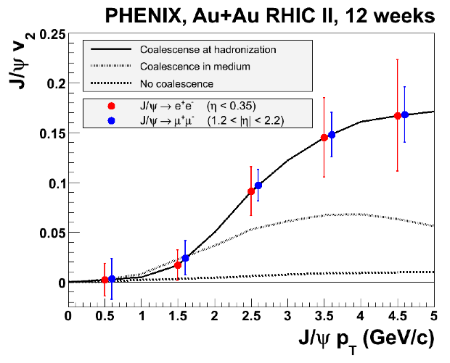

Projections for RHIC II
We can use a simple MC or an analytic expression to estimate the error on v₂ for a given sample size (RHIC II projection).
Also incorporate PHENIX RP resolution and J/ψ signal/background.
*RHIC II J/ψ projections courtesy Tony Frawley

Slide 17
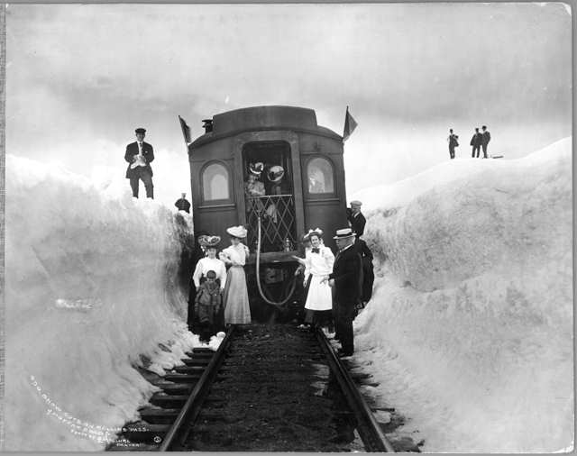

Summary
PHENIX has measured J/ψ R_{AA} in Au+Au and Cu+Cu.
Larger suppression at forward rapidity in Au+Au.
Cu+Cu consistent with CNM projections.
First measurement of J/ψ v₂ in Run 7 Au+Au.
Future high-luminosity running will allow precise measurement of J/ψ v₂.
New d+Au data should allow better constraint of CNM effects, and therefore QGP effects.
*All wildlife photos taken in Rocky Mountain National Park

Slide 18
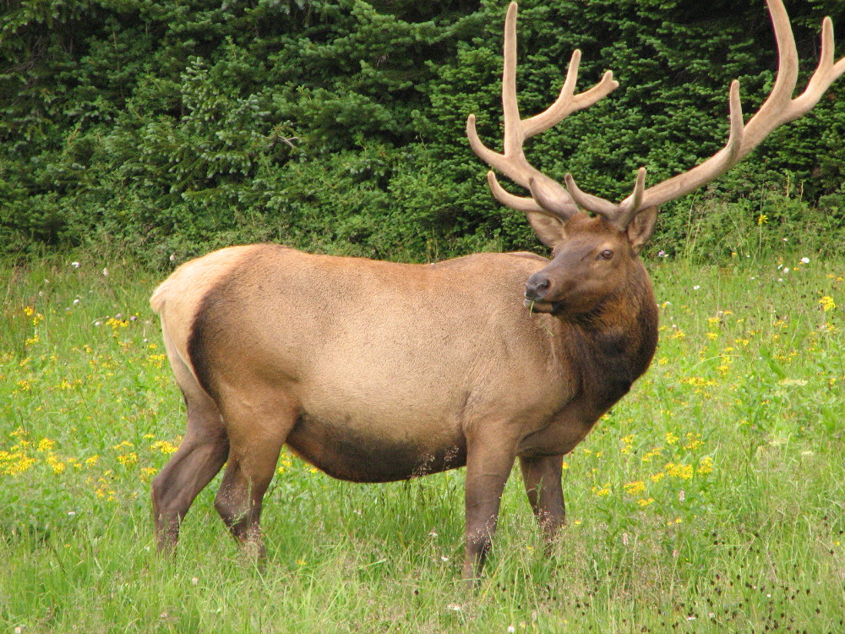
Backups

Slide 19





v₂ Statistical Error
We’ll call our randomly distributed variable X:
Now we can write down some basic statistical quantities:
But we’ll be taking multiple samples, so our measurement is the mean of X, and the statsistcal error is the sqrt of the variance.

Slide 20
