Slide 1
The Hurricane Data Rescue Project : What Once was Lost Now is Found.
Prepared by Neal M. Dorst
Hurricane Research Division
Atlantic Oceanographic and
Meteorological Laboratory

Slide 2
Outline
Introduction
Advertisement
A Brief History
NHRP (1956-1959)
NHRL (1960-1975)
HRD (1976-today)
The data formats
Punch cards
Microfilms
16mm/35mm films
Videotape
What’s been done so far ?
What needs to be done?
Is it worth it ?

Slide 3

First a word from our sponsor
This work is supported by a Climate Database Modernization Program (CDMP) grant from the National Climatic Data Center.
CDMP is a partnership between NCDC and private industry to image and key paper and microfilm records and to make them available on the Web to members of the climate and environmental research community.

Slide 4
First a word from our sponsor
Funding for the first five years of the hurricane data project
Grant AOML
FY04 $200,000 $20,000
FY05 $255,000 $25,500
FY06 $185,000 $18,500
FY07 $120,000 $12,000
FY08 $185,000 $18,500

Slide 5
First a word from our sponsor
HRD’s data rescue project is partnered with Information Manufacturing Corporation (IMC) of Rocket Center, West Virginia. They are carrying out the transfer of films and microfilms to digital media. They are also keying numerical information.

Slide 6
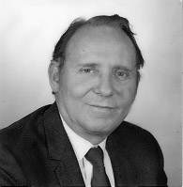
A Brief History
Bob Simpson
First NHRP Director
In 1955 Congress authorized Weather Bureau funds for the National Hurricane Research Project.
Notes:
This was the first permanent research institution within the Weather Bureau.

Slide 7
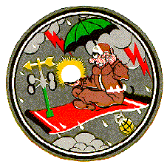
National Hurricane Research Project (1956-1958)
On loan from USAF 59th WRS :
Two WB-50 “A”,”B”
One WB-47 “C”
Both air crews and maintenance personnel
Airbase support at Morrison Field in West Palm Beach
Notes:
59th Weather Reconnaissance Squadron was based on Bermuda. However, the loaned aircraft and crews operated out of West Palm Beach for the convenience of the Weather Bureau personnel.

Slide 8
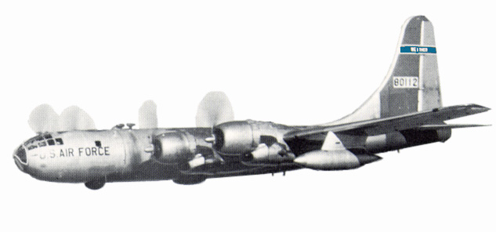
National Hurricane Research Project (1956-1958)
WB-50
Long range bomber collected:
Flight level data
Temperature
Wind Speed and Dir
Pressure
Radar film
Photo Panel film
Hand-held 16mm film

Slide 9
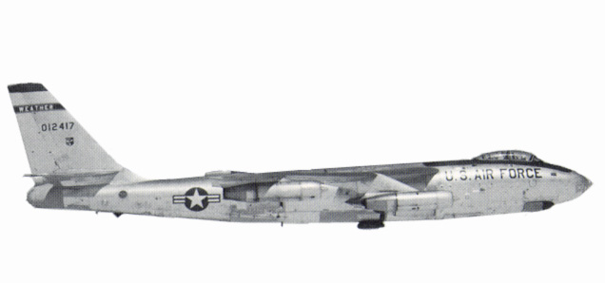
National Hurricane Research Project (1956-1958)
WB-47
High altitude jet collected:
Flight level data
Temperature
Wind Speed and Dir.
Pressure
Radar film
Photo Panel film
Notes:
Operated at 40,000 to 45,000 feet high, far above the WB-50 operational ceiling. This was important for documenting the outflow region of hurricanes.

Slide 10
National Hurricane Research Project (1959)
USAF direct support ended
However, data pods are mounted on 59th WRS’s aircraft
Photo Panel film
Dept. Commerce acquires their own aircraft
Notes:
Photo Panel films automatically recorded flight data and provides information on 1959 hurricanes that is not otherwise available.

Slide 11
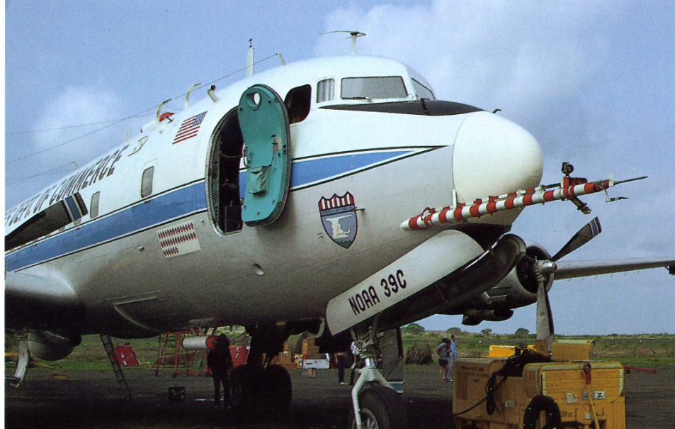
National Hurricane Research Laboratory (1960-1973)
Two DC6 aircraft
39 Charlie “A”
40 Charlie “B”
One B57 jet “C”
One DC4 aircraft “D”
One B26 aircraft “E”
One WC130 aircraft “F”

Slide 12
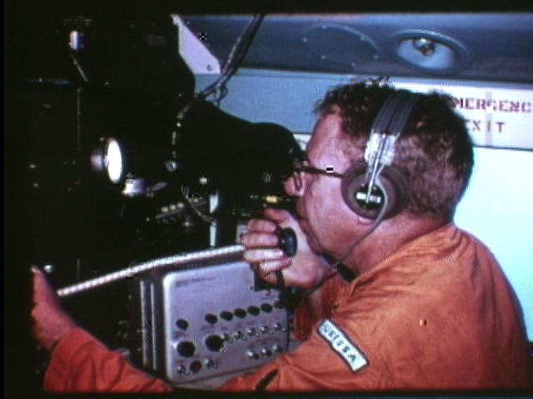
National Hurricane Research Laboratory (1960-1975)
DC6 & C130 aircraft
Flight level data
Temperature
Dew point
Wind speed and dir.
Pressure
Liquid water content
Radar film
Belly
Cross section
Fixed camera film
Photo Panel film
Foil impact

Slide 13
National Hurricane Research Laboratory (1973-1975)
Dept. Commerce plans upgrade to its air fleet
One DC6 and One C130 are kept to cover needs until new planes are ready

Slide 14
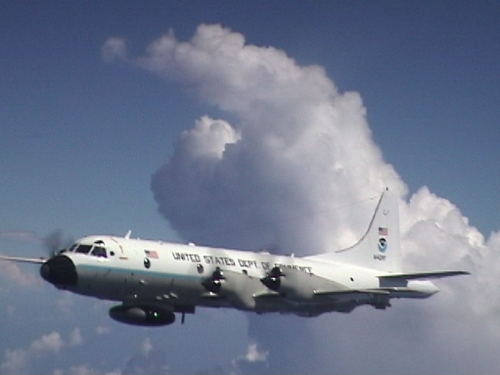

Hurricane Research Division/AOML (1976- Now)
One C130 aircraft ”F”
Two P3 aircraft
“Kermit” “H”
“Miss Piggy” ”I”
One G-IV jet
“Gonzo” “N”

Slide 15
Hurricane Research Division/AOML (1976- Now)
Data from 1977 on is available in digital format and readily accessible.

Slide 16
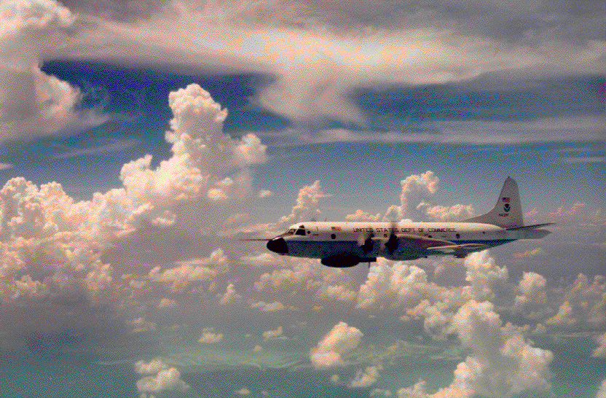
Hurricane Research Division/AOML (1976- Now)
P3 aircraft
Flight level data
Radar digital tape
Nose
Belly
Tail (Doppler)
Cloud Physics digital
2D-C
2D-P
FSSP
Remote sensors digital
SFMR
WARDS
Etc.
Fixed camera film and video

Slide 17
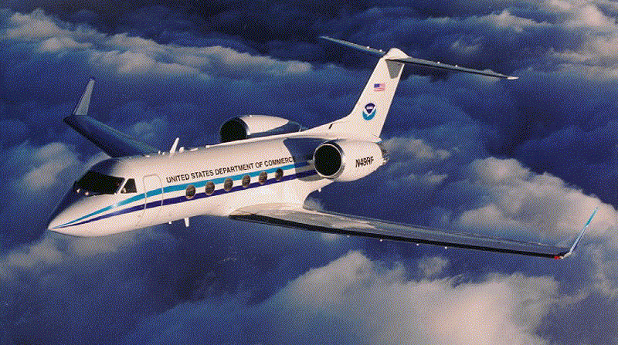
Hurricane Research Division/AOML (1976- Now)
G-IV jet
Flight level data (?)
Dropsondes
In the future :
Radar

Slide 18
Data formats
Digital flight level data
Time
Position
Temperature
Pressure
Wind
Humidity
Liquid water

Slide 19
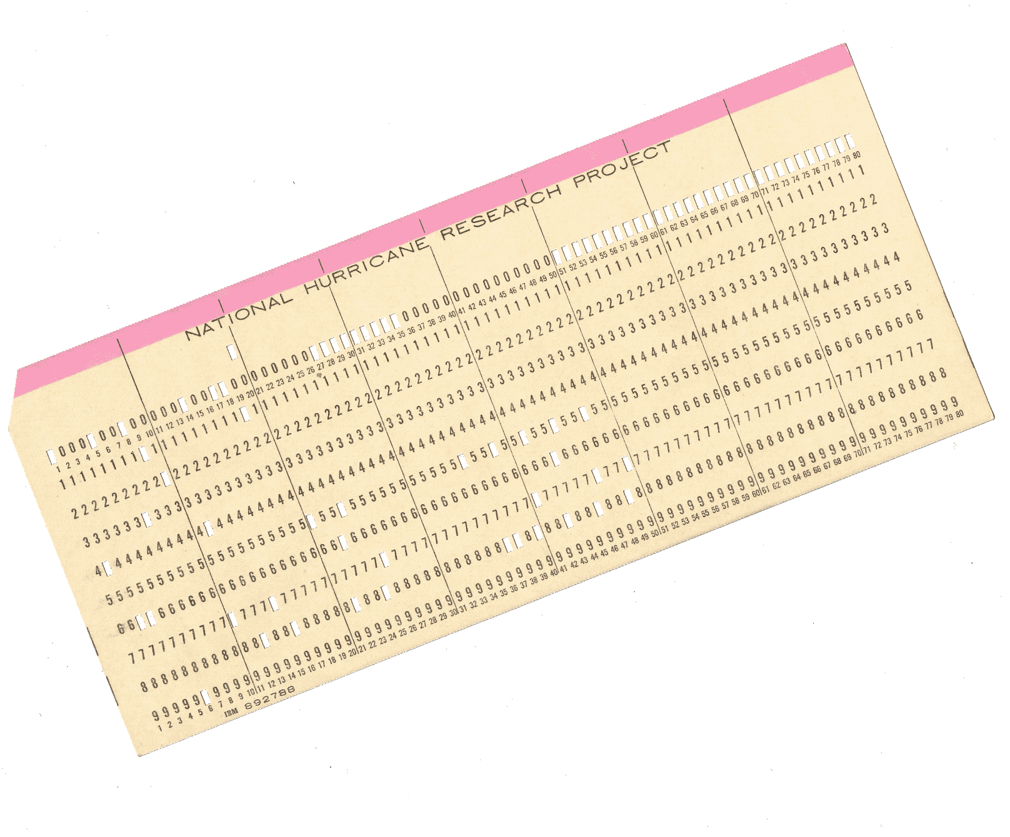
Data formats
Digital flight level data
Time
Position
Temperature
Pressure
Wind
Humidity
Liquid water
First recorded on punch cards
for 1956-1975 period.

Slide 20
Data formats
For 10 second data a typical flight will require 3000 to 3600 cards. Multiply by hundreds of flights, results in hundreds of thousands of cards.
Boxes of cards were sent to archive in Atlanta over the years. Too bulky to retrieve for rescue.

Slide 21
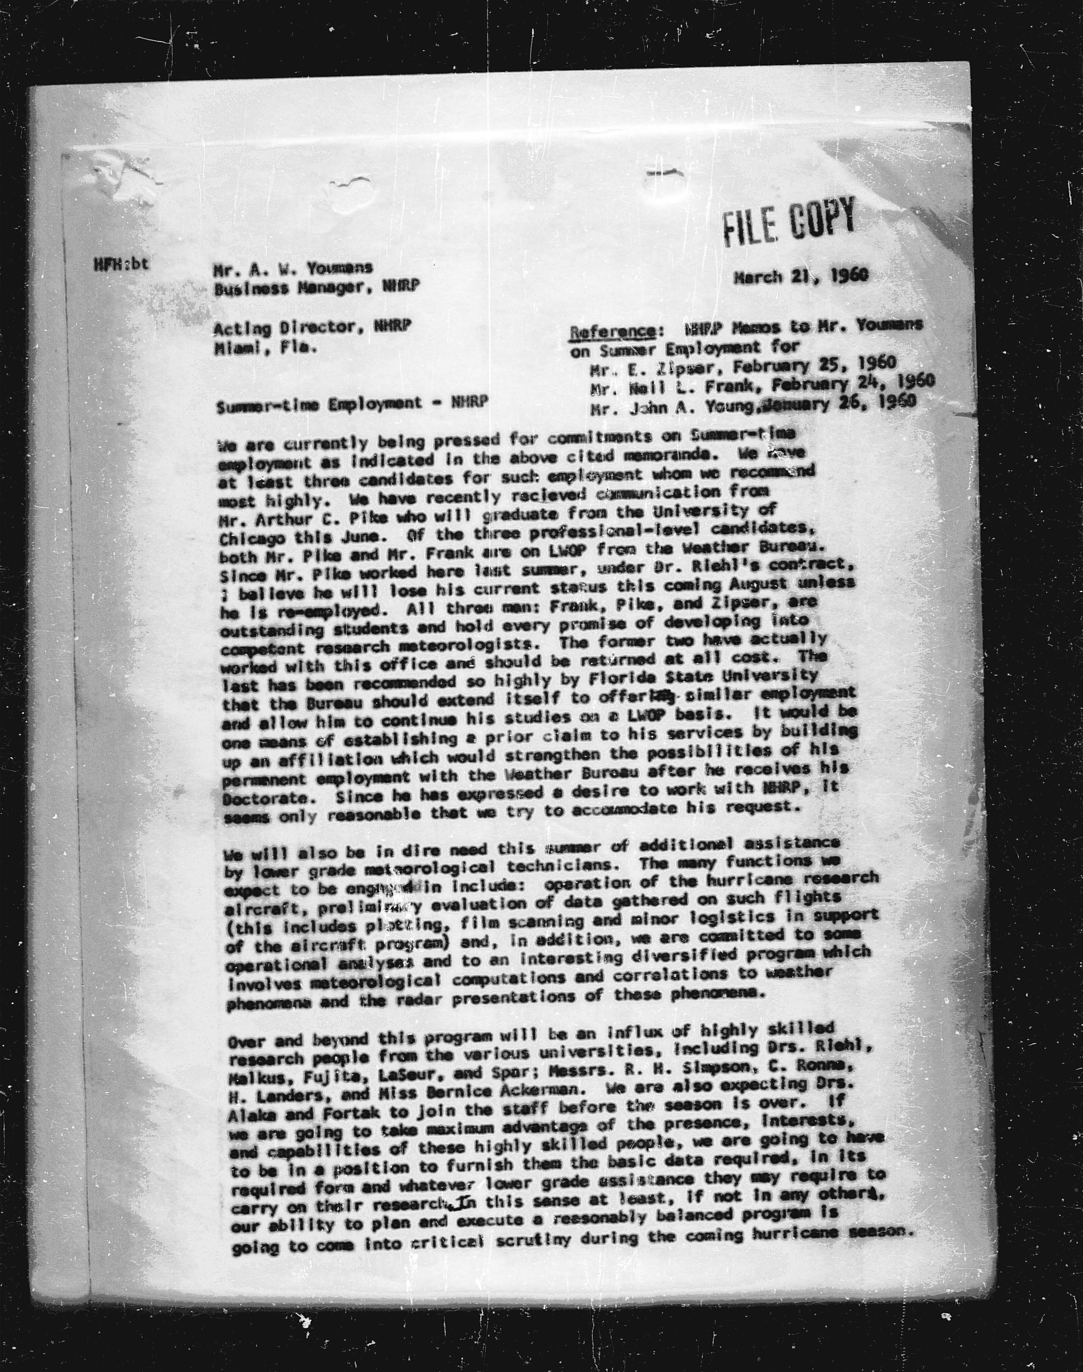
Data formats
Administrative files were saved on microfilm and contain letters, notes, and experiment plans. Of historical interest and offers context for earlier work. These microfilms have been saved as digital images on DVD by IMC.

Slide 22
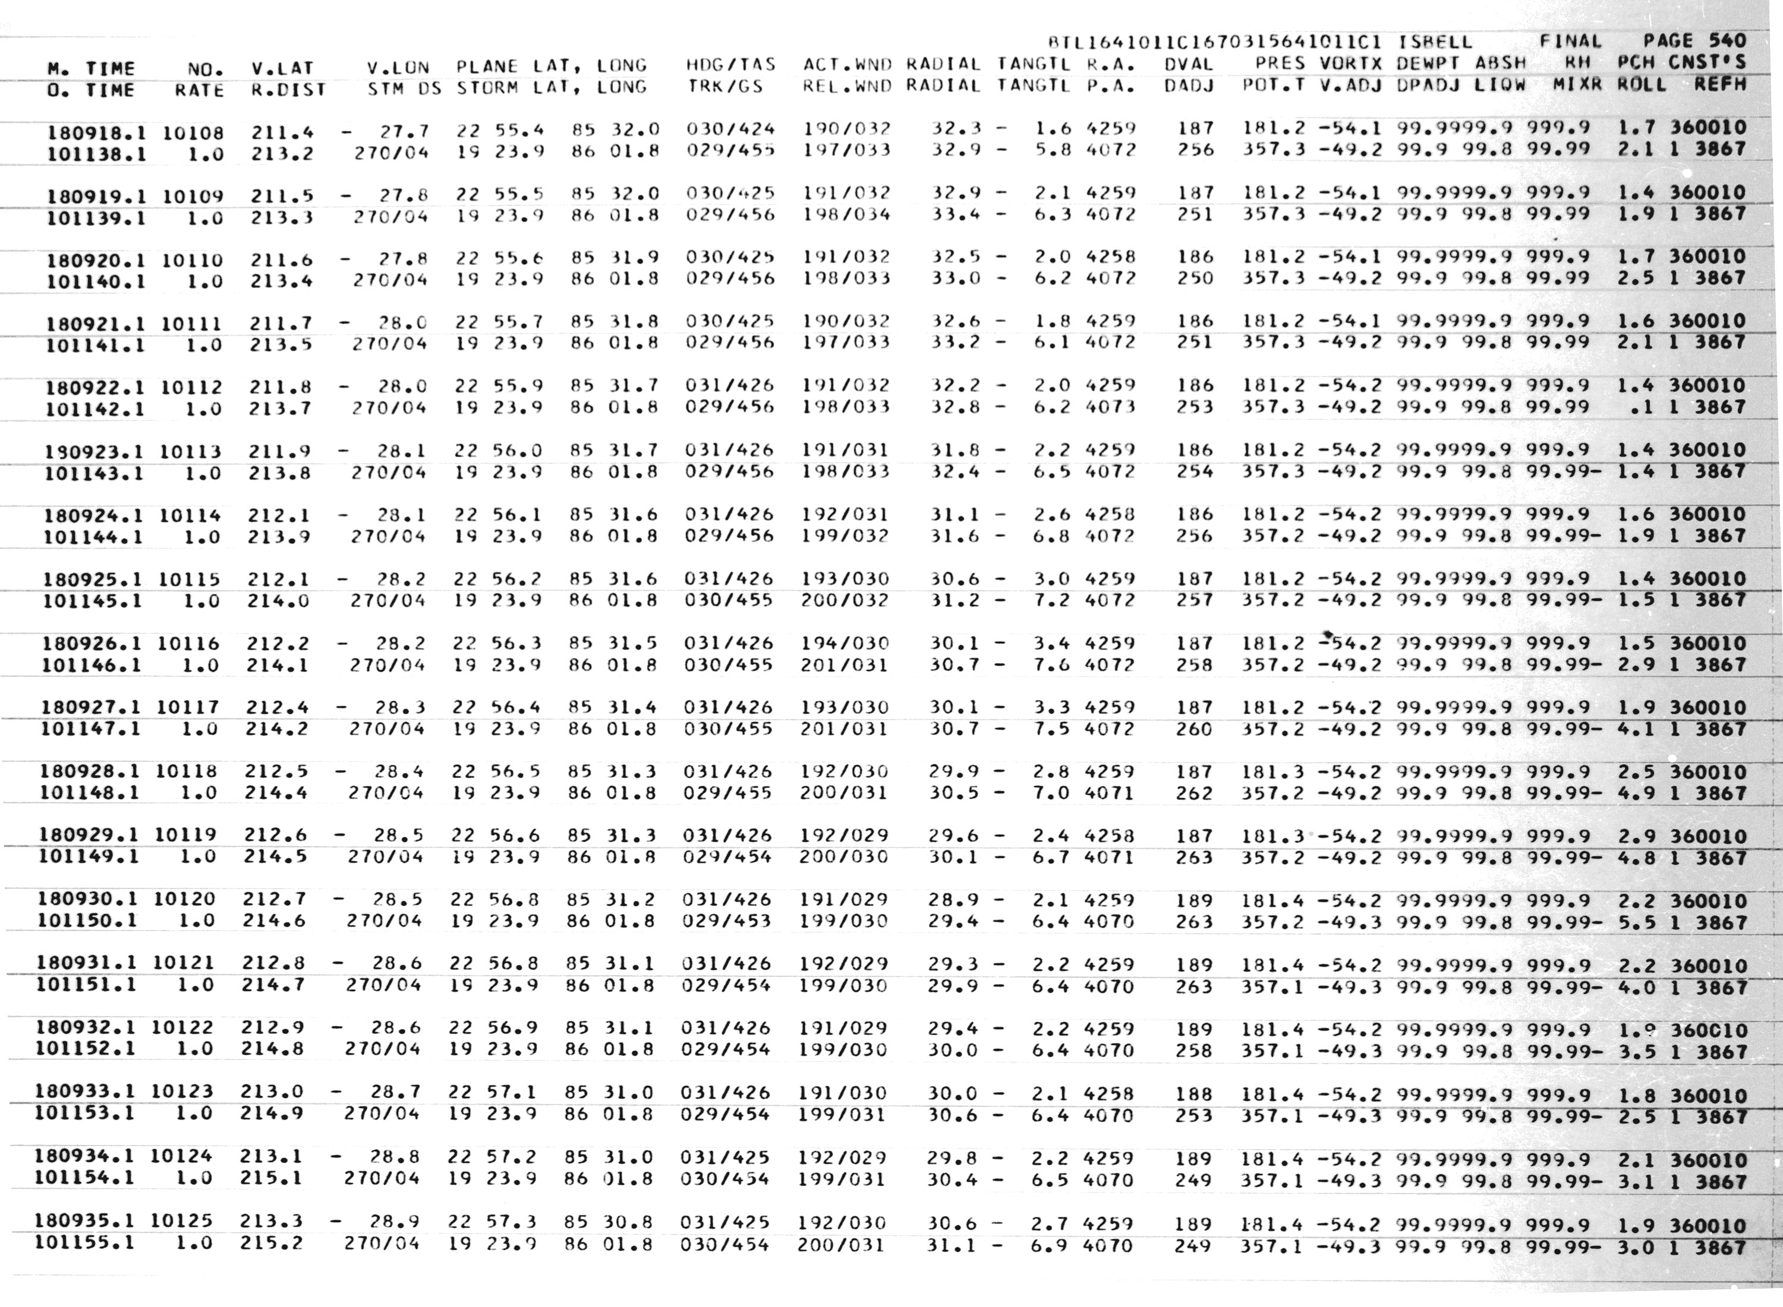
Data formats
In addition the microfilms contained data printouts of most of the flights from this period. This represents the QC’ed flight level data and can be keyed into digital form.

Slide 23
Data formats
Information from the microfilm DVDs is being keyed in by IMC to make the data available in digital form. This makes the data computer-friendly and accessible again.

Slide 24
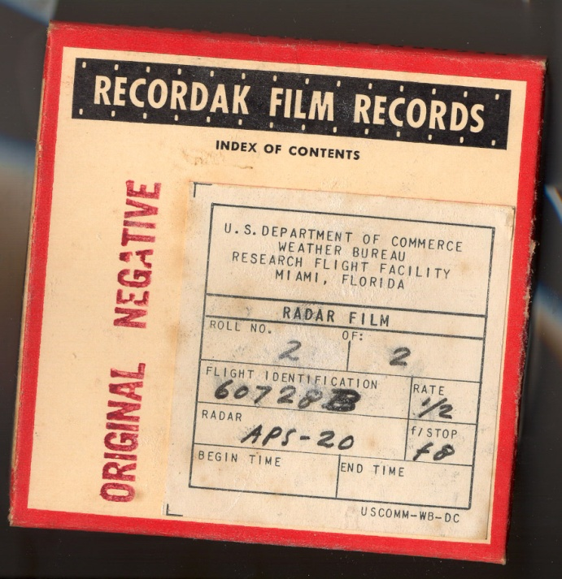
Data formats
Photo Panel and Radar data from 1956-1975 are recorded on 35mm film.
Plans are to save radar films as streaming video for qualitative reference.

Slide 25
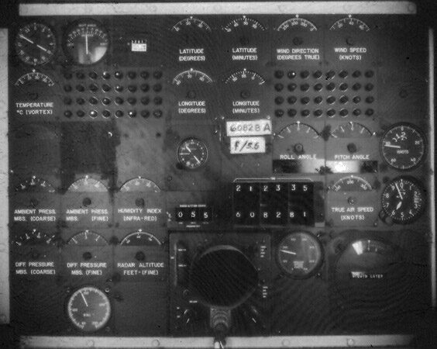
Data formats
Photo Panel film is 35mm images of an instrument panel which contains both digital and analog readouts of:
Time
Position
Temperature
Humidity
Pressure

Slide 26
Data formats
Photo Panel film was intended as a backup for the digitally recorded data. Therefore, we do not intend to digitize these films as long as printout data is available.

Slide 27
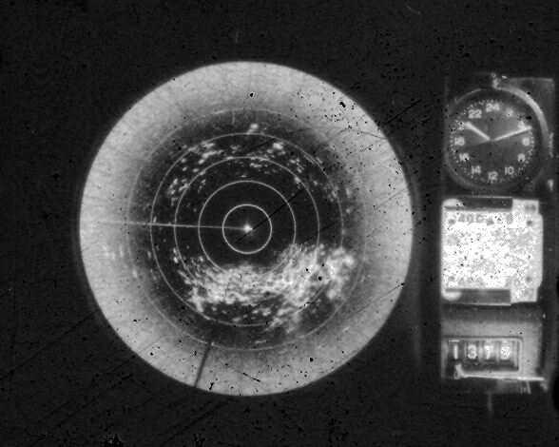
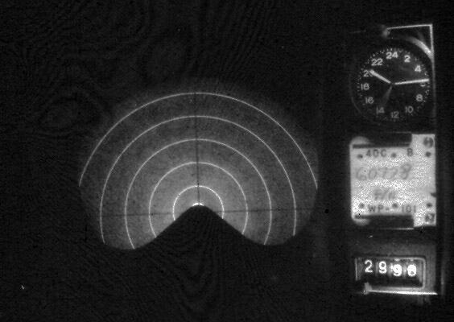
Data formats
Radar film is 35mm images of radar display scope.
It comes in two flavors
PPI (horizontal)
RHI (vertical)

Slide 28
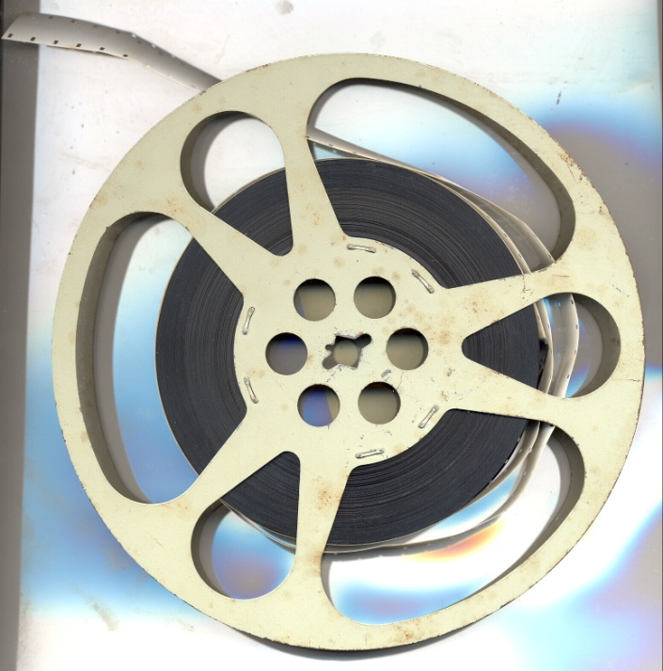
Data formats
Fixed camera and hand-held film are mostly 16mm movie film. Limited quantities of 35mm fixed camera films exist here at the Lab. Many were sent to the archive in Atlanta and may not be retrievable.

Slide 29
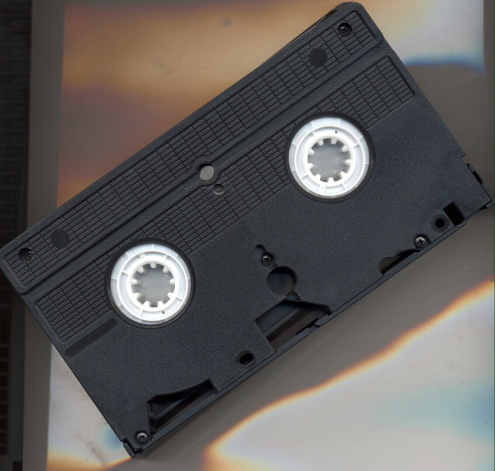
Data formats
The fixed cameras were recorded on Super VHS tapes from 1994 until 2005. Since 2006 video has been recorded directly into digital formats.

Slide 30
What’s been done so far ?
All administrative microfilms including all the flight level data printouts. 256 DVDs
Fixed camera films 1956-1979. 17 DVDs
All Super VHS videos from 1994-2005. 208 DVDs

Slide 31
What needs to be done?
Digitize the printouts of flight level data (5% done so far).
~2000 rolls of Radar film.
~300 reels of 16mm flight film.
~100 reels of land based radar film.

Slide 32
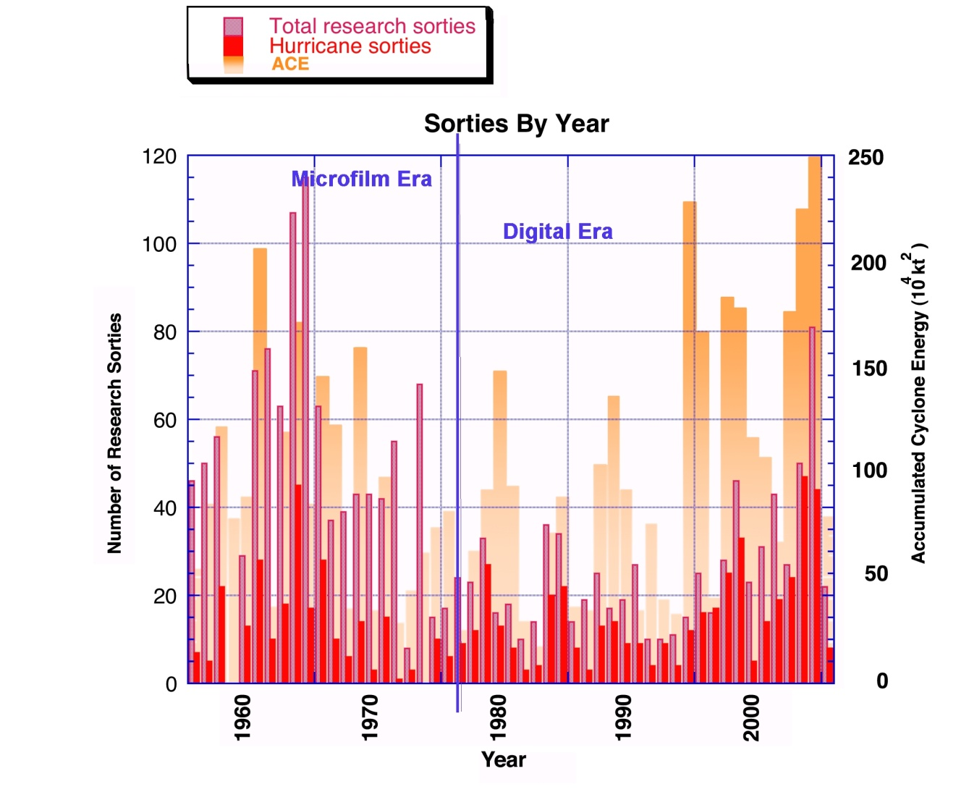
Is it Worth it ?
Notes:
A large number of research sorties took place during the microfilm era. Most of that data is difficult to access by computer.

Slide 33
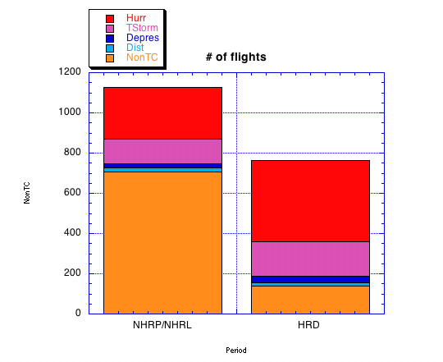
Is it Worth it ?
More total flights in the earlier period 1956-1974 than the later period 1976-2004.
(1127 versus 763)
Notes:
Every hurricane case is an important addition to the data set. Being able to access the older hurricane data will nearly double our cases.

Slide 34
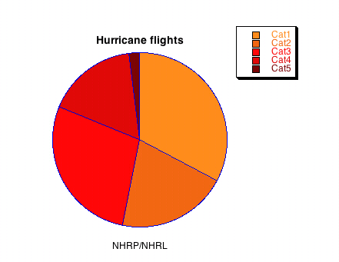

Is it Worth it ?
Slightly more even distribution of hurricanes by category in recent period.
Notes:
The bias may also be due to better sampling of storms, increasing the chance of catching storms at their peak. A close examination of these older flights may clarify this.

Slide 35
Is it Worth it ?
100 % of all hurricane seeding experiments were carried out prior to the P3 era.
Notes:
Questions about the effectiveness of Project STORMFURY can only be answered by looking at the data from this earlier period.

Slide 36
Is it Worth it ?
So much could be learned if we could bring modern insights in storm dynamics to the data of an earlier age. Most of it hasn’t been available to researchers for over thirty years because of difficulty in access. A serious reanalysis is overdue.
Notes:
Questions about the effectiveness of Project STORMFURY can only be answered by looking at the data from this earlier period.

