Slide 1
W physics at RHIC – Physics case and preparations in STAR and PHENIX
RHIC Spin Collaboration Meeting,
April 21
Matthias Grosse Perdekamp (UIUC)
Pavel Nadolsky (ANL)
Ralf Seidl (RBRC)
Bernd Surrow (MIT)

Slide 2
Outline
Introduction, Theory:
Current knowledge of quark helicity distributions
Real W production as high-scale access to (anti)quark helicities
Inclusive W→lepton Single spin asymmetries theoretically well understood
Experimental preparedness for W-physics
STAR: EEMC + Forward Gem Tracker (FGT) upgrade :
Technology under control
Installation schedule
PHENIX
Central Arm: EMCal + DCs , expected asymmetries
Muon arms: RPC and and Muon Tracker FEE upgrades:
Backgrounds: Simulation and reduction , Absorber
Installation schedule
Expected asymmetries

Slide 3
Current knowledge of helicity distributions:
NLO FIT to DIS & SIDIS data
D. De Florian et al. PRD71:094018,2005
NLO @ Q²=10 GeV²
χ²_{DIS}
χ²_{SIDIS}
Δu_{v}
Δd_{v}
Δu
Δd
Δs
Δg
ΔΣ
Kretzer
206
225
0.94
−0.34
−0.049
−0.055
−0.051
0.68
0.28
KKP
206
231
0.70
−0.26
0.087
−0.11
−0.045
0.57
0.31
SIDIS data improves description of all Δq, especially light sea
Kretzer FF favors SU(3) symmetric sea, not so for KKP
ΔΣ ~30% in all cases

Slide 4
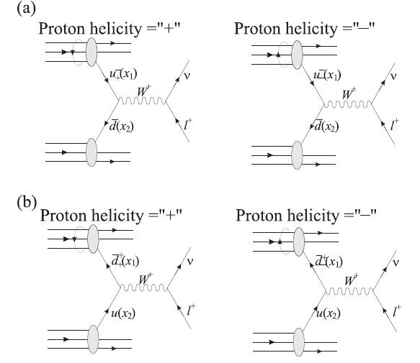
Real W production as access to quark helicities
Maximally parity violating V-A interaction selects only lefthanded quarks and righthanded antiquarks:
➔Having different helicities for the incoming proton then selects spin parallel or antiparallel of the quarks
➔Difference of the cross sections gives quark helicities Δq(x)

Slide 5
Quark and antiquark helicities probed in W production
Building single spin asymmetries of decay lepton
Positive lepton asymmetries sensitive to Δu (x) and Δ‾d (x)
Negaitv lepton asymmetries sensitive to Δd (x) and Δ‾u (x)

Slide 6
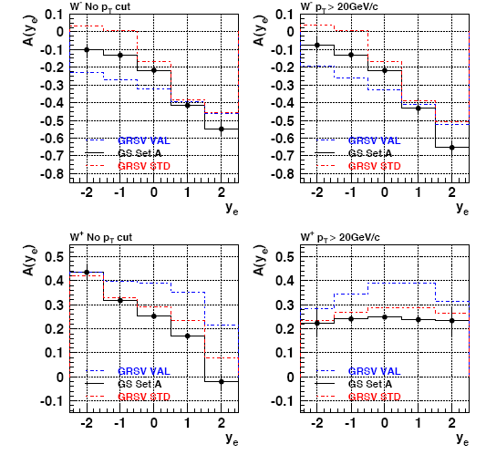
Asymmetries and sensitivities
Large asymmetries in the forward regions due to the u and d quark polarizations
Very different parameterizations in the backward regions due to
sea polarizations
Large scale way to test quark polarizations
Pin down sea

Slide 7
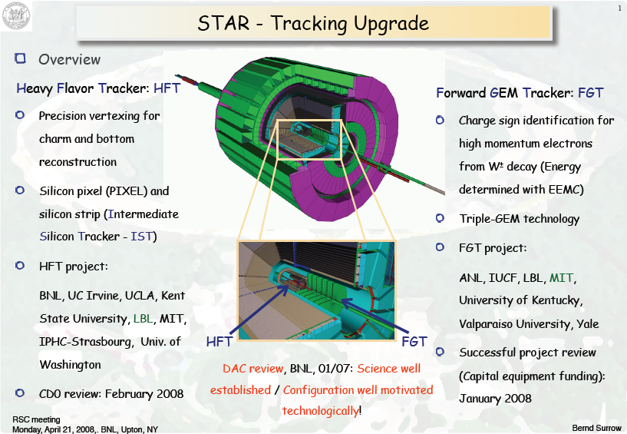
STAR

Slide 8
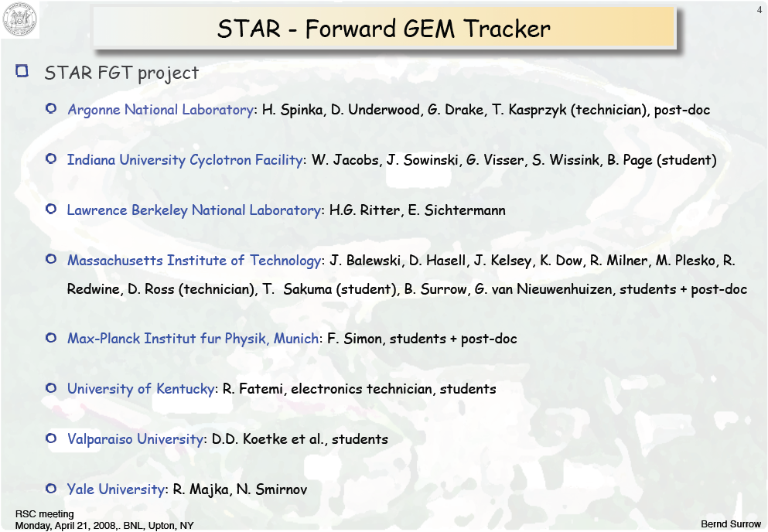

Slide 9
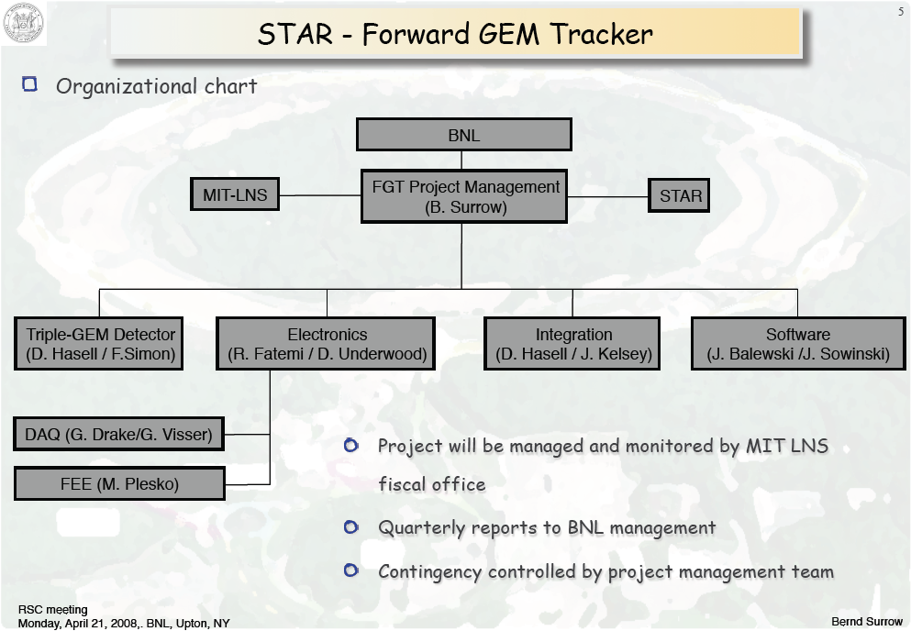

Slide 10
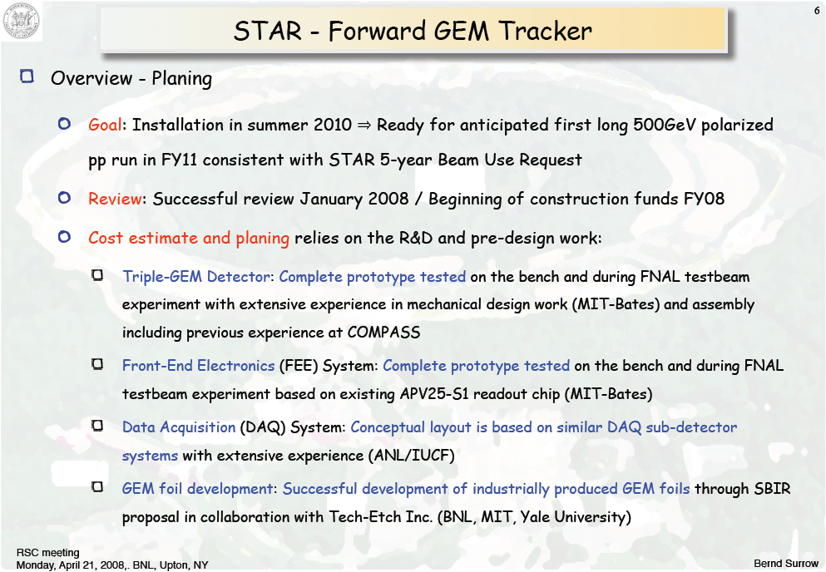

Slide 11
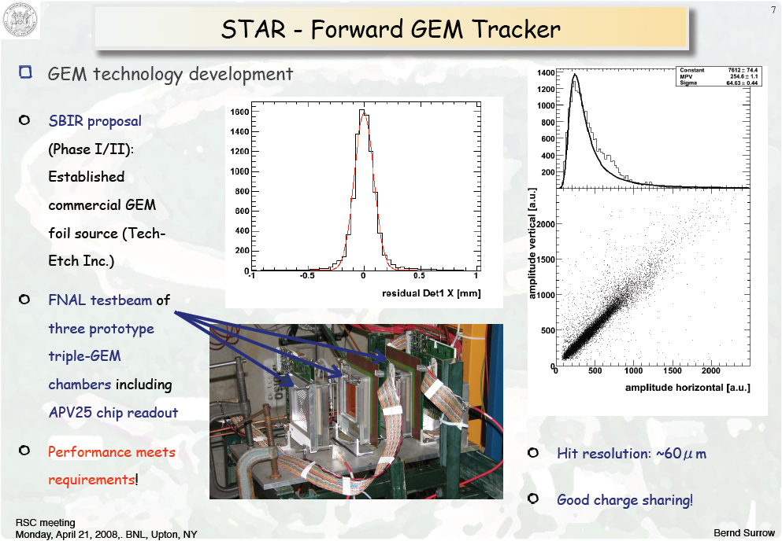

Slide 12
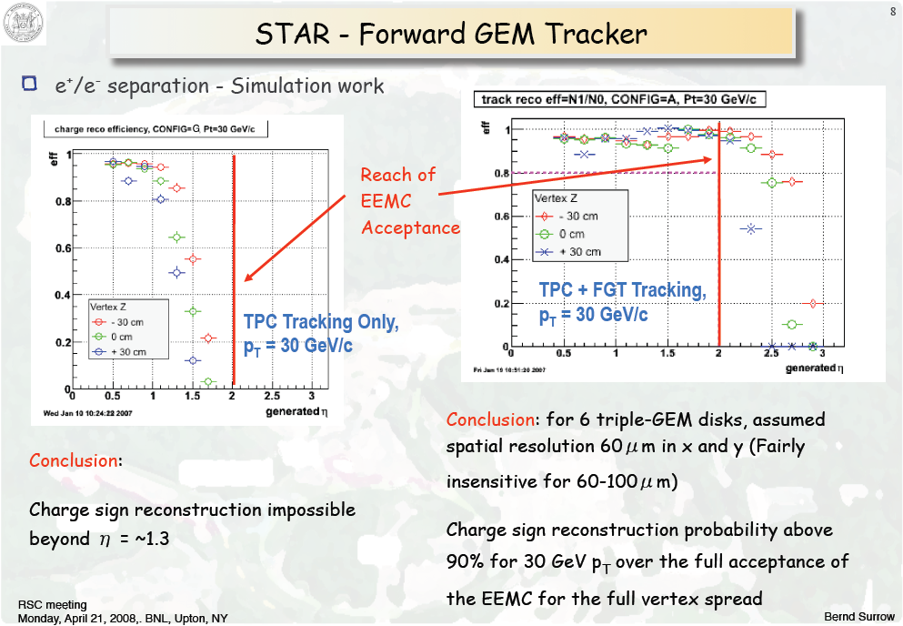

Slide 13
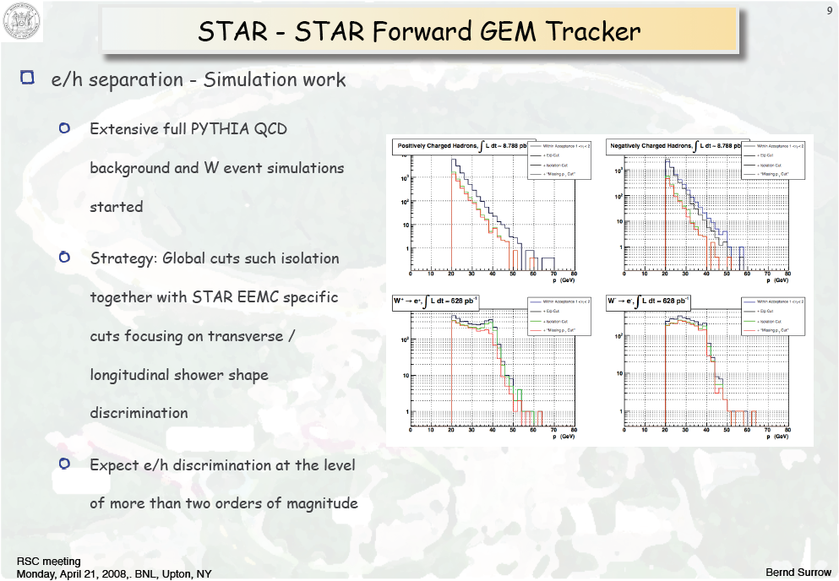

Slide 14
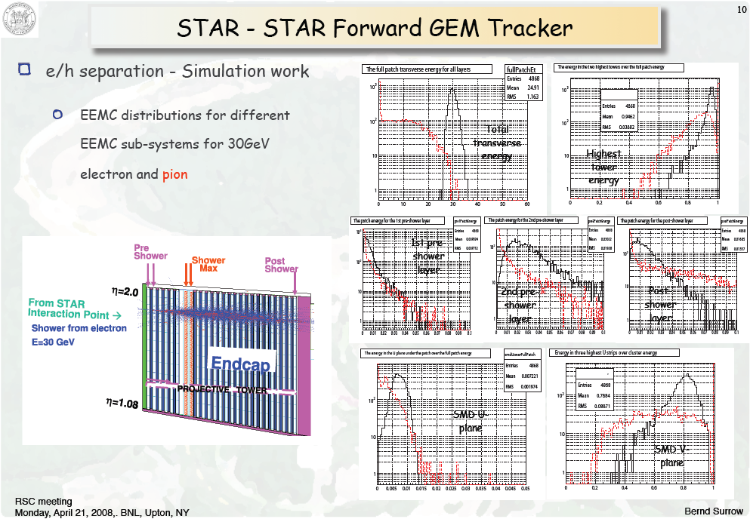

Slide 15
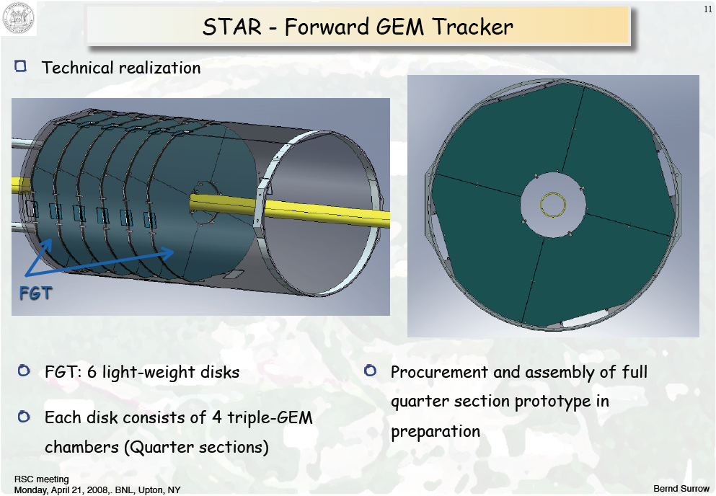

Slide 16
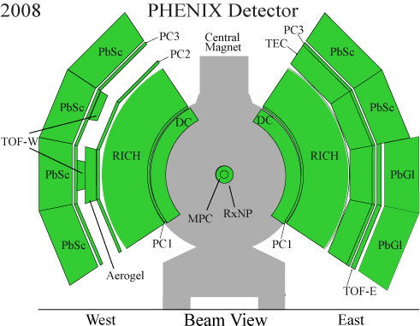
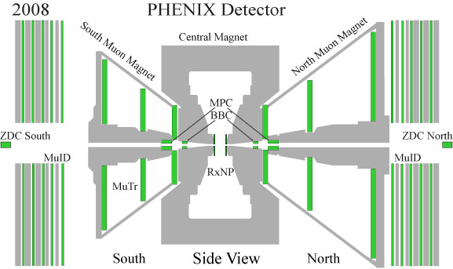
PHENIX
Central arm
Forward/ Backward Muon arms

Slide 17
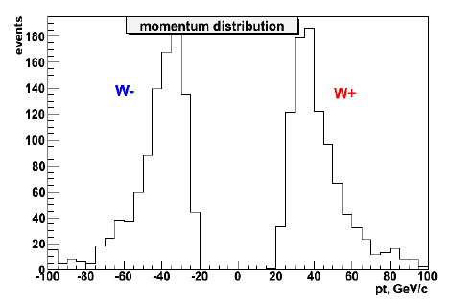
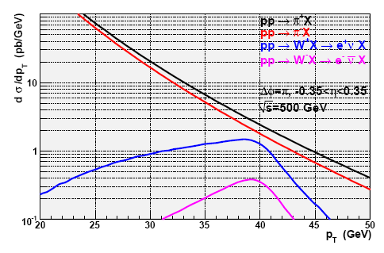
Central arm W measuremements
Existing EMCal and DCs are adequate to detect electrons from W decays
W momentum resolution about 8-9 GeV
Charge reconstruction efficiency ~95%
Deposited energy in EMCal and W isolation reduces hadron background by several orders of magnitude
Clean measurements already possible now

Slide 18
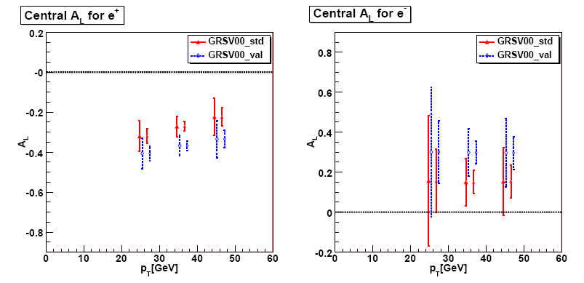
Expected Central arm asymmetries
Assumed luminosity:
319 pb⁻¹ and 1320 pb⁻¹
For central detector, still generated asymmetries
Large asymmetries to be seen
Even in central part distinction power between Sea scenarios

Slide 19
Forward/Backward arms: Trigger needs
Hadronic decays dominate muon rates
W dominate only above 20-25 GeV
DAQ cannot take full rate @500GeV
Current muon trigger momentum “blind”
Need for a momentum sensitive muon trigger
Add Resistive Plate Counters(RPCs)
Add fast readout electronics for Muon tracker

Slide 20
Trigger Upgrade Group in PHENIX: RPCs
A. Basye, D. Isenhower, D. Jumper, N. Sparks, R. Towell, C. Watts, J. Wood and R. Wright
Abilene Christian University, Abiline
K. Barish and R. Seto
University of California, Riverside
S. Hu, X. Li, F. Zhou and S. Zhou
CIAE, Beijing, China
A. Linden-Levy, E. Kinney, J. Nagle
University of Colorado, Boulder
C.Y. Chi, W. Sippach and W. Zajc
Columbia University and Nevis Laboratory, New York
C. Butler, K. Dayana, X. He, C. Oakley and J. Ying
Georgia State University, Atlanta
J. Blackburn, M. Grosse Perdekamp, C. Lee, Y.-J. Kim, B. Meredith, T. Natoli, N. Mucia,
D. Northacker, J.-C. Peng, E. Thorsland, A. Veicht, A. Vossen and R. Yang
University of Illinois, Urbana Champaign
J. Hill, T. Kempel, J. Lajoie, G. Sleege, C. da Silva and F. Wei
Iowa State University, Ames
J.H. Bae, B. Hong, B. D. Kim, B. I. Kim, K. B. Lee, K. S. Lee, C. S. Park, S. Park and K.-S. Sim
Korea University, Seoul, Korea
B. Fadem, J. Herstoff and P. Lichtenwalner
Muhlenberg College, Allentown, PA 18104, USA
Y. Mao and R. Han
Peking University, Beijing, China
G. Bunce and R. Seidl
RIKEN BNL Research Center

Slide 21
Trigger Upgrade Group in PHENIX: muTr FEE
T. Mibe, N. Saito
KEK, Tsukuba, Japan
K. Aoki, S. Dairaku, K. Imai, K. Karatsu, T. Murakami, A. Sato, K. Senzaka, K. Shoji, K. Tanida
Kyoto University, Kitashirakawa-Oiwakecho, Kyoto, Japan
M. Brooks and M. Leitch
Los Alamos National Laboratory, Los Alamos
D. Fields
University of New Mexico, Albuquerque
Y. Fukao and A. Taketani
RIKEN Institute, Hirosawa, Wako, Saitama, Japan
K. Kurita and J. Murata
Rikkyo University, Tokyo, Japan
78 collaborators from 18 institutions in the US, Japan, Korea and China
Funding:
muTr → $2.6 Million from JSPS
RPCs → $2.0 Million from NSF, $300k institutional

Slide 22
MuTr Front End Electronics (FEE) upgrade
AD board steals charge from FEE
Does Csplit work well ?
Efficiency of strip hit information?
Instrument MuTr Stations 1-3
Collaborative effort between KEK,RIKEN, Kyoto, Rikkyo and LANL

Slide 23
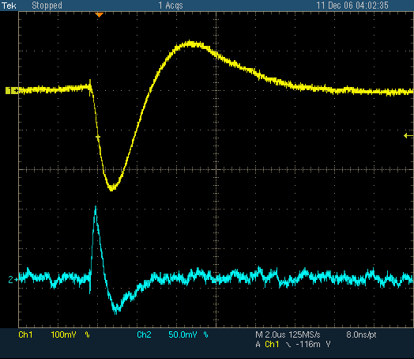
Test Pulse Input to Chamber
Pulse Shape of CPA output on FEE & Amp. output on AD Board
100mV/div.
50mV/div.
2usec/div.

Slide 24
Overall Layout of the PHENIX RPC Muon Trigger Spectrometer
RPC3
RPC2
RPC1(a,b)
RPC2
RPC3

Slide 25
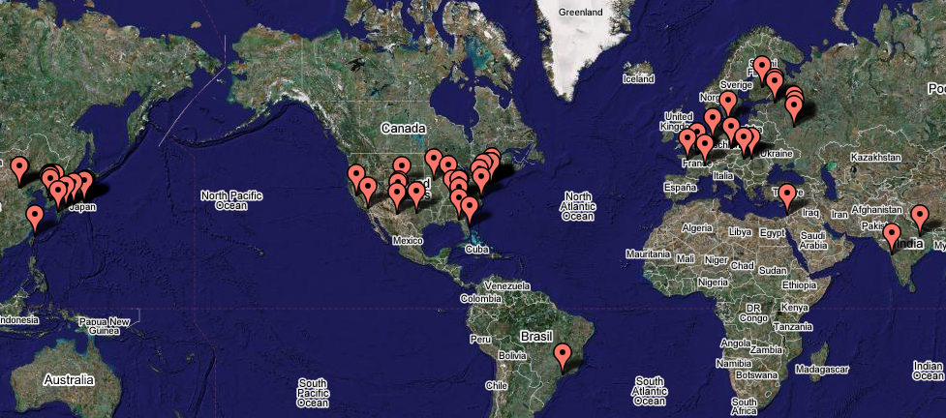
Manufacturing of RPC Gaps and Parts for PHENIX → Tested Successfully with Prototype C
frames and parts
gas cell route
Korea
BNL
Italy
China
bakelite route
►Bakelite produced and cut in Italy ►Gas gaps are produced at Korea University
►RPC frame & parts are procured in China (CIAE) ►Final assembly done at BNL.

Slide 26
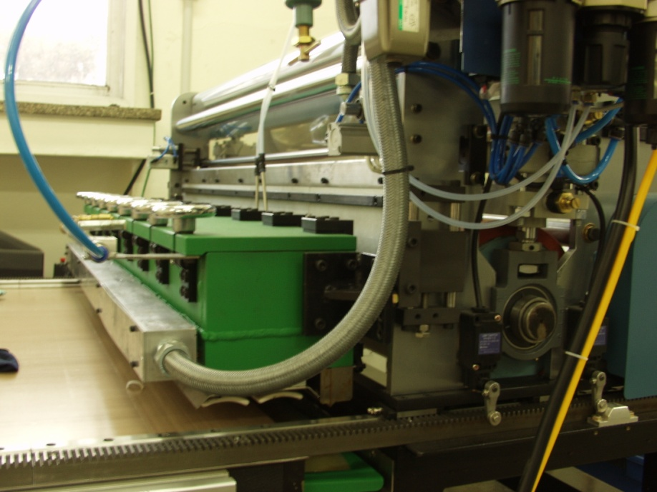
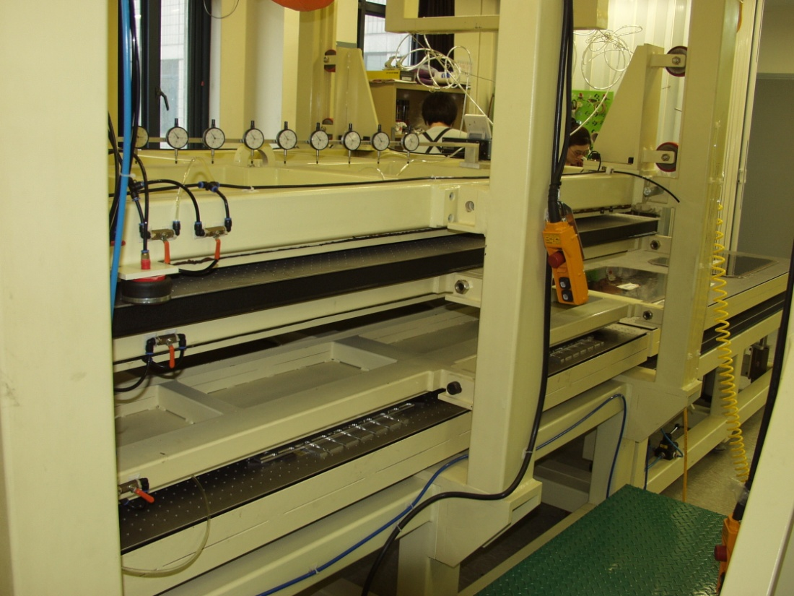
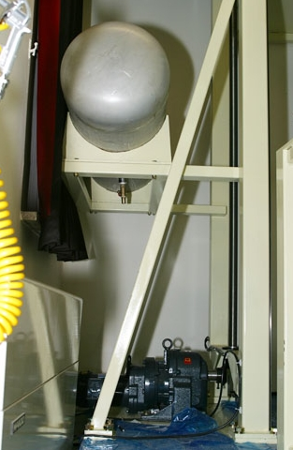
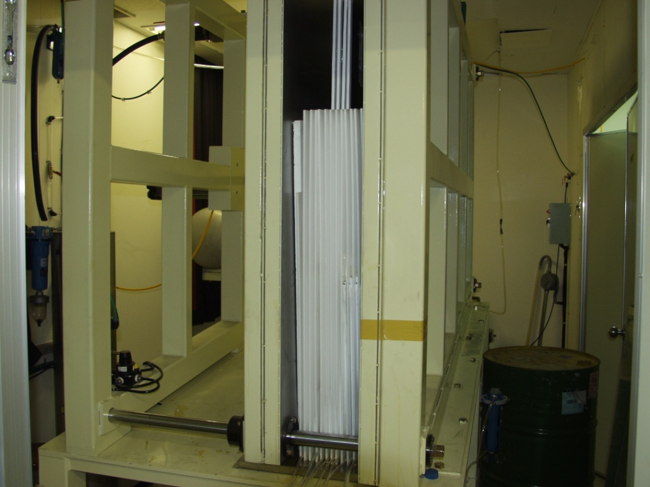
Gas Gap
Production
at Korea
University
(prototype C,
presently
prototype D)

Slide 27
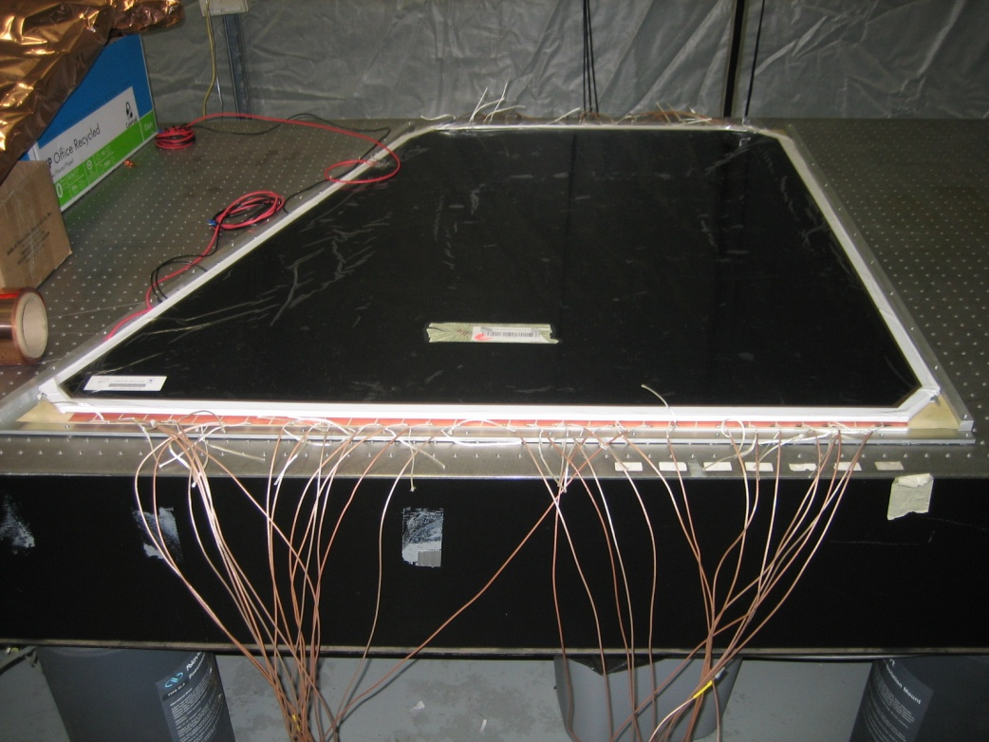
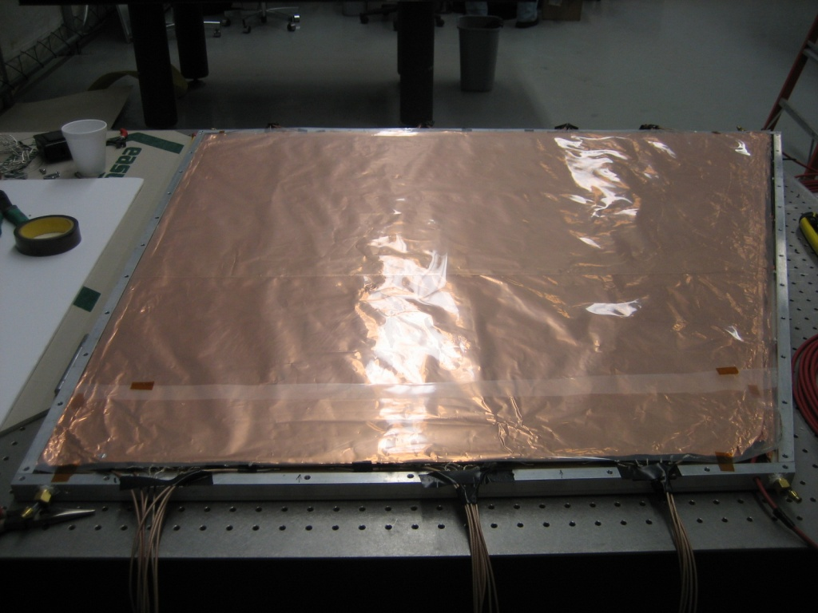
Assembly of the first (of three) Prototype C

Slide 28
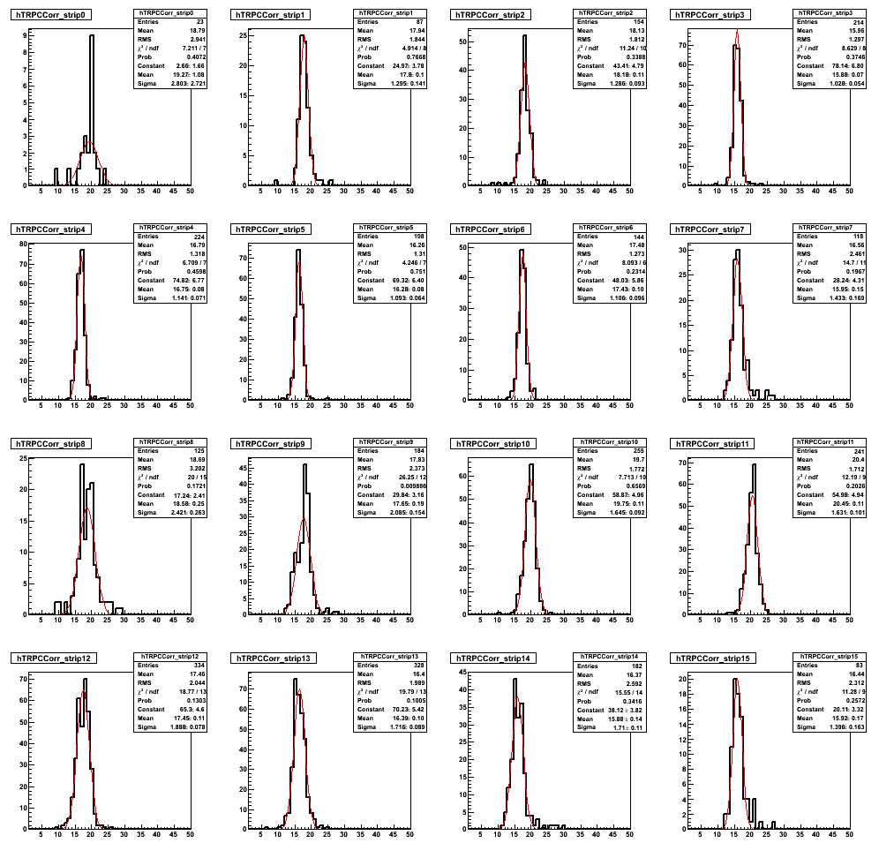
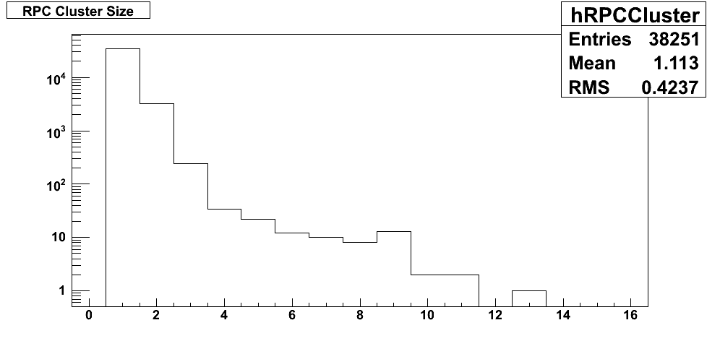
First RPC Prototype C Test Results
All TDC widths are less than 3 ns.
Cluster size seems constant from 9.3 to 9.5 kV.
First efficiencies ~95% at 9.5 kV.

Slide 29
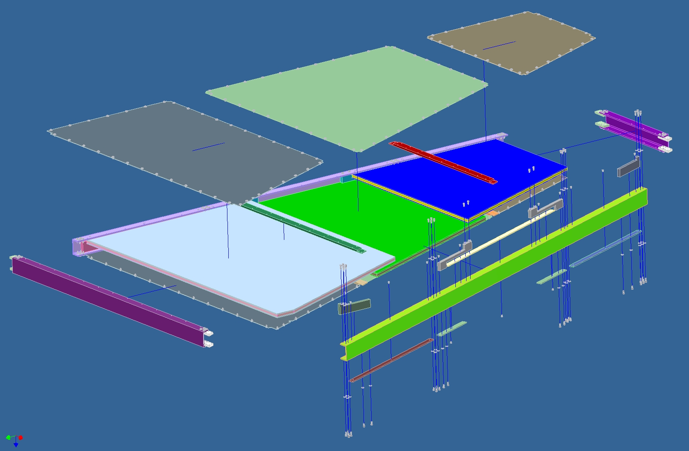
Prototype D: Exploded View

Slide 30
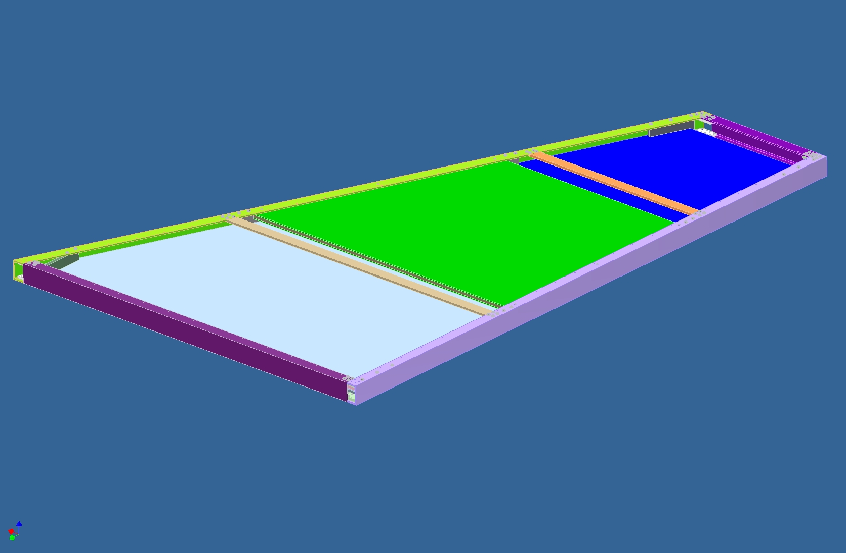
Detector Modules Assembled, upper skin removed

Slide 31
Schedules for PHENIX Muon trigger upgrade
Muon Tracker FEE upgrade
RPC upgrade
Final review passed in March
Boards in production
Full North installation (Stations 1-3) this summer
South installation summer 2009
Protoype C (2 modules running in 912)
Prototype D (2 half octants) in production + 1Octant of Absorber , to be installed this summer
RPCs 2 and 3 North + Absorber North to be installed 2009
RPCs 2 and 3 South to be installed 2010
First Full Trigger FEE+RPCs in run 10

Slide 32
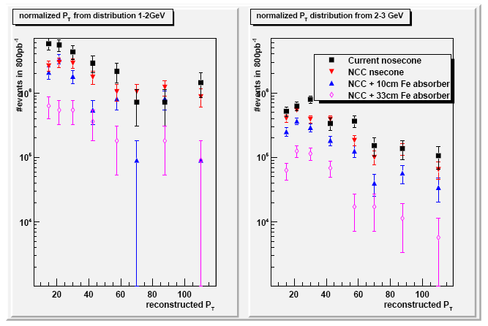
Backgrounds in the offline analysis: Fake high-P_{T} hadrons
Main offline background: Low P_{T} hadrons decaying within muon tracker volume mimicking a high P_{T} track
Tight cuts reduce S/B ratio to 1/3
Hadron absorber after Central magnet yoke to obtain 3/1 ratio

Slide 33
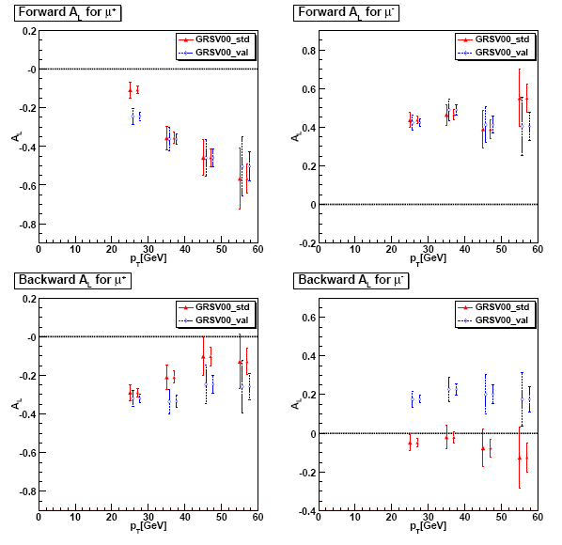
Expected asymmetries
Assumed luminosity:
319 pb⁻¹ and 1320 pb⁻¹
Full detector simulation
Inclusion of S/B of 3/1
Huge asymmetries to be seen
Even with RUNI statistics GRSV std and valence can be distinguised on the 7σ level

Slide 34
Summary
W Single spin asymmetries as direct measurement of quark and antiquark helicities
High scale, sensitive to distinguish sea sceanarios
STAR:
Forward Gem Tracker upgrade + Endcap calorimeters to detect forward/backward decay electrons
Anticipated installation: summer 2010
PHENIX:
FEE upgrade to use Muon Tracker in Trigger
RPC upgrade
First arm installed 2009, second arm 2010

