Slide 1
Interactions between Atmospheric Variability over the Pacific and North Atlantic basin – Role of Transient Eddies
Ying Li
AOS Program, Princeton University
Advisor: Gabriel Lau
Oral Research Seminar
April 8, 2008

Slide 2
Outline
Part I: Introduction
Teleconnection patterns associated with ENSO, PNA and NAO
Seasonal dependence
Part II: Dynamical Mechanisms
Stationary wave propagation
Storm track activity, transient eddy fluxes of momentum and heat
Part III: Future Work and Preliminary Results
Overall Summary

Slide 3
Part I:
Introduction

Slide 4
Teleconnections
El Nino-Southern Oscillation (ENSO); North Atlantic Oscillation (NAO); Pacific-North American Pattern (PNA)
Wallace and Gutzler (1981): Correlations
Horel (1981); Barnston and Livezey (1987); Nigam(2003): Varimax rotated EOF
Hoskins and Karoly (1981): Rossby wave propagation on a sphere
MODEL: Geophysical Fluid Dynamics Laboratory (GFDL) Climate Model version 2.1 (CM2.1)
A coupled ocean-atmosphere-land-ice model (Delworth et al. 2006)
A 2000-yr integration is performed after a 220-yr spinup period.
Fixed 1860 radiative forcings, including atmospheric trace gases, solar irradiance, and distribution of land cove
Anthropogenic aerosols are not considered.
Model resolution (atmosphere): 2° latitude ×2.5 °longitude; 24 vertical levels.
Utility of long integrations based on CM2.1
Document the nature of the robust teleconnection patterns in the control simulation
Apply our understanding of natural model variability to investigate the responses to changes in external forcing.
Study the model mechanisms contributing to these teleconnection patterns, which represent the internal variability in the model control run.

Slide 5
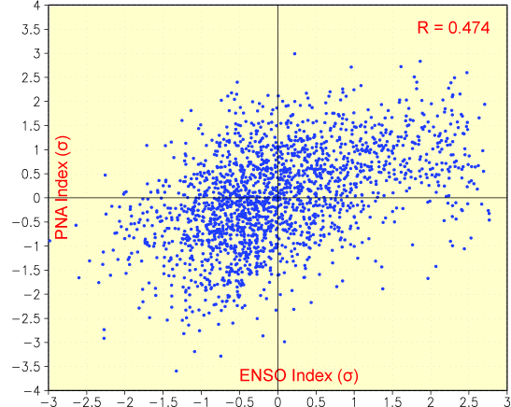
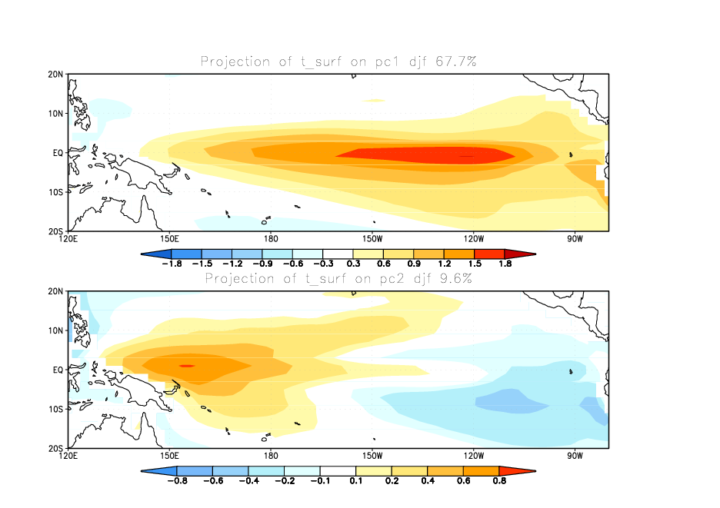
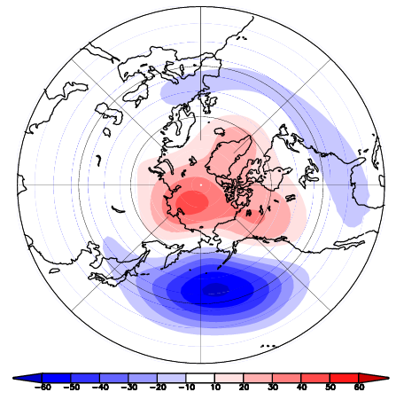
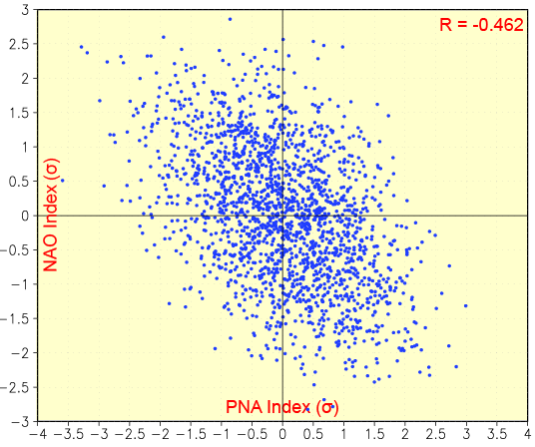
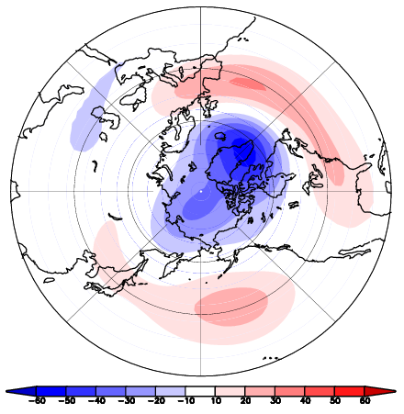
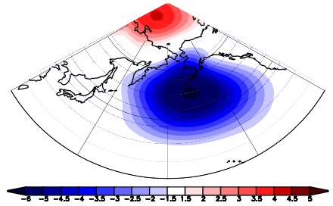
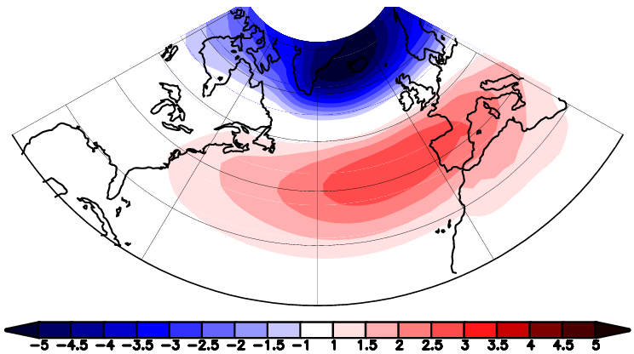
Teleconnection Patterns (DJF-mean)
EOF1 of SST over TP(ENSO) 67.5%
+
?
Regression of Z₅₀₀ against PC1 (PNA)
Regression of Z₅₀₀ against PC1 (NAO)
EOF 1 of SLP over N.Pac 42.9%
EOF1 of SLP over N.Atl(NAO) 46.1%
−

Slide 6
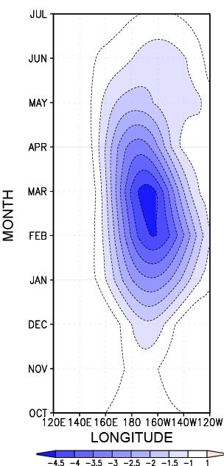
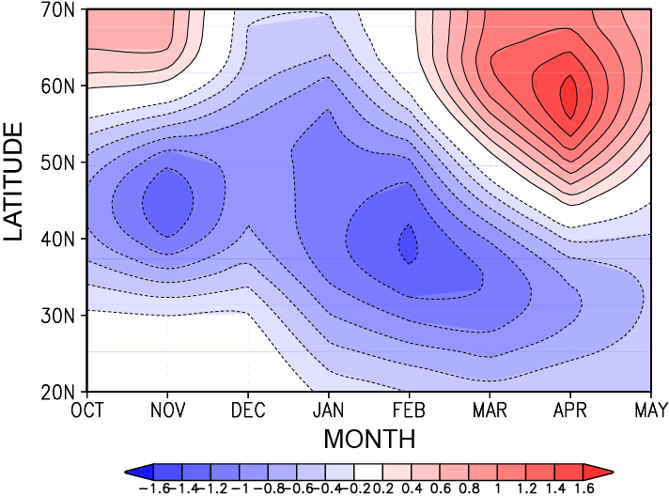
Strong Seasonal Dependence in Late Winter
-1.6
-4.5
Regression of the SLP averaged over the 35°-55°N latitude band over the N.Pac against the ENSO index
Regression of the SLP averaged over the 70°-20°W longitude band
over the N.Atl against the ENSO index

Slide 7
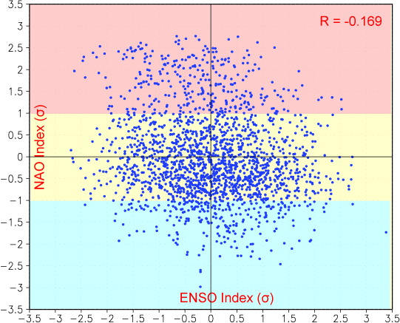
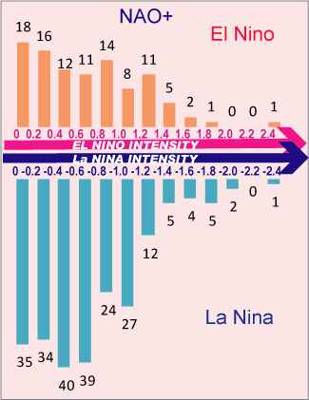
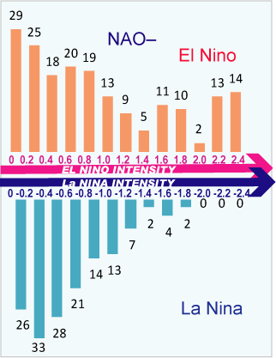
ENSO index: PC1 of the EOF1 of SST over TP
(DJF-mean)
NAO index: PC1 of the EOF1 of SLP over NA (DJFM-mean)
NAO+
NAO-

Slide 8
QUESTION: Which dynamical processes are responsible for the atmospheric-ocean variability over the tropical Pacific, North Pacific and North Atlantic in late winter?
Three Possible Mechanisms:
1
Stationary wave propagation
2
Storm track activity, Transient eddy fluxes of momentum and heat
3
Internal variability e.g. Aleutian Low (AL) and Icelandic Low (IL) seesaw

Slide 9
Previous Studies
Stationary Wave Propagation
Simmons et al. (1983), Branstator (1985): Stationary wave are very important in maintaining the low-frequency atmospheric anomalies
Karoly et al. (1989): shows linearized, steady state primitive equation model solution to thermal forcing in the tropics in northern hemisphere winter
Transient eddies
Held et al. (1989): The response to the anomalous transient eddies are important for the extratropical wave train in the linear simulation of the GCM
Hoerling and Ting (1994): the mechanism by which events in the tropics can control the behavior of transient eddies in extratropics
Internal atmospheric variability
Honda and Nakamura(2001a,2005): Upstream Aleutian Low influence on the Euro-Atlantic sector (Aleutian Low (AL) and Icelandic Low (IL) Seesaw)
Branstator (2002): the existence of large –scale zonally propagating teleconnection structures

Slide 10
Part II: Dynamical Mechanisms a) Stationary Wave Propagation

Slide 11
Stationary Wave Activity Flux
Application
Propagation of wave activity; Interaction between stationary waves and time mean flow.
Horizontal components of F flux by Plumb (1985):
σ: pressures/1000hPa
λ, φ: longitude and latitude
u, v: horizontal geostrophic
velocities computed from Φ
overbar: time mean
asterisk: deviations from the zonal mean
Properties
F flux is parallel to the group velocity in the WKB sense.
Its divergence (convergence) is where the wave train is strongly forced (dissipated).

Slide 12
Method
Composite charts was constructed based on the PC1 of the EOF analysis
Type | Criteria | Number of Cases
Strong El Nino | PC1>1.5σ | 192
Strong La Nina | PC1<-1.5σ | 83
Strong NAO+ | PC1>1.5σ | 144
Strong NAO- | PC1<-1.5σ | 143
All the composites are averaged over Feb. and Mar.

Slide 13
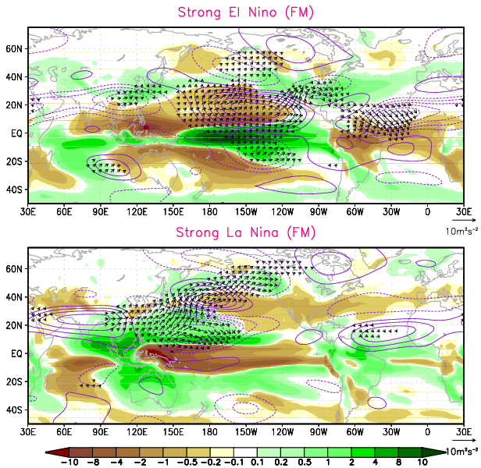
Eastern Pacific
Not too much polarward and eastward propagation
Instead, mostly equatorward
Western Pacific
Precipitation (shading), Fs(arrow), Ψ*₂₅₀(contour)

Slide 14
b) Storm Track Activity: Transient Eddy Fluxes of Momentum and Heat

Slide 15
Data Processing
2000 yr-long daily data
Partition the filtered time series into individual months
Calculating the transient variance or covariance for each monthly segment
41 weights
Lanczos method (Duchon 1979)
2-10 day “band-pass” filtering

Slide 16
Extended EP Vector
Illustrate local interactive processes between transient eddies and the time mean flow
Horizontal components of E vector by Trenberth (1986) :
u, v: horizontal wind
prime: deviations from the corresponding time mean quantities
overbar: time mean
Properties (Hoskins et al 1983)
y
y’
The angle of the tilt:
x
ϕ
2ϕ
x’
E

Slide 17
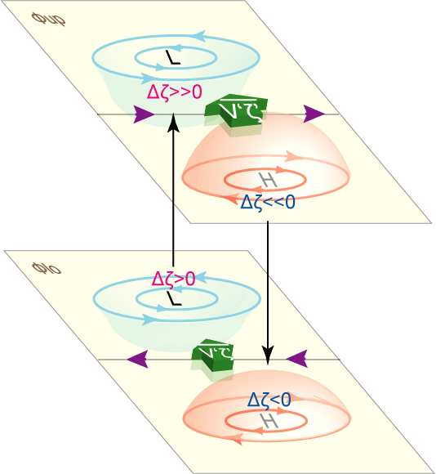
The transient forcing: geopotential height tendency due to the synoptic-scale eddy vorticity flux convergence
Barotropic component:
Physical explanation:
Lau and Holopainen (1984), Lau and Nath (1991)

Slide 18
Z₂₅₀ : atmospheric variability
: storm track
E vector: propagation of transient eddies
: eddy induced geopotential height tendency
Tropical Pacific
SST Forcing associated with El Nino
North Pacific
Seasonal mean Z
North Pacific
Storm track
E vector
North America
Hypothesis
1
2
+
-
Western Atlantic
North Atlantic
Storm track
Downstream of NAO(-)
E vector
is in phase with Z associated with NAO(-)
3
4
5
+
-

Slide 19
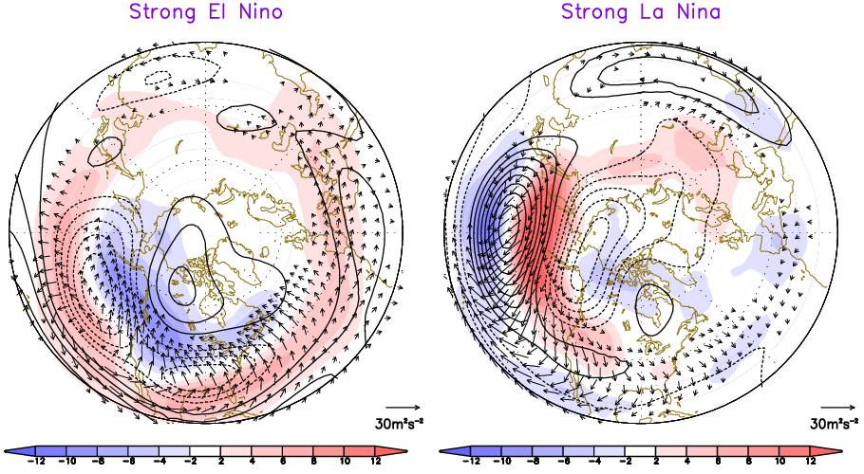
Tropical Pacific
North Pacific
1
North Pacific
SST Forcing associated with El Nino
Seasonal mean Z
Storm Track
E vector
Z₂₅₀(contour), Storm Track ( ,shading), E vector (arrow)

Slide 20
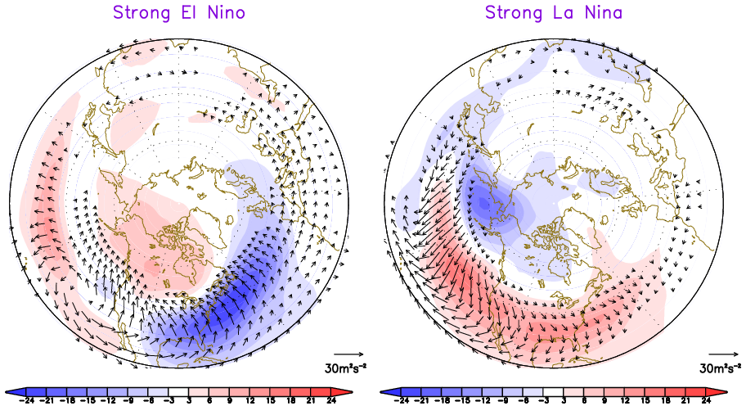
North Pacific
2
North America
Storm Track
E vector
+
-
E vector(arrow),
(shading)

Slide 21
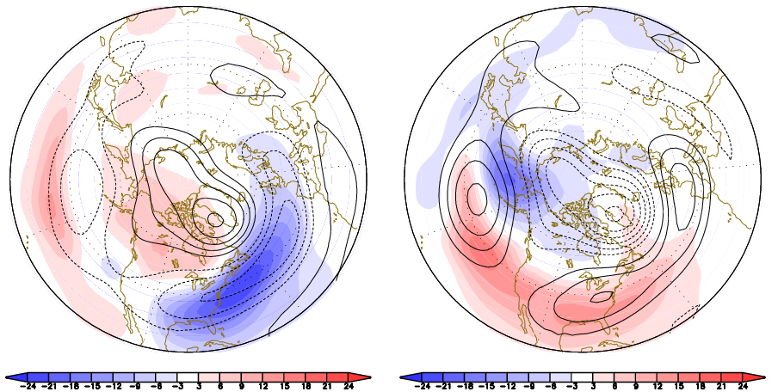
North America
3
Western Atlantic
+
is in phase with Z associated with NAO(-)
-
El Nino induced , NAO(-) Z₂₅₀
La Nina induced , NAO(+) Z₂₅₀
Z₂₅₀(contour), NAO composites
(shading), ENSO composites

Slide 22
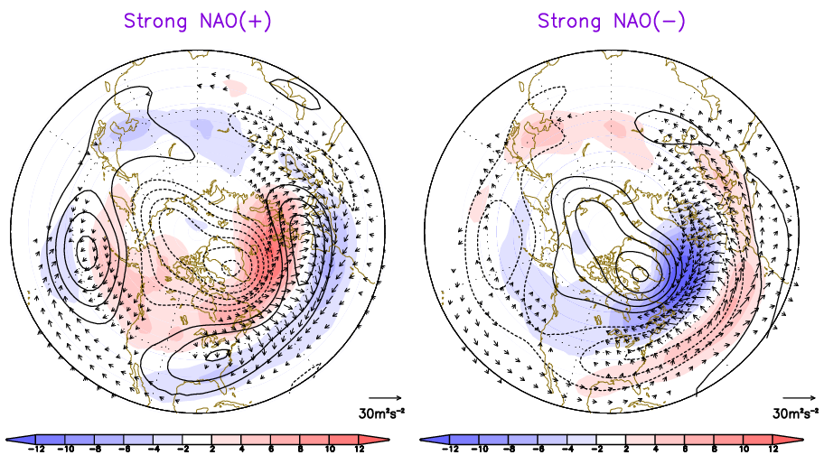
Western Atlantic
4
North Atlantic
is in phase with Z associated with NAO
Storm track
E vector
Z₂₅₀(contour), Storm Track(shading), E vector(arrow)

Slide 23
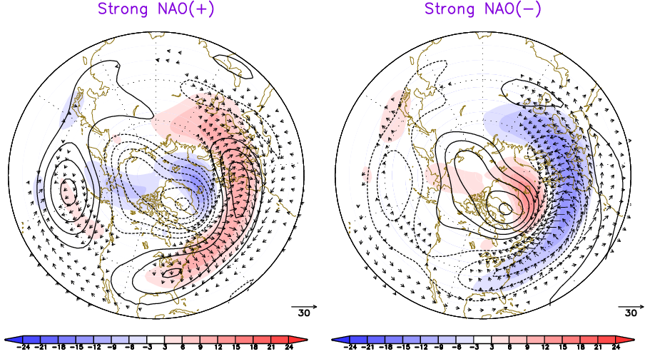
North Atlantic
5
Downstream of NAO(-)
Storm track
E vector
+
-
Z₂₅₀(contour), E vector(arrow),
(shading)

Slide 24
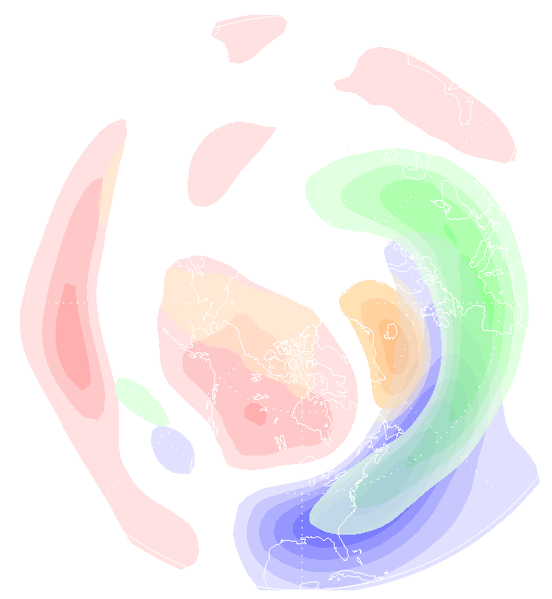
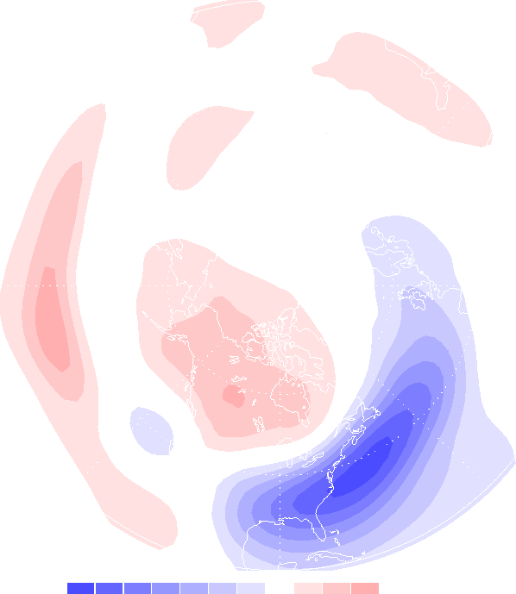
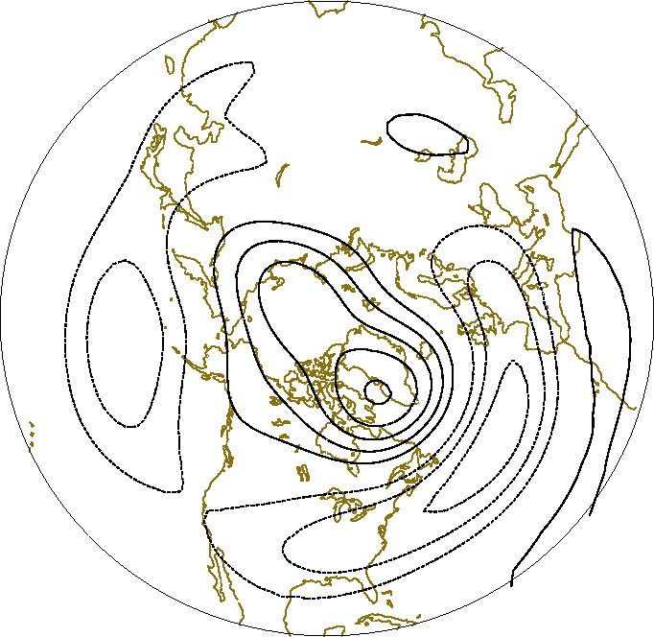
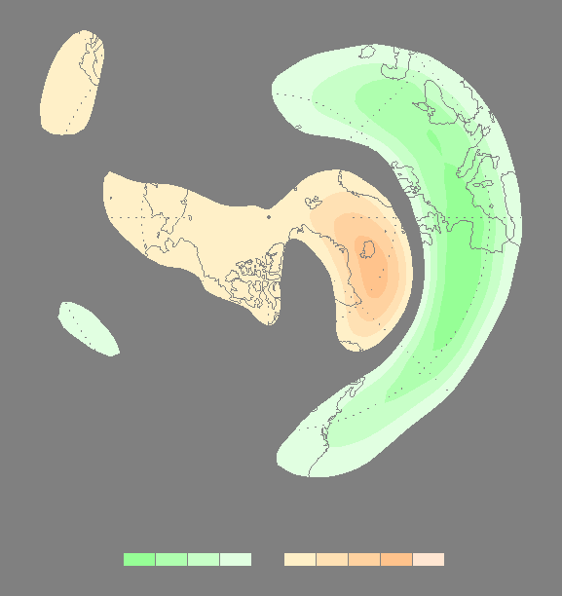
Summary for El Nino, NAO-
+
−
+
−
+
-
Z₂₅₀NAO(-)

Slide 25
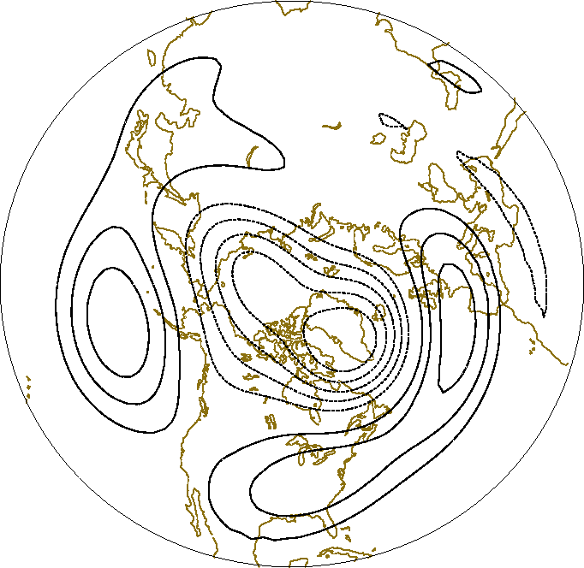
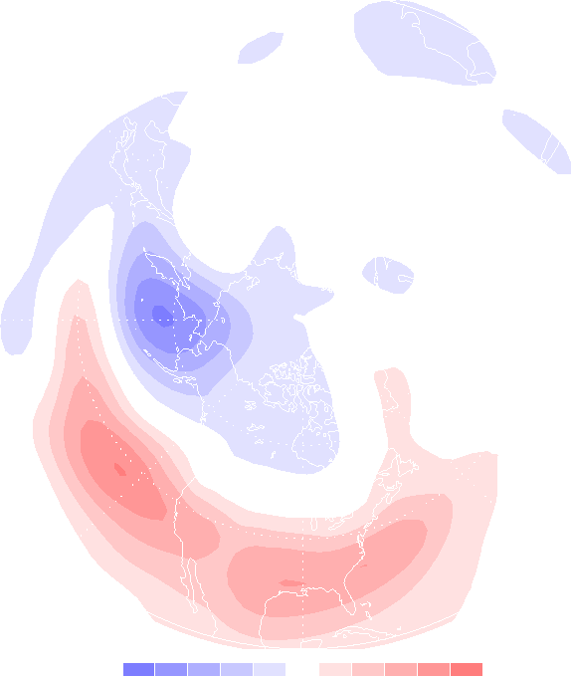
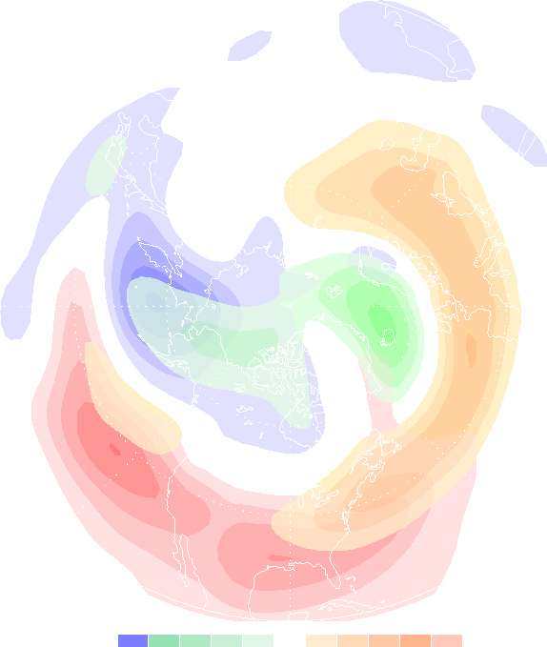
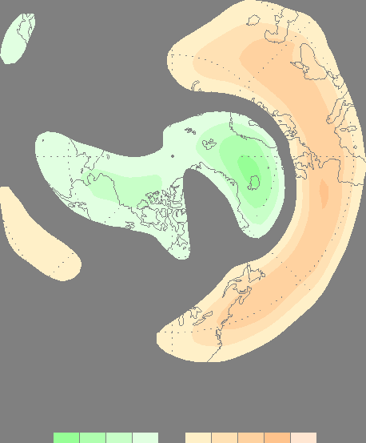
Summary for La Nina, NAO+
−
+
−
+
+
-
Z₂₅₀NAO(+)

Slide 26
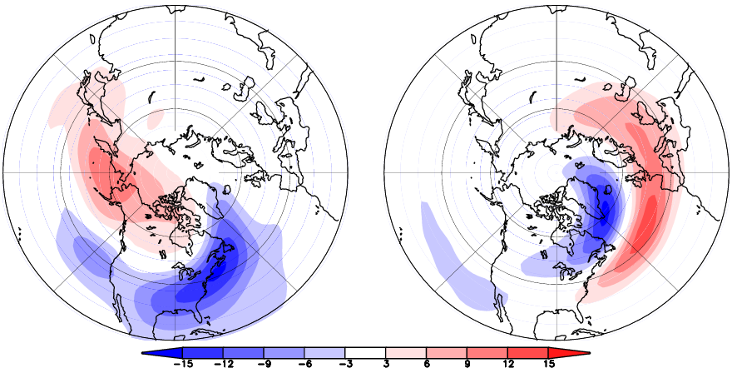
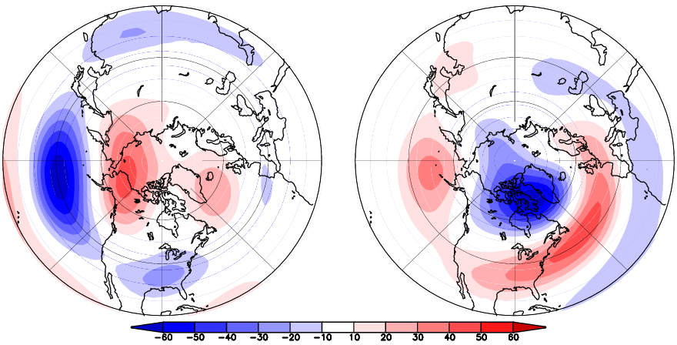
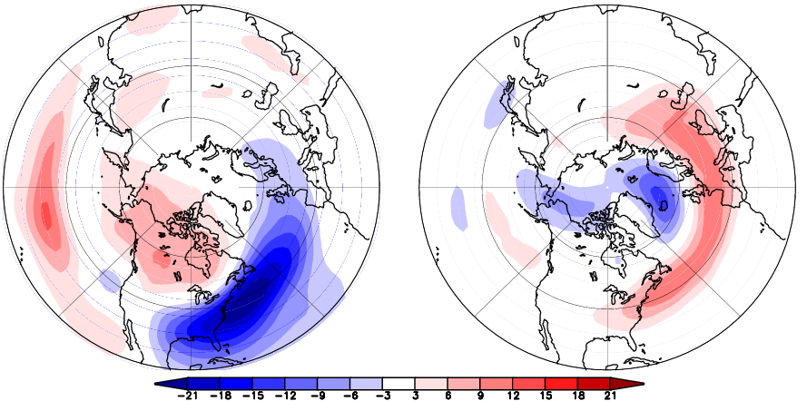
Regr Z₂₅₀ vs PC
EOF 1 of dz/dt 17.0%
EOF 2 of dz/dt 8.2%
El Nino composite dz/dt
NAO+composite dz/dt
EOF 1- related
PNA
EOF 2 -related
WA

Slide 27
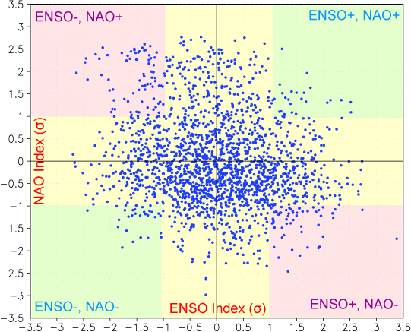
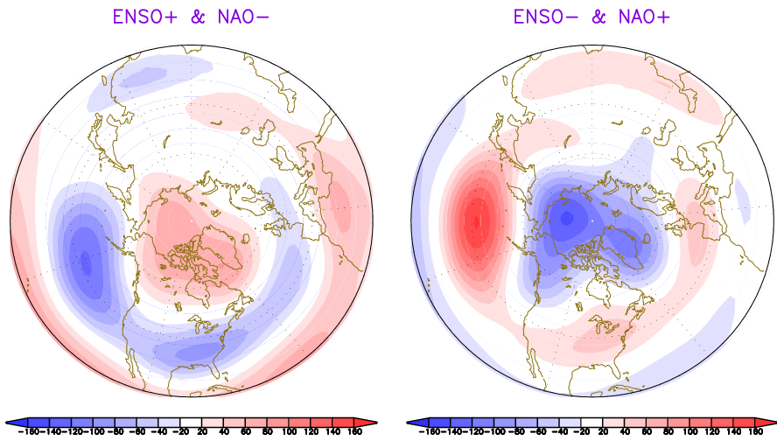
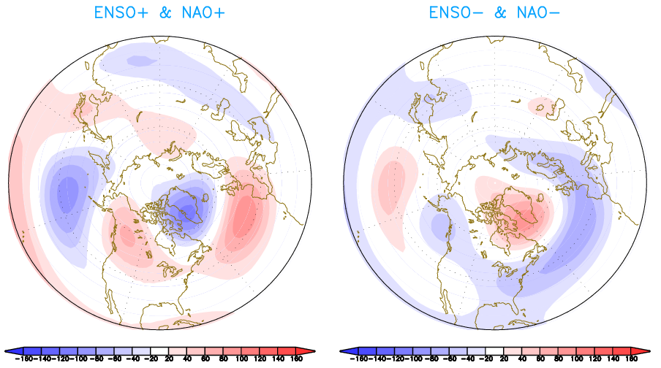
Z₂₅₀
Z₂₅₀

Slide 28
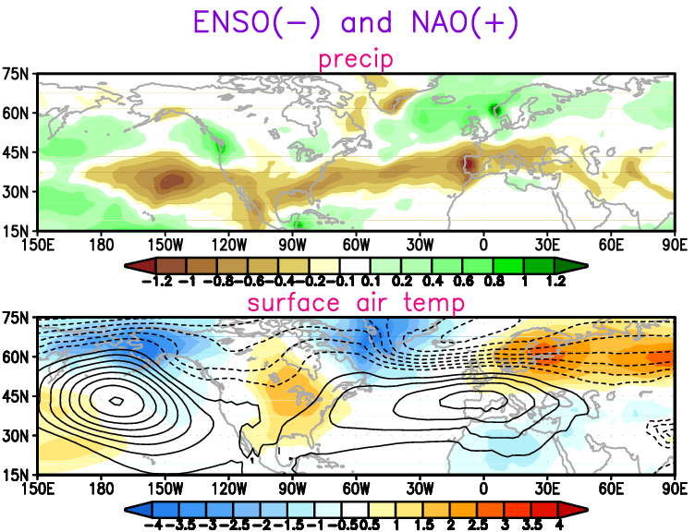
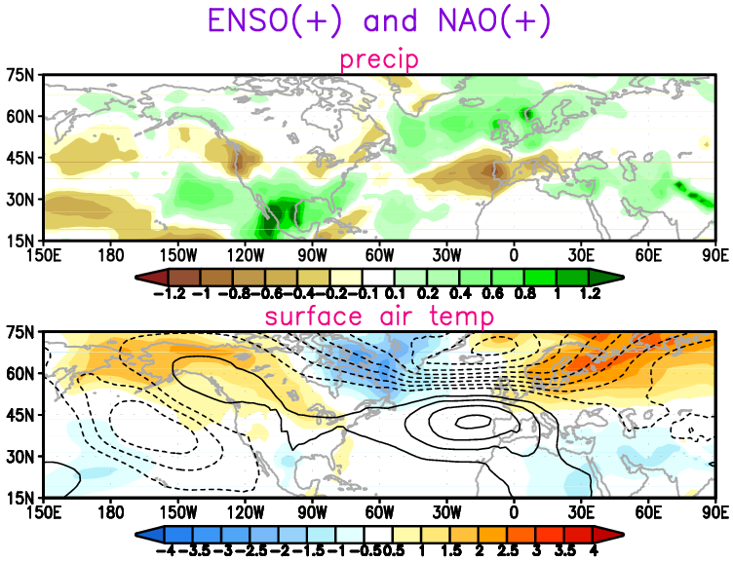
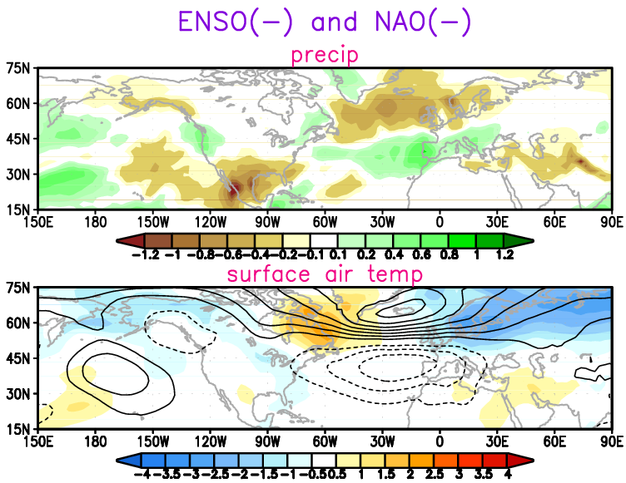
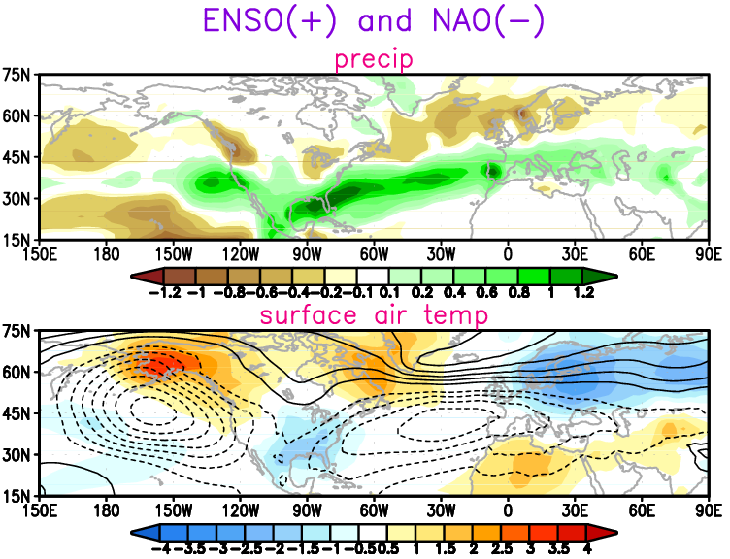

Slide 29
Summary-1
The ENSO-related stationary wave train is characterized by equatorward propagation over the North Atlantic .
Stationary wave propagation does not seem to explain ENSO influences on atmospheric variability over the North Atlantic.
However, the ENSO-related SST anomalies in tropical Pacific in CM2.1 is shifted westward relative to observations. This spatial displacement of the SST forcing may lead to underestimation of the ENSO impacts on the simulated North Atlantic variability.
GCM reproduces the Nonlinearity associated with the El Nino and La Nina.

Slide 30
Summary-2
2. The barotropic component of the transient eddies may play an important role in linking ENSO to North Atlantic variability.
The ENSO-induced transient eddy forcing over the North Atlantic resembles the NAO pattern.
The characteristic pattern of eddy-induced geopotential height tendency variability associated with ENSO and NAO are themselves the principle modes of tendency variability in the model.
Reinforcement of the NAO-like pattern by ENSO-related transient eddy forcing over the North Atlantic leads to patterns with high degree of zonal symmetry. This process may contribute to the formation of hemispheric-scale annular modes.
The strong and weak combination of ENSO and NAO will have different implication of the climate over the North America and North Atlantic.

Slide 31
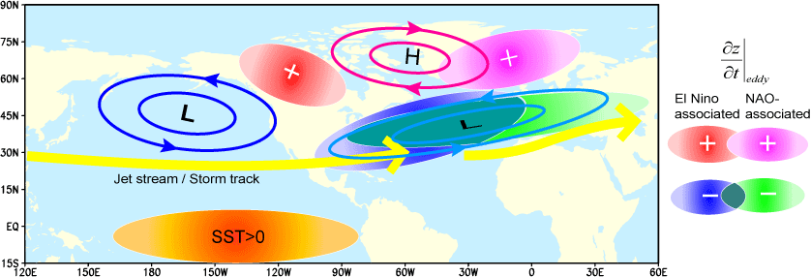
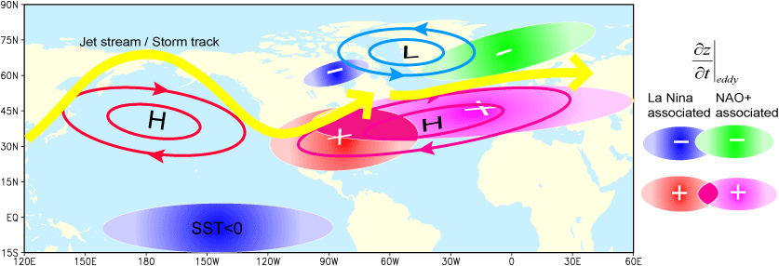
Schematic graph for transient eddy forcing
El Nino
La Nina

Slide 32
Part III: Future Work and Preliminary Results

Slide 33
Future Work
Further Diagnosis of the Transient Eddies
Aleutian Low (AL) and Icelandic Low (IL) Seesaw
Observational Evidence
New Experiments

Slide 34
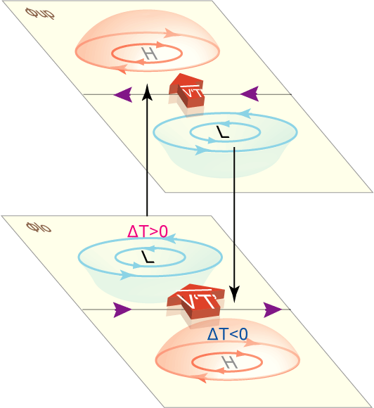
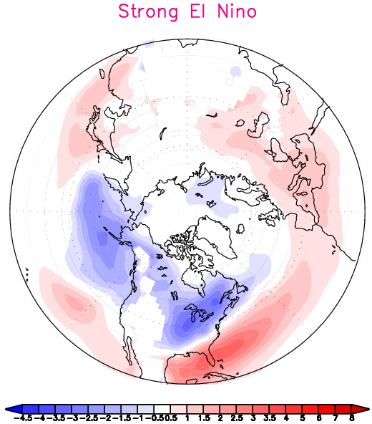
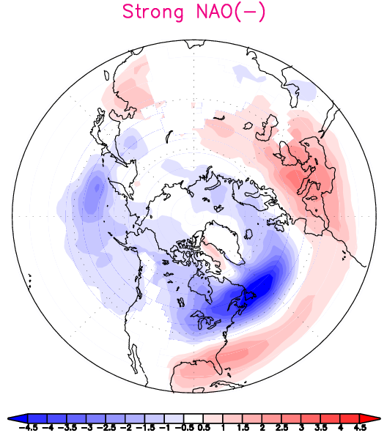
3-D Tendency due to barotropic and baroclinic components of eddy forcing
Physical explanation:
Lau and Holopainen (1984)
Lau and Nath (1991)

Slide 35
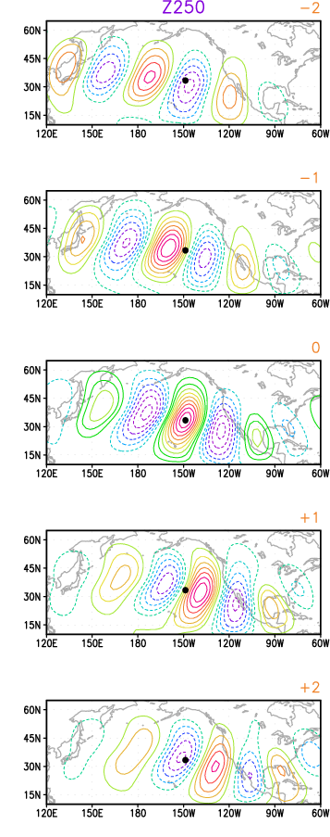
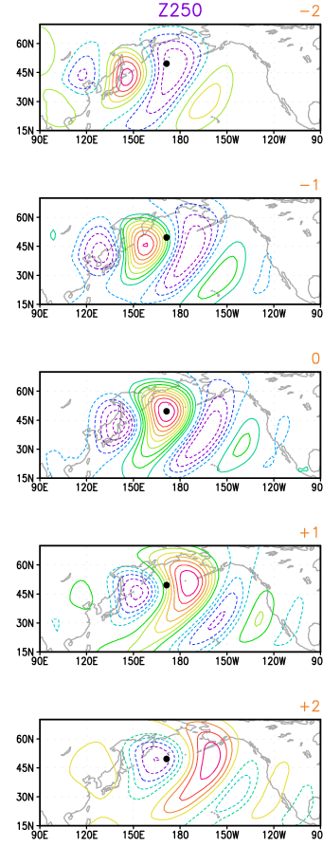
Structure of transient eddies
Strong El Nino
Strong La Nina
One point lag-correlation map
How does the tilt of the axes of eddies change as they propagate eastward, especially over the North Atlantic region?
Are they consistent with the implication from the E vector?

Slide 36
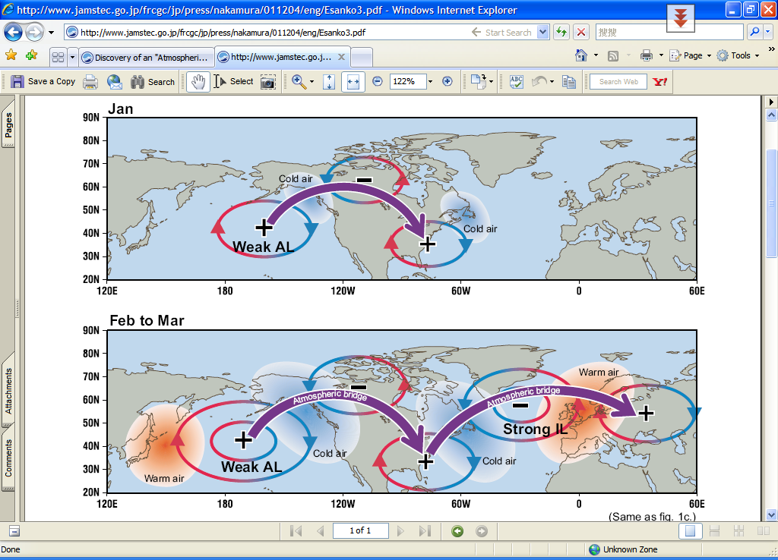
Seesaw between Aleutian Low and Icelandic Low (Honda and Nakamura 2001)
http://www.jamstec.go.jp/frcgc/jp/press/nakamura/011204/eng/Esanko3.pdf

Slide 37
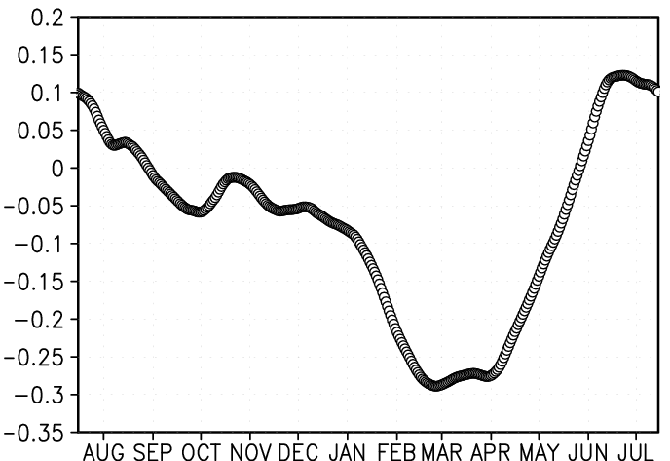
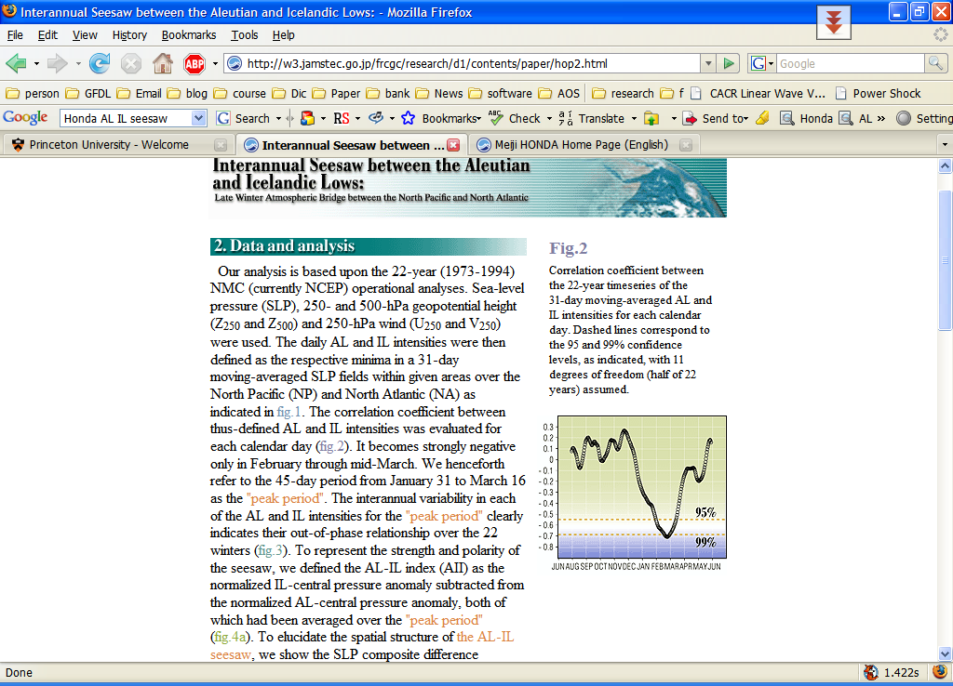
Correlation coefficient between the 2000-year time series of the 31-day moving-averaged AL and IL intensities for each calendar day
CM2.1
strongly negative correlation in February and March

Slide 38
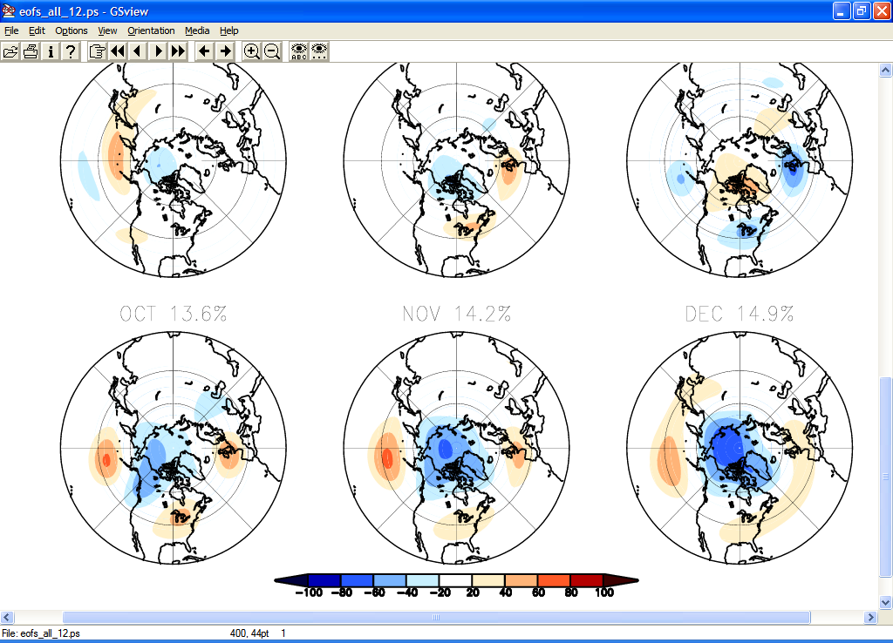
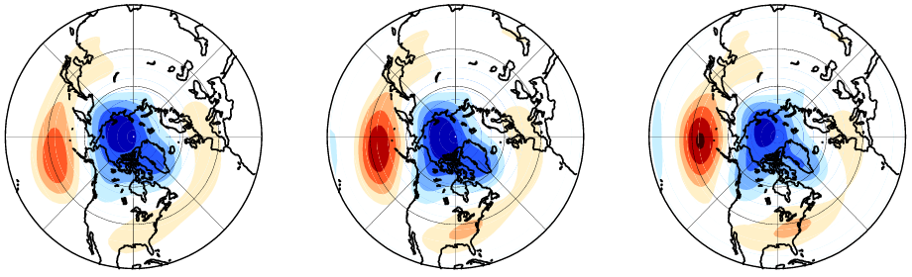
EOF of the Z₂₅₀ for Individual calendar Month
NOV
DEC
JAN
FEB
MAR

Slide 39
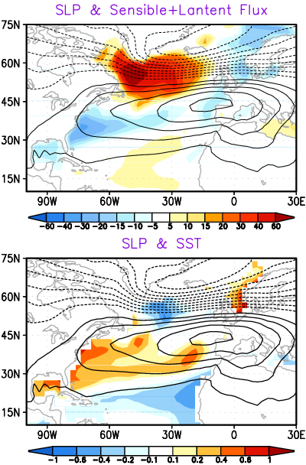

Two way air-sea interaction
NAO+ composite
JF
Atmos.
Ocean
Flux
upward: positive
?
Atmos.
FM
How long can this SSTAs persist? Alexander and Deser (1995)
What’s the atmospheric response to midlatitude SSTAs?
Lau and Nath (1996) ), Peng et al. (2002)
Notes:
In the extratropics, the heat fluxes appears to forces the SST, SSTAs reaches its maximum in late winter following the highest ocean-to-atmosphere fluxes, and can persist past lag 0 due to the large thermal inertia of the ocean.
The spatial pattern of surface fluxes is in good agreement with that of the SST anomalies one month later.
The pattern of modal surface heat flux anomalies bear a distinct resemblance to the pattern driven form the observations (Cayan 1992)
Because cooler than normal air masses in the extratropics are usually drier than normal, so the sum of Fl and Fs and shown.
How long can this SSTAs persist, will it reoccur? Namias and Born(1970,1974) and Alexander and Deser (1995) discussed a mechanism whereby SSTAs forced from surface hear flux anomalies may persist from one winter to the next. (more detail)
What’s the atmospheric responses to the midlatitude SSTAs. Results from Lau and Nath (1996) have shown that air-sea interactions can have a substantial impact on the variability of the atmosphere by prolonging the timescales of atmosphere.
Since an SST tripole can both be forced by the NAO and also force an NAO like anomaly (Rogers 1997; Rodwell et al, 1999; Sutton et al. 2000; Peng et al. 2002) air sea interactions apparently enhance the annular response.
The primary difference between strong heat flux and weak SSTAs near 60N.
Possible reason: oceanic convection and deep vertical mixing play a key role in the heat budget for this region.
The presence of such convection and deep vertical mixing means that the mixed layer is much deeper.
The effective thermal capacity in this region is therefore much larger.
Thus, damping the response of ocean to surface flux forcing.

Slide 40
Overall Summary
Observational evidence
Diagnosis of output from High-resolution run
ENSO forcing in the tropical Pacific
Stationary wave
Transient eddy
Circulation changes over North Atlantic
New experiments
SSTAs over North Atlantic
AL-IL seesaw
full ocean model
Coupled with
Mixed layer model

Slide 41
Acknowledgements
My advisor Gabriel Lau
The advisory committee:
Isaac Held
Geoffrey K. Vallis
Thomas L. Delworth
Andrew Wittenberg, Gabriel. A. Vecchi
Mary Jo Nath

Slide 42


