Slide 1



Cold Nuclear Matter Eﬀects on J/ψ as Constrained by d+Au Measurements at √s_{NN} = 200 GeV in the PHENIX Experiment
Matthew Wysocki
University of Colorado
For the PHENIX Collaboration

Slide 2
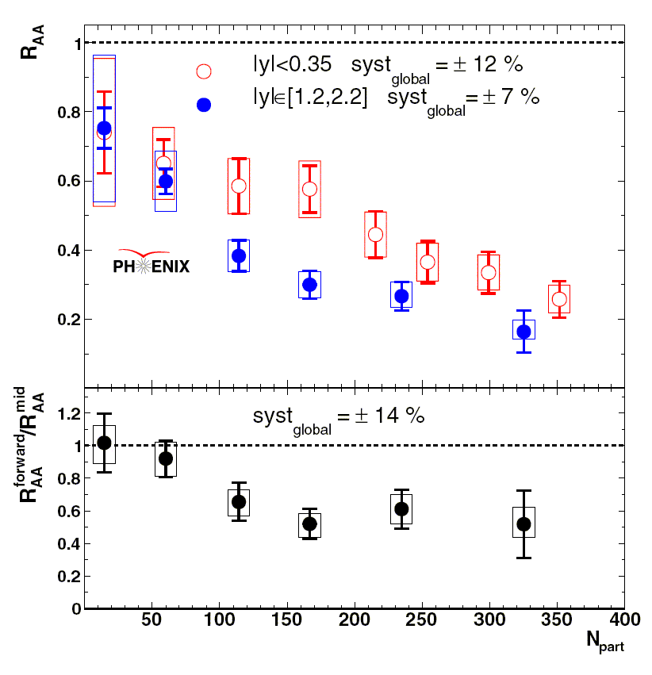
Introduction
Phys. Rev. Lett. 98 (2007) 232301
nucl-ex/0611020
There is much interest in J/ψ suppression in hot nuclear matter!
For the latest PHENIX charm- onia measurements, see:
Session XVIII: Susumu Oda and Catherine Silvestre
poster by Cesar Luiz da Silva
Unfortunately, this is not sufficient to understand hot nuclear matter effects. We must also understand the cold nuclear matter effects on the J/ψ. That is our baseline.
Run-4 Au+Au

Slide 3
Cold Nuclear Matter Effects on J/ψ Production
Cold nuclear matter is a complicated place!
Shadowing, gluon saturation, anti-shadowing, EMC effect…
Initial and final state partonic multiple scattering…
Cronin effect…
One way that we can study CNM is through high-energy p+A or d+A collisions.
At RHIC we use √s_{NN}=200 GeV d+Au, which was first collided in Run-3 and now again in Run-8.

Slide 4
What Can We Do Now?
New p+p data set in 2005 with an order of magnitude better statistics.
Two years of improvements in:
Reconstruction software
Signal extraction
Understanding of detector
Need d+Au analysis done using same method as the new p+p data, so we can do an apples-to-apples comparison.
Run-4 and Run-7 R_{AA} also use this p+p reference.
For details of the analysis, see arXiv:0711.3917 (accepted for publication in Phys. Rev. C).

Slide 5
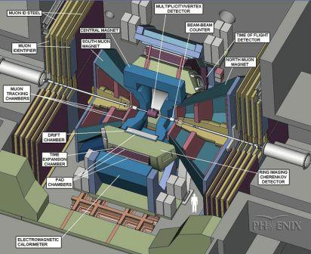
The PHENIX Experiment
Drift Chamber, Pad Chamber, EMCal & RICH detect J/ψ→ee at mid-rapidity.
Au ion
y<0
Beam-Beam Counter used to measure centrality and collision z-position.
MuTr and MuID detect J/ψ→μμ at forward & backward rapidities.
deuteron
y>0

Slide 6
Parton Momentum Cartography
Nuclear PDFs are modified in various x-ranges.
Shadowing, anti-shadowing, EMC effect, etc.
Here we probe 3 ranges of x, in both the shadowing and anti-shadowing regions, using PHENIX detectors at forward, x~0.002-0.01 backward, x~0.01-0.05 and mid-rapidity, x~0.05-0.2.
Fermi Effect
anti-shadowing
Saturation?
EMC effect
shadowing
x

Slide 7
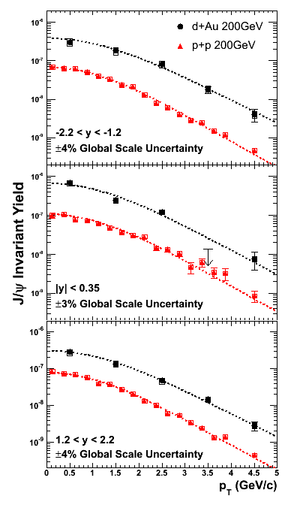
J/ψ p_{T} Spectra
arXiv:0711.3917
d+Au data are from Run-3, p+p are from Run-5.
Fits are to a power law over p_{T} ∈ [0,5] GeV/c, then integrated to get <p_{T}²>.
Can compare to other systems to study p_{T}-spectrum broadening from Cronin Effect/multiple scattering.
For discussion of this see the talk by Susumu Oda in XVIII.

Slide 8
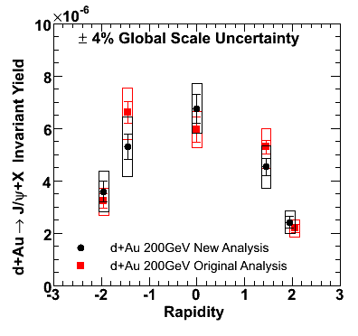
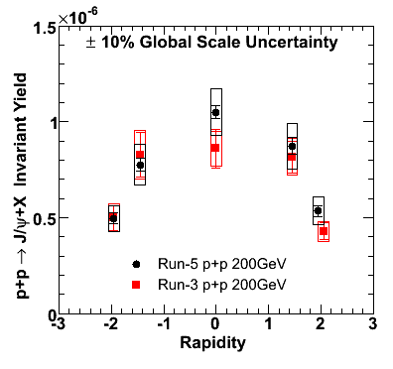
J/ψInvariant Yields
d+Au
p+p
arXiv:0711.3917
arXiv:0711.3917
d
Au

Slide 9
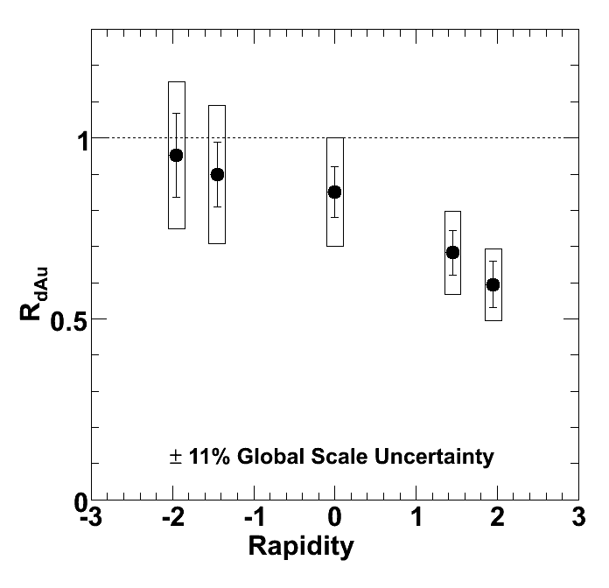

J/ψ Nuclear Modification Factor
arXiv:0711.3917
Calculate using new p+p data and new d+Au analysis.
Suppression at forward rapidity (deuteron-going direction). This is sensitive to low-x partons in the Au nucleus.

Slide 10
Comparison to Nuclear Models
One can use EKS¹ and NDSG² nuclear modified PDFs to calculate R_{dAu} as a function of rapidity.
Assume that all additional J/ψ suppression can be accounted for by a single parameter due to interactions with the Au ion. Express this in terms of a breakup cross section, σ_{breakup}.
Then we can fit our measured R_{dAu} to extract σ_{breakup}.
¹K. J. Eskola, V. J. Kolhinen, and R. Vogt, Nucl. Phys. A696, 729 (2001)
²D. de Florian and R. Sassot, Phys. Rev. D69, 074028 (2004)
R_{dAu} from nuclear-modified PDFs
σ_{breakup}

Slide 11
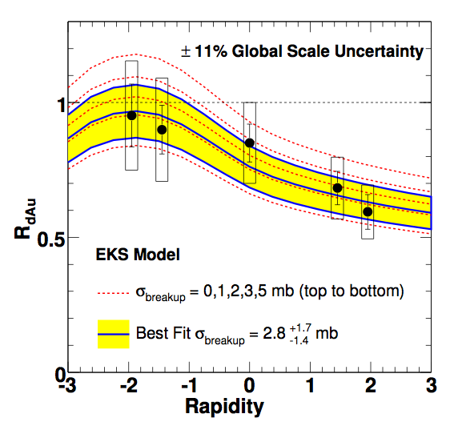
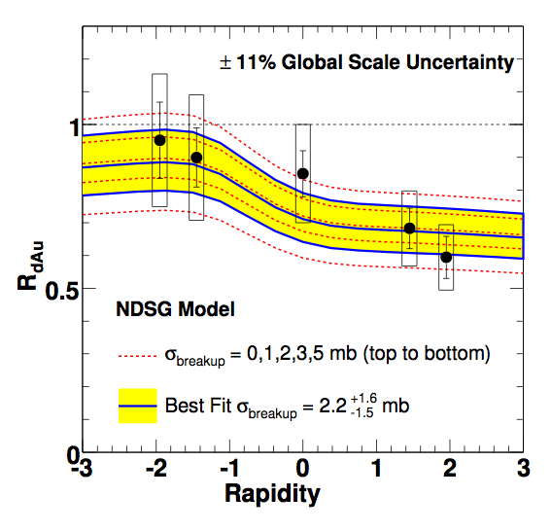
Comparison to Nuclear Models
arXiv:0711.3917
arXiv:0711.3917
Using EKS (NDSG) model we get σ_{breakup} = 2.8^{+1.7}_{-1.4} (2.2^{+1.6}_{-1.5}) mb.
Both are compatible (within very large error bars) with σ_{breakup} = 4.2±0.5 mb measured at the CERN SPS.
B. Alessandro et al., Euro. Phys. J. C48, 329 (2006), nucl-ex/0612012

Slide 12
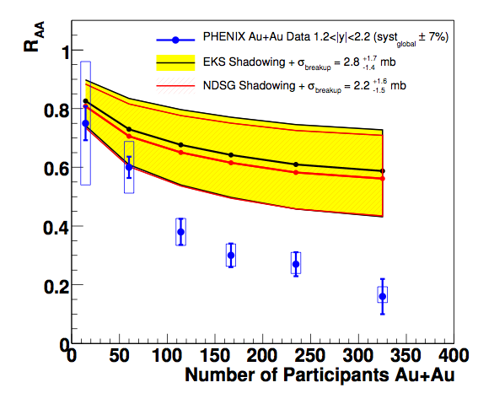
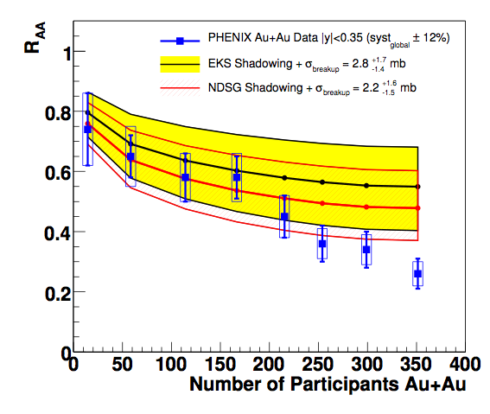
Extrapolation to Au+Au
We can use the calculated σ_{breakup} due to CNM effects to extrapolate to CNM effects in Au+Au collisions.
Assuming these nuclear modified PDFs are exactly correct, there is statistically significant J/ψ suppression beyond CNM effects at forward rapidity in Au+Au collisions.
It must be noted that the error bands are correlated between forward and mid-rapidity.
Mid-rapidity
Forward rapidity
PHENIX Au+Au |y|<0.35
EKS Shadowing + σ_{breakup}
NDSG Shadowing + σ_{breakup}
PHENIX Au+Au 1.2<|y|<2.2
EKS Shadowing + σ_{breakup}
NDSG Shadowing + σ_{breakup}
±12% Global Scale Uncertainty
±7% Global Scale Uncertainty
arXiv:0711.3917

Slide 13
Centrality in d+Au
At RHIC we are also able to make measurements vs. impact parameter.
In Run-3 we use 4 centrality bins, each corresponding to a range of impact parameters.
We can also express the bins in terms of the average number of nucleon-nucleon collisions in that bin (N_{coll}).
b

Slide 14
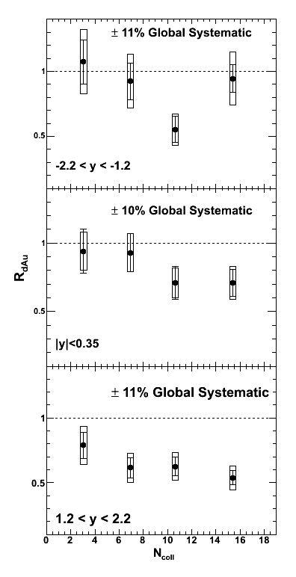
J/ψ R_{dAu} vs. N_{coll}
Again, significant suppression only at forward rapidity.
Possible hint of a trend w.r.t. N_{coll}, at forward and mid-rapidity, but we are hitting the limits of our Run-3 statistics. Looking forward to Run-8 result (QM2009?).

Slide 15
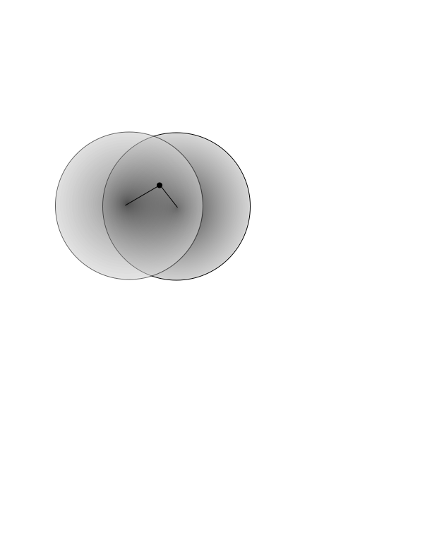
A More Data-Driven Projection
However, if we do not want to assume either of the previous models, then we may try a different approach.
In this case we assume that the modification factor depends only on the radial position in the nucleus. We can then use the measured R_{dAu} vs. impact parameter to constrain this ℜ. We also appropriately incorporate the statistical and systematic errors on the data¹.
ℜ is the modification on J/ψ due to one Au nucleus, so we take ℜ(+y)*ℜ(-y) for Au+Au collisions.
ℜ(r_{1,}r₂)
¹For details of statistical analysis method,
see poster by Jamie Nagle.
For more details see:
Proposal: R. Granier de Cassagnac, hep-ph/0701222.
Calculation: A. Adare et al., arXiv:0711.3917
r₁
r₂

Slide 16
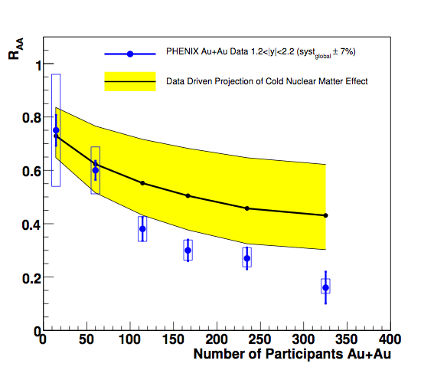
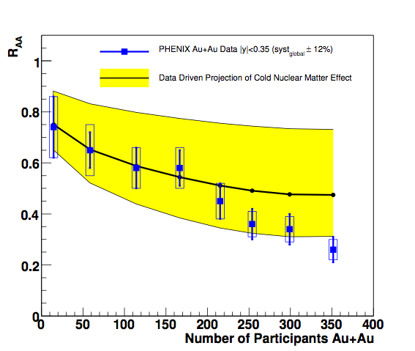
Data-driven Projection to Au+Au
Larger uncertainty bands than those from nuclear-modified PDFs and σ_{breakup}. In this case we cannot rule out Au+Au suppression entirely from cold nuclear matter effects, within the statistical and systematic uncertainties.
It should be noted that contrary to the previous Au+Au projection, these uncertainty bands are not directly correlated between rapidities.
Mid-rapidity
Forward rapidity
PHENIX Au+Au |y|<0.35
Data-driven Projection of CNM Effects at mid-rapidity
PHENIX Au+Au 1.2<|y|<2.2
Data-driven Projection of CNM Effects at forward rapidity
±12% Global Scale Uncertainty
±7% Global Scale Uncertainty
arXiv:0711.3917

Slide 17
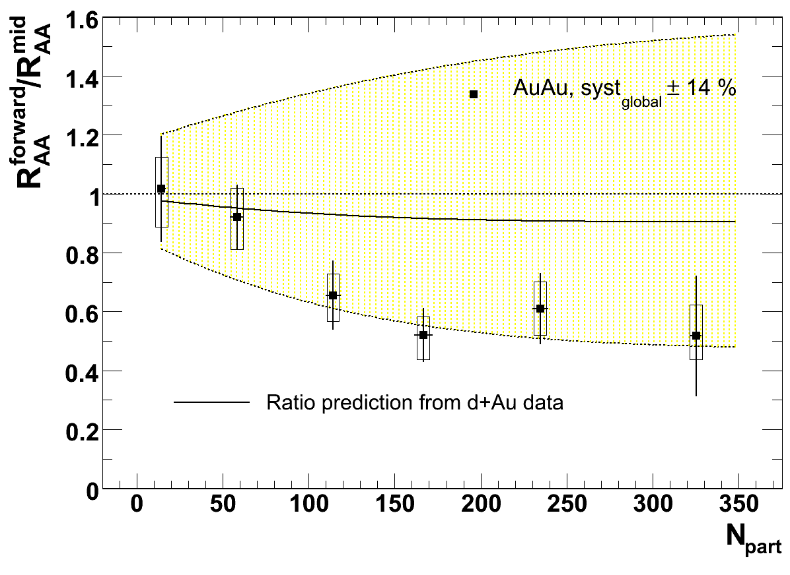
Data-driven Projection to Au+Au
Larger uncertainty bands than those from nuclear-modified PDFs and σ_{breakup}. In this case we cannot rule out Au+Au suppression entirely from cold nuclear matter effects, within the statistical and systematic uncertainties.
It should be noted that contrary to the previous Au+Au projection, these uncertainty bands are not directly correlated between rapidities.
Mid-rapidity
Forward rapidity
PHENIX Au+Au |y|<0.35
Data-driven Projection of CNM Effects at mid-rapidity
PHENIX Au+Au 1.2<|y|<2.2
Data-driven Projection of CNM Effects at forward rapidity
±12% Global Scale Uncertainty
±7% Global Scale Uncertainty
arXiv:0711.3917

Slide 18
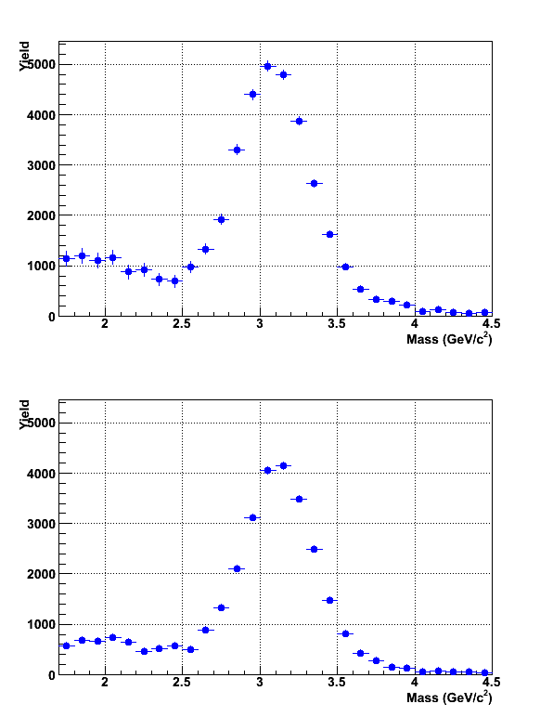
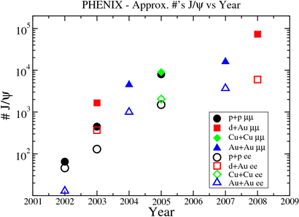
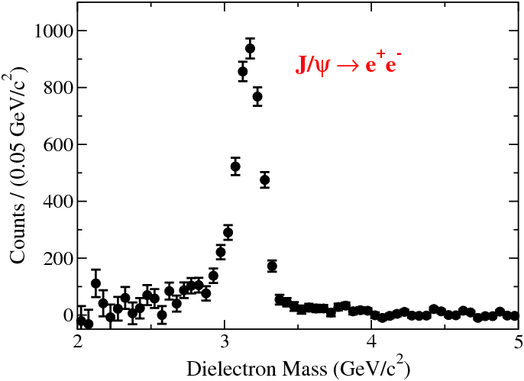
Run-8 d+Au J/ψ
South Arm Dimuon Mass
Central Arm Dielectron Mass
Already many J/ψ recorded in Run-8 d+Au.
Over 50x as many J/ψ as Run-3!
Should allow for a much-improved R_{dAu} measurement in the near future, with smaller statistical errors as well as better constrained systematic uncertainties.

Slide 19
Summary
R_{dAu} measured using new p+p data and a new analysis of d+Au data at forward, backward, and mid-rapidity, and in 4 centrality bins.
Statistically-significant suppression observed at forward rapidity.
Comparison to EKS and NDSG nuclear shadowing calculations used to estimate σ_{breakup}. Extrapolation of these models to Au+Au do not reproduce the full J/ψ suppression at forward rapidity.
A less model-dependent extrapolation from the measured R_{dAu} is unable to constrain the CNM contribution to the measured suppression in Au+Au.
Looking forward to much better constraints on CNM effects in Run-8 results!

Slide 20
Backup

Slide 21
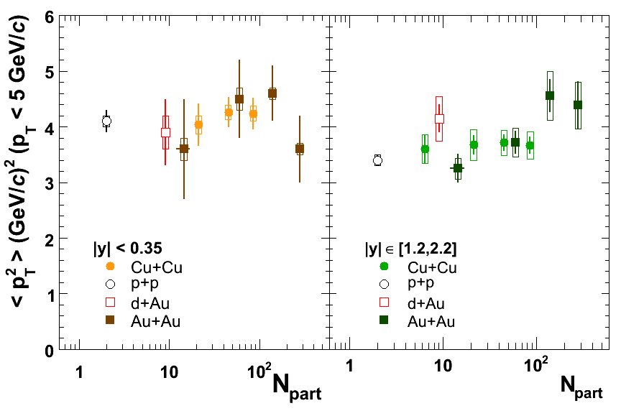
<p_{T}²> from All Runs
arXiv:0801.0220

Slide 22
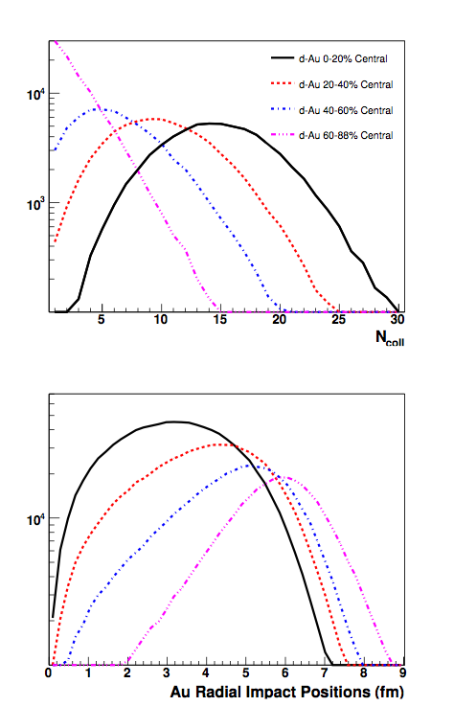
Centrality in d+Au
At RHIC we are also able to make measurements vs. impact parameter.
In Run-3 we use 4 centrality bins, each corresponding to a range of impact parameters.
We can also express the bins in terms of the average number of nucleon-nucleon collisions in that bin (N_{coll}).

