Slide 1
Strange Quark Matter 2008 Experiment Summary
W.A. Zajc
Columbia University
( this talk available at http://www.phenix.bnl.gov/phenix/WWW/publish/zajc/sp/presentations/SQM08/ )

Slide 2
Preface
It’s an experiment summary talk only in the sense that …
It was an experiment to ask me to provide such a talk…
Roughly- an attempt to summarize “experimental” situation for “strange quark matter” ~ “flavor physics in nuclear matter”
Work in 1/N expansion:
N = Number of plots presented at the conference
1/N = probability your favorite topic will be addressed

Slide 3

Outline- will take “top-down” approach
Top
Bottom
Charm
Strange
Up
Down

Slide 4
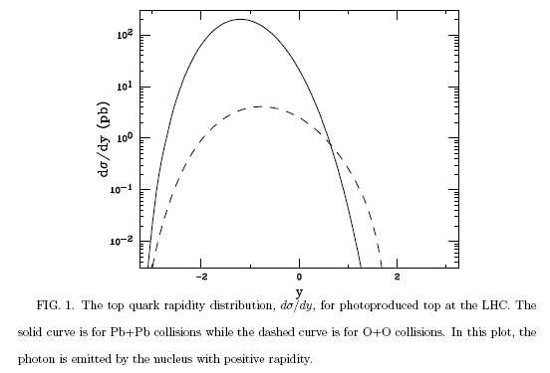
Top
Irrelevant to date
LHC- potential to change that:
Photoproduction of top in peripheral heavy ion collisions
Spencer R. Klein, Joakim Nystrand, Ramona Vogt
In relativistic heavy ion collisions, top quarks can be produced by photon-gluon fusion when a photon from the Weizs\"acker-Williams virtual photon field of one nucleus interacts with a gluon in the other nucleus. Photoproduction with heavy ions at the Large Hadron Collider (LHC) will be the first accessible non-hadronic top production channel. We calculate the $t \bar t$ photoproduction cross sections, pair mass and top quark rapidity distributions in peripheral heavy ion collisions. The cross sections are sensitive to the top quark charge and the large-$Q^2$ gluon distribution in the nucleus. We find a cross section of 94 pb in calcium-calcium collisions, leading to 190 pairs in a one month ($10^6$ sec) LHC run. We also find $p$Pb and $p$Ca cross sections of 5.8 and 3.4 pb respectively, resulting in 6 and 34 $t\bar t$ pairs per month.

Slide 5
Outline- will take “top-down” approach
Top
Bottom
Charm
Strange
Up
Down

Slide 6
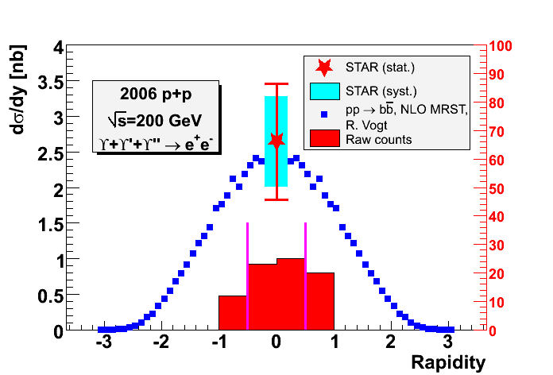
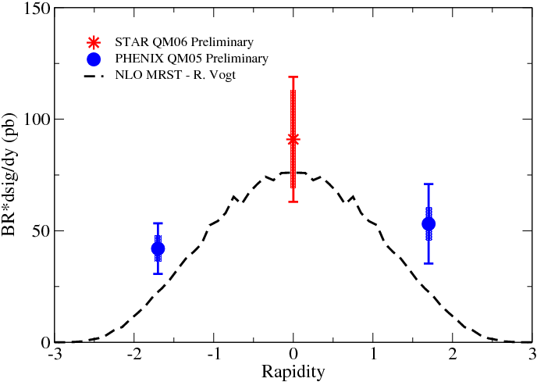
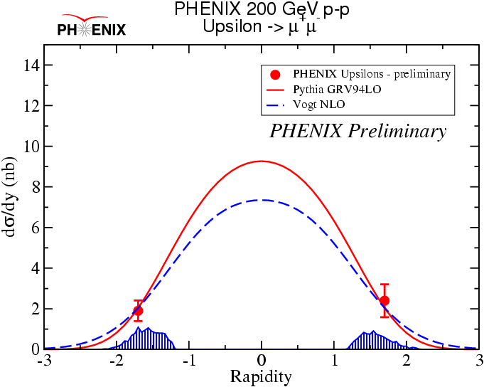
Bottom (onium)
Already relevant at RHIC:
pQCD calibration:
Xu
Gunji

Slide 7
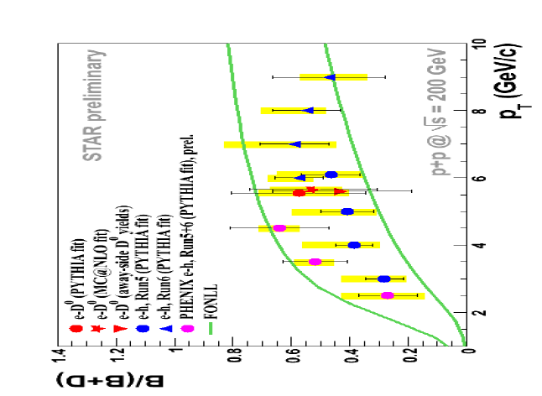
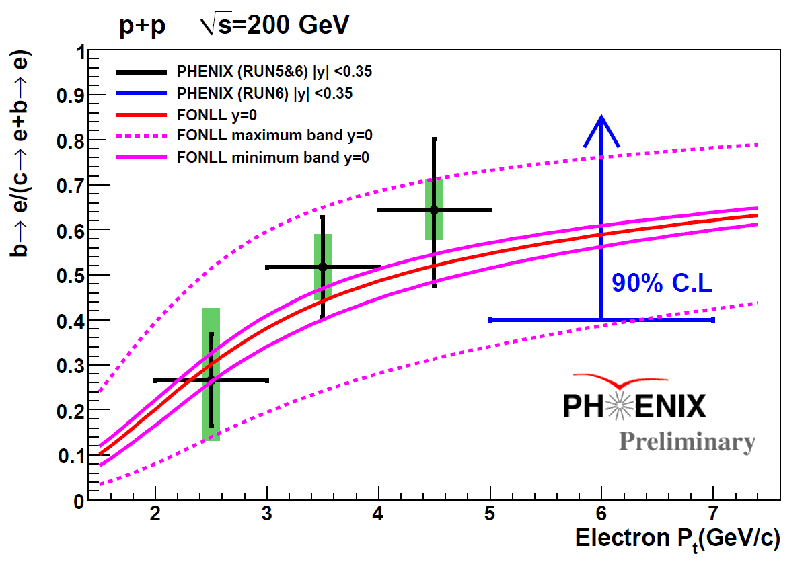
Bottom
Already important at RHIC:
Necessary to understand heavy flavor energy loss mechanism :
Sakai
Morino

Slide 8
Outline- will take “top-down” approach
Top
Bottom
Charm
Strange
Up
Down

Slide 9
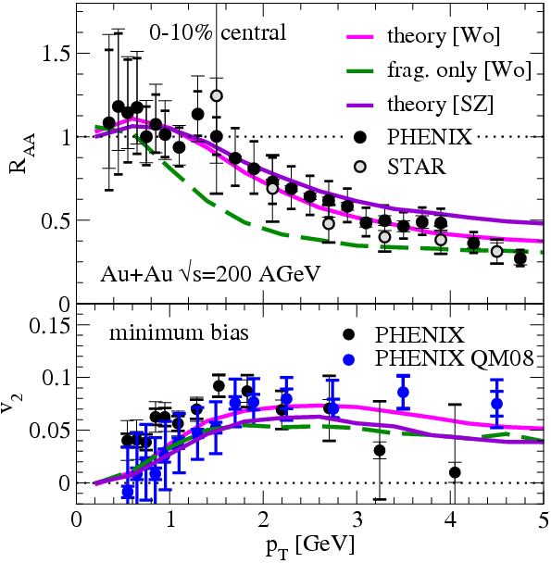
Charm
Rapp
Rosati
Xu
Conserved !
Loses energy:
PHENIX and STAR R_{AA} ~ consistent
R_{AA} ~ unchanged in region where b’s should dominate
Flows
Again, little evidence for decoupling of b’s

Slide 10
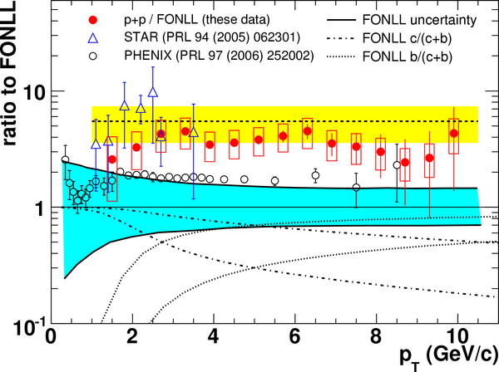
The Factor of ~2:
Being addressed:
STAR
10-fold reduction in material budget
Work on understanding
momentum resolution
e/π from data
PHENIX
Cross checks via e+e- spectrum
Together
Joint effort to study/resolve discrepancy
Jin
Xu

Slide 11
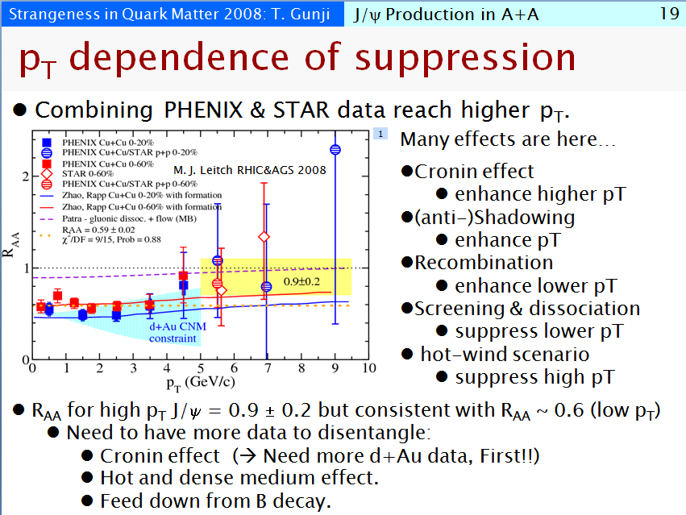
Charmonium
A still (increasingly?) complicated story:
Nicely illustrated on this slide by Taku Gunji:
Be very wary of this plot !

Slide 12
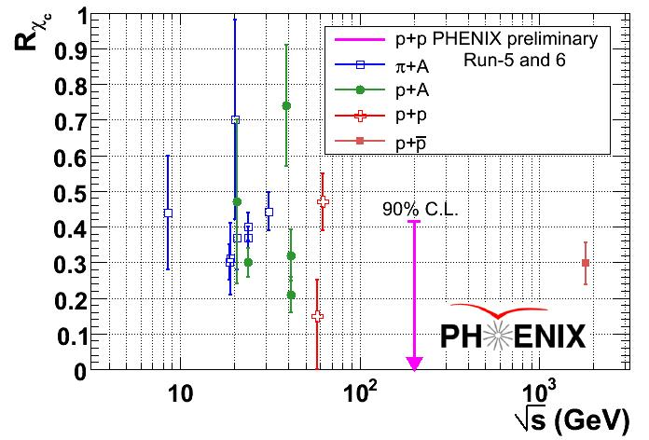
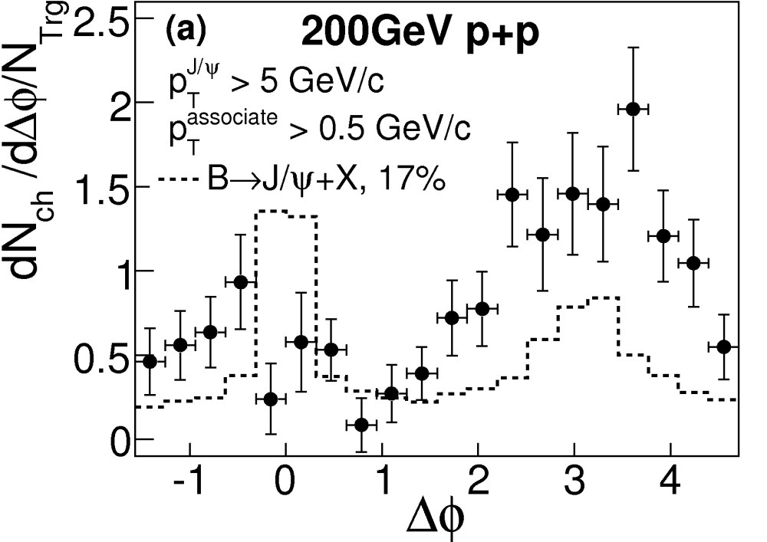
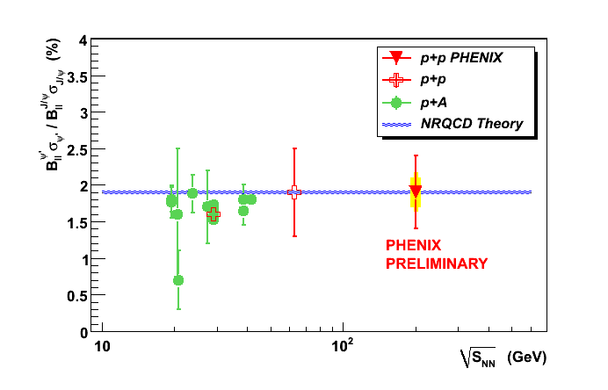
‘Heavy’ Lifting Is Underway
In situ measurements of ‘backgrounds’ :
χ_{c} → J/ψ : 20-40%
ψ’ → J/ψ : ~8%
B→J/ψ : ~4% (@RHIC)
Detailed analysis of cold nuclear matter effects (Granier de Cassagnac)
Gunji
Levy
Xu
STAR Preliminary

Slide 13
Outline- will take “top-down” approach
Top
Bottom
Charm
Strange
Up
Down

Slide 14
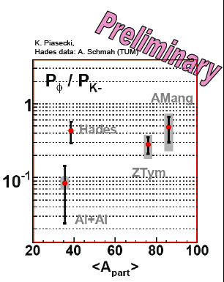
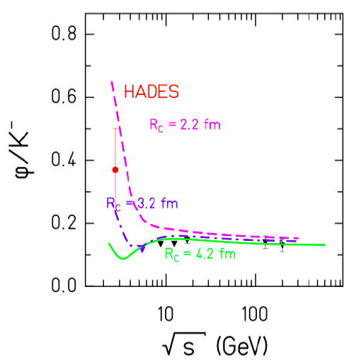
Truly ‘Strange’
Large φ/K⁻ ratio in subthreshold region :
Herrmann
Fabbietti

Slide 15
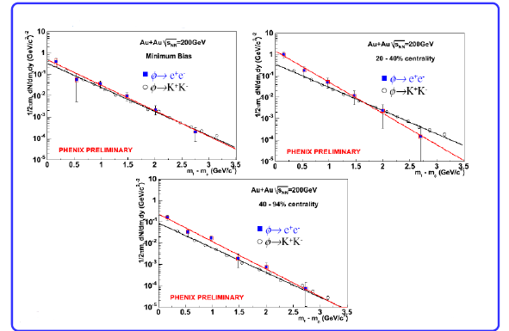
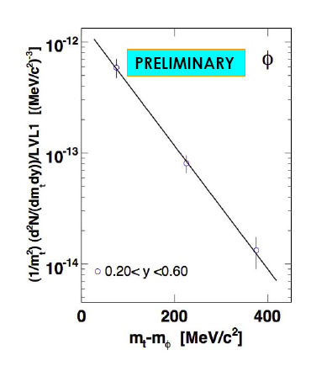
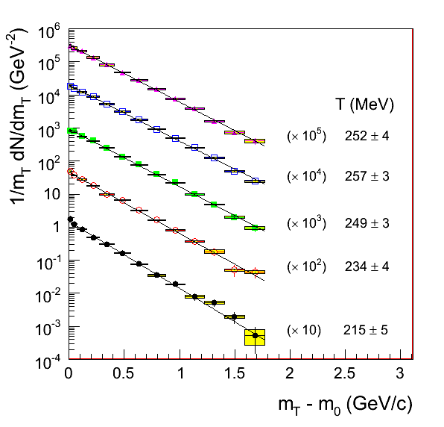
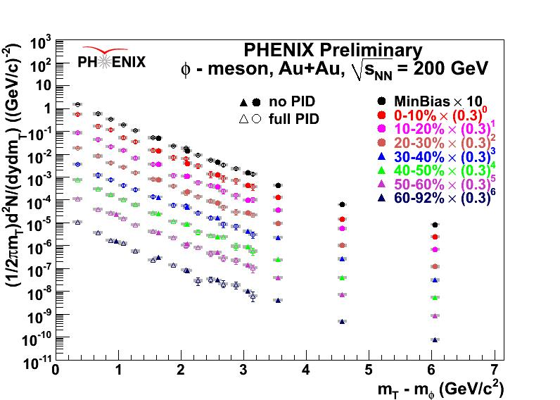

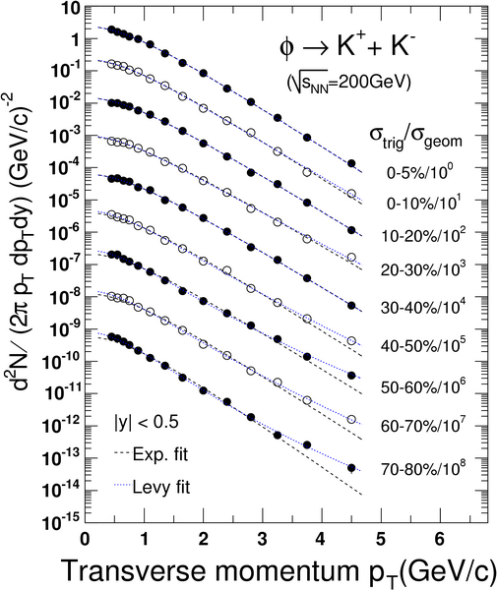


Huge Abundance of φ (Plots)
Measured from √s_{NN} = 2.6(!) to 200 GeV
A favorite of experimentalists and theorists alike at SQM08
SQM08 → HSQM08
Key in testing:
Canonical suppression
Constituent scaling
de Falco
Fabbietti
Rosati
Mohanty
Sharma

Slide 16
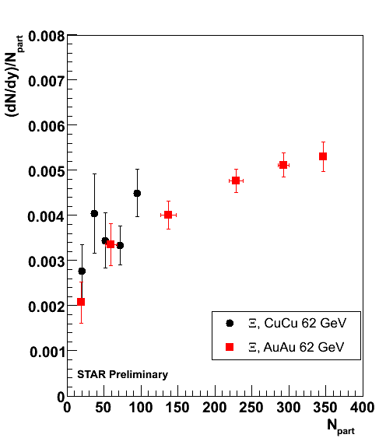
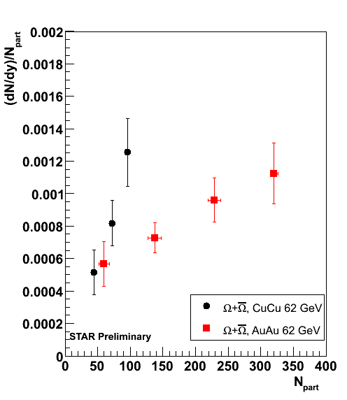
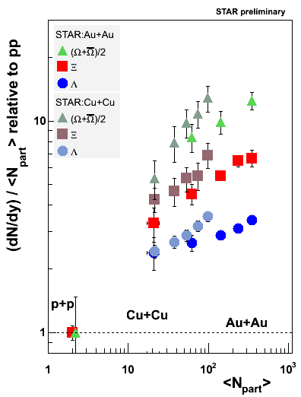
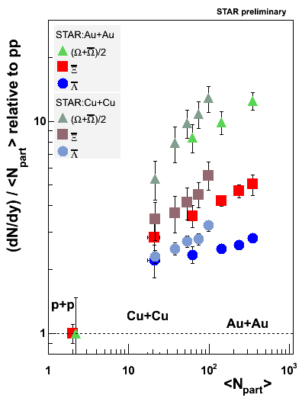
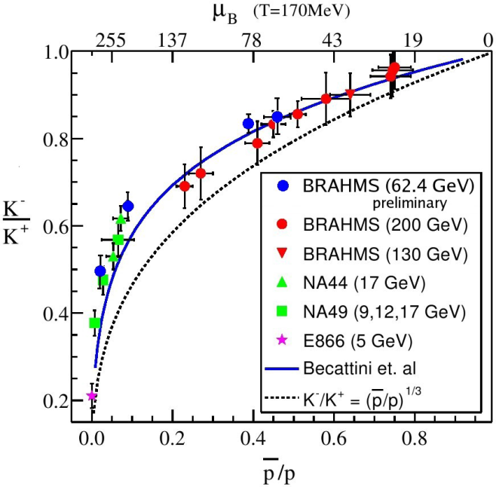
The Main Event
Systematics of (multiple) strangeness production
Famous plots since early days of SPS program
Additional comments later
Arsene
Timmins
Munhoz

Slide 17
Outline- will take “top-down” approach
Top
Bottom
Charm
Strange
Up
Down
The “Bulk”

Slide 18
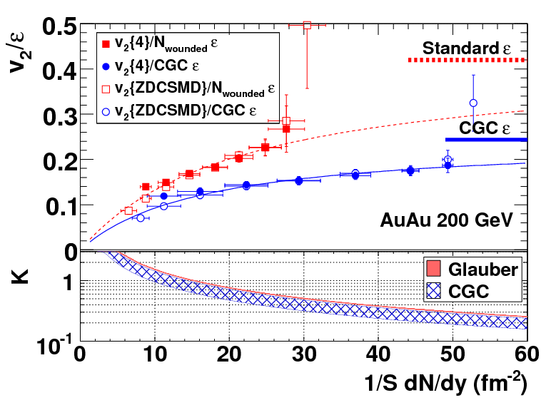
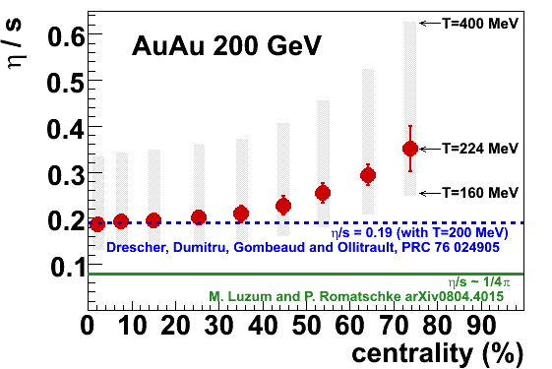
Detailed Studies of Bulk Flow
Experimental extraction of Knudsen number K = λ_{mfp}/L on way to η/s estimate:
Bai
Barranikova
STAR Preliminary

Slide 19
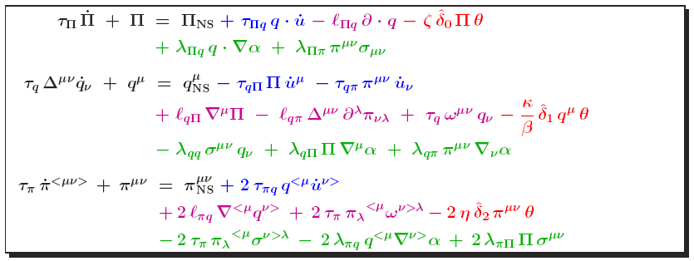
The Difficulties with Hydro
Seemingly insurmountable:
Unknown Initial Conditions
Eccentricity fluctuations
Unknown equation of state
Instabilities, acausal effects in relativistic viscous hydro
Hadronic rescattering effects
Bulk viscosity
Numerical viscosity
Finite size, core/corona effects
Rischke
Werner
Hirano
Csernai
Song

Slide 20
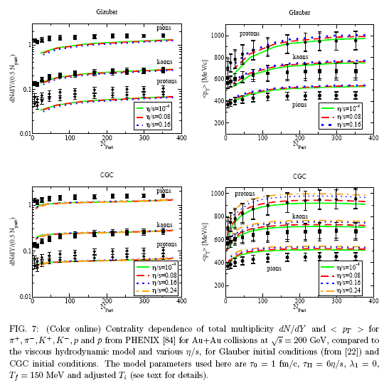
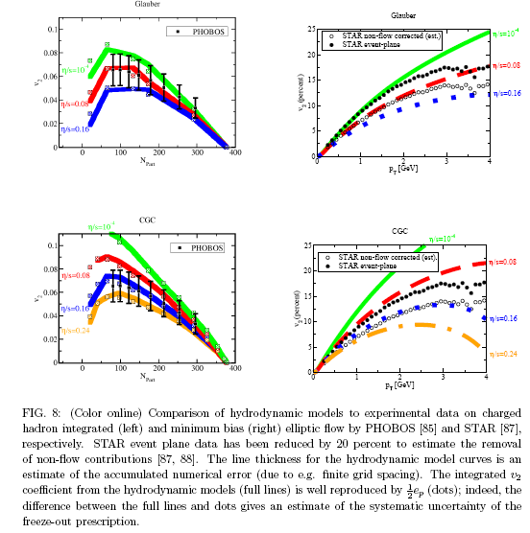
Concordance
BNL, April 2008:
Workshop on Viscous Hydrodynamics and Transport Models in Heavy Ion Collisions
Workshop Summary
Song
Luzum and Romatschke, arXiv:0804.4015

Slide 21
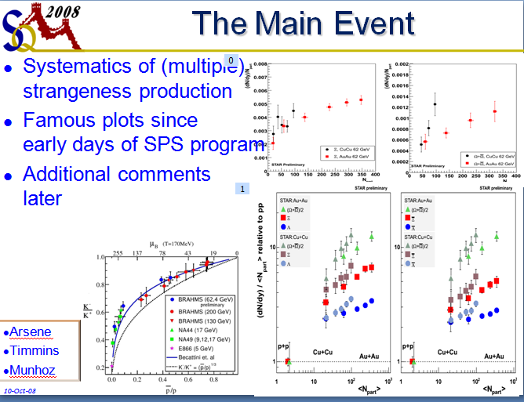
Editorial Comment
It was not clear to this (distant) observer if the same drive to “concordance” is being applied in this famous sector.
Need to (re?)-establish “L’Accorde de Trento”
Berndt Müller:
“Theory needs to develop robust observables that can be measured with precision.”
(and falsified)

Slide 22
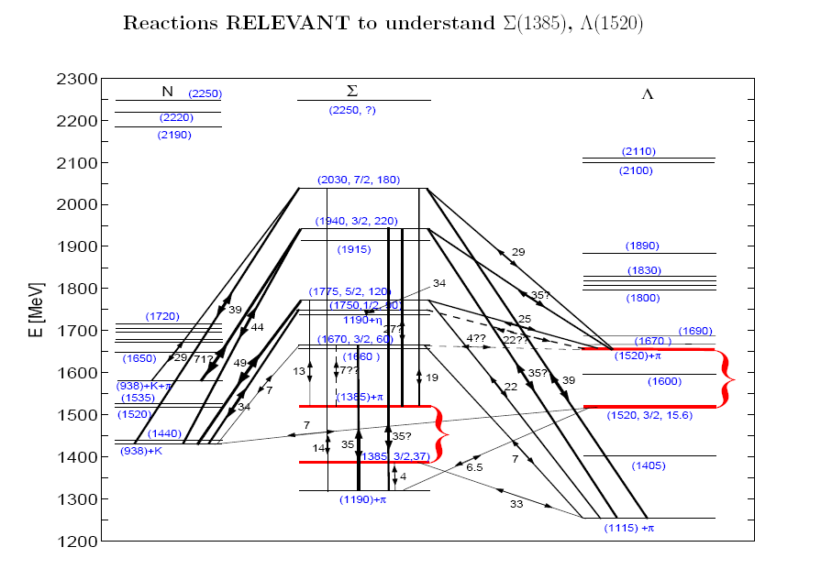
An Optimistic Note
The sitzfleisch is there:
http://www.physics.arizona.edu/˜torrieri/SHARE/share.html
Rafelski
Torrieri

Slide 23
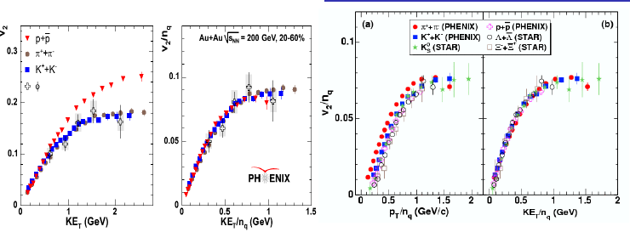
Largely Missing
Fluctuations
Relation between
Observed constituent scaling:
Implications(?) for quasiparticles
Conflict(?) with “perfect fluid” behavior
What are the relevant degrees of freedom?
Torrieri
Sharma

Slide 24
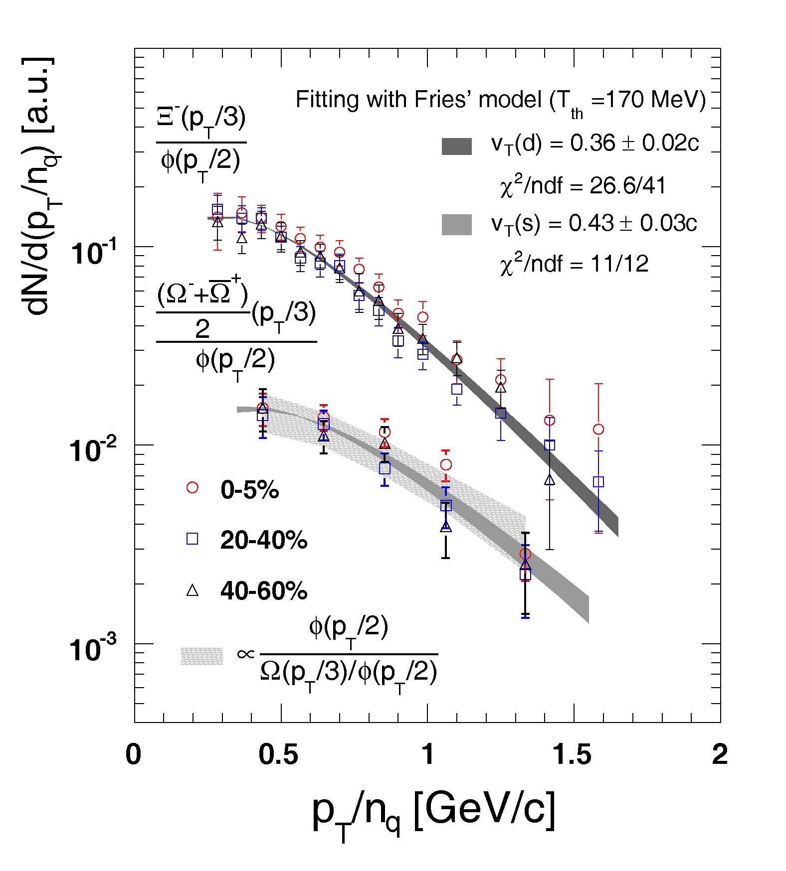
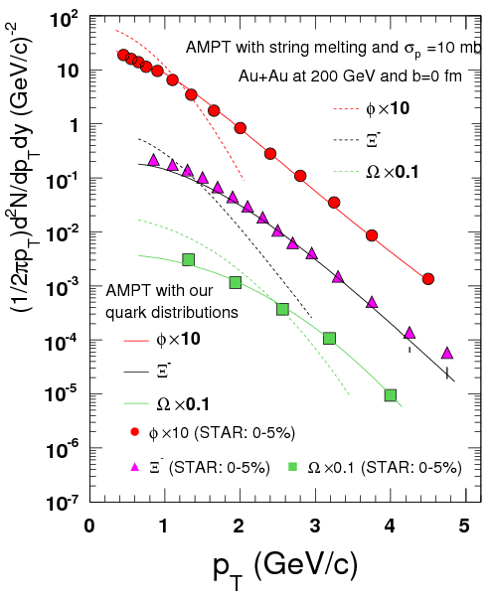
Recombination Revisited
Apply constituent scaling to “0-th moment” of flow
Interplay (p_{T}, KE_{T}), (v_{T}, T) helps understand d.o.f.?
Chen
Huang

Slide 25
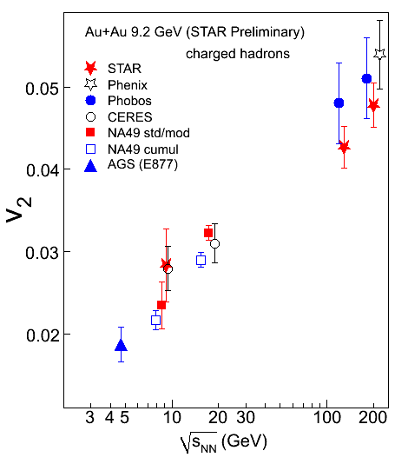
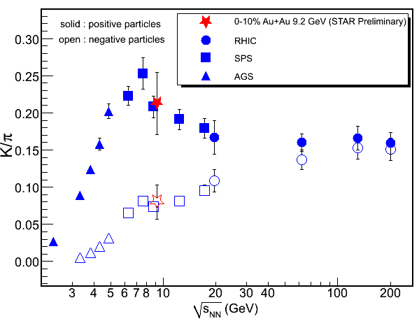
Onward to the Critical Point
RHIC Run-8:
Low energy segment at √s_{NN}=9.2 GeV
STAR- first results from ~3000(!) events:
Kumar

Slide 26
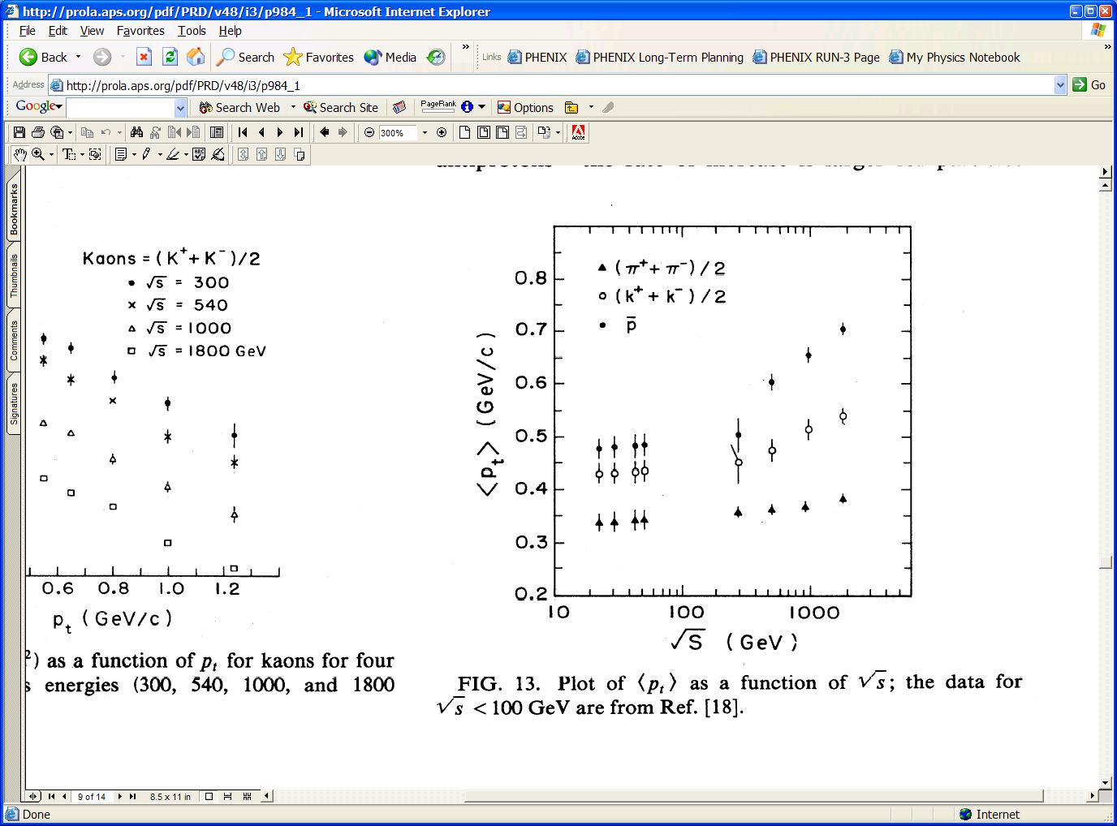
Paucity of World’s p+p Data

Slide 27
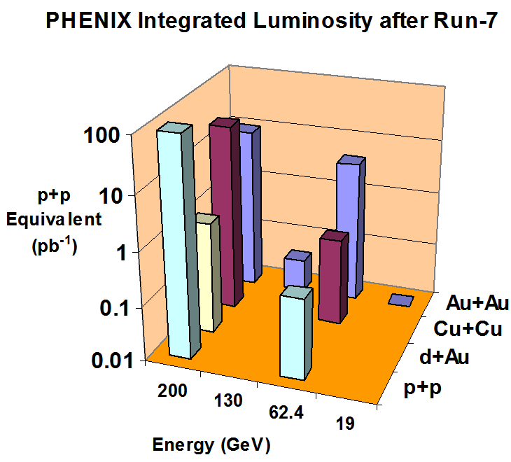
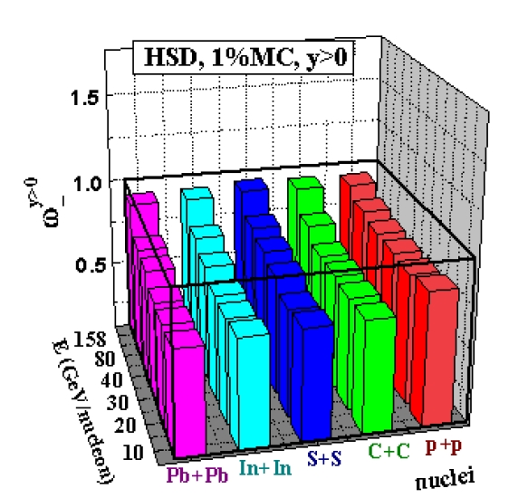
Scans Done Right
As in NA61 proposal
Gazdzicki
As proposed, Sep-04

Slide 28
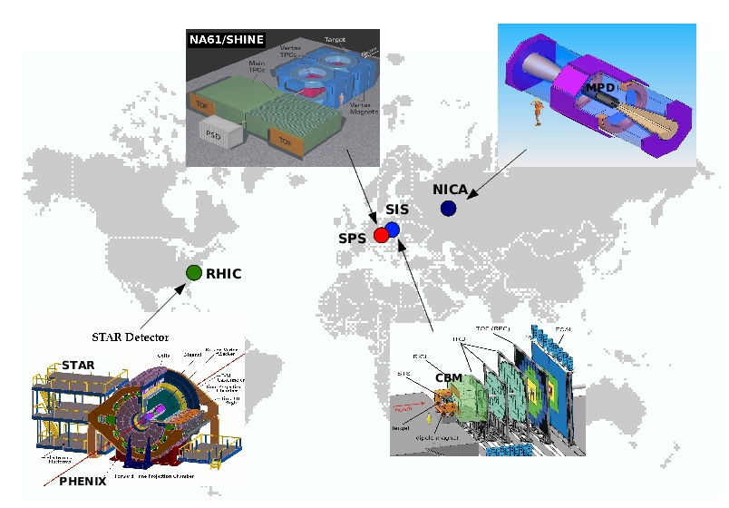
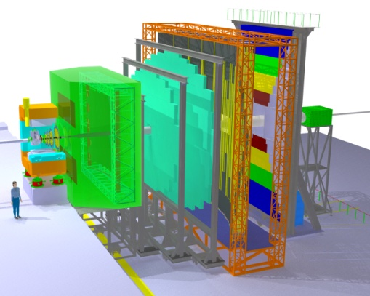
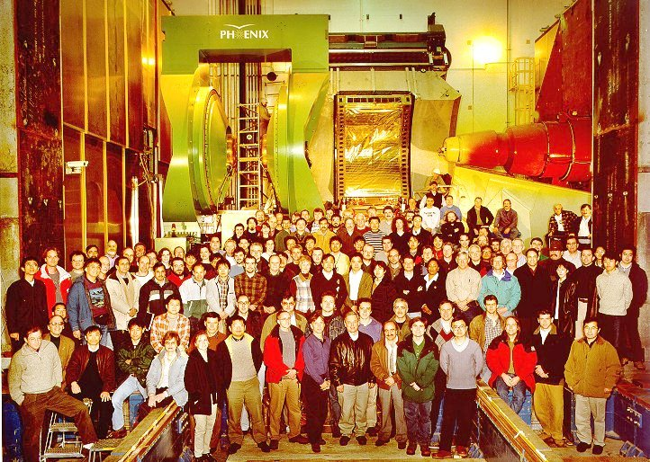
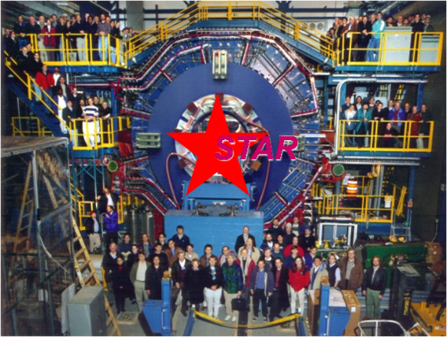

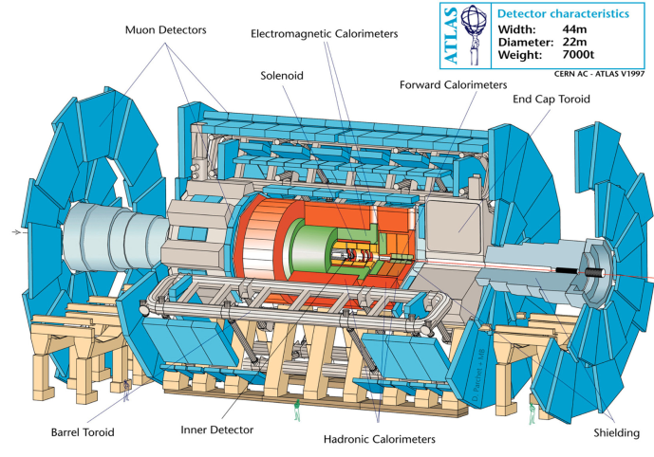
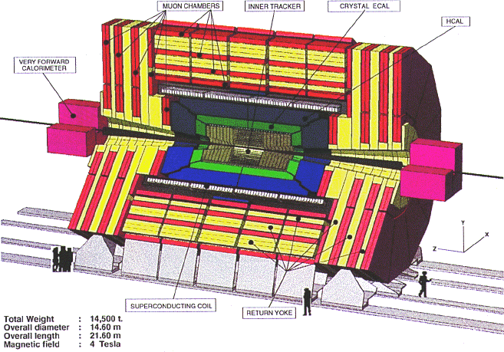
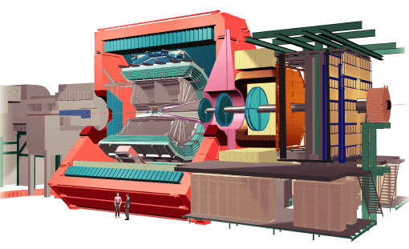
The Future Is (almost) Now
Incredible “Golden Era” for our field:
NICA
GSI-FAIR
SPS
RHIC-II
LHC
Stoecker
Senger
Gazdzicki
Xiao

Slide 29

Summary of the Summary
Too many superb results to summarize in 30 minutes !
The past is prologue to an exciting future
Most importantly: Local Organizing Committee
Xiangzhou Cai
Weiqin Chao
Liewen Chen
Jianping Cheng
Jinghua Fu
Yuanning Gao
Xiaomei Li
Zuotang Liang
Feng Liu
Yuxin Liu
Qing Wang
Qun Wang
Hushan Xu
Daicui Zhou
Pengfei Zhuang
Bingsong Zou

