Slide 1
Thermal dileptons at SPS energies
Sanja Damjanovic NA60 Collaboration
Quark Matter 2008, Jaipur

Slide 2
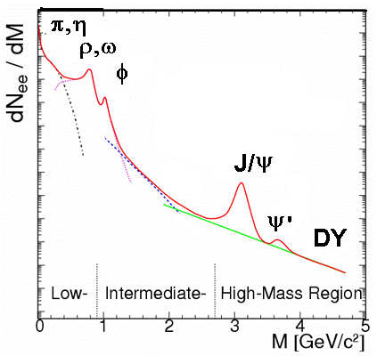
Thermal dileptons in high energy nuclear collisions
Production sources
LMR: M<1 GeV
hadronic: ππ → ρ* → ℓℓ prime probe of chiral symmetry restoration (R. Pisarski, PLB ‘82)
IMR: M>1 GeV
hadronic: ??? partonic: qq → ℓℓ original expectation : prime probe of deconfinement (Kajantie, McLerran, al. ‘82 ff)

Slide 3
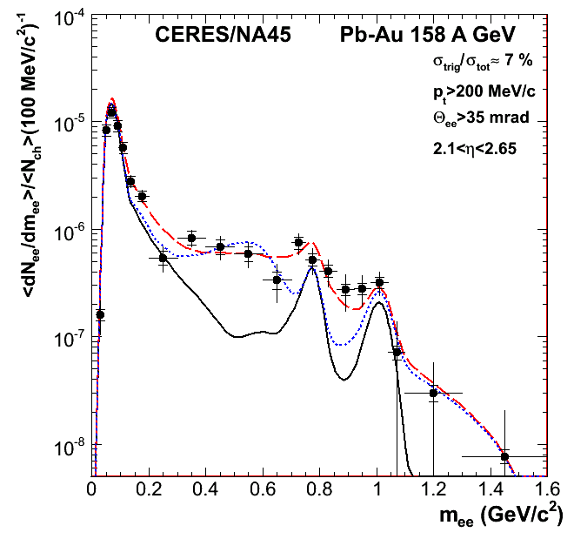
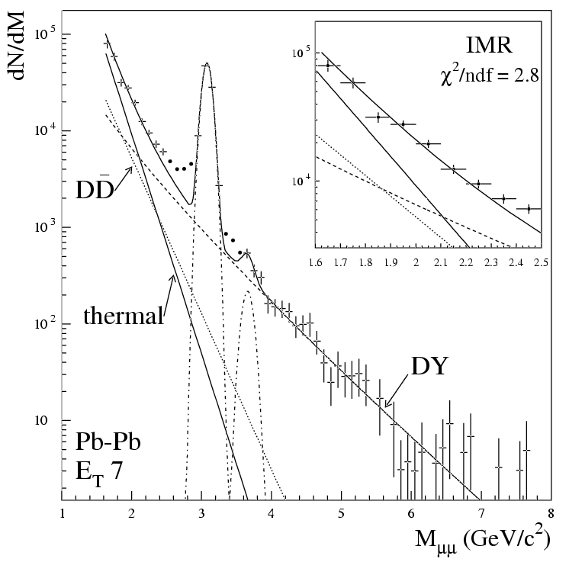
LMR: mostly NA45/CERES IMR: NA34, NA38, NA50
Previous SPS results on excess dileptons
Rapp-Wambach Brown/Rho
meson cocktail
2000 data
statistical accuracy and resolution insufficient to unambiguously determine the in-medium spectral properties of the ρ
no experimental capability to distinguish a prompt thermal dileptons from decay dileptons due to open charm

Slide 4
A third generation experiment:
NA60

Slide 5
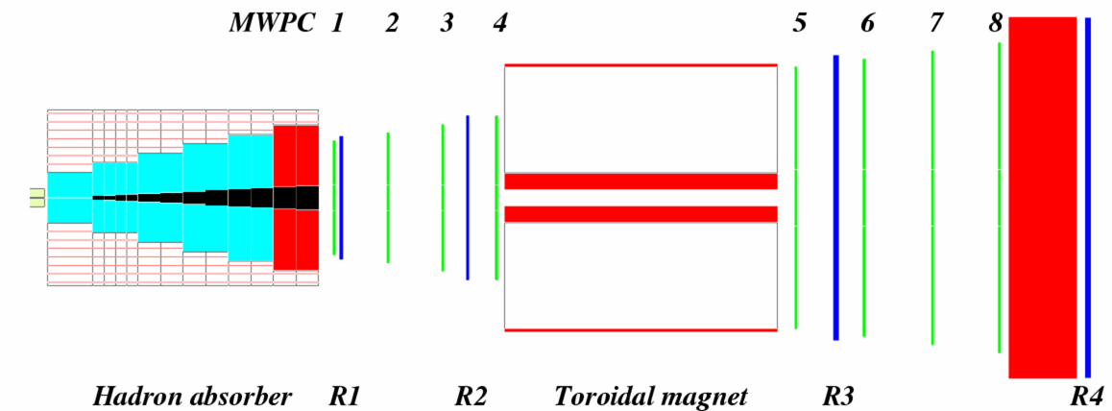
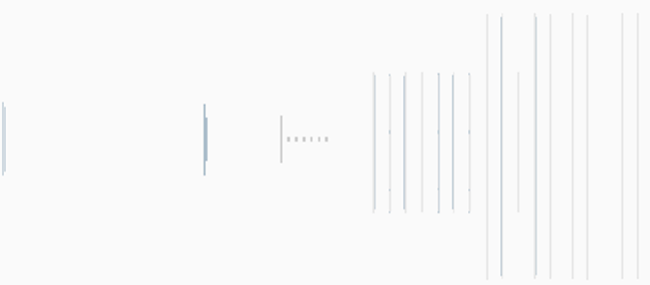
Measuring dimuons in NA60: concept
2.5 T dipole magnet
muon trigger and tracking (NA50)
beam tracker
Si-pixel tracker
magnetic field
targets
hadron absorber
<1m
>10m
Track matching in coordinate and momentum space
Improved dimuon mass resolution
Distinguish prompt from decay dimuons
Additional bend by the dipole field
Dimuon coverage extended to low p_{T}
Radiation-hard silicon pixel detectors (LHC development)
High luminosity of dimuon experiments maintained

Slide 6
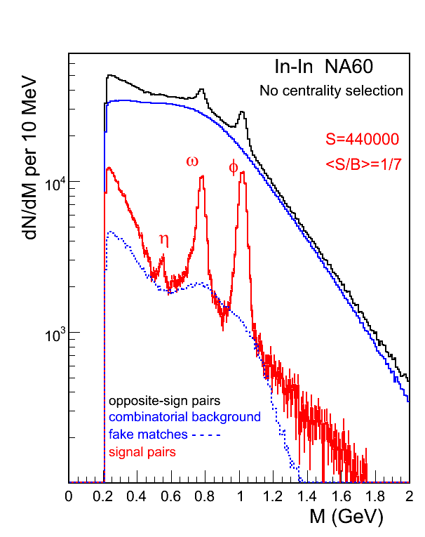
Low-mass data sample for 158 AGeV In-In
subtraction of
combinatorial background
- fake matches between the two spectrometers
net sample: 440 000 events
for the first time, η, ω, ɸ clearly visible in dilepton channel in AA
mass resolution: 20 MeV at the ω position

Slide 7
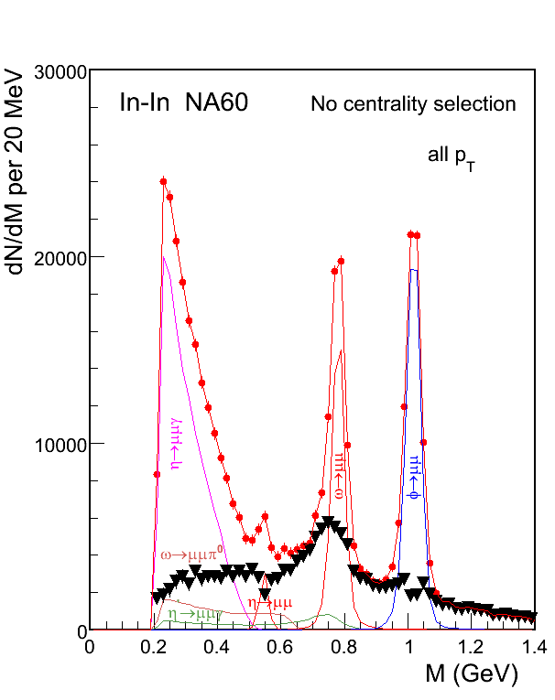
Excess dimuons
Phys. Rev. Lett. 96 (2006) 162302
Peripheral data (not shown):
well described by meson decay cocktail (η, η’, ρ, ω, ɸ) and DD
More central data (shown):
existence of excess dimuons
isolation of excess by subtraction of the measured decay cocktail (without ρ), based solely on local criteria for the major sources η Dalitz, ω and ɸ

Slide 8
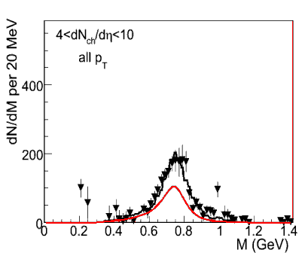
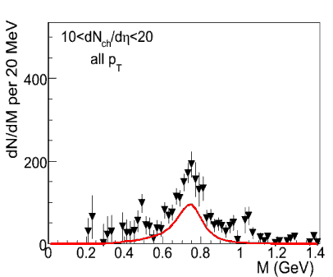
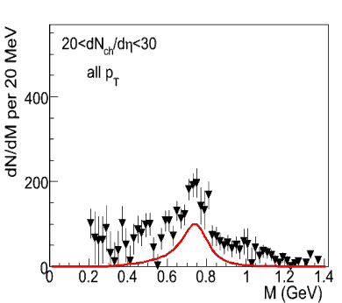
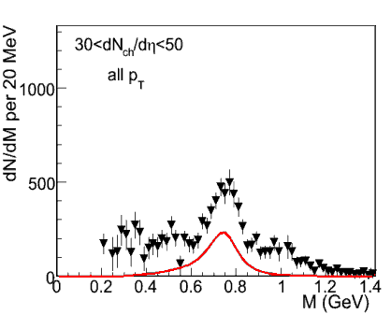
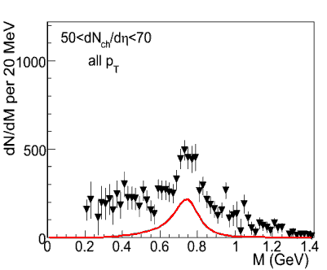
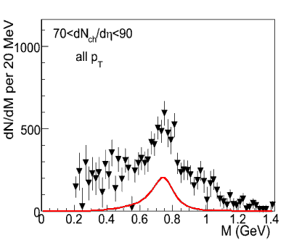
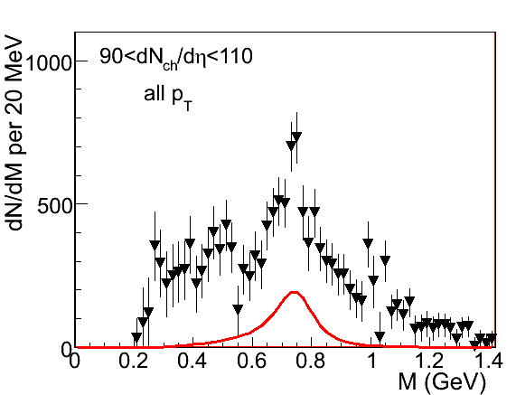
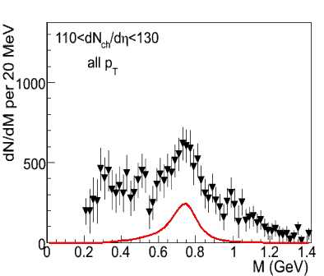
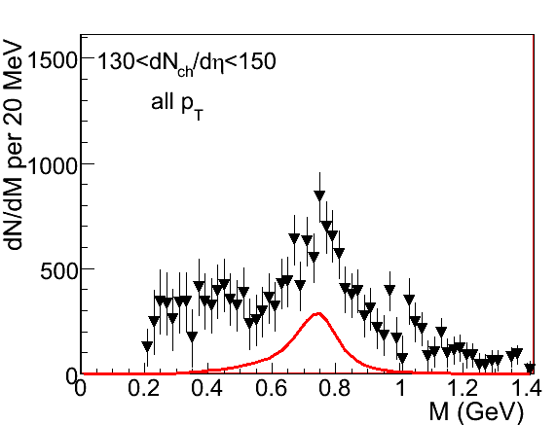
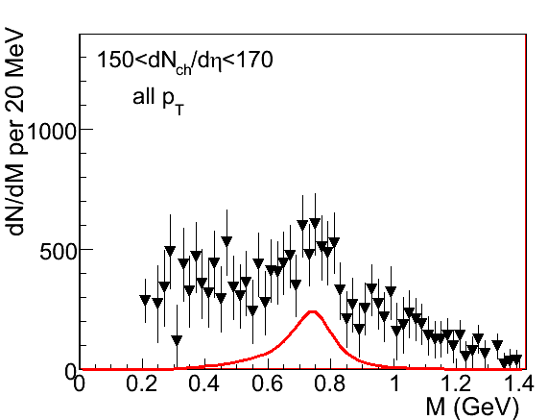
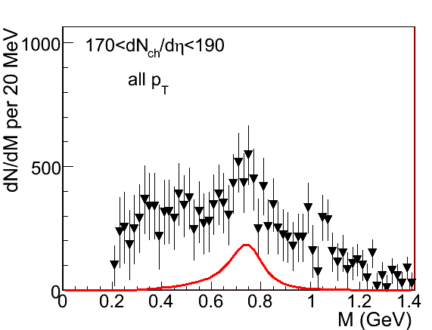
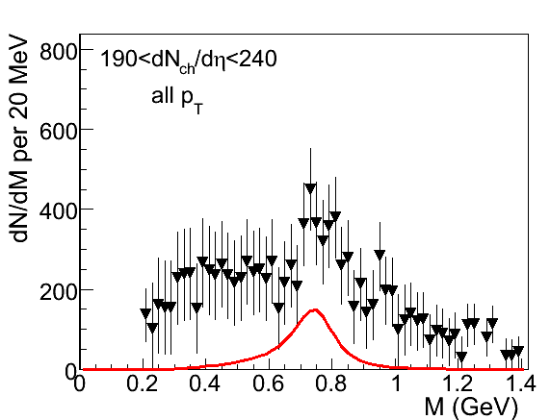
Excess mass spectra in 12 centrality windows
Eur.Phys.J.C 49 (2007) 235
all p_{T}
no cocktail ρ subtracted DD subtracted
clear excess above the cocktail ρ (bound to the ω with ρ/ω=1.0)
excess centered at the nominal ρ pole rising with centrality
monotonic broadening with centrality
“melting” of the ρ

Slide 9
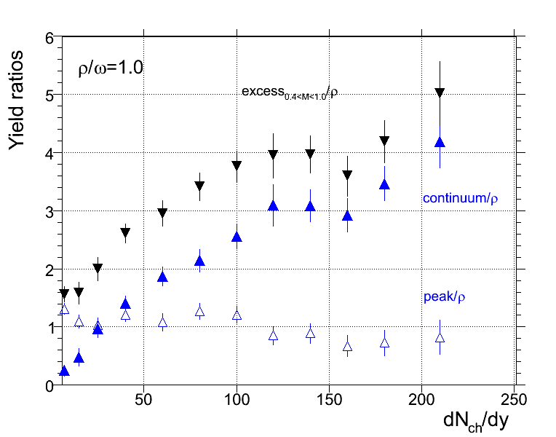
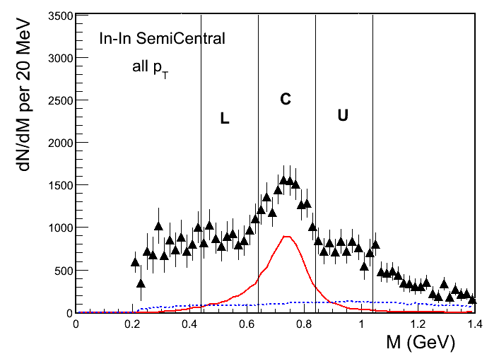
Centrality dependence of excess yields
ρ
peak: R=C-1/2(L+U) continuum: 3/2(L+U)
normalization to cocktail ρ, bound to ω with ρ/ω=1.0
- strong increase of continuum (by a factor of >10) - decrease of ρ peak (nearly a factor of 2) - rapid initial increase of total, reaching already 3 at dN_{ch}/dη=N_{part}=50

Slide 10
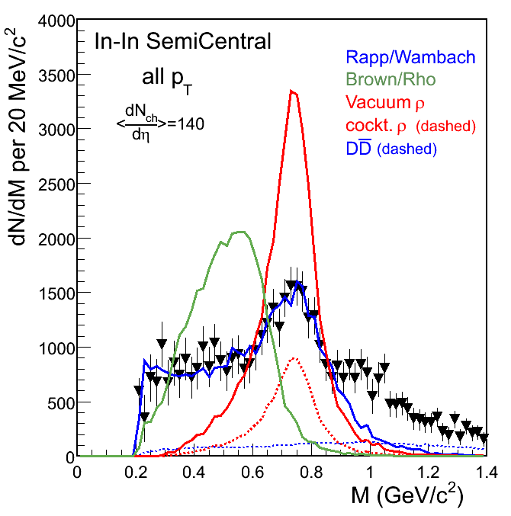
Comparison of data to RW, BR and Vacuum ρ
Phys. Rev. Lett. 96 (2006) 162302
Predictions by Rapp (2003) for all scenarios
Theoretical yields normalized to data for M<0.9 GeV
Only broadening of ρ (RW) observed, no mass shift (BR)
Data and predictions as shown, after acceptance filtering, roughly mirror the ρ spectral function, averaged over space-time and momenta. (Eur.Phys.J.C 49 (2007) 235)

Slide 11
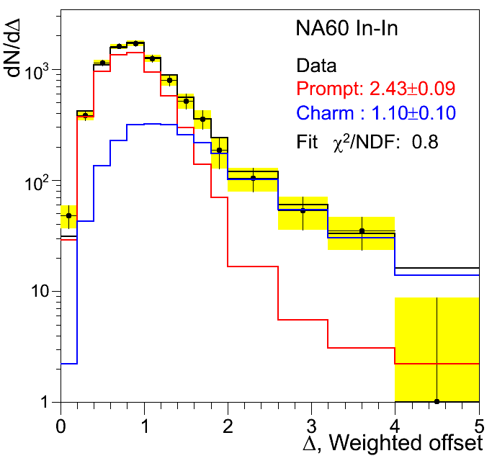
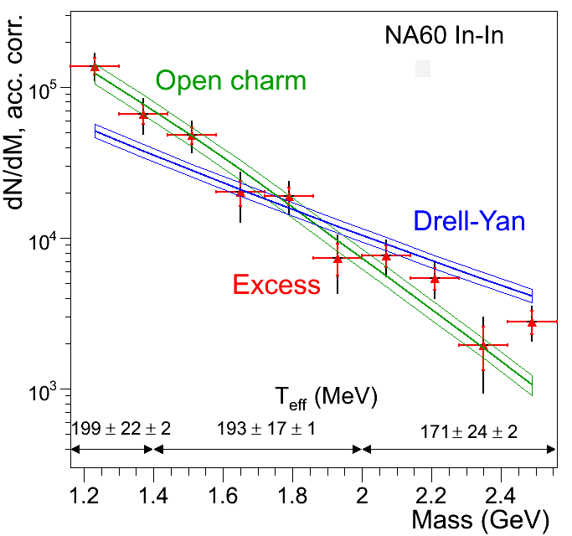
Extension to intermediate mass region
measurement of muon offsets Δμ: distance between interaction vertex and track impact point
isolation of excess by subtraction of measured open charm and Drell-Yan
charm not enhanced; excess prompt; 2.4 × DY
excess similar to open charm steeper than Drell-Yan

Slide 12
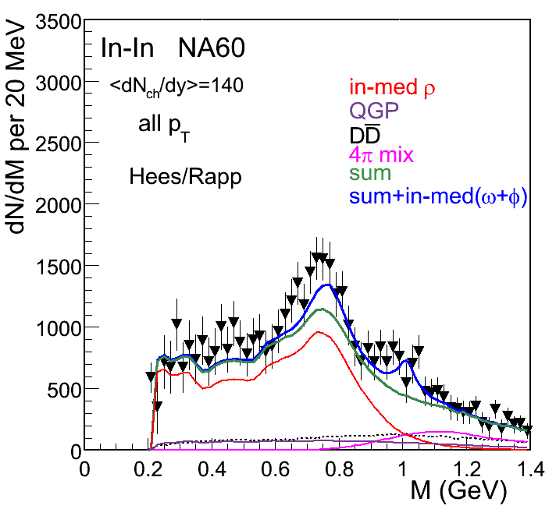
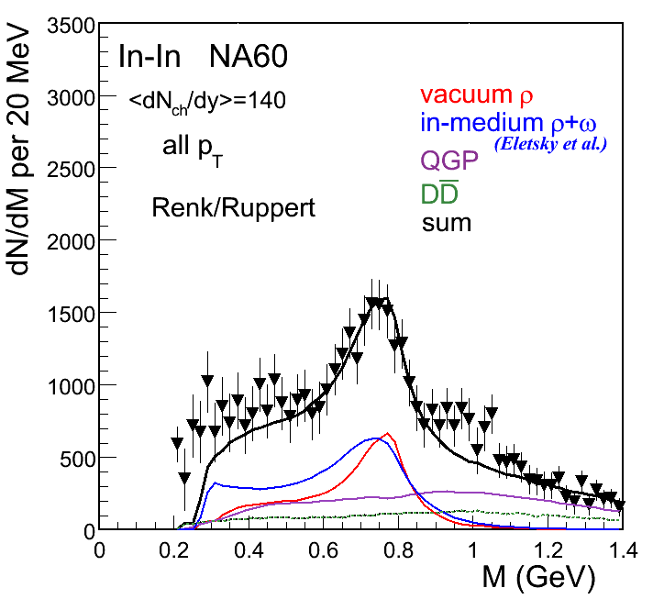
Hadron-Parton Duality for M >1 GeV
Hees/Rapp Phys.Rev.Lett. (2006)
Renk/Ruppert, hep-ph/0702012
Mass region above 1 GeV described in terms of hadronic processes, 4π …
Mass region above 1 GeV described in terms of partonic processes, qq…
How to distinguish?

Slide 13
Transverse momentum spectra

Slide 14
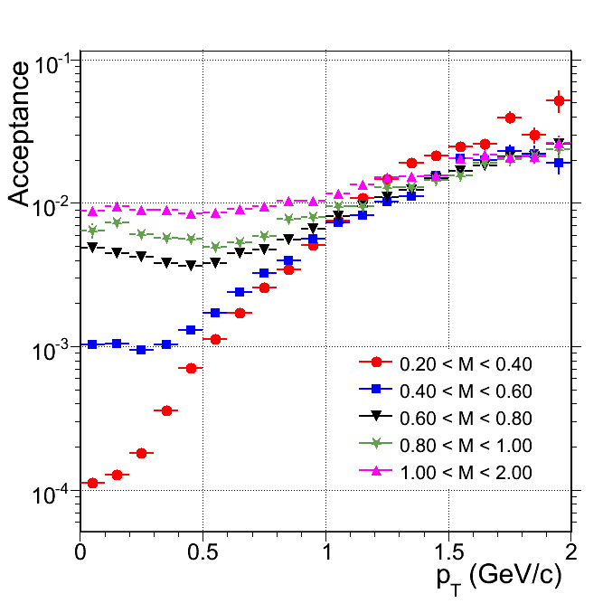
Strategy of acceptance correction
● reduce 4-dimensional acceptance correction in M-p_{T}-y-cosΘ_{CS} to 2-dimensional correction in M-p_{T}, using measured y distributions and measured cosΘ_{CS} distributions as an input ● requires separate treatment of the excess and the other sources, due to differences in the y and the cosΘ_{CS} distributions
acceptance vs. M, p_{T}, y, and cosΘ understood to within <10%, based on a detailed study of the peripheral data

Slide 15
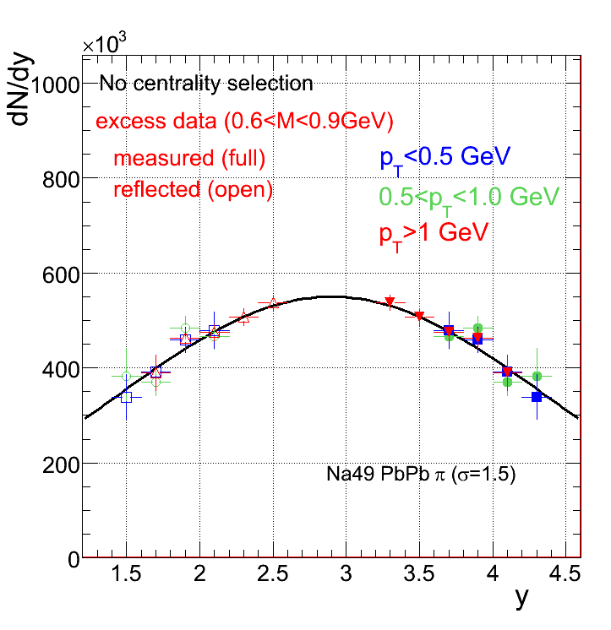
Experimental results on the y distribution of the excess
use measured mass and p_{T} spectrum as input to the acceptance correction in y (iteration procedure)
In-In
results close to rapidity distribution of pions, independent of p_{T}
NA60 π (σ=1.5)
average rapidity density in NA60 acceptance smaller by only ~15% than at mid-rapidity

Slide 16
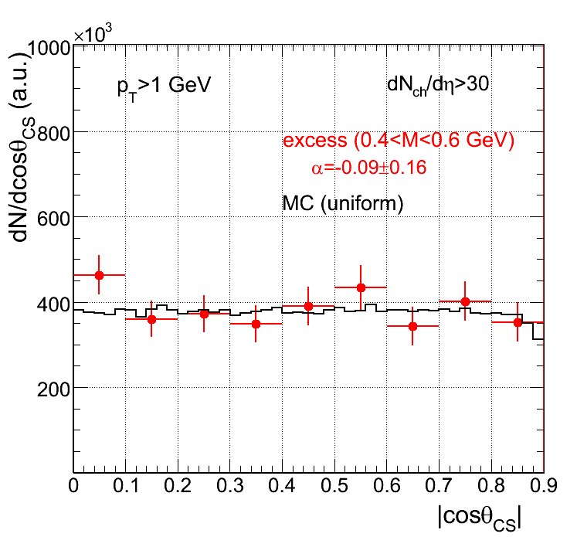
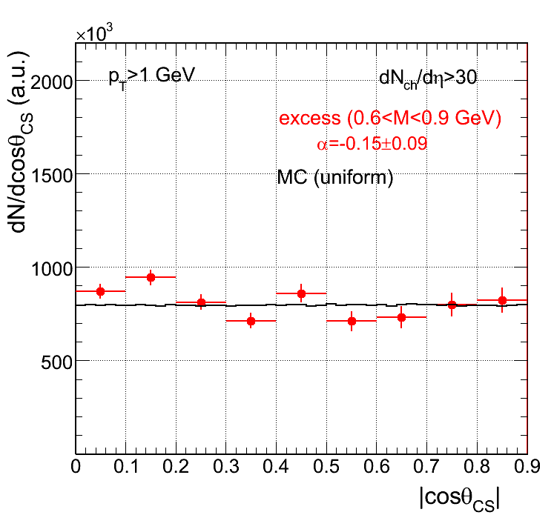
Experimental results on cosΘ_{CS} distributions: excess
Collins Soper frame
y
p_{µ+}
integration over azimuth angle
x
ϑ_{CS}
z axis
p_{projectile}
p_{target}
Viewed from dimuon rest frame
For the first time, the polarization of thermal radiation is measured and found to be zero (different from DY), as anticipated since decades.
Polarization also found to be zero for the ω and ɸ
errors purely statistical

Slide 17
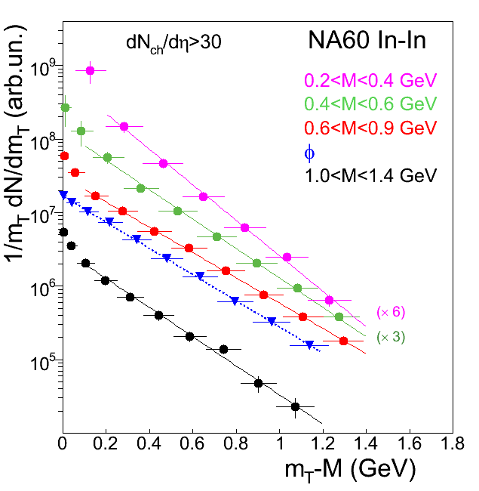
Centrality-integrated excess m_{T} spectra
Phys. Rev. Lett. 100 (2008) 022302
transverse mass: m_{T} = (p_{T}² + M²)^{1/2}
proper relative normalization
steepening at low m_{T}; not observed for hadrons (like φ)
signs for mass-dependent radial flow?
monotonic flattening of spectra with mass up to M=1 GeV, followed by a steepening above
fit m_{T} spectra for p_{T}>0.4 GeV with

Slide 18
What can we learn from p_{T} spectra?
Radial Flow
Origin of dileptons

Slide 19
Dilepton transverse momentum spectra
three contributions to p_{T} spectra
T - dependence of thermal distribution of “mother” hadrons/partons
M - dependent radial flow (v_{Τ}) of “mother” hadrons/partons
p_{T} - dependence of spectral function, weak (dispersion relation)
note: final-state lepton pairs themselves only weakly coupled
→ handle on emission region, i.e. nature of emitting source
hadron p_{T} spectra determined at freeze-out T_{f} (restricted information)
dilepton p_{T} spectra superposition from all fireball stages
early emission: high T, low v_{T} late emission: low T, high v_{T}
final spectra from space-time folding over T-v_{T} history from T_{i} → T_{f} (including low-flow partonic phase)

Slide 20
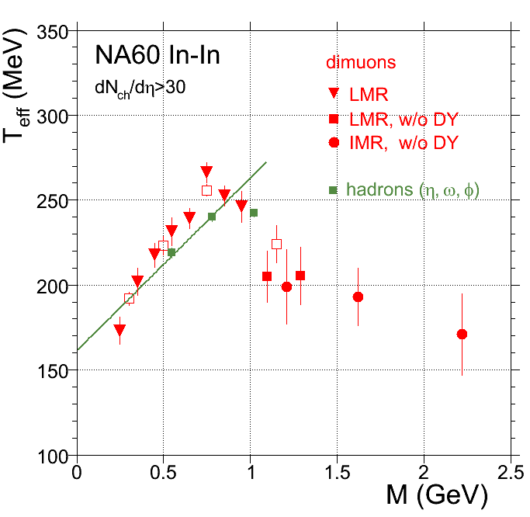
Evolution of inverse slope parameter T_{eff} with mass
Strong rise of T_{eff} with dimuon mass, followed by a sudden drop for M>1 GeV
Rise reminiscent of radial flow of a hadronic source
But: thermal dimuons emitted continuously during fireball expansion (reduced flow), while hadrons are emitted at final freeze-out (maximal flow); how can T_{eff} be similar?
Systematic errors studied in great detailed (CB, cocktail subtraction, acceptance, y and cosϑ_{CS} distributions, subtraction of DY and open charm → on level <= statistical errors.

Slide 21
Disentangling the m_{T} spectra of the ρ peak and the continuum

Slide 22
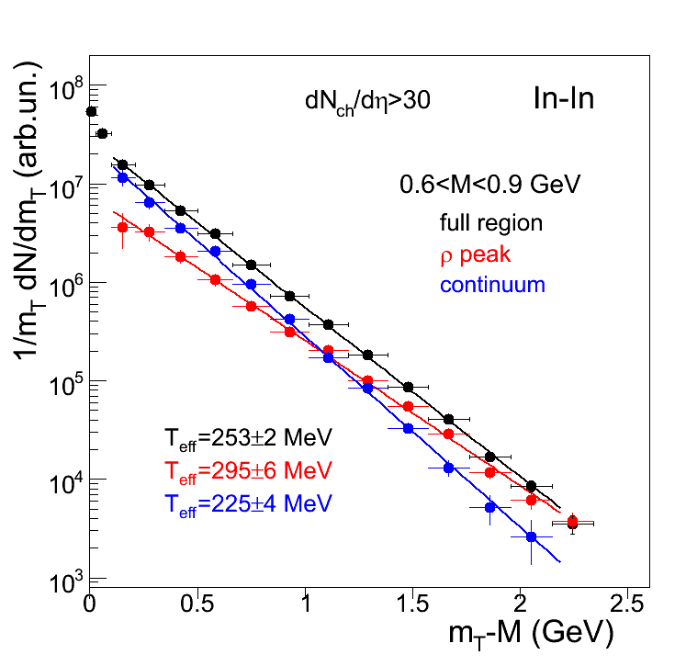
Shape analysis and p_{T} spectra
identify the ρ peak with the freeze-out ρ in the dilute final stage, when it does not experience further in-medium influences.
use side-window subtraction method
peak: C-1/2(L+U) continuum: 3/2(L+U)
m_{T} spectra very different for the ρ peak and continuum: T_{eff} of peak higher by 70+-7 MeV than that of the continuum ! all spectra pure exponential, no evidence for hard contributions

Slide 23
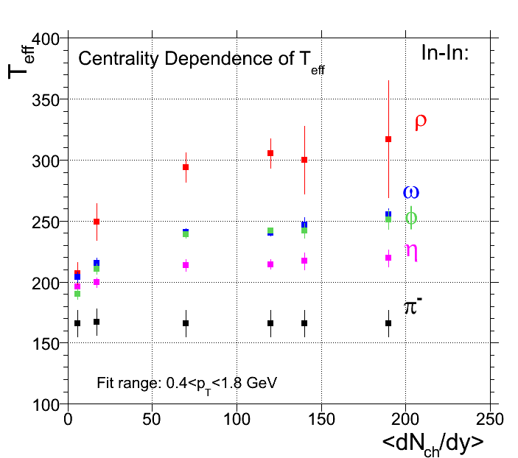
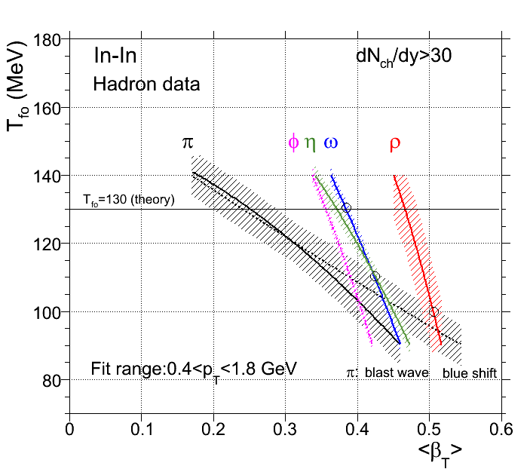
Hierarchy in hadron freeze-out
crossing of hadrons with π defines T_{f}, v_{T} max reached at respective hadron freeze-out
different hadrons have different coupling to pions (ρ maximal) → clear hierarchy of freeze-out (also for light-flavored hadrons)
use of Blast wave code
for a given hadron M, the measured T_{eff} defines a line in the T_{fo}-v_{T} plane
large difference between ρ and ω (same mass)

Slide 24
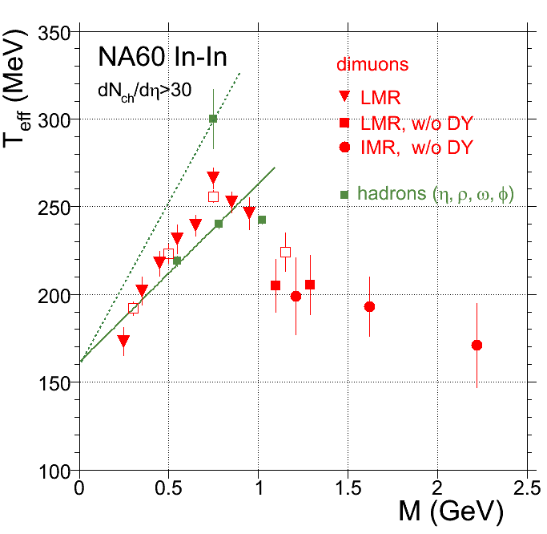
The rise and fall of radial flow of thermal dimuons
Phys. Rev. Lett. 100 (2008) 022302
Strong rise of T_{eff} with dimuon mass, followed by a sudden drop for M>1 GeV
Combining M and p_{T} of dileptons seems to overcome hadron-parton duality
Rise consistent with radial flow of a hadronic source (here ππ→ρ→μμ) , taking the freeze-out ρ as the reference
Drop signals sudden transition to low-flow source, i.e. source of partonic origin (here qq→μμ)

Slide 25
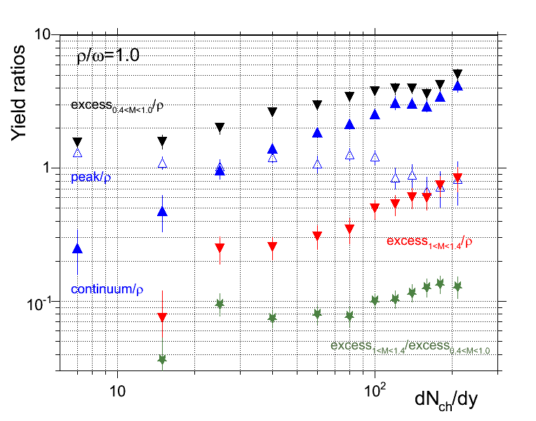
Centrality dependence of the individual yields
- strong increase of low-mass continuum
- decrease of ρ peak (nearly a factor of 2)
- peak/continuum flat for 30<dNch/dh<100, decreasing above
- very steep increase of high mass yield (DD and DY subtracted) - even steeper than that of total low-mass yield → increase of ratio
- increase mostly above dN_{ch}/dη=100, roughly quadratic in dN_{ch}/dη

Slide 26
Acceptance-corrected mass spectra

Slide 27
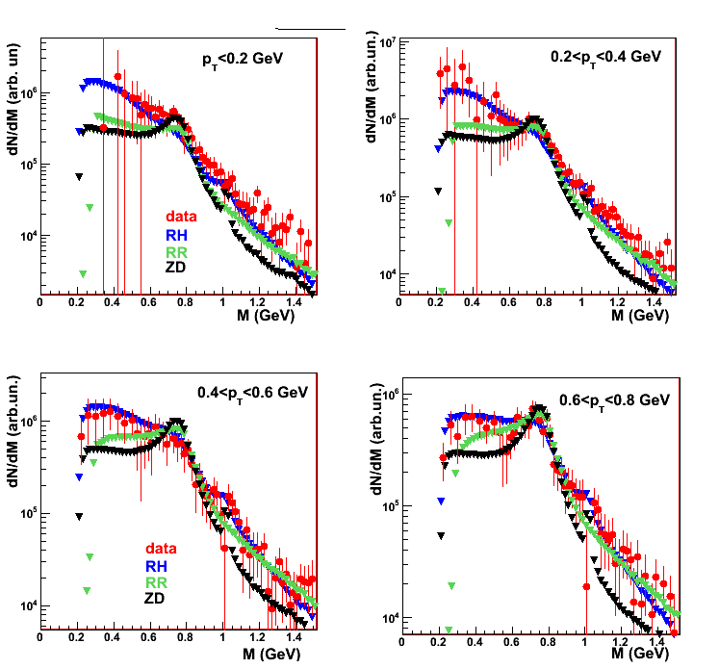
Data in comparison to theory : 0<p_{T}<0.8 GeV
One common absolute normalization factor, fixed for 0.6<M<0.9 GeV 0<p_{T} <2.4 GeV
Differences at low mass mostly reflect differences in the low-mass tail of the spectral functions

Slide 28
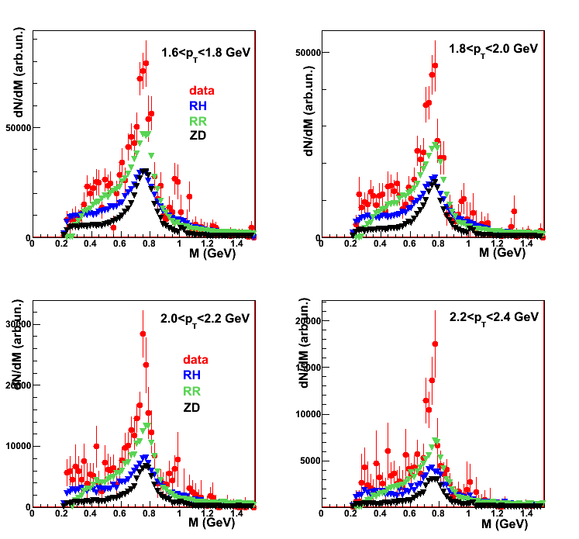
Data in comparison to theory : 1.6<p_{T}<2.4 GeV
One common absolute normalization factor fixed for 0.6<M<0.9 GeV 0<p_{T} <2.4 GeV
Differences at higher masses and higher p_{T} mostly reflect differences in the flow

Slide 29
Conclusions
Pion annihilation major contribution to the lepton pair excess in heavy-ion collisions at SPS energies in the region M<1 GeV
In-medium ρ spectral function identified; no significant mass shift of the intermediate ρ, only broadening; connection to chiral restoration?
First observation of radial flow of thermal dileptons; mass dependence tool to identify the nature of the emitting source; mostly partonic radiation for M>1 GeV?

Slide 30

The NA60 experiment
http://cern.ch/na60
CERN
Heidelberg
~ 60 people
13 institutes 8 countries
Palaiseau
Bern
BNL
Riken
Stony Brook
Yerevan
Lisbon
Torino
Clermont
Cagliari
Lyon
R. Arnaldi, R. Averbeck, K. Banicz, K. Borer, J. Buytaert, J. Castor, B. Chaurand, W. Chen, B. Cheynis, C. Cicalò, A. Colla, P. Cortese, S. Damjanović, A. David, A. de Falco, N. de Marco, A. Devaux, A. Drees, L. Ducroux, H. En’yo, A. Ferretti, M. Floris, P. Force, A. Grigorian, J.Y. Grossiord, N. Guettet, A. Guichard, H. Gulkanian, J. Heuser, M. Keil, L. Kluberg, Z. Li, C. Lourenço, J. Lozano, F. Manso, P. Martins, A. Masoni, A. Neves, H. Ohnishi, C. Oppedisano, P. Parracho, P. Pillot, G. Puddu, E. Radermacher, P. Ramalhete, P. Rosinsky, E. Scomparin, J. Seixas, S. Serci, R. Shahoyan, P. Sonderegger, H.J. Specht, R. Tieulent, E. Tveiten, G. Usai, H. Vardanyan, R. Veenhof and H. Wöhri

