Slide 1
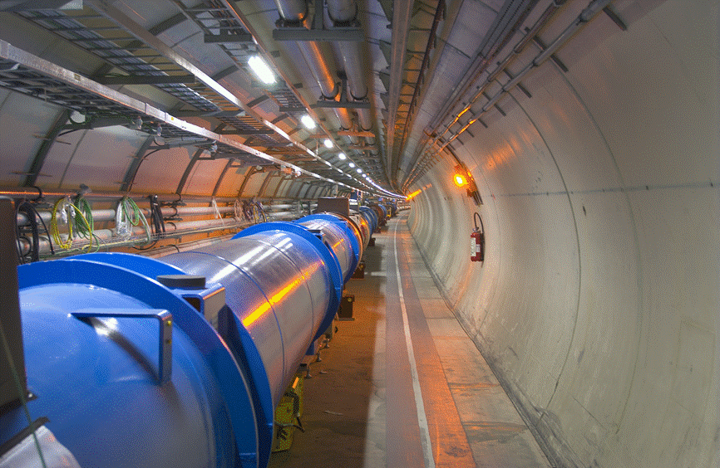
The LHC as a Nucleus-Nucleus Collider
John Jowett
CERN

Slide 2
LHC Status Summary

Slide 3
Status of the LHC
We are almost at the end of the long road from the first public “Feasibility Study of a Large Hadron Collider in the LEP Tunnel” (1984) to colliding protons and heavy nuclei in the LHC.
Enormous efforts made in recent years to minimise slippage of the schedule.
Solutions to engineering setbacks have been found and implemented
Main cryogenic line (QRL)
Low-beta (“triplet”) quadrupoles
Plug-in modules for vacuum interconnects
Installation of the collider’s hardware is complete.
Hardware, then beam, commissioning will soon be fully under way.

Slide 4
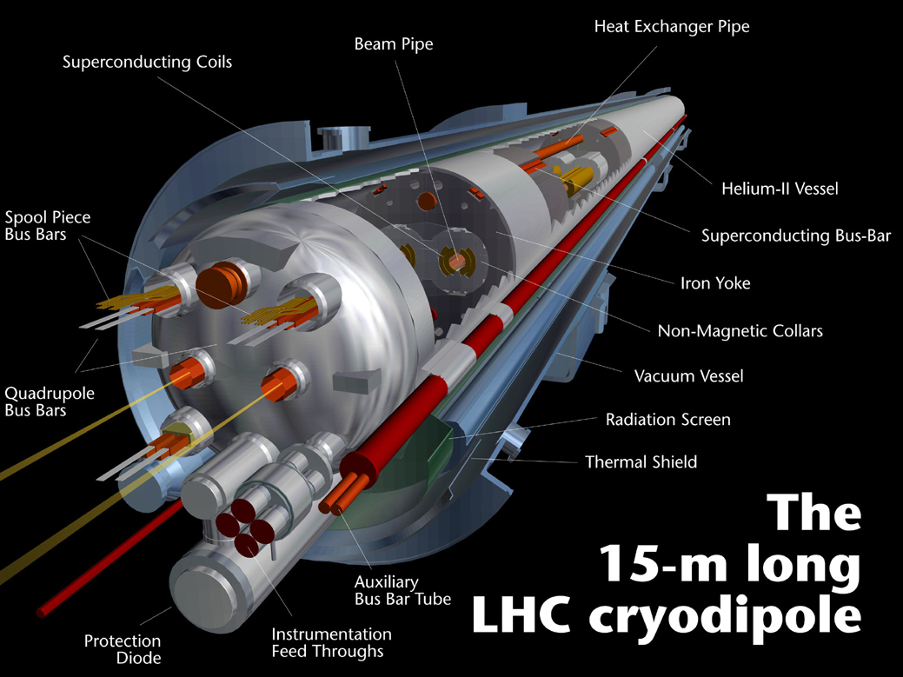
1232 dipole magnets operating at 1.9K
7TeV
8.33T
11850A
7MJ
The most prominent of a host of technological developments.

Slide 5
Schematic LHC
4 large experiments
ALICE
ATLAS
CMS
LHC-b
Notes:
General reminder

Slide 6
Master Schedule (published 8 Oct 2007)
12
23
34
45
56
67
78
81
Mar.
10
10
Mar.
11
11
12
12
13
13
Apr.
Apr.
14
14
15
15
16
16
17
17
May
May
18
18
19
19
20
20
21
21
Jun.
Jun.
22
22
23
23
24
24
25
25
26
26
Jul.
27
27
Jul.
28
28
29
29
2007
2007
30
30
Aug.
31
31
Aug.
32
32
33
33
34
Consolidation
34
Sep.
35
35
Sep.
36
36
37
37
38
38
39
39
Oct.
40
40
Oct.
41
41
42
42
43
43
Nov.
44
44
Nov.
45
45
46
46
47
47
48
48
Dec.
49
49
Dec.
50
50
51
51
52
.
Jan.
52
01
01
Jan.
02
02
03
03
04
04
05
05
Feb.
06
06
Feb.
07
07
08
08
09
09
Mar.
10
10
Mar.
11
11
12
12
13
13
Apr.
14
14
Apr.
15
15
16
16
17
Machine Checkout
17
18
18
May
19
19
May
20
20
21
Beam Commissioning to 7 TeV
21
22
22
Jun.
23
23
Jun.
24
24
2008
2008
25
25
26
26
Jul.
27
27
Jul.
28
28
29
29
30
30
31
31
Aug.
32
32
Aug.
33
33
General schedule Baseline rev. 4.0
34
Interconnection of the continuous cryostat
Flushing
34
35
35
Sep.
36
36
Sep.
37
37
38
38
39
Leak tests of the last sub-sectors
Cool-down
Oct.
Global pressure test &Consolidation
39
Oct.
40
40
41
41
42
42
43
Warm up
43
Cool-down
44
Inner Triplets repairs & interconnections
44
Nov.
45
45
Nov.
46
46
47
47
48
48
Dec.
Powering Tests
Global pressure test &Consolidation
49
Powering Tests
50
49
Dec.
51
50
52
51
.
52

Slide 7
Current outlook
Expect whole machine to be cold by beginning of June
2-3 weeks behind published schedule
Technically feasible but “success-oriented”, i.e., sensitive to any major new problem
Then start commissioning with proton beams to achieve injection, RF capture, good lifetime on the injection plateau
Hard to predict time necessary, should not be rushed …
75 ns bunch spacing (for LHC-b) asap
Real luminosity will depend on ability to protect machine
must gain experience with collimation, etc.

Slide 8
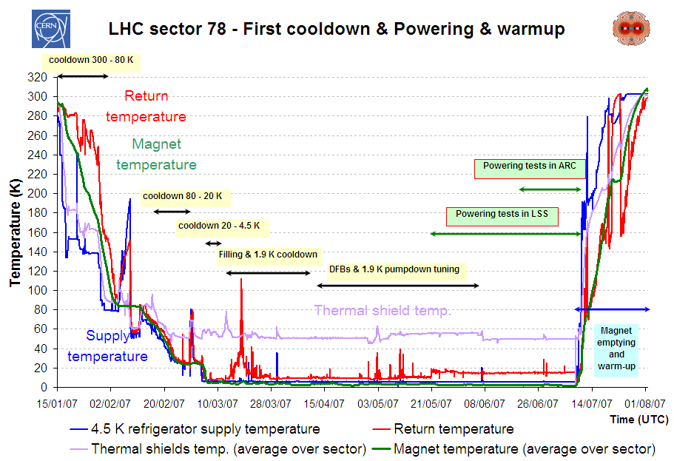
Commissioning of sector 78 (no triplet)
From RT to 80K precooling with LN2. 1200 tons of LN2 (64 trucks of 20 tons). Three weeks for the first sector
From 80K to 4.2K. Cooldown with refrigerator. Three weeks for the first sector. 4700 tons of material to be cooled
From 4.2K to 1.9K. Cold compressors at 15 mbar. Four days for the first sector

Slide 9
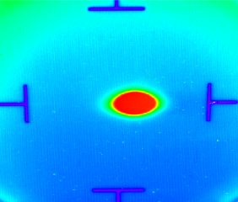
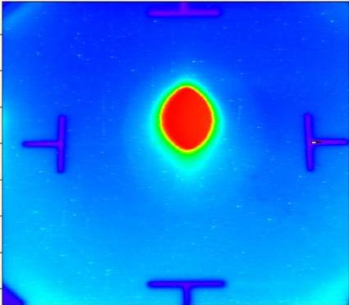
LHC proton injection - overview
23.10.2004, 13:39 → first beam at end of TI 8
IR8
combined length 5.6 km
over 700 magnets
ca. 2/3 of SPS
TI 8 beam tests 23./24.10.04 6./7.11.04
28.10.2007, 12:03
→ first beam at end of TI 2
TT40 beam tests 8.9.03
TI 8
SPS
LHC
IR2
TI 2
TI 2 beam test 28./29.10.07
PMI2
TI 2 upstream part installed and HW commissioned by 2005.
Courtesy of V. Mertens

Slide 10
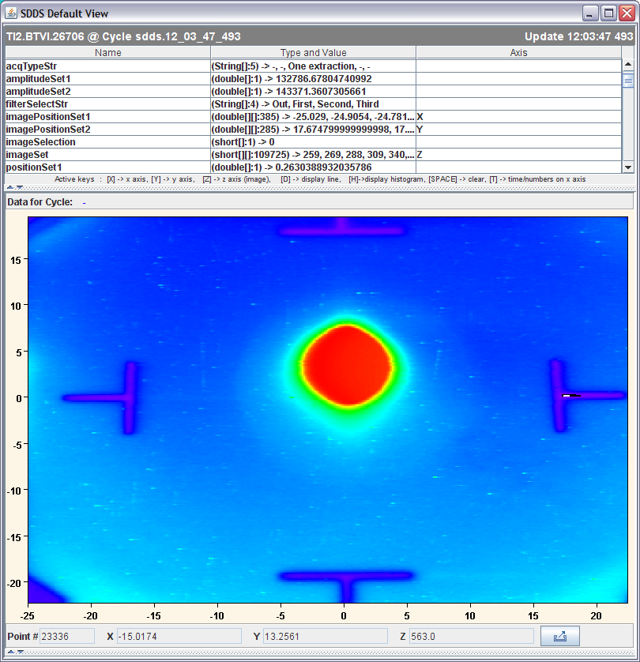
Proton beam in TI2 at 12:03:47 on 28 Oct 2007
First shot straight down the line.
This BTV screen is the last in the part of TI2 which could be explored with beam on 28 October 2007. It is located some 70 m after the lowest point in TI2, and some 700 m away from the temporary dump, which in turn is placed at some 50 m from the end of the TI2 tunnel, to avoid irradiating the LHC area..
BTVI26706
Courtesy of V. Mertens

Slide 11
Commissioning the LHC with proton beams

Slide 12
Luminosity
Parameters in luminosity
Number of particles per bunch Ν
Number of bunches per beam k_{b}
Relativistic factor γ
Normalised emittance ε_{n}
Beta function at the IP β *
Crossing angle factor F
Full crossing angle θ_{c}
Bunch length σ_{z}
Transverse beam size at the IP σ*

Slide 13
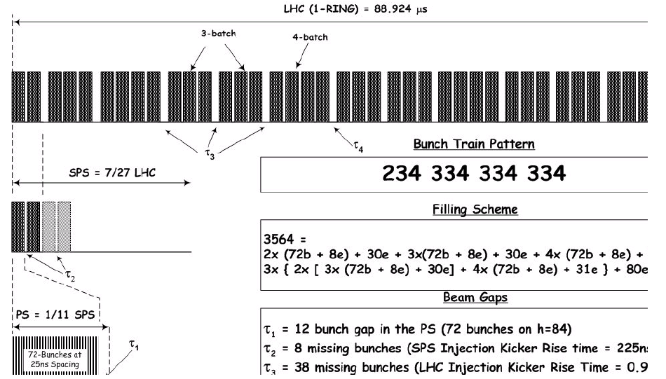
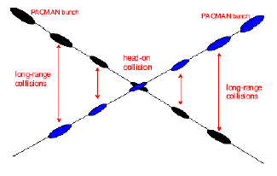
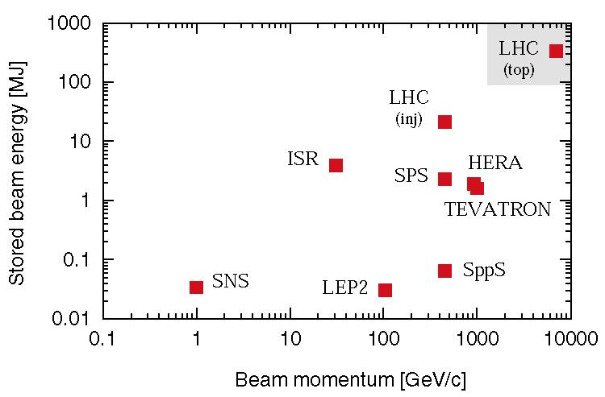
Nominal p-p luminosity
Nominal settings
Beam energy (TeV) | 7.0
Number of particles per bunch | 1.15 10¹¹
Number of bunches per beam | 2808
Crossing angle (μrad) | 285
Norm transverse emittance (μm rad) | 3.75
Bunch length (cm) | 7.55
Beta function at IP 1, 2, 5, 8 (m) | 0.55,10,0.55,10
Related parameters
Luminosity in IP 1 & 5 (cm⁻² s⁻¹) | 10³⁴
Luminosity in IP 2 & 8 (cm⁻² s⁻¹) | ~5 10³²
Transverse beam size at IP 1 & 5 (μm) | 16.7
Transverse beam size at IP 2 & 8 (μm) | 70.9
Stored energy per beam (MJ) | 362
Requires Phase II collimation

Slide 14
Commissioning strategy for protons
Stage A
B
C
D
Hardware commissioning | Machine checkout | Beam commissioning | 43 bunch operation | 75ns ops | 25ns (I) | Install Phase II and MKB | 25ns (II)
No beam
Beam
Pilot physics run
First collisions
43 bunches, no crossing angle, no squeeze, moderate intensities
Push performance
Performance limit 10³² cm⁻² s⁻¹ (event pileup)
75ns operation
Establish multi-bunch operation, moderate intensities
Relaxed machine parameters (squeeze and crossing angle)
Push squeeze and crossing angle
Performance limit 10³³ cm⁻² s⁻¹ (event pileup)
25ns operation I
Nominal crossing angle
Push squeeze
Increase intensity to 50% nominal
Performance limit 2 10³³ cm⁻² s⁻¹
25ns operation II
Push towards nominal performance

Slide 15
Stage A p-p physics run
Start as simple as possible
Change 1 parameter (k_{b} N β*_{1 , 5}) at a time
All values for
nominal emittance
7TeV
10m β* in point 2 (luminosity looks fine)
Protons/beam <10¹³
Stored energy/beam <10MJ
(c.f. SPS fixed target beam)
Parameters |  |  | Beam levels |  | Rates in ATLAS or CMS |  | Rates in ALICE
k_{b} | N | β* 1,5 (m) | I_{beam} proton | E_{beam} (MJ) | Luminosity (cm⁻²s⁻¹) | Events/ crossing | Luminosity (cm⁻²s⁻¹) | Events/ crossing
1 | 10¹⁰ | 11 | 1 10¹⁰ | 10⁻² | 1.6 10²⁷ | << 1 | 1.8 10²⁷ | << 1
43 | 10¹⁰ | 11 | 4.3 10¹¹ | 0.5 | 7.0 10²⁸ | << 1 | 7.7 10²⁸ | << 1
43 | 4 10¹⁰ | 11 | 1.7 10¹² | 2 | 1.1 10³⁰ | << 1 | 1.2 10³⁰ | 0.15
43 | 4 10¹⁰ | 2 | 1.7 10¹² | 2 | 6.1 10³⁰ | 0.76 | 1.2 10³⁰ | 0.15
156 | 4 10¹⁰ | 2 | 6.2 10¹² | 7 | 2.2 10³¹ | 0.76 | 4.4 10³⁰ | 0.15
156 | 9 10¹⁰ | 2 | 1.4 10¹³ | 16 | 1.1 10³² | 3.9 | 2.2 10³¹ | 0.77

Slide 16
Evolution through p-p stages A,B,C
All values for nominal emittance, 7 TeV, β*=10 m in points 2 and 8
Parameters |  |  | Beam levels |  | ATLAS, CMS |  | ALICE (LHC-b)
k_{b} | N | β* 1,5 (m) | I_{beam} proton | E_{beam} (MJ) | Luminosity (cm⁻²s⁻¹) | Events/ crossing | Luminosity (cm⁻²s⁻¹) | Events/ crossing
43 | 4 10¹⁰ | 11 | 1.7 10¹² | 2 | 1.1 10³⁰ | << 1 | 1.2 10³⁰ | 0.15
43 | 4 10¹⁰ | 2 | 1.7 10¹² | 2 | 6.1 10³⁰ | 0.76 | 1.2 10³⁰ | 0.15
156 | 4 10¹⁰ | 2 | 6.2 10¹² | 7 | 2.2 10³¹ | 0.76 | 4.4 10³⁰ | 0.15
156 | 9 10¹⁰ | 2 | 1.4 10¹³ | 16 | 1.1 10³² | 3.9 | 2.2 10³¹ | 0.77
936 | 4 10¹⁰ | 11 | 3.7 10¹³ | 42 | 2.4 10³¹ | << 1 | 2.6 10³¹ | 0.15
936 | 4 10¹⁰ | 2 | 3.7 10¹³ | 42 | 1.3 10³² | 0.73 | 2.6 10³¹ | 0.15
936 | 6 10¹⁰ | 2 | 5.6 10¹³ | 63 | 2.9 10³² | 1.6 | 6.0 10³¹ | 0.34
936 | 9 10¹⁰ | 1 | 8.4 10¹³ | 94 | 1.2 10³³ | 7 | 1.3 10³² | 0.76
2808 | 4 10¹⁰ | 11 | 1.1 10¹⁴ | 126 | 7.2 10³¹ | << 1 | 7.9 10³¹ | 0.15
2808 | 4 10¹⁰ | 2 | 1.1 10¹⁴ | 126 | 3.8 10³² | 0.72 | 7.9 10³¹ | 0.15
2808 | 5 10¹⁰ | 1 | 1.4 10¹⁴ | 157 | 1.1 10³³ | 2.1 | 1.2 10³² | 0.24
2808 | 5 10¹⁰ | 0.55 | 1.4 10¹⁴ | 157 | 1.9 10³³ | 3.6 | 1.2 10³² | 0.24

Slide 17
Staged commissioning plan for protons
Hardware commissioning 450 GeV and 7TeV
2008
Machine checkout | Beam commissioning 450 GeV
A
Machine checkout | Beam commissioning 7TeV | 43 bunch operation | Shutdown
No beam
Beam
Most probable first Pb-Pb run
2009
B
C
Shutdown | Machine checkout | Beam Setup | 75ns ops | 25ns ops I | Shutdown
No beam
Beam

Slide 18
Ion Injector Chain for LHC

Slide 19
LHC Ion Injector Chain
ECR ion source (2005)
Provide highest possible intensity of Pb²⁹⁺
RFQ + Linac 3
Adapt to LEIR injection energy
strip to Pb⁵⁴⁺
LEIR (2005)
Accumulate and cool Linac3 beam
Prepare bunch structure for PS
PS (2006)
Define LHC bunch structure
Strip to Pb⁸²⁺
SPS (2007)
Define filling scheme of LHC
Notes:
Performance of LHC depends on quality of beam that can be injected

Slide 20
Ion Injector Chain – key facts
Beam required for LHC is much more demanding than SPS fixed target ion beams
Required new electron cooler ring LEIR and many other changes and upgrades (bulk of cost of I-LHC project)
Two sets of LHC beam parameters correspond to different modes of operations of injectors
“Early beam”: 10 times fewer bunches in LHC but same bunch intensity, simplifies injectors but provides useful initial luminosity
“Nominal beam”: full 592 bunches in LHC, more complicated injector operations
See elsewhere for full information

Slide 21
LHC Pb Injector Chain: Key Parameters for luminosity 10²⁷ cm⁻² s⁻¹
Stripping foil
¹50 eμA_{e} x 200 μs Linac3 output after stripping
² Same physical emittance as protons,

Slide 22
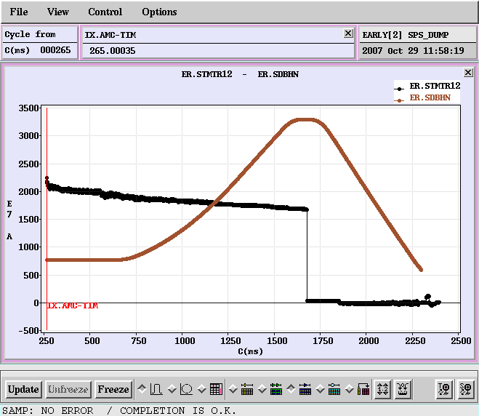
Injector Chain Status Summary (1)
Source + Linac3
Intensity OK for Early Scheme (record = 31 eμA of Pb⁵⁴⁺ out of the linac)
More stability/reliability required for Nominal Scheme will be supplied by upgrade of source generator to 18 GHz
Numerous other improvements implemented or coming.
LEIR
Early beam obtained, reliable
Reproducible

Slide 23
Injector Chain Status Summary (2)
LEIR for Nominal
Progress but some concerns about intensity loss
Requires substantial development time in 2009
PS + transfer lines
Early scheme now OK (much effort)
No development towards Nominal possible in 2007
Requires development time in 2009
N.B. LHC ion injectors will not be operated in 2008
Resources all devoted to p-p for LHC

Slide 24
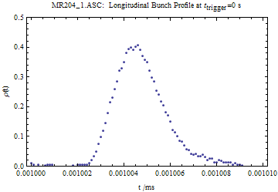
Injector Chain Status Summary (3) SPS
First commissioning of LHC Pb beam late 2007
Time lost due to mishaps, RF hardware
Early beam mostly commissioned and extracted
See next slide
Crystal collimation test (H8 beamline) had to be dropped
Development time required in 2009!
At injection energy, bunch typically loses half intensity in 2 min (real time of movie), c.f. Nominal injection plateau 47 s.
May still improve. Otherwise considering new filling scheme to shorten this plateau (75ns spacing in LHC).

Slide 25
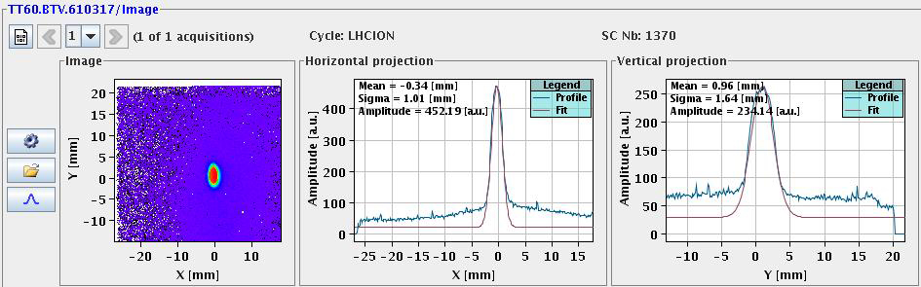
First beam of lead nuclei ejected from SPS towards LHC
TI2 line set up for protons worked first time (same magnetic rigidity)
No synchronization of extracted beam (yet)
(*) Extracted intensity was ~20% of design due to vacuum leak in PS, but 90% design intensity had been accelerated 2 weeks before
Parameter | Design | Achieved | Unit
N | 3.6 | 0.7 (*) | 10⁸ ions
ε_{H} | 6 10⁻³ | 6 10⁻³ | π.mm.mrad
ε_{V} | 6 10⁻³ | 6 10⁻³ | π.mm.mrad
ε∗_{H} | 1.2 | 1.2 | μm
ε∗_{V} | 1.2 | 1.2 | μm

Slide 26
Pb-Pb Collisions in the LHC

Slide 27
The LHC will collide lead nuclei at centre-of-mass energies of 5.5 TeV per colliding nucleon pair.
This leap to 28 times beyond what is presently accessible will open up a new regime, not only in the experimental study of nuclear matter, but also in the beam physics of hadron colliders.

Slide 28
Nominal vs. Early Ion Beam: Key Parameters
Parameter | Units | Nominal | Early Beam
Energy per nucleon | TeV/n | 2.76 | 2.76
Initial Luminosity L₀ | cm⁻² s⁻¹ | 1 10²⁷ | 5 10²⁵
No. bunches/bunch harmonic |  | 592/891 | 62/66
Bunch spacing | ns | 99.8 | 1350
β* | m | 0.5 (same as p) | 1.0
Number of Pb ions/bunch |  | 7 10⁷ | 7 10⁷
Transv. norm. RMS emittance | μm | 1.5 | 1.5
Longitudinal emittance | eV s/charge | 2.5 | 2.5
Luminosity half-life (1,2,3 expts.) | H | 8, 4.5, 3 | 14, 7.5, 5.5

Slide 29
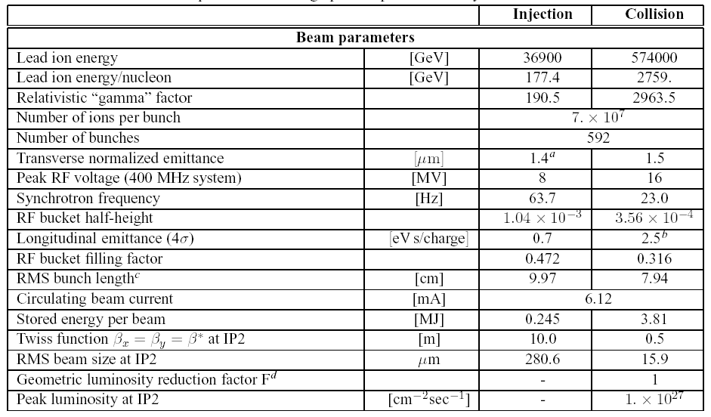
Nominal scheme parameters
Notes:
From 10/12/2003 version of Design Report

Slide 30
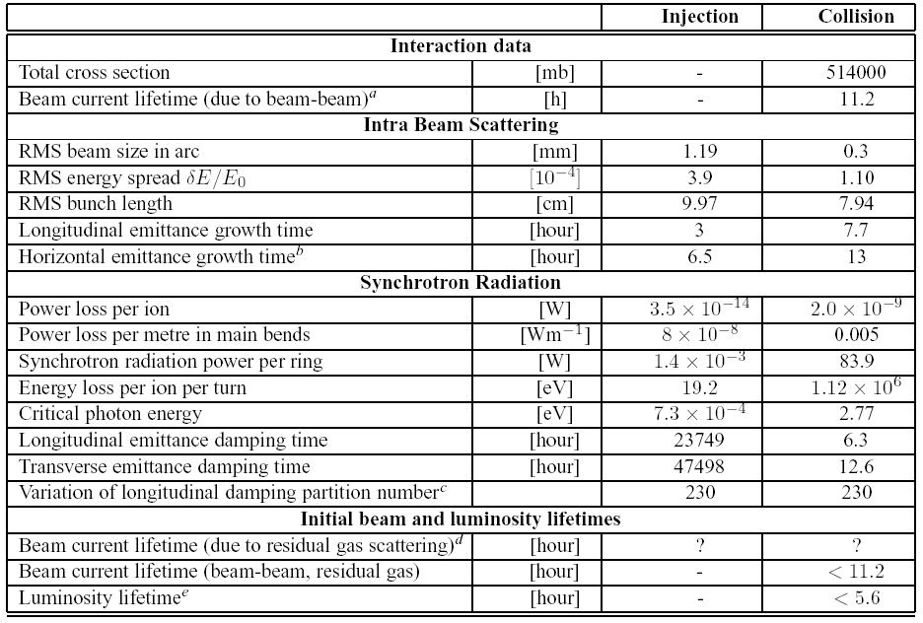
Nominal scheme, lifetime parameters
Notes:
From 10/12/2003 version of Design Report

Slide 31
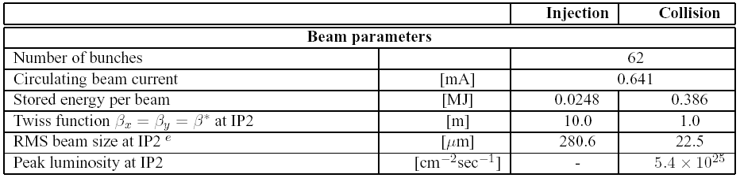
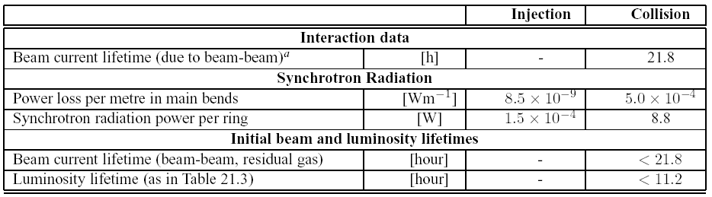
Early scheme Parameters
Only show parameters that are different from nominal scheme

Slide 32
Nuclear Beam Physics
Ultraperipheral and hadronic interactions of highly-charged beam nuclei will cause beam losses
Bound-free pair production (BFPP) at the IP, direct limit on luminosity
Collimation inefficiency, direct limit on beam current
Direct luminosity burn-off of beam intensity by BFPP and electromagnetic dissociation (EMD) processes dominates luminosity decay

Slide 33
Pair Production in Heavy Ion Collisions
We use BFPP values from Meier et al, Phys. Rev. A, 63, 032713 (2001), includes detailed calculations for Pb-Pb at LHC energy
BFPP can limit luminosity in heavy-ion colliders, S. Klein, NIM A 459 (2001) 51

Slide 34
Luminosity Limit from BFPP in LHC
IP2
Longitudinal Pb⁸¹⁺ ion distribution on screen
Beam screen
Main Pb⁸²⁺ beam
Secondary Pb⁸¹⁺ beam emerging from IP and impinging on beam screen
Beam screen in one magnet

Slide 35
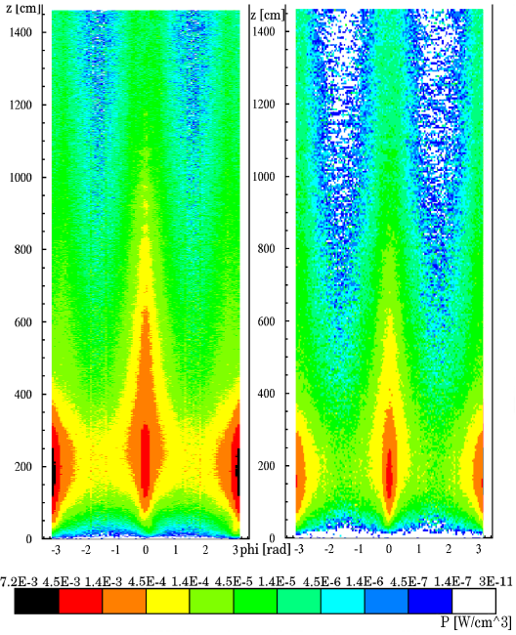
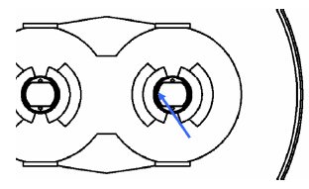
Consequences for the LHC
281 kHz loss rate at nominal L
25 W heating power in dispersion suppressor dipole magnet
Detailed Monte-Carlo of hadronic shower: heavy-ion interactions with matter in FLUKA
Revised estimates of quench limit (thermodynamics of liquid He and heat transfer) suggest magnets are not likely to quench due to BFPP beam losses
However, quench still possible within estimated uncertainties
Quench limit, Monte Carlo, BFPP cross section, …
Additional beam loss monitors installed around IPs to monitor these losses in LHC operation, can redistribute them to some extent
Unwrapped inner coil
Unwrapped outer coil

Slide 36
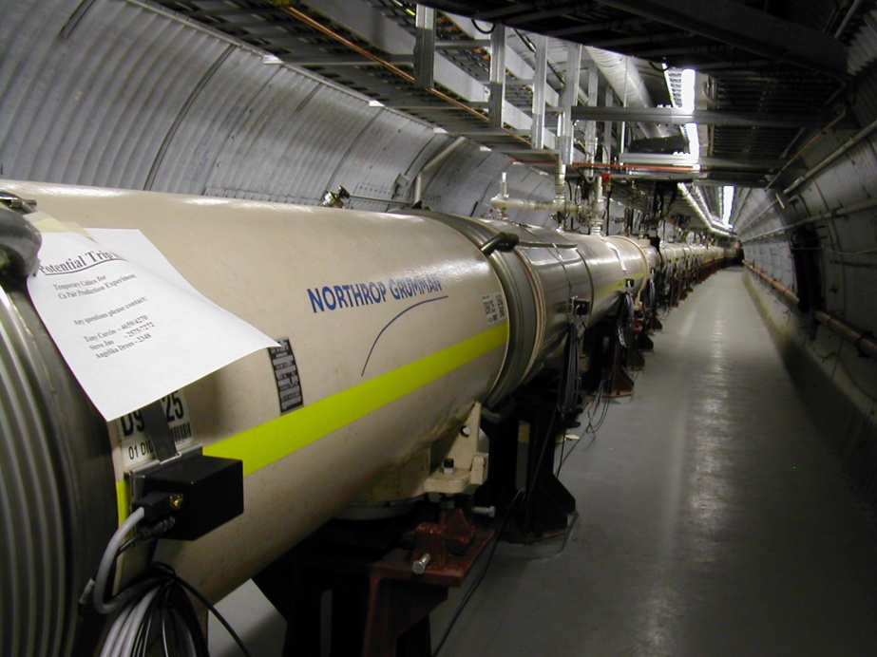
Test of LHC methodology at RHIC
Parasitic measurement during RHIC Cu-Cu run
Loss monitors setup as for LHC
Just visible signal!
Compared predictions and shower calculations as for LHC
Reasonable agreement
R. Bruce et al, Phys. Rev. Letters 99:144801, 2007
We still need to benchmark quench limit (in LHC!)
View towards PHENIX

Slide 37
Ion Collimation in LHC
Collimation system essential to protect machine from particles that would be lost causing magnet quenches or damage
Principle of collimation for protons:
Particles at large amplitudes undergo multiple Coulomb scattering in sufficiently long primary collimator (carbon), deviating their trajectories onto properly placed secondary collimators which absorb them in hadronic showers
Ions undergo nuclear fragmentation or EMD before scattering enough
Machine acts as spectrometer: isotopes lost in other locations, including SC magnets
Secondary collimators ineffective

Slide 38
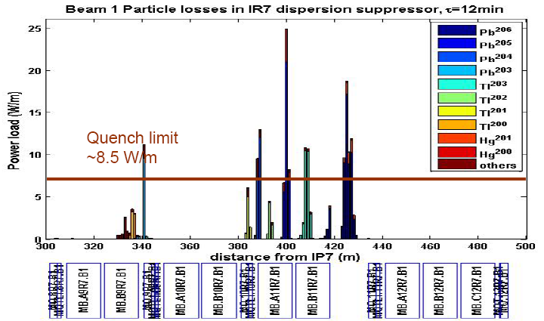
LHC Collimation Example
Loss map after IR7 (betatron cleaning section). Collision optics, standard collimator settings. Special simulation, requires much nuclear physics input, etc. Used to locate additional beam loss monitors for ion runs.
Courtesy G. Bellodi

Slide 39
Remarks on Ion Collimation
Probably the major limit for LHC ion luminosity
Nevertheless:
Conventional (1996) quench limit (tolerable heat deposition in superconducting magnet coils) now appears pessimistic
This is a soft limit: losses only get to this level if, for some reason, the single-beam (not including collisional) losses reach a level corresponding to a lifetime of 12 min.
Simulations benchmarked with real beams
LHC collimator in SPS (2007) - good agreement
Earlier data from RHIC - consistent
Phase II Collimation upgrade needed for p-p
Looking at what can be included for ions
New ideas: crystals, magnetic collimation, optics changes, high-Z primary collimators, …

Slide 40
Other limits on performance
Total bunch charge is near lower limits of visibility on beam instrumentation, particularly the beam position monitors
Must always(!) inject close to nominal bunch current
Rely on ionization profile monitors more than with protons
Intra-beam scattering (IBS, multiple Coulomb scattering within bunches) is significant but less so than at RHIC where it dominates luminosity decay
Vacuum effects (losses, emittance growth, electron cloud …) should not be significant

Slide 41
Operational parameter space with lead ions
L
cm
2
s
-
1
1.
´
10
27
BFPP Quench limit, Collimation limit?
1.
´
10
26
1.
´
10
25
Nominal
1.
´
10
24
Early
1.
´
10
23
Visible on BCTDC
Nominal single bunch current
Visibility threshold on FBCT
Visibility threshold on arc BPM
1.
´
10
22
Visible on BCTDC
I
b
m
0.01
0.05
0.1
0.5
1
5
10
Thresholds for visibility on BPMs and BCTs.
Notes:
This shows the performance parameter space, luminosity vs single bunch current.
Luminosity in Early (higher beta*, fewer bunches) and Nominal schemes shown on diagonal lines.
Various thresholds for visibility of ion bunches on beam instrumentation (BPM=beam position monitors, xBCT are current transformers) shown as red, green lines, blue dots on luminosity curves.
Luminosity limits from Bound-Free Pair Production (problem first identified by Spencer Klein) and Collimation problems may occur from about factor 2 below nominal.
Conservatively, we would be restricted to the points to the right of the green curve.
Message: operating parameter space is rather restricted.

Slide 42
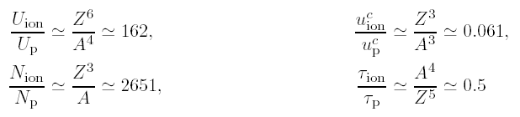
Synchrotron Radiation
Nuclear charge radiate coherently at relevant wavelengths (~ nm)
Scaling with respect to protons in same ring, same magnetic field
Radiation damping for Pb is twice as fast as for protons
Many very soft photons
Critical energy in visible spectrum
This is fast enough to overcome IBS at full intensity
Radiation damping enhancement for all stable isotopes
Lead is (almost) best, deuteron is worst.

Slide 43
Luminosity evolution: Nominal scheme
BPM visibility threshold
Transverse emittance
Particles per bunch
Increasing number of experiments reduces beam and luminosity lifetime.
An “ideal” fill, starting from design parameters giving nominal luminosity.
Luminosity
Notes:
To give an idea of luminosity evolution in an “ideal” fill, that starts with the full design luminosity 10^27 (maybe in 2009?).
LHC is first heavy ion storage ring in which synchrotron radiation has significant effects on beam dynamics. Emittance is expected to shrink (stronger for lead ions than for protons), it overcomes the intensity-dependent intra-beam scattering which is a major luminosity limitation at RHIC (radiation damping = “free beam cooling”).
These plots result from solving a set of non-linear coupled differential equations relating emittance, particles per bunch, etc, including effects of luminosity losses, IBS, radiation damping, beam-gas, RF noise,
Adding experiments (different coloured curves) reduces beam lifetime because of the very large cross-sections for EM processes that remove particles from the beam.
Emittance shrinkage is faster with more experiments because particles are removed more quickly from beam so IBS is less.
Zero-experiment case is shown as a reference: note that emittance is almost constant because radiation damping and IBS almost compensate. Slow intensity decay in this case is from beam-residual gas interactions.
With 3 experiments illuminated, the BPM threshold may force us to dump beam when single bunch intensity falls below visibility threshold on BPMs.
The “Early Scheme” to be used for startup in 2008, when working properly, should give ~20 times less luminosity which should decay somewhat more slowly.
N.B. Early Scheme should start with same single bunch intensity as Nominal. So fill lengths should be a bit longer.

Slide 44
Example: average luminosity
Average luminosity depends strongly on time taken to dump, recycle, refill, ramp and re-tune machine for collisions.
Average luminosity with 3h turn-around time, in ideal fills starting from nominal initial luminosity.
Maximum of curve gives optimum fill length.
Beams will probably be dumped to maximise average L before BPM visibility threshold is reached.
Notes:
Probably a backup slide
shows how to maximise average luminosity knowing the turn-around time.
3 h is pretty optimistic! Certainly much longer in the early days of operation. But longer turn-around will push the maximum of the curves to the right, longer optimum fill length.
May do better than this if we succeed with adjusting beta* during fills (as proposed by Andreas Morsch).
This shows that we would normally dump beams for this reason BEFORE reaching the BPM visibility threshold.

Slide 45
Commissioning Pb-Pb in the LHC Main Rings
Basic principle: Make the absolute minimum of changes to the working p-p configuration
Magnetically identical transfer, injection, ramp, squeeze of IP1, IP5
Same beam sizes
Different RF frequency swing,
Add squeeze of IP2 for ALICE
Requirements
LHC works reasonably well with protons
Ion injector chain ready with Early Beam (lead time!)
After Early scheme push up number of bunches towards Nominal
always maximising bunch current

Slide 46
How long will it take?
This will be a hot-switch, done when the LHC is already operational with protons
Not a start-up from shutdown
Previous experience of species-switch:
RHIC several times, typically from ions to p-p, with 1 week setup + 1 week performance“ramp-up”
More complicated optics changes than LHC (injection is below transition with ions, above with protons)
Protons are polarized
Done a few times with CERN ISR, late 1970s
Went very quickly (< 1 day), because magnetically identical
LHC closer to ISR than RHIC from this point of view

Slide 47
Beyond Baseline Pb-Pb Collisions
Further stages not yet scheduled within CERN programme:
p-Pb: preliminary study made (2005)
Injectors can do it.
Concerns about different revolution frequencies, moving beam-beam encounters, in LHC (2 in 1 magnet) but effects seem weak enough
Lighter ions
Resources concentrated elsewhere so far.
Will take time and detailed scheduling together with other upgrades to LHC.

Slide 48
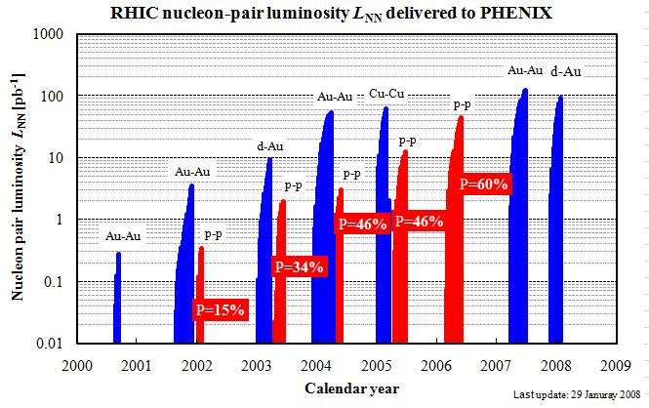
RHIC programme as a model for LHC?
RHIC II,
eRHIC
c.f. LHC longer-term upgrades, LHeC, … ?
c.f. LHC medium term upgrades: Pb-p, lighter A-A, …
c.f. LHC baseline Pb-Pb
Plot from Wolfram Fischer

Slide 49
Summary
The LHC is on track for first proton beams in summer 2008
Schedule remains sensitive to mishaps
First Pb-Pb run expected at end 2009
very sensitive to time and resources available for ion injectors in 2009
“competition” for LHC beam time with p-p
Pb-Pb luminosity limited by new beam physics
Understanding improving, tested
Measures taken to monitor and alleviate
Number of active experiments
Programme beyond baseline Pb-Pb to be established and studied

Slide 50
Acknowledgements
This talk sketched some aspects of the work of many people, over many years, in “Ions for LHC” and “LHC” Projects, in CERN and many collaborating institutes around the world.
Particular thanks for slide material to:
R. Bailey, G. Bellodi, H. Braun, R. Bruce, C. Carli, L. Evans, W. Fischer, D. Kuchler, D. Manglunki, S. Maury
Thank you for your attention

Slide 51
Backup slides

Slide 52
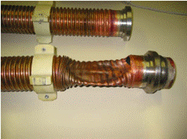
Triplets – Heat exchanger problem
During the pressure test of Sector 7-8 (25 November 2006) the corrugated heat exchanger tube in the inner triplet failed by buckling at 9 bar (external) differential pressure.
The inner triplet was isolated and the pressure test of the whole octant was successfully carried out to the maximum pressure of 27.5 bar, thus allowing it to be later cooled down.
Reduced-height of corrugations and annealing of copper near the brazed joint at the tube extremities accounted for the insufficient resistance to buckling.
New tubes were produced with higher wall thickness, no change in corrugation height at ends, and e-beam welded collars to increase distance to the brazed joint.
Installation of these tubes was made in situ.

Slide 53
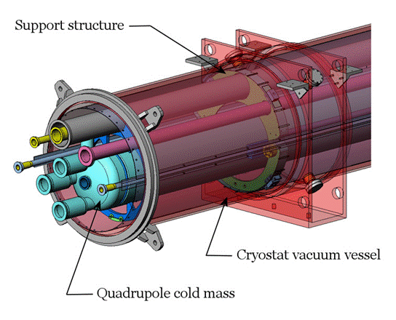
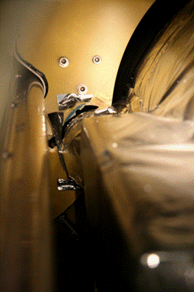
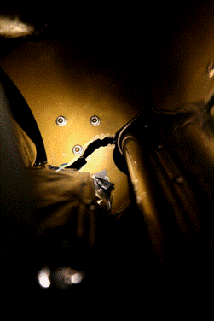
Triplets – Supports problem
Q1 supports at IP 5L
On Tuesday 27 Mar 2007 there was a serious failure in a high-pressure test at CERN of a Fermilab-built “inner-triplet” series of three quadrupole magnets.

Slide 54
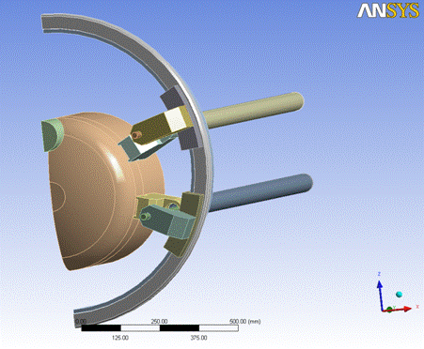
Triplets – Supports solution
Requirements for repair
Must be implemented in situ
Does not displace the fixed points of the assembly
React loads with sufficient stiffness to limit deflection at 150 kN design load
Acts at any temperature between 300K and 2K
To be implemented in Q1 and Q3
Solution adopted
Affixed at Q1 non-IP end and at Q3 IP end
Transfer load at all temperatures
Limits support deflections
Compound design with Invar rod and aluminium alloy tube
Attached with brackets to cold mass and cryostat outer vessel
Status
All triplets repaired by September
Problem solved

Slide 55
PiM summary
The problem
Contact fingers in an arc interconnect buckled into beam aperture
Post-mortem examination shows this took place during sector warm-up
Was a major worry (there are 4000 of them!) but limited extent (% level)
Understood why it happened (manufacturing problem)
Solutions being implemented for first beam
The LHC is being closed with components corrected to be within original specification and working as closely as possible to nominal conditions
Aperture is being systematically checked before cooldown, and will be after each warm-up
Longer term perspective
The data used to make the PIM design is being double-checked, and detailed FE analysis is in progress both to simulate the failures and check the robustness of the design
Once this procedure is complete, and the reasons for the manufacturing defects understood, a long term strategy will be adopted
There is now no reason why this problem should have further impact on the machine schedule

Slide 56
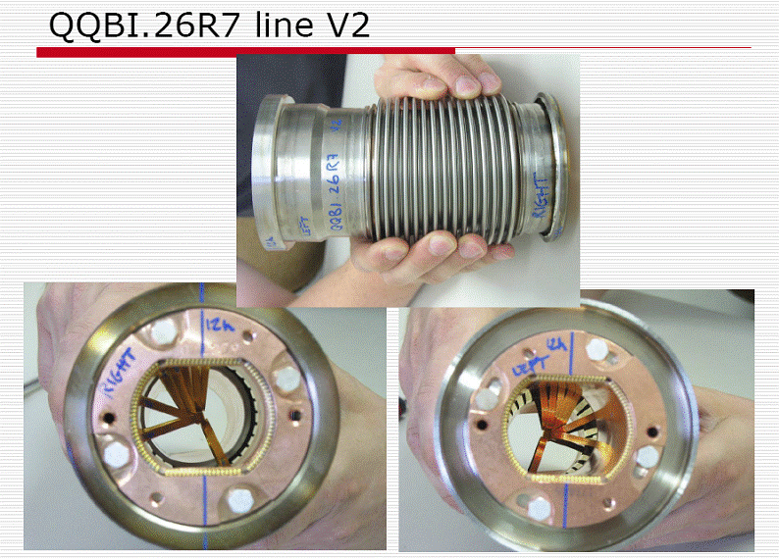
Shielded bellows on the cold interconnects (PiMs)

Slide 57
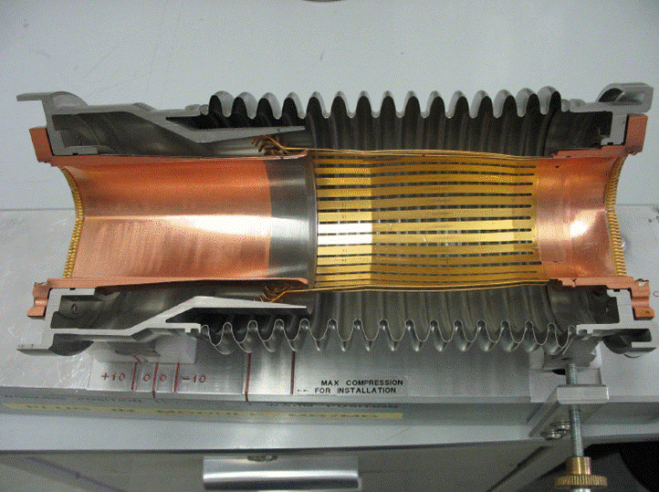
Plug in Module in equivalent cold position

Slide 58
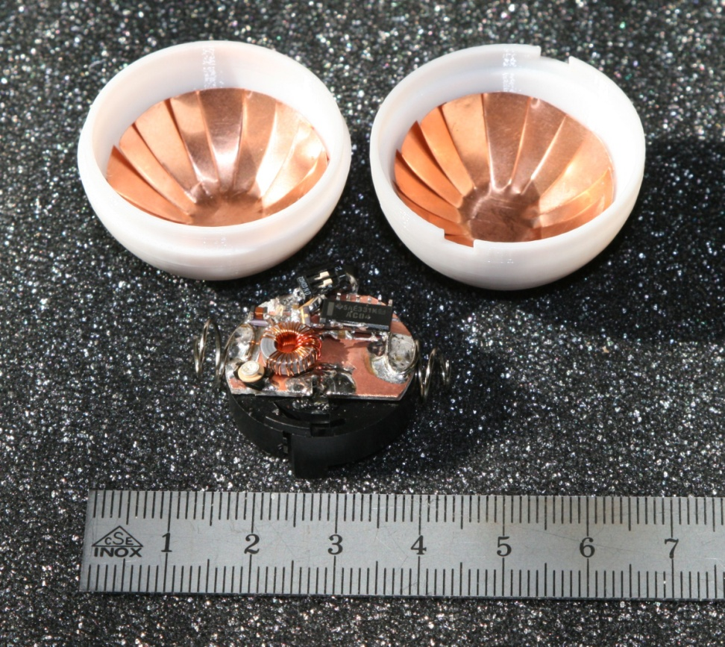
RF mole
Polycarbonate shell
Diameter
34mm exterior
30mm interior
Total weight
~15 g (ball 8g)
RF characteristics
40MHz resonantcircuit
Generates 20V between copper electrodes
Battery powered
Over 2hr lifetime
Capacitive coupling to BPM electrodes
1V ⇒~5mV
-45db Coupling
BPM trigger threshold at ~3mV

Slide 59
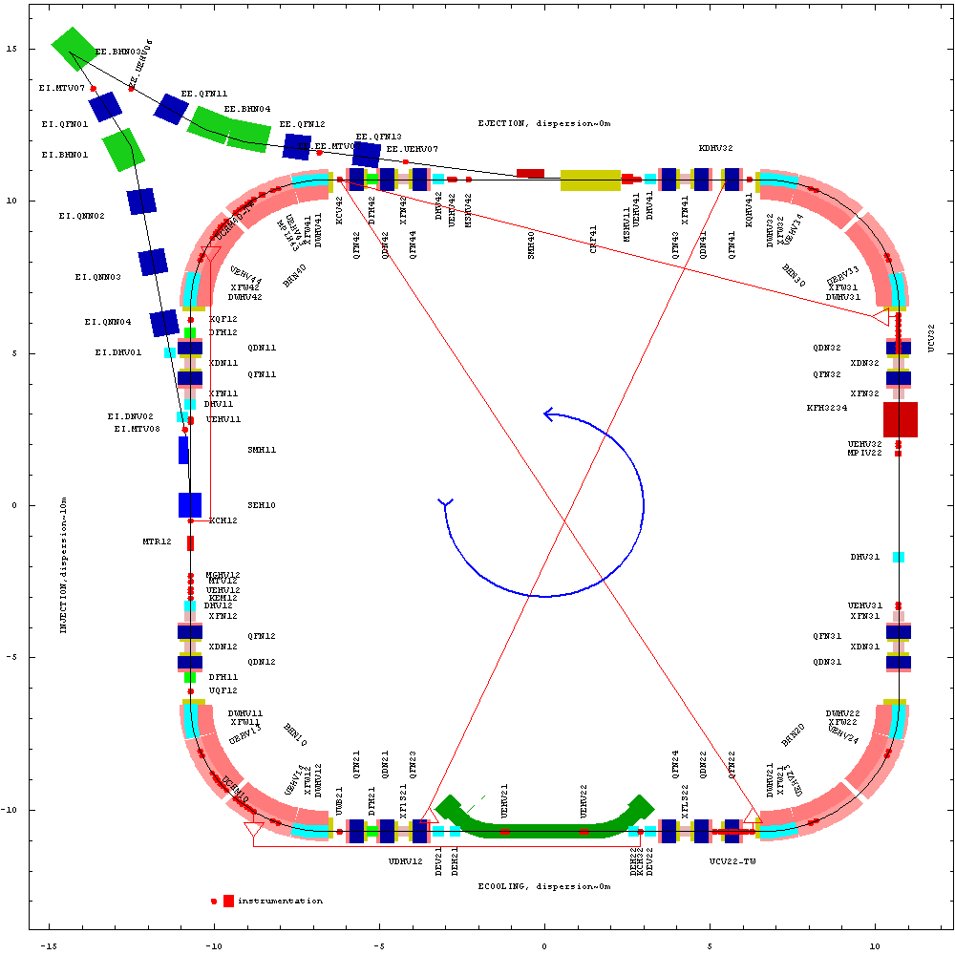
LEIR (Low-Energy Ion Ring)
Prepares beams for LHC using electron cooling
circumference 25p m (1/8 PS)
Multiturn injection into horizontal+vertical+longitudinal phase planes
Fast Electron Cooling : Electron current from 0.5 to 0.6 A with variable density
Dynamic vacuum (NEG, Au-coated collimators, scrubbing)
Ejection
Quadrupole
triplet
RF
D=0
RF
vacuum sector 4
Injection
Ejection
kicker
D0
D0
Quadrupole doublet
dipole
E-Cooling
D=0

Slide 60
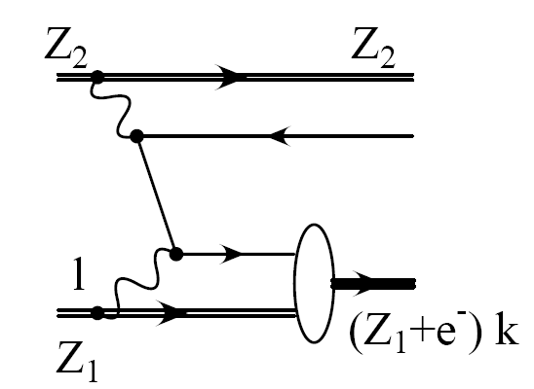
Dependence of BFPP cross-section on Z
Hand-waving, over-simplified argument!
G. Baur et al, Phys. Rept. 364 (2002) 359

Slide 61
Tracking of BFPP ions in the LHC
BFPP ions tracked with MAD-X from every IP that might collide ions
ATLAS
ALICE
CMS
BFPP orbit oscillating with the dispersion function
Fraction of the beam might be lost further downstream
Could be used to spread out the heat load

