Slide 1
AAC Meeting
A Mu2e Upgrade Plan for the Project X Era
Chuck Ankenbrandt
Muons, Inc. and Fermilab
February 4, 2009

Slide 2
Introduction
Synergies among NFs, MCs, and a Mu2e Upgrade:
All three need an intense proton source.
At Fermilab, Project X (initially 1 MW @ 8 GeV).
Project X needs an 8-GeV “customer”.
That could be the Mu2e experiment (upgraded).
The same 8-GeV ring(s) could be used for all three.
All three (or two!) will benefit from muon cooling.
Cooling may be provided by a helical cooling channel.
The Mu2e application is easier than that of the MC.
The Mu2e need is earlier than that of the MC.
Multiple uses of bright muons build HEP support.
Muon cooling technology will enable a diverse program.
The other kind of lepton collider is a one-trick pony.
We should come to praise spinoffs, not bury them.

Slide 3
MANX and Mu2e
MANX proposes to test a helical cooling channel.
The same kind of HCC might be used to upgrade the Mu2e experiment.
Mu2e plans to use ~ 25 kW of beam power from the Booster.
HEP community would like sensitivity of 10⁻¹⁸ instead of 10⁻¹⁶
Can we find a way to use 1 MW of beam from Project X?
Probably we’ll need to rethink everything.
Bob Bernstein, co-spokesperson for Mu2e, said I could use some of the slides he prepared for this meeting.
Jim Miller, the other Mu2e co-spokesperson, said I could use some of his slides from the PAC meeting.

Slide 4
Structure of this talk
Introduction
Mu2e Baseline Design
A Mu2e Upgrade Plan
Summary/Conclusions

Slide 5
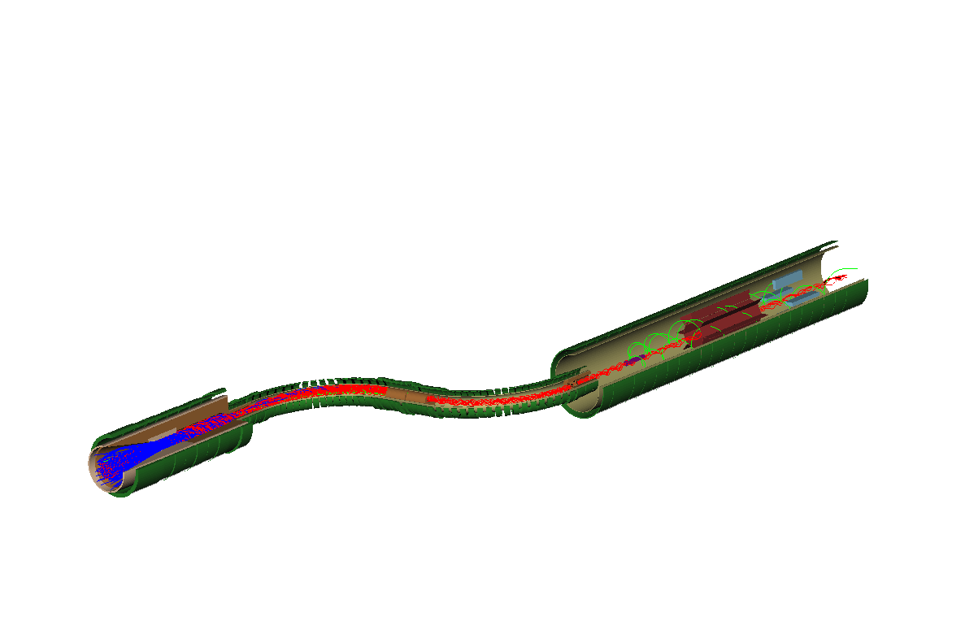
Mu2e Muon Beamline- follows MECO design
Muons are collected, transported, and
detected in superconducting solenoidal magnets
Muon
Stopping Target
Calorimeter
Tracker
Proton Beam
Target
Shielding
Muon Beam
Collimators
Proton
Target
Pions
Electrons
Muons
Detector
Solenoid
Transport
Solenoid
Selects low momentum μ⁻
Avoids straight line from production target to detectors
Production
Solenoid
Delivers 0.0025 stopped
muons per 8 GeV proton
Jim Miller
Notes:
5

Slide 6

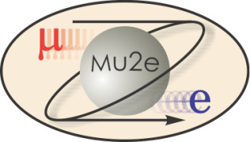
Two Classes of Backgrounds
 | Prompt | Decay-In-Orbit
Source | Mostly π’s produced in target | Physics Background nearly indistinguishable from signal
Solution | Design of Muon Beam, formation, transport, and time structure | Spectrometer Design: resolution and pattern recognition
R. Bernstein, FNAL AAC Seminar Jan 2009

Slide 7
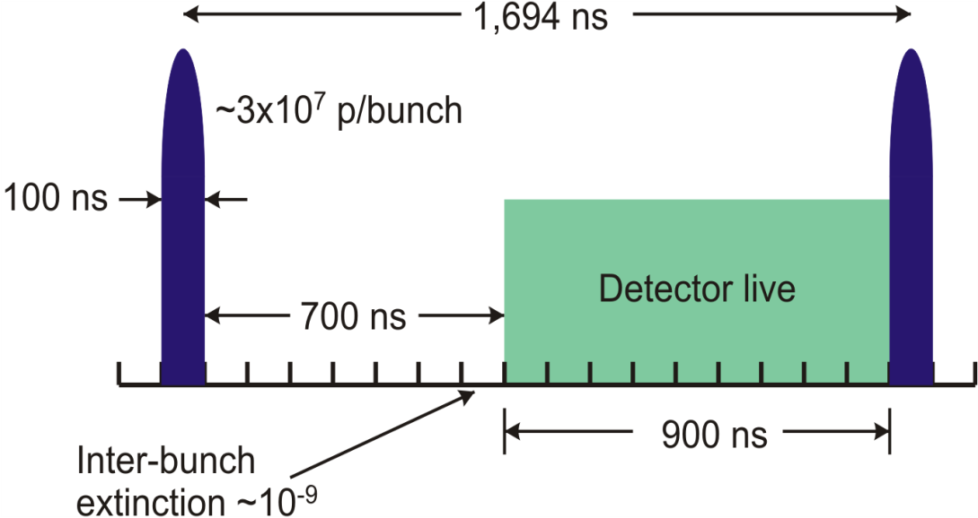
Prompt Backgrounds
Particles produced by proton pulse which interact almost immediately when they enter the detector: π, neutrons, pbars
Radiative pion capture
π-+A(N,Z) →γ +X.
γ up to m_{π}, peak at 110 MeV; γ→ e+e- ;
if one electron ~ 100 MeV in the target, looks like signal: limitation in best existing experiment, SINDRUM II?
Why this wait?
R. Bernstein, FNAL AAC Seminar Jan 2009
Notes:
76 MeV from relativistic kinematics

Slide 8
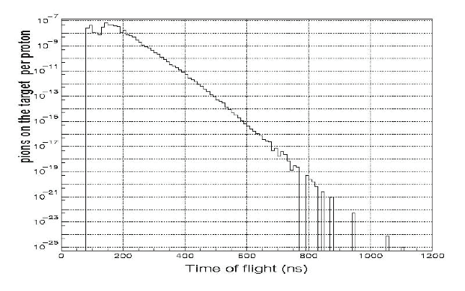
Radiative π vs. Time
π on target per proton
This is a main reason why we have to wait 700 nsec
would be really nice to eliminate pions another way!!
Upgrade alert!
Gain 10¹¹ in π rejection by waiting 700 nsec
R. Bernstein, FNAL AAC Seminar Jan 2009

Slide 9
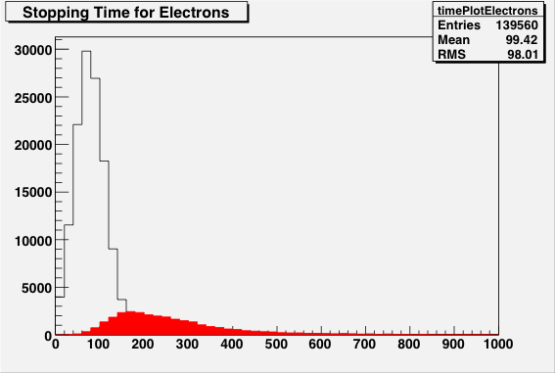
Beam Flash
Beam electrons: incident on the stopping target and scatter into the detector region.
Need to suppress e⁻ with E>100 MeV near 105 MeV signal
electrons
Upgrade alert!
muons
R. Bernstein, FNAL AAC Seminar Jan 2009

Slide 10
Other Backgrounds
In-flight muon decays yielding electrons
If p_{μ} > 76 MeV/c, can get > 100 MeV electron
Late arriving electrons from spiraling in field
Momentum selection and a tighter timing distribution would help!
Upgrade alert!
R. Bernstein, FNAL AAC Seminar Jan 2009

Slide 11
Backgrounds from Stopped Muons(Cont’d)
Ordinary muon capture on the nucleus
In aluminum, 40% capture, 60% decay, lifetime = 864 ns
n, p are low energy, γ are mostly low energy, well below conversion electron energy: create high rate background in detectors, potential track recognition errors
Neutral background (n, γ) is reduced by displacing detectors downstream from the stopping target
Protons are reduced by placing thin absorbers in their path
Muon radiative decay, γ near conversion energy, prob ~ few x 10⁻⁵; endpoint for aluminum 102.4 MeV, 2.5 MeV below conversion electron energy. Smaller event rate but still significant compared to DIO.
In-flight muon decay
p_{μ}>75 MeV/c can decay to >100 MeV electron
Upgrade alert!
Jim Miller

Slide 12
Long Transit Time Background
Particles with low longitudinal velocity can take a long time to traverse the beam line, arriving at the stopping target during the measurement period
Antiprotons and radiative pion capture:
Antiprotons are stopped by a thin window in middle of transport
Adjust measure start time until most long-transit time pions decay
Example of a potential problem
Pion decays into a muon early in the transport solenoid
Muon can have small pitch and progress very slowly downstream
Muon can decay after a long time into an electron
Decay electron can be >100 MeV if p_{μ}>75 MeV/c
Electron could scatter in collimators, arriving at the target late during the measurement period, where it could scatter into the detector acceptance
To suppress this…
Straight sections of solenoids have dB_{s}/ds<0.02 T/m
Greatly reduces number of particles (e.g. π−>μ) with small pitch
Gradient criterion not necessary in curved solenoid sections, low pitch particles are swept away vertically by dB_{s}/dr field gradient.
Upgrade alert!
Jim Miller

Slide 13
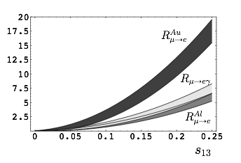
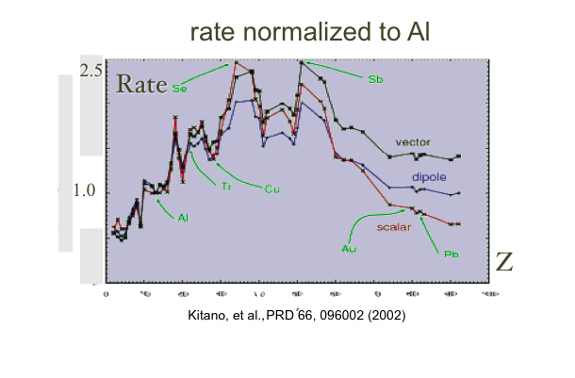
Choice of Stopping Material: rate vs wait
Stop muons in target (Z,A)
Physics sensitive to Z: with signal, can switch target to probe source of new physics
Why start with Al?
can see up to x4 effect!
s13 is NOvA mixing angle
< 0.2 or so
V. Cirigliano, B. Grinstein, G. Isidori, M. Wise Nucl.Phys.B728:121-134,2005. e-Print: hep-ph/0507001
Upgrade alert!
R. Bernstein, FNAL AAC Seminar Jan 2009
13

Slide 14
Prompt Background and Choice of Z
choose Z based on tradeoff between rate and lifetime: longer lived reduces prompt backgrounds
Nucleus | Rμe(Z) / Rμe(Al) | Bound Lifetime | Conversion Energy | Fraction >700 ns
Al(13,27) | 1.0 | 864 nsec | 104.96 MeV | 0.45
Ti(22,~48) | 1.7 | 328 nsec | 104.18 MeV | 0.16
Au(79,~197) | ~0.8-1.5 | 72.6 nsec | 95.56 MeV | negligible
R. Bernstein, FNAL AAC Seminar Jan 2009
14

Slide 15
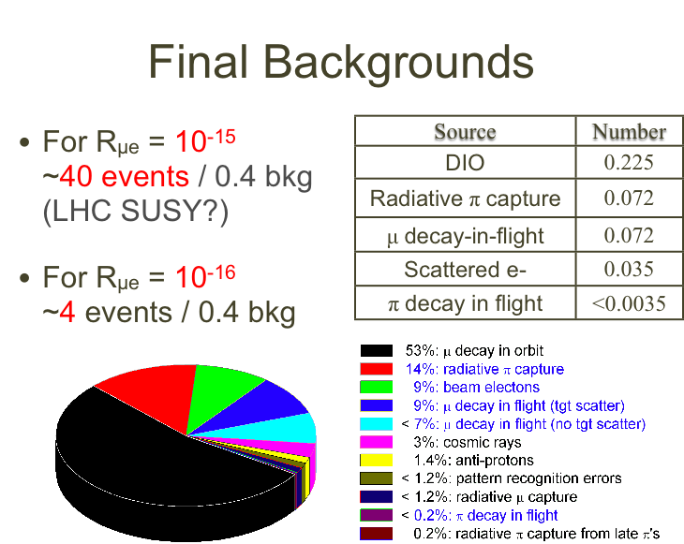
R. Bernstein, FNAL AAC Seminar Jan 2009

Slide 16
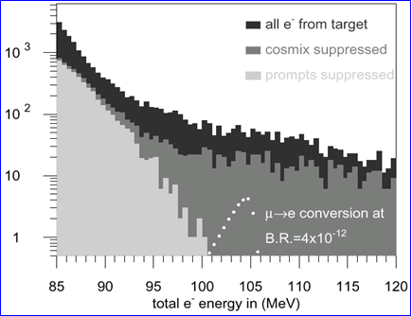
Previous Data, μN→eN
From SINDRUM Experiment
High energy tail of Decay-in-orbit (DIO) electrons. Simulated conversion peak
DC beam
Rate limited by need to veto prompt backgrounds!→ pulsed beam

Slide 17
Mu2e Upgrades
Signal?
Yes
No
1. Change Z of Target
to determine source of new physics
2. Need Project X to provide statistics
1. Probe additional two orders of magnitude made possible by Project X
2. Need upgrades to muon transport and detector
R. Bernstein, FNAL AAC Seminar Jan 2009
17

Slide 18
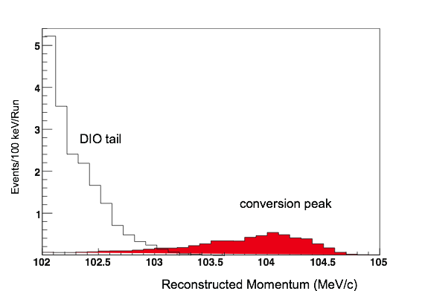

Upgrade Plans...
Signal?
No
Yes
1. Change Z of Target
to determine source of new physics
2. Prompt Rates will go up at higher Z, have to redesign detector and muon transport
1. Both Prompt and DIO backgrounds must drop to measure
R_{μe} ~ 10⁻¹⁸
2. Detector, Muon Transport, Cosmic Ray Veto, Calorimeter
R. Bernstein, FNAL AAC Seminar Jan 2009
18

Slide 19
Upgrade Challenges
If we want higher Z targets, must shorten the 700 nsec wait time, perhaps 700 → 70 nsec
Beam flash
Radiative pi capture
But without a signal, also need to improve resolution from decay-in-orbit background
Just the beam improvements are not enough: would only reduce background x2
Resolution of spectrometer and pattern recognition algorithms; new hardware?
Extinction: need ~x100 better
Upgrade alert!
R. Bernstein, FNAL AAC Seminar Jan 2009

Slide 20
Conclusions (upgrade)
Resolution and background issues are critical
Project X will get at least x10 in statistics,
With a signal
Explore different targets
Reduce radiative pion background
Decrease time spread of muons
And with a limit, the beam related sources are only ½ of background – resolution becomes the limiting problem
Upgrade alert!
R. Bernstein, FNAL AAC Seminar Jan 2009
20

Slide 21
Structure of this talk
Introduction
Mu2e Baseline Design
A Mu2e Upgrade Plan (rethink everything)
Summary/Conclusions

Slide 22
Major components of the plan
Accumulate protons from linac into bunches
No. bunches can be optimized vs Z of the target.
!st ring: accumulate and form N bunches
Bunch rotate into shorter bunches
Transfer M bunches at a time to 2nd ring and extract
Two-stage slow extraction to mitigate losses
Produce pions in dipole plus wedge system
Transmit muons to stopping target
Match quasi-monochromatic pion beam into HCC
(matching section is also decay volume)
Cool and degrade muons in HCC
Match into stopping target solenoid
Use S-bend a la MECO to transport e’s to detector

Slide 23
Project X
Parameters
8-GeV H⁻ Linac
1 MW of beam power initially
5 Hz repetition rate
~1.3 msec beam pulse
~20 mA beam current during pulse
Upgrade Path to 4 MW for NF/MC
10 Hz?
2.5 msec?
Must “repackage” the beam to meet NF/MC needs.
Can use the same bunching rings for Mu2e.

Slide 24
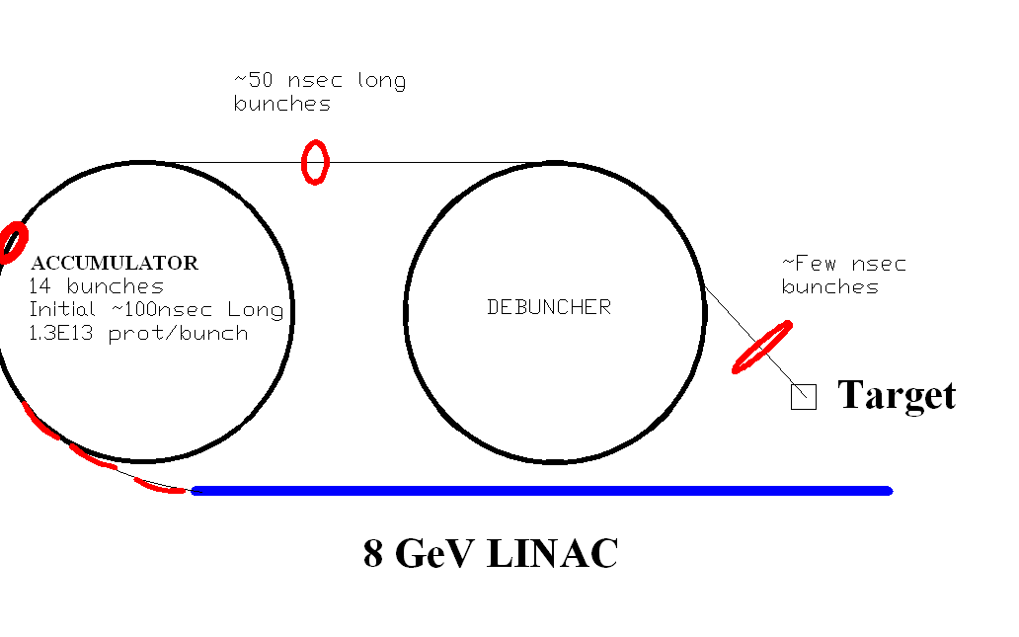
Providing p Bunches for a ν Factory or a μ Collider
Accumulate protons from linac into N bunches
24
Notes:
Test
24

Slide 25
Two-stage resonant extraction
Extraction loss fraction ~ septum width/step size ~ 1%
Losses of 10 kW in ring would be serious.
Protons hitting wires get partial deflection by E field
Worse than interactions and multiple scattering
Those protons are likely to hit the Lambertson septum
Brute force: reduce width, increase step size
New concept: two-stage extraction
Move Lambertson ~ 270 degrees downstream from 1st septum
Add second electrostatic device ~ 90 degrees from 1st septum
Second device has two wire septa, with E field in between
Circulating and extracting protons are undeflected
“Damaged” protons are deflected by second device to dump or to test beam area

Slide 26
Stopping Muon Beams 101
(Taken from Talk At Project X Physics Workshop)
p + A -> π + X
~One charged pion of each sign per 8-GeV proton
Pion decay length is 7.8 meters for p = mc
π −> μ + ν decay kinematics in lab:
There’s less than 29 MeV/c of transverse momentum.
Momentum distribution of relativistic muons is uniform between about 60% and about 100% of pion momentum.
Polarization is completely correlated with longitudinal momentum.
Where the pions are: cf. next slide.
Passing the muons through material causes the momentum spread to grow significantly. (dE/dx causes longitudinal heating.) cf. following slide.

Slide 27
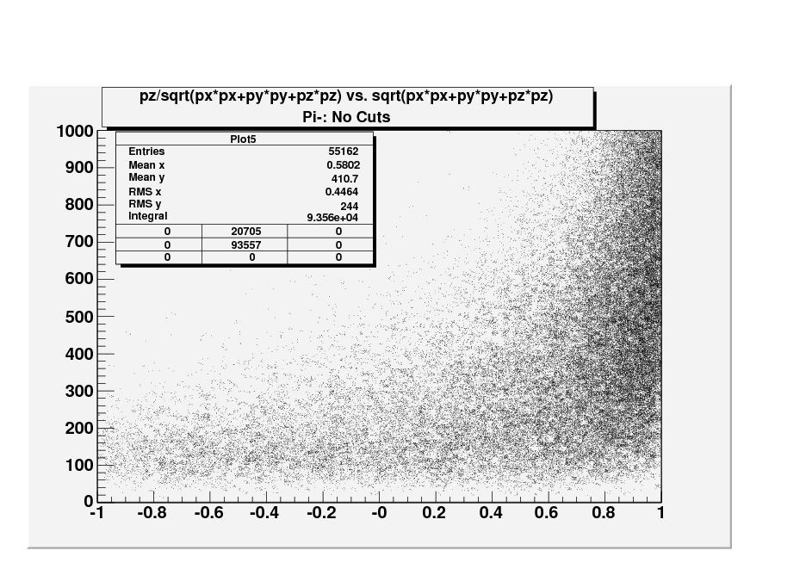
Momentum vs. Cosine of production angle (from C. Yoshikawa)
p
Cos theta

Slide 28
μ
Muons, Inc.
Momentum vs. Cosine of production angle (from C. Yoshikawa)
Alt. B
MECO
Alt.A

Slide 29
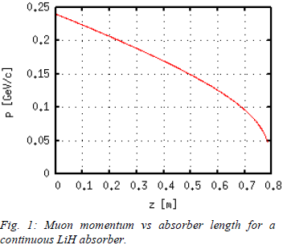
Momentum vs Range in LiH

Slide 30
Concepts
(a) π/μ production
(b) momentum
evolution
SBIR Cooling Concept:
6D particle density
increase
Absorber density
decrease
a)
b)
HCC acceptance
MECO acceptance
(From Mary Anne Cummings)

Slide 31
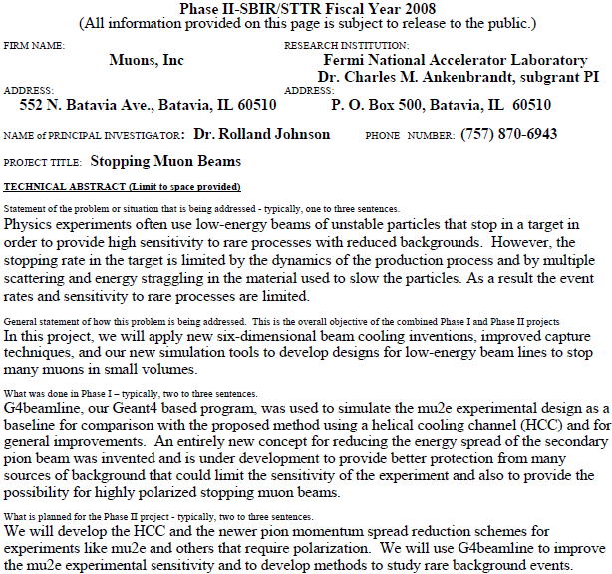
SBIR: Stopping Muon Beams

Slide 32
However, …
Above example used collider target solenoid (20 T)
Not a fair comparison with MECO (5 T)
Perhaps not affordable for mu2e
Also, Mu2e collaborators don’t want proton beam pointed at detector.
Ergo, explore other concepts:

Slide 33
Target + Wedge @ Dipole Edge
Proton beam
target
Start of match to HCC
wedge
BR=1 Tm
Followed by low-Z absorber in HCC to cool the beam and reduce its energy.

Slide 34
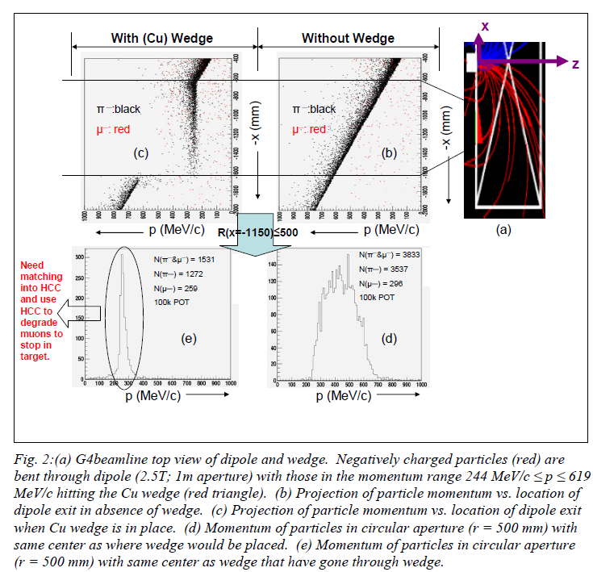
Dipole + Wedge Results

Slide 35
Transmit muons to stopping target
Match quasi-monochromatic pion beam into HCC
(matching section is also pion decay volume)
Cool and degrade muons in HCC
Match into stopping target in solenoid

Slide 36
Reconfigure stopping target/detector
Use S-bend a la MECO to transport e’s to detector.
Perhaps can reuse muon transport solenoid from Phase I.
Remove proton catcher around stopping target.
Many advantages result…

Slide 37
Advantages
Much higher proton flux is available (thanks to Project X) and usable.
The production target configuration is easily shielded.
The coils of the production dipole are shielded by iron pole tips.
The pions are produced forward, so we don’t need a small-radius target.
So it’s easier to handle ~ 1 MW of beam power.
Wrong-sign particles from the production target are eliminated.
Hi-Z wedge suppresses electrons from production target.
There’s much less straggling in flight times of muons and pions.
Angles in beam are smaller, so don’t need precise fields to avoid trapping.
Hadronic “flash” is suppressed; they stop upstream, in the degrader.
The protons from muon capture are eliminated in the S-bend solenoid.
(5 MeV protons have p~100 MeV/c.)
Since we don’t need a proton catcher around the stopping target, the energy resolution for the signal electrons is better.
Helps suppress background from muon decay in orbit.
(Can make polarized muon beam for other applications.)

Slide 38
In conclusion:
A promising Mu2e Upgrade concept has emerged.
The concept seems to have many advantages.
No disadvantages are obvious to the naked eye.
The ideas are synergistic with the Project X initial configuration and with the subsequent evolution of the facility for a neutrino factory and/or a muon collider.
Support for the development of the concept is requested.
Extensive design and simulation work is needed.
Experimental testing of the muon transport and cooling is essential.

Slide 39
Backup slides

Slide 40
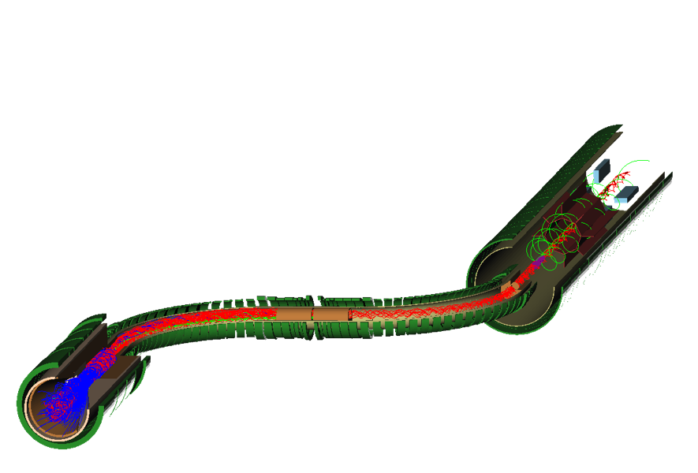
Detector and Solenoid
Tracking and Calorimeter
Decay into muons and transport to stopping target
Pictures from G4Beamline/MuonsInc
S-curve eliminates backgrounds and sign-selects
Production: Magnetic mirror reflects π’s into acceptance
R. Bernstein, FNAL AAC Seminar Jan 2009
40
Notes:
40

Slide 41
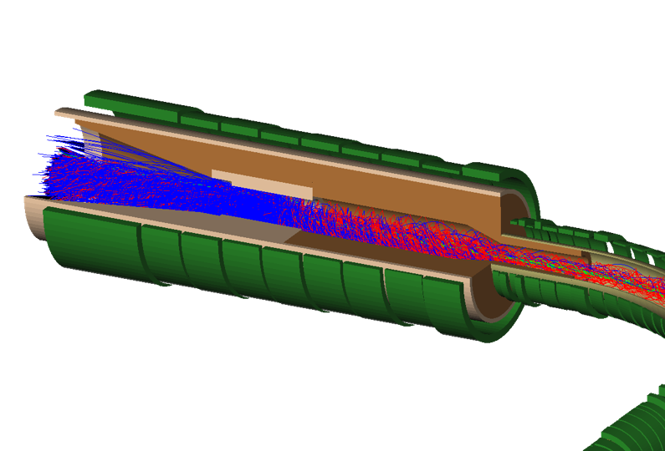
Production Solenoid:
Protons enter opposite to outgoing muons
Protons leave through thin window
π’s are captured, spiral around and decay
muons exit to right
Target Shielding
Proton Target
Pions
Protons enter here
4 m × 0.30 m
R. Bernstein, FNAL AAC Seminar Jan 2009
41
Notes:
41

Slide 42
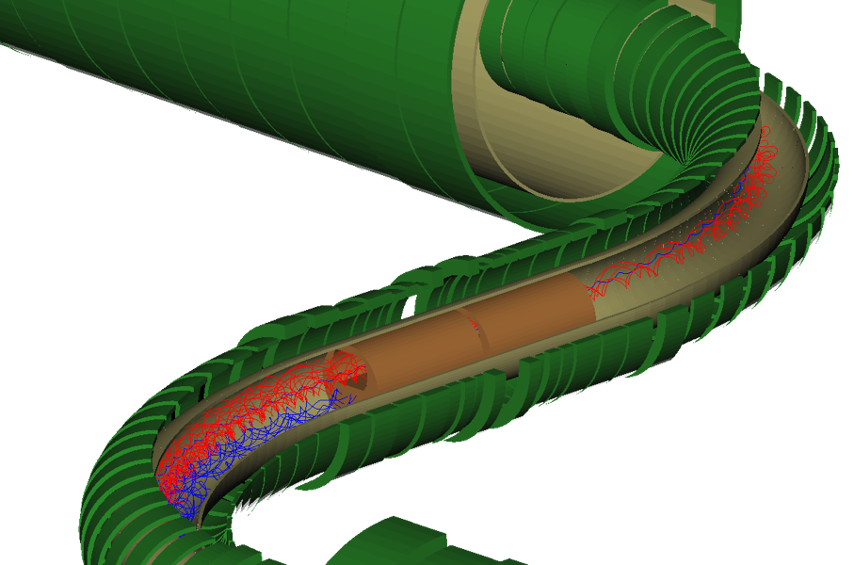
Transport Solenoid
Curved solenoid eliminates line-of-sight transport of photons and neutrons
Curvature drift and collimators sign and momentum select beam
occasional μ⁺
13.1 m along axis × ~0.25 m
R. Bernstein, FNAL AAC Seminar Jan 2009
42
Notes:
42

Slide 43
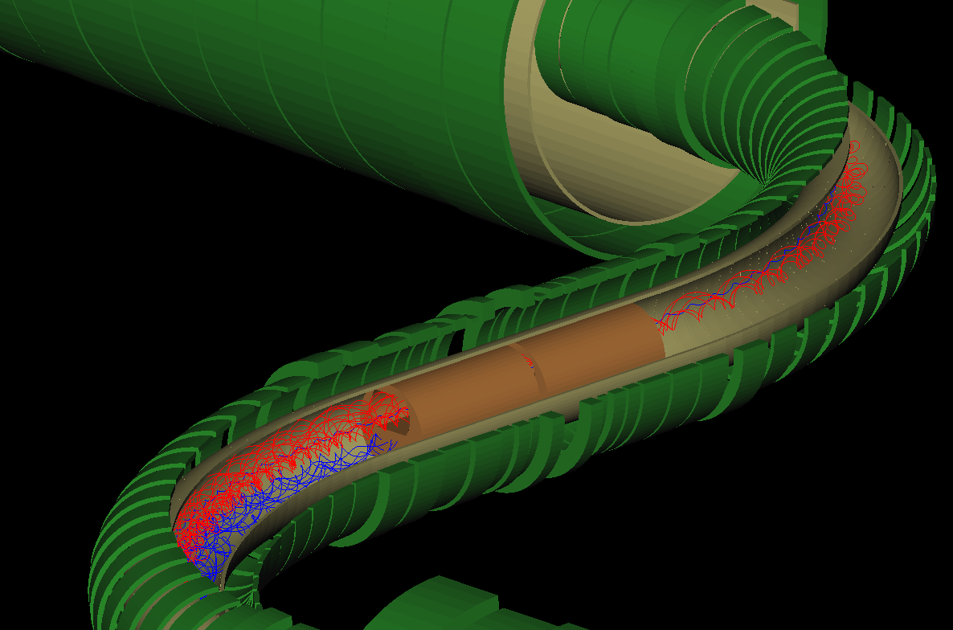
Separation of μ⁻ from μ⁺
μ⁻
cm
μ⁺
cm
43
PAC Meeting - Nov. 3 2008
43
Notes:
43
43

Slide 44
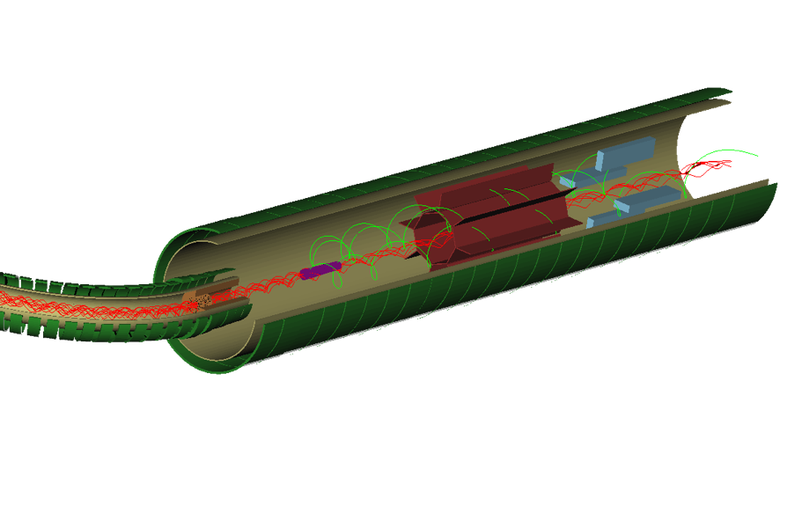
Detector Solenoid
octagonal tracker surrounding central region:
radius of helix proportional to momentum
low momentum particles and almost all DIO background passes down center
10 m × 0.95 m
Al foil stopping target
signal events pass through octagon of tracker
and produce hits
R. Bernstein, FNAL AAC Seminar Jan 2009
44
Notes:
44
so background goes down center and signal spirals out to tracker

Slide 45


Pulsed Beam Structure
Tied to prompt rate and machine: FNAL near-perfect
Want pulse duration << , pulse separation ≥
FNAL Debuncher has circumference 1.7 μsec !
Extinction between pulses < 10⁻⁹ needed
= # protons out of pulse/# protons in pulse
10⁻⁹ based on simulation of prompt backgrounds
R. Bernstein, FNAL AAC Seminar Jan 2009
45
45
Notes:
45

Slide 46
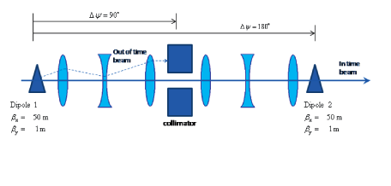
Extinction Scheme
Eliminate protons in beam in-between pulses:
“Switch” dipole timing to switch signal and background: accept only out-of-time protons for direct measurement of extinction
Continuous Extinction monitoring techniques under study
Cerenkov light with gated PMT for beam flash
achieving 10⁻⁹ is hard; normally get 10⁻² – 10⁻³
CDR under development
R. Bernstein, FNAL AAC Seminar Jan 2009
46
46
Notes:
46

Slide 47
Project X Timing
Must run and analyze Mu2e Phase I
We will continue to refine our existing design and look for new ideas
solenoid? tracking? time structure?
Finish analysis Phase I around 2020 then
Project X makes a program possible, improving as we learn
R. Bernstein, FNAL AAC Seminar Jan 2009
47
47
Notes:
47
in principle, we could run at project x without significant upgrades -- run longer, and can take instantaneous rates x4 higher. So that would get about an order of magnitude right away. Getting additional x10 is hard and requires redesign.

Slide 48
Advantages of Wedge@edge
Hard momentum cutoff at ~ 150 MeV/c
Eliminates wrong-sign particles
Full width of target magnet is used: magnetic field volume is not wasted
Particles heavier than muons stop in degrader, not in stopping target;
thus much better hadron background rejection than in MECO design
Electrons get eaten by high-Z wedge, thus probably not a problem.
Better background suppression means might live with higher intensity
Little dispersion in muon arrival times
May have better mu/proton ratio:
Uses pions at peak of momentum distribution
Uses pions produced near zero degrees
May be less expensive than MECO (maybe even fly under P5 radar?)
Probably can operate with shorter deadtime after proton arrival
=>More usable muons per proton
=>Could use titanium or other material having Z greater than Aluminum
Proton beam points away from experiment and is easily dumped.
Produces polarized stopping muon beam
Polarization can be varied by changing the thickness of the degrader

