Slide 1
AAC Meeting
MANX at RAL Experiment: Beam Line, Detectors, and Plans
Bob Abrams
February 4, 2009

Slide 2
Overall Strategy
Utilize/adapt existing MICE HW and SW ¹
MICE beam line
MICE beam instrumentation
MICE spectrometers and particle ID counters
DAQ and electronics
Simulation and analysis SW
Infrastructure and facilities at RAL
Add MANX-specific HW and SW
Faster TOF for better P_{L}, 6D emittance determination
Trackers inside HCC for trajectory determination
¹ Many of the figures and pictures presented here were taken from MICE documents and presentations

Slide 3
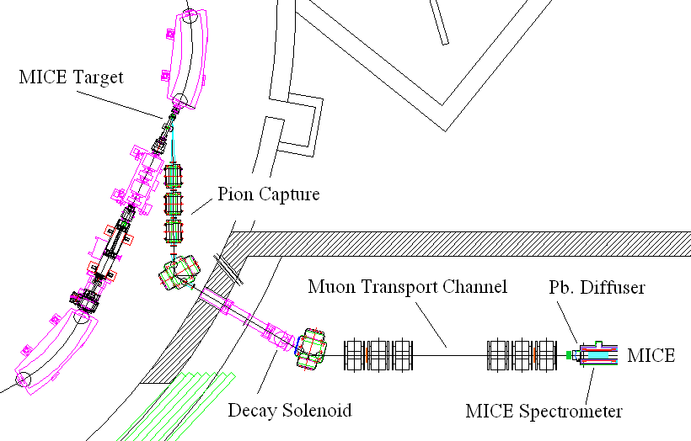
RAL: MICE Beam Line
ISIS: 800 MeV Protons
50 Hz, 100µs spill
(1x10 mm Ti
1 dip per 50 spills)
For MANX:
Retune beam for ~370 MeV/c muons
(MICE Plans to operate at 140, 200, 240 MeV/c)
~400-480 MeV/c
/MANX
Apparatus
~140-250 MeV/c
(Upstream)
(5m)

Slide 4
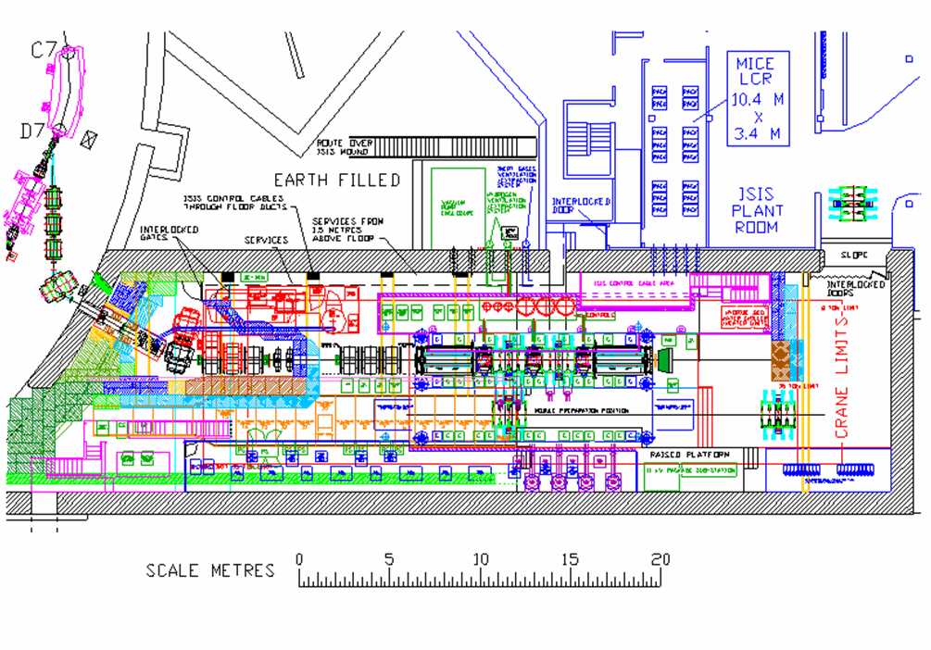
Q1
Q2
MICE
Beam
Detectors
Q3
BM2
Q4 Q5 Q6
Q7 Q8 Q9
DS
BC1
BM1,BC2
CKOVB
GVA1
GVA2
CKOVA

Slide 5
MICE Detectors Available for MANX
Detector | Purpose | Size (cm²⁾ | Number (Per unit) | Type | Source
BM1,2 BC1, 2 GVA1, 2 | Beam profile Beam trigger Beam trigger | 20x20 | (8x + 8y) | Scint fibers Scint ctrs Scint paddle | U. Geneva
TOF 0, 1 & 2 | Pi-mu ID, RF timing(MICE) (~70 ps time res) | ~40x40 | 10x + 10y 7x + 7y | BC-420 scint | INFN Milano Pavia
CKOV1,2 | Pi-mu ID Trigger | 45x45 | 4 PMTs | Cherenkov Aerogel rad | U. Miss
Trackers (Upstream&Downstream) | Momentum measurement | ~17.5 cm active radius | 5 stations 2-3 coord per stat’n | Scint Fibers (x, u, v) 4T Solenoid | LBNL, IIT FNAL, UCL RAL, Osaka
KL (Upgraded KLOE EMCAL) | Downstream electron ident | 120 x120 | 4 layers 30/layer | Scint Fibers Pb Foils | INFN Rome
EMR (Electromagnetic Ranger) | Downstream e-mu ID | 120 x120 | 9 layers 9 (x or y) per layer | Scintillator strips | INFN Milan

Slide 6
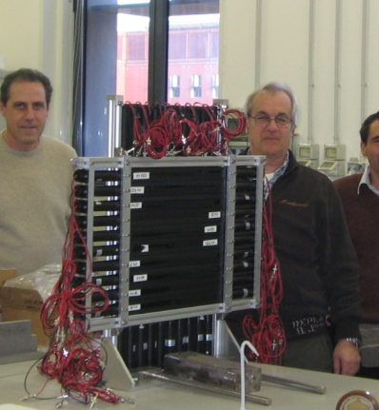
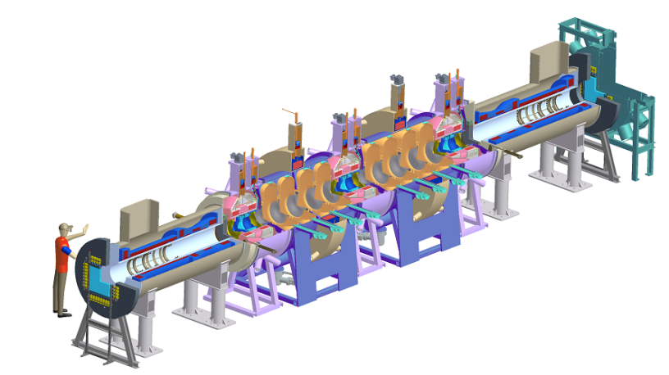
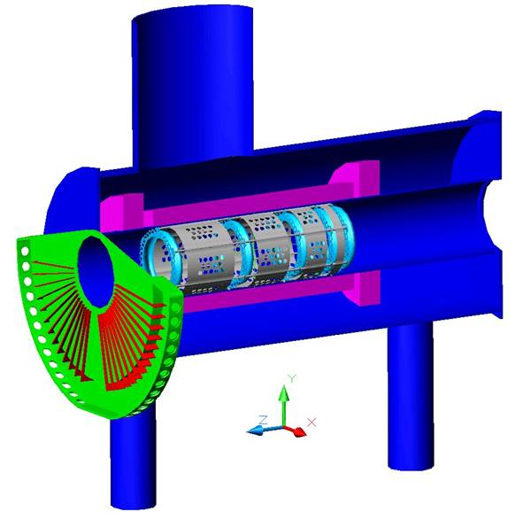
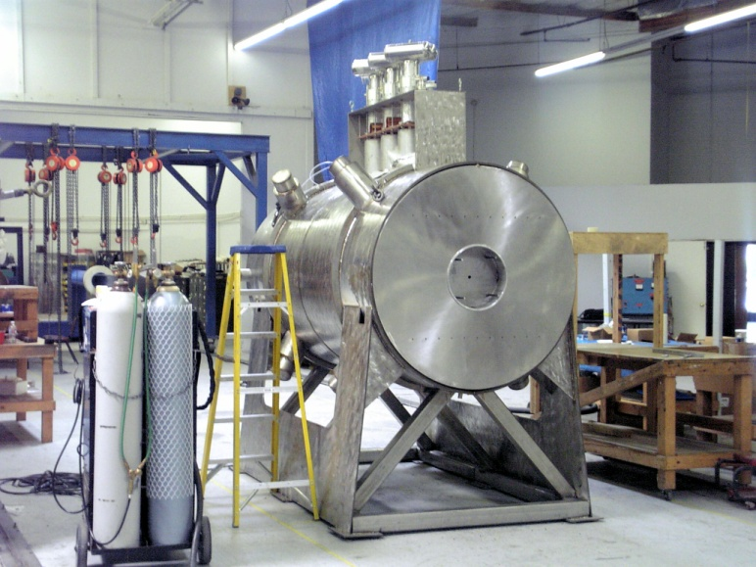
MICE Detectors
MICE cooling channel
(to be replaced with HCC)
TOF0
(70 ps)
CKOV1: Cherenkov
Tracker and Solenoid
KL, EMR: Electron Muon Ranger

Slide 7
Layout in MICE Hall
Remove MICE cooling apparatus
Move downstream
Tracker and Cal farther
downstream to make room for HCC
Q7-Q9
Upstream Tracker
unchanged

Slide 8
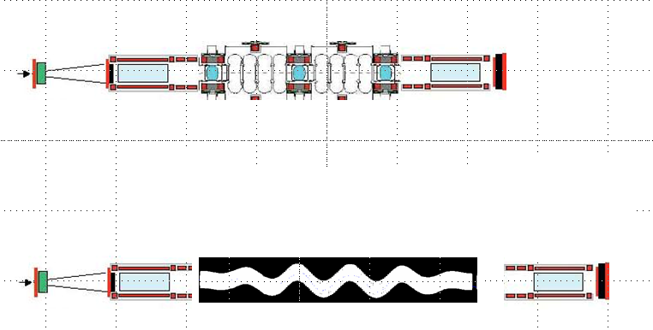
Layouts with MICE Channel and MANX Apparatus
Beam
Stop
Tracker Cool RF Cool RF Cool Tracker EMR
Rails
Full MICE Setup (Step 6)
6 m
5.5 m
TF1
TF2
3.2m HCC
TF3
TF4
2.4 m
Matching
S1 S2 S3 S4
2.4 m
Matching
2.6 m
8 m
New TOF Ctrs (TF)
New Trackers (S)

Slide 9
New MANX Detectors
Fast TOF Counters
Better determination of longitudinal component of momentum
Improves computation of 6D emittance
MICE TOF ctrs → 70psec resolution
MANX MCP TOF (10 ps or better) counters can supplement or supplant MICE TOFs to improve resolution
Trackers inside HCC
Better definition of trajectory inside HCC
Measure emittance evolution inside HCC
Calibration/verification with empty HCC

Slide 10
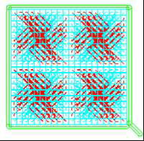
MCP TOF Detectors
Concept (Frisch et al)
Goal: 5-10 ps resolution
MTBF tests achieved: 13 ps
5 cm x 5 cm tiles
2mm x 2mm anodes
Good space resolution
Anode unit has transmission lines and time digitizers
DAQ, FPGA, custom chips in progress
International Psec Timing Collaboration
Advancing the art toward 1 psec goal
Medical applications, e.g. PET scanners
Other HEP applications
MgF Cathode MCP Anode/ transmline/
_{Anode layout}
Designed for equal times for signals
Tom Roberts, Valentine Ivanov (Muons, Inc.) and Henry Frisch (U. Chicago) have submitted an SBIR proposal for G4BL simulation of MCP gain for TOF counters with microchannel plates.
Low-cost large-area nanoporeMCP materials
in development at ANL: alternative to commercial MCPs

Slide 11
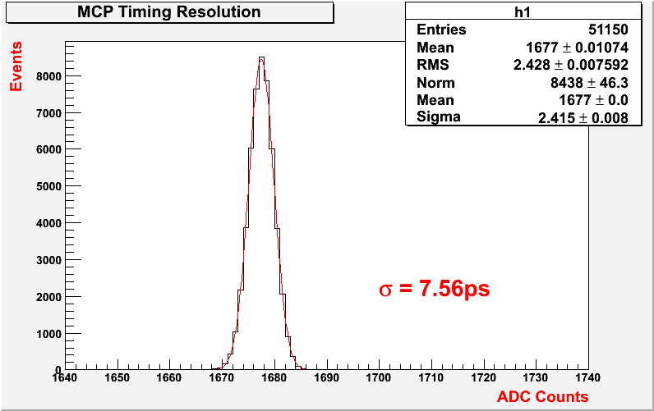
MCP TOF Counters for Better P_{L}
Example:
p = 300 MeV/c muon, γ=3, β = 0.94
For L=3m, t = 10.6 ns
Δp/p = γ² Δt/t
Then
For Δt = 50 ps resolution: Δp/p = 4.3%
For Δt = 5 ps resolution: Δp/p = 0.43%
Time difference between 2 commercial MCPs, response to laser pulses, intrinsic MCP resolution 4ps (ANL test stand, 408nm)
TOF measurement of P_{L} is complementary to measurement by MICE tracker:
- MICE tracker measures P_{T} and infers P_{L} by track angle, ΔP_{L}/P_{L} ~ 2%.
- TOF measures P_{L} directly (given particle ID), ΔP_{L}/P_{L} ~ 0.5%.
For MANX: ~50 (5cmx5cm) tiles cover the 40 cm diameter MICE solenoid aperture. Tiles with commercial MCPs ~$5k each

Slide 12
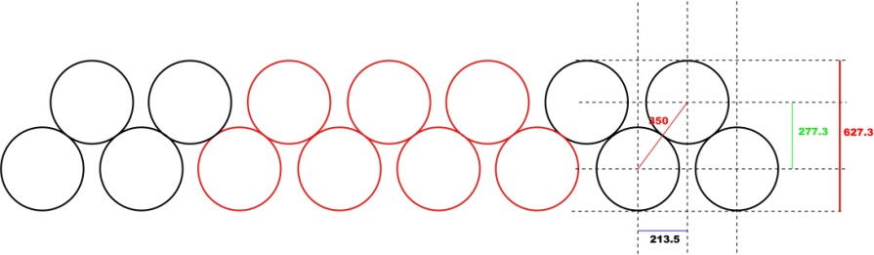
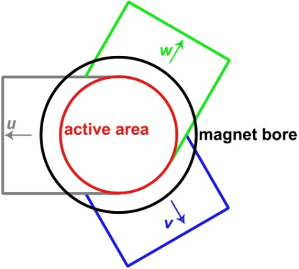
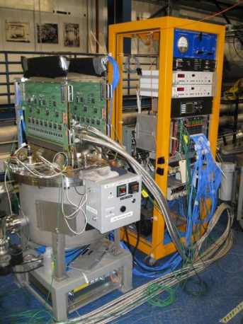
MANX HCC Tracker Design (based on MICE Tracker)
0.35 mm Scintillating fibers
Two overlapping layers per coordinate
Combine signals in groups of 7
Resolution ~0.5 mm per 2-layer plane
To cover a 50cm HCC inner diameter requires 306 channels
Each channel 1.63mm wide, containing 7 fibers (2142 fibers total).
Each 3-plane station requires 918 channels,
Total of 3672 channels for 4 stations inside the HCC
~0.5% X0 per station (HCC Liq He is ~50%X0)
Existing MICE readout:
VLPCs and electronics are Fermilab D0 CFT components

Slide 13
MANX HCC Tracker Concept 1
Based on MICE tracker design
Tracker unit is installed in HCC bore
Fiber light guides brought out of bore
Optical detectors and electronics outside
Design Challenges
HCC bore is helical, not straight
Alignment, positioning, installation, seals
Bore is filled with Liq He, not He gas at STP

Slide 14
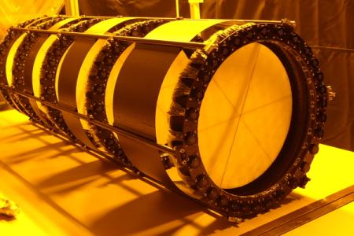
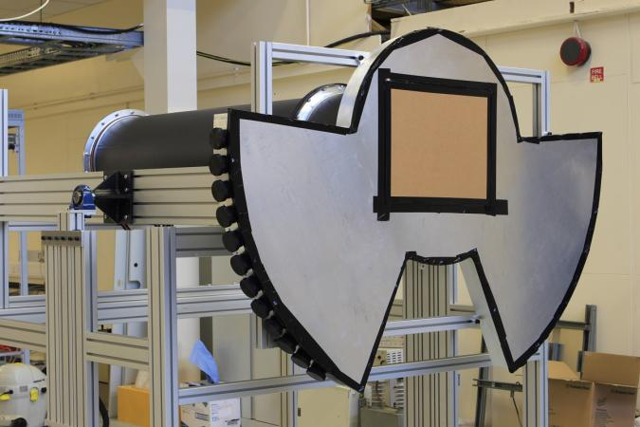
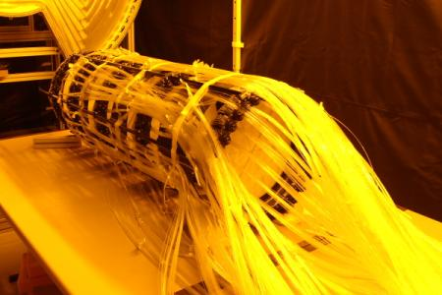
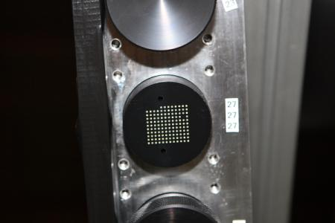
MICE Tracker Assembly
5 tracker stations
Tracker in solenoid
Tracker, waveguide fibers, and patch
panel all assembled
Waveguide fibers attached
Optical feedthrough
Waveguide fibers organized and bundled

Slide 15
MANX HCC Tracker Concept 1
Side View
Detectors
Coils
End View
Cryostat Vessel
Light guides
Optical Connectors
VLPCs and Electronics

Slide 16
MANX HCC Tracker Concept 2
Based on mech design of HCC
Build planes into structure of HCC
Use scint fiber as detectors
Mount SiPMs and digitizers within HCC
Extract electrical signals (not light guides)
Challenges
New technology/application (SBIR proposal)
Access to electronics for repair/maint
Heat inside cryostat?

Slide 17
Trackers Inside HCC Concept 2
Schematic Cryostat Vessel
Detectors
Coils
Signals out
Power in
Active area, fibers
MPPCs
Power in
Signals out
Electronics
Feedthroughs
Scintillating fiber planes
Similar to MICE spectrometer.
Use MPPCs(SiPMs) and onboard readout electronics
Support/mounting frame
Consider 4 trackers (x, u, v) per set
and possibly 2 more outside.
Purpose: Verify trajectories inside HCC
- Helps in commissioning
- Provides measure of track quality, losses within HCC
Bob Abrams and Vishnu Zutshhi (NIU) have an SBIR proposal on this topic.

Slide 18
Running and Data Estimates (Preliminary)
About 10,000 events gives a useful sample for emittance measurement, based on simulations
Expect ~100 µ per spill, ~1% usable for gross emittance calculation, 1 spill/sec
A single 10,000-event run would take ~3 hours.
Expect ~ few hundred runs to vary conditions such as different initial emittances, magnet currents, beam momentum, fill with liquid H₂(?), wedge absorbers, etc.
Longer runs needed to study particular regions of phase space in HCC
Time is needed for commissioning, calibration, beam tuning, background studies, reconfiguring, etc.

Slide 19
Work To Do and in Progress
Simulations of 350 MeV/c beam: tuning, µ rates, backgrounds (NIU, Muons, Inc.)
Simulations of full MANX spectrometer including HCC and new detectors (Muons, Inc., NIU, IIT)
Reconstruction and fitting of tracks in HCC (Muons, Inc., IIT, NIU, FNAL)
Sensitivity analysis, field accuracy requirements, statistics needed, running time estimates (IIT, FNAL, Muons, Inc.)
Calibration procedure, run conditions (Muons, Inc., UCR)
Review all MICE components for use in MANX (Muons, Inc., FNAL, UCR, NIU)
Analysis refinements and additions to MICE analysis SW (FNAL, Muons, Inc., IIT, NIU, JLab)
Design MANX-specific detectors, electronics, and other components (NIU, UC, Muons, Inc., FNAL)

Slide 20
FNAL Support Needed
Designing/Building HCC
Access to lab facilities for fabricating and testing scintillation counters (NIU has some facilities for source testing)
For HCC tracker concept 1: use of available D0 CFT VLPCs and associated electronics
Some electronics design and fabrication (possibly supported by joint SBIR projects)
Use of MTBF for beam tests of detectors
Mapping of HCC magnetic field
Use of PREP electronics for tests at Fermilab
Support Fermilab participants in MANX

