Slide 1
NOAA’s Office of General Counsel

Slide 2
Summary of Content (in order of appearance)
Mission
Vision
Outputs: Products and Services
Programs
Budget
Leadership
Facilities and Personnel

Slide 3
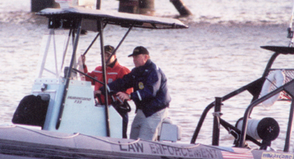
Mission and Values
The NOAA Office of the General Counsel is a team of professionals advancing the mission and objectives of NOAA by delivering legal services of the highest quality. We are committed to providing sound judgment, thoughtful analysis, and constructive advice through effective communication. In an environment fostering innovation and professional development, we apply the rule of law with integrity, respect for people, and commitment to excellence and the public trust

Slide 4
Programs & Outputs
OGC provides legal services and guidance for all matters that may arise in the conduct of NOAA's mission. Critical outputs include:
Legal review of fishery management plans and annual fish harvest limits
Legal review of Endangered Species Act consultations
Legal representation in Enforcement cases
Defense of NOAA’s mandatory fishway prescriptions for new or relicensed hydropower plants
Legal review of petitions for disaster assistance
Legal support to the Commerce Secretary in deciding whether to overturn state objections to federal licenses for coastal projects
Legal review of sanctuary management plans, amendments, and updates
Legal representation in natural resource damage recovery cases
Legal review of Proposed International Agreements, between NOAA and Foreign Government Entities
Legal representation in federal lawsuits against NOAA

Slide 5
OGC Budget
*

Slide 6
Leadership
Jane Luxton, General Counsel
Jane Chalmers, Deputy General Counsel
Mary Beth Ward, Deputy General Counsel
Paul Barker, Assistant General Counsel

Slide 7
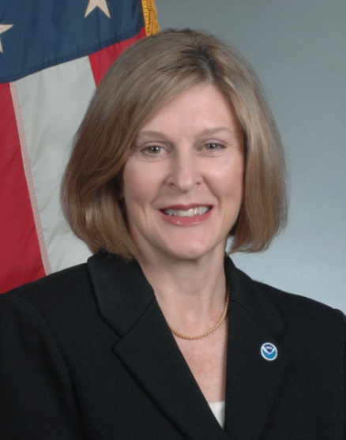
Who We Are: OGC Leadership
Photo Not Available
Photo Not Available
Photo Not Available
Jane Chalmers
Deputy General Counsel
Jane Luxton General Counsel
(Political Appointee)
Mary Beth Ward
Deputy General Counsel
Paul Barker
Assistant General Counsel

Slide 8
Facilities and Personnel
NOAA’s Office of General Counsel headquartered in HCHB, DC
105 attorneys
12 paralegals
19 support staff
Small headquarters staff
Attorneys in 13 offices primarily in Silver Spring, Maryland, and
6 offices around the country
Offices headed by Assistant General Counsels
Fisheries, Ocean Services, Enforcement and Litigation
Senior Counselors
International, Atmospheric and Space Services and Research
Regional Counsels
Advise the National Marine Fisheries Service and manage offices in Gloucester, MA, St. Petersburg, FL, Long Beach, CA, Seattle, WA, Honolulu, HI, and Juneau, AK.
Special Counselor for Natural Resources
Seattle, WA

