Slide 1
NOAA’s Office of Communications

Slide 2
NOAA Communications
NOAA’s Office of Communications coordinates media relations, external affairs, and select internal communications at the corporate NOAA level and also serves a coordinating function throughout NOAA by working closely with the line offices.
Under the leadership of NOAA senior management, the Office of Communications provides messaging, promotion, and coordination for a broad range of external, constituent and communications services.
The goals of NOAA’s Communications Program are to:
Increase NOAA’s name recognition;
Present NOAA’s services to the American public in ways that are easily understood;
Promote “One NOAA” message and integration across agency programs;
Advance key legislation and budget initiatives; and
Engage with, and expand NOAA’s constituencies.

Slide 3
Products and Services
Products
Services
News releases
News conferences
NOAA Web editorial management
Video presentations
Opinion/editorial articles
NOAA World-internal online newsletter
Interview preparation and coordination
Proactive placement of strategic messages in media
Media training
Constituent relations
Exhibits management

Slide 4




Who We Are: Office of Communications Leadership
Photo Not Available
Scott Smullen, Deputy Director, Communications (Career)
Vacant, Deputy Director, Media Affairs
(Career)
Anson Franklin, Director (Political Appointee)
Jeff Donald, Deputy Director, Office of External Affairs (Politcal Appointee)

Slide 5
Who We Are
We are public affairs specialists serving NOAA headquarters and line offices
Headquarters - 7
Fisheries - 4
Weather Service- 8
Research - 5
Satellites - 1
Ocean Service - 2
We are constituent and intergovernmental affairs specialists
Constituent - 2
Intergovernmental -1
Exhibits - 1
Writer/editor - 1

Slide 6
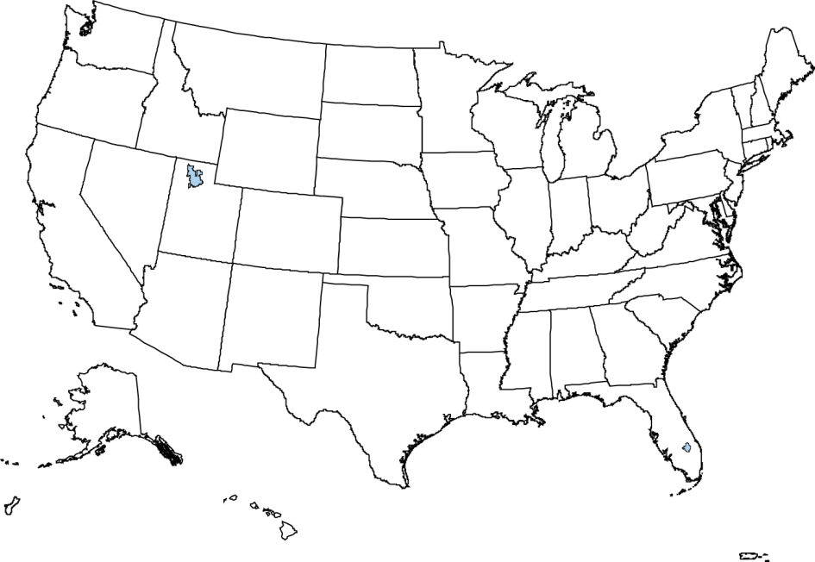
Where We Work
(1) Boulder, CO
(1) Seattle, WA
(1) Long Island, N.Y.
(17) Silver Spring, MD
(1) Salt Lake City, UT
(15) Washington, DC
(1) Kansas City
(1) Ft. Worth, TX
1 Norman, OK
(1) Miami, FL
(1) Honolulu, HI

Slide 7
Questions?

