Slide 1
NOAA’s Office of Marine and Aviation Operations (OMAO)

Slide 2
Summary of Content
Mission and Vision
Organization
Leadership
Personnel
OMAO Programs and Services
Value to NOAA and the Nation
Assets and Facilities
Budget

Slide 3
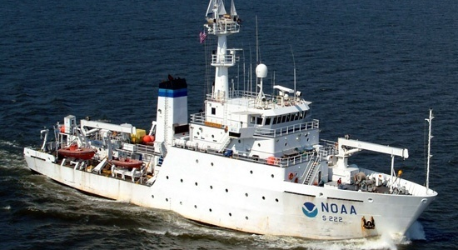
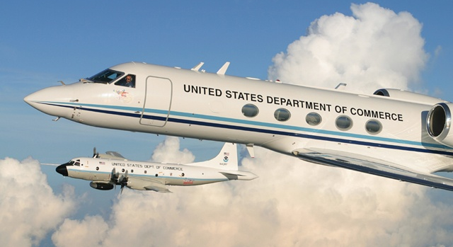
Mission & Vision
To safely and efficiently operate NOAA ships and aircraft, incorporate emerging data acquisition technologies, and provide a specialized professional team responsive to NOAA programs
To be the best in class for sea and air operations and data acquisition for NOAA and the Nation

Slide 4
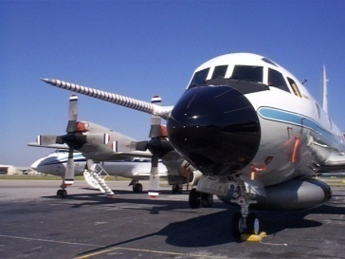
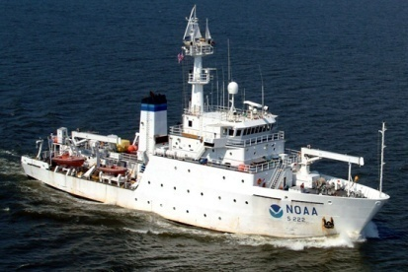
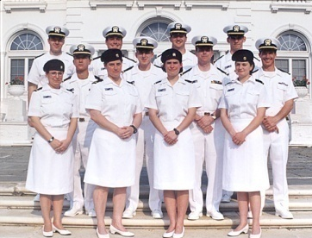
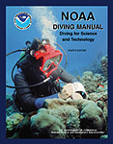
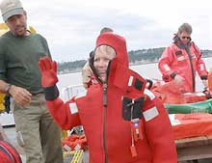
OMAO Organization
Marine & Aviation Operations
Aircraft Operations Center
Marine Operations Center
Commissioned Personnel Center
NOAA Dive Center
Teacher At Sea Program
2

Slide 5
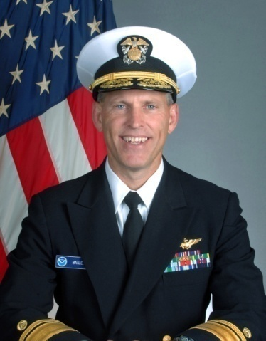
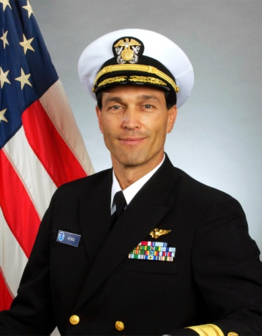
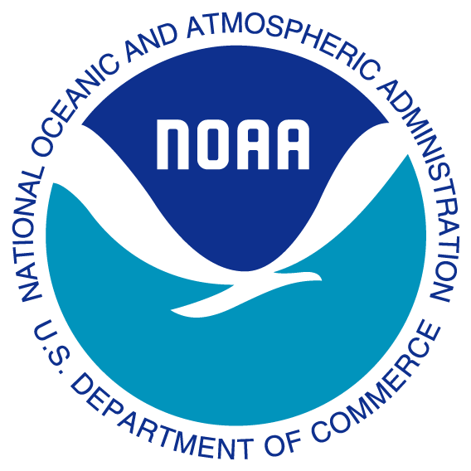
OMAO Leadership
Rear Admiral Jonathan W. Bailey
Director, NOAA Corps and
Office of Marine and Aviation Operations
Rear Admiral Philip M. Kenul, NOAA
Director, Marine and Aviation Operations Centers
Deputy Director
Office of Marine and Aviation Operations

Slide 6
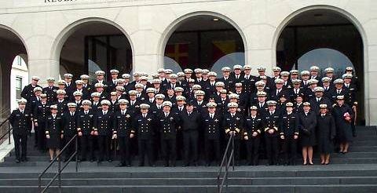
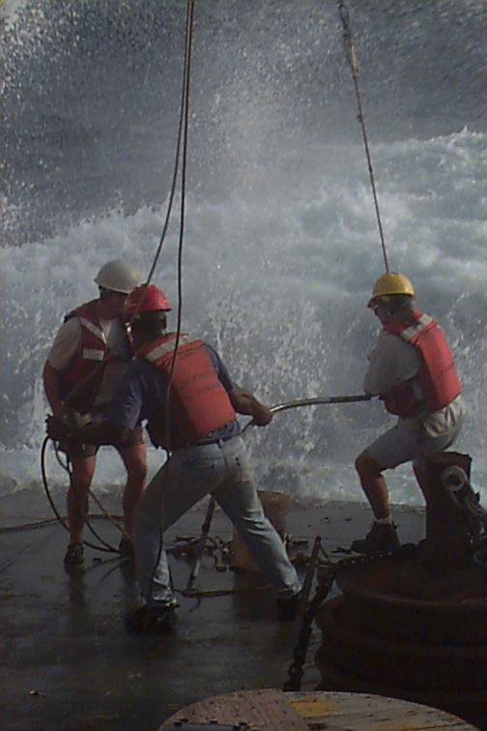
OMAO Personnel
A diverse workforce consisting of six distinct personnel systems and five employee unions:
GS and SES Civilians – Primarily land-side mission support, platform acquisition and maintenance, resource management, and administration
Wage Mariners – Majority of sea going crew aboard NOAA Ships
Commissioned Officers
NOAA Corps officers serve in OMAO’s operational and administrative leadership positions at sea, in the air, and ashore.
Public Health Service officers provide medical care at sea and medical administrative services ashore.
Contractors – Specialized support in IT, platform acquisition, and administration

Slide 7
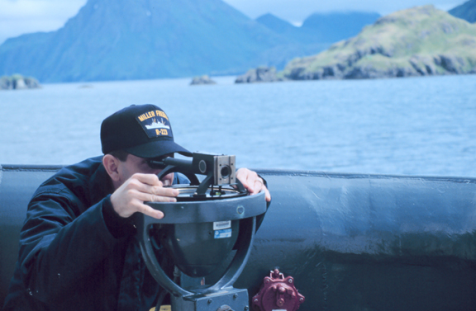
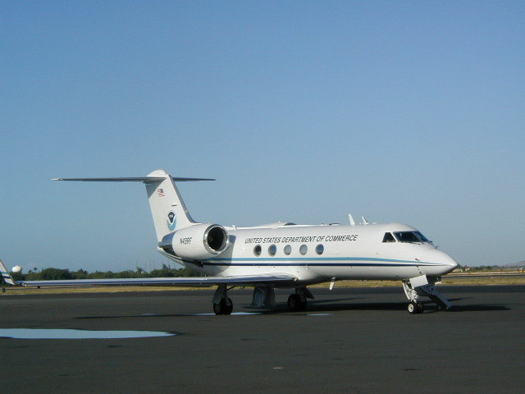
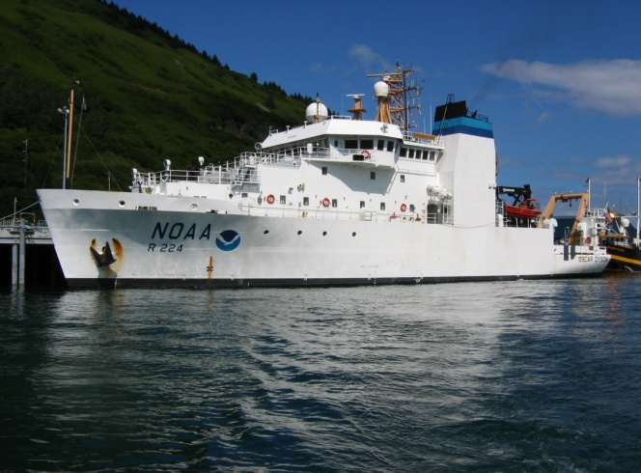
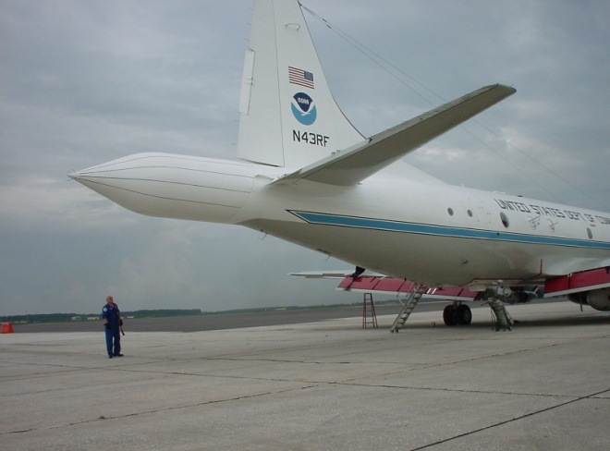
OMAO Programs and Services
Centralized Management of NOAA’s Fleet:
20 NOAA Ships and 12 Aircraft
Safety of Operations
Maintenance and Repair
Platform Allocation
Recapitalization of Fleet

Slide 8
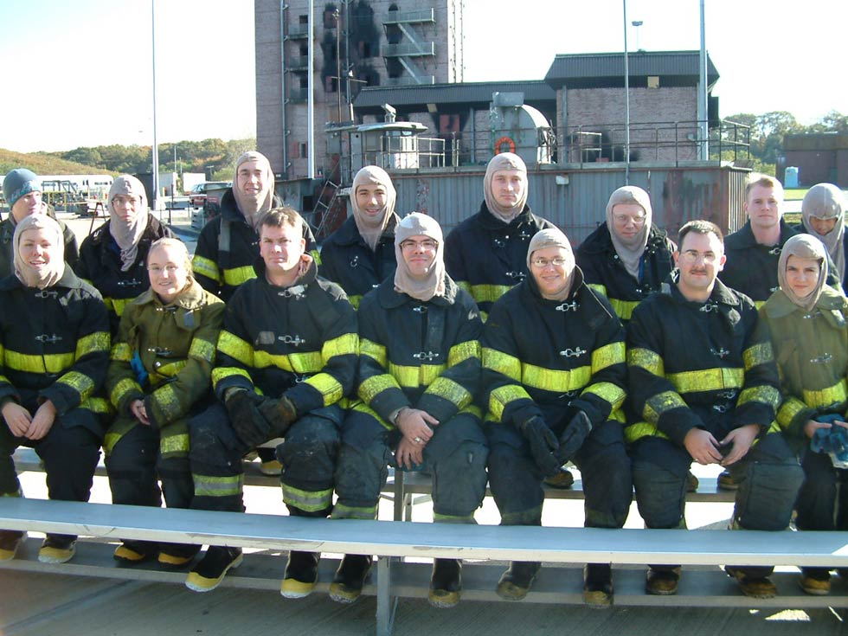
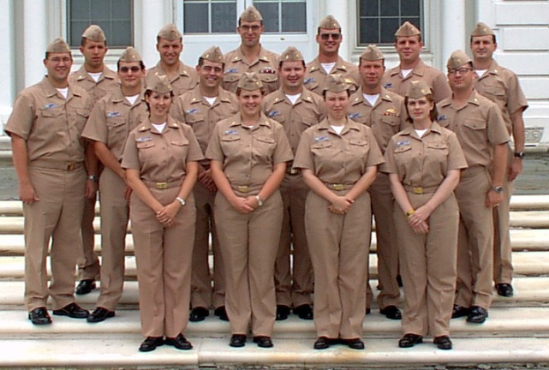
OMAO Programs and Services
Administration of NOAA Commissioned Corps
OMAO administers NOAA’s uniformed service
Director, OMAO is the senior NOAA Corps officer and concurrently serves as Director, NOAA Corps
Approximately 2/3 of NOAA Corps officers are assigned to OMAO
OMAO Commissioned Personnel Center responsibilities:
All human resource management policies and procedures for NOAA Corps officers throughout the Agency
Administration of NOAA Corps pay and benefits
Representation of NOAA Corps in interdepartmental (inter-service) activities affecting uniformed services

Slide 9
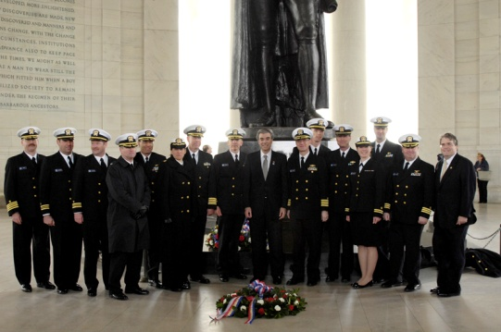
OMAO Programs and Services
NOAA Corps Officers are NOAA’s operational leaders:
Provide the technical and operational expertise, dynamic leadership, and breadth of experience to optimize NOAA’s missions through planning, preparation, and execution.
Rotate between the fleet and shore, increasing the efficiency and effectiveness of scientific operations
One of seven uniformed services who serve with the “special trust and confidence” of the President
Vision
The NOAA Corps will be the nation’s premier, diverse leaders of worldwide environmental observations to ensure the flow of commerce and increased understanding of the global environment.

Slide 10
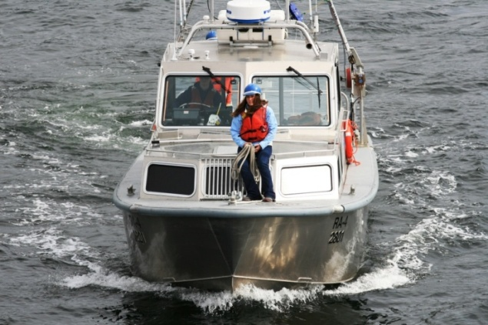
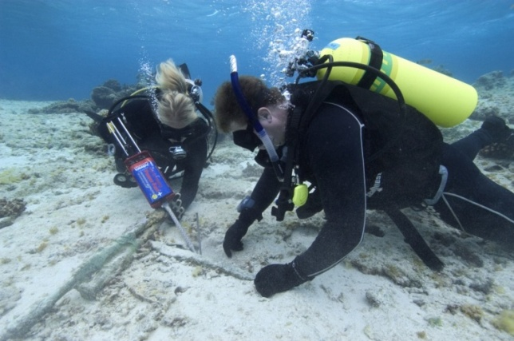
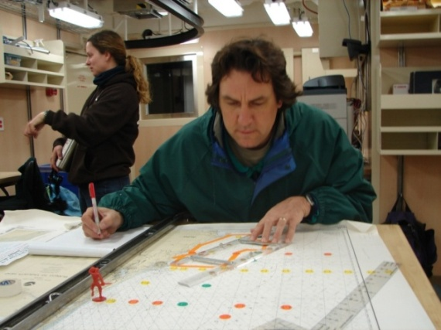
OMAO Programs and Services
Outsourcing Support — aircraft and vessel charters
Aircraft and Small Boat Safety Programs —standardized safety and policy procedures, training and inspection programs
NOAA Dive Program — safety oversight, training and certification
Teacher at Sea Program – fosters environmental literacy at sea and in the classroom

Slide 11
Value to NOAA and the Nation
NOAA Ships and Aircraft are National Assets:
Highly mobile and responsive to national emergencies
Collect data that support the protection of life and property and the economic health of the nation
Have unique capabilities that support all NOAA programs
G-IV
DYSON
P-3

Slide 12
Value to NOAA and the Nation
Current Ship Outputs | National Outcomes
Stock assessment surveys that facilitate management decisions under MSRA, MMPA, and ESA | Supports healthy fisheries. U.S. consumers spent $69.5 billion on fishery products in 2006.
 | Promotes sustainable management of domestic fish stocks. U.S. imports 70% of its seafood annually. The U.S. seafood trade deficit is estimated at $8 billion.
Hydrographic surveys | Facilitates 60,000 port calls per year by vessels required to carry NOAA charts
 | Supports movement of 2.5 billion short tons of cargo through U.S. ports valued at over $1 trillion
Annual health assessments of Pacific coral reefs | Informs management decisions that protect the estimated $578 million of economic benefit from coral reefs to the Pacific Islands
Deployment, maintenance, and upgrades to NOAA’s TAO/TOGA buoys | Provides climate and weather data worth an estimated $300 million to the Nation’s agricultural economy
 | Tracks the development of El Niño/La Niña and anticipates their probable influence on the Atlantic hurricane season

Slide 13
Value to NOAA and the Nation
Current Aircraft Outputs | National Outcomes
Hurricane research, reconnaissance and surveillance flights | Contributes to NOAA hurricane forecasts, warnings, and the associated responses which save $1 billion in property-related damage
 | Contributes $2 billion in savings due to the reduction in hurricane-related deaths from forecasts and warnings
Snow survey observations | Retains current capacity to forecast frequent winter and spring floods in all regions
 | Supports federal, state and municipal water resource programs resulting in over $170 million / year in hydropower benefits alone.
Marine Mammal Surveys | Supports timely and accurate assessments and recovery strategies for species listed under Endangered Species Act and Marine Mammal Protection Act
 | Facilitates annual expenditures for marine wildlife viewing, ranging from $7-10 million in California to $26 million in Stellwagen Bank in New England

Slide 14
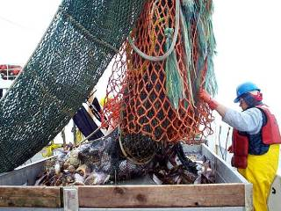
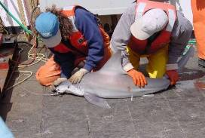
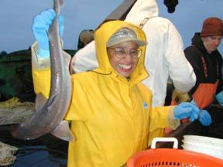
Value to NOAA and the Nation
Fisheries Surveys and Research
Fish Stock Assessments
Marine Mammal Surveys
Biological Sampling
Ecosystems Research

Slide 15
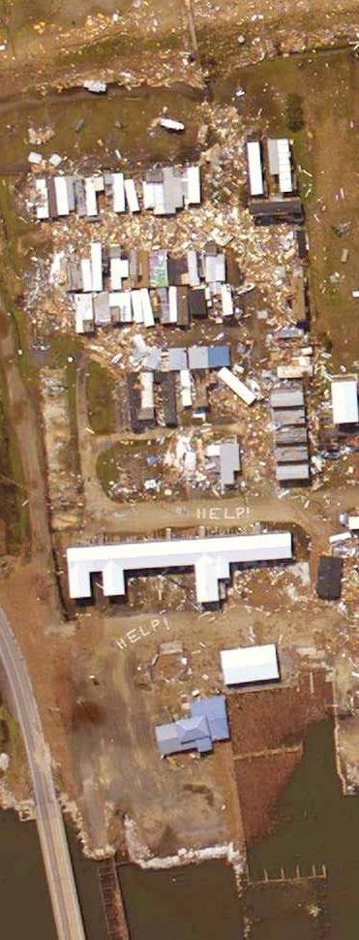
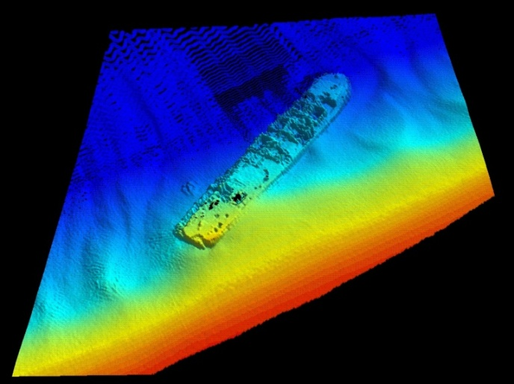
Value to NOAA and the Nation
Marine and Aerial Charting/Mapping
Nautical Chart Data
Dangers to Navigation
Habitat and Coral Reef Mapping
Aerial Mapping and Damage Assessment
Shoreline (LIDAR) Mapping
Storm Damage Assessments
Coral Reef, Kelp Bed, and Algal Bloom Mapping
Coastal Erosion
Port and Harbor Updates
Wetlands Surveys

Slide 16
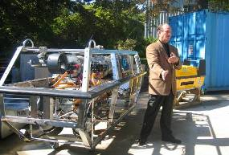
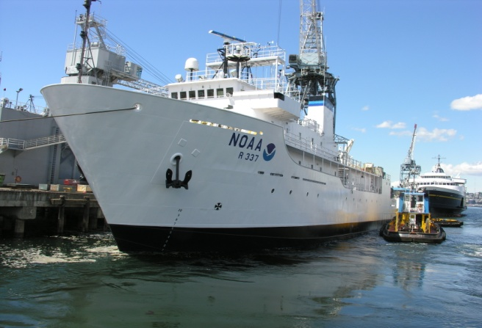
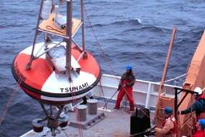
Value to NOAA and the Nation
Oceanographic and Atmospheric Research
Servicing of TAO Array (60 Buoys) and DART System (38 Buoys)
Ocean Exploration
Hydrothermal Vent Studies
Air Quality Studies

Slide 17
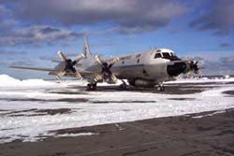
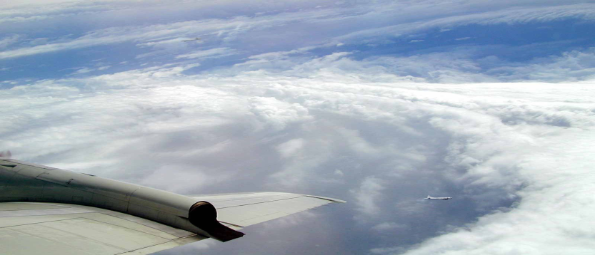
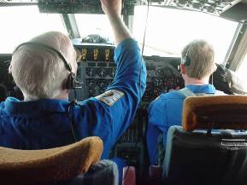
Value to NOAA and the Nation
Research and Forecasting
Hurricane Intensity
Hurricane Track and Landfall Predictions
Winter Storm Intensity and Tracks
Atmospheric Pollutant Studies
Cloud Physics

Slide 18
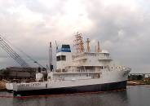
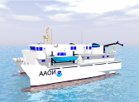
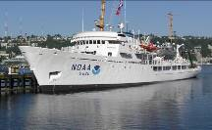
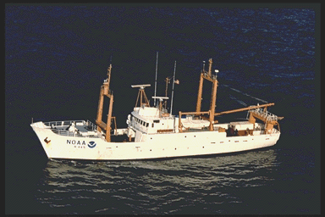
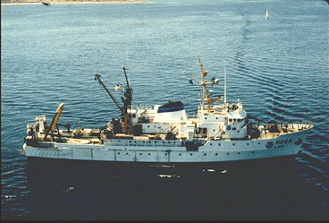
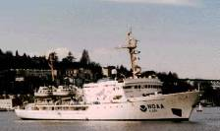

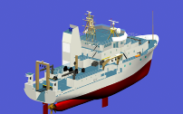

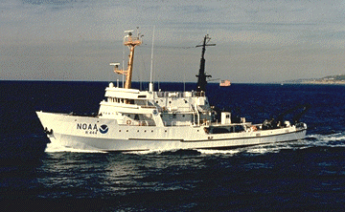
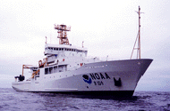
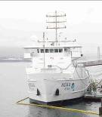
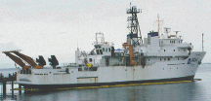
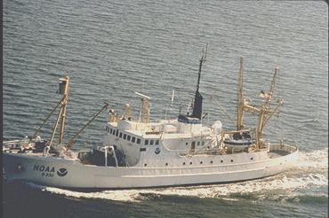
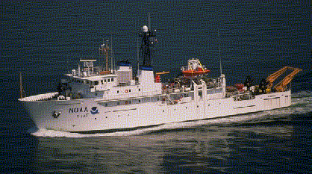
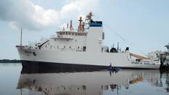
OMAO Assets and Facilities NOAA Ships and Homeports in FY’09
KODIAK (1)
FERDINAND R. HASSLER
KETCHIKAN (1)
OSCAR DYSON
20 Ships
11 Homeports
FAIRWEATHER
MOC-PACIFIC
(4)
DELAWARE II
MILLER FREEMAN
RAINIER
NEW CASTLE (1)
MISSIONS
WOODS HOLE (1)
Nautical Charting
Fisheries Research
Oceanographic Research
Coastal Monitoring
Ocean Exploration
DAVISVILLE (1)
MOC NORFOLK
(1)
OKEANOS EXPLORER
BELL M. SHIMADA
McARTHUR II
THOMAS
SAN DIEGO (1)
CHARLESTON (2)
THOMAS JEFFERSON
PASCAGOULA
(3)
HI’IALAKAI
DAVID STARR JORDAN
RONALD H. BROWN
NANCY FOSTER
GORDON GUNTER
Homeport TBD:
HENRY BIGELOW
OSCAR ELTON SETTE
HONOLULU (3)
KA’IMIMOANA
PISCES
OREGON II

Slide 19


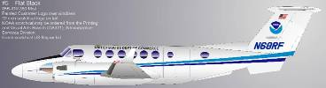
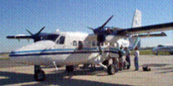

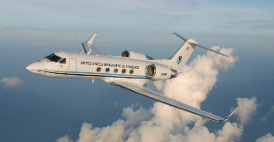
OMAO Assets and Facilities NOAA Aircraft and Bases in FY’09
12 Aircraft, 4 Bases of Operation
Minneapolis
(2)
SHRIKE COMMANDER
JET PROP COMMANDER
MISSIONS
Charting and Mapping
Fisheries Research
Hurricane Research
Environmental Assessment
Dulles, VA
(1)
Monterey, CA (1)
DAMAGE ASSESSMENT AIRCRAFT (to replace Citation)
TWIN OTTER (1)
AOC Tampa
(8)
P-3 (3)
SHRIKE COMMANDER
GULFSTREAM IV
TWIN OTTER (3)

Slide 20
OMAO Budget
*

Slide 21
Fleet Allocation Process
Director OMAO
Final Approval
Implementation
Fleet Council
Arbitrate Priorities
Approve Fleet Policy
Disseminate Fleet Information
Fleet Working Group
Bring Requirements Together
Optimize Fleet Use
Synergize Fleet Use

