Slide 1
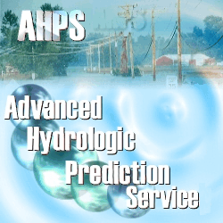
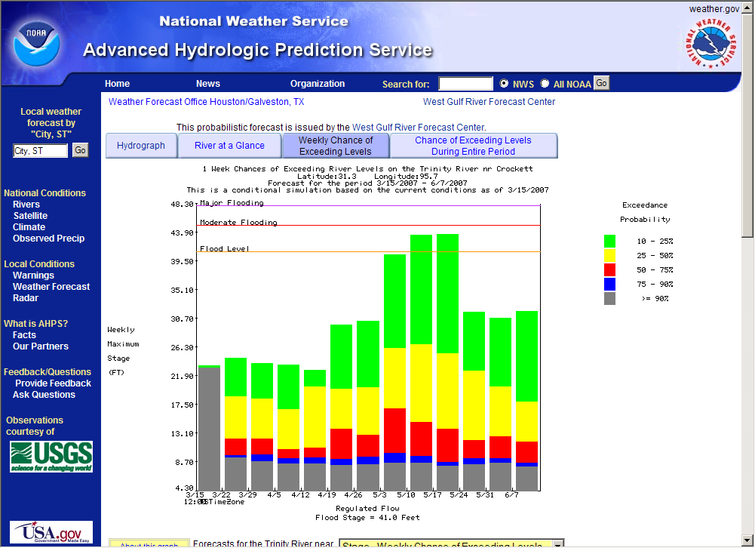
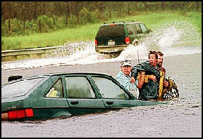
AHPS Implementation within USACE Southwestern Division Mar 27, 2007

Slide 2
AHPS Implementation
Basic Services (all river forecast point locations)
Forecast hydrograph
Probabilistic hydrologic forecasts (long-term)
Full or Expanded Service (all appropriate AHPS forecast locations)
Flash flood forecast information
Short-term probabilistic hydrologic forecast information, including low flow/drought forecasts.
1-2 Week forecasts
Partnered Services
Flood forecast mapping

Slide 3
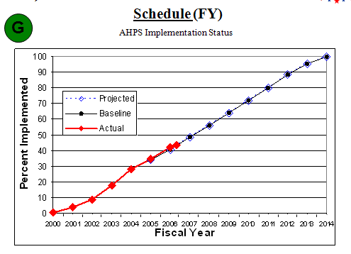
Mar 27, 2007
AHPS Implementation

Slide 4
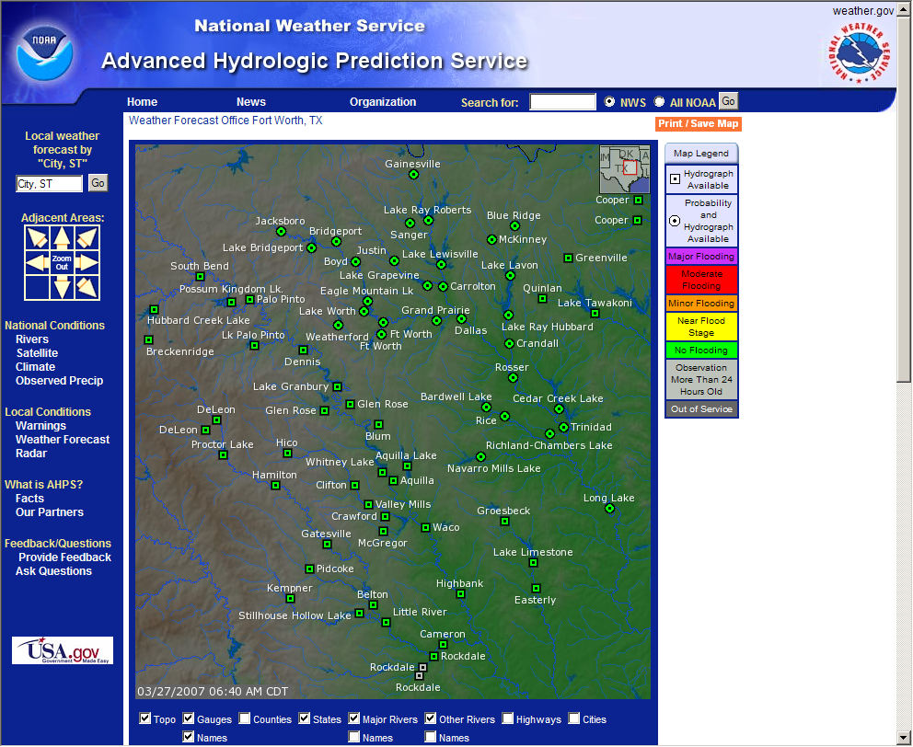
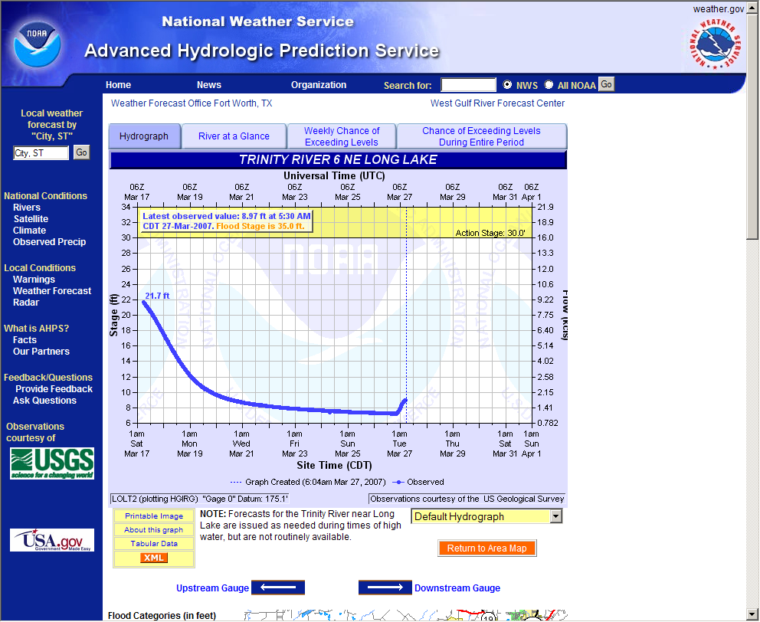
AHPS Implementation

Slide 5
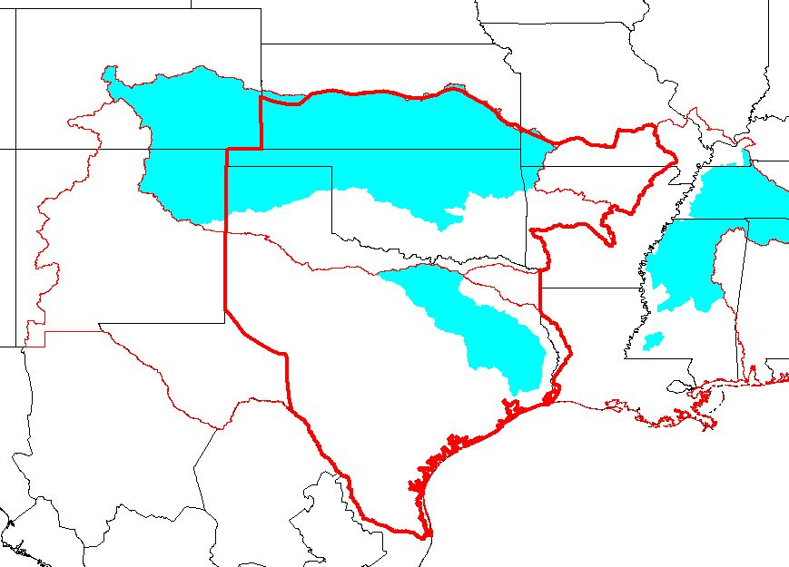
AHPS Implementation through FY 2006
Verdigris River
Neosho / Grand River
Cimarron River
Canadian River
Arkansas River
- Kerr Reservoir
Trinity River
Neches / Angelina River

Slide 6
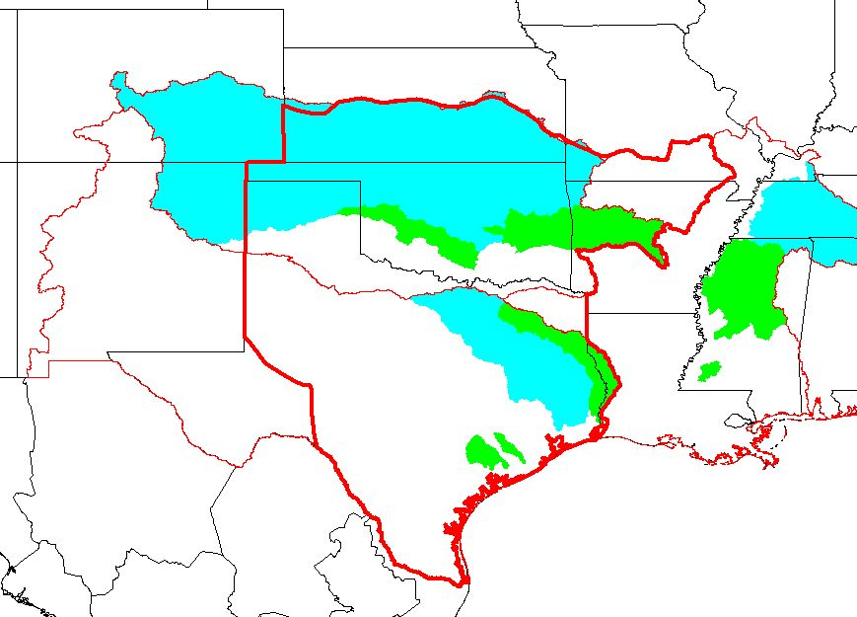
Scheduled Implementation FY 2007
Washita River
Arkansas River
Kerr Res. – Pine Bluff
Sabine River
Lavaca / Navidad River
San Bernard River

Slide 7
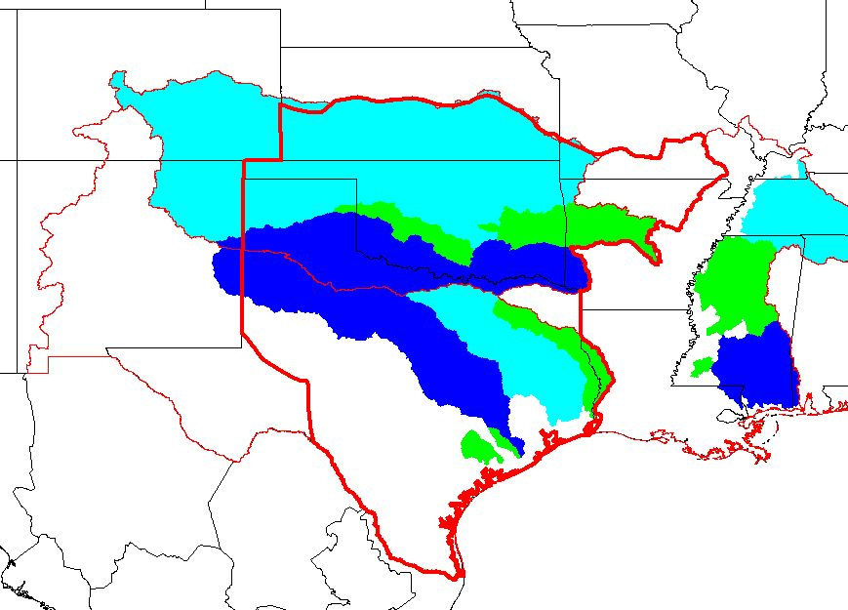
Scheduled Implementation FY 2008
Red River
Brazos River

Slide 8
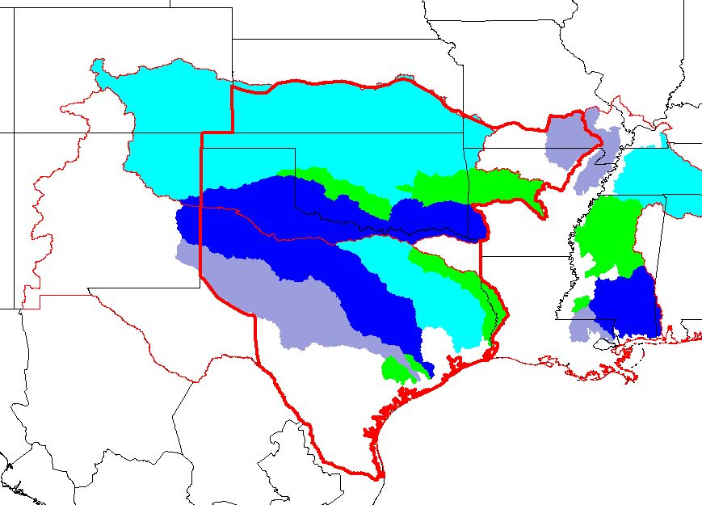
Scheduled Implementation FY 2009
Black River
Colorado River

Slide 9
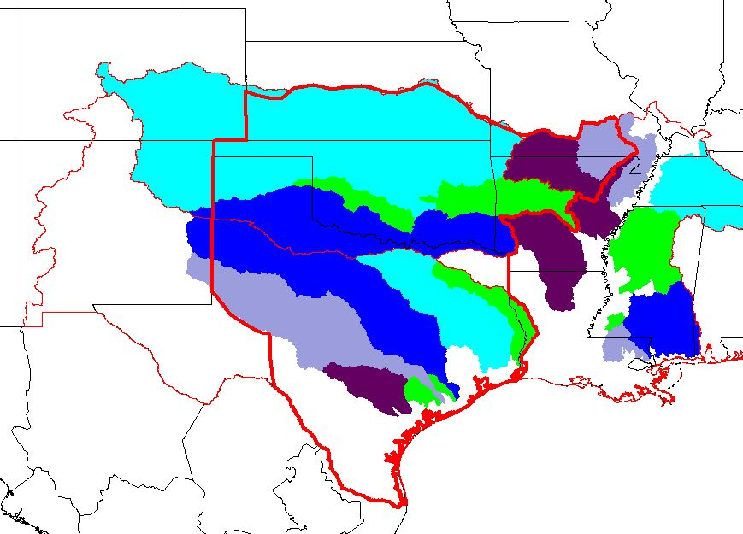
Scheduled Implementation FY 2010
White River
Guadalupe River
San Antonio River

Slide 10
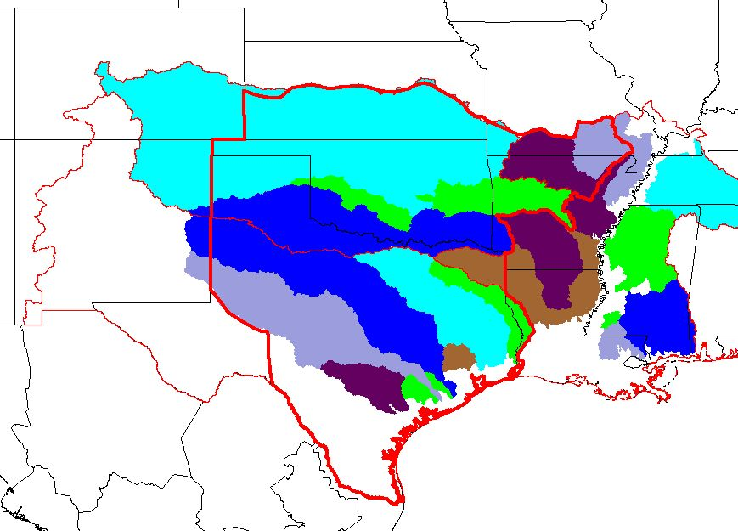
Scheduled Implementation FY 2011
Sulphur River
Cypress Creek
San Jacinto River

Slide 11
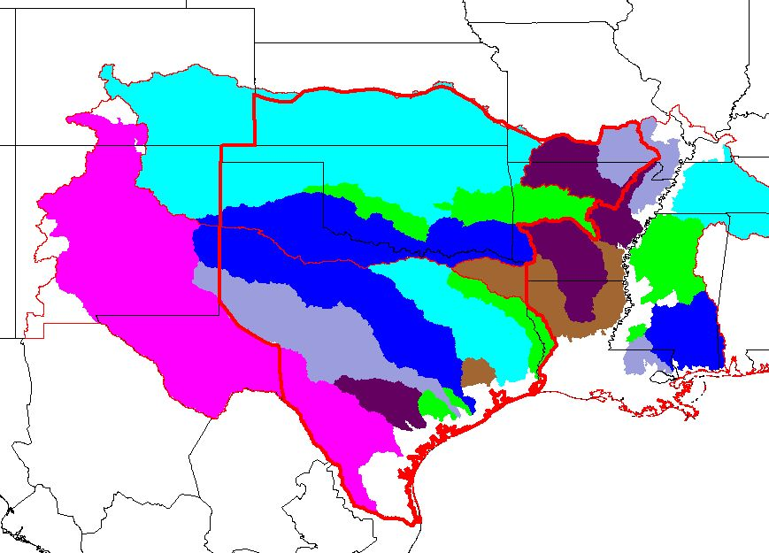
Scheduled Implementation FY 2012+
Nueces River
Pecos River
Rio Grande

