Slide 1

Ground Level Events (GLEs)
E.W. Cliver
Space Vehicles Directorate, Air Force Research Laboratory
GLE CDAW
Palo Alto, CA
6-9 January 2009

Slide 2
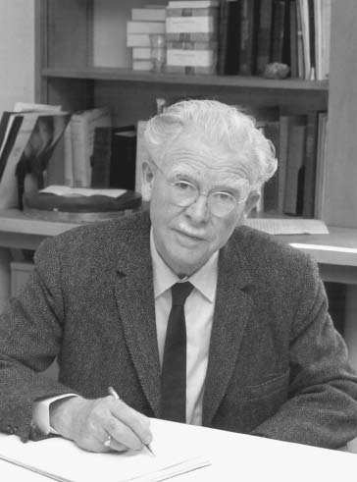
What is a GLE?
Ground Level Event
A high energy (> 500 MeV) solar energetic particle (SEP) event
detected on the Earth’s surface
First detected in 1942 by ionization chambers (Forbush, 1946)
Currently detected by Simpson-developed neutron monitors
70 events detected since 1942 (solar maximum)
Associated with solar flares & coronal mass ejections (CMEs)
Central question in SEP Physics today: Are high-energy SEP events dominated
by flares or by CME-driven shocks?
S.E. Forbush

Slide 3
Overview
Current picture of SEP events
Unusual GLEs
GLEs associated with weak flares
GLEs associated with impulsive flares
GLEs associated with poorly-connected flares
- Open questions

Slide 4
What is the current picture
of SEP acceleration?

Slide 5
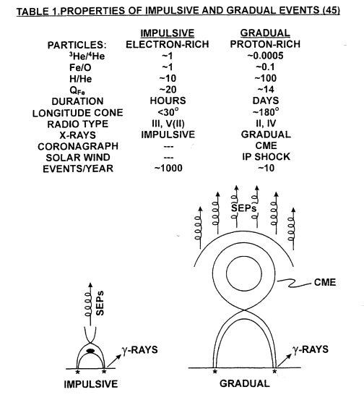

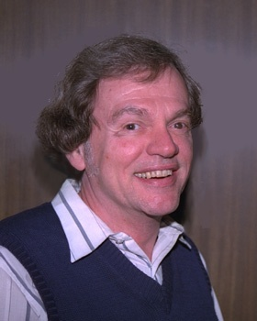
Two-class Paradigm for SEP Events
H.V. Cane
D.V. Reames
Reames (1990, 1993, 1995, 1999)

Slide 6
An Inherent Flaw in the Two-class Picture
Impulsive Events represented a “forced marriage” of:
- low-energy ³He-rich events of Reames,
von Rosenvinge & Lin (1985) and the
- high-energy events of Cane, McGuire, &
von Rosenvinge (1986)
2-100 keV
electrons
>3 MeV
electrons
The ³He-rich events rarely had detectable ~ 10 MeV protons while the impulsive events of Cane et al. included large proton events (e.g., 3 June 1982)
This flaw was revealed when ACE & SAMPEX observations
early in cycle 23 revealed four large (and therefore presumably
Gradual) SEP events with Impulsive characteristics (Cohen et al.,
1999; Mazur et al., 1999). Three of these events were GLEs.
Notes:
Enhanced Fe/O & charge states at E > 25 MeV

Slide 7
How to account for flare SEP properties
in large (gradual) events?
Two Proposed Solutions:
Flare process accelerates > 25 MeV/nuc ions
(Cane et al. 2002, 2003, 2006)
(2) Variable shock geometry & seed particle
populations responsible for composition &
charge state variability in large SEP events
(Tylka et al. 2005, Tylka & Lee, 2006)

Slide 8
Revised SEP Event Classification Scheme
(Flare-based)
Flare Shock
³He-rich Energetic
e/p 10²-10⁴ ~100 ~50
³He/⁴He 10³-10⁴ 10¹-10² ~1
Fe/O ~8 ~3 <1
Z(>50)/O 10²-10³ 10⁻¹-10¹ 10⁻¹-10¹
Ion Spectra -- Power-law Exp Rollover
Q(Fe) ~20 ~20 ~11
SEP Duration <1-20 hr 1-3 days 1-3 days
Longitude Cone <30-70º ~100º ~180º
Radio Type “normal” III III-l(II) IP II
X-ray Duration 10-60 min ~1 hr >1 hr
Coronagraph -- CME CME
Solar Wind -- IP Shock IP Shock
Reames
et al., 1985
(³He-rich)
Cane
et al., 1986
(Impulsive)

Slide 9
Revised SEP Event Classification Scheme
(Shock-based)
Flare Shock
Quasi-Perp Quasi-Par
e/p 10²-10⁴ ~100 ~50
³He/⁴He 10³-10⁴ 10¹-10² ~1
Fe/O ~8 ~3 <1
Z(>50)/O 10²-10³ 10⁻¹-10¹ 10⁻¹-10¹
Ion Spectra -- Power-law Exp Rollover
Q(Fe) ~20 ~20 ~11
SEP Duration <1-20 hr 1-3 days 1-3 days
Longitude Cone <30-70º ~100º ~180º
Seed Particles N/A Flare STs Coronal STs
Radio Type III II II
X-ray Duration 10-60 min ~1 hr >1 hr
Coronagraph -- CME CME
Solar Wind -- IP Shock IP Shock
Reames
et al., 1985
(³He-rich)
Cane
et al., 1986
(Impulsive)

Slide 10
GLES Associated with Weak Flares:
Seed Particles for Shocks
Most GLEs are associated with both big flares & fast CMEs
GLEs on 21 August 1979 & 10 May 1981 provided notable exceptions to this rule of thumb

Slide 11
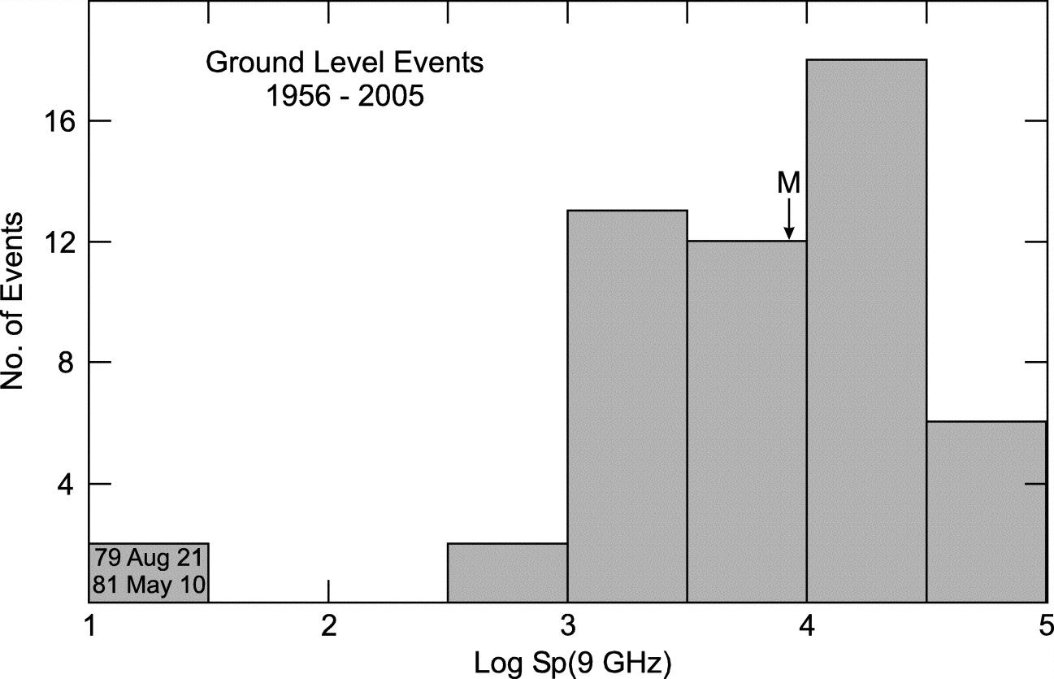
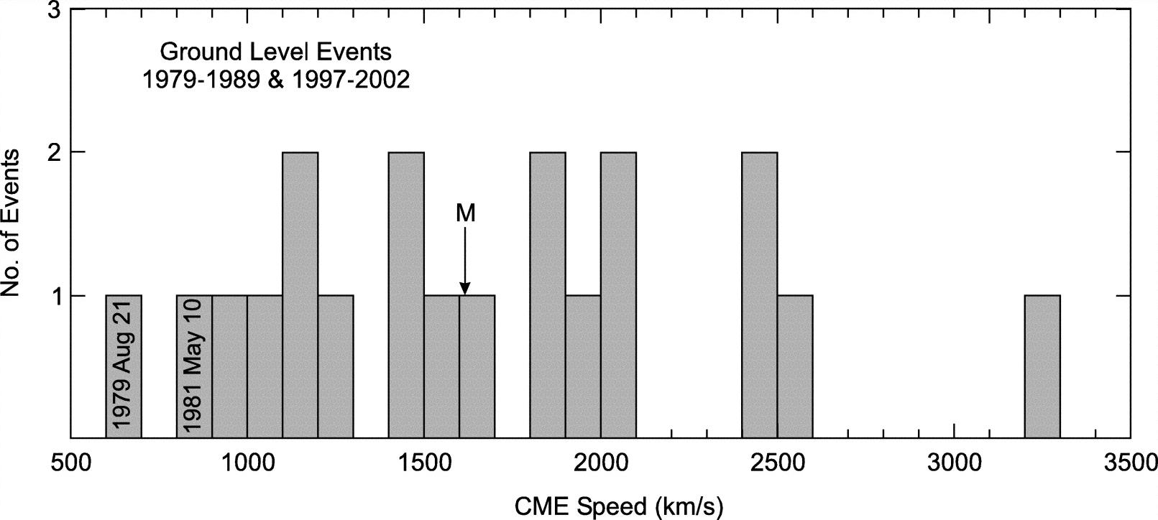

Slide 12
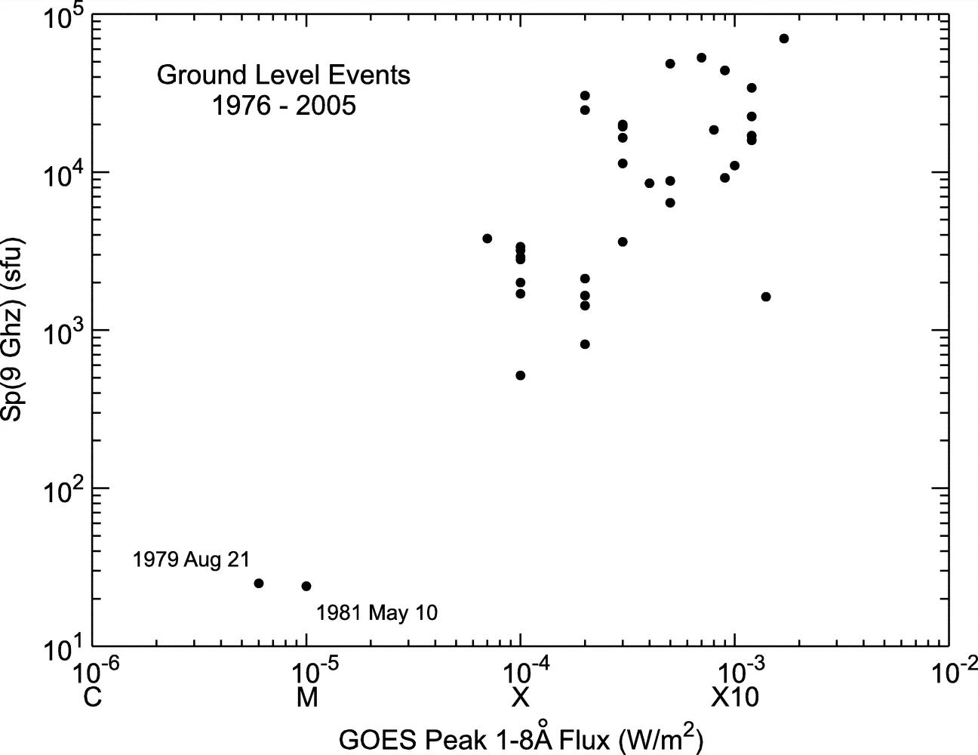

Slide 13
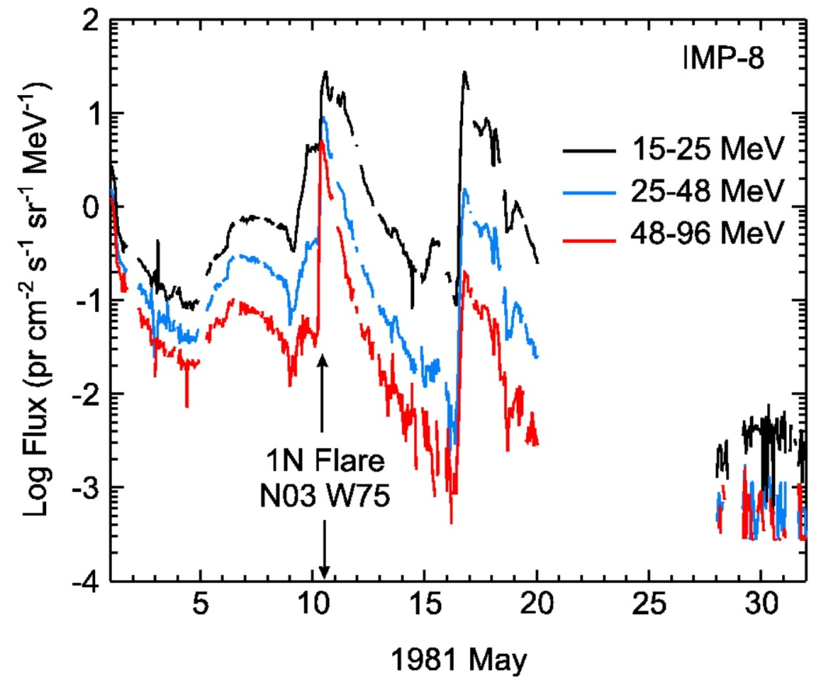
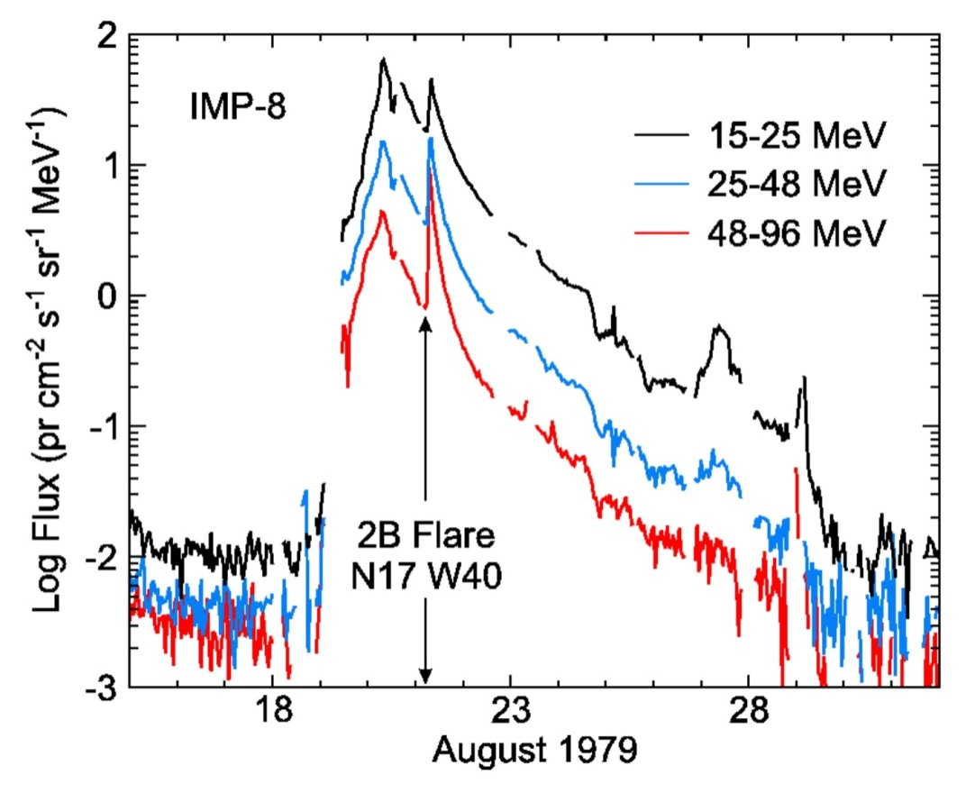
Why did these eruptions “over-achieve”?
Enhanced seed
particle population?
Cliver (2006)

Slide 14
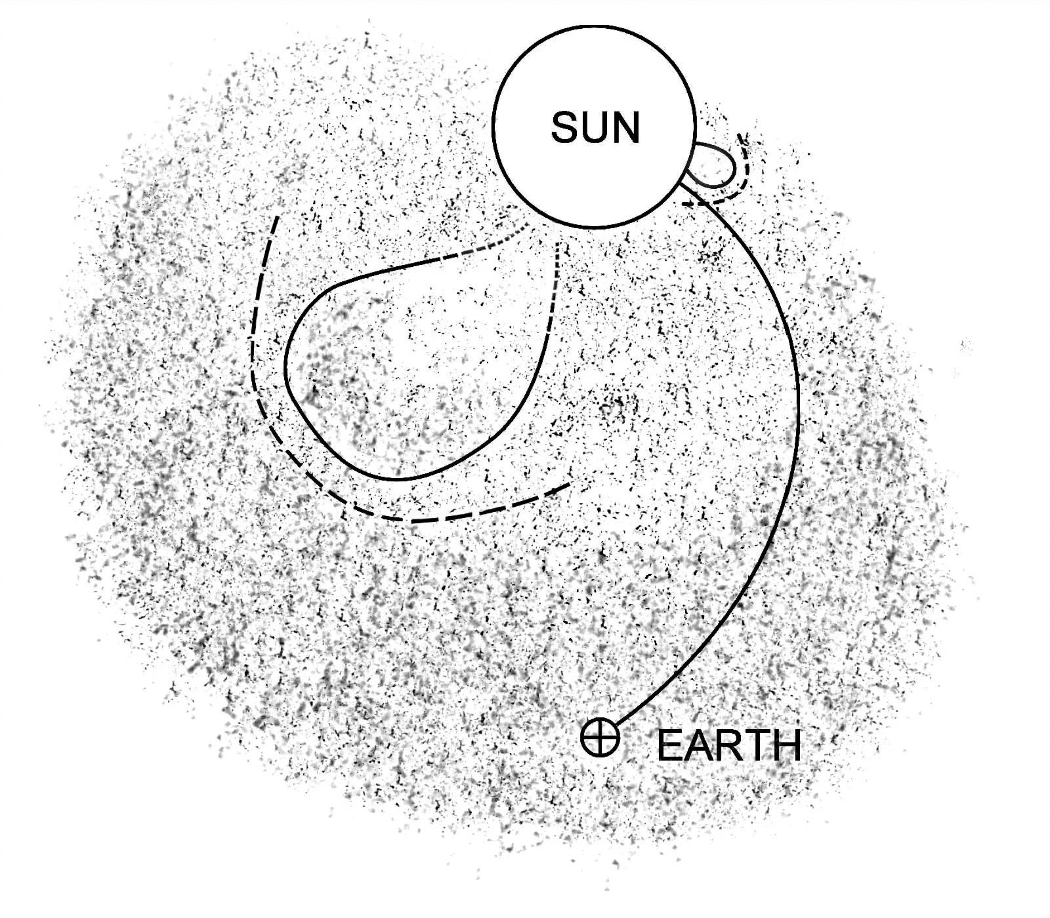
Proposed scenario: Consistent with strong shocks & weak
flares observed in these two events
Timing of 1st arriving GLE particles =>
Shock has access to seed particles within 2-5 R๏

Slide 15
Possible workshop exercise:
Modeling: Does scenario make sense? Quantify?
Spectra of seed particles close to the Sun? (e.g., Mewaldt et al., 2006)

Slide 16
Effect of Seed Particle Enhancement
on a Major Eruption?

Slide 17
20 January 2005 GLE
Flare Origin: ~10⁵ sfu at ~30 GHz
(Grechnev et al., 2008)
Shock Origin: CME speed ~3200 km s⁻¹
(Gopalswamy et al., 2005)
Seed Particles: Of 37 GLEs from 1979-2005,
only five events located from W40-70 had
pre-event 15-25 MeV fluxes at Earth ≥ 10
pr cm⁻² s⁻¹ sr⁻¹ MeV⁻¹
SEP GLE
Long. Bkg % Inc.
21 August 1979 W40 20 6
24 October 1989 W57 30 95
2 November 2003 W56 10 ~10*
20 January 2005 W58 30 ~300*

Slide 18
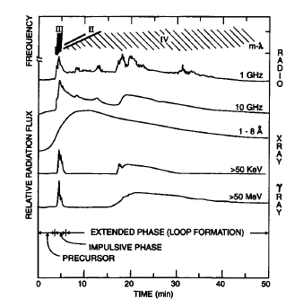
Related Topic:
Origin of long-duration pion-rich gamma-ray-flares
(Ryan, 2000)
Forget everything you ever thought you knew about flares

Slide 19
Two Possible Acceleration Scenarios
Late-phase SEP acceleration in a flare
Precipitation of SEPs from a CME-driven Shock

Slide 20
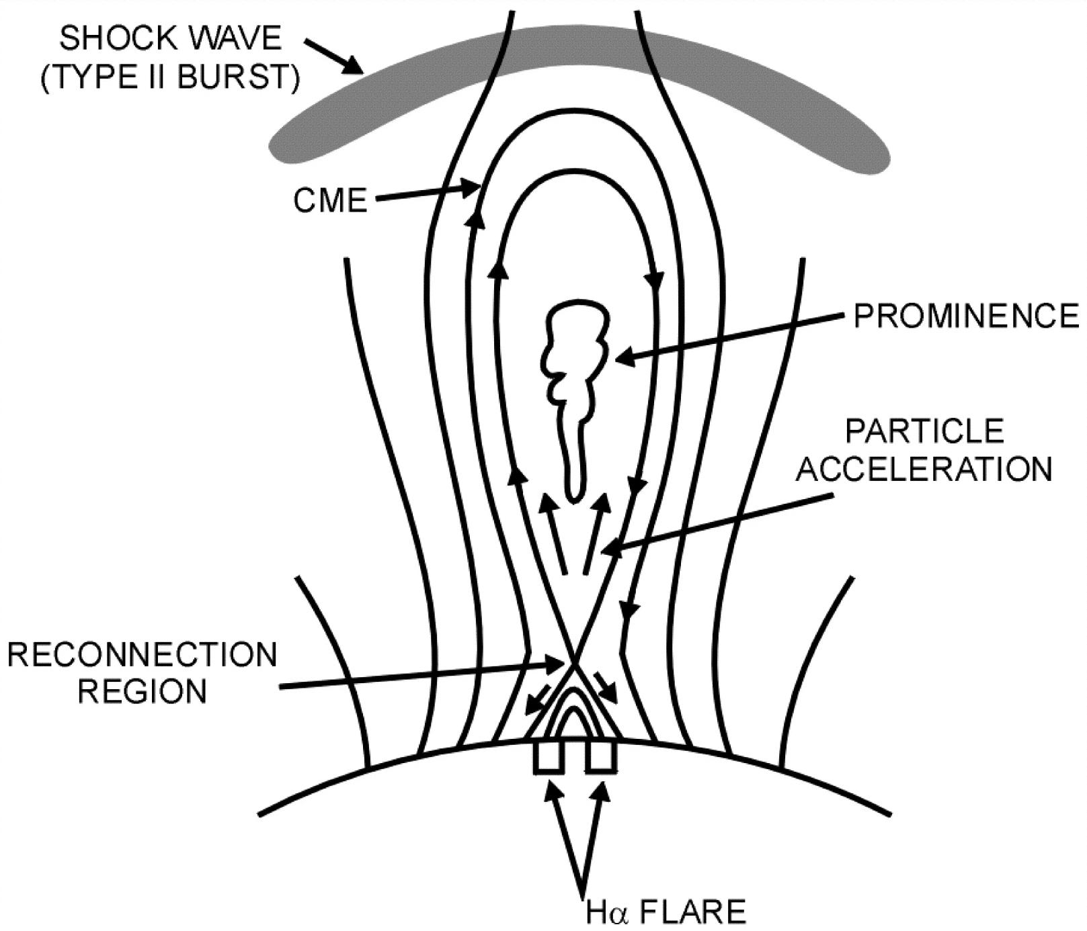
Flare Hypothesis
X
CSHKP-type reconnection in the wake of a CME

Slide 21
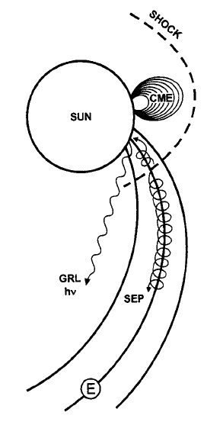
Shock Hypothesis
Cliver, Kahler, & Vestrand (1993)
Extended Pion-rich Gamma-Ray-Flares Due to
Precipitation from Coronal/Interplanetary Shock

Slide 22
Requirement for Shock Hypothesis:
Concurrent SEP Event
Long-Duration Gamma-ray Flares
Date GLE? SEP?
3 June 1982 No (E71) Yes
25 April 1984 No (E43) Yes
16 December 1988 No (E33) Yes
6 March 1989 No (E69) Yes
15 April 1990 No (E57) Yes
26 Mar 1991 No (W23) Yes?
4 June 1991 No (E70) Yes
6 June 1991 No (E44) Yes
9 June 1991 No (E04) Yes
29 September 1989 Yes (W100)
24 May 1990 Yes (W76)
11 June 1991 Yes (W15)
15 June 1991 Yes (W70)
28 October 2003 Yes (E08)
20 January 2005 Yes (W58)
Dunphy & Chupp (1994);
Ryan (2000); Chupp &
Ryan (2009)

Slide 23
Possible workshop exercise:
Modeling: Can precipitation of shock-accelerated
SEPs account for the extended gamma-
ray emission?
Analysis: Use GRO data to look for enhanced gamma-
ray emission during times of enhanced SEP
flux (outside of flares; occulted flares).
Notes:
Problems with flare scenario:
Seed particles irrelevant for SEP event
SEPs need to escape from CME
More energetic interacting particles from weaker fields?

Slide 24
GLEs Associated with Impulsive Flares:
Flare Origin?

Slide 25
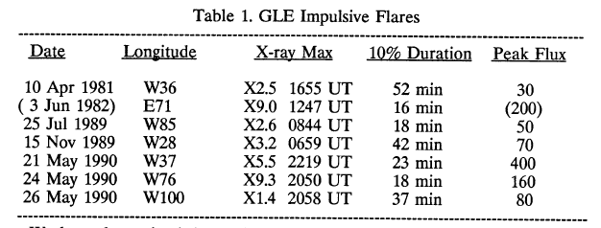
Impulsive GLEs in May 1990:
Flare Origin?
(1976-1990)
Kahler et al. (1991)
Subsequent GLEs linked to impulsive flares
[6 November 1997, 2 May 1998, 6 May 1998]
had high Fe charge states (~19) and high Fe/O (~5)
Cohen et al. (1999)

Slide 26
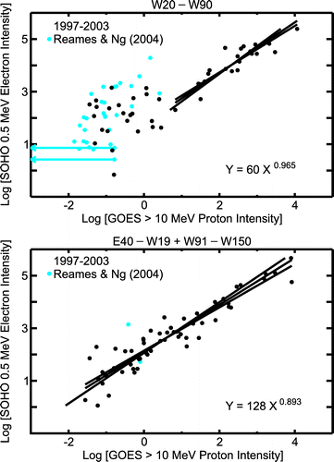
(Cliver & Ling, 2007)
Electron-to-proton ratios as a diagnostic of
flare vs. shock acceleration
1) Flare SEP events have higher and more variable e/p ratios
2) Interacting particles have e/p ratios comparable to the largest
values found in flare SEP events

Slide 27
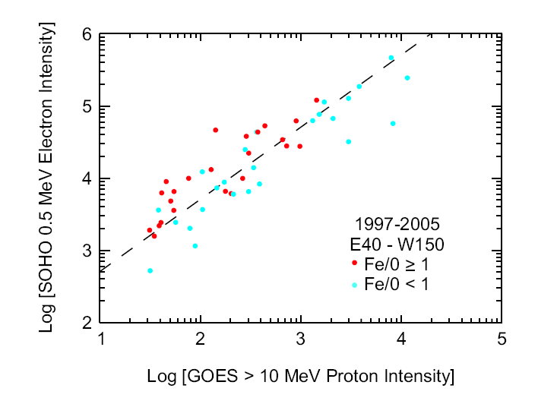
Large SEP events with higher e/p ratios tend
to have higher Fe/O ratios

Slide 28
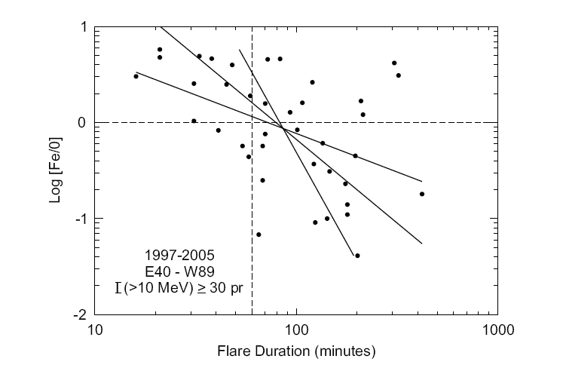
There is a tendency for SEP events associated
with impulsive flares to have high Fe/O ratios
Why?

Slide 29
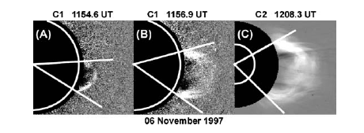
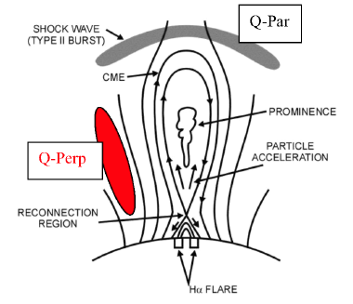
Lateral expansion from a compact source?

Slide 30
Possible Workshop Exercise
For the GLE data base, determine, insofar as possible:
- flare time scale
- e/p ratio
- Fe/O ratio (Tylka et al., 2005)
- Fe charge states
- wave association (Hα, EUV, SXR)
[e.g., 16 July 59 (Athay & Moreton, 1961);
24 May 1990 (Kocharov et al., 1994)]
Science questions:
- flare or shock?
- quasi-perpendicular or quasi-parallel?

Slide 31
GLEs Associated with Poorly-connected Flares
(Longitude < W05 or > W105)
Date Location
28 February 1942 E04
25 July 1946 E15
31 August 1956 E15
3 September 1960 E88
12 November 1960 W04
20 November 1960 W113
28 January 1967 W154
28 January 1967 W154
30 March 1969 W106
1 September 1971 W120
4 August 1972 E08
24 Sep 1977 W120
12 October 1981 E31
16 February 1984 W130
19 October 1989 E09
28 May 1990 W120
24 August 1998 E09
18 April 2001 W115
28 October 2003 E08

Slide 32
Two Possible Propagation Scenarios
- Flare: Connection via a preceding CME
- Shock: Widespread acceleration

Slide 33
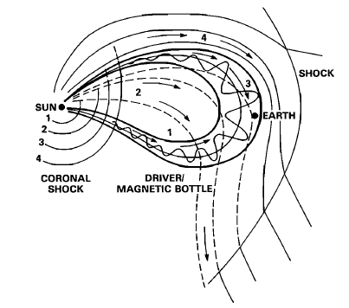
Direct magnetic connection via previous CME
Richardson, Cane, von Rosenvinge (1991)

Slide 34
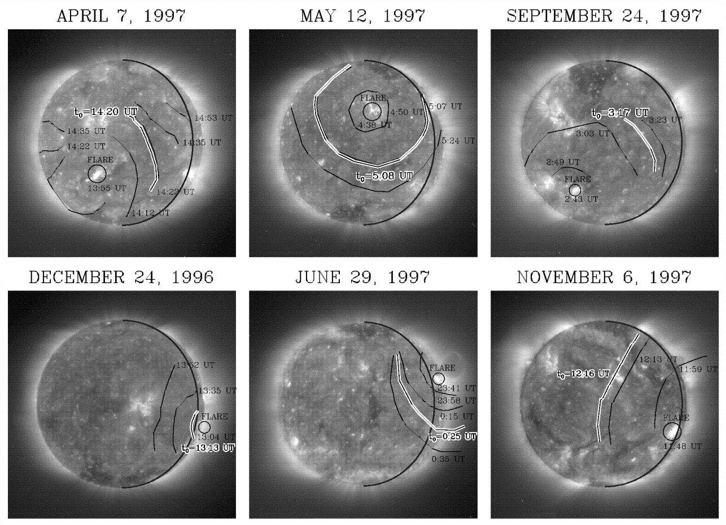
Widespread acceleration at a coronal shock
Krucker, Lin, & Thompson (1999)

Slide 35
Possible workshop exercise
IP connection from space plasma & field data
Wave associations & comparison with injection
onset of GLE particles

Slide 36
Summary
Central question in SEP Physics today: Are high-energy SEP
events dominated by flares or CME-driven shocks?
Possible workshop exercises
Seed particle populations & SEP precipitation (long-duration
gamma-ray events)
Relationships between flare time-scale, e/p, & Fe/O in GLES
Poorly connected GLEs

