Slide 1
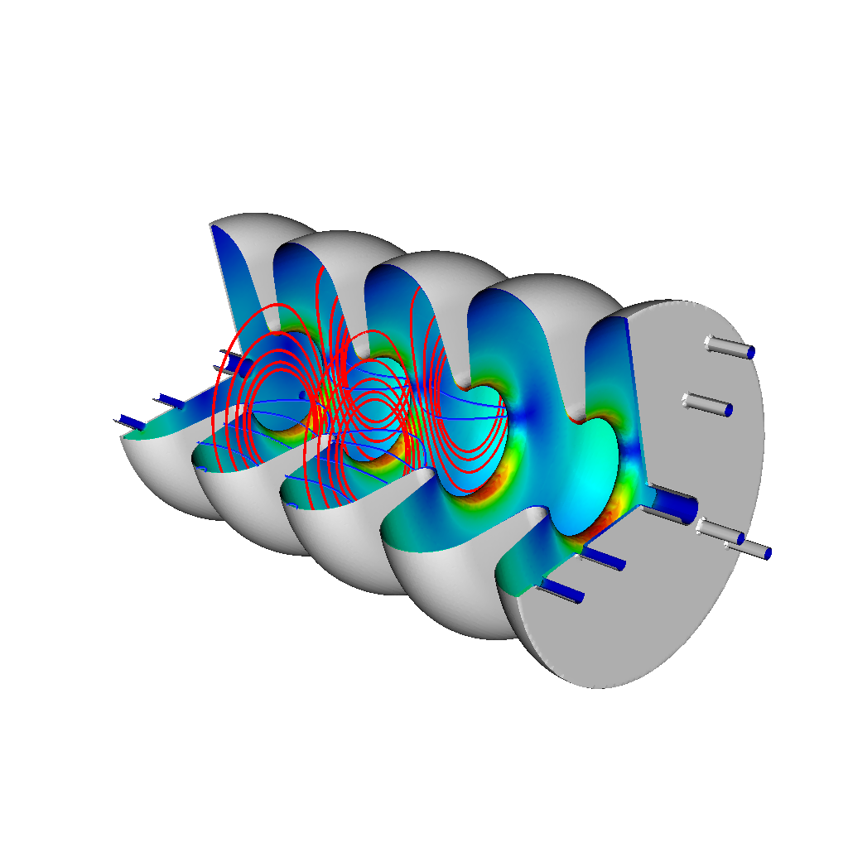
Applications of Frequency Extraction to Cavity Modeling
Travis M. Austin* and John R. Cary*,¶
Tech-X Corporation*, University of Colorado-Boulder¶
Collaborator: Leo Bellantoni, FNAL
UCLA COMPASS Meeting
3 December 2008

Slide 2
Overview
Background on Cavity Modeling
Finite-Difference Time-Domain Simulations
Frequency Extraction Algorithm
Filtered Excitation
Filter-Diagonalization
Verification of Spherical Cavity
Validation of A15 Cavity
Conclusion

Slide 3
Cavity Modeling
Verifying and validating EM codes is a crucial part of cavity modeling since it provides evidence of the effectiveness of the code
COMPASS codes like Omega3p have made a concerted effort at V&V
We focus in this talk on V&V efforts for Tech-X Corporation’s VORPAL code
VORPAL has been successful in the past at laser wakefield simulations and electron cooling

Slide 4
Cavity Modeling
Machining is accurate to about 1 mil or 0.0254 mm
Results in [Burt et al., 2007] showed frequencies to be sensitive to equatorial radius by about 80 MHz/mm for a deflecting cavity
Machining can produce cavities with frequencies shifted by about ± 2 MHz from the original specs.
Careful remeasurements after fabrication can be using simulations instead of bead pull experiments if the simulations are accurate.

Slide 5
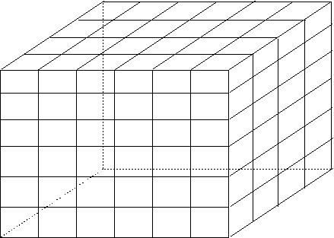
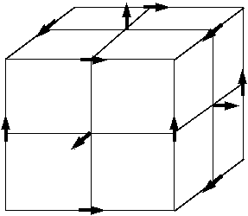
Finite-Difference Time-Domain
Maxwell’s Equations
B_{z}
E_{y}
E_{x}
E_{x}
E_{y}
E_{z}
E_{z}
E_{z}
B_{x}
B_{y}
“Rectangular Grid”
E_{x}
E_{y}
.
.
.

Slide 6
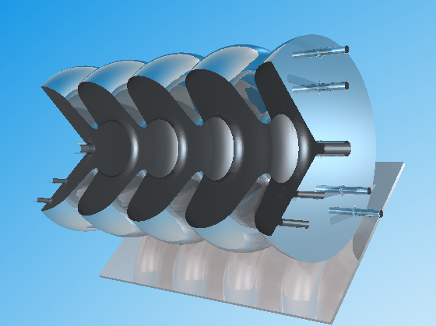
Finite-Difference Time-Domain
Embedded Boundary Methods

Slide 7
Finite-Difference Time-Domain
Embedded Boundary Methods
Curved domains described analytically
These domains are not represented by the logically rectangular domain in contrast to unstructured FE meshes
There are three methods for representing contribution of curved boundaries for logically rectangular domains:
Stairstep
Dey-Mittra
Zagorodnov
Stairstep and Dey-Mittra discussed on next page
Zagorodnov only recently implemented

Slide 8
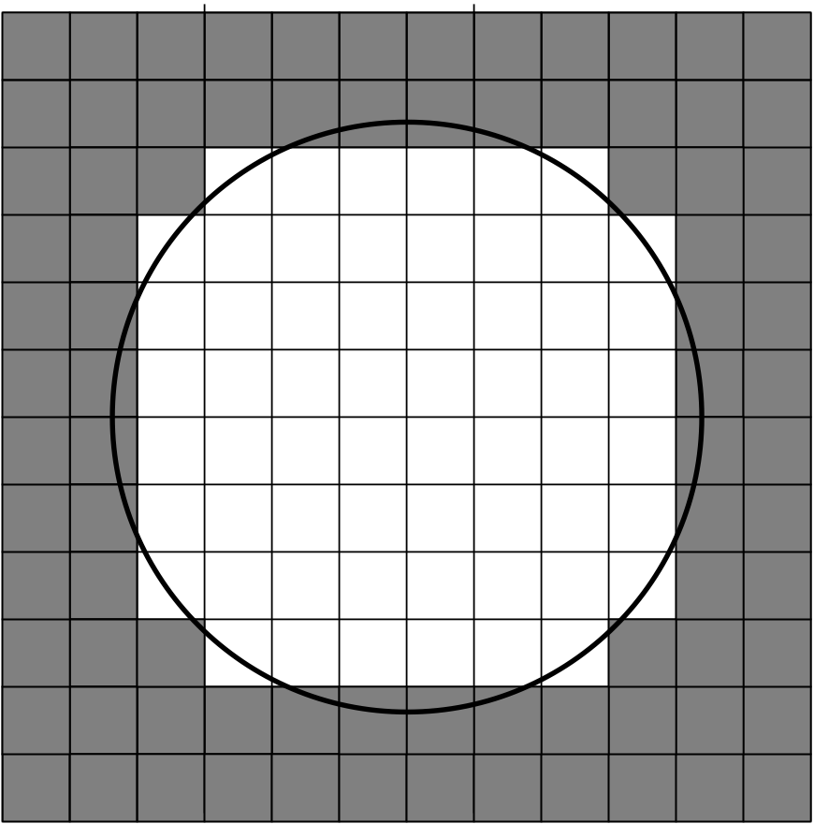
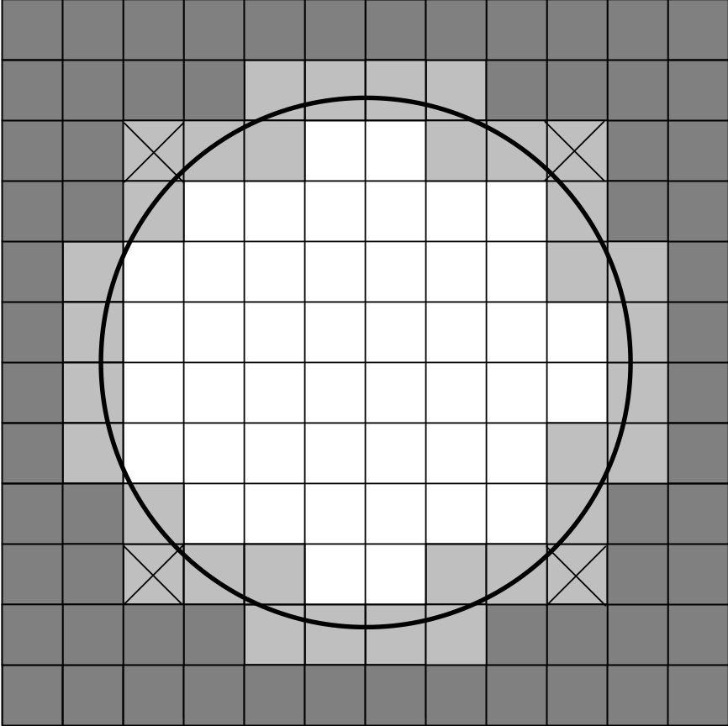
Finite-Difference Time-Domain
(a) Stairstep Approach (b) Dey-Mittra Approach
- Only change Faraday update

Slide 9
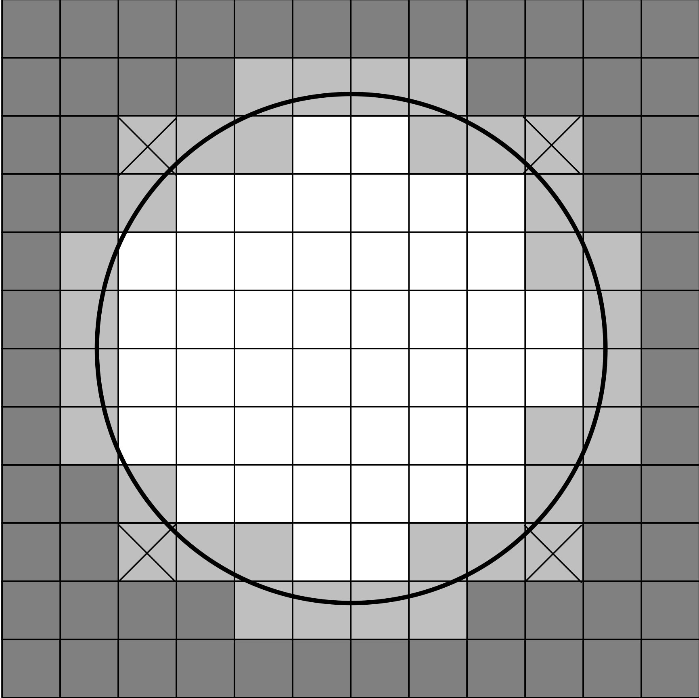
Finite-Difference Time-Domain
FDTD is a second-order method
Curved domains modeled using embedded boundary methods
Embedded boundary method requires adjusting lengths (l_{ij}, l_{ik}, l_{jk}) and areas (a_{ij}) used in the Faraday update step
Faces with small area excluded from computations to minimize the reduction in time-step due to CFL
Method maintains second-order in time and space unless too many cells thrown out

Slide 10
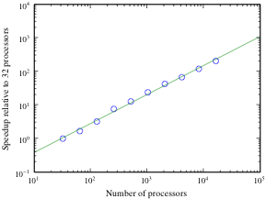
VORPAL Computational Framework
Based on the FDTD method
Mainly uses the Dey-Mittra method for embedded boundaries
Excellent scaling on >10000 processors of Franklin for EM problem with ~200 million grid points
Load balancing and ADI methods currently being investigated for even better performance in the future

Slide 11
Frequency Extraction Algorithm
Eigenvalue problems typically consist of constructing a large matrix system and using an iterative method to find the eigenvalues
Robust eigenvalue solver is necessary to compute the eigenvalues in a reasonable time
These methods require more memory (storing matrix and multiple vectors) and are generally less scalable than FDTD methods
Goal is to construct an eigenvalue solver (or frequency extraction algorithm) that depends on FDTD methods which are very scalable and require minimal memory

Slide 12
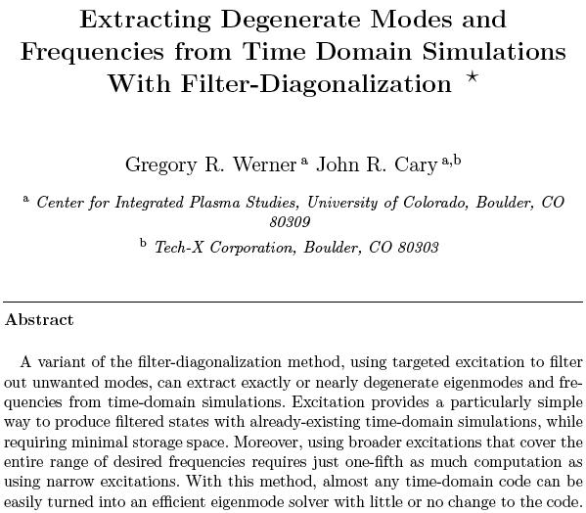
Frequency Extraction Algorithm
Use FDTD method as it scales well for massively parallel machines like the NERSC machine Franklin
Extract frequencies through
Filter to desired modes
Determine subspace with SVD
Diagonalize in subspace
Get multiple modes at once
G.W Werner and J.R Cary, J. Comp. Phys., 227,
5200-5214, 10, (2008).

Slide 13
Frequency Extraction Algorithm
Consider
Then where
Use that vanishes for t > T, where T is the excitation time, i.e.,
where
For the range , we use

Slide 14
Frequency Extraction Algorithm
Determine the approximate number of modes, M, in the range
Obtain L state vectors (s_{l}) for L > M, the number of modes, which correspond to evaluation of the field at L times for t > T and define r_{l} = Hs_{l}
Evaluate (s_{l}) at P random points on the grid to obtain P X L matrix S and the P X L matrix R such that
R and S may be overdetermined so solve instead
Find the SVD of
Find the singular values of
Frequencies are calculated as

Slide 15
Frequency Extraction Algorithm
Degeneracies (or near degeneracies) can be extracted with multiple simulations to generate the state vectors (s_{l})
Once the state vectors are generated from FDTD simulations, the frequency extraction algorithm is quick (< 1min)
Constructing the spatial mode patterns for each frequency also takes only several minutes depending on problem size
Results in [Cary and Werner, 2008] verified method for 2D rectangular wave guide

Slide 16
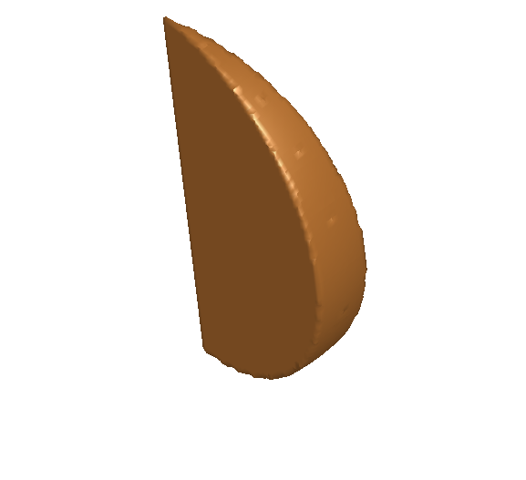
Validation of Sphere
Simulation parameters
18 degree slice of a spherical cavity
Radius = 0.1 m
Grid size = 2 mm
Frequency range = 2 ~ 4 GHz
Expected modes (TEnmp)‏
TE101 2.14396 GHz
TE201 2.74995 GHz
TE301 3.33418 GHz
TE102 3.68598 GHz
TE401 3.90418 GHz

Slide 17
Validation of Sphere
Mode | Analytical (GHz) | Calculated (GHz) | Rel. Error
TE101 | 2.14396 | 2.14550 | 0.00072
TE201 | 2.74995 | 2.75091 | 0.00035
TE301 | 3.33418 | 3.33378 | 0.00012
TE102 | 3.68598 | 3.68458 | 0.00038
TE401 | 3.90418 | 3.90302 | 0.00030
These preliminary results have similar accuracy to HFSS and Microwave Studio. Omega3p more accurate by a three orders of magnitude. (HFSS, Microwave Studio, and Omega3p results obtain from JLab. VORPAL results produced by Seah Zhou of Tech-X Corp.)

Slide 18

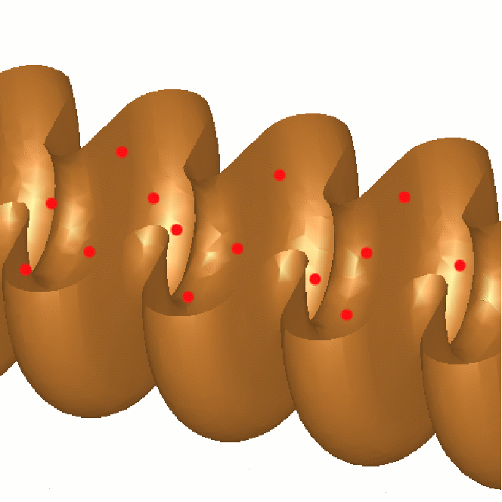
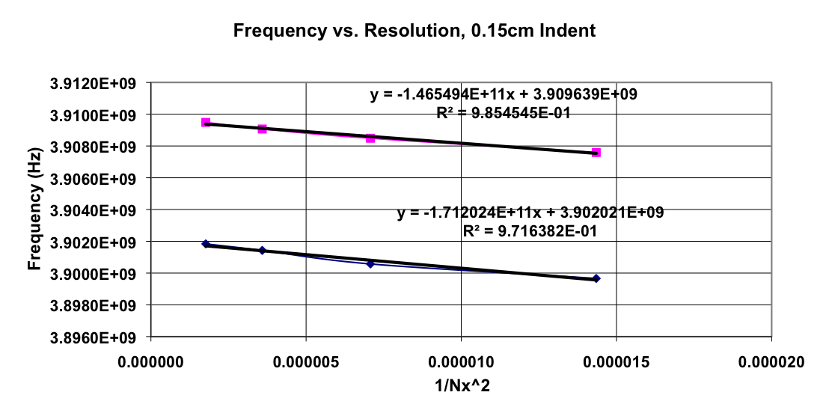
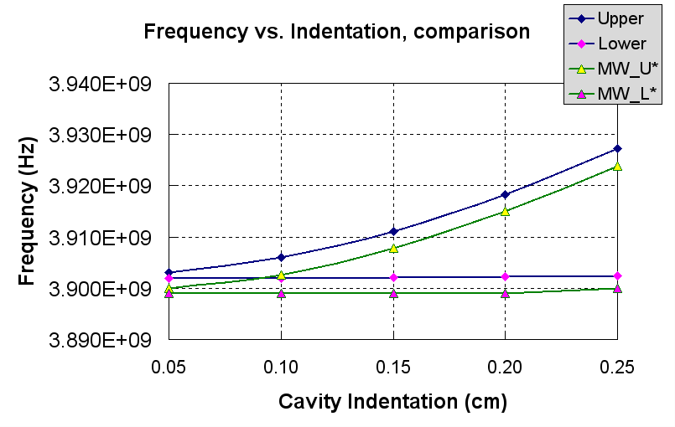
Validation of A15 Cavity
Background
Compute frequencies for 9-cell crab cavity and compare to MAFIA/MWS
Crab cavity squashed in the z-direction to eliminate degeneracies
Simulations with up to 25 million cells
Extrapolated results consistently differ from MAFIA/MWS by ~3 MHz

Slide 19
Validation of A15 Cavity
A15 Cavity is an aluminum cavity fabricated at Fermilab in 1999
Designed for development of a K+ beam
It has been extensively tested, measured, and simulated
Simulations performed by MAFIA considered computing frequencies of accelerating and deflecting modes
Tech-X using VORPAL has concentrated on the deflecting (TM₁₁₀) modes from the A15

Slide 20
Validation of A15 Cavity
Equator Radius: 47.19 mm
Iris Radius: 15.00 mm
Cavity Length: 153.6 mm
Cavity contains end plate holes used for bead pull experiments and for creating dipoles
Five Deflecting Modes:
f₀ | f₁ | f₂ | f₃ | f₄
3902.810 | 3910.404 | 3939.336 | 4001.342 | 4106.164

Slide 21
Validation of A15 Cavity
Excitation Pattern:

Slide 22
Validation of A15 Cavity
Simulation Parameters:
Two simulations used to capture degeneracies
Excitation time: 100 periods @ 4 GHz
Total simulation time: 150 periods @ 4 GHz
Max number of grid points: ~20 million grid points
Max Total Time Steps: 437369 time steps

Slide 23
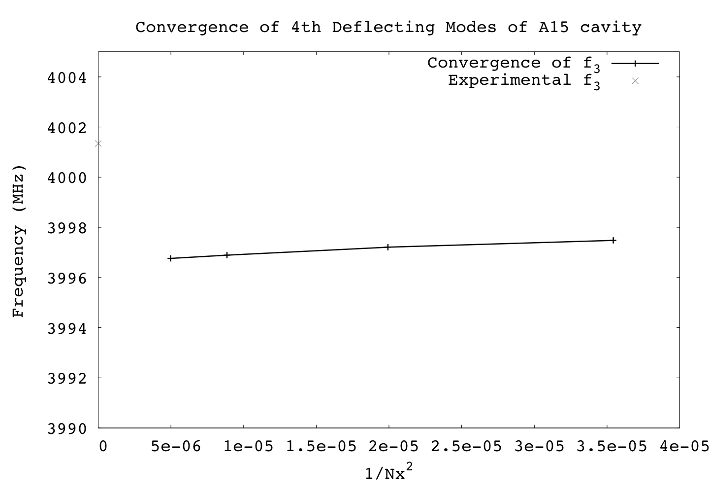
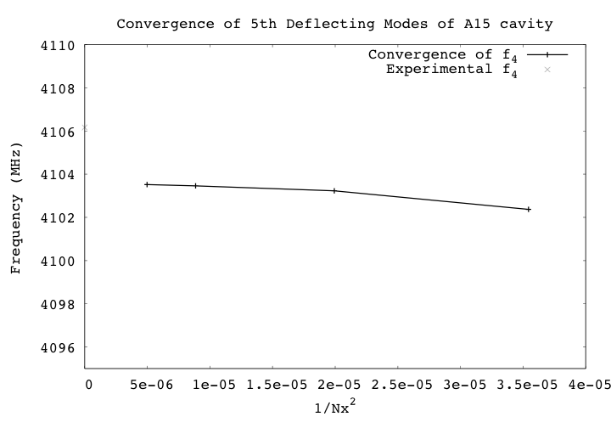
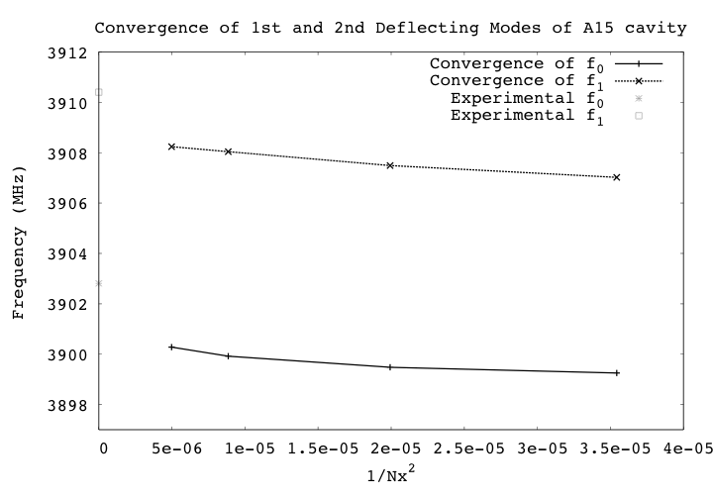
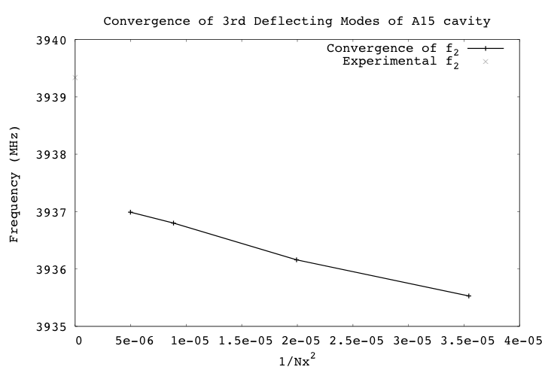
Validation of A15 Cavity

Slide 24
Validation of A15 Cavity
Relative Error of Deflecting Modes Computed by MAFIA:
f₀ | f₁ | f₂ | f₃ | f₄
1.4e-3 | 1.3e-3 | ------- | ------- | -------
Relative Error of Deflecting Modes Computed by VORPAL:
f₀ | f₁ | f₂ | f₃ | f₄
6.5e-4 | 4.9e-4 | 5.1e-4 | 1.2e-3 | 6.1e-4

Slide 25
Validation of A15 Cavity
VORPAL was too low by 2 MHz for the p mode
MAFIA was too low by 5 MHz for the p mode
MAFIA calculations were too large on spacing between the p deflection mode and the next higher mode by 6.41% and VORPAL calculations were too large by 7.6%
Possible causes for differences between calculations and experimental measurements:
Failed to account for atmospheric conditions
End plate holes lead to frequency shift
Discrepancies between specs and machining

Slide 26
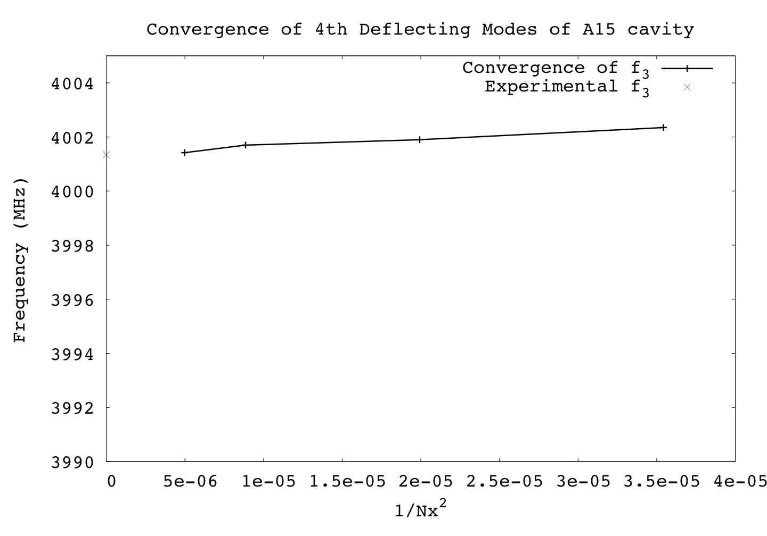
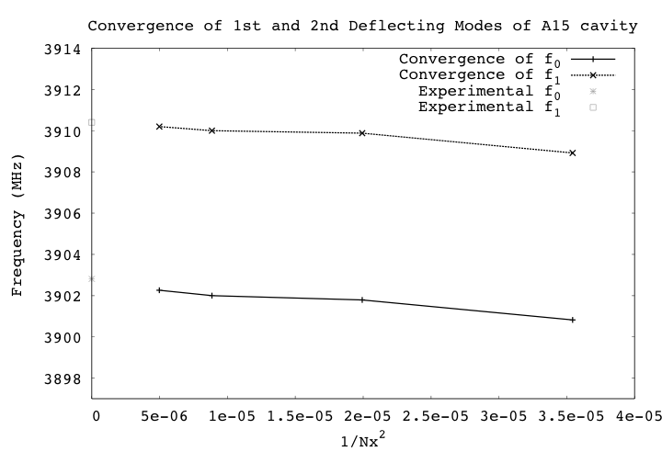
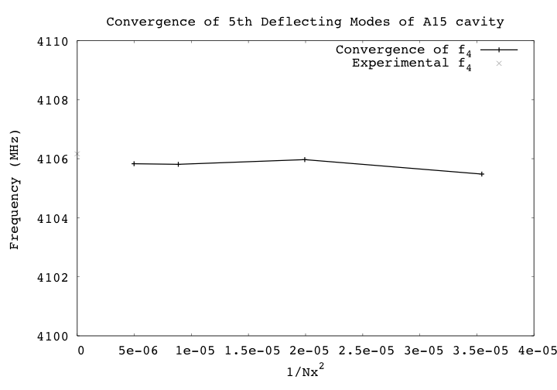
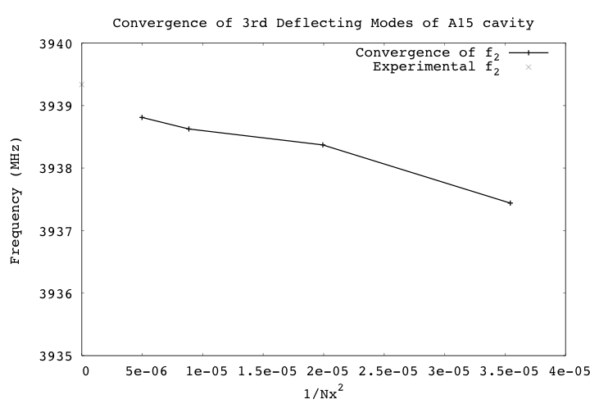
A15 Accelerator Cavity Computations

Slide 27
Validation of A15 Cavity
Relative Error of Deflecting Modes Computed by VORPAL for original equatorial radius:
f₀ | f₁ | f₂ | f₃ | f₄
6.5e-4 | 4.9e-4 | 5.1e-4 | 1.2e-3 | 6.1e-4
Relative Error of Deflecting Modes Computed by VORPAL for 0.03 mm smaller equatorial radius:
f₀ | f₁ | f₂ | f₃ | f₄
5.6e-5 | 1.4e-5 | 7.3e-5 | 7.0e-5 | 7.6e-5

Slide 28
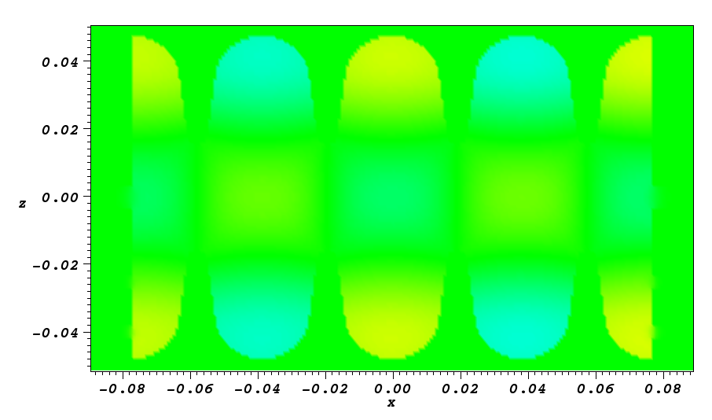
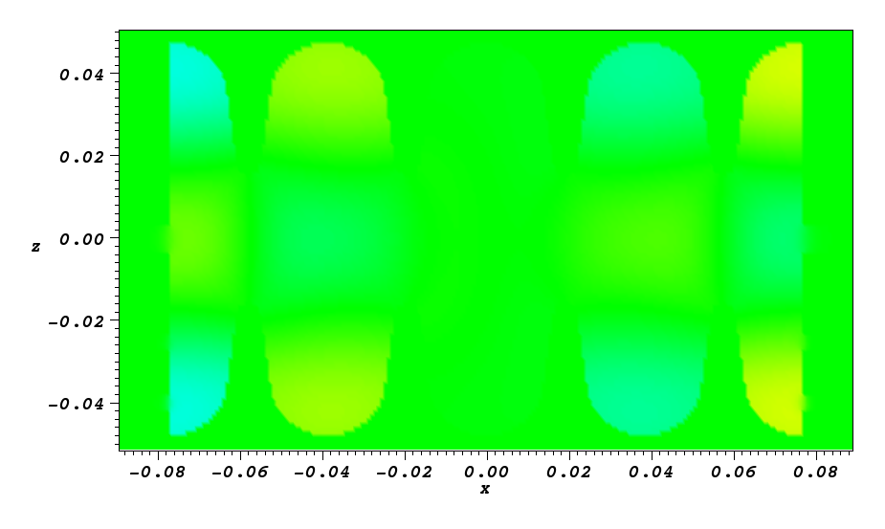
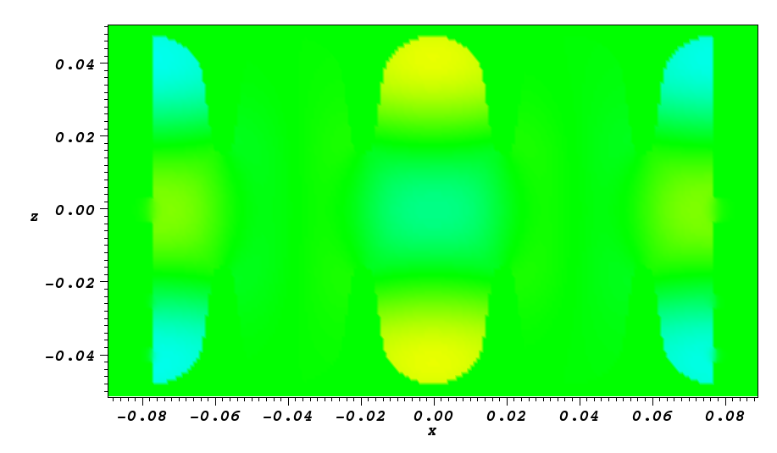
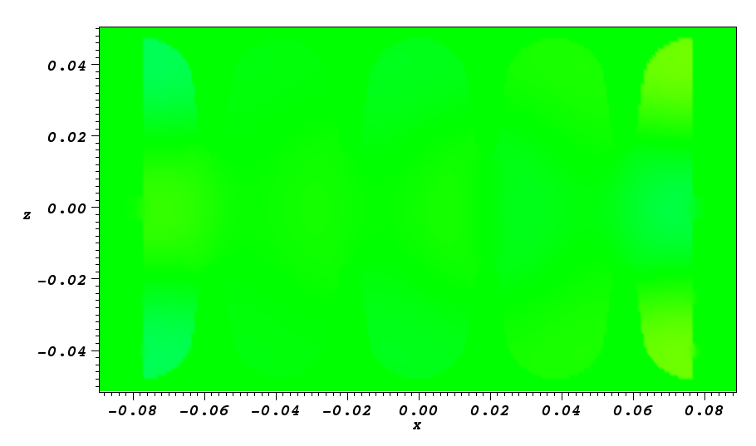
A15 Cavity Computations
3902.810 MHz (p mode)
3910.404 MHz
3939.336 MHz
4001.342 MHz

Slide 29

Complete Picture of p deflection mode

Slide 30
Final Remarks
Thanks to Leo Bellantoni at FNAL for assisting on verification study
Working with Jlab on further validation for sphere and examining maximum value of B field on surface
We are currently working on a paper which will be submitted soon showcasing this work
Future topics consist of using algorithm in an optimization loop for cavity design.

