Slide 1
Next Generation Clinical Trials TRANSCEND
caBIG CTMS F2F : April 28-29, 2008
Sorena Nadaf M.S.,
Director, Translational Informatics; Chief Informatics Officer
University of California San Francisco,
Helen Diller Family Comprehensive Cancer Center

Slide 2

TRANSCEND
TRANslational Informatics System to
Coordinate Emerging Biomarkers, Novel Agents, and Clinical Data

Slide 3
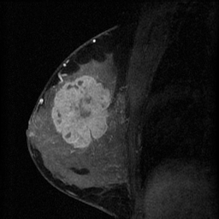
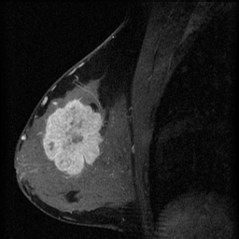
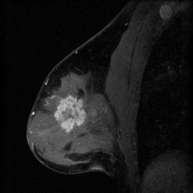
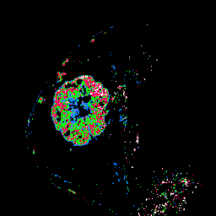
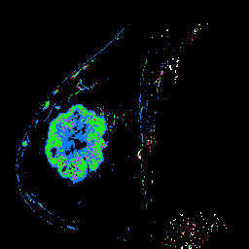
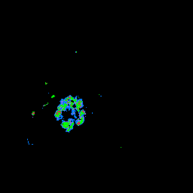
Background PI: Laura Esserman M.D. and UCSF The I-SPY TRIALS I-SPY 1→I-SPY 2
National trials to integrate imaging and tissue biomarkers to
Predict response to Rx → Tailor Rx to response

Slide 4
Changing the Paradigm To Accelerate Progress
Understand biology
of the tumors that present
Tailor therapy
accordingly, at the outset, find the right set of markers to rapidly predict response, introduce new agents
Targeted Therapy Trials
neoadjuvant approach should enable us to dramatically shorten the timeline and cost to assess new agents

Slide 5

CALGB INTERSPORE ACRIN NCICB
Investigation of
Serial studies to
Predict
Your
Therapeutic
Response with
Imaging and
And
moLecular analysis

Slide 6
Founding Principles of the I-SPY Trial
Investigators agreed to sharing data and biologic materials
Data to be released after completion of trial and accessible to the community
Adherence to data standards
Use of common data elements

Slide 7
Accomplishments of I-SPY
Organized national team of participants:
CALGB, SPORE, ACRIN,NCICB, Advocates
9 clinical sites
8 laboratories
Developed standardized methods for MR imaging
Accuracy,reproducibility of volume measurement being studied
Developed methods to optimize assays for, share, and distribute frozen small core bx material
CGH, expression, protein arrays; p53 sequencing
Developing tools to support data sharing, tissue tracking, common information repositories, clinical trial automation
Agreement to share data, reward participation on all levels
CALGB: Lab Trak
NCICB: caINTEGRATOR; Quality Indicator portal
caBIG: caIMAGE will yield real time data images for the ammendment
Patient Accrual completed, on time
237 patients on trial
8-12 per month

Slide 8
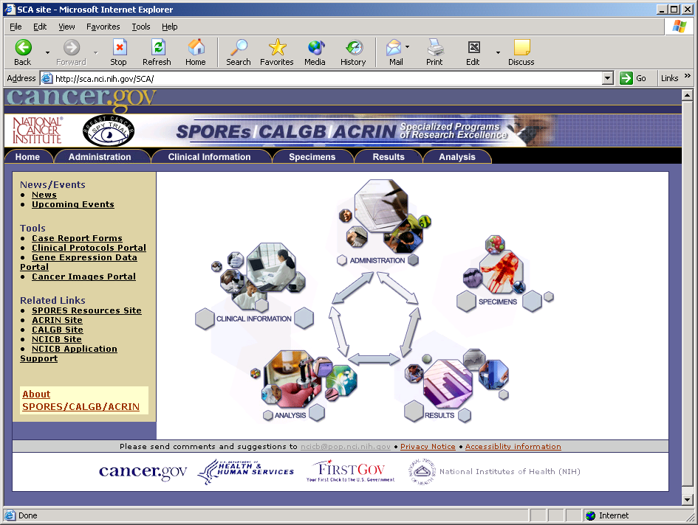
I SPY Trial Web Portal
Protocols, Accruals
Clinical Case Report Forms, Patient Demographics
Specimens, IHC, FISH Assays
caINTEGRATOR
Gene Expression, Tissue Arrays, Imaging, H&E Images
Analysis Tools

Slide 9
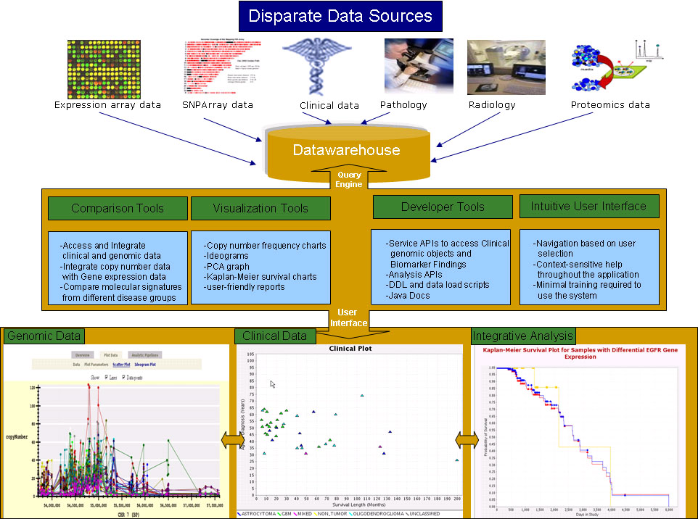

Slide 10
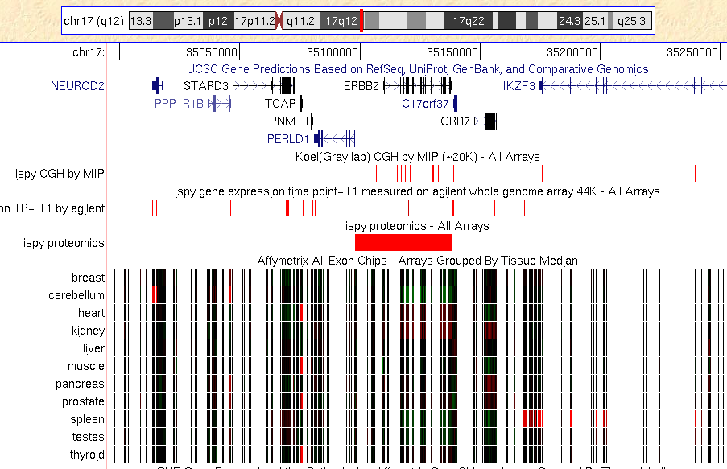
Connect Cancer Genomics Browser to the Human Genome Browser David Hausler, Jing Zhu, et al. UC Santa Cruz

Slide 11
I-SPY 2
Adaptive Design

Slide 12
I-SPY 2 Adaptive Design Trial Goals
Identify women at highest risk
Introduce the most promising drugs in development that are individually targeted to the person’s tumor.
Three key transformative concepts in this trial:
Learn as we go, using the information from each person as they go through the study to help the next
Use early markers (imaging and tissue/blood) to measure success, so that we can learn in months rather than years
Test the concept of personalized medicine leveraging the molecular tools that have been in development for the last decade

Slide 13
Specifications for I-SPY 2
Validate, test, and qualify biomarkers
as we test new agents
Adaptive Design concept allows learning, change
Change/add new agents when response is not optimal
Learn as we go
Integrate organizational management principles to eliminate enormous inefficiencies
Trial “rounds” proceed without interruption
New agents will be added adaptively
Primary endpoint is to improve the CR rate
Goal: accelerate ability to identify effective tailored treatments
CQI: Create an approach to treat, learn, adapt, treat, learn, adapt
Data entered and analyzed real time
Design anticipates need for personalized medicine

Slide 14
Avoid Technology Obsolescence
Current technology will be used for assignment today
Additional biomarkers on new technology platforms will run in parallel
Analysis will be possible in real time
At the trial matures, new technology can be compared to current technology and used in future trials if it is comparable and cheaper or better

Slide 15
Informatics Integration Clinical Care→Clinical Research→Clinical Care
Patients seek trials
Point of Care Data Collection
Tissue Inventory
Specimen tracking
Storing assay results
Connecting results to patient data and outcomes, other assays
Breastcancertrials.org
Open Source “Wizards”
caTISSUE
caTISSUE
caINTEGRATOR
caARRAY, cancer genome browser

Slide 16

“Informatics Integration”…..
TRANSCEND Project –
TRANslational Informatics System to
Coordinate Emerging Biomarkers, Novel Agents, and Clinical Data

Slide 17
Primary Objectives of TRANSCEND are to:
Demonstrate the use of web-based case report forms (CRFs) to facilitate data collection and transmission to NCI.
Demonstrate the use of clinically based data collection in support of case report form generation in the I-SPY trial at two sites (UCSF, UPenn).
Demonstrate the integration of an electronic health record system (Tolven eCHR) with an established translational research infrastructure currently in place for the I-SPY trial.

Slide 18
1° TRANSCEND Objectives continued:
4. Develop/extend breast cancer common data elements (caDSR)
5. Demonstrate the use of caBIG standards in the integration of a clinical care system with other caBIG tools (caINTEGRATOR, caTISSUE).
6. Develop a general approach utilizing caBIG standards for data elements, controlled vocabularies, and system interfaces in constructing a translational research platform spanning genomic/proteomic, radiographic, and clinical data.
7. Evaluate the effectiveness of the TRANSCEND infrastructure in collecting high quality (complete, correct, timely) structured phenotypic data for the I-SPY trial.

Slide 19
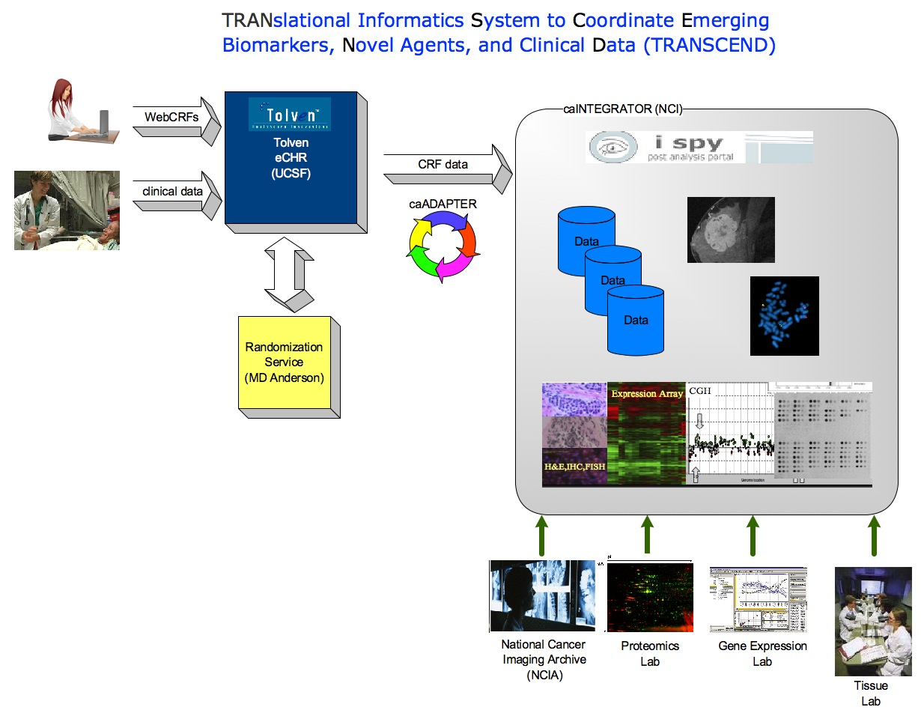
TRANSCEND Project

Slide 20
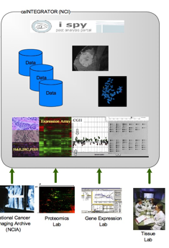


Preliminary Data Flow
Randomization
Web Service
Health provider
Data entry using
Clinical Wizards
TOLVEN
Web PHR
Staff entry of
CRF online
Manual entry of
- Local lab data
- Clinical data
TolvenID is unique
participant identifier

Slide 21
Case Report Forms
Will implement electronic case report forms (CRF) using an existing web-enabled open source clinical information system infrastructure (Tolven).
Enable two modes of CRF entry:
(1) web-based CRF-like forms
(2) entry of clinical data by healthcare providers during clinic visit, CRF is auto-assembled by the system using information entered by provider.
I-SPY 2 participating institutions will have a choice of either mode.
UCSF and UPenn will use the auto-assembly mode, which involves clinical staff entering patient data into the Tolven-based clinical information system in their clinic.

Slide 22
CRF Rules
Auto-assembly of CRFs from clinical data will require rules for interpretation of data entered in clinical form.
The Tolven system includes a rules engine that utilizes the common rules language, OPS5.
OPS5 based rules will be developed to enable the auto-assembly CRF construction from clinical data.
The rules are also necessary in order to have the system help establish the suitability and completeness of captured clinical data in becoming appropriate “answers” for the questions in the case report forms.

Slide 23
Common Data Elements
This project will require establishing a core set of common data elements for breast cancer.
We will derive existing elements from the NCI caDSR.
Any additional elements needed but not in the caDSR will be submitted for proposed inclusion in the caDSR.

Slide 24
Phase I and Phase II of TRANSCEND
PHASE I
development and deployment of TRANSCEND within the University of Pennsylvania and the UCSF Breast Cancer Center for use with I-SPY trial patients.
PHASE II
evaluate the usability of the TRANSCEND platform for capture of clinical data in support of translational research.
Implement caTISSUE and integrate into the TRANSCEND
Requires caTISSUE to support lab tracking

Slide 25
Phase I: Task 1 – Development of TRANSCEND
Task 1.1: Analysis of I-SPY CRFs to identify clinical questions relevant to data generation for CRFs.
Task 1.2: Derivation of caDSR based data elements required in the CRF. The team will work with the NCI to add data elements found to be missing in the caDSR . What about the V3 data type issue?
Task 1.3: Design of clinical data collection ‘pages” on the Tolven platform using existing ‘wizard-driven’ data entry using Tolven’s rules-driven forms infrastructure.
Task 1.4: Develop case report form (CRF) generator as PDF forms for submission to CALGB.

Slide 26
Phase I: Task 2 – System Testing of TRANSCEND
Task 2.1: Development of test cases based on functional requirements and expected behavior.
Task 2.2: Conduct test plan using test cases and formal feedback to Tolven regarding pass/fail.
Task 2.3: Certify TRANSCEND platform

Slide 27
Phase I: Task 3 – System Documentation
Task 3.1: Develop user-training guides for clinical users (to be used in Task 5)
Task 3.2: Develop system documentation including system architecture diagrams, relevant UML diagrams, and documentation regarding data elements and controlled terminology mappings.

Slide 28
Phase I: Task 4 – Deploy TRANSCEND at UCSF and University of Pennsylvania
Task 4.1: Deploy TRANSCEND eCHR (Tolven) training and production environments within UCSF BCC and UPenn
Task 4.2: Conduct user training on TRANSCEND training environment
Task 4.3: Create user accounts and go-live

Slide 29
Phase I: Task 5 – Project Management/Status Reporting Task 6 –caBIG Silver Compatibility Review
Task 5.1: Monthly status reports to NCI
Task 5.2: Risk Management meetings twice a month
Task 6.1: Contact caBIG review and ask for workspace mentors to help begin assembling documentation for caBIG review.

Slide 30
Phase II: Task 1 – Evaluation
Task 1.1: Conduct usability evaluation through direct observation of users in a clinic environment.
Task 1.2: Conduct data quality evaluation of data entered through the eCHR component.

Slide 31
Phase II: Task 2 – Interfacing TRANSCEND/Tolven eCHR with caINTEGRATOR
Task 2.1: Conduct analysis to determine data elements and process for interfacing with caINTEGRATOR.
Task 2.2: Implement outbound Tolven interface to caINTEGRATOR using either caADAPTER or existing caINTEGRATOR API.
Task 2.3: Test eCHR-caINTEGRATOR interface with 1,000 data element test set.

Slide 32
Phase II: Task 3 – Integration of caTISSUE with TRANSCEND
Task 3.1: Install caTISSUE server for I-SPY at UCSF.
Task 3.2: Develop interface strategy and design for caTISSUE and TRANSCEND/Tolven eCHR.
Task 3.3: Develop caBIG compliant interface between caTISSUE, caINTEGRATOR and Tolven eCHR.

Slide 33
Phase II: Task 4 – Planning for Additional Integration
Task 4.1: Work with Dr. Hylton to create a plan to develop interfaces to tools that automate the calculation of MRI tumor volume
Task 4.2: Work with Joel Salz and Elliot Siegel to develop plan to build interfaces to National Cancer Imaging Archive (NCIA)

Slide 34
Project Timing
Phase I: April 2008 – September 2008
Phase II: October 2008 – March 2009
I-SPY2 Trial Launch: Spring/Summer 2009

Slide 35
Questions & Discussion

