Slide 1
CTCAE v3.0 Revision Project All-hands Working Group Education and Training October 20, 2008
Prepared by:
Ann Setser, CBIIT, NCI
Notes:
1

Slide 2
Outline
CTCAE v3.0 As-is
MedDRA Fundamentals
CTCAE v3.0 Relationship to MedDRA
CTCAE v3.0 Revision Goals
Harmonize with MedDRA
100% MedDRA single concepts
Revise and extend AE terms and severity indicators to be machine interpretable; conformance with caBIG Vocabulary Standards
Establish a formal, ongoing governance for future versions
Understandability, Reproducibility, Usability
Notes:
2

Slide 3
CTCAE Background
The Cancer Therapy Evaluation Program (CTEP) of the National Cancer Institute (NCI) developed the original Common Toxicity Criteria (CTC) in 1983 to aid in the documentation and analysis of adverse effects of chemotherapy.
The CTC is a list of Adverse Event (AE) terms commonly encountered in oncology accompanied by a grading (severity) scale for each AE.
1983 CTC v1 ~ 50 terms
1998 CTC v2 ~ 300 terms
CTCAE v3 ~ 1000 terms
2008 Draft 1 ~ 820 terms – MedDRA terms

Slide 4
CTCAE Purpose
To facilitate the evaluation of new cancer therapies, treatment modalities and to standardize reporting of AEs across groups and modalities.
http://ctep.cancer.gov

Slide 5
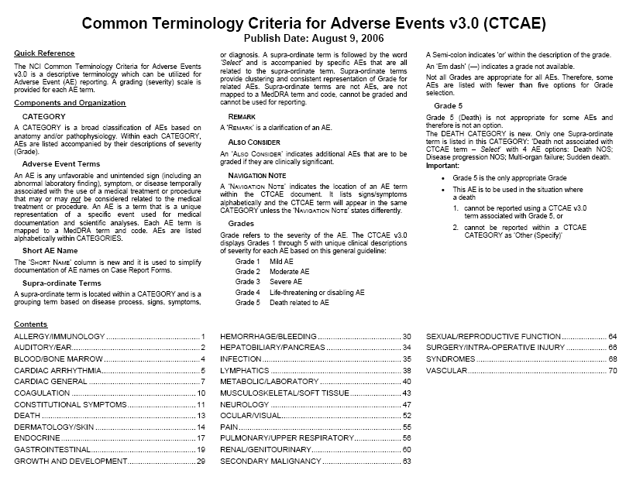

Slide 6
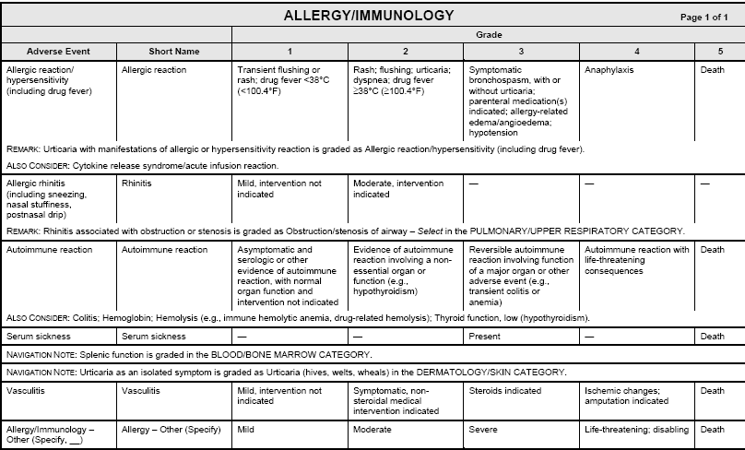

Slide 7
Medical Dictionary for Regulatory Activities – MedDRA Background
Is a clinically validated international medical terminology used by regulatory authorities and the regulated biopharmaceutical industry throughout the entire regulatory process, from pre-marketing to post-marketing activities, and for data entry, retrieval, evaluation, and presentation.
Is the adverse event classification dictionary endorsed by the International Conference on Harmonisation of Technical Requirements for Registration of Pharmaceuticals for Human Use (ICH).
Is used in the US, European Union, and Japan. Its use is currently mandated in Europe and Japan for safety reporting.

Slide 8
MedDRA Structure
System, Organ, Class | SOC | Highest level of the terminology, and distinguished by anatomical or physiological system, etiology, or purpose | 26
High Level Group Term | HLGT | Subordinate to SOC, supraordinate descriptor for one or more HLTs | 332
High Level Term | HLT | Subordinate to HLGT, superaordinate descriptor for one or more PTs | 1,688
Preferred Term | PT | Represents a single medical concept | 18,075
Lowest Level Term | LLT | Lowest level of the terminology, related to a single PT as a synonym, lexical variant, or quasi-synonym (Note: All PTs have an identical LLT) | 66,135

Slide 9
MedDRA
MedDRA translations
Czech
Dutch
English
French
German
Italian
Japanese
Portuguese
Spanish
MedDRA includes Standardised MedDRA Queries (SMQs). SMQs are groupings of terms that relate to a defined medical condition or area of interest.
http://www.meddramsso.com

Slide 10
CTCAE v3.0 & MedDRA Use
10
CTCAE & MedDRA
MedDRA is used by the biopharmaceutical industry and regulatory agencies within the ICH regions
CTCAE use by Industry
CTCAE is widely used in oncology and HIV clinical research
Notes:
10

Slide 11
Comparison
MedDRA
List of terms
>86,000
Content: Comprehensive
---
Hierarchy: 5 levels
Medically validated
CTCAE v3.0
List of terms
1,059
Content: Oncology
Severity Scale
Hierarchy: 2 levels
---

Slide 12
CTCAE v3.0 Issues & MedDRA
CTCAE v3.0 Terms
Multiple concepts
One/many element of Grade description is critical AE concept
Not all MedDRA terms

Slide 13
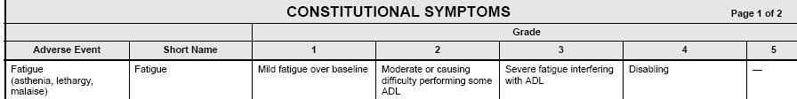
CTCAE v3.0 Multiple Concepts in one AE Term
Mapped to MedDRA: Fatigue 10016256
CTCAE v4.0/MedDRA
Fatigue
Asthenia
Lethargy
Malaise
13
Notes:
13

Slide 14
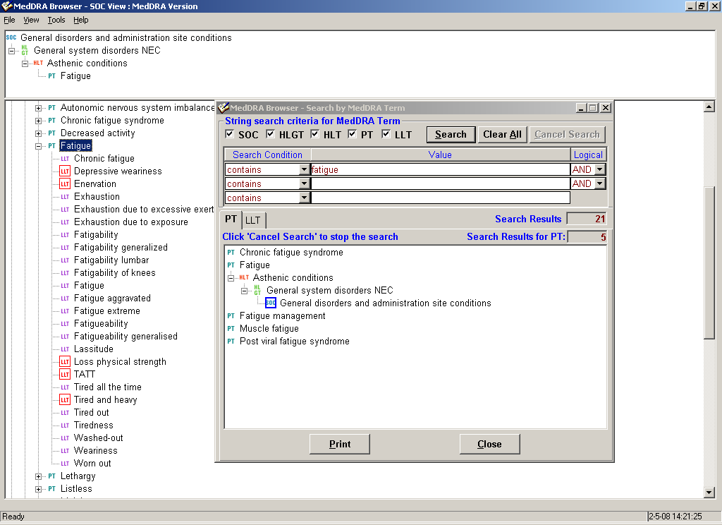
MedDRA Preferred Term
Fatigue + 20 LLTs

Slide 15

CTCAE v3.0 Revision Critical concept listed in Grade only – not as AE Term
CTCAE v4.0/MedDRA
Allergic reaction
Anaphylaxis
15
Notes:
15

Slide 16
CTCAE v3.0 Revision Rationale
Oncology community reported concerns/challenges using CTCAE vs/and MedDRA
MedDRA MSSO International Meeting
caBIG VCDE Review of CTCAE
CTEP, NCI & FDA discussions

Slide 17
MedDRA MSSO Blue Ribbon Panel CTCAE & MedDRA April 2006
AstraZeneca,
Bayer Healthcare Corporation
Bristol Myers Squibb
Celgene Corporation
Charles River Laboratories
Chugai Pharmaceutical Co.
Eisai Medical Research
EMMES Corp.
Hoffman La Roche
Human Genome Science, Inc
Johnson & Johnson
MedImmune, Inc.
Merck and Company
META Solutions
National Cancer Institute
PSI International, Inc
Radiation Therapy Oncology Group (RTOG)
Schering International
AFSSAPS
FDA
JPMA

Slide 18
MedDRA MSSO Blue Ribbon Panel
Summary
CTCAE – MedDRA mapping imprecise
CTCAE terms too general – loss of granularity
‘Other, specify’ ambigious
Grade 5 Death
Critical concepts in Grades
Lack of CTCAE maintenance
To facilitate data exchange within internal databases using MedDRA and with regulatory authorities for the purpose of SAE reporting, must establish a mechanism to ‘translate’ or ‘convert’ CTCAE terms from investigators to MedDRA terms.

Slide 19
caBIG™ VCDE (Vocabulary & Common Data Elements) January 2007
Evaluation CTCAE
Task: Evaluation of Understandability, Reproducibility, Usability of CTCAE
James J. Cimino, M.D.
Professor of Biomedical Informatics and Medicine Columbia College of Physicians and Surgeons
jjc7@columbia.edu

Slide 20
Cimino Summary and Conclusions
Reconciliation with MedDRA is an issue
No standard governance
CTCAE is not a true controlled terminology
CTEP version of CTCAE does not meet most criteria
A few inconsistencies were found
AE-Grade names unhelpful
Codes should be used as pointers
Content maintenance is an issue
Formal evaluations of content lacking

Slide 21
NCICB
National Cancer Institute Center for Bioinformatics
2001 provide the interoperable biomedical informatics infrastructure, tools, and data that biomedical communities need for research, prevention and care
CBIIT
NCI Center for Biomedical Informatics and Information Technology.

Slide 22
CTCAE v3.0 Revision Project
CTCAE Governance Group
FDA,CBIIT,CTEP, PhRMA
Establish long term governance of CTCAE
Develop the strategic vision of CTCAE
Drive the development of CTCAE
Steering committee
CBIIT, CTEP,VCDE, WG Leads
Review/
Comments
Defines work; prioritizes and schedules the content
WG
CTCAE Editing/modeling
WG
WG
WG
Semantic Media Wiki
WG
WG
WG
Internal review
CTCAE draft version
CTCAE Version 4.0

Slide 23
CTCAE Revision Timeline
Phase 1: July 5 – Sept. 10 Review Draft 1
Address CTCAE v3.0 Terms only
Represent terms as single concept MedDRA terms
Phase 2: Nov. 3 – March 13
Address Grading (severity) scales
Add new terms
CTEP Help Desk Requests
Others
Also Consider, Remarks, Navigation Notes, Others
Public Review: April 9 – May 6
Phase 3: May 7 – May 26
Working Group; Steering Committee; Advisory Board Review
Final: May 27 - Publication

Slide 24
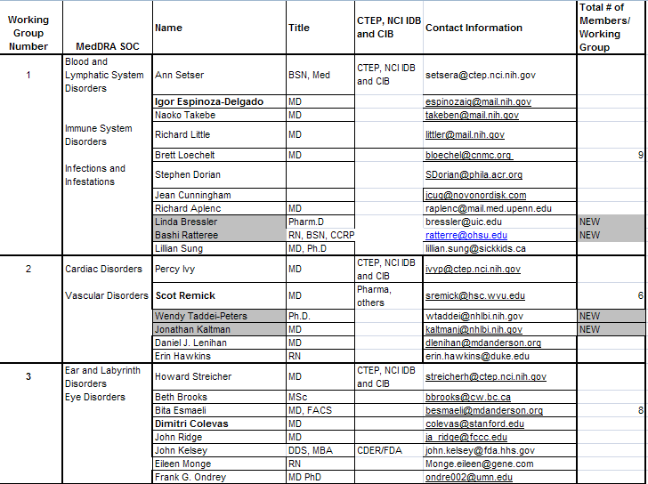

Slide 25
Working Group
WG Lead will/might assign # of terms/grades to be addressed by each WG member weekly
WG Lead is responsible for maintaining timelines / completeness, accuracy of data entry
WG Lead is also member of Steering Committee

Slide 26
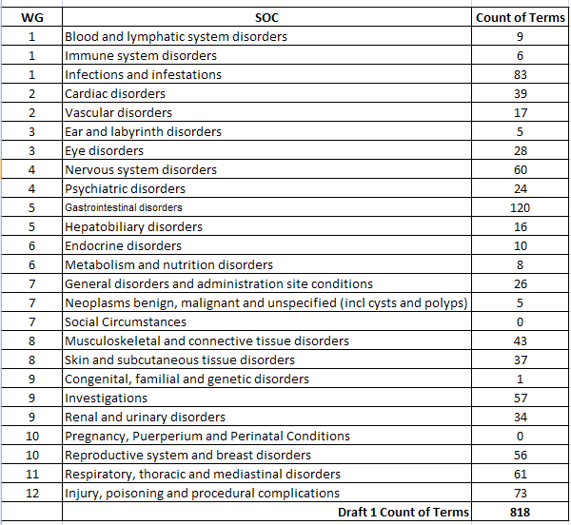
CTCAE Revision Draft 1

Slide 27
CTCAE Revision Methods
Centra: On-line Meetings
gForge: Repository of documents
CTCAE files
Meeting Minutes
PP presentations
Participants
Wiki: Working site
All Working Group / Steering Committee comments, recommentations, etc.

Slide 28
CTCAE v3.0 Revision Project Wiki – How to Use
Prepared by:
Ann Setser, CBIIT, NCI
October 20, 2008

Slide 29
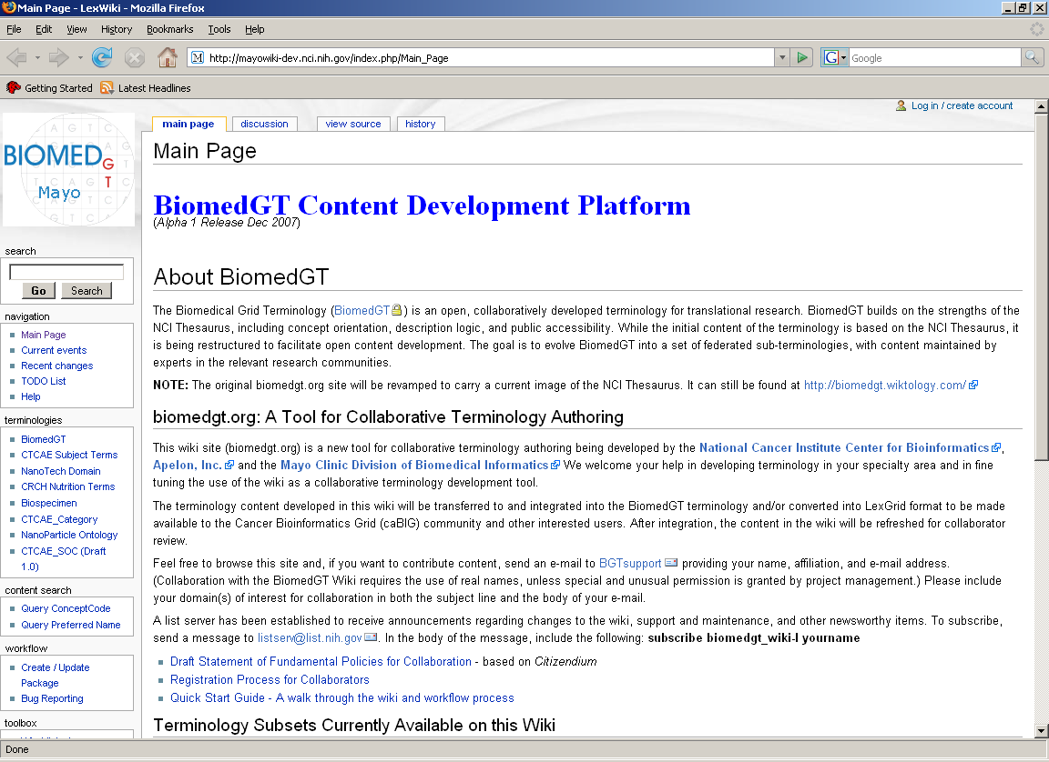
http://biomedgt.nci.nih.gov
Click Log in

Slide 30
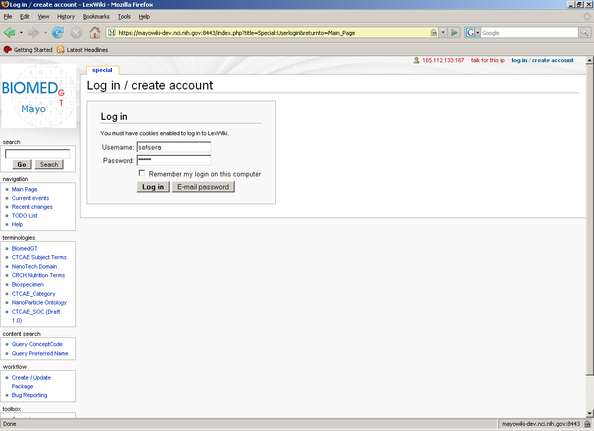
Type in Usename & Password
Click ‘Log in’

Slide 31
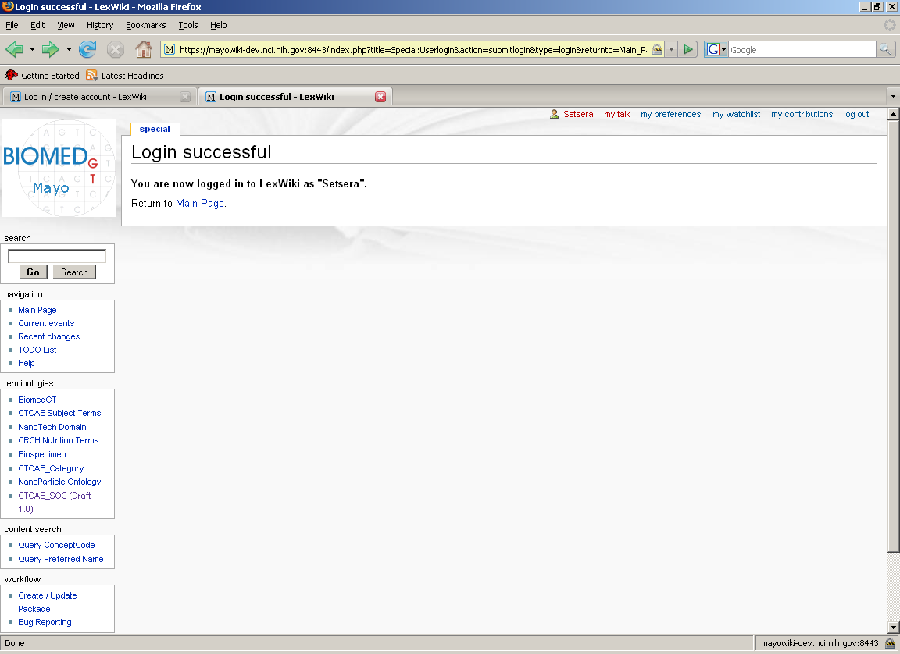
Click on ‘CTCAE_SOC (Draft 1.0)’

Slide 32
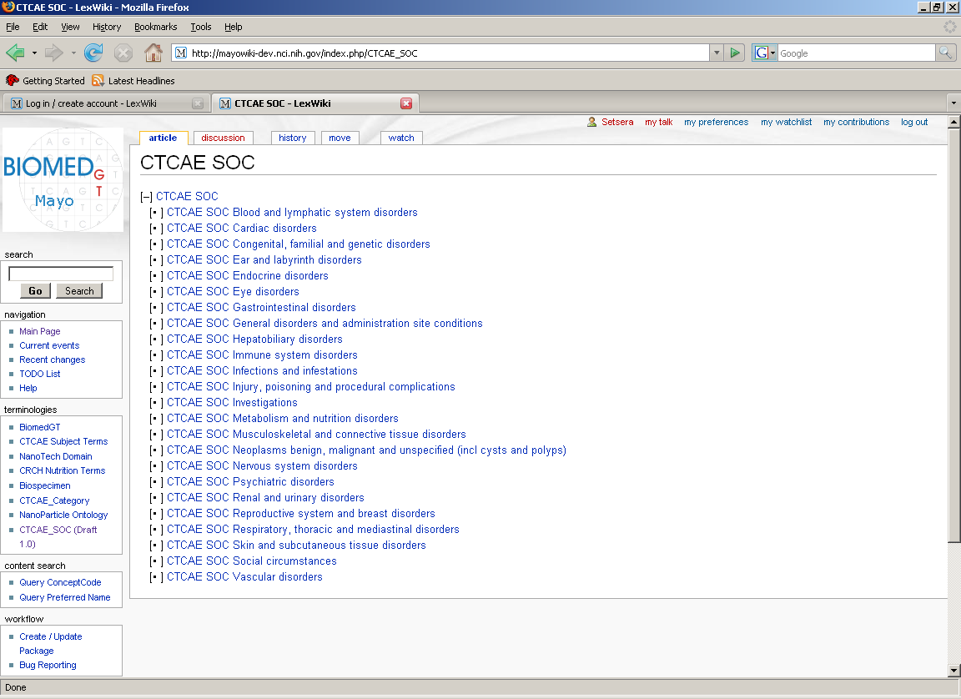
All SOCs appear.
Click on SOC of interest

Slide 33
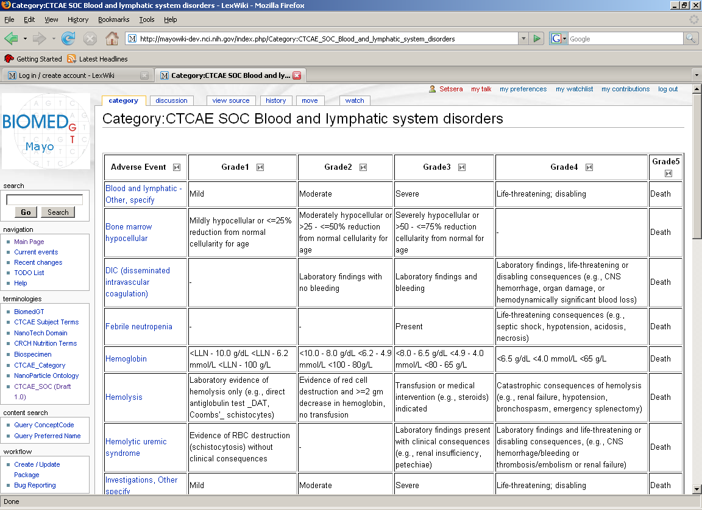
When a SOC is selected, all AEs listed within that SOC appear.
Grading scales will appear if the term is an ‘Edited’ or a ‘Split’ CTCAE v3.0 term.
Grading scale will not appear if the term is ‘New’ (not previously listed in CTCAE v3.0)

Slide 34
Click on one AE term to be addressed

Slide 35
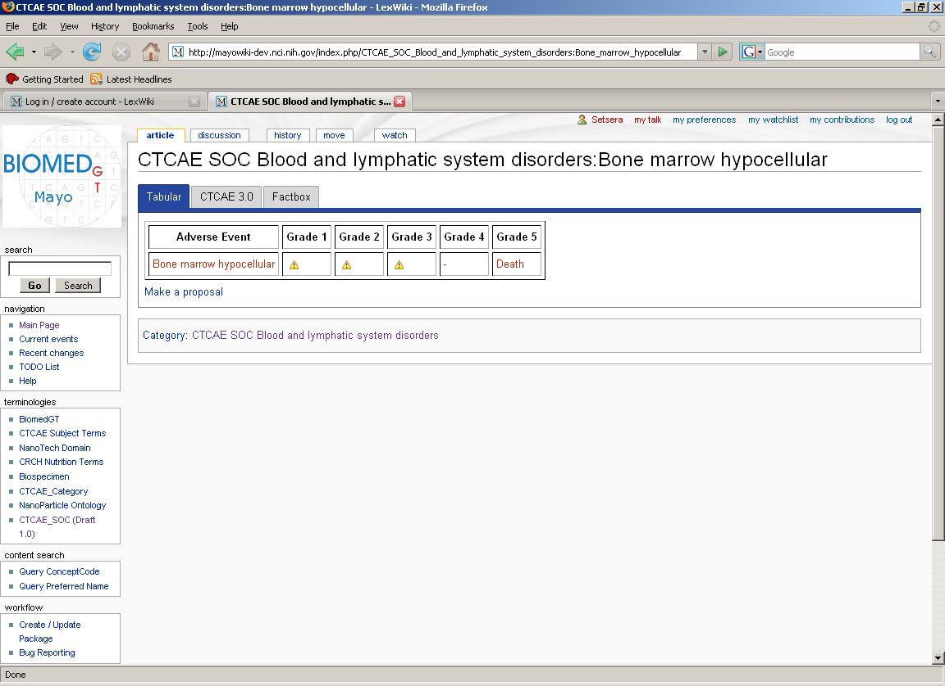
The AE term selected appears with Grading scale (former CTCAE v3.0 ‘Edited’ or ‘Split’ term); or without Grading scale (if ‘New’ term)

Slide 36
There are 2 options.
1. Discussion option
Click on ‘discussion’ tab to make comments about this term or this Grading scale

Slide 37
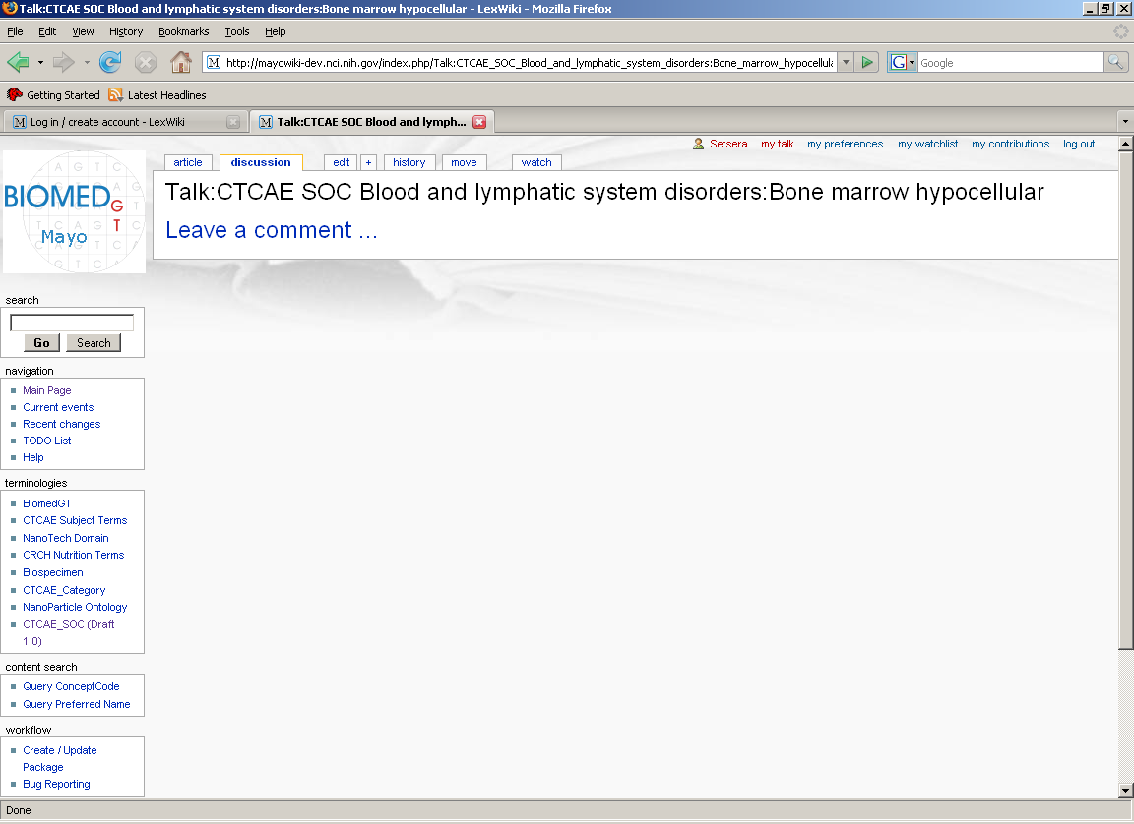
Discussion option
Click ‘Leave a comment

Slide 38
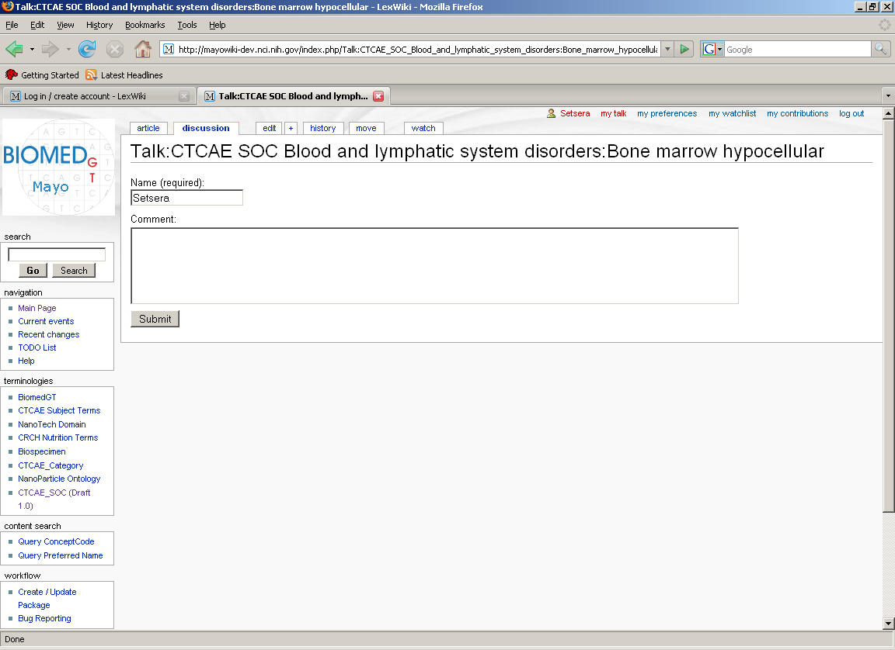
Discussion option
Type comments in text box.
Click ‘Submit’
Comments are saved and the date, time, and your name are appended to the comment.

Slide 39
There are 2 options.
2. Make a Proposal option
Click on ‘Make a proposal’ tab to enter exact text (correct spelling, case, no abbreviations, etc.) for AE term and/or Grading scale.

Slide 40
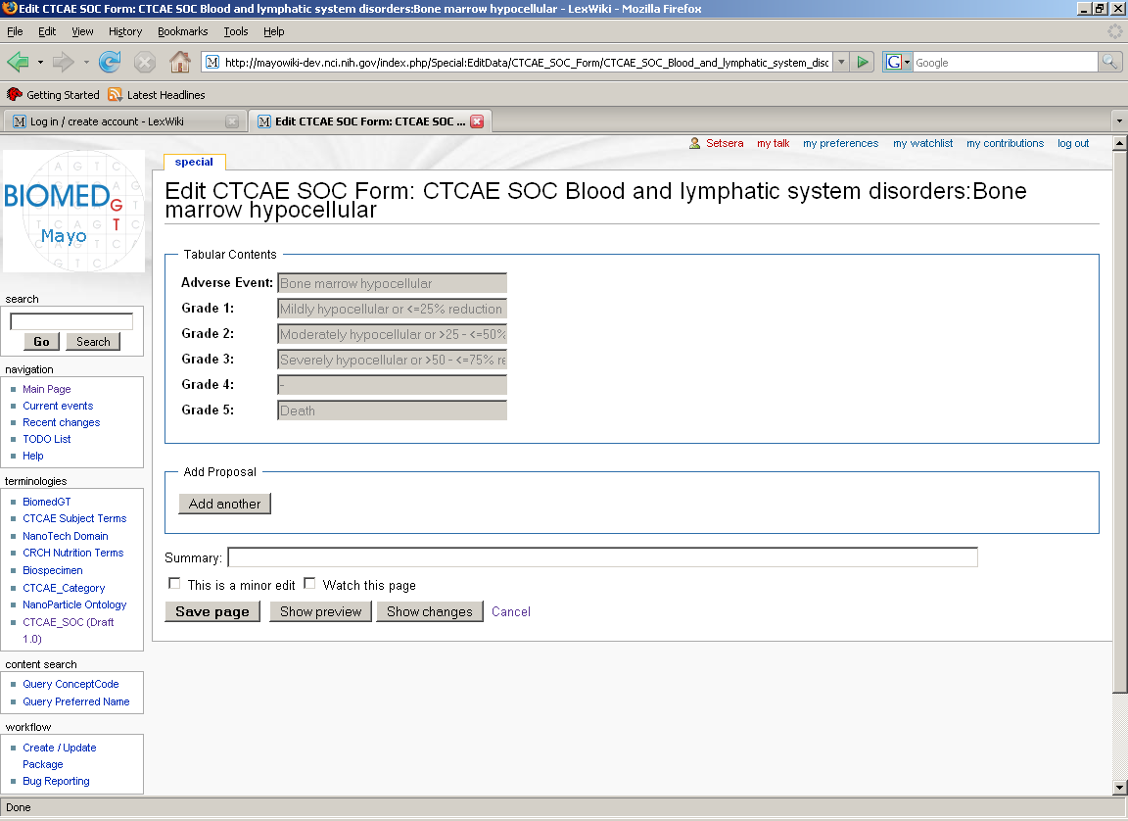
This screen appears when ‘Make a proposal’ is clicked.
Click on ‘Add another’

Slide 41
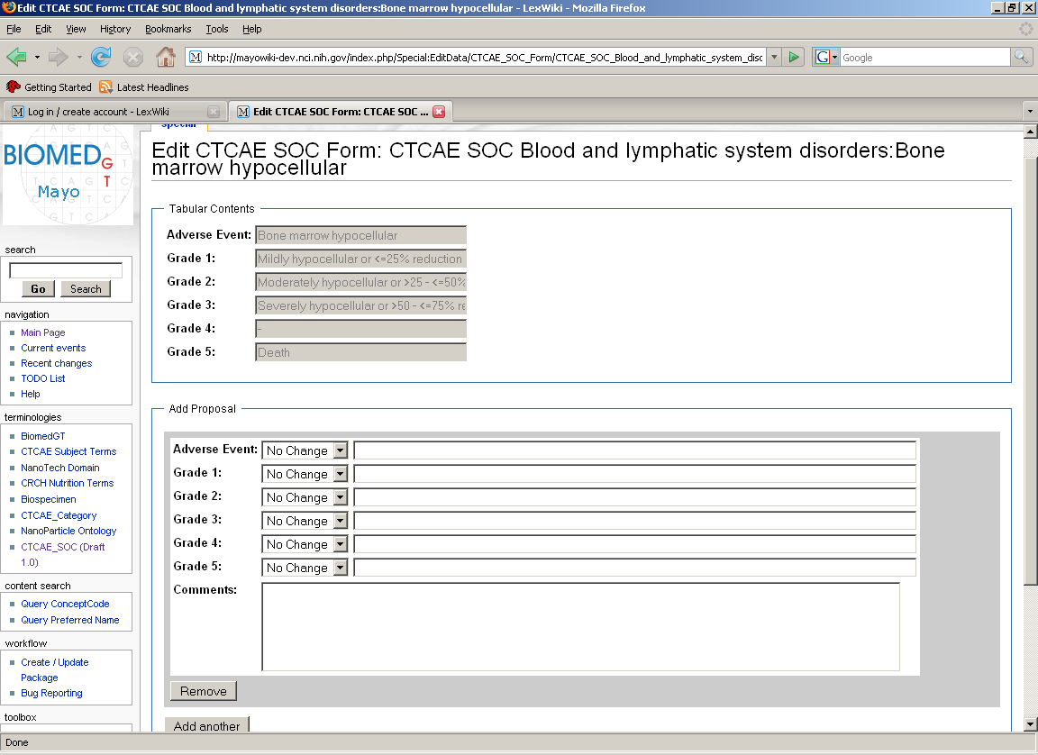
Adverse event - Select the appropriate indicator for your Proposal:
No change – Copy and paste AE name into Adverse Event data field
New – Enter in new AE term (only after MedDRA approval)
Edit – Changes to existing term
Delete – Delete existing term

Slide 42
Grades- Select the appropriate indicator for your Proposal:
No change – Copy and Grade text into Grade data field
New – Enter in new Grade text
Edit – Changes to existing Grade text
Delete – Delete existing Grade text

Slide 43
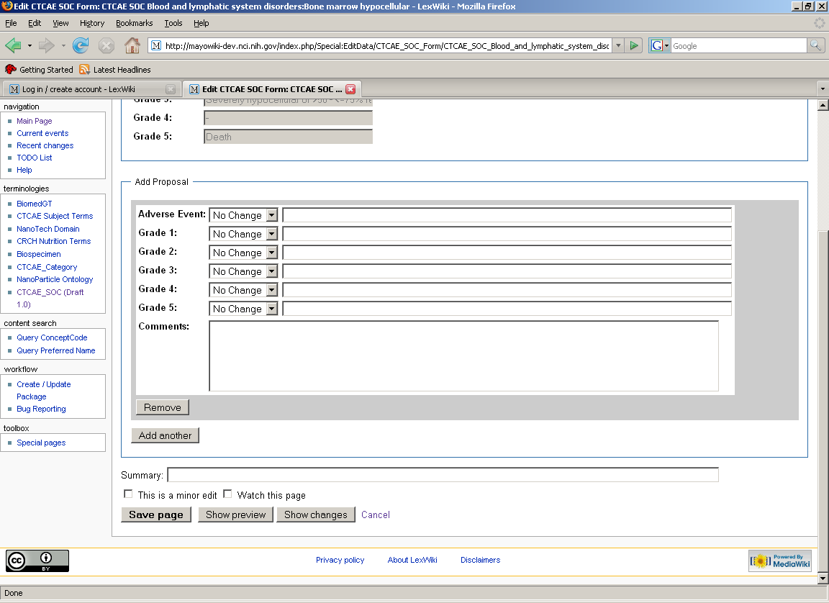
IMPORTANT !
Be sure to scroll down and ‘Save page’

Slide 44
Find More Information about CTCAE v3.0
CTCAE Online Instructions and Guidelines
http://ctep.cancer.gov/
Link to CTCAE v3.0 Revision Project Recorded Education Session
https://webmeeting.nih.gov/p19665680
Questions about project:
Ranjana Srivastava,
srivastava_ranjana@bah.com

Slide 45
gForge
Repository / library working documents
Historical
Current
gForge site
gForge PP ‘How to Use’

