Slide 1
caAERS Overview
Session Date: ##/##/## Session Length: ## minutes Target Audience: End Users
Notes:
Elements in red still need to be filled out.

Slide 2
Session Details: Participants & Logistics
Introduction of Trainer(s)
Audience Introductions
Name, Role, Organization
Reason for Attending
Facility Logistics
Classroom access, restrooms, phones, etc
Notes:
If you are conducting this class in person this slide should inform participants of class room rules, restroom locations or things that help the participants feel comfortable in the environment

Slide 3
Am I in the right place? What is caAERS and who will use it?
WHAT: caBIG Adverse Event Reporting System
WHY:
Designed to centralize and automate the collection and distribution of Adverse Events to reporting groups,
Enhancing patient safety
Enhancing collaborative research data sharing
WHO: For Clinical Trial Managers and Clinical Trial Patient managers
HOW (1) Requires familiarity with Clinical Trials and reporting systems such as ADEERS, Medwatch, etc.
HOW (2) Requires familiarity with web browsers
Notes:
This slide will explain why caAERS was created. Its emphasis will be operational rather than analytical, though some time may be spent explaining the enhanced research.

Slide 4
What am I going to do? How to use this presentation
You can use this presentation alone, or can switch between it and the caAERS live site to try things presented
https://sbdev1000.semanticbits.com:8031/caaers/public/login
Login as: SYSTEM_ADMIN
Password: system_admin
Notes:
Change username and password, and possibly public site.

Slide 5
What will I learn? Session Goals
By the end of this training, you will be able to:
Set up caAERS for use
Create a trials
Create reports
Create report rules
Create an Adverse event (Routine and Expedited)
Add a patient (if necessary)
Add an event you know requires
Add an event where you do not know the reporting requirements and let the system decide
Complete and submit a report
Enter a routine AE (no reporting)

Slide 6
Session Details: Lesson Plan
Lesson 1: Pre-use requirements and setup types
Lesson 2: Basic navigation
Lesson 3: Creating Reports and Rules
Lesson 4: Creating Trials
Lesson 5: Adding patients
Lesson 6: Adding Routine Adverse Events
Lesson 7: Adding and reporting Serious Adverse Events
Notes:
In pre-use, mention must be made of variations in setup, that is, in some instances trials and patients will be imported automatically, in others they will not. Lesson 7 is the longest and most pertinent

Slide 7
Lesson 1: Pre-use requirements and setup types
Who sets up caAERS?
Local versus hosted
Possible setups (imported versus entry)
What needs to be setup before you can use it?
User logons, site and staff definitions
Study and patient imports (optional)
Grid configurations
Notes:
Discuss possible usage configurations, but not in detail. The last point should be mentioned, so that if something is forgotten, they will blame their IT staff, not the application

Slide 8
Lesson 1 Review & Questions
What is the level of support at your center
What CTMS (Clinical Trial Management System) are you using?
Notes:
Resources available for which setup option may or may not be recognized by the end users. It is also important that the users understand how caAERS does or does not interface with their local CTMS

Slide 9
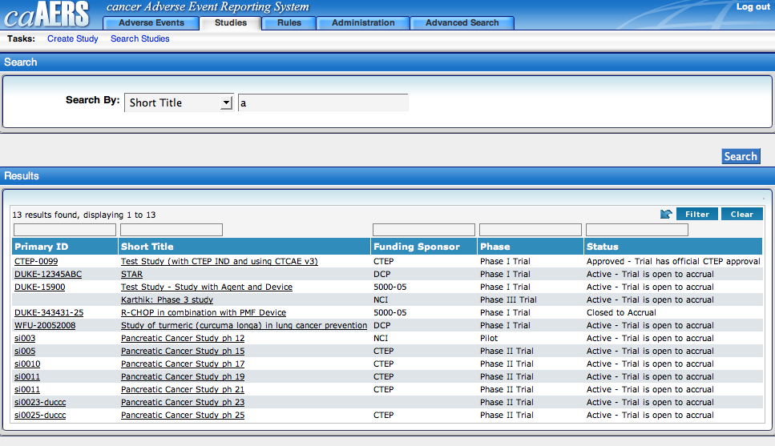
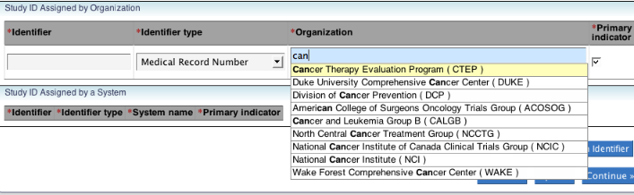
Lesson 2: Basic navigation
Search options
Button searches
Google type searches
Notes:
Have these slide in? note the blue color indicates the Google search

Slide 10
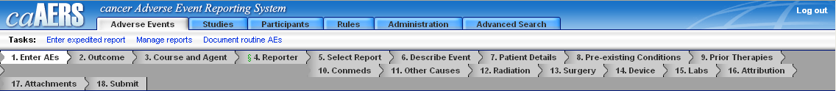
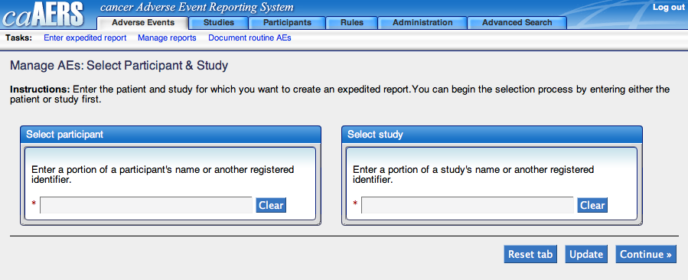
Lesson 2: Basic navigation
Tabs, and directed tabs
Required field designations
Save, save and continue
Notes:
Note green symbol and red asterisk, tabps, links and directed tabs (replace once the wrap problem is fixed?)

Slide 11
Lesson 3: Creating Reports and Rules
Reports first, rules second!
Required fields
Delivery option
Which rules can be setup and which rules can be imported?
Import preferred
Reporters and System admin should build together!
Protocol managers must understand what in the trial definition triggers the reports so they can define the trial correctly!
Notes:
The user interface for creating the report is beyond the scope and scale of this presentation, User should simply be aware that the interfaces are there, and should seek help in the first setup to build them.

Slide 12
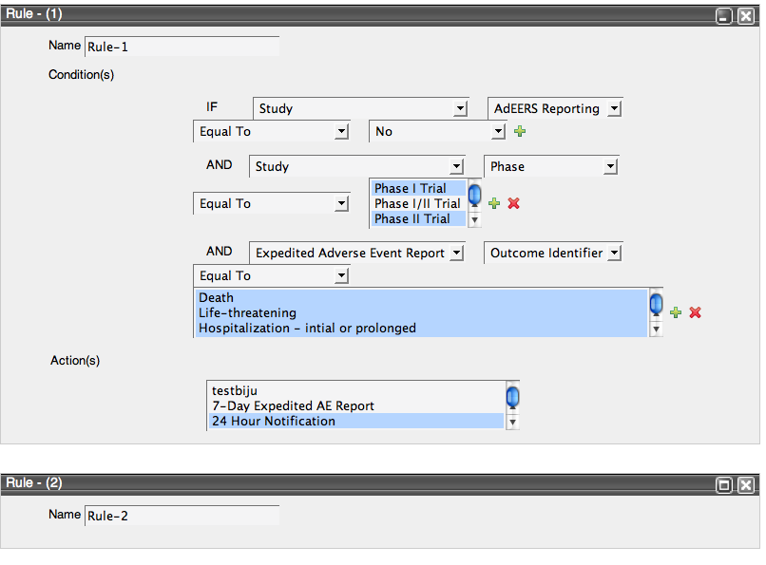
Lesson 3: Creating Reports and Rules
Who should do this?
Notes:
If the user cannot understand the logic of this screen, they should not be entering the rules!
Note green plus and red x and describe meaning (add/delete)
Rule creation requires some expertise, it is important for the user to fully understand the logic skills needed to setup rule, but you don’t want the programmer alone to do it either, as he or she may not understand reporting rules. It is also important that the protocol manager be there, so they understand the importance of certain key fields.

Slide 13
Lesson 4: Creating Trials
Who should do this?
Create or import?
Key fields that drive reports and rules.
Notes:
It is important that this be clearly defined, ie, who defines trials and what the institutional practice is

Slide 14
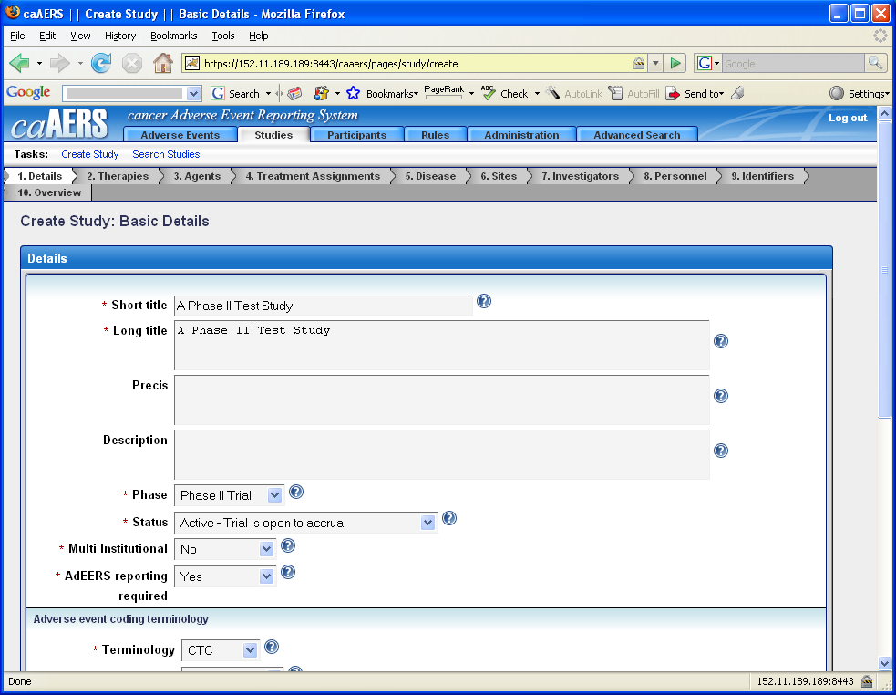
Creating a trial
Notes:
Note the red * as required fields is a standard. Also note the inline help options. Use precis as an example as this is likely to be new to a lot of users.

Slide 15
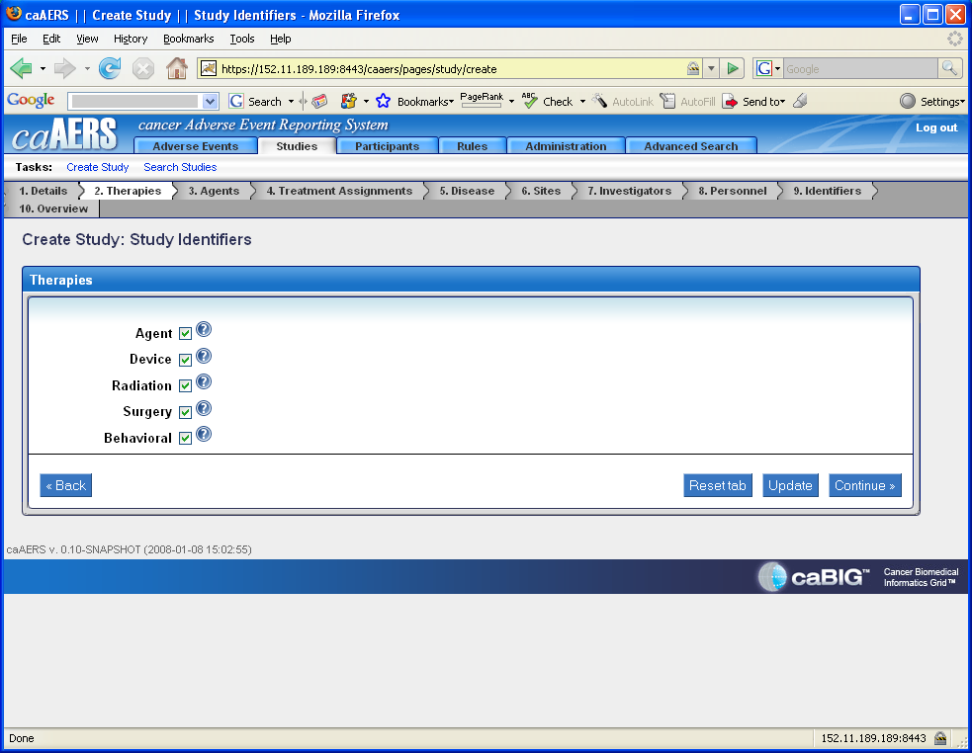
Creating a trial
Notes:
This screen probably needs to be redone as this is not identifiers and there needs to be some inline note to check all that apply

Slide 16
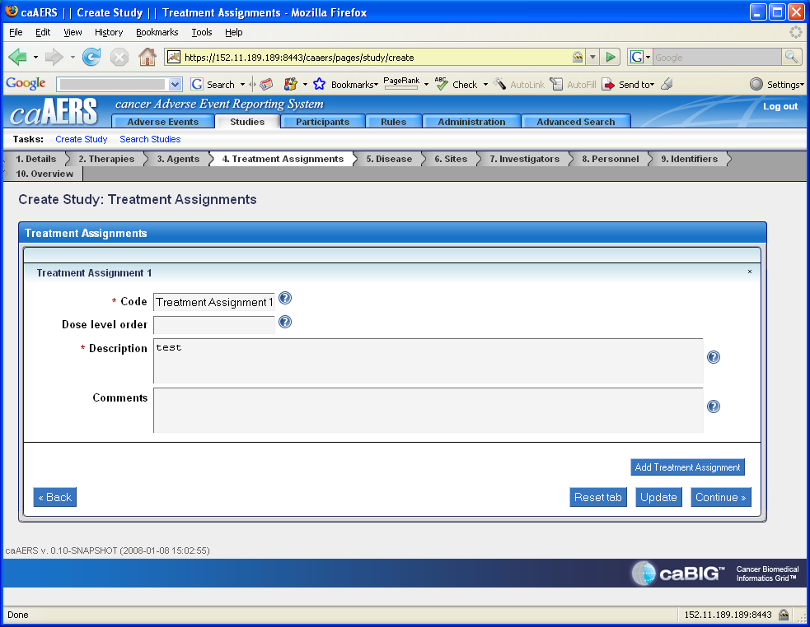
Creating a trial other screens

Slide 17
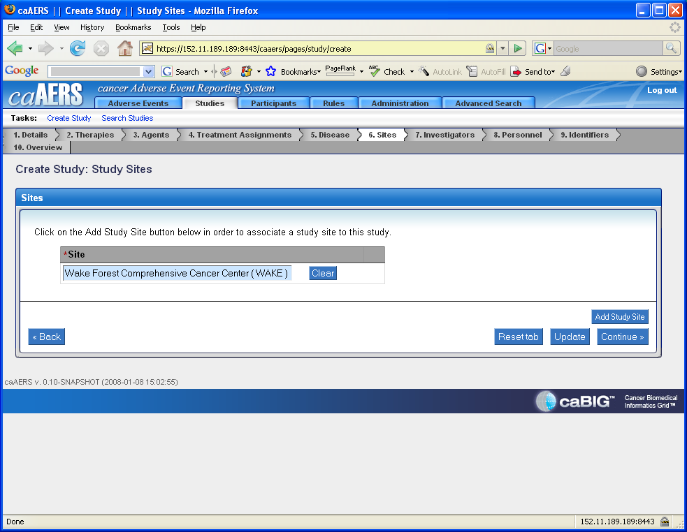
Creating a trial other screens
Notes:
Do not click on the gray box, have to click on “Add Study Site” first.
I am assuming that if this is multi-institutional that all sites would have to be added. If so, this needs to be explained. Note that the sites must be defined before you can add them.

Slide 18
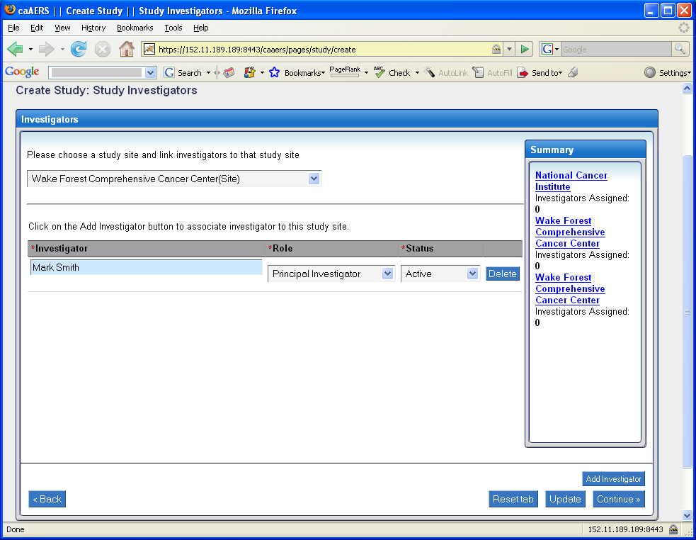
Creating a trial other screens
Notes:
Note that this is a drop down vs a search.
Note that investigators are linked to sites which is why site is selected first and then the “click on add investigator” shows up. This is not there when this screen first appears.
Next step is to add investigator, role choices are site PI, site investigator and PI. We need to be able to define the difference.
Status choices are active and inactive.
Need to explain what to do if an investigator is involved in multiple sites but in different roles. I am assuming that could occur?

Slide 19
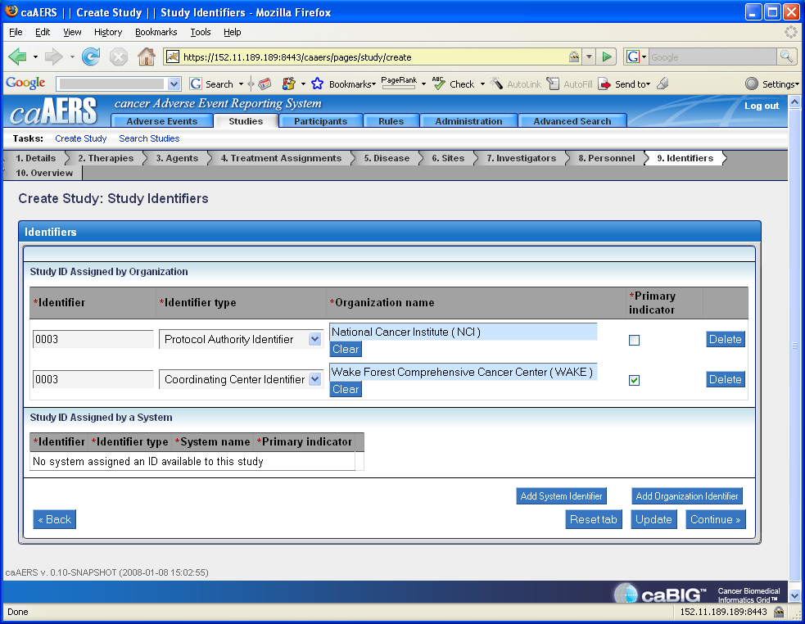
Creating a trial other screens
Notes:
Discuss identifiers. Depending upon the culture, users may not be used to multiple identifiers, and exactly what a primary indicator is and the rules for its use must be explained

Slide 20
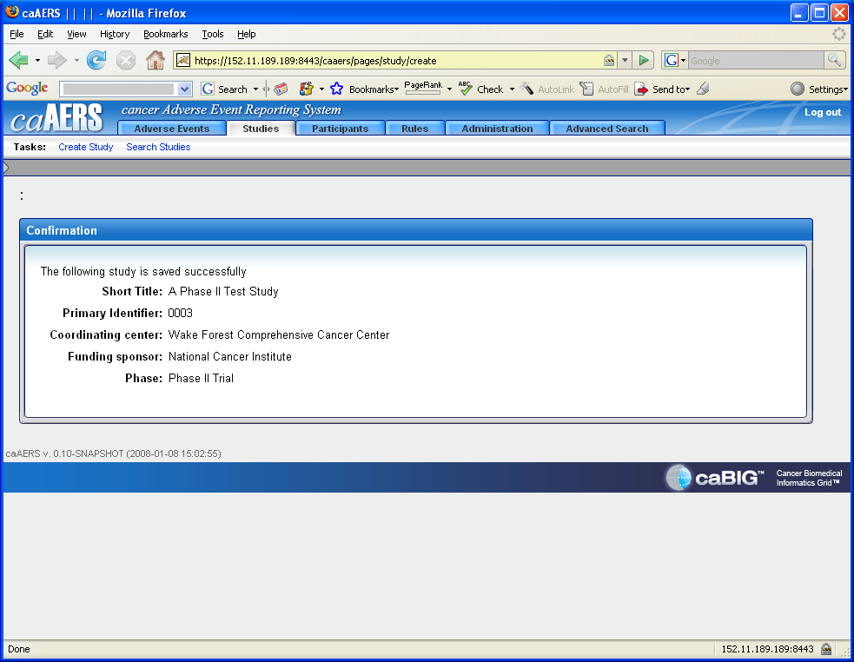
Creating a trial other screens
Notes:
You are done!

Slide 21
Lesson 4 Review & Questions
How much detail is needed?
Which trials?
Notes:
21
The more detail the better, as it will automatically flow to the AE report. However, re-emphasize that if a trial is mischaracterized (sponsor, IND holder etc) it may cause a rule to misfire. Study coordinators may be relying on event coordinators to know this… but this knowledge will quickly fade when they come to rely on the rules.

Slide 22
Lesson 5: Adding patients
Who should do this?
Create or import?
Notes:
Again, import is preferred. However, if your patient is not in the system and you have to create an event, you will have to do this

Slide 23
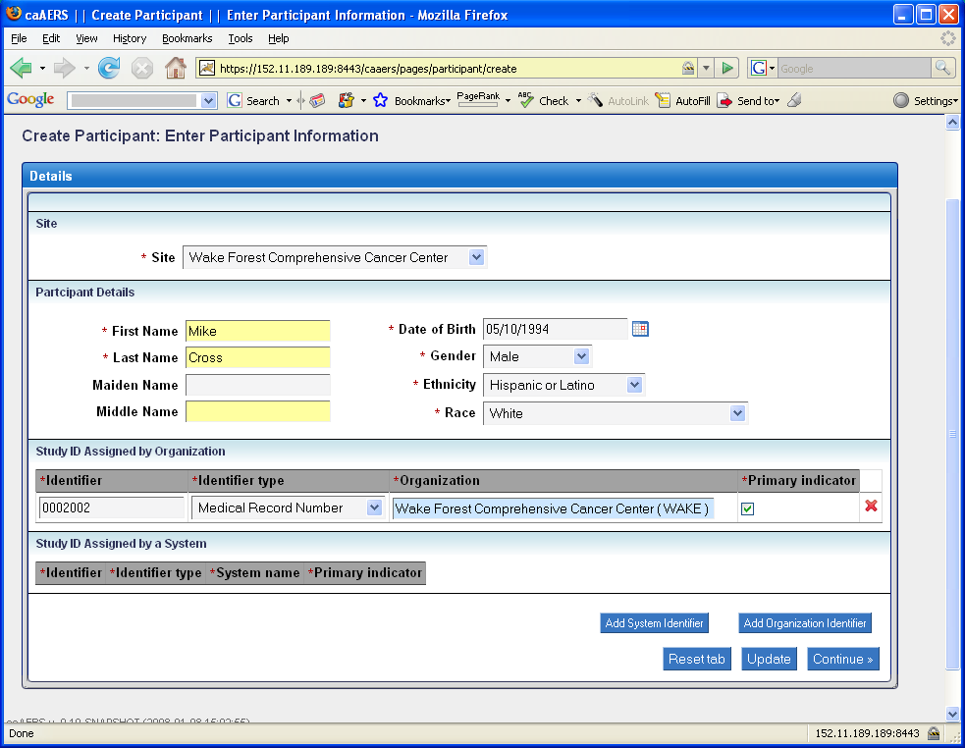
Creating a participant
Notes:
Note that the calendar for date of birth, like other calendars, can be selected using the calendar or can be typed in with correct format.
Identifier choices are MRN, Cooperative group number and Other.
Study ID Assigned by a System is but needs explanation.

Slide 24
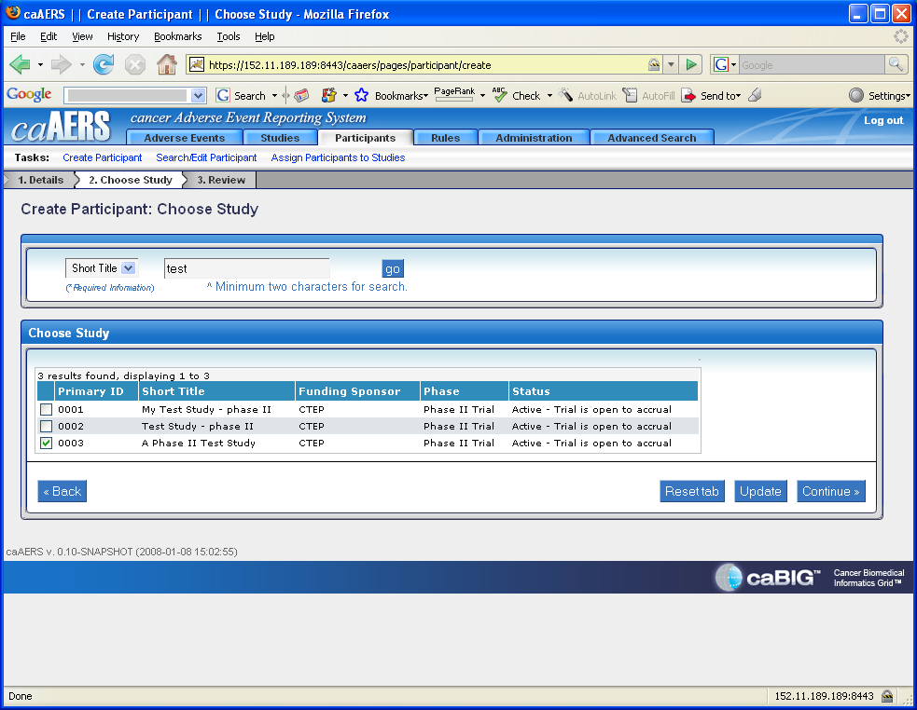
Assigning a participant to a study
Notes:
Note that when searching for a study, the box which requires 2 minimum characters is a list, not a google type search list. Have to hit GO.

Slide 25
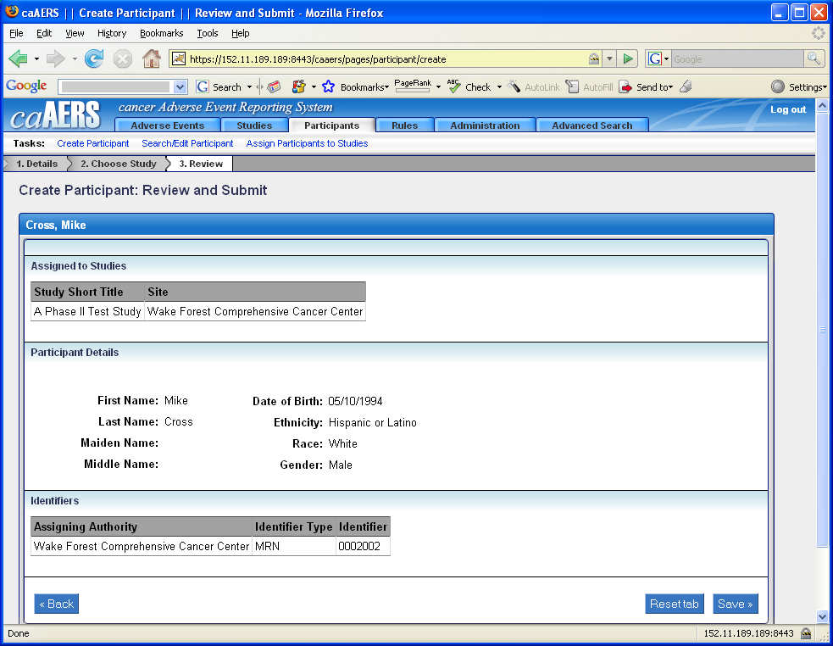
Creating a participant
Notes:
I think it is interesting that the title of this page is review and submit. You would think there would be a submit button but instead it is a save that the user needs to click on. Worth pointing out.

Slide 26
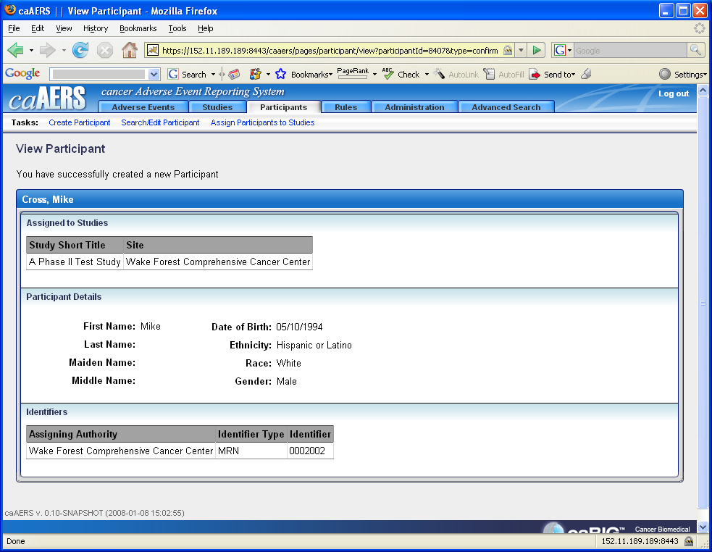
Participant added!
Notes:
Re-emphasize navigation tabs. Some users get stuck here, always looking to the bottom to return to a main screen.

Slide 27
Lesson 5 Review & Questions
Search for patient first or add patient?
Notes:
Highly suggest that if several users share responsibilities that a search would be first to make sure they have not already been added since I don’t think there is a duplicate check at this point. Even if there are not shared responsibilities, busy users forget who they have entered what on unless working on a new patient. So add first is safe if new patient.

Slide 28
Lesson 6: Adding Routine AE
Who should do this?
If your center is using caAERS for routine AE’s
No solicited AE’s/Templates in version 1.0
Notes:
Again, some institutions will not use it, so make that clear.

Slide 29
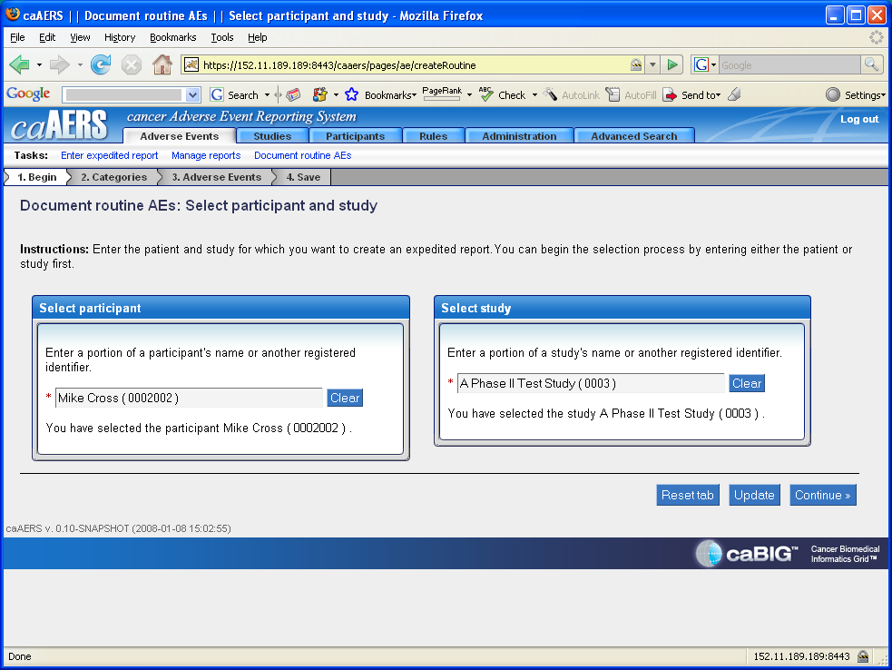
Adding routine AE’s
Notes:
State the more characters entered, the shorter the list of options. If you enter a few letters, do not assume that the list is complete….

Slide 30
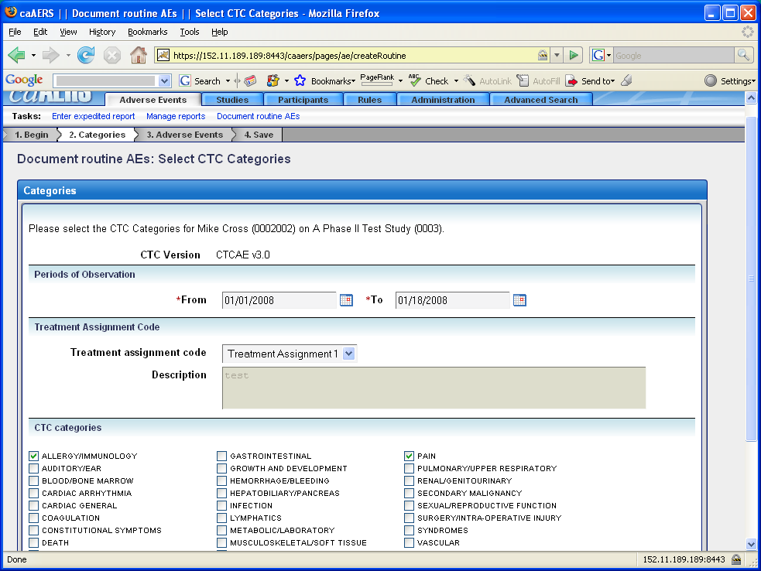
Adding routine AE’s
Notes:
Once on this page. Instruct that this is for all AE’s within the period of observation, EVEN if one is an SAE. It needs to be included and should route you to SAE reporting.

Slide 31
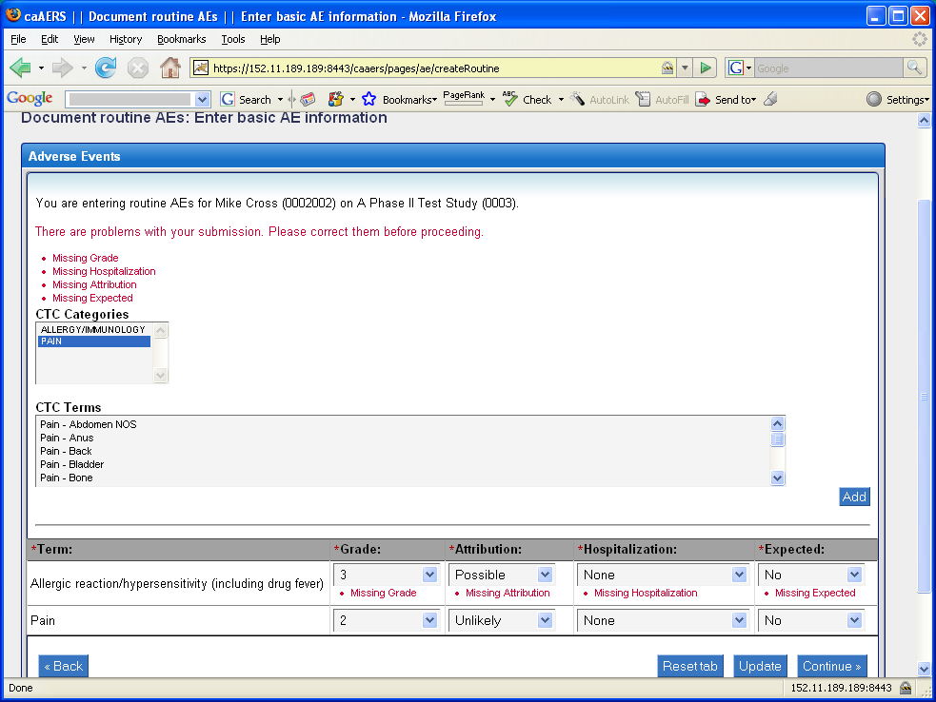
Adding routine AE’s
Notes:
Oh yes, my favorite pg. It punishes you before you have a chance to misbehave.
Once you see this message, you must click on each category for the CTC terms to show up. You then have to click on the CTC term that applies and click on Add.
Now, the term, fields for grade, attribution, hospitalization, expectedness show up. These have to be completed.
You then have to select the next CTC category and repeat this process before clicking on continue.

Slide 32
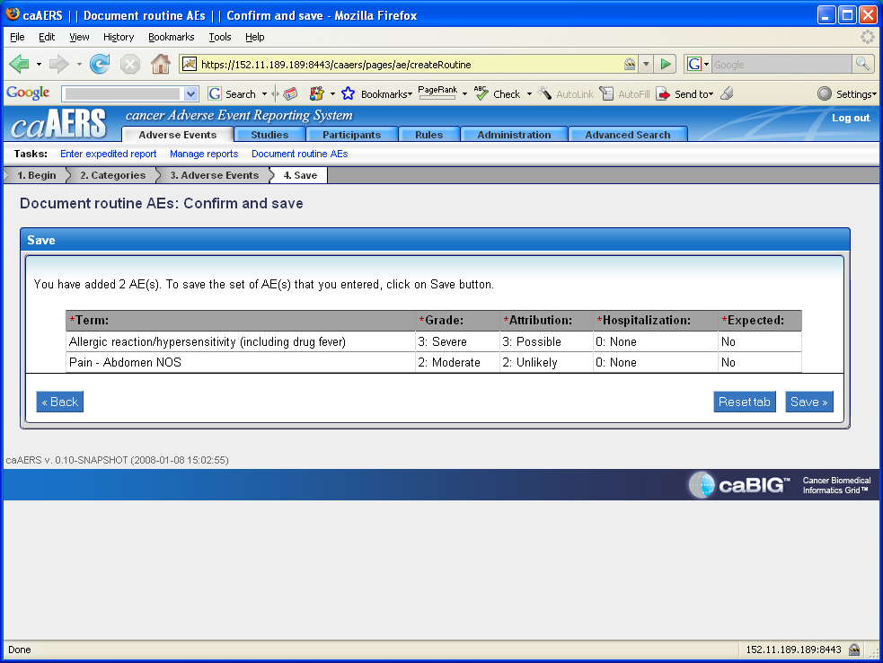
Adding routine AE’s

Slide 33
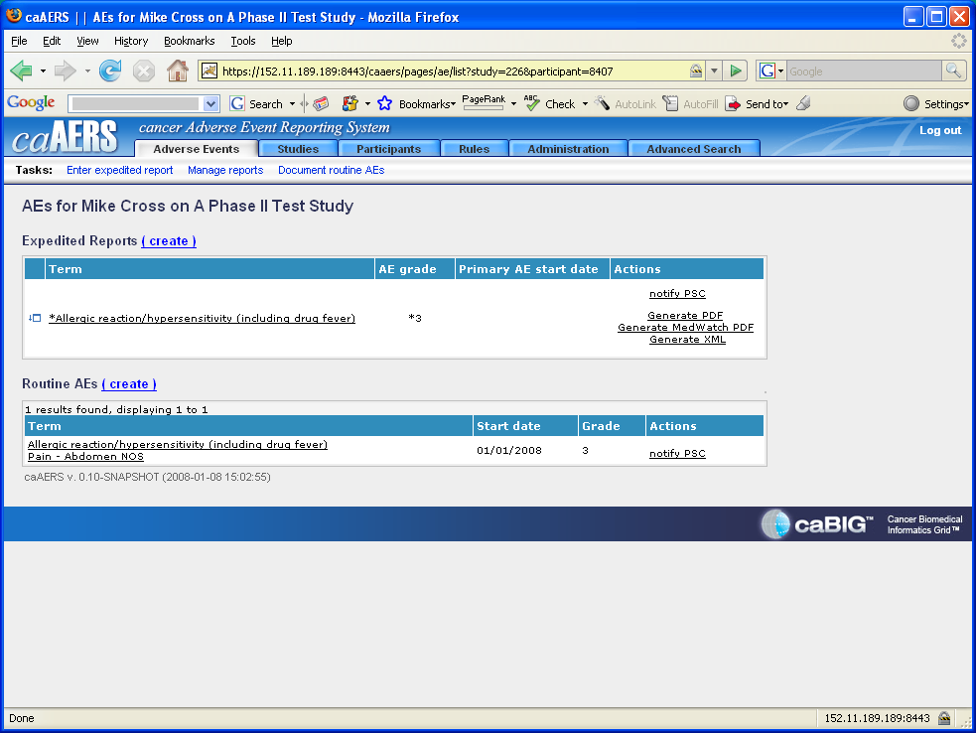
Routine AE’s
Notes:
Instruct that this identifies if any the AE requires expedited reporting. Can click on create to start the process or can come back. Point out the expedited event is also listed in the routine AE’s. Also point out the report window box on the left.
Need explanation of what notify PSC means and how this is set up.

Slide 34
Lesson 6 Review & Questions
How do you know if you should use this?
Notes:
Some users will not use routine testing. And will only use this screen if they do not know if the AE requires SAE. This is an important point that must be clarified. Templates “solicited” AE’s need to be addressed

Slide 35
Lesson 7: Adding SAE
Who should do this?
Patient and event managers
If your center is using caAERS for SAE reporting
Notes:
While it will be rare, some sites might only use routine AE ‘s

Slide 36
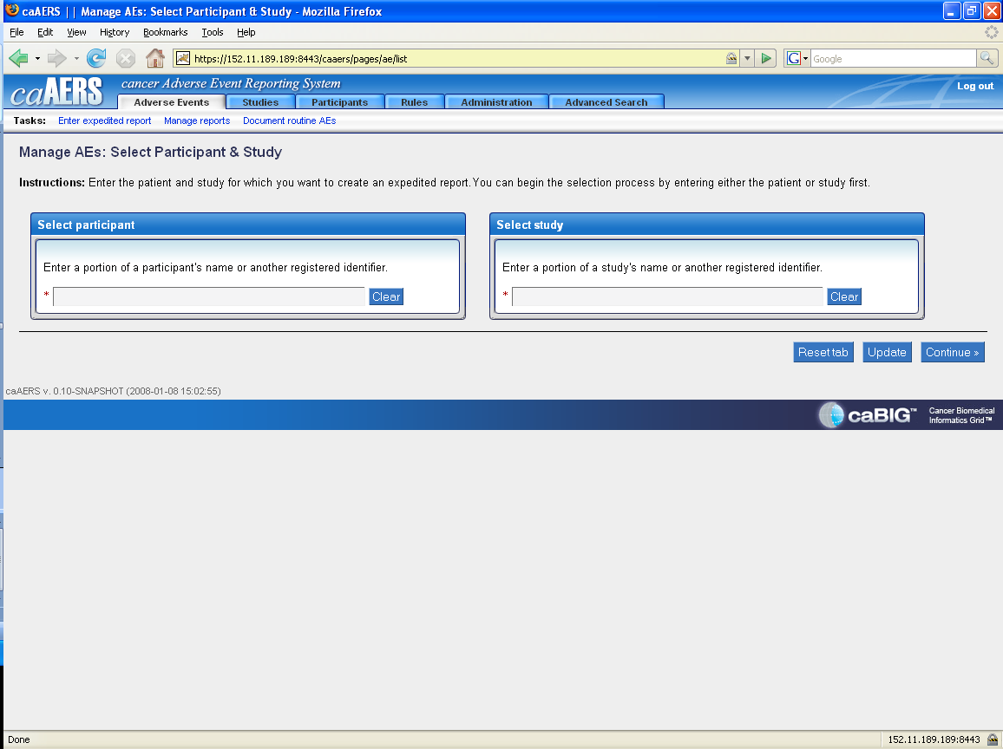
Adding SAE’s… start with Adverse events
Notes:
Click on enter expedited report, or manage reports (for already begun)

Slide 37
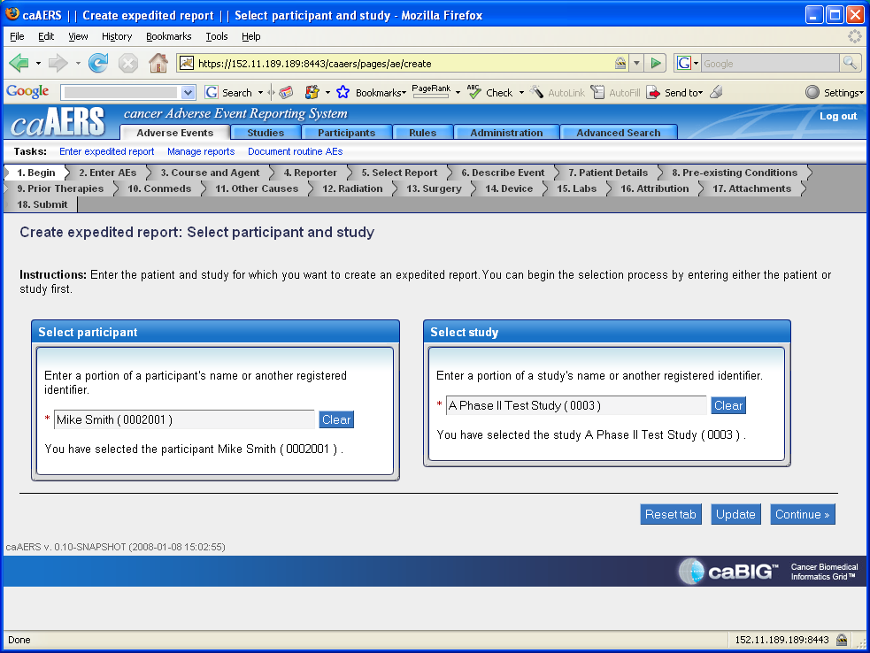
Selecting patient and study

Slide 38
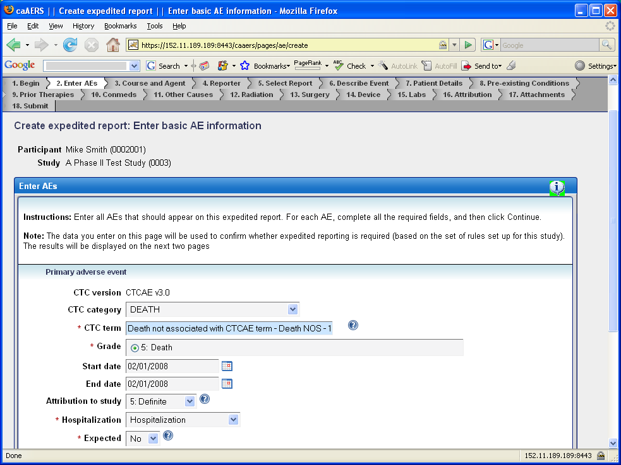
Basic SAE details
Notes:
Point out that even though the instructions refer to AE’s, it is really an SAE.
Once the category has been selected, you then have to type a portion of the associated CTC term. This is what is stated in the ?.
Note that if more than one AE is entered, one of them is determined to be the primary AE and it is always the first one listed.

Slide 39
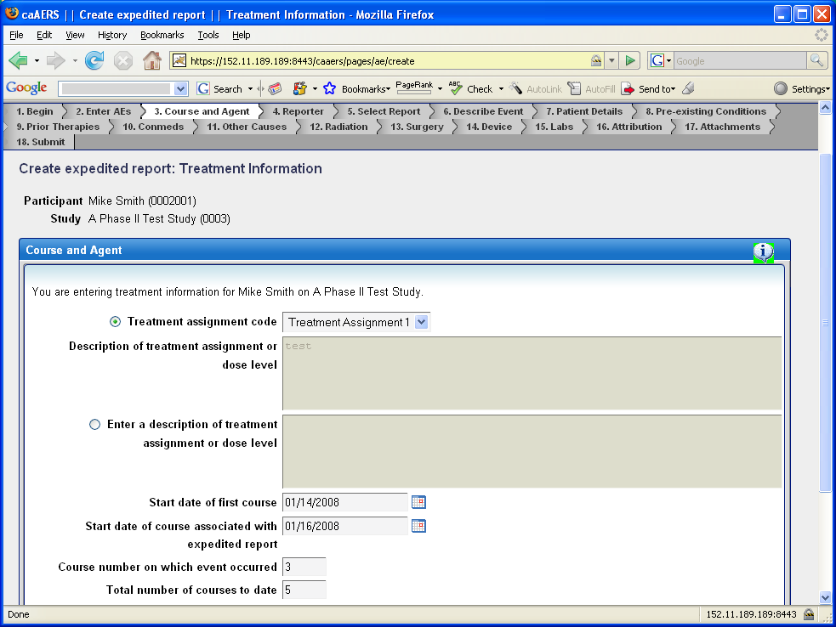
Study treatment information
Notes:
Note on this page that the description of treatment assignment or dose level is not listed as being required, however, it is because there is no treatment assignment code. Therefore, you have to click on the circle beside “Enter a description of treatment, etc” and type in something. This has to be completed before continue.
(redo once this is fixed?)

Slide 40
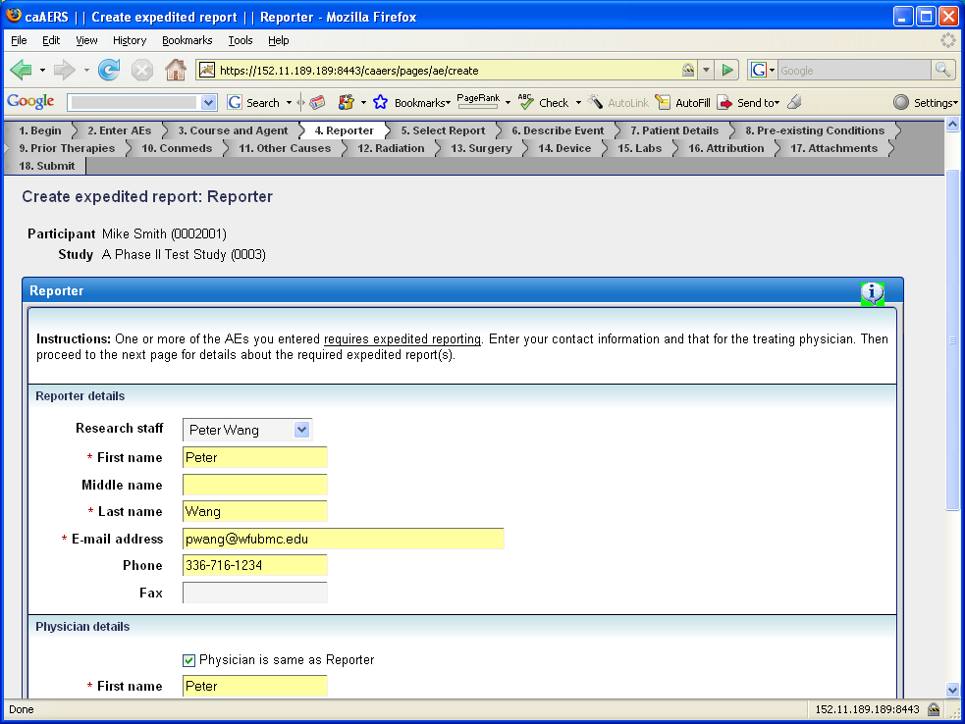
Reporters
Notes:
This page will appear even if the SAE’s you entered do not require expedited reporting based on the rules set up for the study.

Slide 41
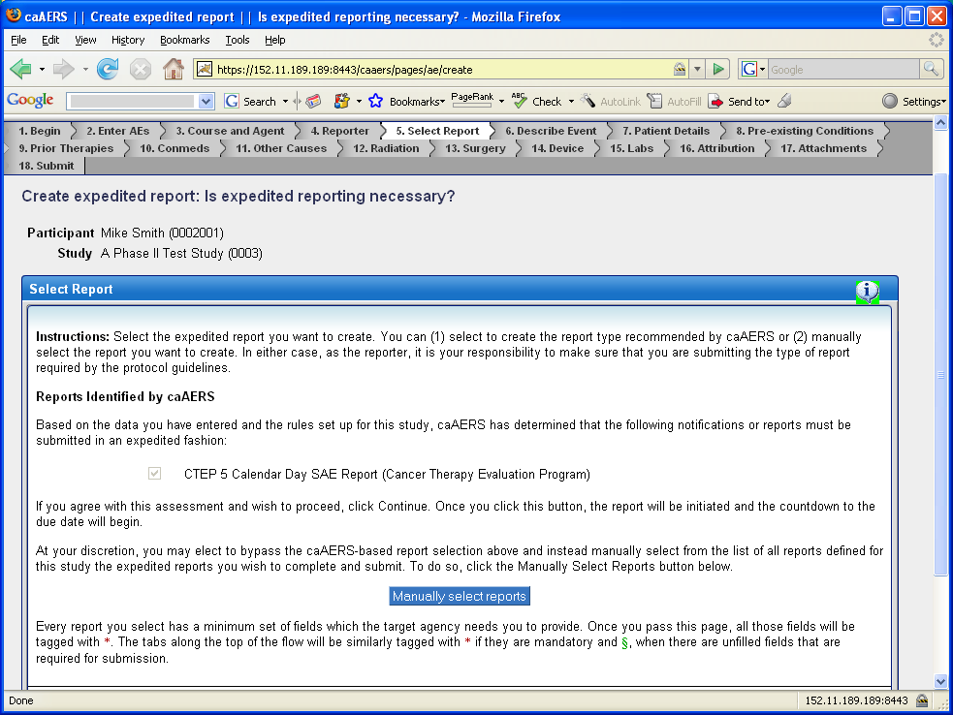
Reporting required
Notes:
If you continued to report an AE even though the system said it did not need reporting, there will still be options of reporting and notifiication to choose from.

Slide 42
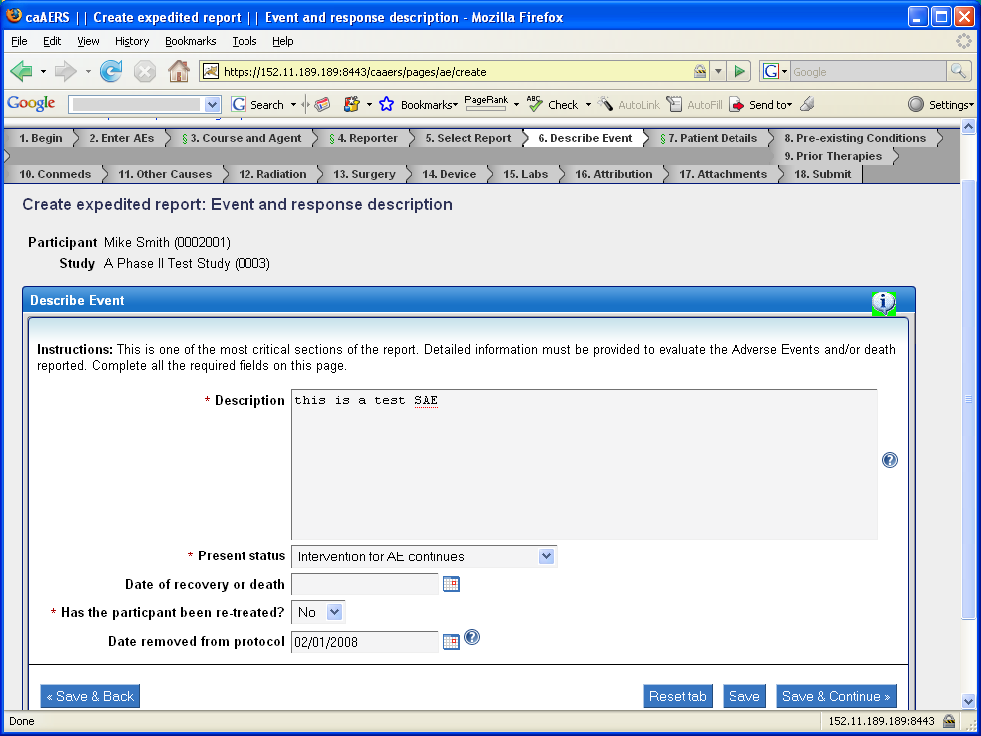
SAE entry screens continued
Notes:
Now that the report is selected, required tabs that are not complete get the green symbol.

Slide 43
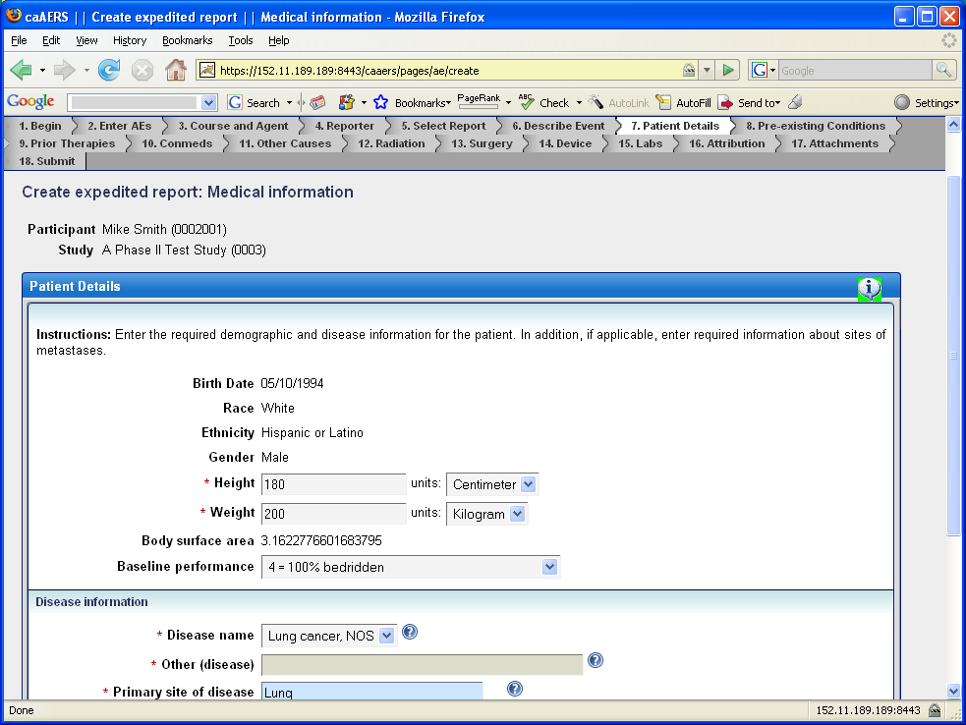
SAE entry screens continued
Notes:
Please note that once the height and weight are entered, the body surface area is automatically calculated.
Either enter disease name from drop down box and primary disease site or other disease and other site of disease. Cannot enter both.

Slide 44
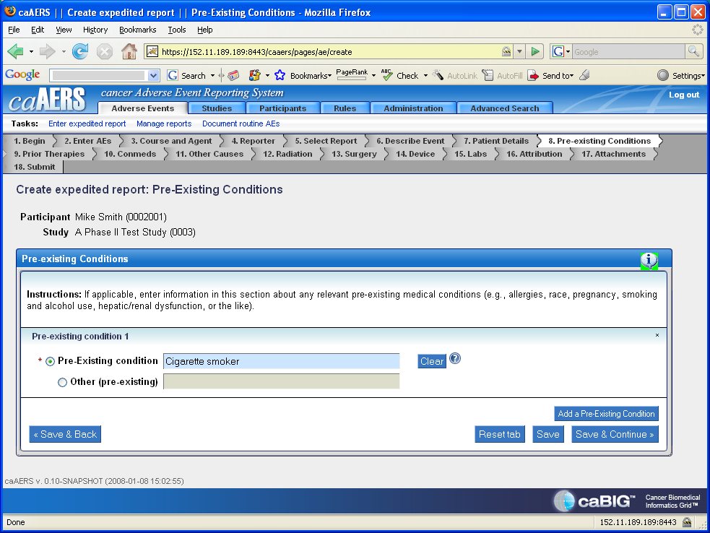
SAE entry screens continued
Notes:
Same idea as previous page, one or the other.

Slide 45
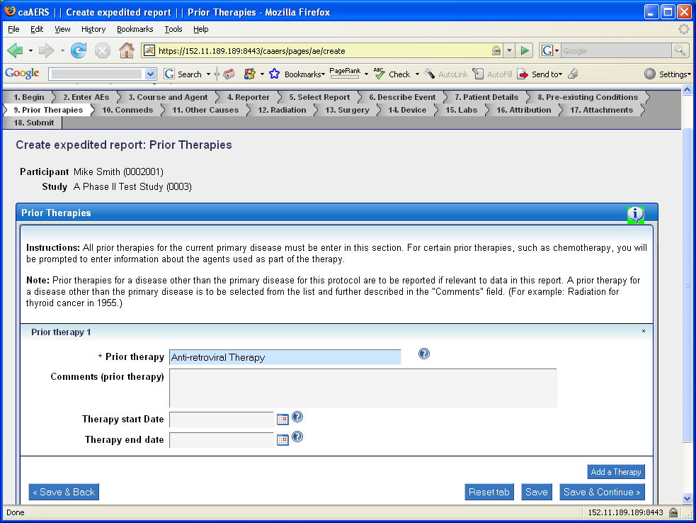
SAE entry screens continued

Slide 46
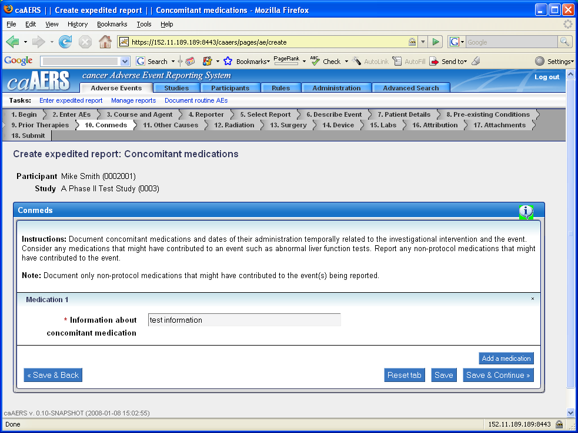
SAE entry screens continued

Slide 47
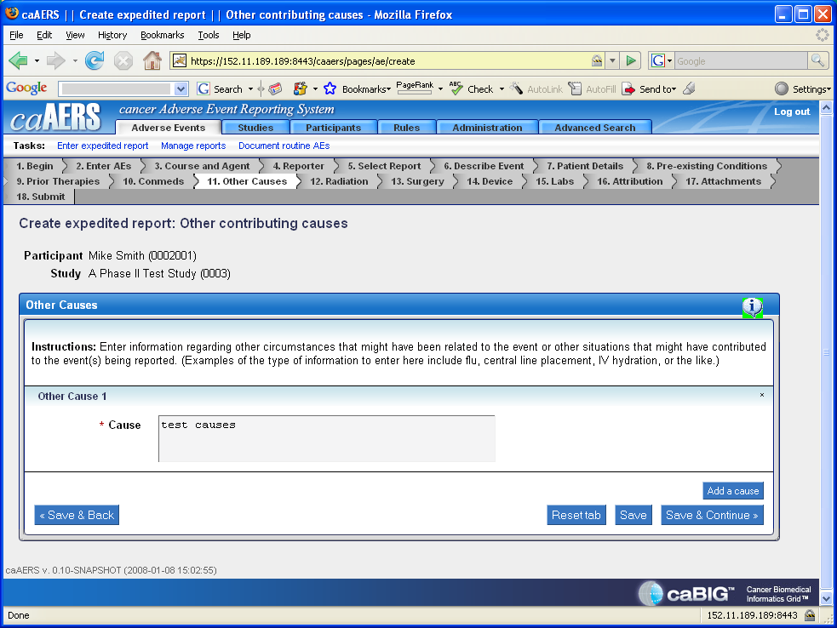
SAE entry screens continued

Slide 48
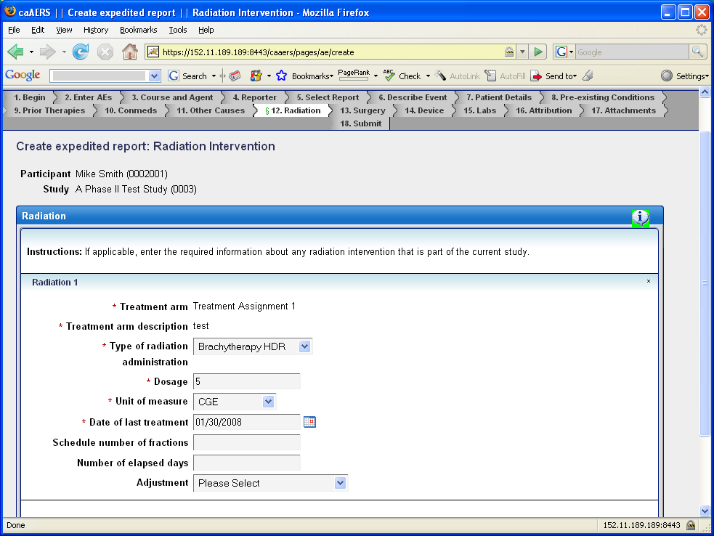
SAE entry screens continued

Slide 49
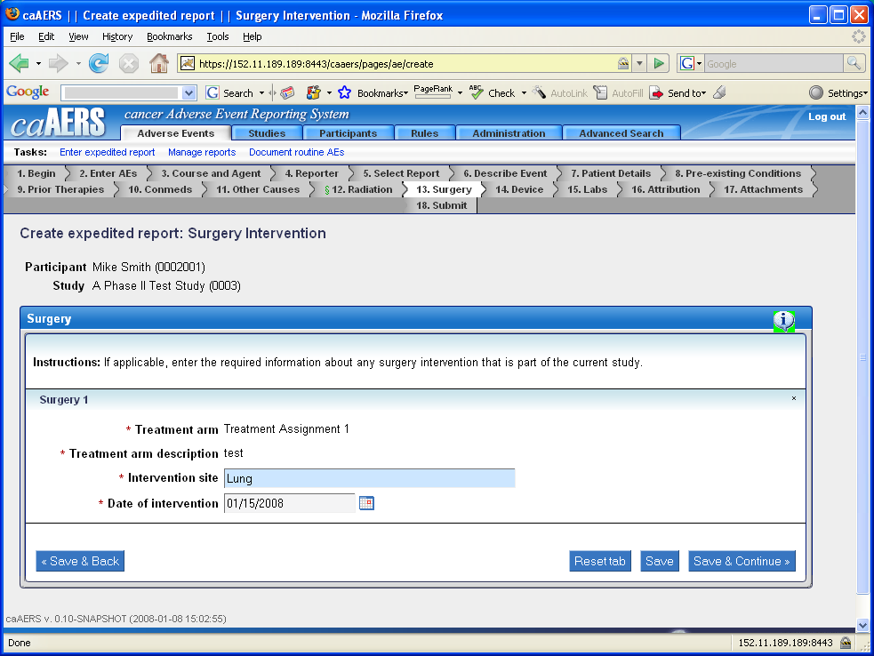
SAE entry screens continued

Slide 50
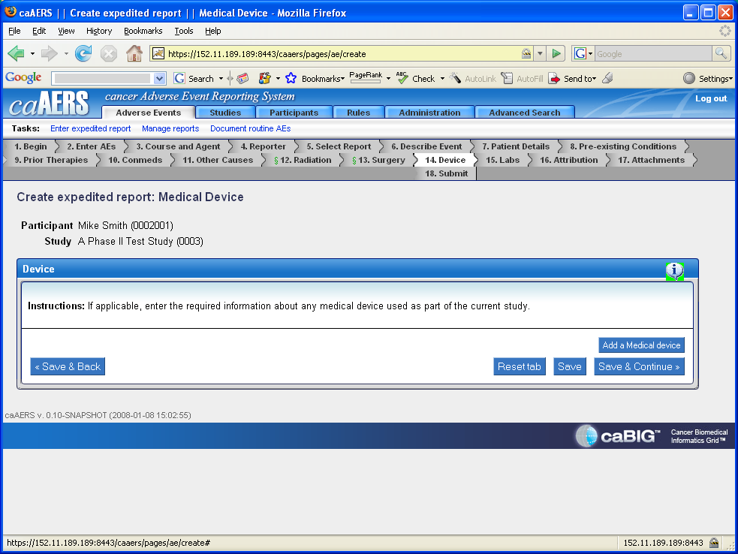
SAE entry screens continued

Slide 51
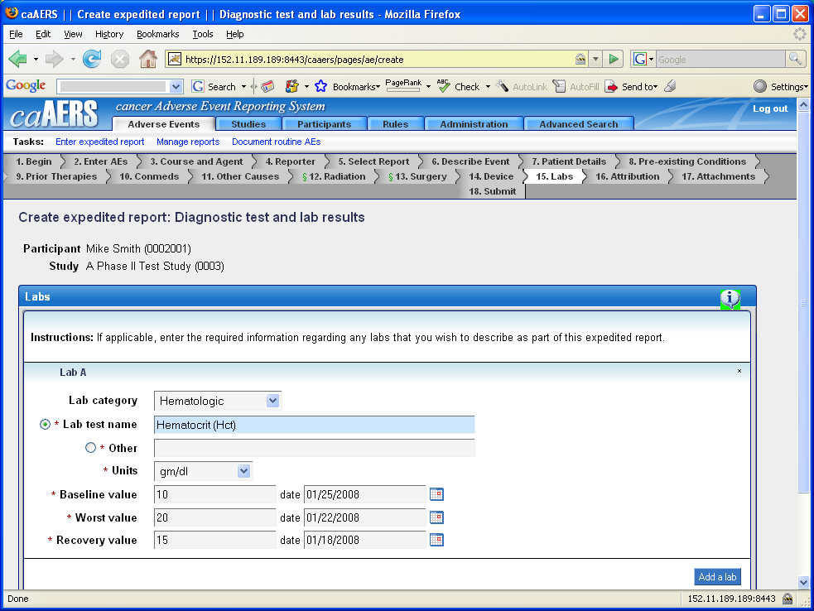
SAE entry screens continued
Notes:
Lab categories include bone marrow, chemistry, coagulation, hematologic, microbiology, and respiratory. Note that in this report (unlike standard 5 day report) this is not required

Slide 52
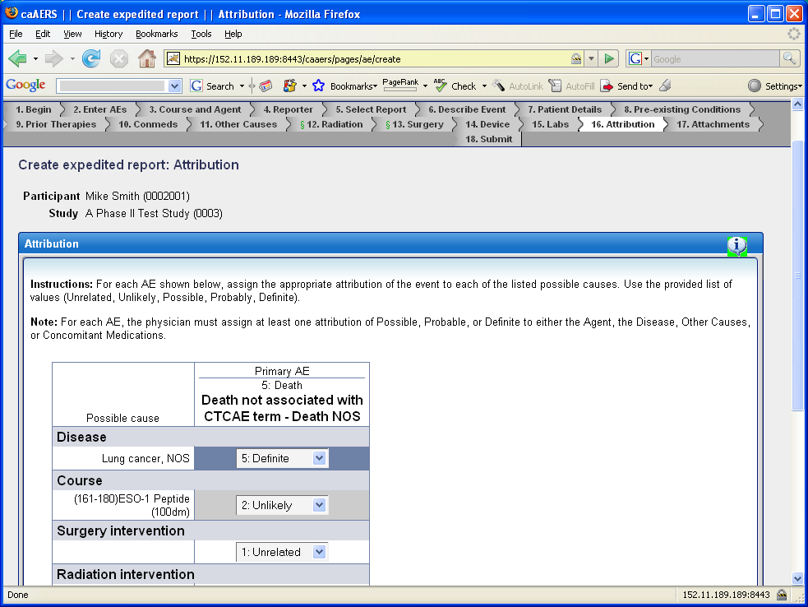
Key SAE screen
Notes:
For CTEP reporting at least one has to have an attribution of possible, probable definite.

Slide 53
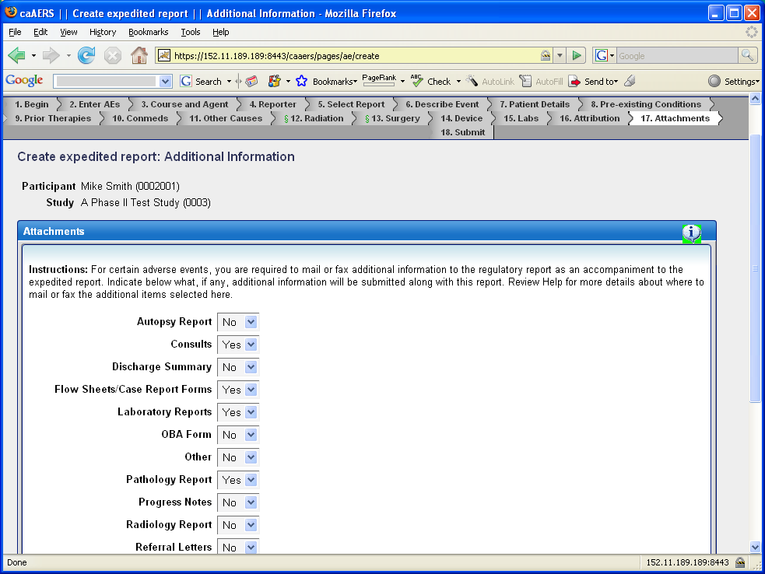
More SAE screens

Slide 54
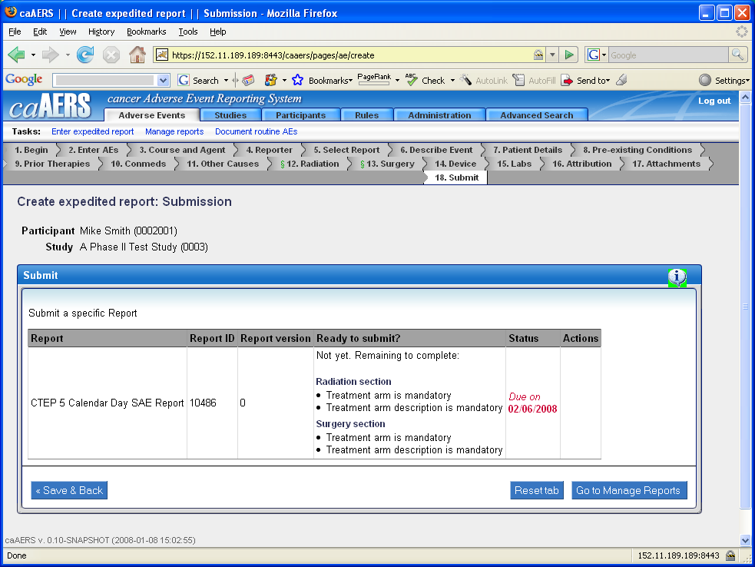
Not ready yet!
Notes:
This screen lists problems that are preventing submission

Slide 55
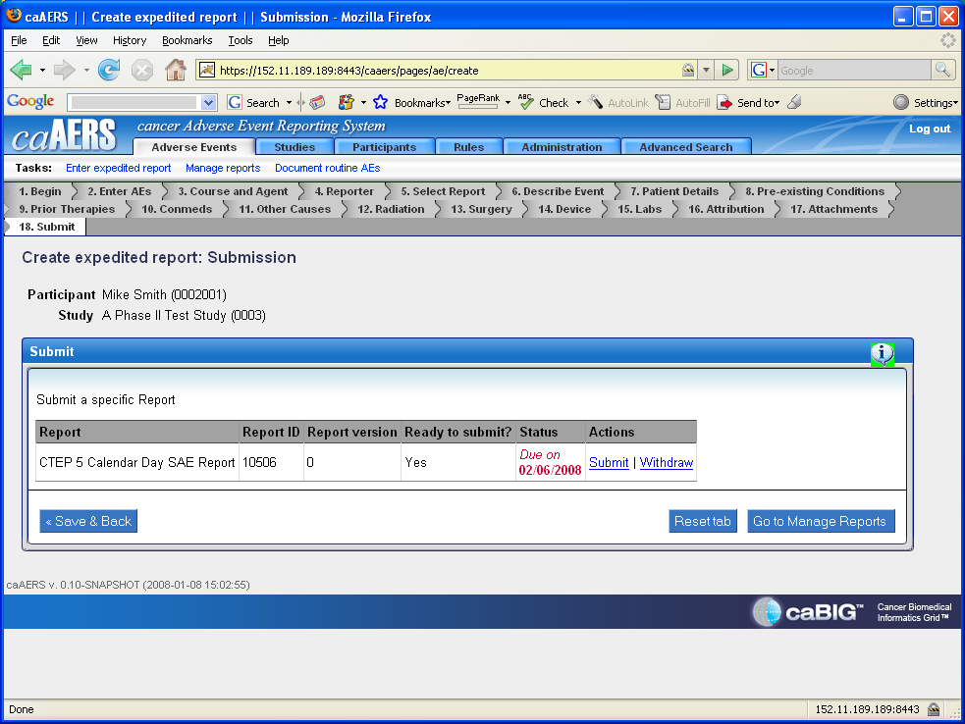
All ready to submit!
Notes:
The key to this screen are the submit and withdraw links..

Slide 56
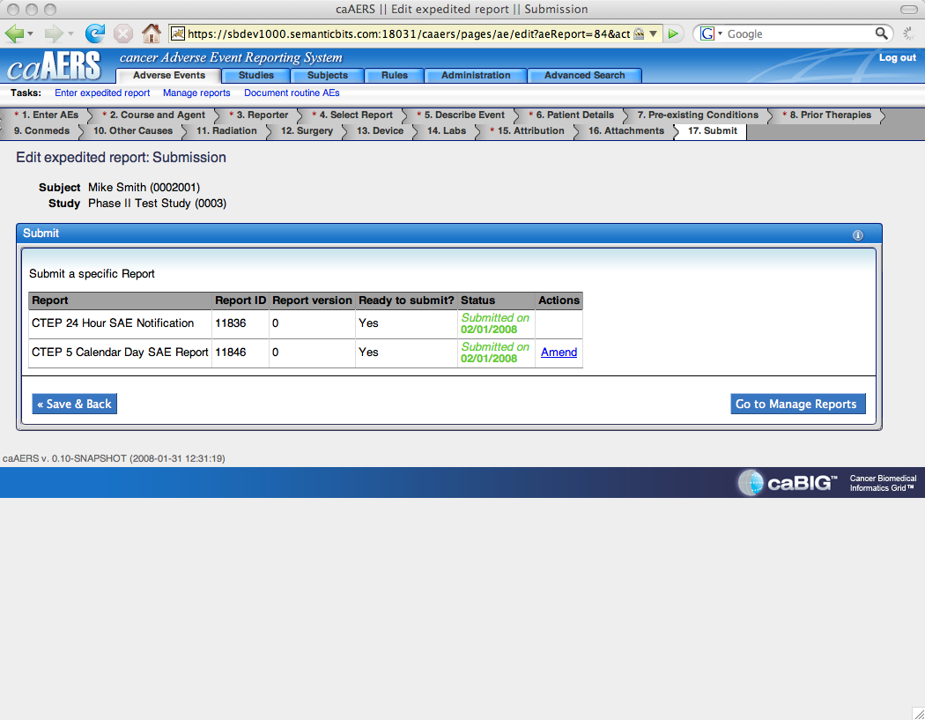
Done!

Slide 57
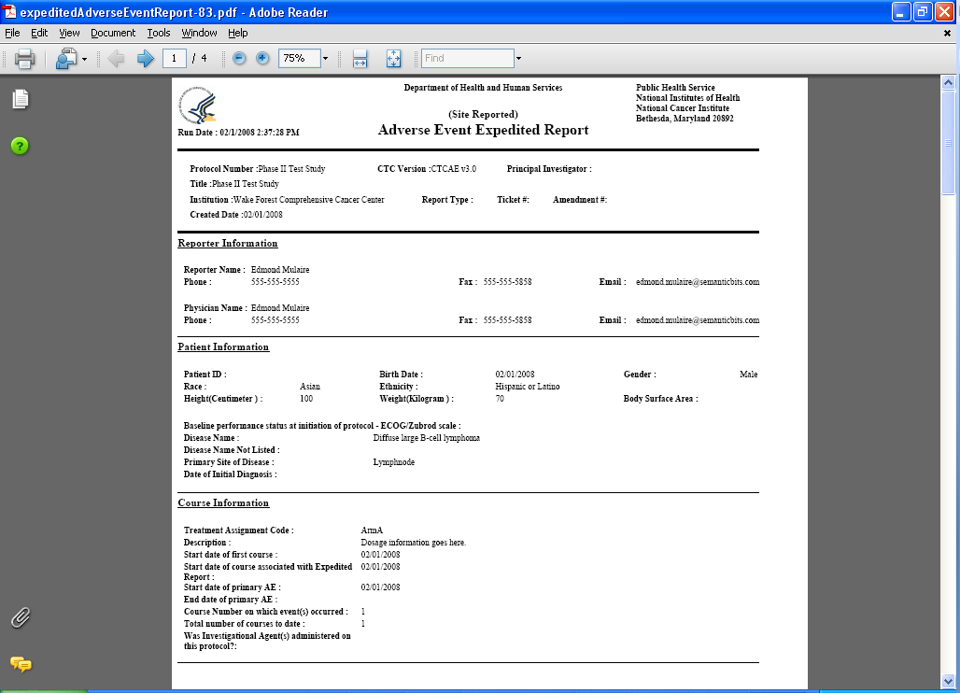
The report is delivered as a pdf

Slide 58
Lesson 7 Review & Questions
What if a report is not in the system?
Why would I override the rules?
How do I amend a report?
Notes:
Review the routine AE to SAE transition, review reliability of engine depending how the base rules are implemented

Slide 59
Session Summary: Review
A reminder of caAERS objectives: Patient safety
You should now be able to find your way through entering required data for adverse events

Slide 60
Session Summary: Questions
Notes:
Simply allow questions

Slide 61
Session Summary: Looking for more?
On line training session
Contact the appropriate institutional person about getting caAERS
List key contact information here
Notes:
Reiterate online site?

Slide 62
Session Summary: Course Evaluation
How could we improve this presentation?
Email XXXX@YYY.com

