Slide 1
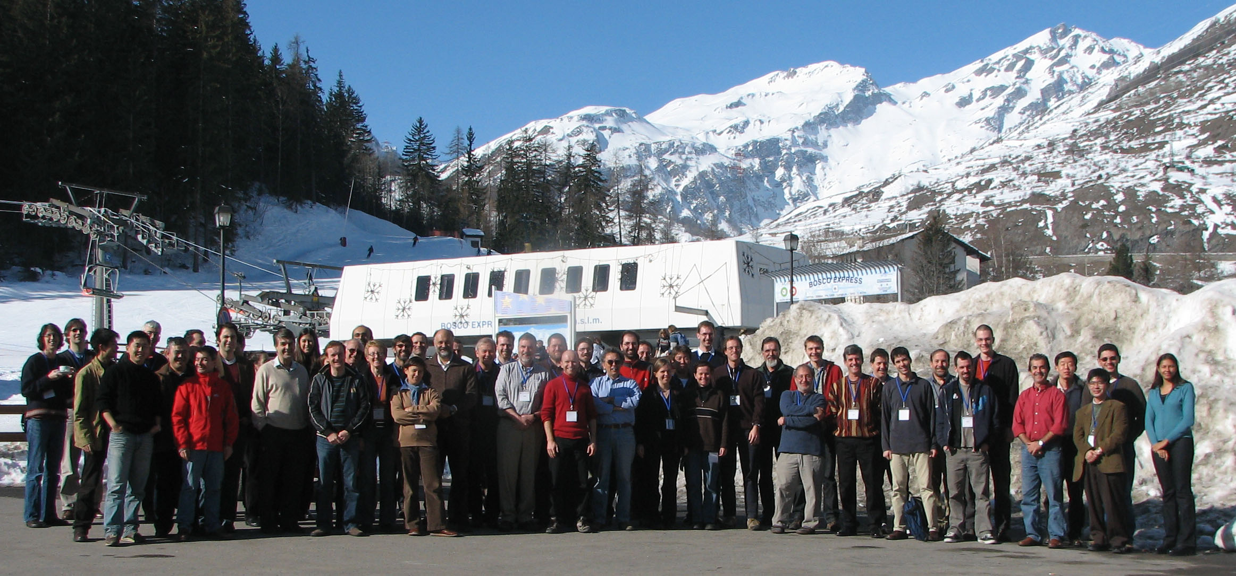
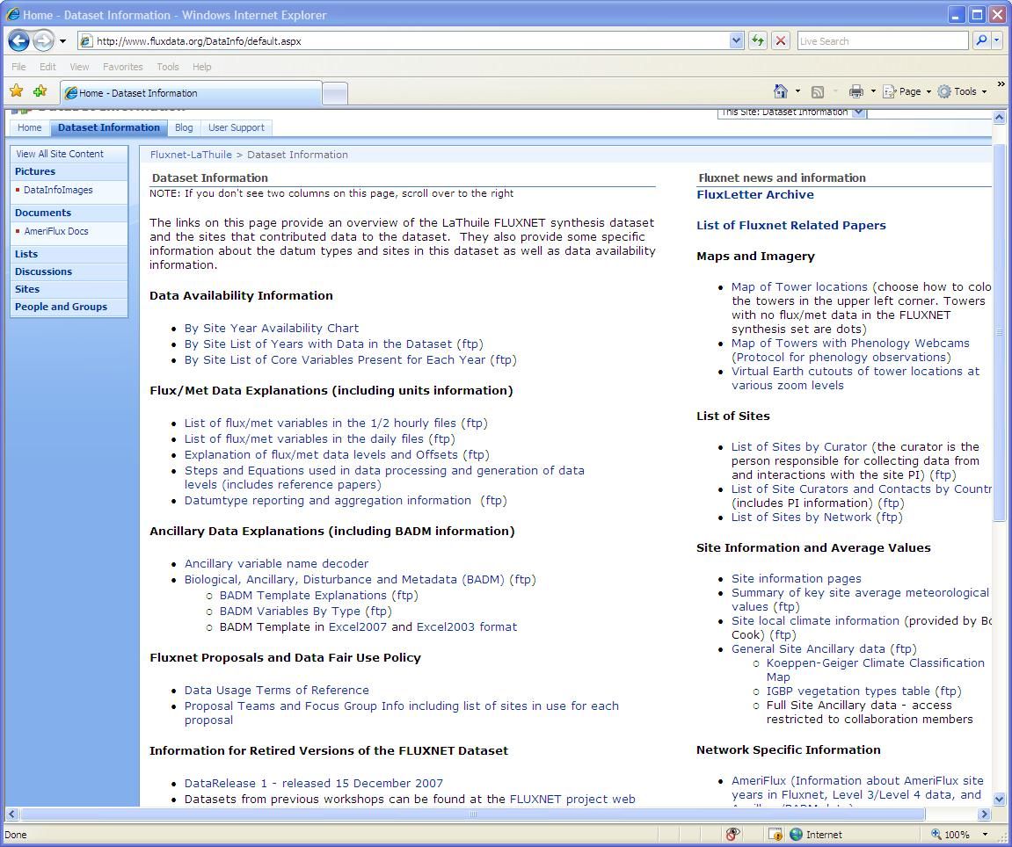
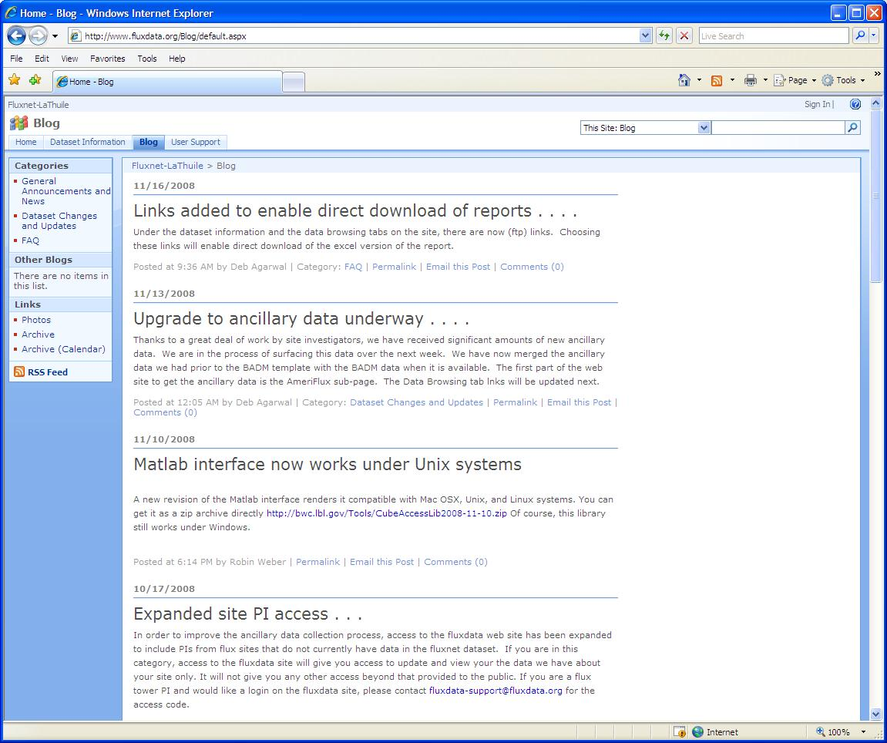
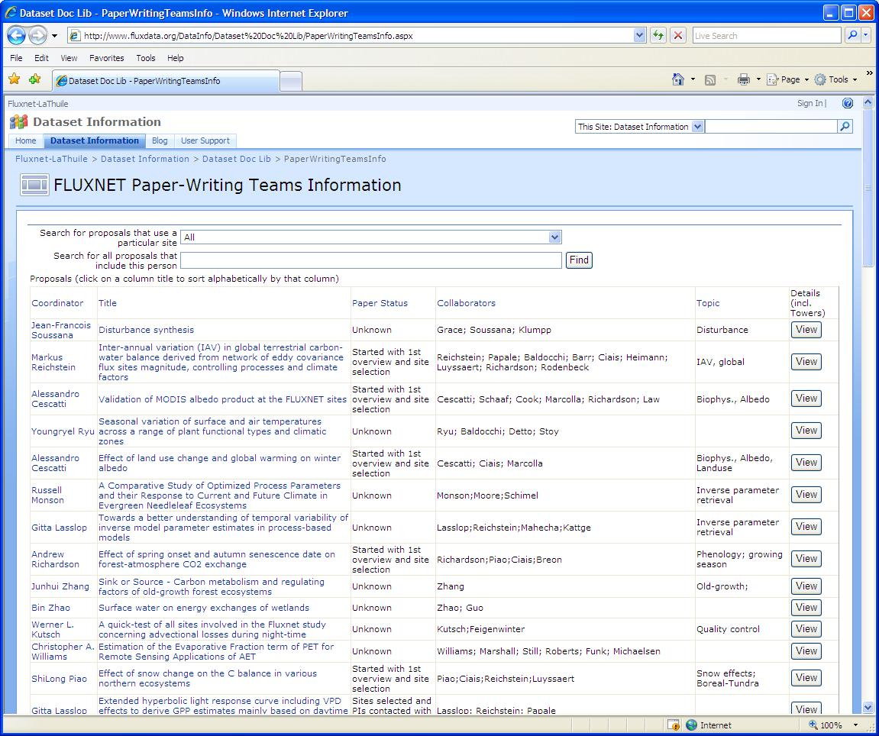
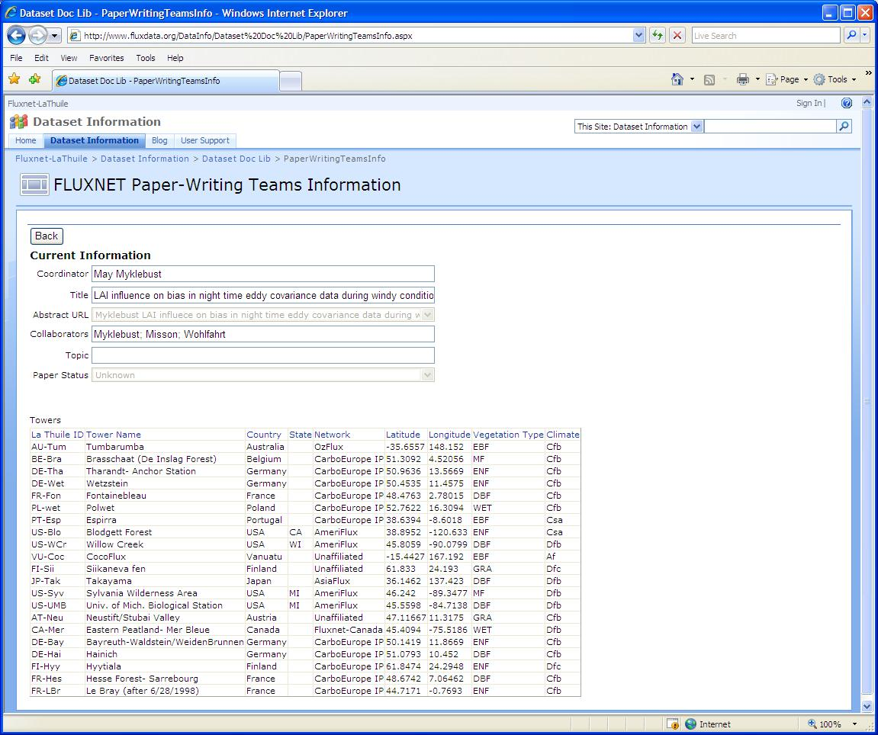
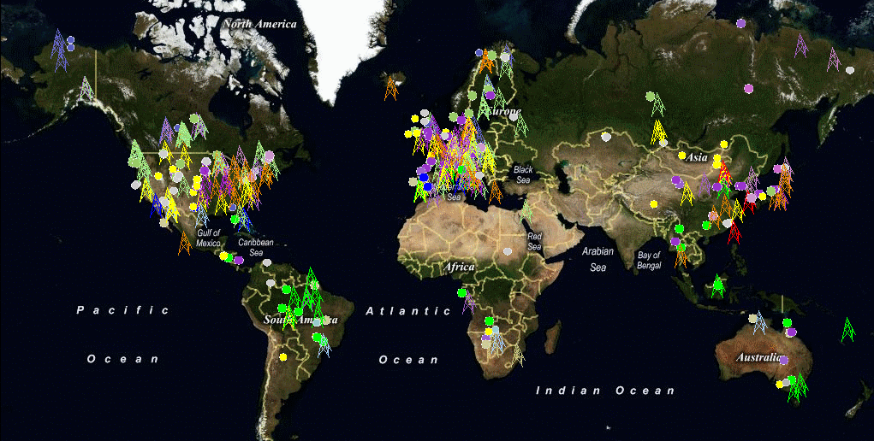
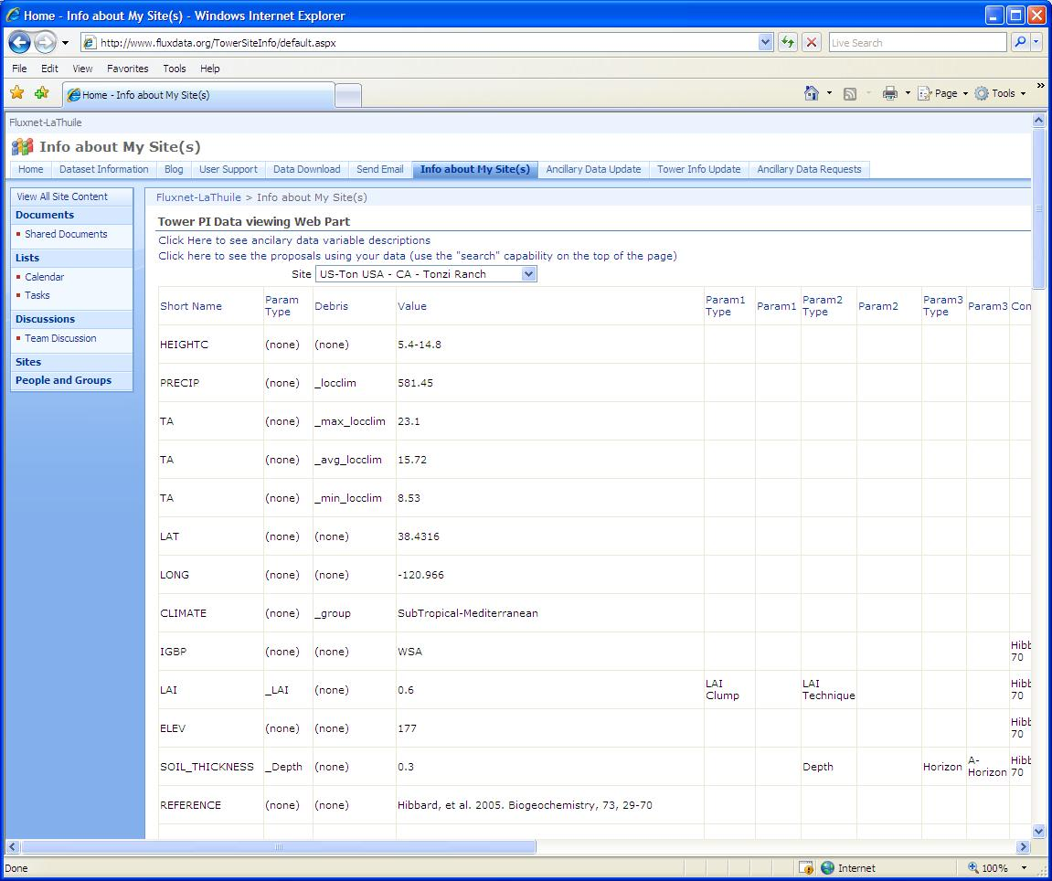
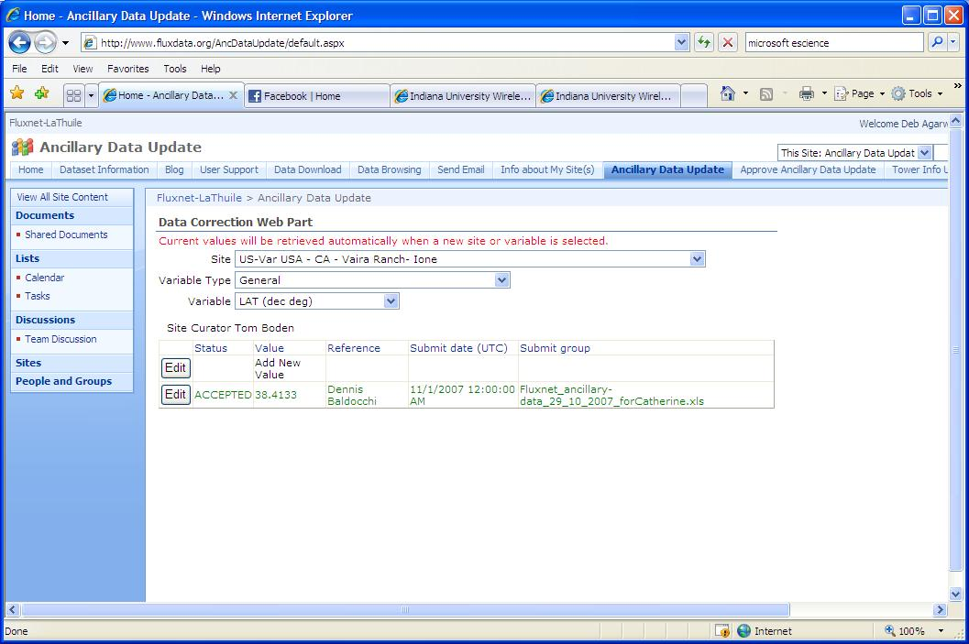
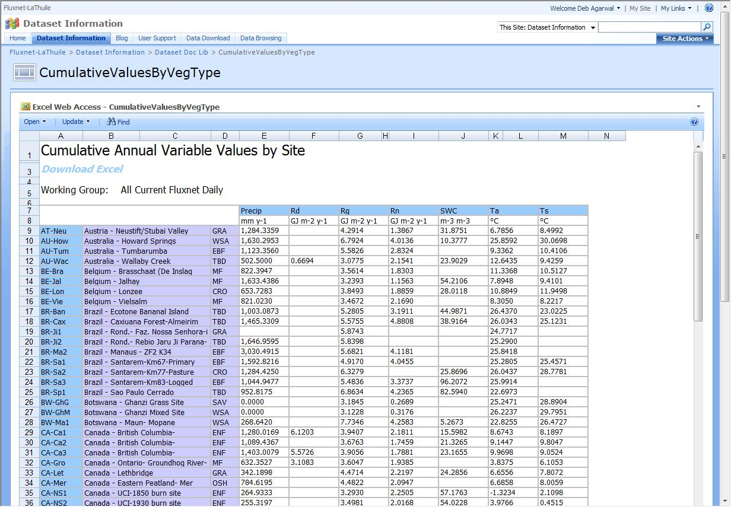
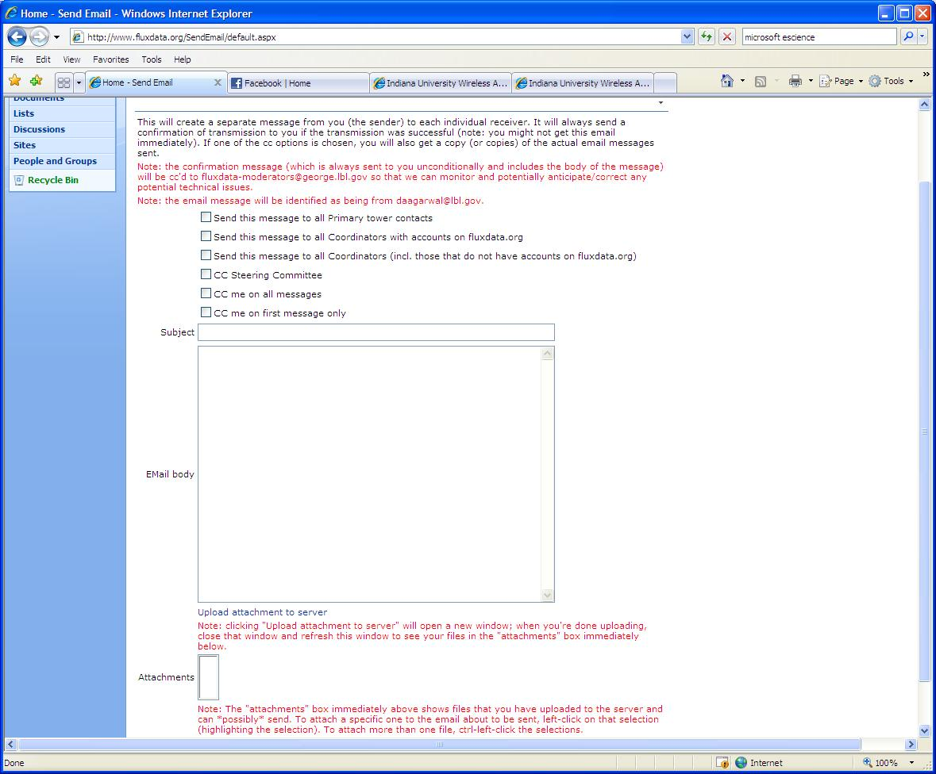


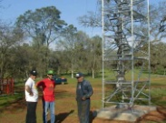






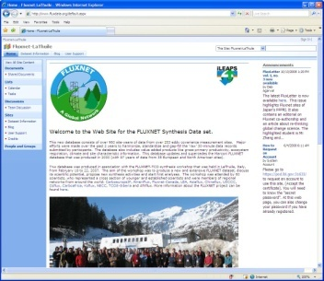
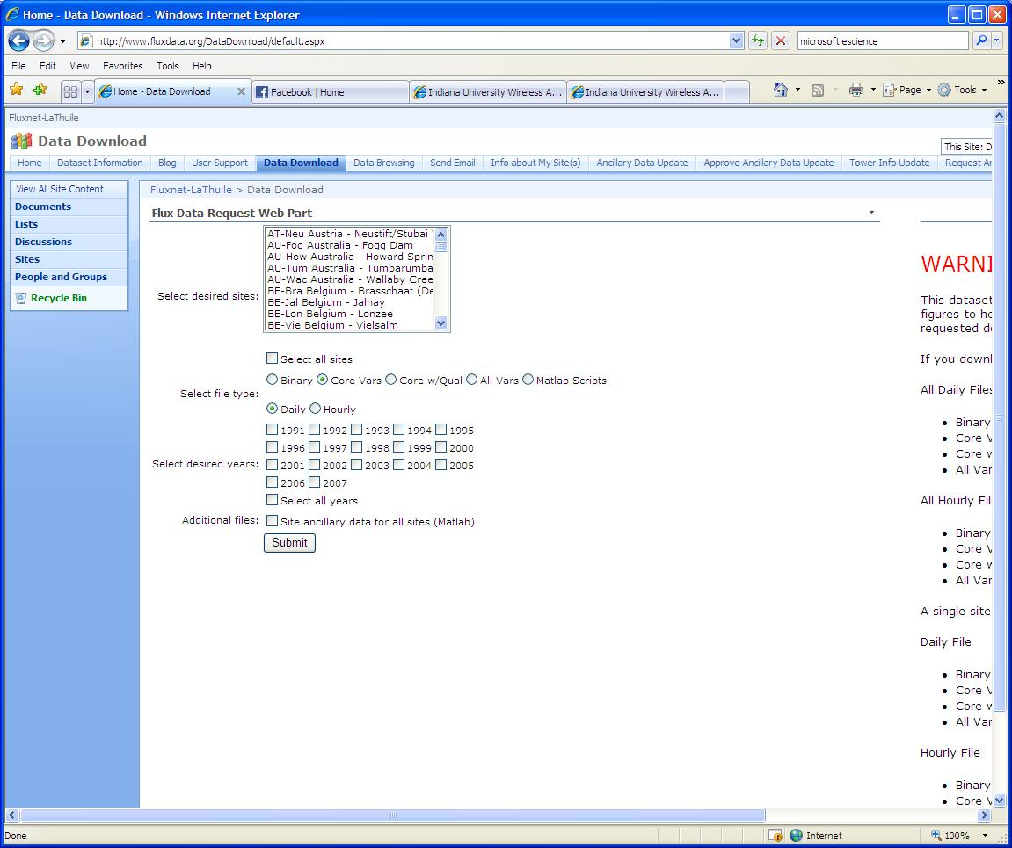

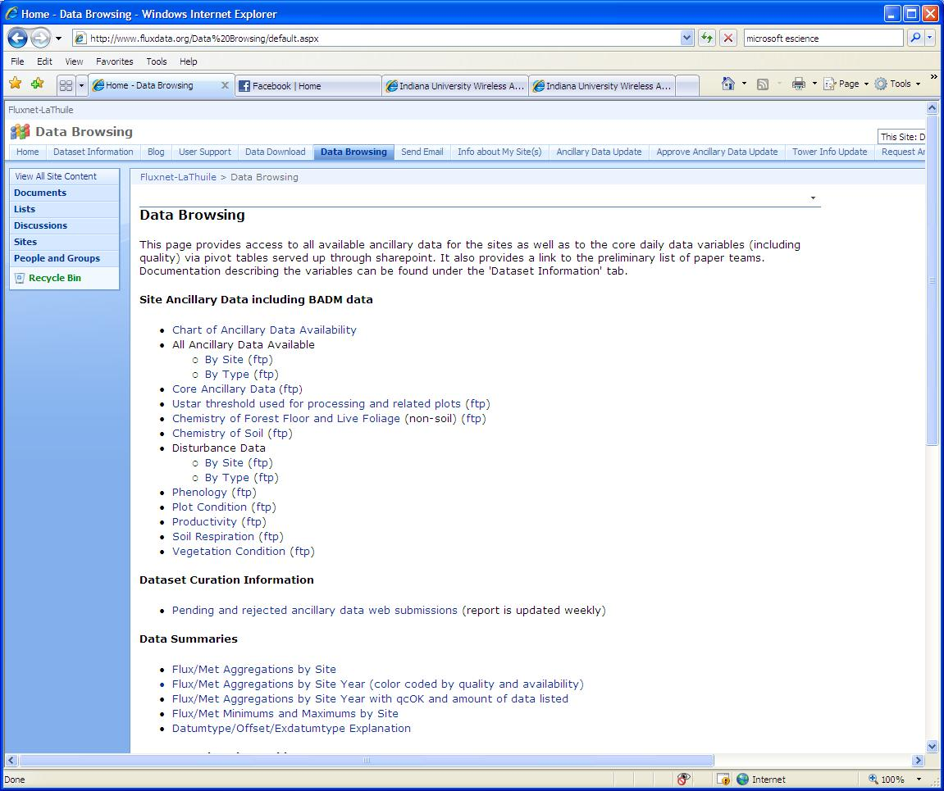


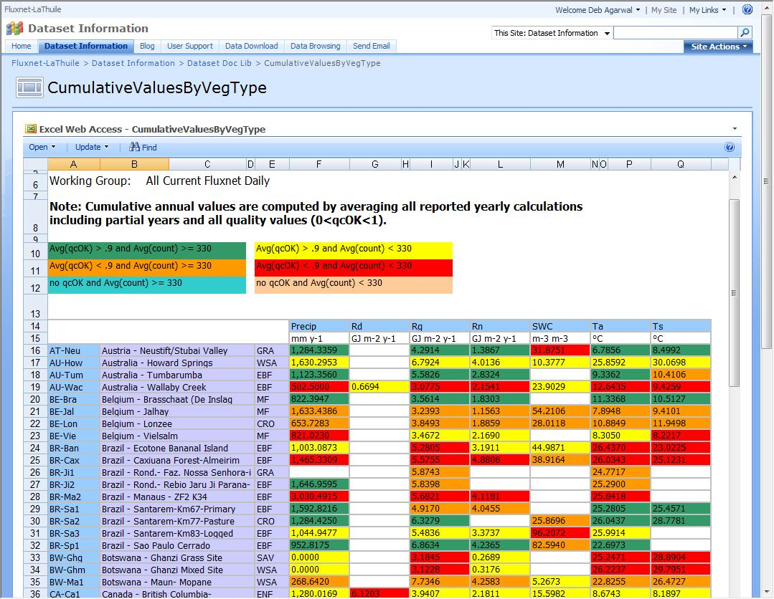


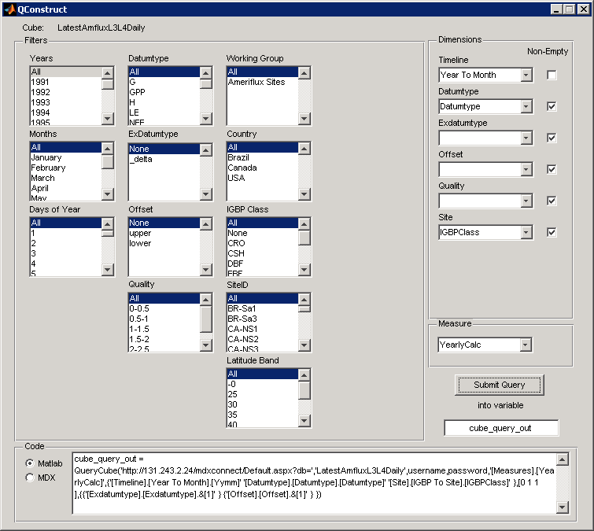
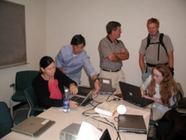
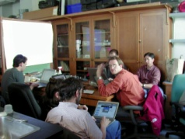
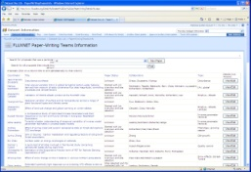
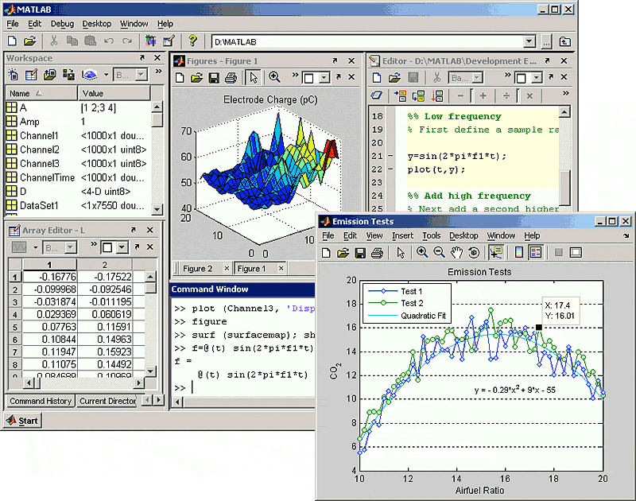

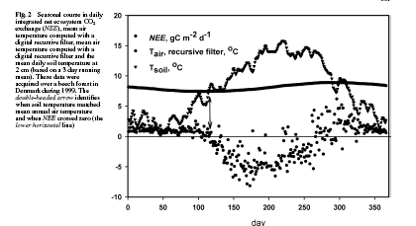
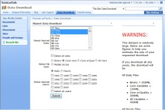
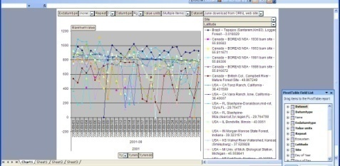

















Interaction Support for the Global Fluxnet Data Set
IN23B-1092
Deb Agarwal^{abd} (daagarwal@lbl.gov), Marty Humphrey^{e} (humphrey@cs.virginia.edu), Norman Beekwilder^{e} (nfb5z@cs.virginia.edu), Monte Goode^{abd} (MMGoode@lbl.gov), Keith Jackson^{abd} (krjackson@lbl.gov), Robin Weber^{ad} (rjweber@lbl.gov), Catharine van Ingen^{c} (vaningen@microsoft.com ), and Dennis Baldocchi^{ad} (baldocchi@nature.berkeley.edu) Berkeley Water Centerª; Lawrence Berkeley National Laboratory^{b}; Microsoft Research^{c}; University of California, Berkeley^{d}; University of Virginia^{e}
We have developed a collaborative web portal which enables data browsing on line, orchestrates the data curation virtual conversation, and enables the synthesis team conversation with sites. Behind the portal is an archive database and OLAP data cube for simple data browsing through query. Scientists can download data files, browse data summaries, update metadata and annotate the data through the portal. Synthesis teams can select sites and exchange e-mail with those sites through the portal. The data can also be browsed directly from Excel spreadsheets or MatLab from the scientist desktop; the scientist sees no difference between data “in the cloud” and on the desktop. We believe the portal enables science researchers to concentrate on science rather than data management and the collaboration features enable continued growth.
Abstract
The FLUXNET synthesis data set contains on the order of 960 site-years of sensor data from over 260 sites around the world. This is a living data set; a data update this year should add new site-years from over 200 sites. The data are the ground truth for carbon-climate studies linking models and remote sensing as well as comparative field analyses. Over 70 synthesis teams are using this data to do global and regional scale analyses. The size of the dataset makes browsing the data difficult; for example, a search of the dataset for sites with particular meteorological characteristics would require a download of the complete dataset and then running all of the data through a preliminary analysis. Synthesis studies often need additional non-sensor measurements such as root biomass, soil composition, or fire occurrence; some of these variables require detailed knowledge of the site and the science. The large number of sites makes the assembly, cleaning, and long term curation of the non-sensor data daunting; a virtual conversation between the data providers, data users, and data curators is needed. The large number of sites also makes tracking updates to the site information and communicating with site PIs difficult for synthesis study teams.
Fluxdata Collaboration Portal Public Views: blog, user manual, synthesis activity information, and information about the data set
Worldwide FLUXNET Tower Locations
Fluxdata Collaboration Portal Measurement Site Scientist Views: site information display and update, site data download, communicate with synthesis teams, and e-mail participants
Measurement Site Scientists
Regional Networks
Site Measurement Scientists (129)
Steering Committee of Regional Networks
Permission to pursue synthesis activity using the data
Quality Assess and Gap Fill
Fluxdata web site
Ancillary site data
Data usage permission
Credit/co-authorship
Contribution to analysis
Synthesis Paper Teams (70)
Data access, updates, and corrections
Collaboration support
Information on other teams
Synthesis activities
Data Access and Summaries, Site Biological and Ancillary Metadata, and Collaboration Support
Quality and Gap Fill (2)
Clarification
Correction
Interpretation
T SOIL
Data access via data cube
Fluxdata Collaboration Portal Synthesis Team Views: download data, e-mail measurement site scientists, extensive site and data set details, and data access and browsing via Matlab and Excel
T AIR
Onset of photosynthesis
FLUXNET Data Flow: Archiving, Processing, Access, and Synthesis Steps
FLUXNET Virtual Conversations to Support Synthesis Activities
URL: http://www.fluxdata.org/ e-mail: fluxdata-support@fluxdata.org

