Slide 1
Program Planning and Integration
Guiding NOAA Strategically

Slide 2
PPI
VISION
MISSION
PPI is driven toward the ideal of one NOAA working together, guided by a clear strategic vision for planning, programming, and execution to achieve NOAA’s goals.
Lead the implementation of NOAA’s Strategic Vision by
Developing and evolving of NOAA’s Strategic Plan
Managing designated programs according to matrix principles
Promoting the development of effective programs by integrating knowledge, talent, and resources across NOAA
Integrating social science and environmental policy analyses into decision-making

Slide 3
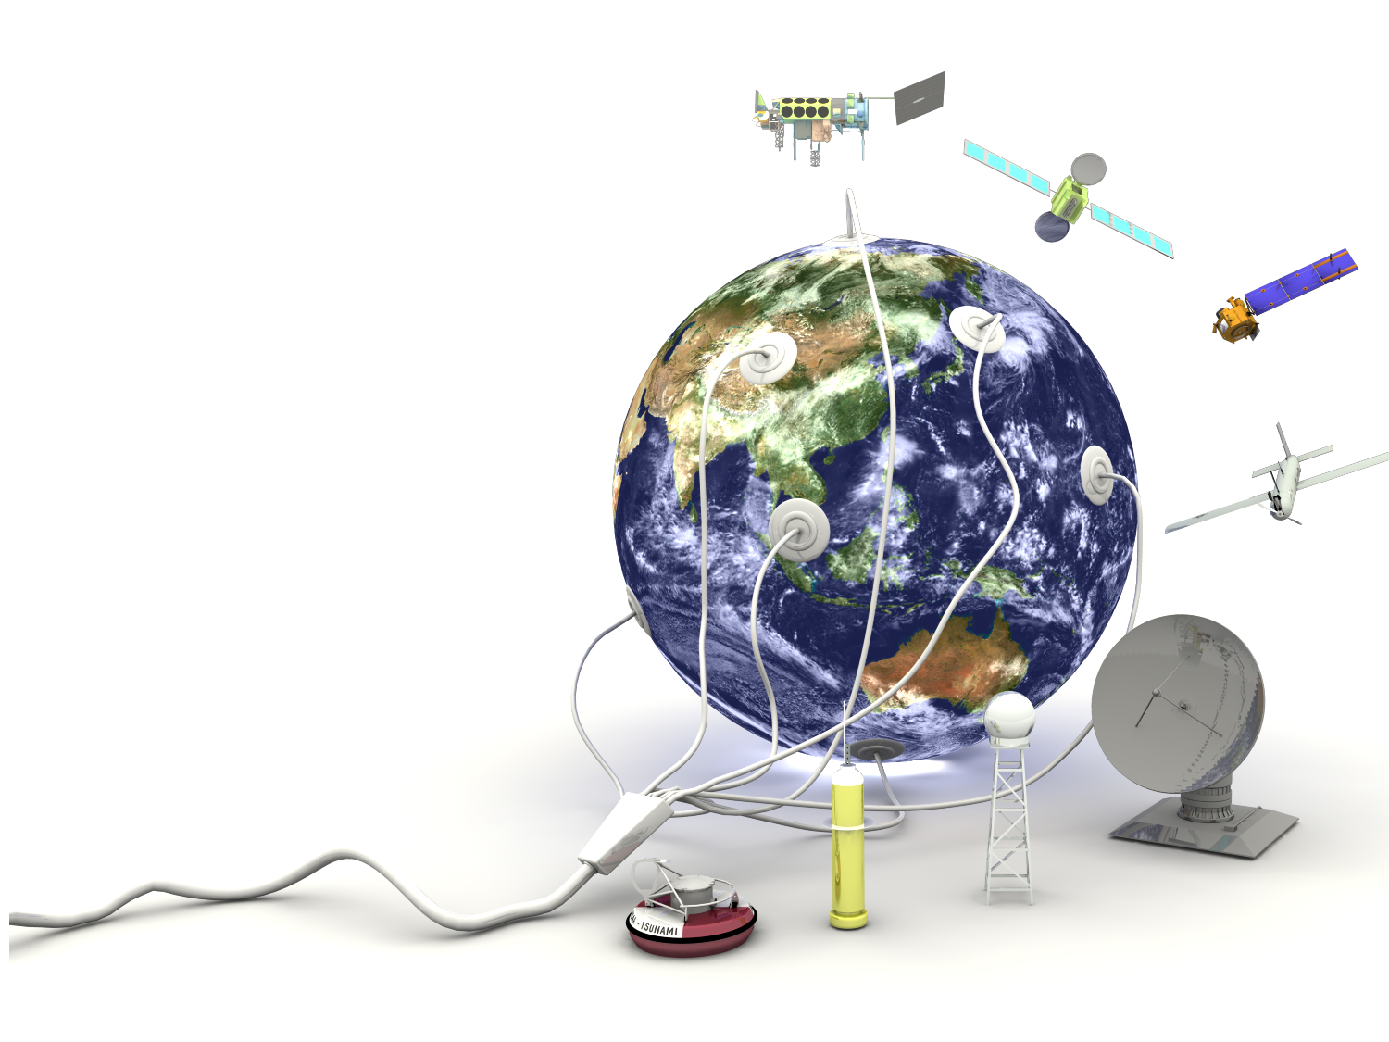
PPI Helps Build a Stronger NOAA
Planning Across NOAA
Ensures Agency Investments and Actions are
Guided by a Strategic Plan
Articulates Yearly Investment Priorities
Improves Alignment of Programs to Planning
Advances Stakeholder Involvement
Integrating Across NOAA
Improves Direction, Integrity and Performance
of NOAA Programs and Program Structure
Provides executive-level representation and
support to cross-cutting programmatic and
organizational issues
Catalyzes, Launches and Monitors New
Internal Policies to Advance Program
Integration

Slide 4
PPI Budget
 | FY 2007 | FY 2008 | FY 2008 (personnel) | FY 2009 (PPI spend plan)*
PPI (appropriation) | $1,952.0K | $1,975.0K | 10.7 (FTE ceiling) | $1,998.0K
Analyst Support (direct bill) | $853.7K | $922.7K | 7.0 | $782.8K
NEPA Coord. (direct bill) | $435.5K | $461.4K | 3.3 | $473.1K
*
*
* Values dependent on appropriation and/or approval of direct bill request.

Slide 5
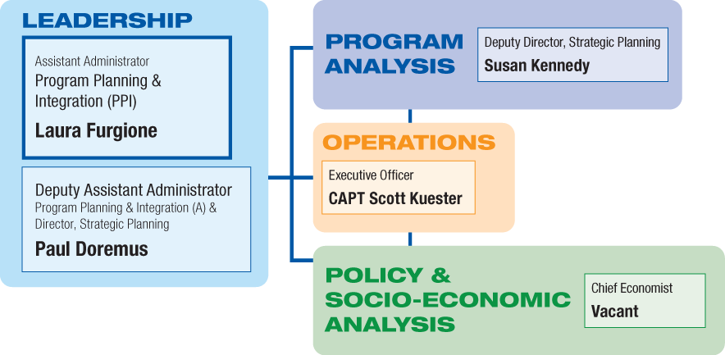
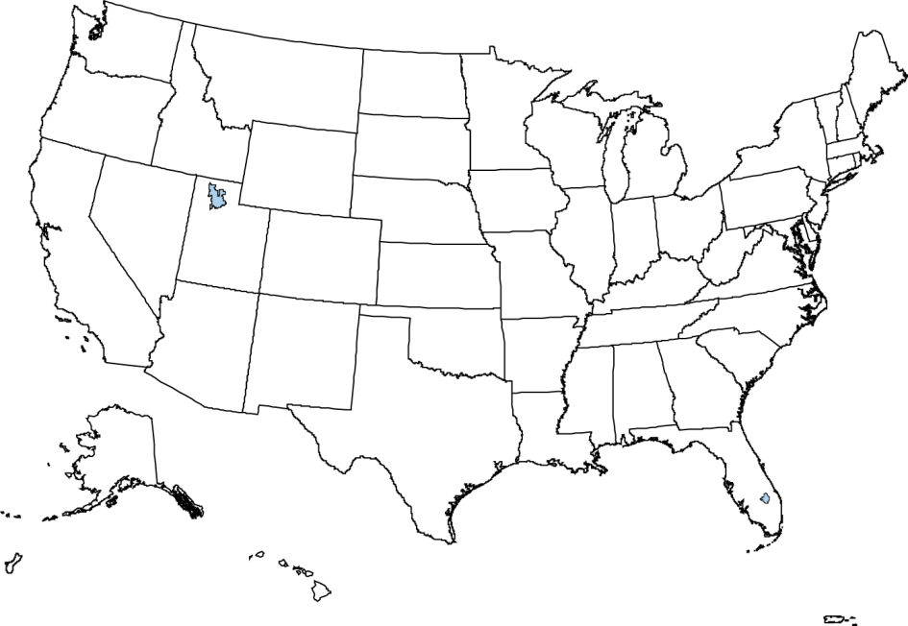
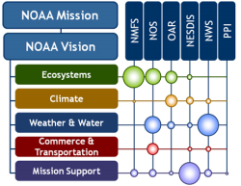
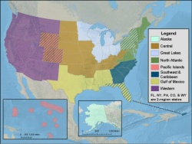


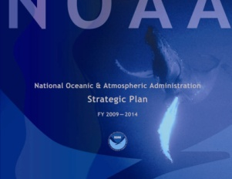
Who We Are PPI Organization
X
X
X
X
X
Building 3 | Silver Spring, MD
FTE 11
Vacancies 2
Building 3 | Silver Spring, MD
FTE 11
Vacancies 2
Building 3 | Silver Spring, MD
FTE 11
Vacancies 2
Building 3 | Silver Spring, MD
FTE 11
Vacancies 2
Building 3 | Silver Spring, MD
FTE 11
Vacancies 2

Slide 6
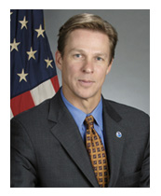
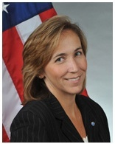
PPI Leadership
Laura K. Furgione
Assistant Administrator
Paul N. Doremus, PhD Acting Deputy Assistant Administrator &
Director of Strategic Planning

Slide 7
PPI Products and Core Capabilities
Products
NOAA Strategic Plan
Annual Planning Guidance
Strategy Papers
Strategic Portfolio Analyses
Climate Services Implementation Plan
Annual Execution Year Guidance
Business Operations Manual
Regional Collaboration Corporate Guidance
Economic Statistics for NOAA
Core Capabilities
Strategic Planning
Performance Evaluation
Program Integration
Policy Integration
National Environmental Policy Act Coordination Responsibilities

Slide 8

Core Capability: Strategic Planning
PPI is responsible for managing the NOAA-wide planning cycle and for producing its outputs while employing PPI’s expertise in social, economic and policy analysis to understand and evaluate the societal impact of NOAA programs.
Compelling long-range plan for NOAA (next generation Strategic Plan)
Annual investment priorities that guide programming and budgeting (AGM)
Guidance on the annual Planning process
Interactions with NOAA stakeholders: acquire, synthesize, and respond to inputs

Slide 9
Core Capability: Performance Evaluation
PPI leads NOAA’s development of performance measures, both at the Program and the corporate level.
NOAA-wide evaluation system and corresponding measurement methods and metrics
Refine performance measures over time; ensure consistent and appropriate use across diverse processes
Progress assessments for NOAA’s strategic programs
Interface with NOAA Budget Office regarding
Performance evaluation methods
Performance metrics
Performance-based management practices

Slide 10
Core Capability: Program Integration
PPI provides oversight of the direction, integrity and performance of NOAA Programs and the Program Structure.
Improve the long-term performance and integrity of NOAA’s strategic programs
Strengthen implementation of matrixed programs
Integrate strategic programs with Line Office execution capabilities and needs
Strengthen regional scale program integration (Regional Collaboration)
Improve integration, integrity, and effectiveness of PPBES
Coordinate effective program strategies for corporate issues, e.g., Coastal and Climate

Slide 11
Core Capability: Policy Integration
PPI represents NOAA in select interagency functions; it also catalyzes, launches, and monitors the implementation of new internal policies.
Provide NOAA- and DOC-level Coordination on National Environmental Policy Act
Represent the NOAA Program in select Executive Branch efforts
Guide implementation and monitor progress of select high-priority, NOAA-wide programmatic, regulatory, and managerial policy exercises
Transition of research to application
Partnerships with private and academic sectors
NOAA’s use of social science to prioritize activities

Slide 12
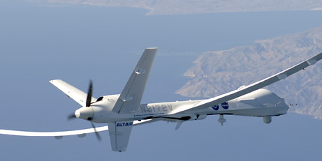
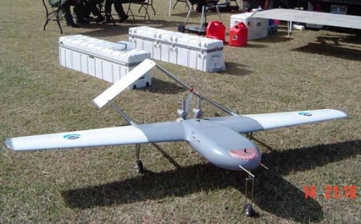
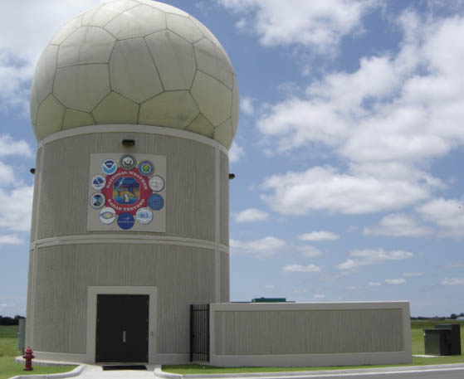
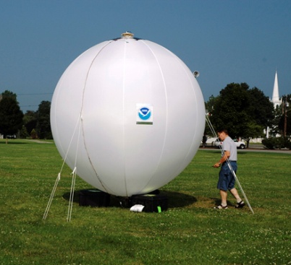
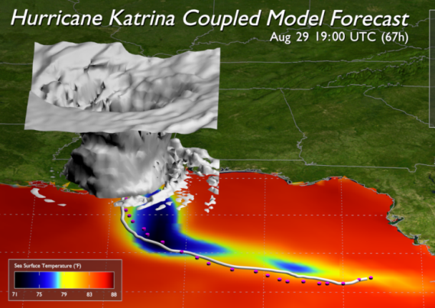
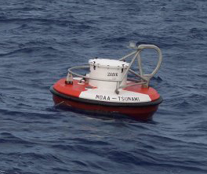
PPI Highest Priority Issues
Climate Information Services Implementation Plan
Next Generation NOAA Strategic Plan
Development of Strategic Business Cases
Regional Collaboration Effort
Line Office Execution Reporting Guidance

Slide 13
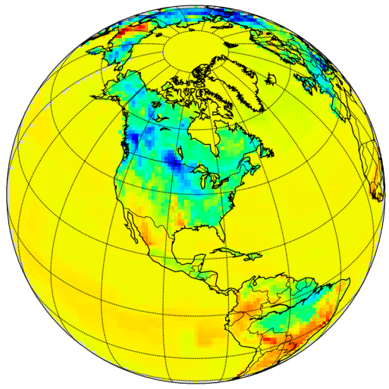
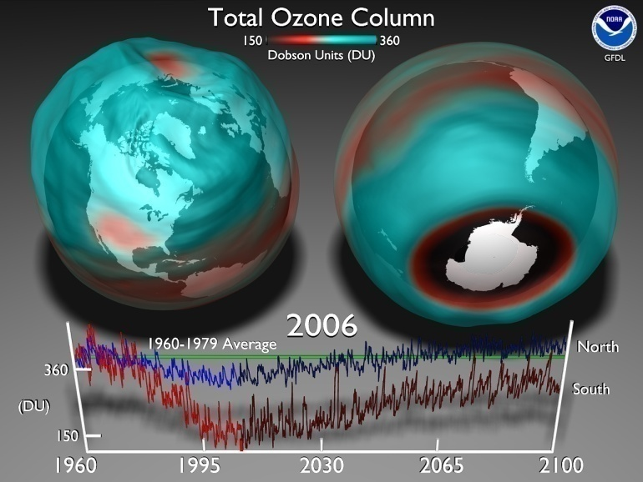
Highest Priority Issue: Climate Information Services Implementation Plan
Collaborate with NOAA’s Climate Goal Team to ensure continued progress building a business case for the development of a climate service at NOAA
Collaborate in the development of an operational model for the provision of climate information services
Review capacity gaps in climate related to the provision of climate information services
Propose organizational solutions for addressing gaps and expanding NOAA’s climate service portfolio

Slide 14

Highest Priority Issue: Next Generation NOAA Strategic Plan
Develop NOAA goals and objectives to better frame and guide investment choices
Align the organization w.r.t. corporate performance goals and objectives
Describe NOAA’s functions and how they accomplish NOAA’s goals and objectives
Account for long term economic, technological, and environmental benefits

Slide 15
Highest Priority Issue: Development of Strategic Business Cases
Build Compelling Business Cases for NOAA services
What is the public DEMAND?
What is NOAA’s ROLE?
What are NOAA’s current CAPABILITIES?
What are NOAA’s capability GAPS?
What is NOAA’s proposed SOLUTION?
What would be the social and economic IMPACTS?
What would be the technical, organizational, and fiscal RISKS?

Slide 16
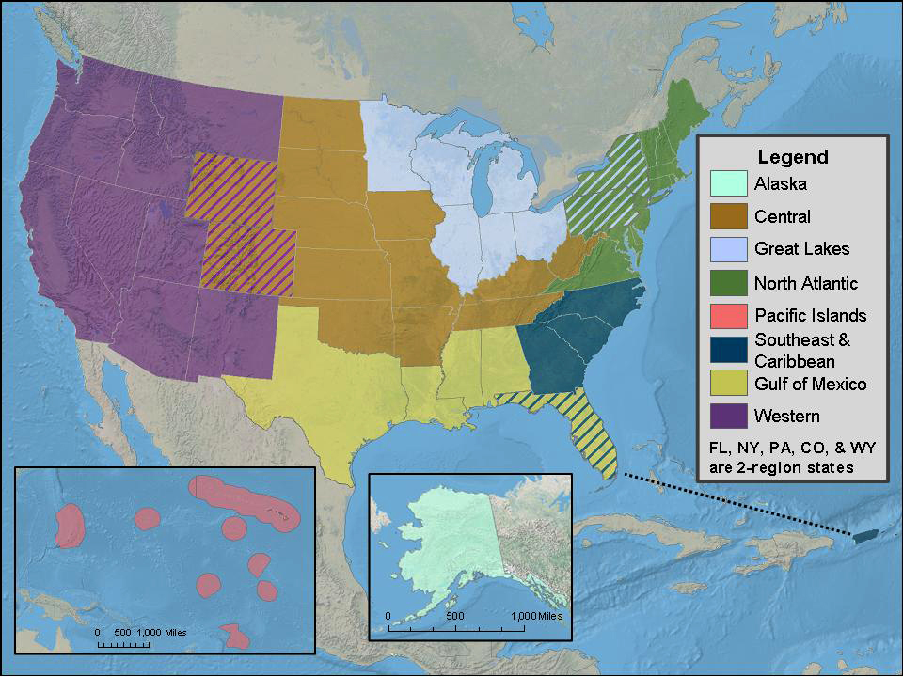
Highest Priority Issue: Regional Collaboration Effort
Address NOAA mission priorities at appropriate geographic scales
Address distinct regional challenges related to NOAA’s mission
Leverage current and emerging regional partnerships to respond to stakeholder needs
Enhance NOAA’s value to and impact on the region

Slide 17
Highest Priority Issue: Line Office Execution Reporting Guidance
Execution reporting serves four purposes
Program execution tracked against corporate performance measures and reported to DOC
Financial execution tracked against spending plans and reported to NOAA CFO
Line Office execution priorities tracked against AOPs and reported quarterly
Corporate NOAA execution priorities tracked against AOPs and reported semi-annually
Reporting guidance designed to
Improve alignment of Annual Operating Plans with NOAA priorities
Streamline and increase effectiveness of execution reporting and briefings on core measures of operational performance
Acknowledge those priorities that are critical to NOAA’s success and warrant special attention during the execution year

Slide 18
Questions?

