Slide 1
Run 8 pC results
Vipuli Dharmawardane (NMSU)
RSC meeting
Sep 12th 2008

Slide 2
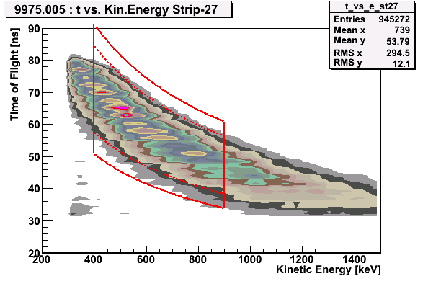
Run Selection
Asymmetry/
Polarization
Profile parms.
Good
Runs
Calibrations/
Energy correction
Extract Polarization/
Normalize to HJet
Same quality checks as run 05 and 06
Carbon mass position deviation : < 0.5 GeV from the Carbon mass
Carbon mass width : deviation below 1.9 sigmas
Number of events in banana : strips inside 20% from the average
Fill #s: 9942, 9947, 9948 problems with pC data → Borrow results from HJet

Slide 3
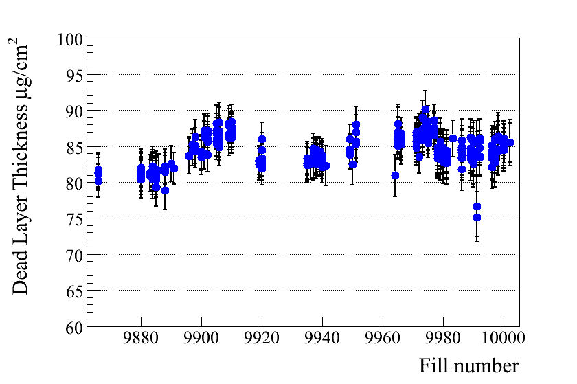
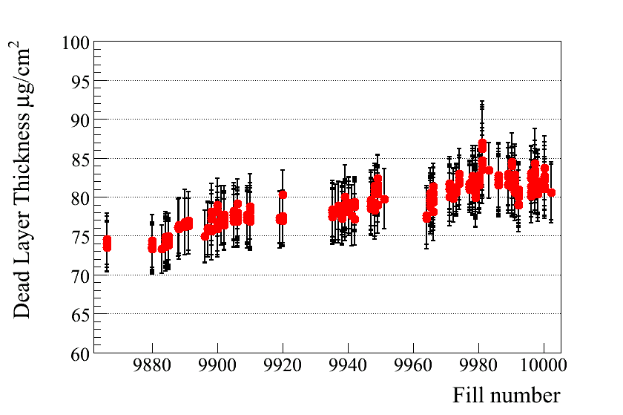
Run Selection
Asymmetry/
Polarization
Profile parms.
Good
Runs
Calibrations/
Energy correction
Extract Polarization/
Normalize to HJet
Energy correction

Slide 4
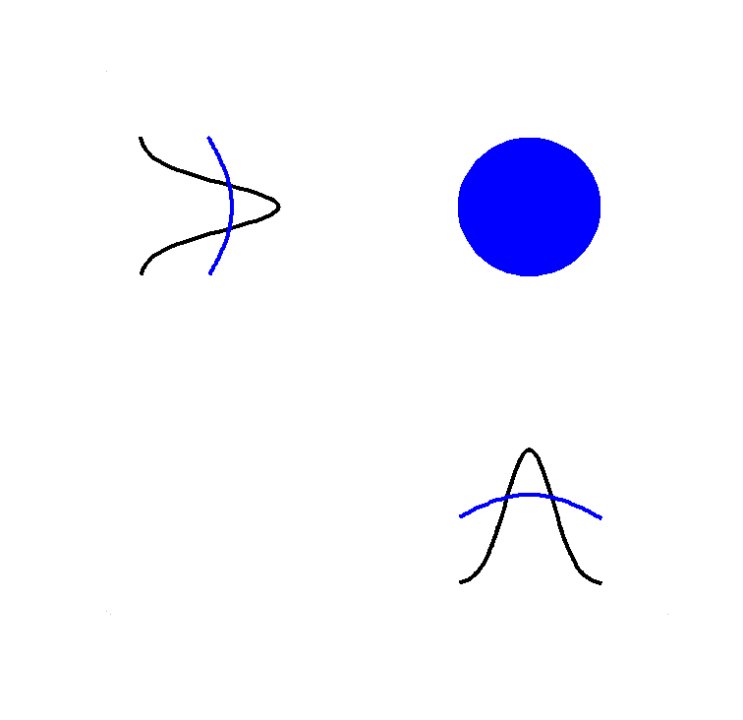
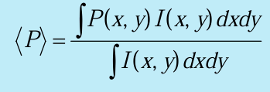
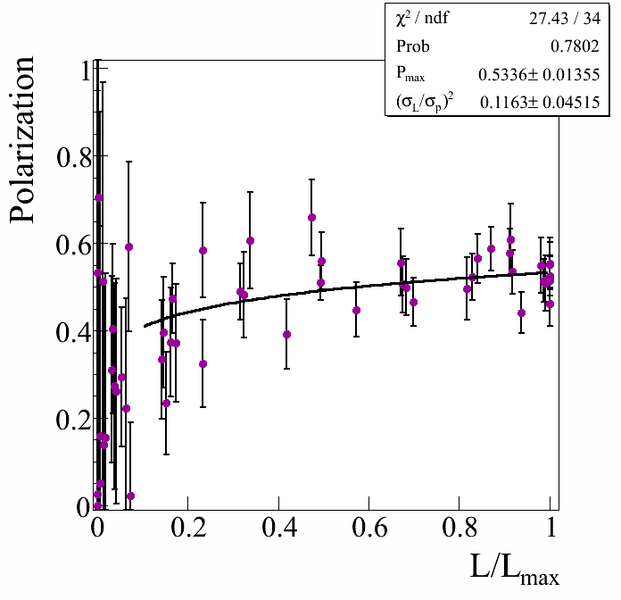
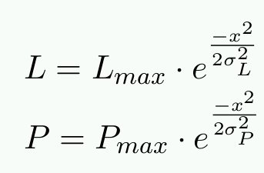
Polarization Profile
HJet
VERTICAL / HORIZONTAL
SCANS
A fit to P Vs L/L_{max} to determine P_{max} and σ_{L}/σ_{P}
Intensity/
Polarization
profile
Fixed target measurements
P_{max}

Slide 5
Polarization Profile
HJet
VERTICAL / HORIZONTAL
SCANS
A fit to P Vs L/L_{max} to determine P_{max} and σ_{L}/σ_{P}
Intensity/
Polarization
profile
Fixed target measurements
P_{max}

Slide 6
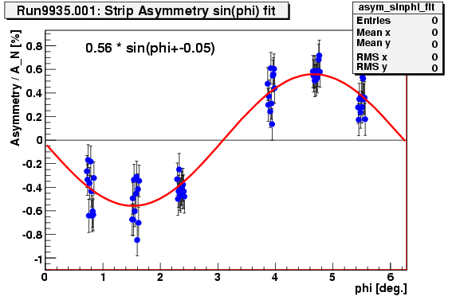
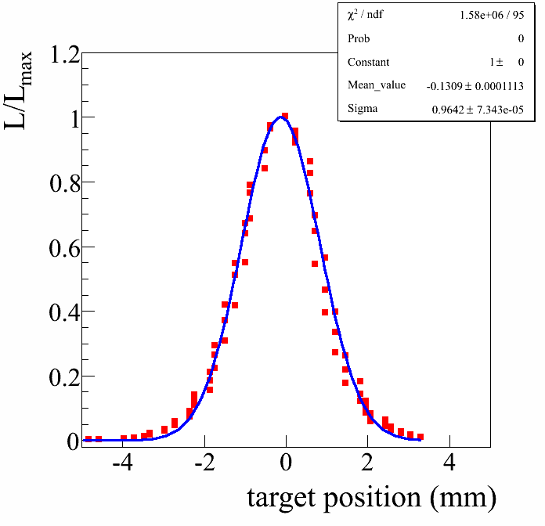
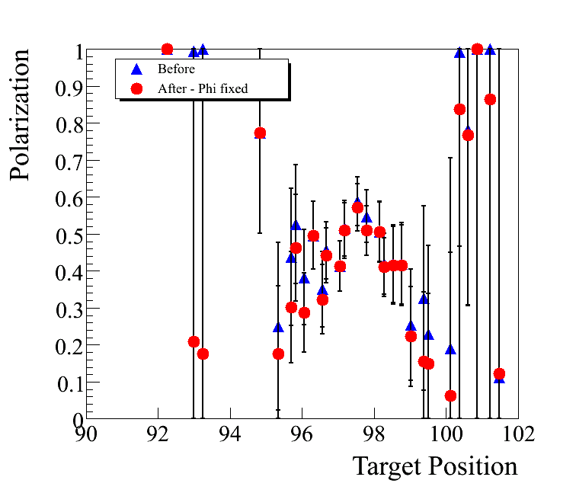
Polarization Profile
RUN08
Φ₀ was kept fixed at average Φ₀
Polarization for each target position is determined by doing a sin phi fit to asymmetry Vs phi measured at each target position

Slide 7
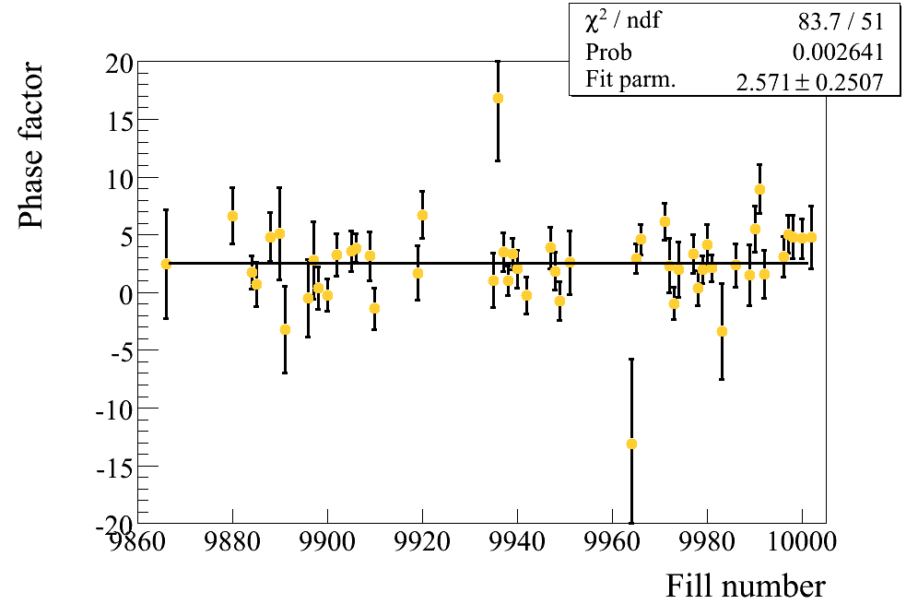
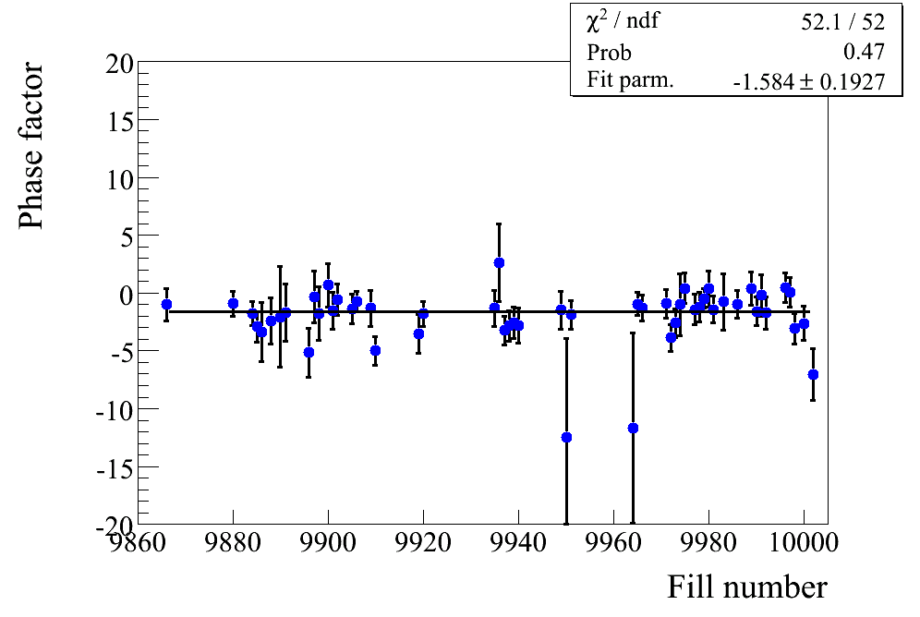
Polarization Profile
RUN08
Φ₀ was kept fixed at average Φ₀
Φ₀ YELLOW
Φ₀ BLUE

Slide 8
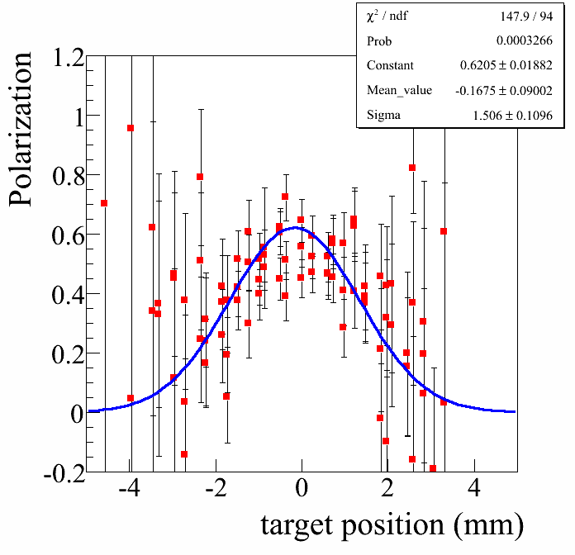
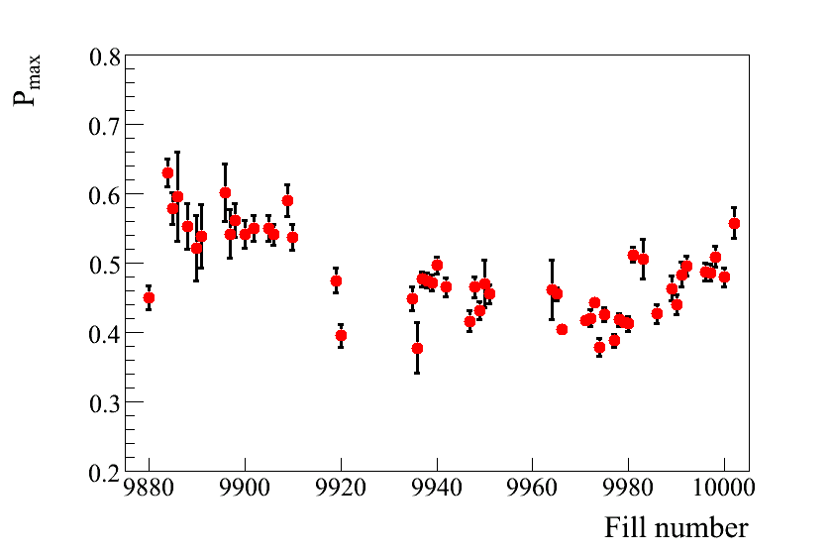
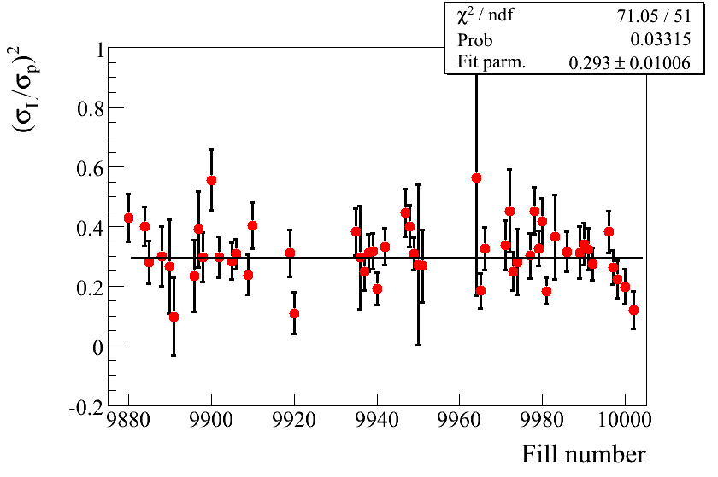
Polarization Profile : YELLOW
HORIZONTAL SCANS
Run 6 0.1-0.15

Slide 9
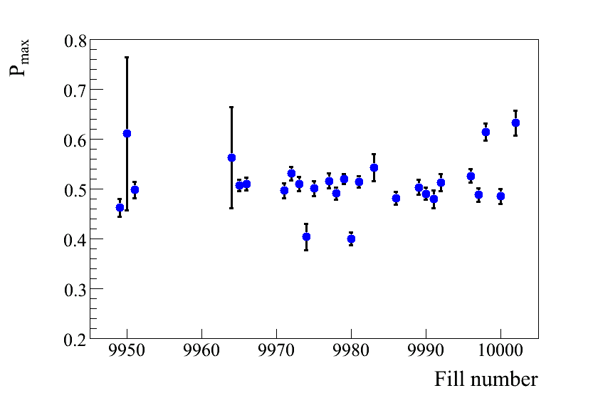
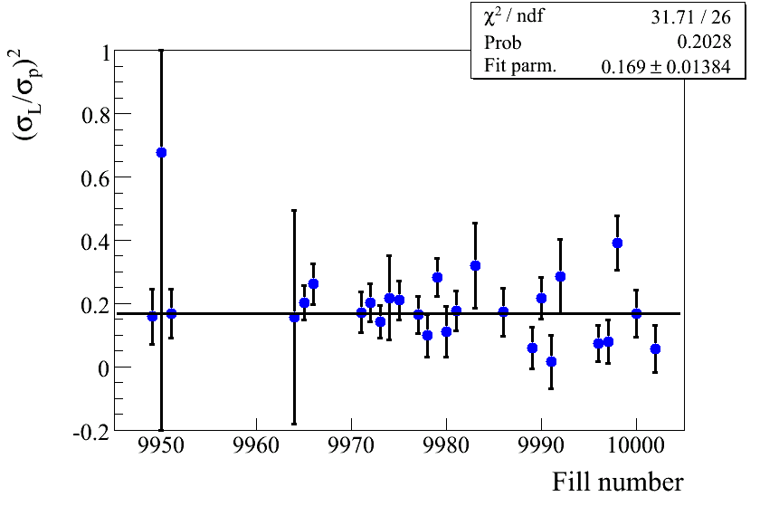
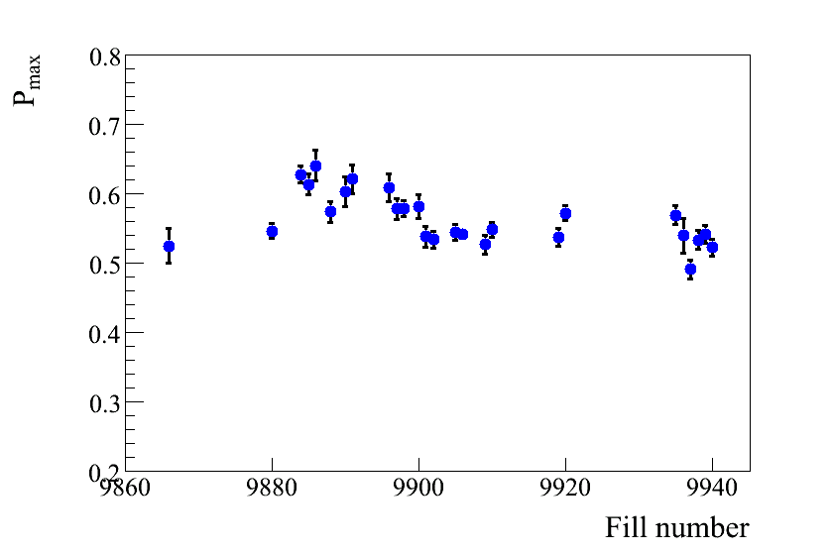
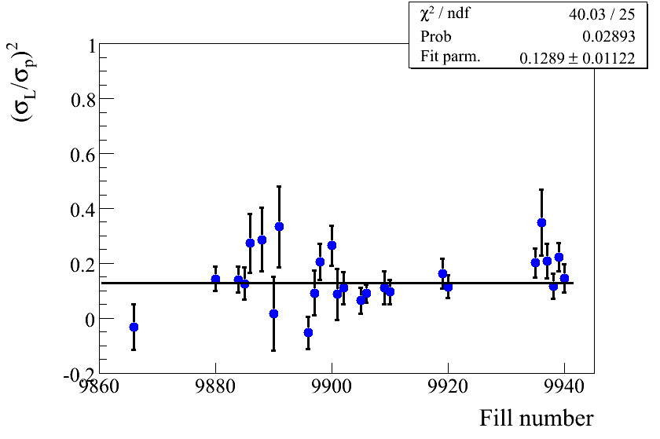
Polarization Profile : BLUE
VERTICAL SCANS
Run 6 0.1-0.15
HORIZONTAL SCANS

Slide 10
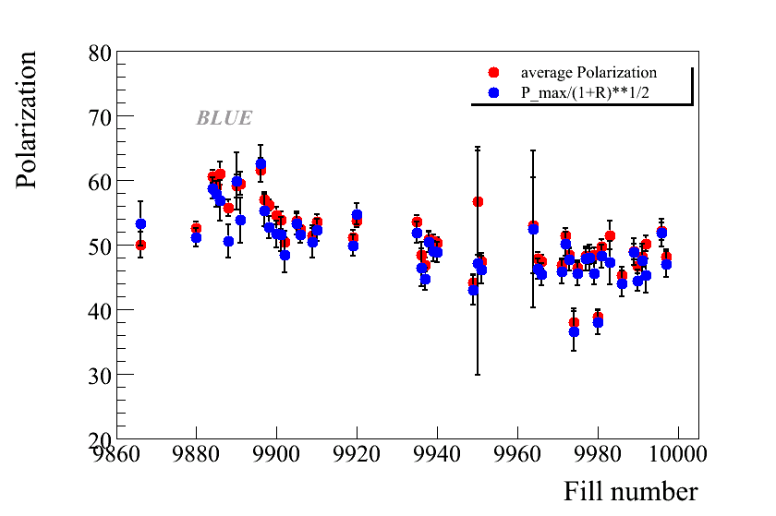
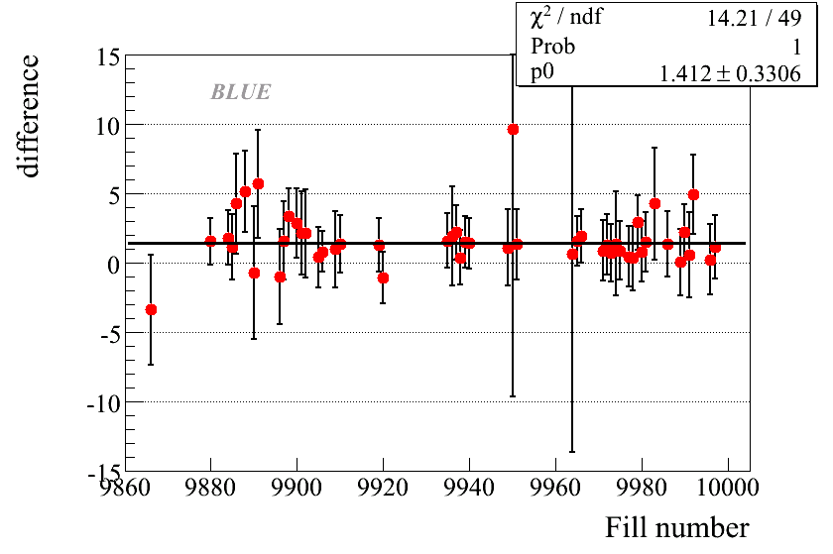
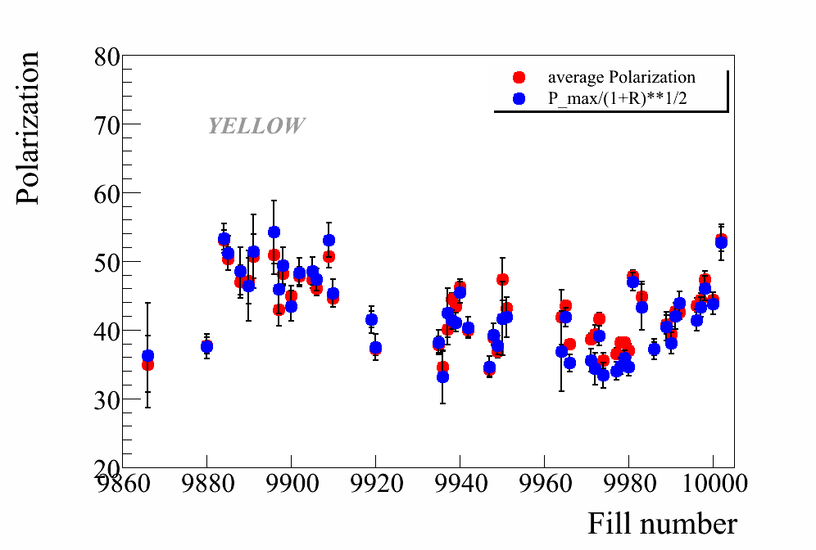
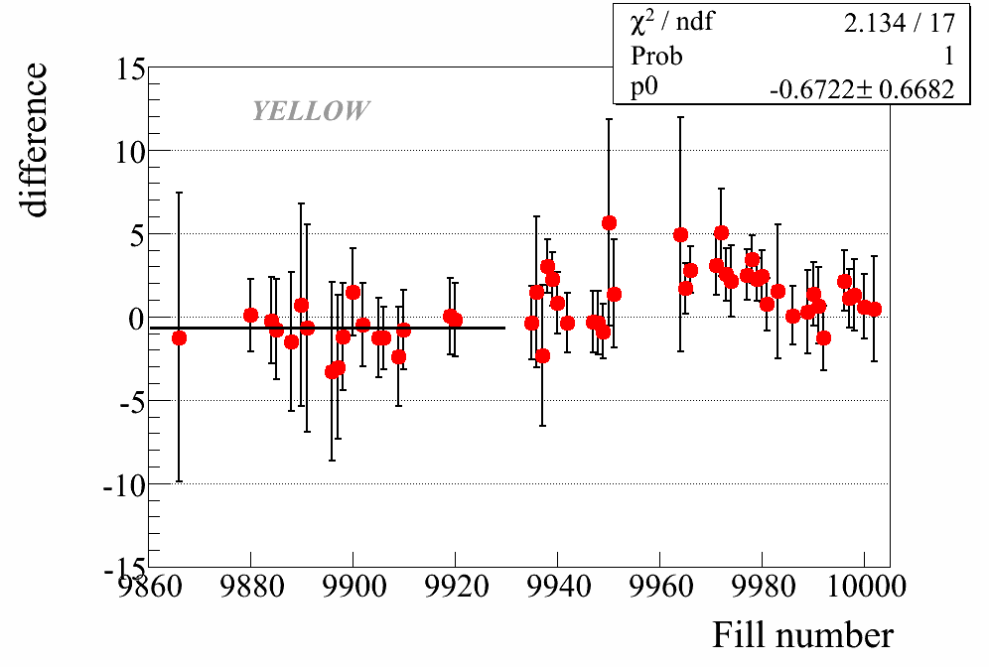
Polarization profile: consistency checks
Average over all
scan positions

Slide 11
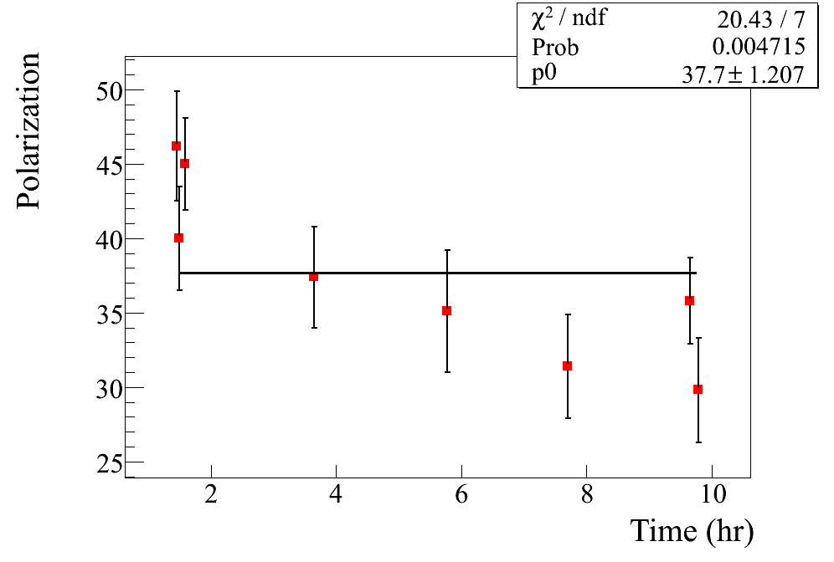
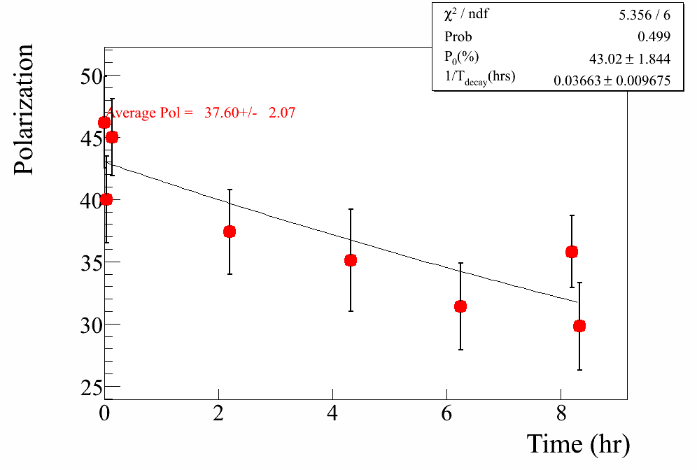
Polarization decay
Fill 9880
Both linear and exponential fits to Polarization for each fill
Assume the functional form
Average Polarization
Assumed α_{L} = 15 hrs

Slide 12
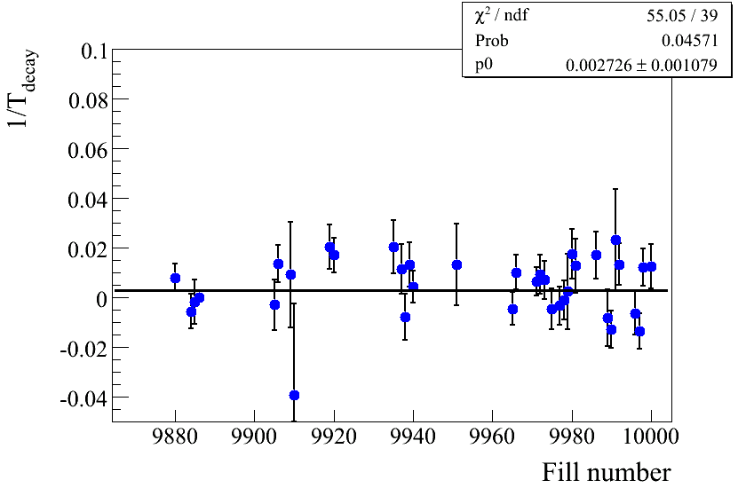
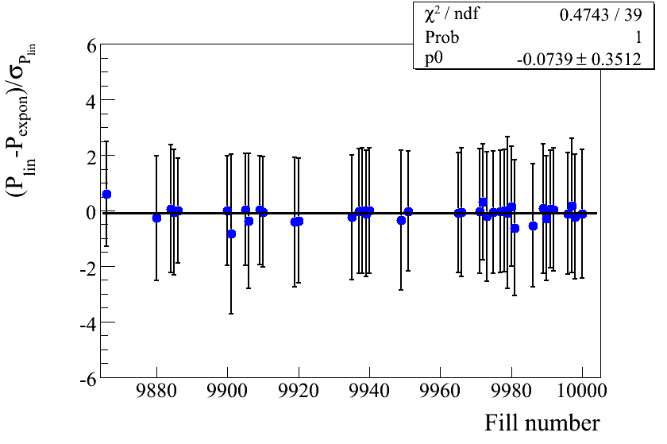
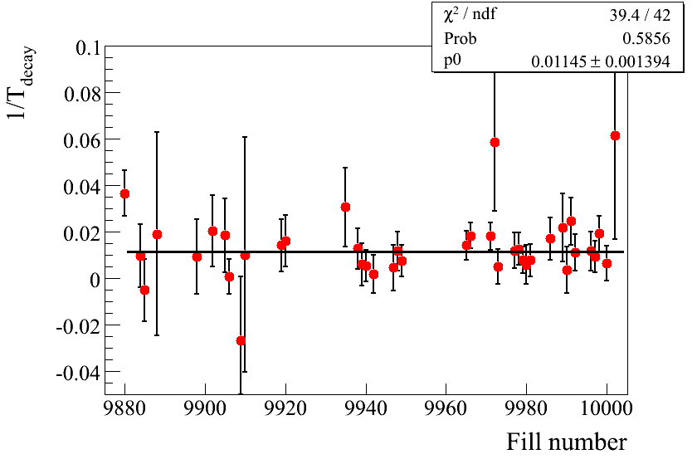
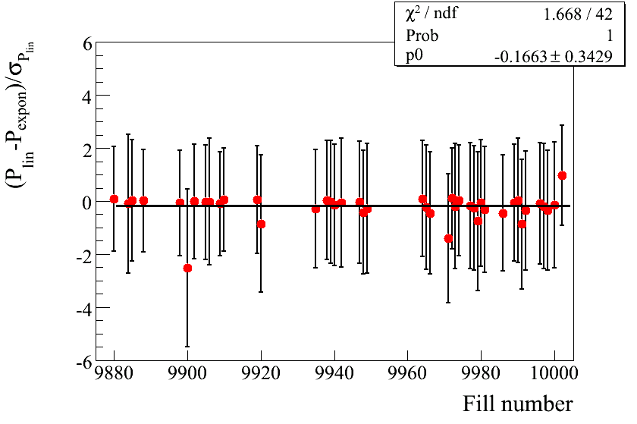
Polarization decay
T_{decay} ≈ 370 hrs
BLUE
T_{decay} ≈ 90 hrs
YELLOW

Slide 13
Polarization decay
T_{decay} ≈ 370 hrs
BLUE
Yellow beam shows a faster polarization decay
Difference between the average polarization calculated assuming no decay and exponential decay is consistent with zero
T_{decay} ≈ 90 hrs
YELLOW

Slide 14
NORMALIZATION TO HJET
PERIOD | pC average | pC/HJet
All | 39.59± 0.39 | 1.091± 0.035
1 | 41.00 ±0.61 | 1.045± 0.054
2 | 38.16± 0.73 | 1.124± 0.069
3 | 39.55± 0.69 | 1.110± 0.062
Golden runs
1.101±0.053
OK runs
1.078±0.048
Golden runs
1.086±0.082
OK runs
1.051±0.031
PERIOD | pC average | pC/HJet
ALL | 47.96 ±0.53 | 1.062± 0.029
1 | 52.02± 0.65 | 1.086± 0.055
3 | 47.02± 0.74 | 1.090± 0.044
4 | 47.80± 1.38 | 0.982± 0.057
Run 5 ≈ 1.01 Run 6 ≈ 1.15

Slide 15
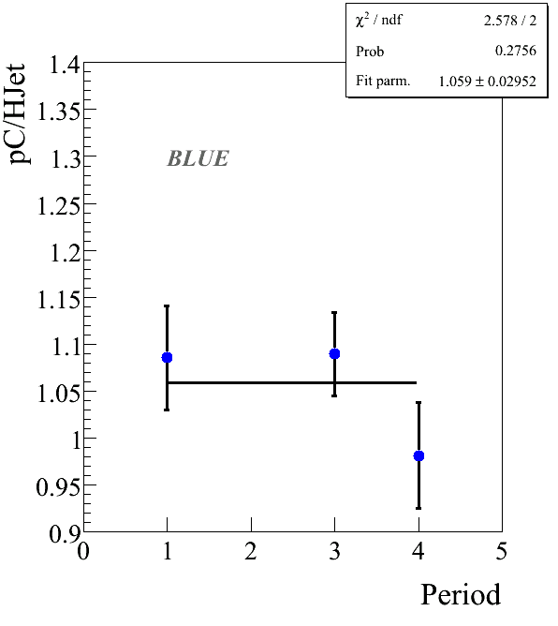
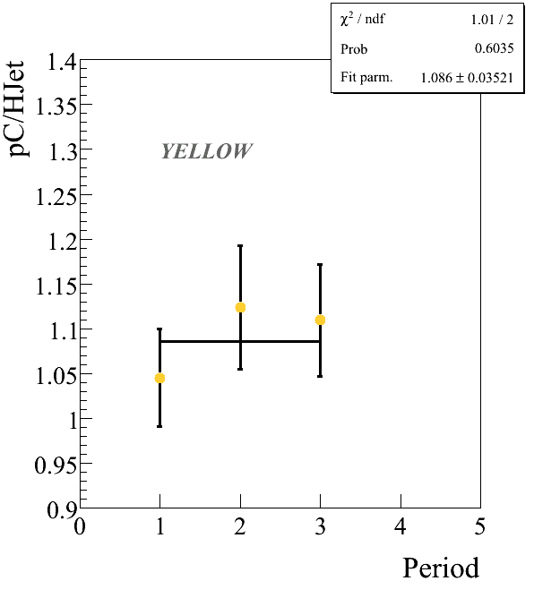
NORMALIZATION TO HJET

Slide 16
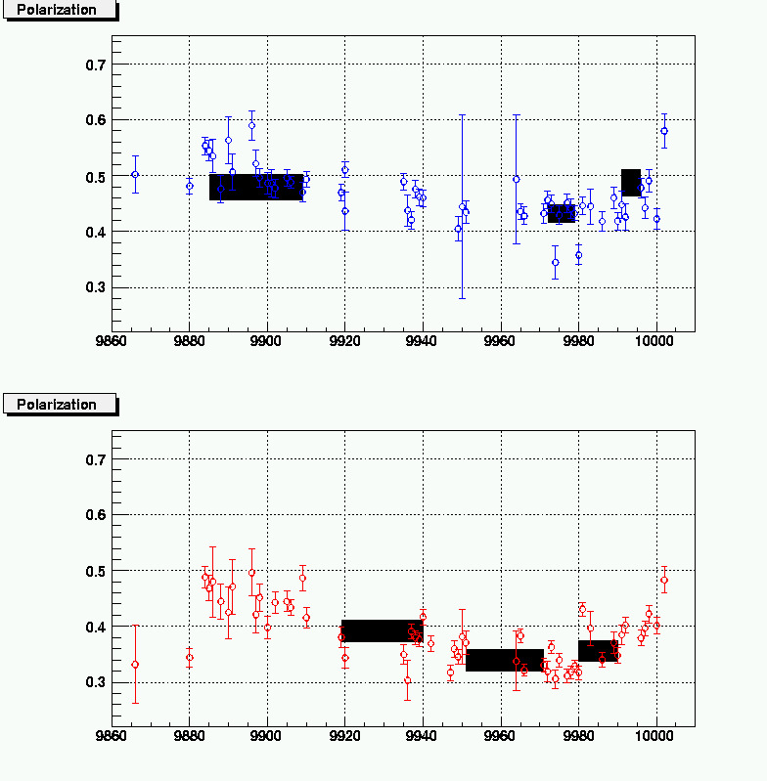
pC/Hjet comparison

Slide 17
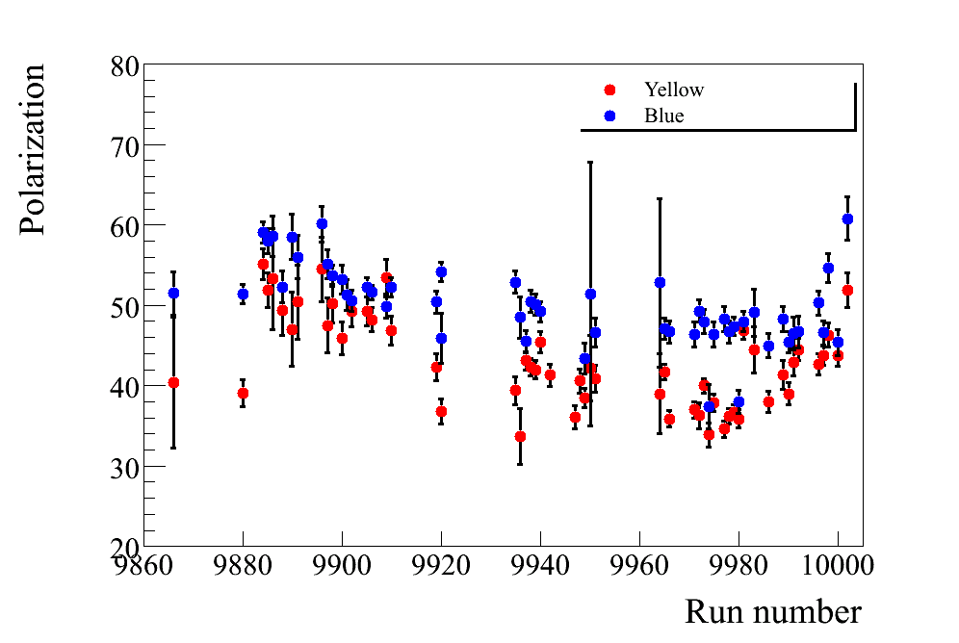
Polarization for experiments

Slide 18
Uncertainties due to polarization profile
Same approach as run 6
L_{max} determination < 0.2%
Scan is not continuous → We may miss the maximum
Target vibrations (flat profiles) <1%
Simulations done by Sasha → Uncertainty is negligible
Assumption that the profiles are Gaussian < 0.5%
R distributions for vertical/horizontal profile
●Studied the variation in R
●For Blue we have both vertical and horizontal scans
●For Yellow we only have horizontal scans
TOTAL < ≈ 1.1%
RUN 8
SPECIFIC

Slide 19
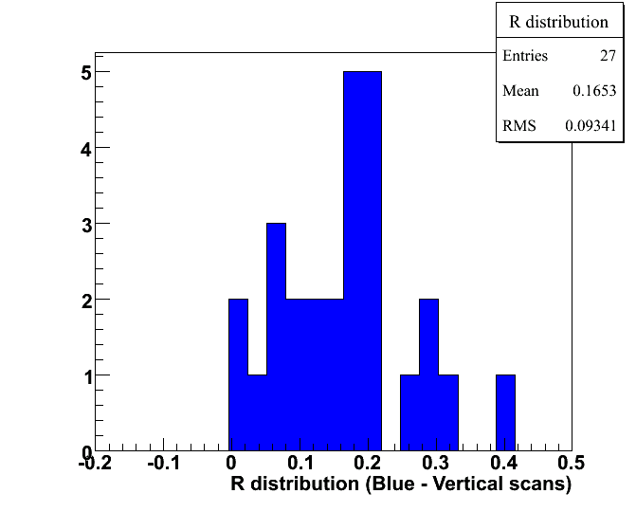
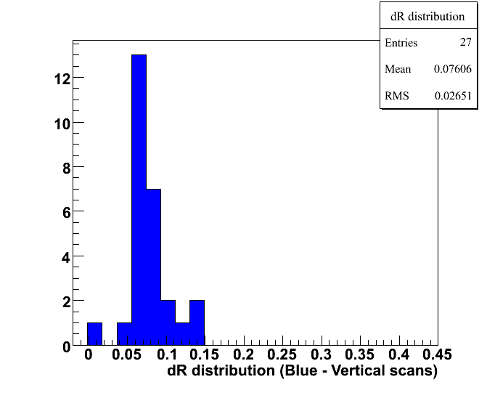
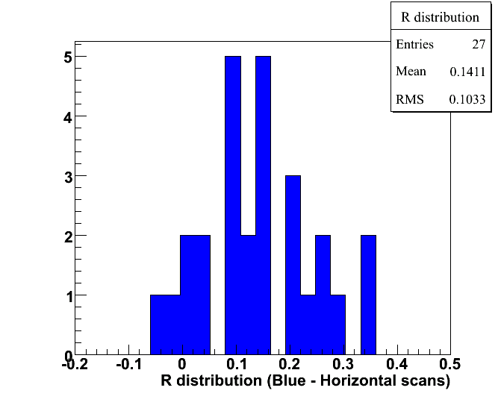
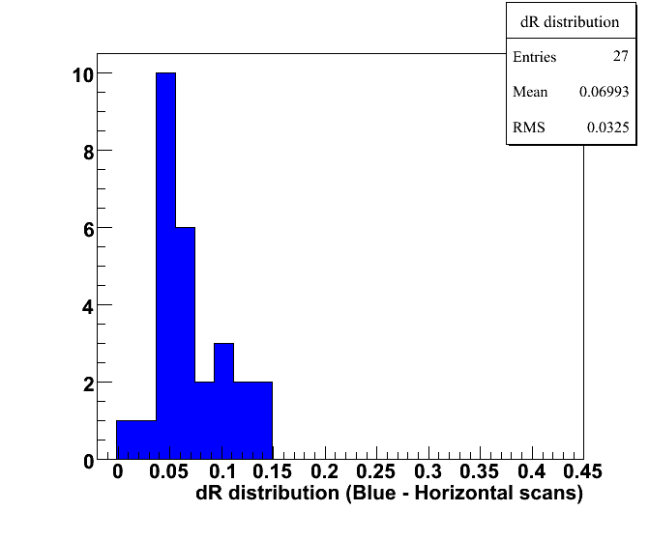
Uncertainties due to polarization profile -Blue
R distribution
δR distribution
Global uncertainty is zero → R is known for both vertical and horizontal scans
Vertical Scans
R →0.07-0.26
Horizontal Scans
R→0.04-0.24
On average
0.15±0.11

Slide 20
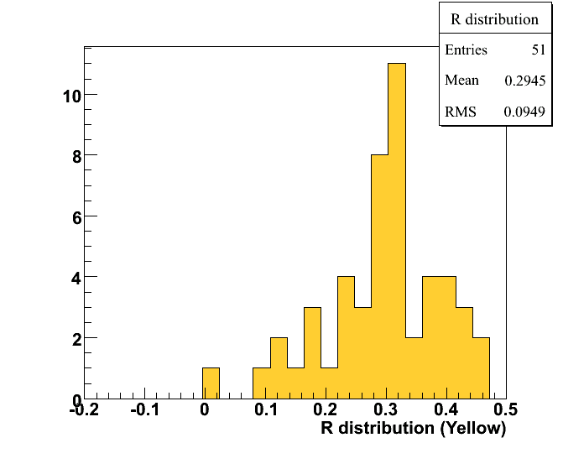
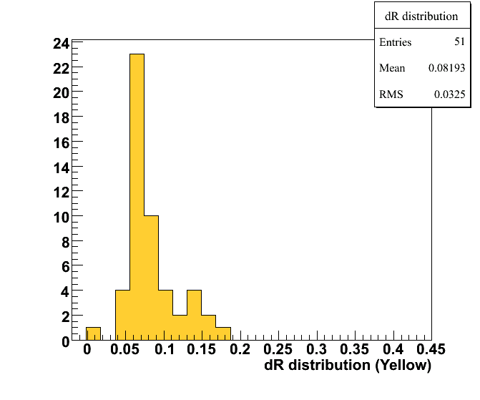
Uncertainties due to polarization profile -Yellow
R distribution
δR distribution
Horizontal Scans
R→0.20-0.39
No vertical scans for Yellow
Assume 0-0.39 variation in R
Fill uncertainty and global uncertainty ≈ 5%

Slide 21
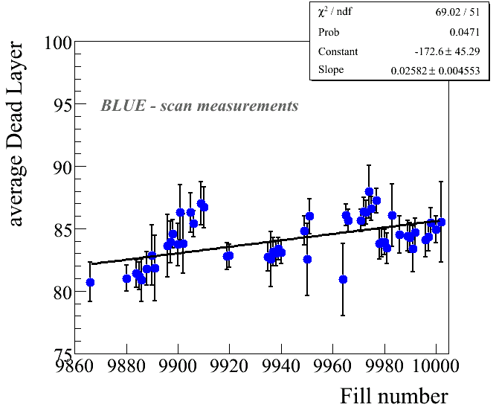
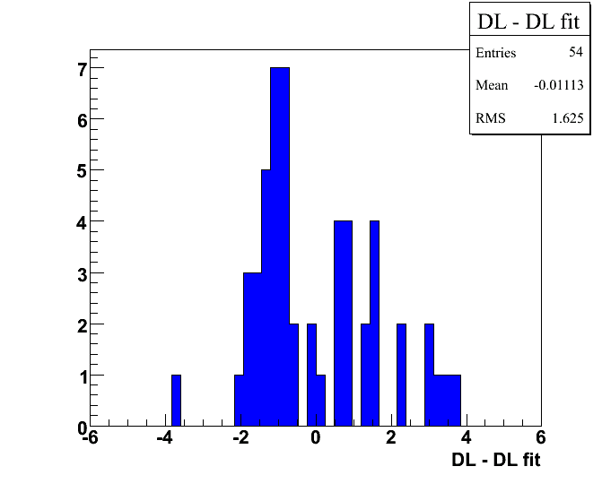
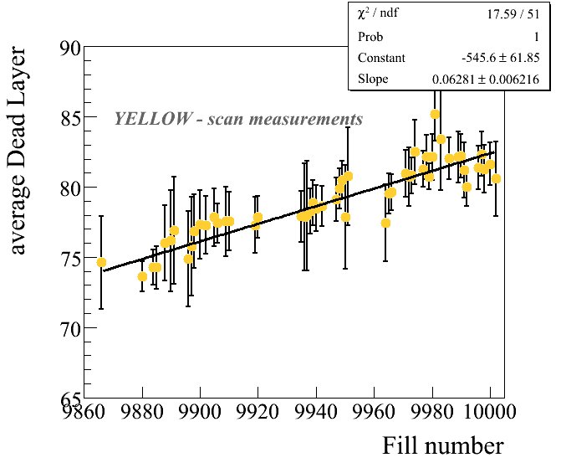
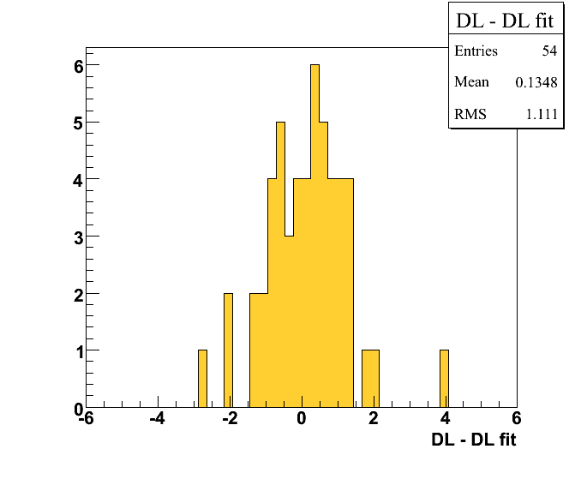
Uncertainty due to Dead Layer
Fill to fill uncertainty
Fill uncertainty
1.6*0.6 ≈ 1%
Dead layer variation
within ±3 μg/cm²
Polarization ±1.8%
Dead layer variation
within ±4 μg/cm²
Polarization ±2.4%
Fill uncertainty
1.1*0.6 ≈ 0.7%

Slide 22
Uncertainties : Summary
Fill to fill uncertainties
Horizontal/Vertical profile 3.0% 5.0%
Energy correction/dead layer 1.0% 0.7%
Global uncertainties
Jet normalization, stat 2.5% 3.0%
J et normalization (profile) 1.1% 1.1%
Jet normalization, systematic uncert.
Pol. Profile (for experiments) 0.5% 5.0%
Energy correction/deal layer 1.8% 2.4%

Slide 23
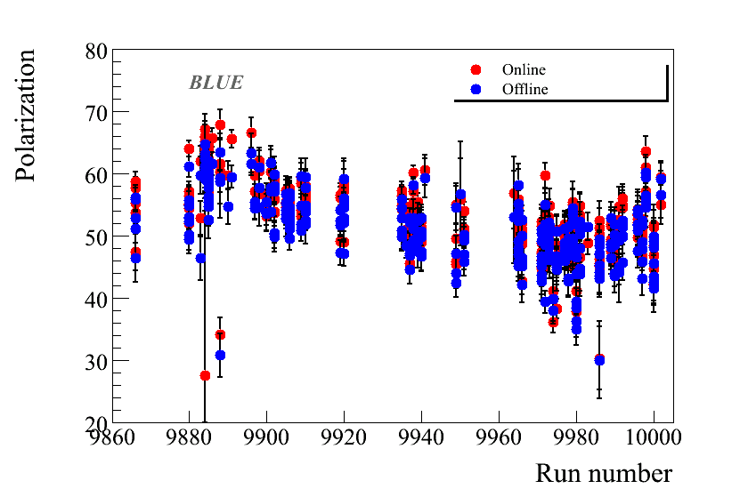
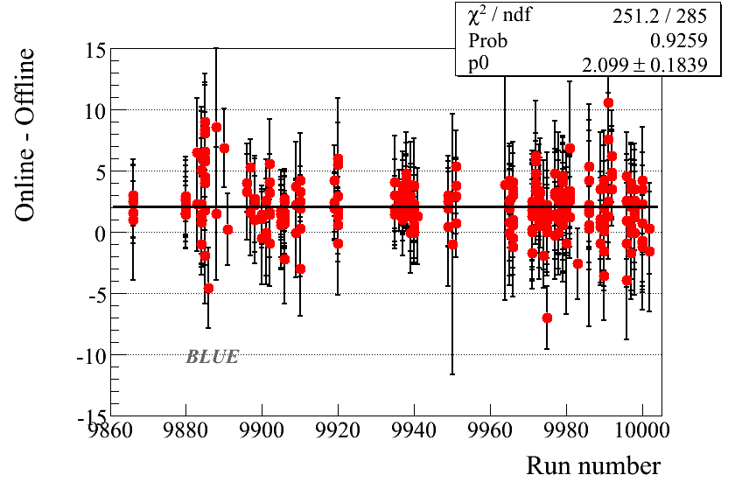
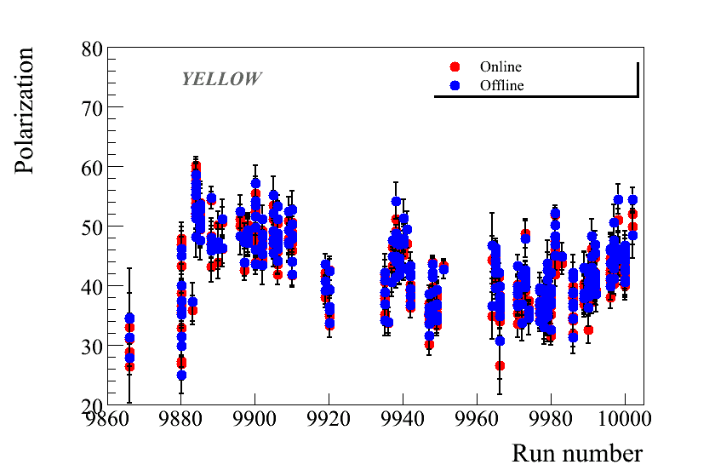
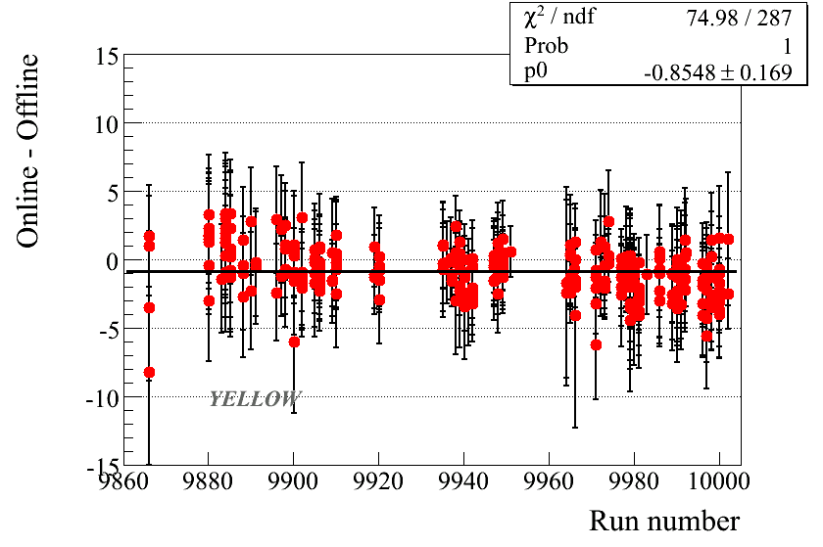
Online/Offline comparison
In case you are curious …..

Slide 24
BACKUP SLIDES

Slide 25
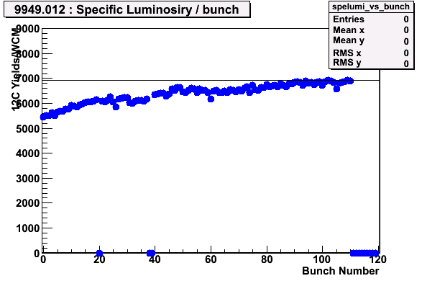
Run Selection
Same quality checks as run 05 and 06
Carbon mass position deviation : < 0.5 GeV from the Carbon mass
Carbon mass width : deviation below 1.9 sigmas
Number of events in banana : strips inside 20% from the average
Data taken with Blue vertical target 5
Fill #s :9942,9947,9948,9949

Slide 26
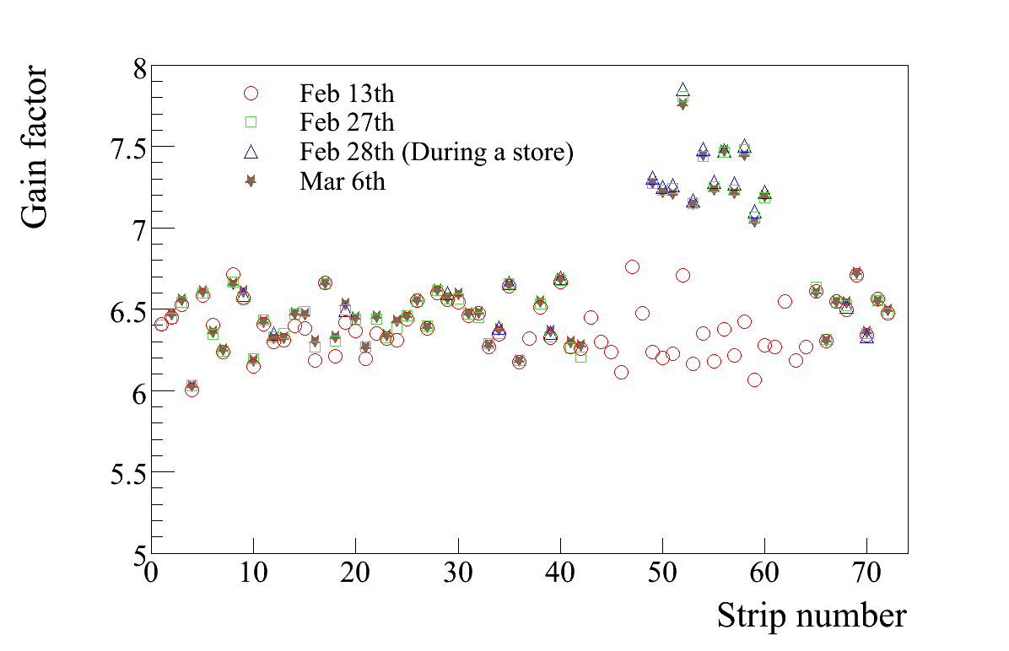
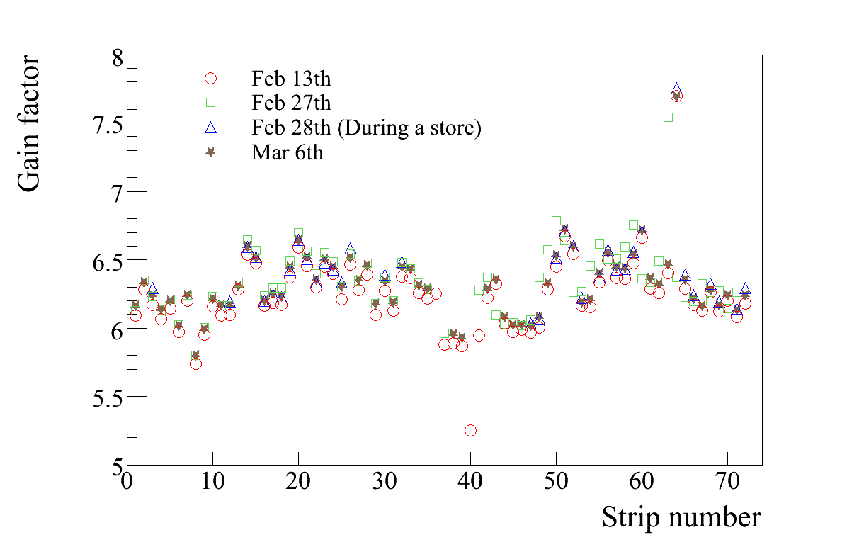

Calibrations
All runs
YELLOW
BLUE
Feb 16th 2008 (Fill 9886)
Feb 13th constants for det 1,2,3,4 and 6
Detector 5
Upto Fill 9886 Feb 13th constants
Feb 27th constants after Fill 9886
Jump in Detector 5 current

Slide 27

Dead layer : YELLOW

Slide 28

Dead layer : BLUE

Slide 29




Rate dependence
Dead layer rate dependence
T0 rate dependence

Slide 30
Polarization : BLUE

Slide 31
Polarization : YELLOW

Slide 32
Polarization : YELLOW

Slide 33

Polarization : YELLOW

Slide 34

Polarization : YELLOW

Slide 35
Online/Offline: BLUE

Slide 36
Online/Offline: BLUE

Slide 37
Online/Offline: YELLOW

Slide 38
Online/Offline: YELLOW

